Slide 1
Pre-hospital Shock Index in severe trauma patients.
Martin Tonglet, Liège University Hospital

Slide 3
Introduction
Shock Index (SI) is defined as the ratio of the Heart Rate (HR) to systolic Blood Pressure (BP).
Crit Care. 2013 Aug 12;17(4):R172.
The Shock Index revisited - a fast guide to transfusion requirement? A retrospective analysis on 21,853 patients derived from the TraumaRegister DGU.
Mutschler M, Nienaber U, Münzberg M, Wölfl C, Schoechl H, Paffrath T, Bouillon B, Maegele M; TraumaRegister DGU.
J Trauma. 2011 Feb;70(2):384-8
Identifying risk for massive transfusion in the relatively normotensive patient: utility of the prehospital shockindex.
Vandromme MJ, Griffin RL, Kerby JD, McGwin G Jr, Rue LW 3rd, Weinberg JA.

Slide 4
Material and methods
82 patients were included in a single-center, non-controlled clinical trial evaluating the Trauma-Induced Coagulopathy Clinical Score TICCS (Tonglet et al, Critical Care, 2014).
Pre-hospital HR and BP were recorded.
A blood sample was collected at the time of admission and patients’pH was recorded. 24 hours survival and 30 days survival were recorded.
Retrospectively, SI was calculated and patients with SI >= 1 were distinguished from the ones with SI < 1.

Slide 5
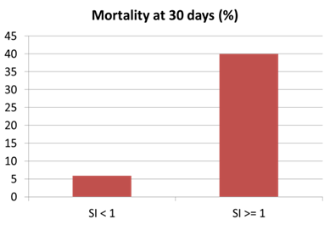
Results

Slide 6
Conclusion
In trauma, a pre-hospital SI >= 1 is associated with acidosis and higher mortality rate.
SI may be a useful and simple criterion to identify trauma patients at risk for immediate complications and thus requiring specific and emergent measures.

