Slide 1
Does a ‘Massive Transfusion Protocol’ activation necessarily mean massive transfusion ?
Martin Tonglet, Liège University Hospital

Slide 2


Slide 3
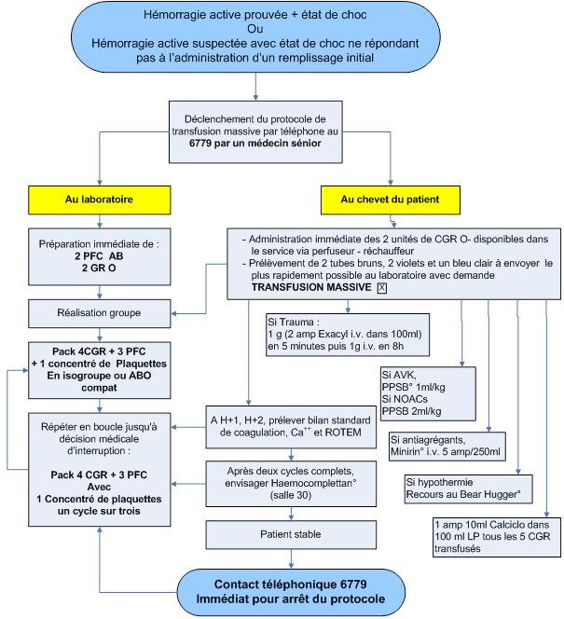
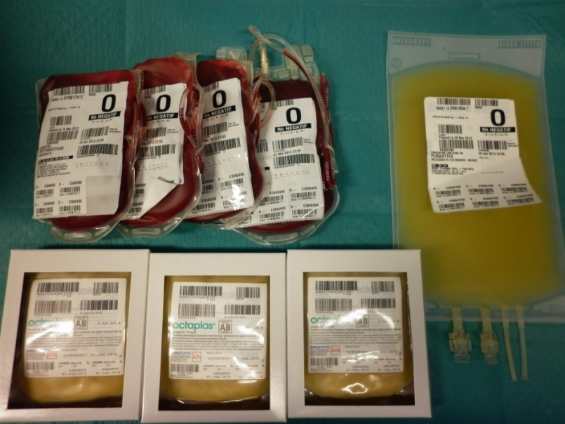
Introduction
Rev Med Liege. 2014 Feb;69(2):82-8.
Implementation of a massive transfusion protocol in an emergency department.
Tonglet M, Minon JM, Damas F, Clanet M, Vergnion M.
MT is traditionally defined as the transfusion of 10 or more units of Packed Red Blood Cells PRBC within 24 hours.

Slide 4
Material and methods
A retrospective analyze of the 33 activations was realized.
The number of PRBC units, Plasma units and Platelets Concentrate PC transfused within the first 24 hours was recorded.
The use of others therapeutic actions like surgery or interventional radiology was recorded as well as 24 hours survival and one year survival.

Slide 5
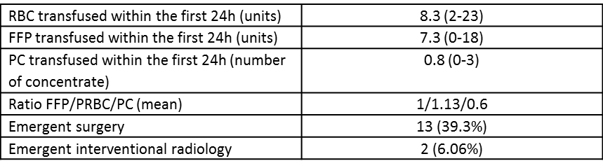
Results
- Only 9 of the 33 patients (27.2%) reach the traditional definition of MT.
- 23 patients (69.6%) reach another existing definition of MT consisting of the transfusion of 4 or more units of PRBC within the first hour of care.
- 45.3 % of the patients underwent an emergent hemostatic procedure

Slide 6
Discussion and Conclusion
This retrospective analysis surprisingly shows that MTP activation leads to MT in only 27.2%.
Over activations ? Better criteria for activation ?
The retrospective definition of MT (>10 PRBC within 24 hours) doesn’t properly define massive bleeding and excludes trauma patients who need an early acute hemostatic resuscitation (EAHR)?
In our local institution (CHR Citadelle), MTP activation doesn’t necessarily lead to MT but more likely to EAHR combining early transfusion and early hemostatic procedures.

