Slide 1

Ultra-narrow superconducting junctions: electromigration to shed light on quantum point contacts
Xavier D.A. Baumans
Experimental Physics of Nanostructured Materials
Physics Department, University of Liège
BELGIUM
ASC September 2016

Slide 2
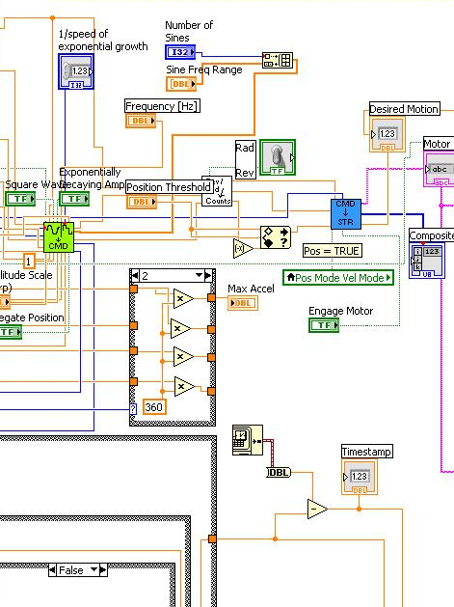
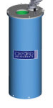

Collaborators
A. V. Silhanek, O.-A. Adami (ULg, BE)
V. S. Zharinov, D. Cerbu, N. Verellen, J. E. Scheerder, G. Zhang, V. V. Moshchalkov, J. Van de Vondel (KULeuven, BE)
G. Papari (U. Federico II and CNR-SPIN, Naples, IT)

Slide 3

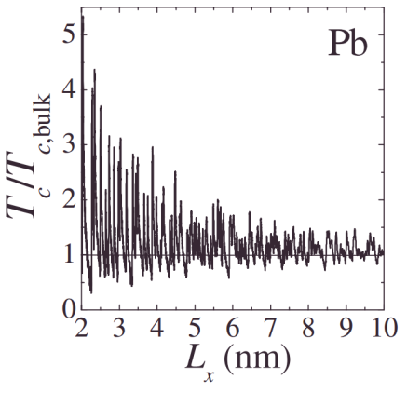
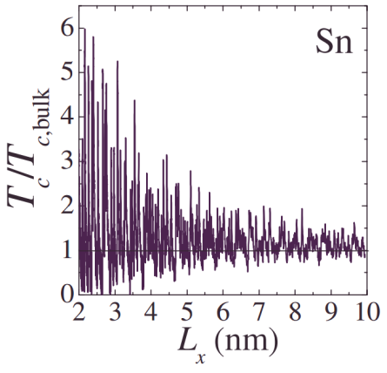
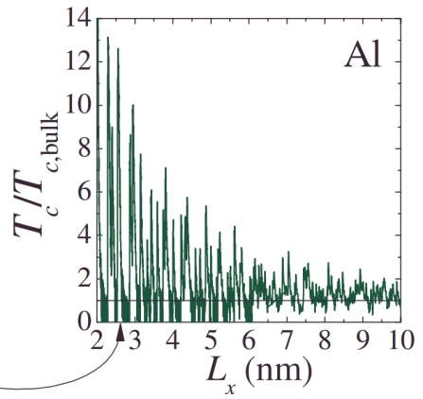
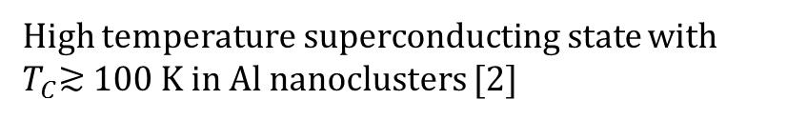

Context and Motivation
Promising future for nanoscale superconductors …
[1]
$<$ $10$ nm
High temperature superconducting state with
$T_{C}$≳ 100 K in Al nanoclusters [2]
[1] Croitoru et al., Phys. Rev. B 76, 024511 (2007) | [2] Halder et al., Nano Lett. 15, 1410 (2015)
Notes:
Halder= It has been predicted that as a result of the shell levels’ high degeneracy, nanoclusters composed of just tens to hundreds of atoms can display pair correlations associated with the superconducting state. For certain sizes and materials, the pairing may become exceptionally strong. Al cluster with 66 atoms.

Slide 4
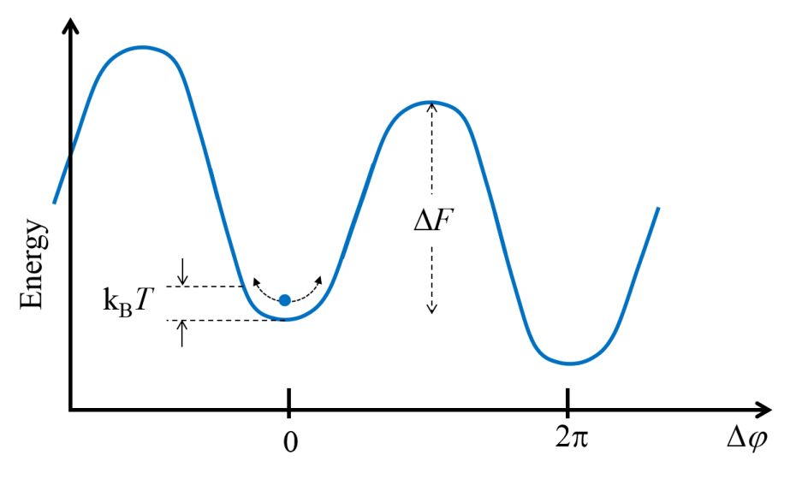
Context and Motivation
Threaten by fluctuations …
TPS
QPS
Arutyunov, Golubev, Zaikin, Physics Reports 464, 1 (2008)
Notes:
If T→0 then TPS play no role, but QPS are T independent and they are finite even at T=0.
Making sigma small we increase both TPS and QPS probability, but still at very low T, TPS are negligible while QPS not.

Slide 5
Evidence of TPS to QPS transition requires going beyond EBL resolution…
Giordano et al., Phys. Rev. Lett. 43, (1979)
Ar+ ion sputtering for progressive reduction of an Al nanowire effective cross section down to few nm
Tape peel-off technique
Al and MoGe
w=20 nm and L > 80 nm
Bae et al.,
Nanoletters 9, 1889 (2009)
Zgirski et al., Nanoletters 5, 1029 (2005)
See also Altomare et al., Appl. Phys. Lett. 86, 172501 (2005)
Notes:
In recent works, Bezryadin-Tinkham carbon nanotubes of width 10 nm were used as substrates supporting MoGe superconducting film.

Slide 6
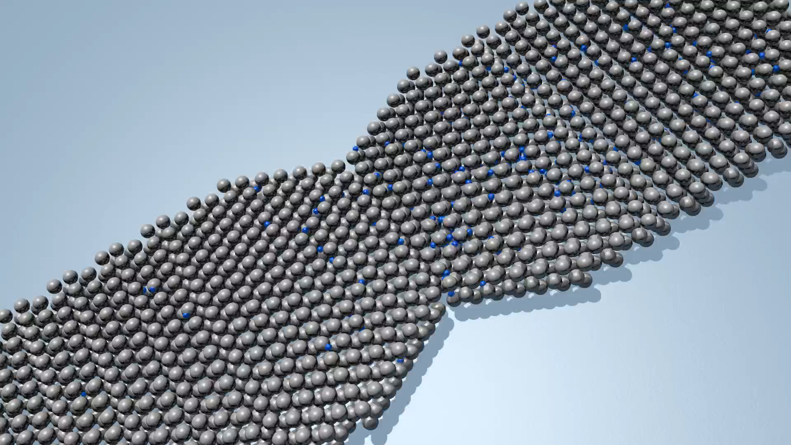
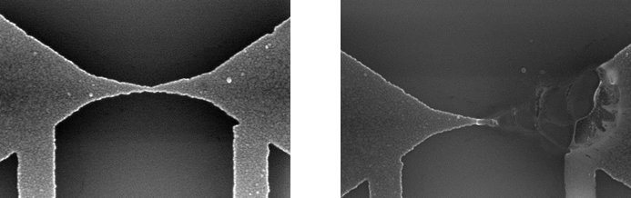
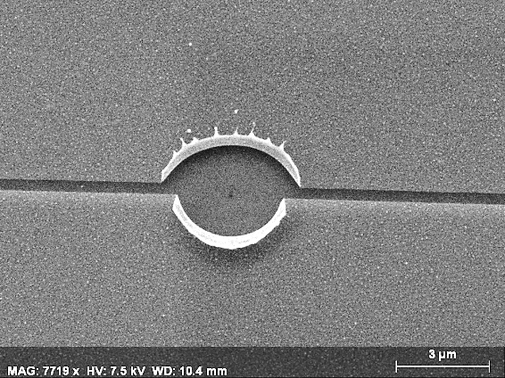
An alternative technique: electromigration
voids
formation
current
crowding
Resistance
dR/dt
T
Current
Uncontrolled electromigration
Ho & Kwok, Rep. Prog. Phys (1981)

Slide 7
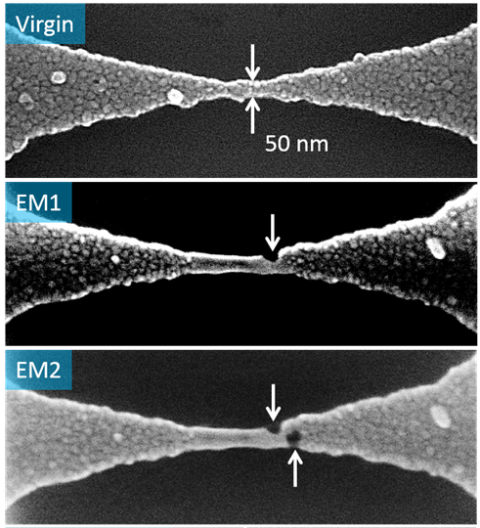
Controlled electromigration
voids
formation
current
crowding
Resistance
dR/dt ~ const.
T
Current
Z = 2 μm
W₁= 150 nm
W₀ = 50 nm
See Campbell, J. M. & Knobel, R. G. Appl. Phys. Lett. 102, 023105 (2013)

Slide 8
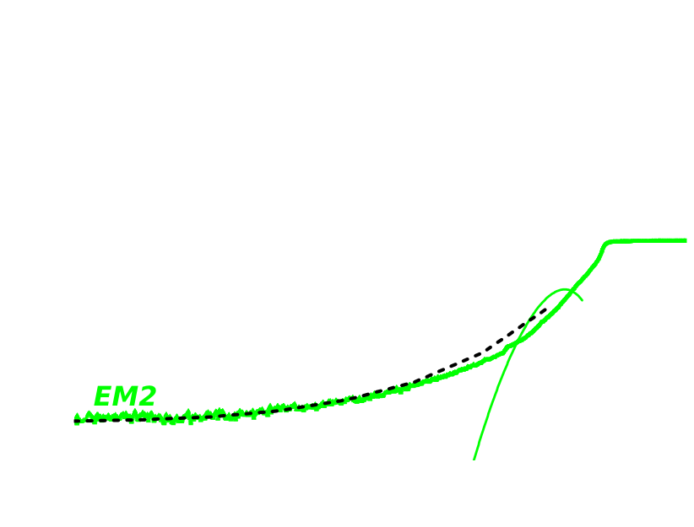
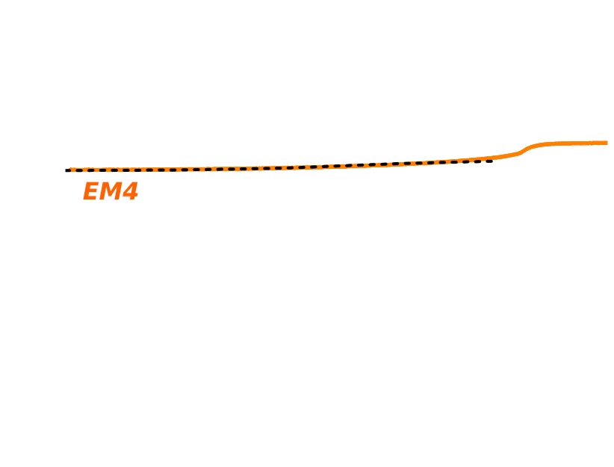
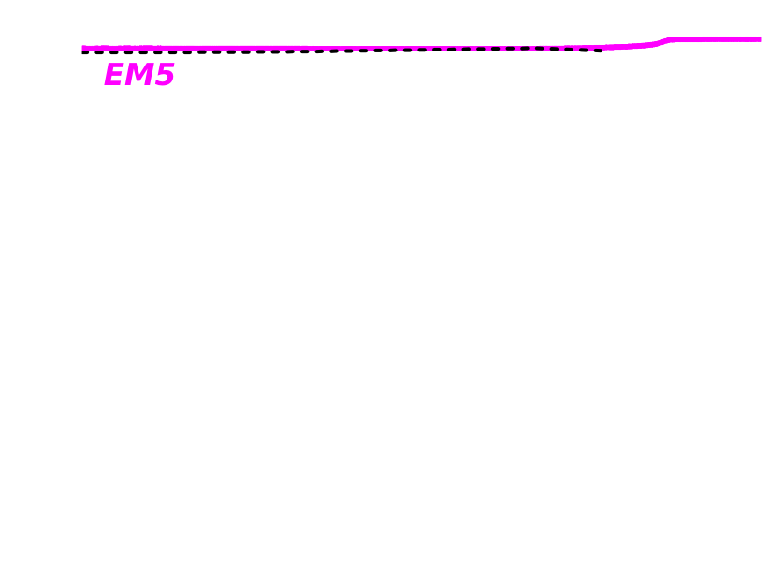
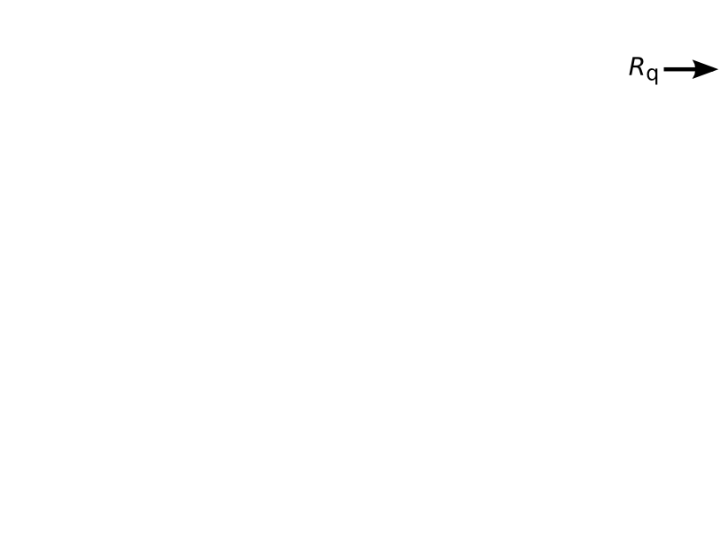
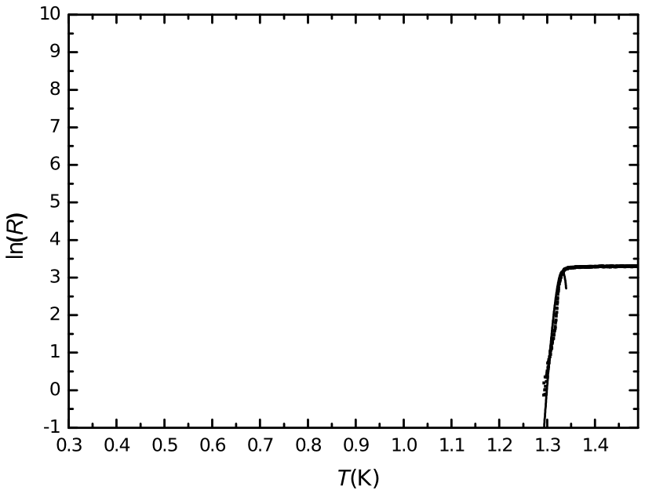

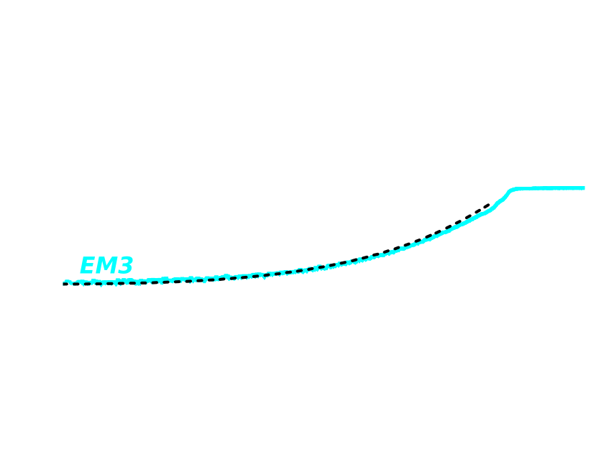
R(T) evidence the TPS to QPS transition
ΔF
Φ
Φ+2π
X. D. A. Baumans et al., Nat. Commun. 7, 10560 (2016)
Notes:
Rq=6,5 kOhms → single conduction channel, possibly single atom.

Slide 9
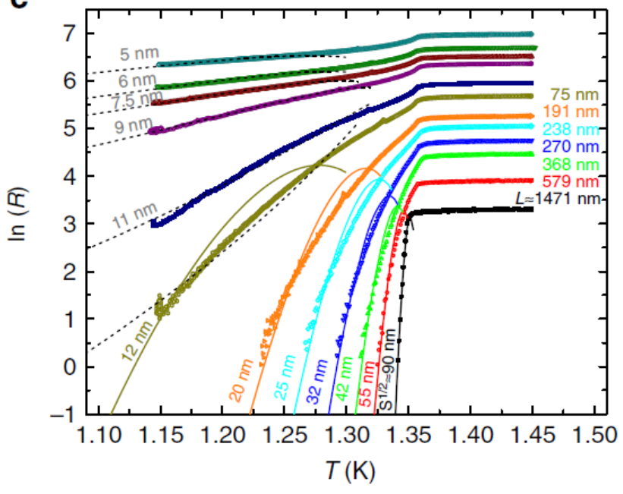
R(T) evidence the TPS to QPS transition

Slide 10
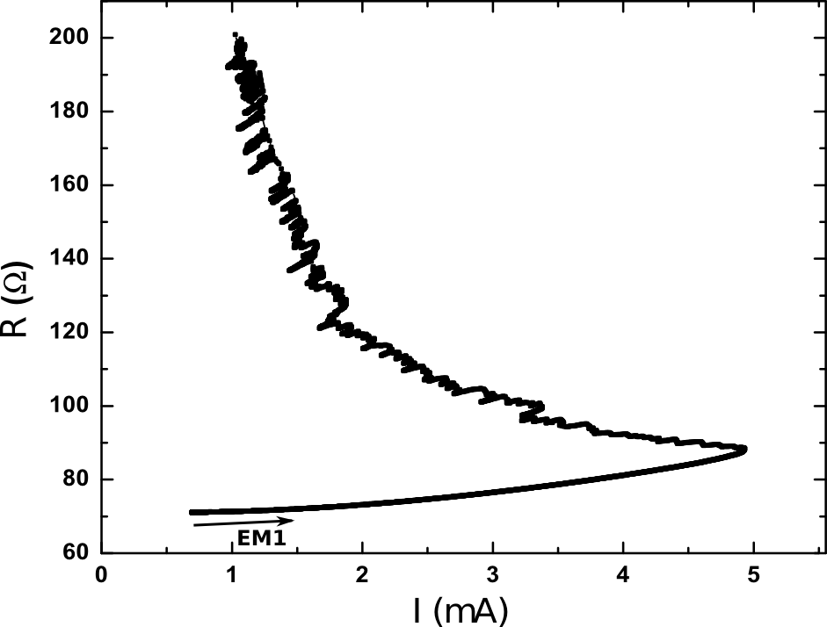
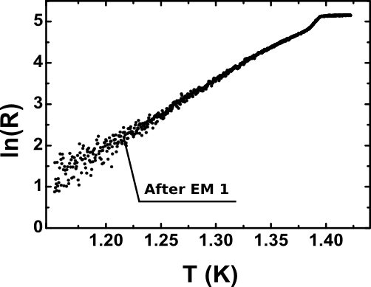
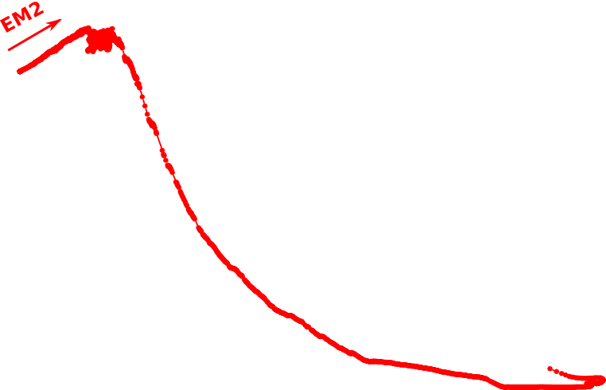
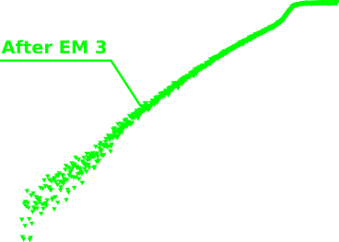
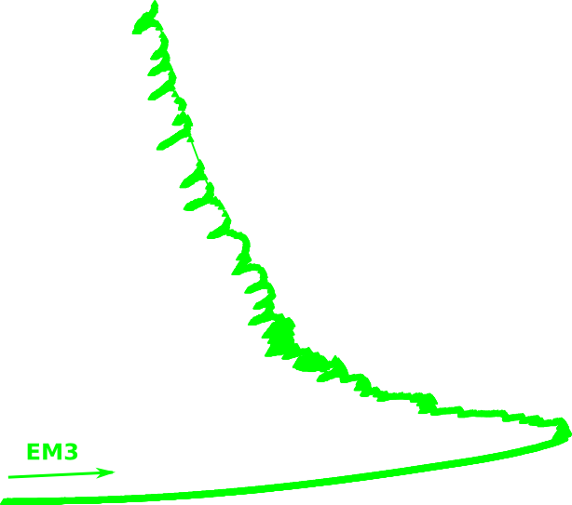
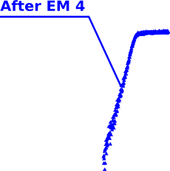
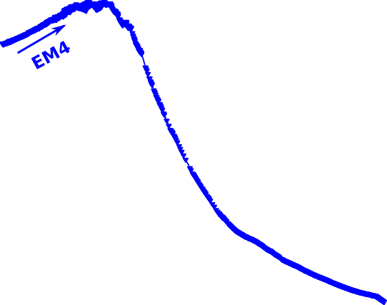
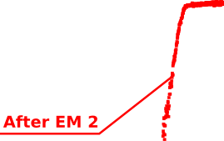
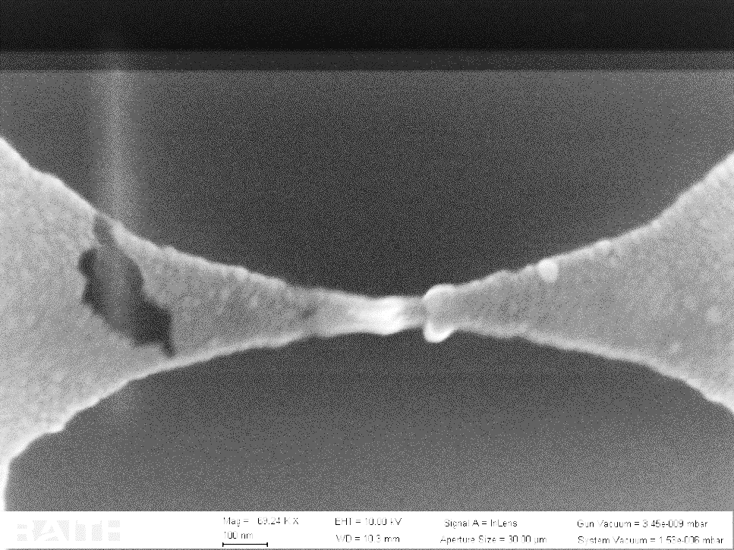
Healing via anti-electromigration
Electromigration
Before healing
I
I
I
I
After healing
10
Anti-Electromig.
Ittah et al. Nano Letters (2008) | Xiang et al. Nano Letters (2009)

Slide 11
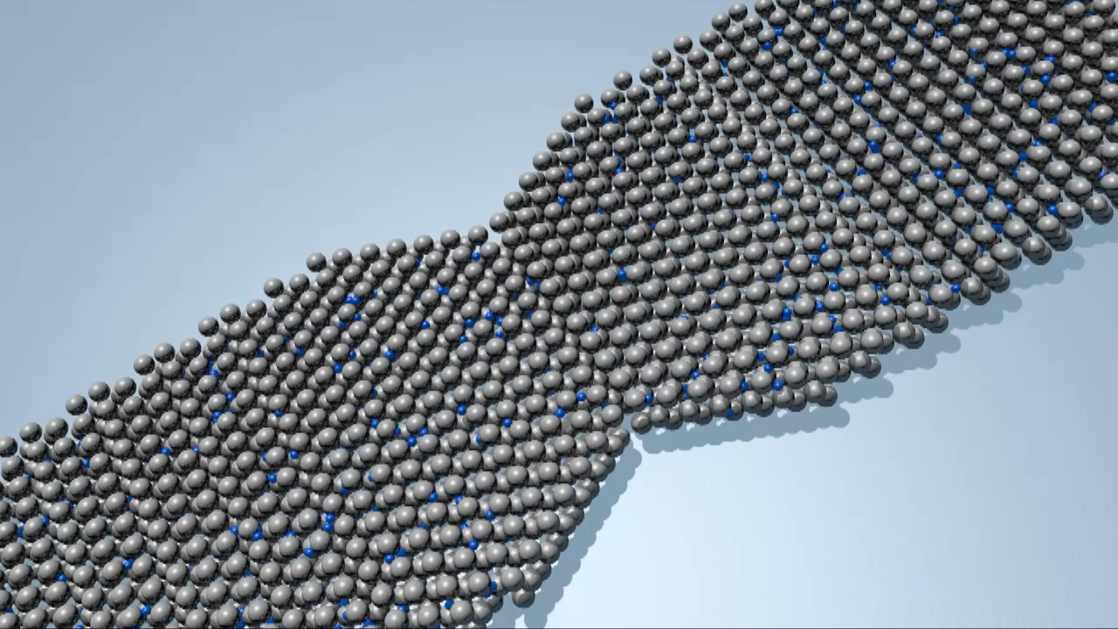
Conclusion
Electromigration is a promising method to create superconducting nanostructures beyond EBL resolution
R(T) evidence the transition from TPS to QPS
Negative Magnetoresistance as a side effect of different Tc of the contact leads
Upcoming
V(I)s measurements and the statistical distribution of critical current reinforce the evidence of TPS-QPS transition.
Notes:
It is possibility to obtain atomic size constrictions.
The EM process has certain degree of reversibility down to few Ohms

Slide 12




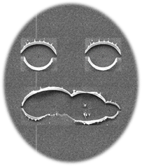
Acknowledgements

Slide 13
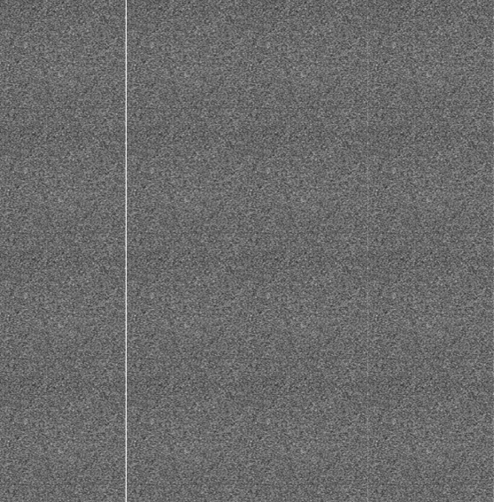
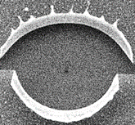
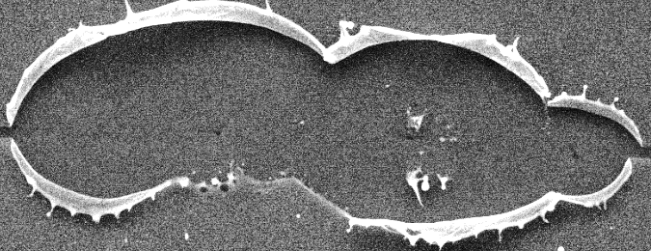

Slide 14
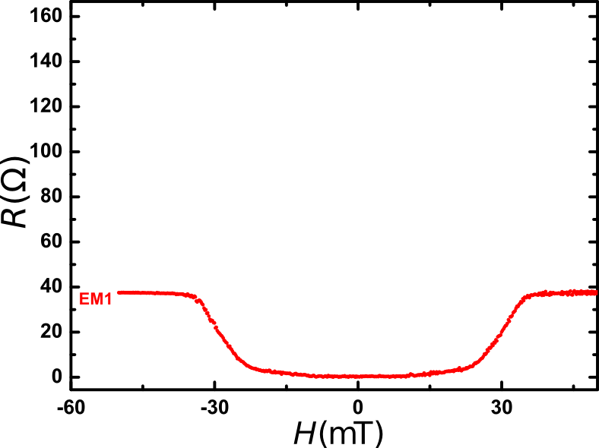
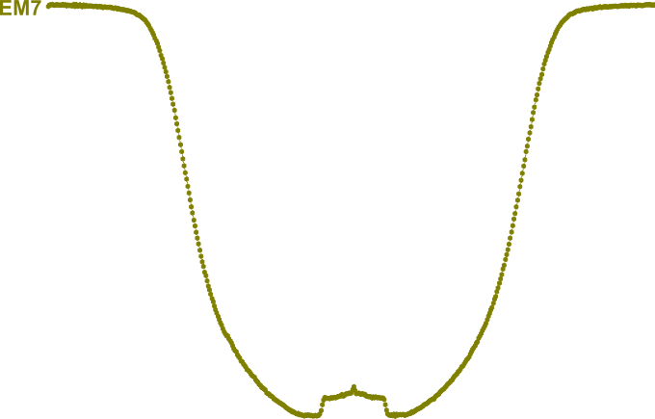
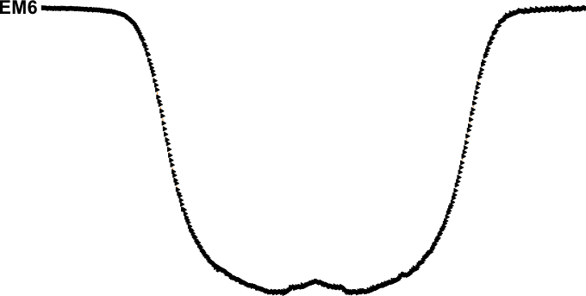
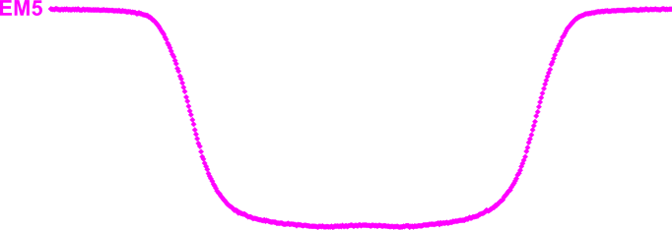
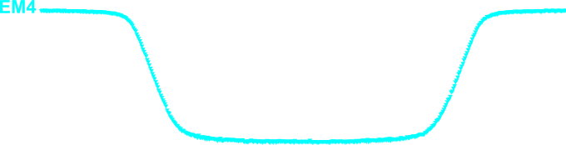
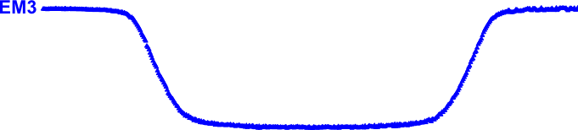
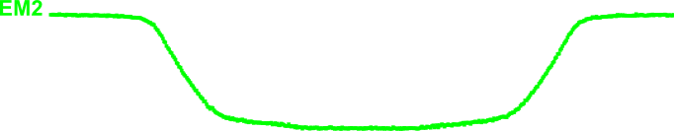
R(B): NMR and phase slips
X. D. A. Baumans et al., Nat. Commun. 7, 10560 (2016)

Slide 15
R(B): NMR and phase slips
J_{S} ~ J_{T}
J_{S} << J_{T}
J_{T}
X. D. A. Baumans et al., Nat. Commun. 7, 10560 (2016)

Slide 16
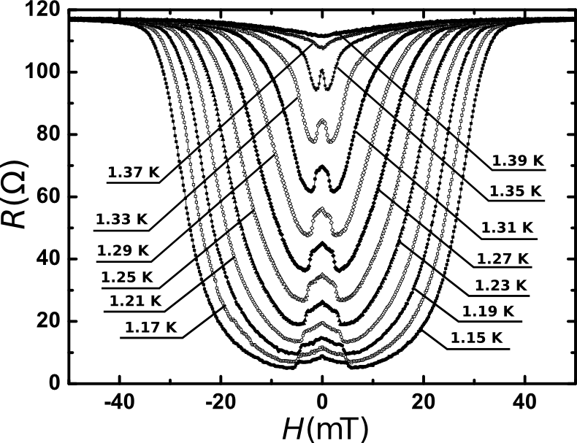
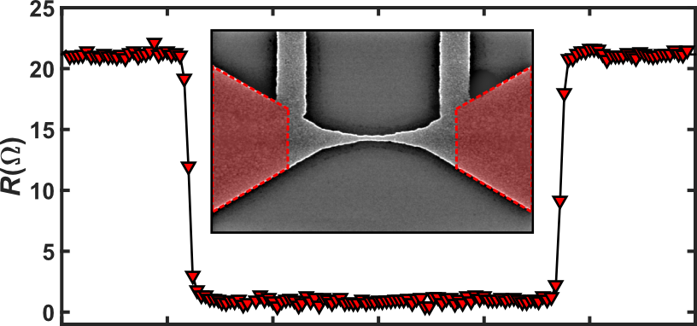
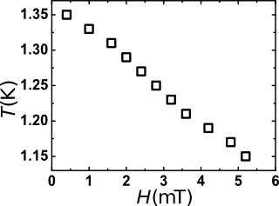
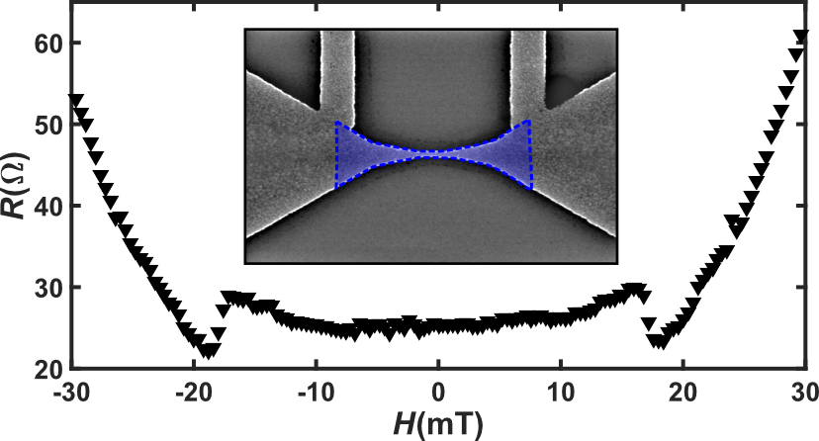
R(B): NMR and phase slips
H_{C2}
X. D. A. Baumans et al., Nat. Commun. 7, 10560 (2016)

Slide 17
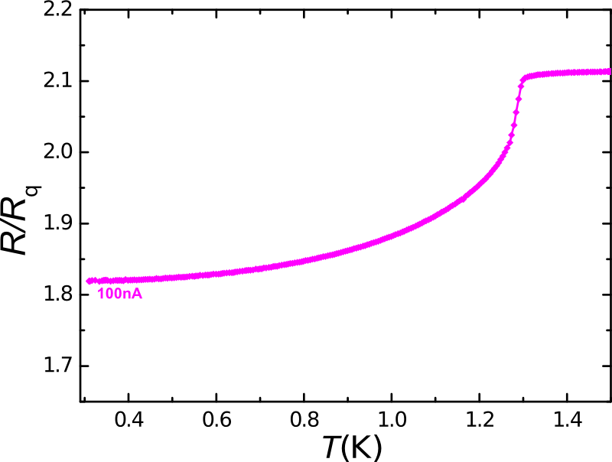
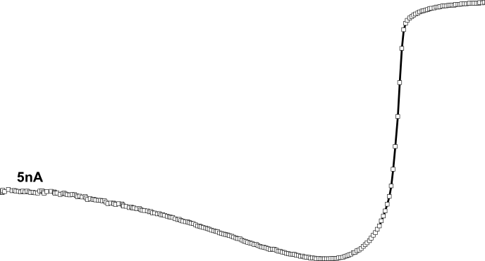
Quantum Point contact
Similar effects reported by
A. Bezryadin, C. N. Lau & M. Tinkham
Nature (2000) in MoGe nanowires
Theory for JJ
Penttilä et al. PRL (1999)
X. D. A. Baumans et al., Nat. Commun. 7, 10560 (2016)
Notes:
The insulating state is delocalized in the πηασε-space and localized in the charge space, meaning localization of the Cooper pairs.
A bias voltage weaken the charge-localization effect, leading to the observed reduction in the differential resistance

Slide 18
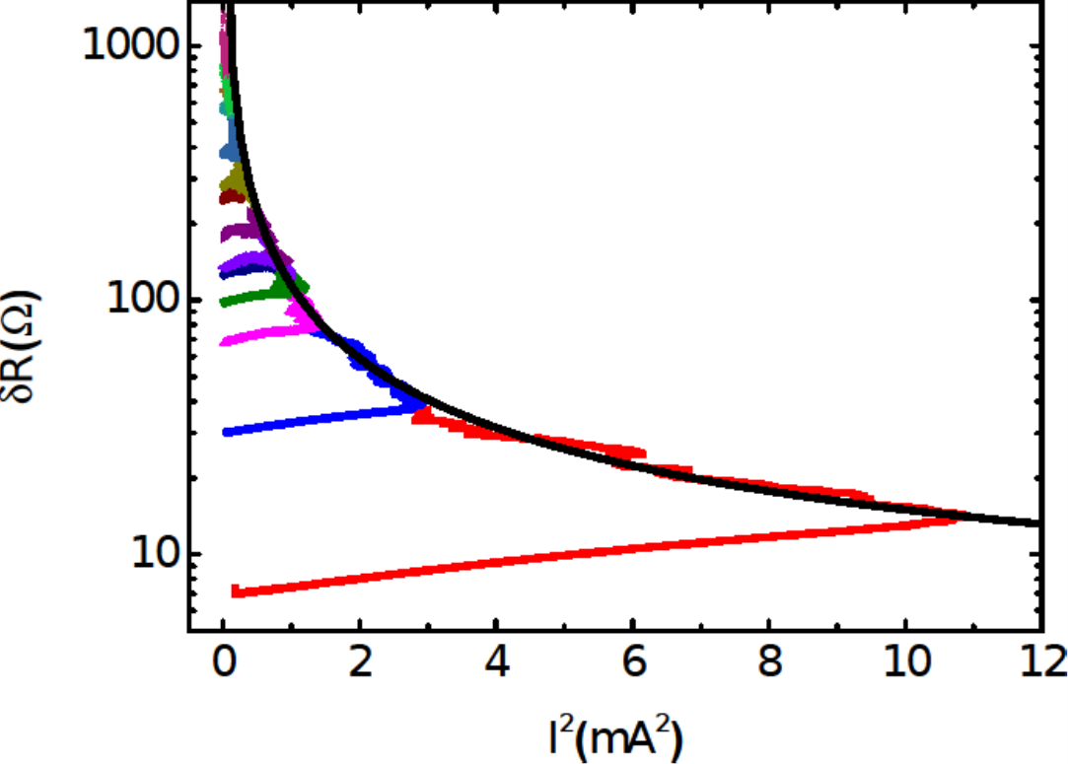
Constant power electromigration

Slide 19
ΔF
Energy
k_{B}T
0
2π
Δϕ

Slide 20
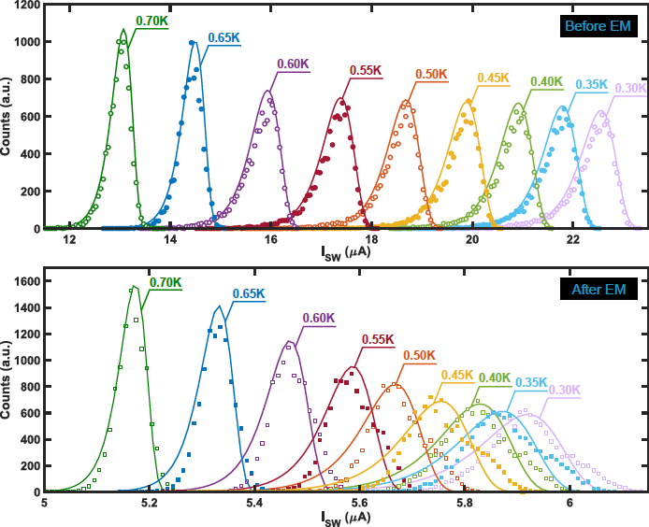
I_{C} distributions

Slide 21
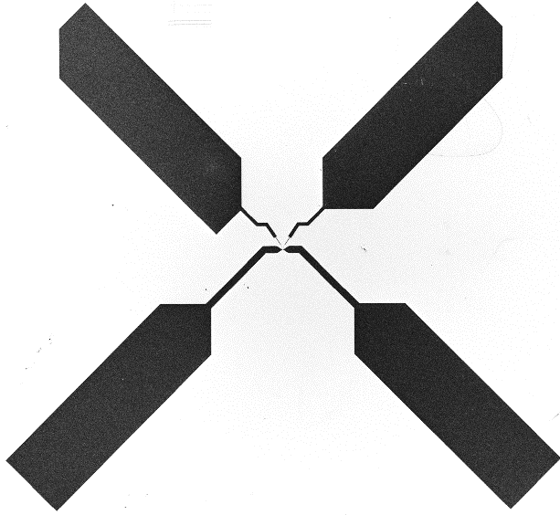
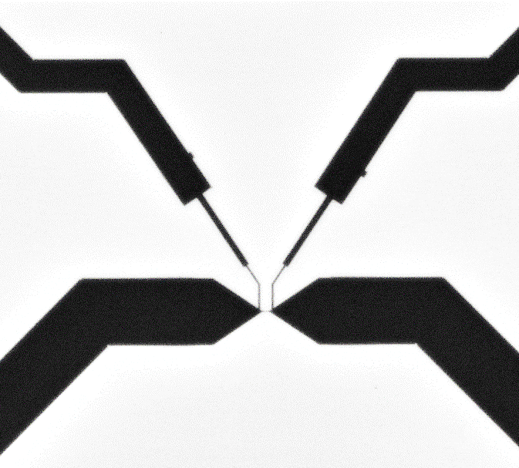
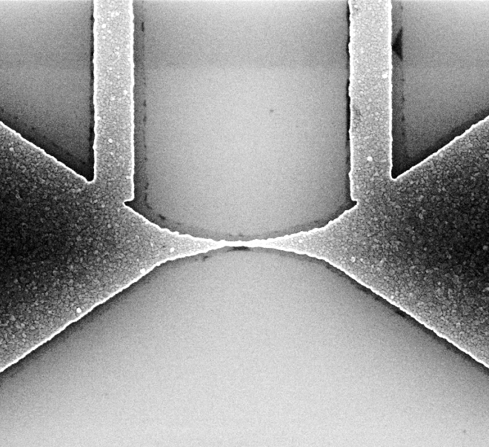

V⁺
(a)
V⁻
(b)
Si
Al
I⁺
200 µm
I⁻
20 µm
(c)
(d)
50 nm
1 µm

Slide 22


R(B): NMR and phase slips
H_{C2}
X. D. A. Baumans et al., Nat. Commun. 7, 10560 (2016)

Slide 23
V⁺
(a)
V⁻
(b)
(c)
50 nm
Si
Al
I⁺
200 µm
I⁻
20 µm
1 µm
(d)
(e)
(f)

Slide 24


Slide 25

Results
Critical current (I_{C})

Slide 26
Results
I_{C}(T): another point of view on TAPS/QPS crossover

Slide 28
The PID controller (SRS-SIM960) monitors the voltage across the
point contact junction as measured with a differential amplifier (Signal Recovery 5113 pre-amp) and adjusts its output to keep this voltage at a given
setpoint. The voltage across the junction as well as the current through it are
monitored by a computer, which then controls the PID setpoint according to the feedback algorithm.
The PID controller has a bandwidth of 100 kHz, which allows for small corrections to the device voltage at a rate much faster than what is provided by the software feedback.

