Slide 1
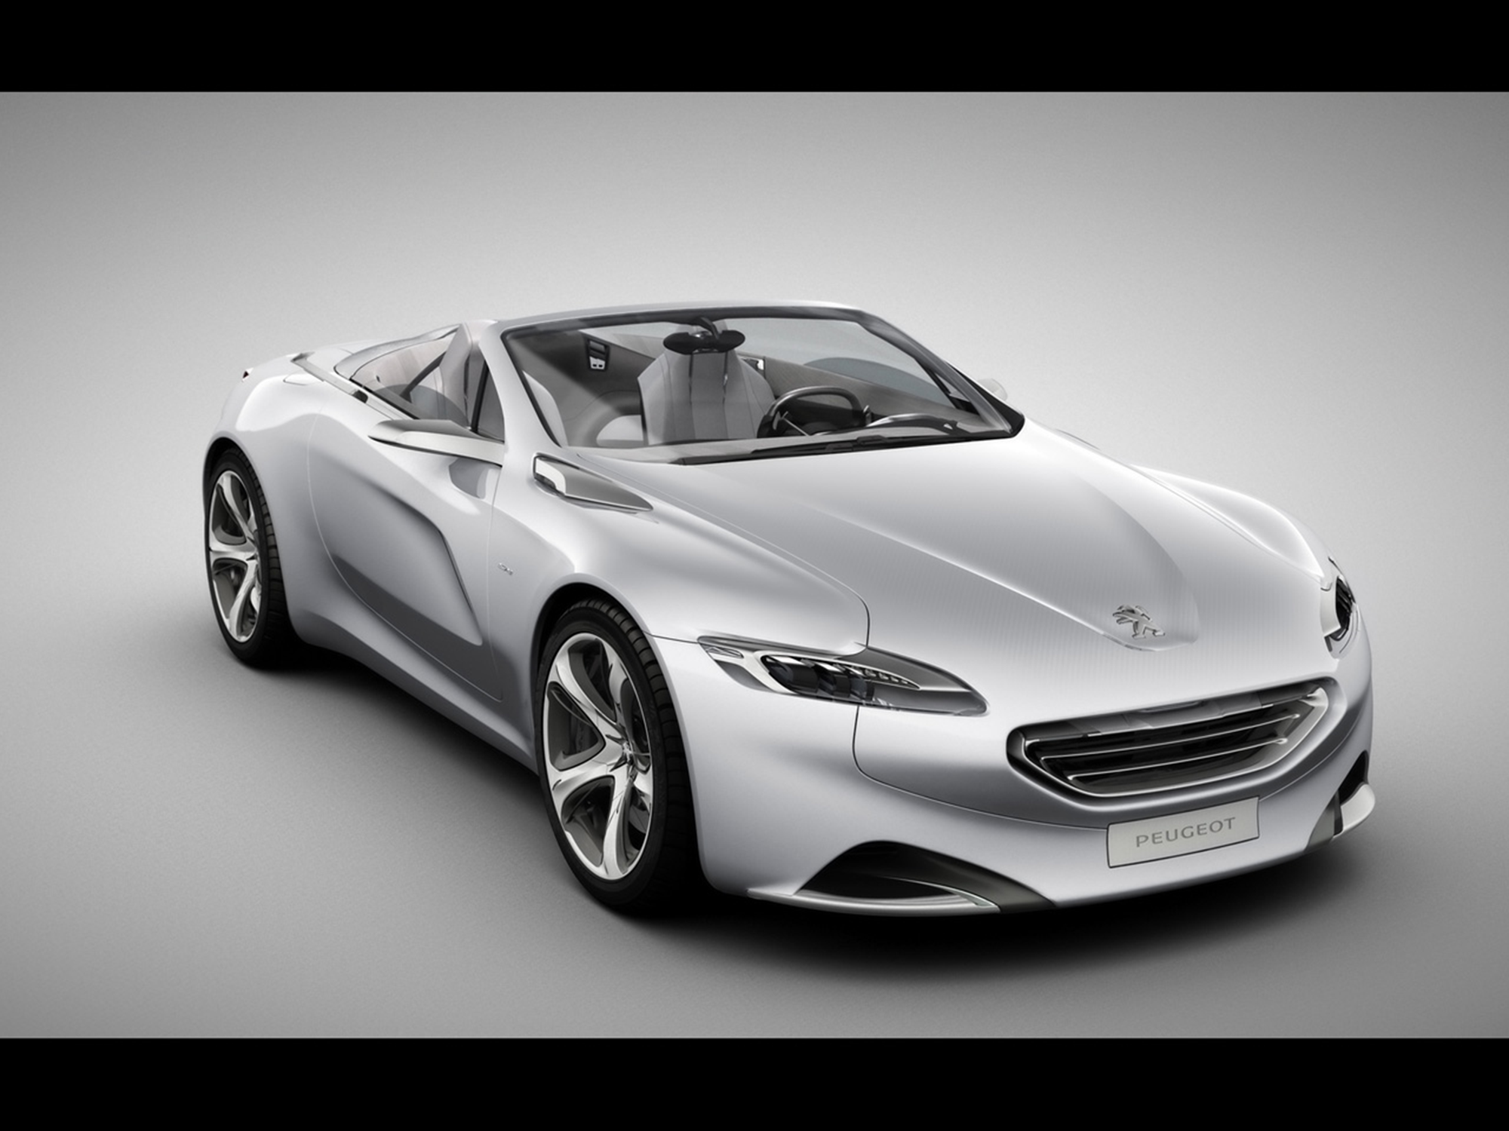





EXPERIMENTAL INVESTIGATIONS OF THE VALORIZATION OF THE EXHAUST WASTE HEAT OF A GASOLINE ENGINE BASED ON A RANKINE CYCLE
Olivier Dumontª, Arnaud Legrosª, Mouad Diny^{b} & Vincent lemortª
ª University of Liege (Belgium)
^{b} PSA Groupe, Direction Recherche et Dévelopement (France)

Slide 2
Introduction
Table of content
Introduction
Pump
Conclusions and prospects
Heat exchangers
Expander

Slide 3
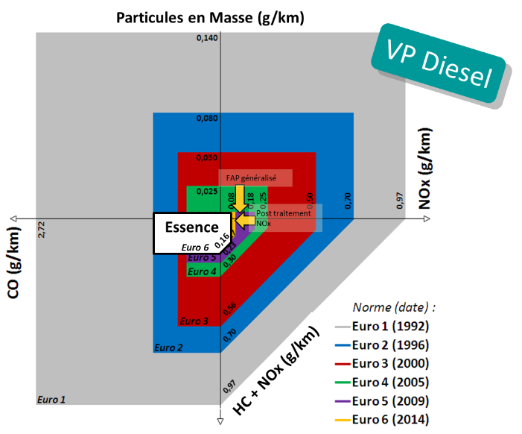
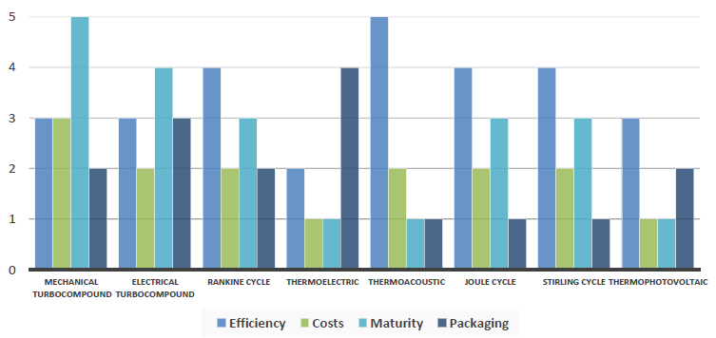
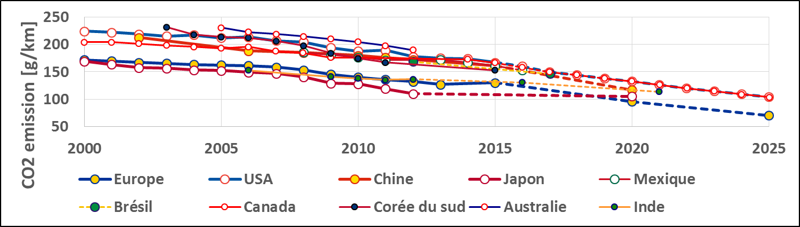
Introduction
Context
Energy transition in the transport sector
World convergence on CO2 emissions limitations
Decrease of other polluants emissions (CO, HC, NOx)
Interest for the Rankine cycle
[] Energies;ISSN 1996-1073 4, Comparison and impact of waste heat recovery technologies on passenger car fuel consumption on a normalized driving cycle. 8 Legros Arnaud Guillaume Ludovic , Diny Mouad , Zaïdi Hamid and Lemort Vincent

Slide 4
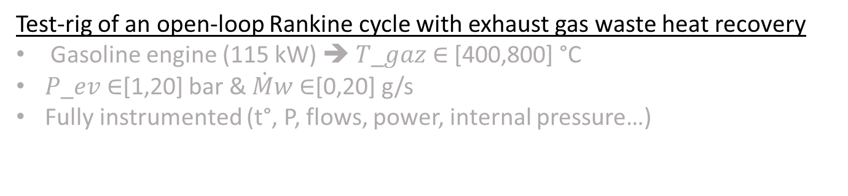
Introduction
Test-rig
Test-rig of an open-loop Rankine cycle with exhaust gas waste heat recovery
Gasoline engine (115 kW) ➔ 𝑇_𝑔𝑎𝑧 ∈ [400,800] °C
𝑃_𝑒𝑣 ∈[1,20] bar & $\dot{M}$𝑤 ∈[0,20] g/s
Fully instrumented (t°, P, flows, power, internal pressure…)
Electricity generation from scroll expander to the battery

Slide 5
Table of content
Introduction
Introduction
Pump
Conclusions and prospects
Heat exchangers
Expander

Slide 6

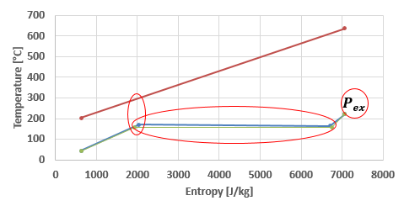
Evaporator
Description
Spiral counter-flow evaporator characteristics
Evaporator efficiency: pressure drop and pinch point into account
Parameter | Value
Mass | 3.7 kg
Volume | 2.34 dm³
Water exchange area | 0.708 m²
Compacity | 302.6 m²/m³

Slide 7
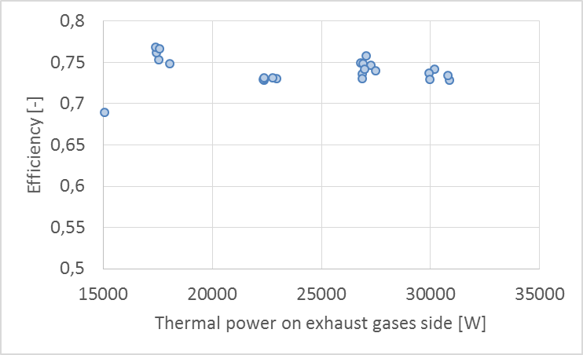
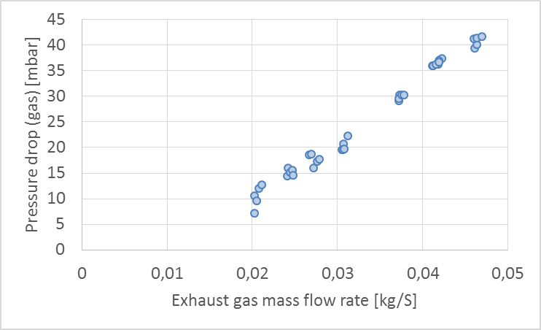
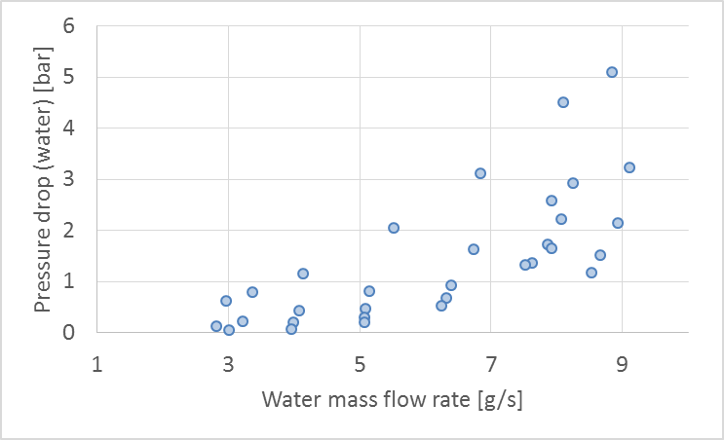
Evaporator
Performance
Rather constant efficiency
High pressure drop on the water side

Slide 8
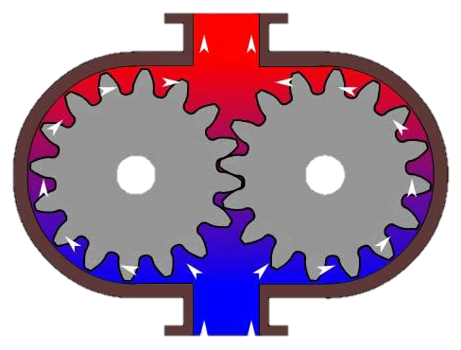
Table of content
Pump
Introduction
Pump
Conclusions and prospects
Heat exchangers
Expander

Slide 9

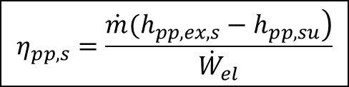
Pump
Description
Gear pump characteristics
Volumetric efficiency and isentropic efficiency
Parameter | Value
Swept volume | 0.5 cm³
Max. pressure | 20 bar
Max. mass flow (3000 RPM) | 20 g/s
Max. power consumption | 105 W
$$η_{pp,s}=\frac{\left.\dot{m}(h_{pp,ex,s}−h_{pp,su}\right)}{{\dot{W}}_{el}}$$
$$ε_{pp,vol}=\frac{{\dot{V}}_{pp,su}}{N_{pp}V_{pp,s}}$$

Slide 10
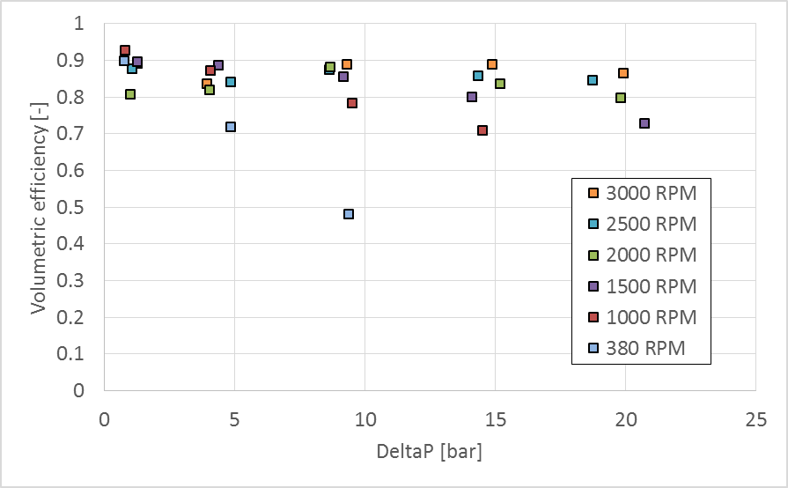
Pump
Performance
Maximum isentropic efficiency = 45%
Maximum volumetric efficiency = 90%

Slide 11
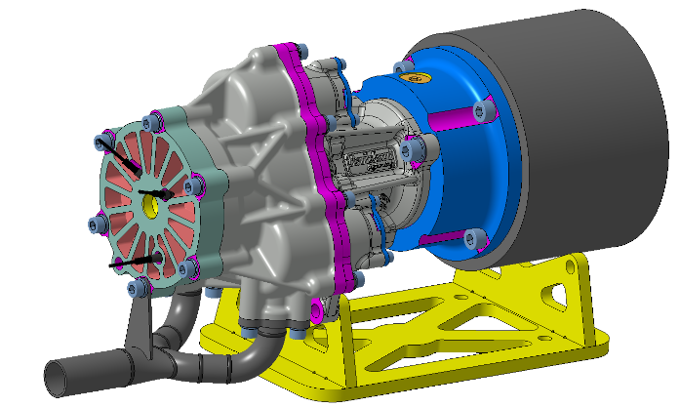
Table of content
Expander
Introduction
Pump
Conclusions and prospects
Heat exchangers
Expander

Slide 12
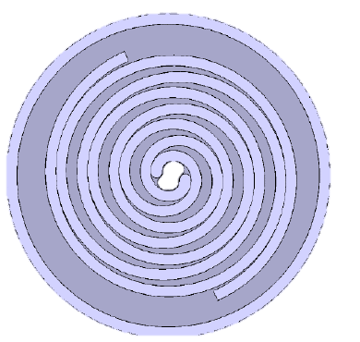
Expander
Description
Hermetic oil-free scroll expander
Taylor-made with a deterministic model of scroll
  Pockets of fluid, leakages, friction
Optimization of the geometry based on a normalized cycle
Parameter | Value
Swept volume | 8 cm³
Max. rotational speed | 15 000 RPM
Max. temperature | 250°C
Pressure | Up to 20 bars

Slide 13
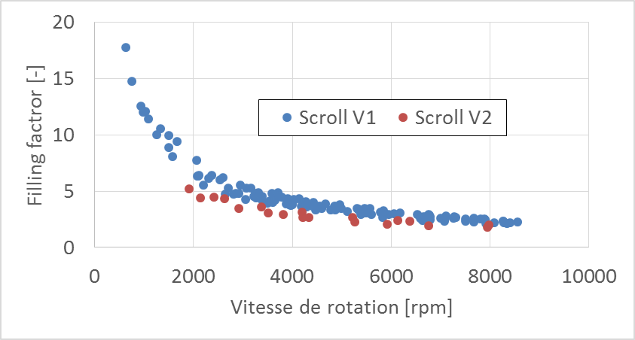
Expander
Performance
Hermetic oil-free scroll expander
Isentropic efficiency and Filling factor
V1 and V2 (20% reduced lateral clearance)
Electrical power ~ 1kW

Slide 14
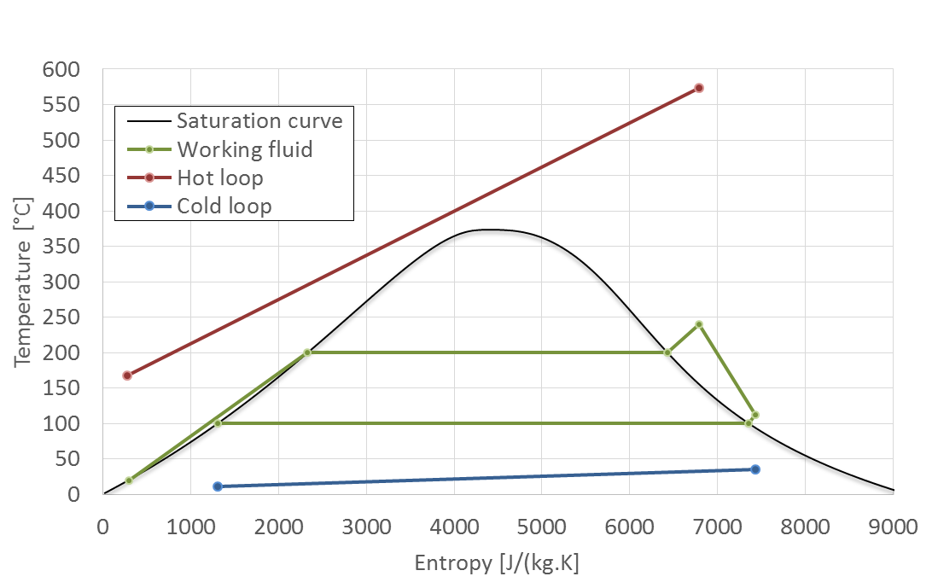


Global
Performance
Evaporator
15000 W
Expander
950 W
$η_{is}$ = 25%
Efficiency=5.9%
Net power = 885 W
Pump
65 W
$η_{is}$ = 35%
> 600W

Slide 15
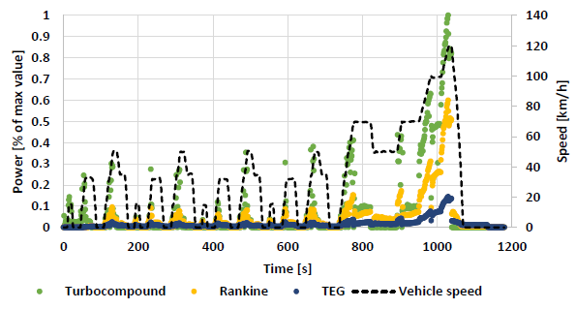
Table of content
Expander
Introduction
Pump
Conclusions and prospects
Heat exchangers
Expander

Slide 16

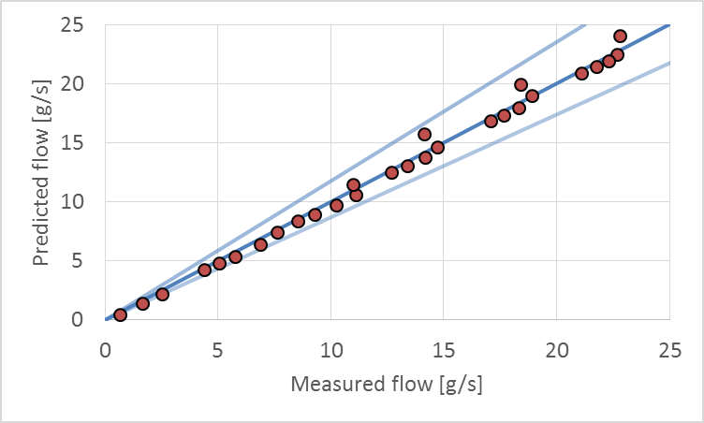
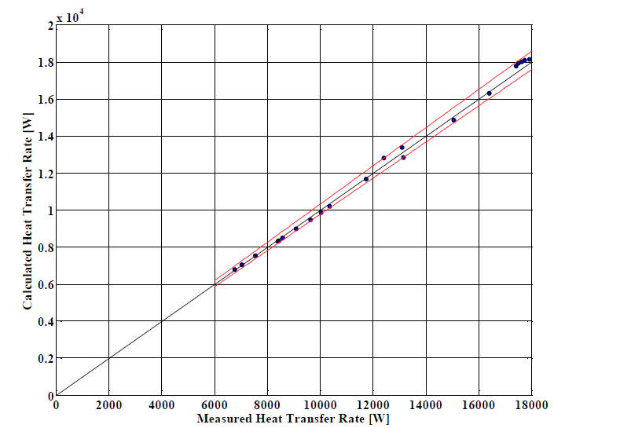
Conclusion
Experimental investigation
  Volumetric gear pump
  Taylor-made scroll expander
  Evaporator
Evaluation of the performance
  Rankine cycle steady-state model calibrated based on the experimentation
  Possibility of CO2 emissions reduction of 6.7 g/km
  Reduction of BSFC (Brake Specific Fuel Consumption) up to 5%
Perspectives
  Fluids : water mixture with ethanol
  Layout: cooling engine + R245fa
  Scroll V3 + turbine

Slide 17


Conclusion
Thank you for your attention!
Olivier.dumont@ulg.ac.be

