Slide 1


Between bovine milk production and reproduction : the challenge
Professor Christian Hanzen
University of Liège, Belgium
Faculty of veterinary Medicine
Department of bovine Theriogenology
www.facebook.com@theriogenologie
Dr Nguyen Kien Cuong
Nong Lam University
Faculty of Animal Science and Veterinary Medicine
Ho Chi Minh City
19th Congress of the Federation of Asian Veterinary Associations (FAVA)
September 2016, Ho Chi Minh City, Vietnam
Notes:
1
I would like to thank the organizers for inviting me in their beautiful country and this beautiful city of Ho chi Minh. This is the sixth time I come to Vietnam and it’s always with the same pleasure.
Today I would like give you some general informations on
milk production around the world

Slide 2

BELGIUM : 30.000 km2 and 11 millions people and 3 millions bovine
My office
UNIVERSITY OF LIEGE
200 years old,
24.000 students (23 % foreigners)
10 faculties
2900 academic and scientific
Publications peer reviewed (2015) :
4182
see http://orbi.ulg.ac.be/
The veterinary faculty
Notes:
2
Belgium is a very small country, 11 times smaller than Vietnam.
University of Liège is one of the thirteen balgian faculties.
Very old, she has 24.000 students, and 2.900 academic and scientific people.
His research activity is quite important since 4182 peere reviewed papers have been published in 2015.

Slide 3
Some data about cow’s milk in the world
Notes:
3

Slide 4
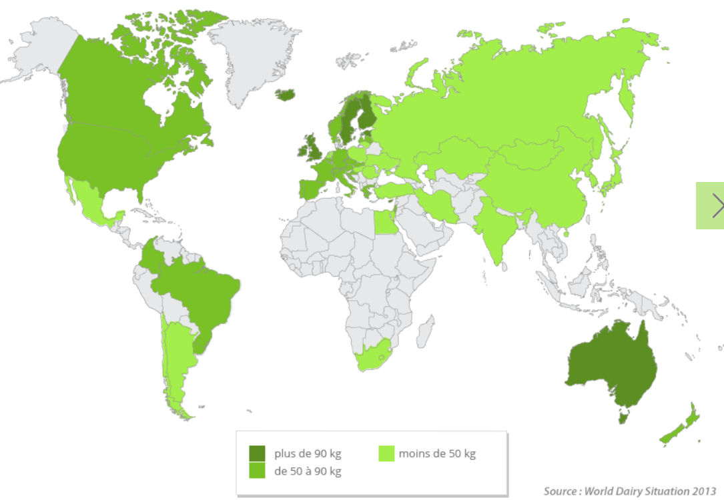
Huge differences in the consumption of whole milk in the world (kg) in 2012 (Source http://www.fil-idf.org)
UK : 105 l
Russia : 35 l
USA : 74 l
China : 17 l
Vietnam : 23 l
<50 kgs
Australia : 110 l
>50 kgs
Notes:
5
Such consumption is also quite different according to the countries.
In dark green you can see the highest consumers of milk and in light green the lowest.
Some more specific figures can be given USA, UK ….

Slide 5
Milk from cows (2013 in millions tonnes)
(Source http://www.fil-idf.org)
83 %
13 %
Notes:
7
In 2013, the world milk production was 782 billions of liters. 83 % of this total milk production was produced by cows, 13 % by buffaloes and 4 % by others species.

Slide 6
Distribution of cows and milk production are quite different according
to the continents (Source http://www.fil-idf.org)
% of dairy cows and total milk production by continent
(Source http://www.fil-idf.org : 2014)
269 millions cows
646,1 millions tonnes
Notes:
8
Distribution of cows and milk production are quite different according to the continents. In one side you have ASIA, continent who have 40 % of the total number of cows but assume 28 % of the total milk production. We can compare theses figures with thoses recorded in European Union 9 % and 24 % respectively or thoses recorded in Central and North Amercia 6,4 and 18 % respectively.

Slide 7
Huge differences of the average milk production per cow (Kg/year) by continent
Notes:
9
The average milk production of milk by cow is very different according to the continent. Several thousands liters per cow and per year in central, north america and Europa but only 520 kgs in Africa.
It is those who most need that produce the least.

Slide 8
Huge differences of individual milk production according to the country
Notes:
10
Looking to this graph you can observed how different can be the milk production according to the country. In india a cow on average produce 1300 litres per year but 12.000 liters in Israel

Slide 9
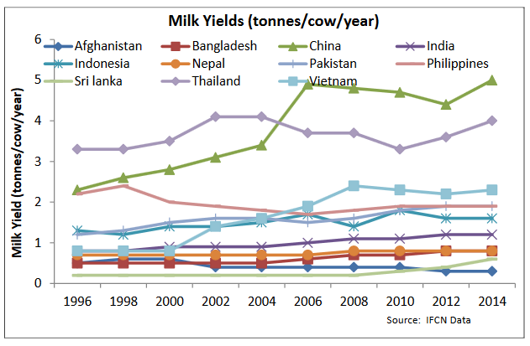
Huge differences of individual milk production according to the country (ASIA)
http://www.dairyasia.org/file/Proceedings_Dairy-Asia-2016_First-Draft.pdf
China
Vietnam
Notes:
11
Such differences can be also observed in different countries in ASIA : around 2000 liters in Vietnam but 5000 litters in CHINA

Slide 10
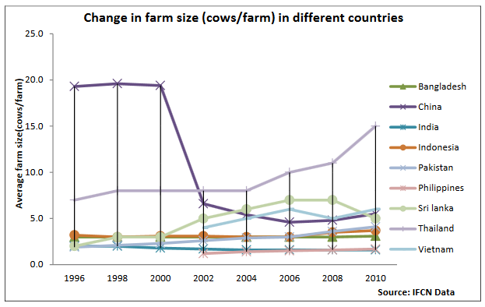
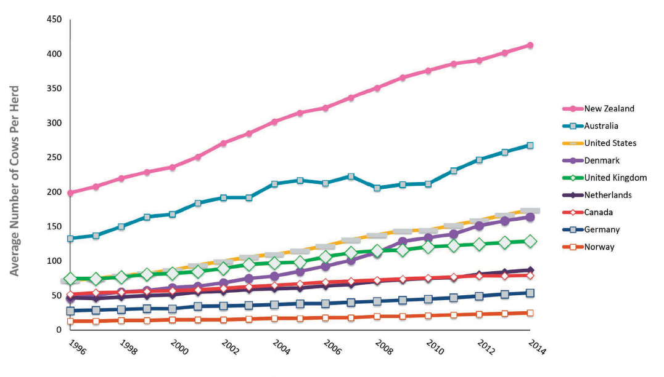
Two contexts of milk production according to the size of the farms
Barkema et al. J.Dairy Science 2015, 98, 1-20.
http://www.dairyasia.org/file/Proceedings_Dairy-Asia-2016_First-Draft.pdf
Notes:
12
Comparing around the world the size of the farms, we can observed again.
Outside Asia, each farm gas between 20-40 cows (like in Norway or Germany) and 250 to 400 cows like in Australia or New Zealand.
In most of asiatic countries the average number of cows is rather low. In Vietnam 97 % of the farms has less than 20 cows. In China this average number is around 15. Of course many exceptions can be observed. Wen can mentionned TH milk farm in Vietnam.

Slide 11
Summary
- The figures related to milk consumption and production appears to be quite different according to the continents, countries and cows.
- Nevertheless, the market of milk is a world market.

Slide 12
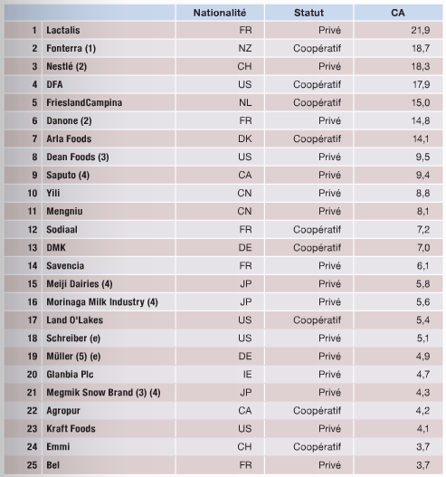
The milk : the white market
Billions dollars)
World milk consumers :
2,4 billions in 2012 and 4,2 billions in 2025
World milk production :
782 billions of milk (2013)
47 % of the world production are under control of factories
25 % of total milk production control by 25 factories
In developing countries :
80 % of milk are not controlled by factories (informal market FAO 2006)
http://www.maison-du-lait.com/fr
Notes:
14
The milk produced around the world is commercialized according to two network.
The first is an unformal network : the producer directly sell he milk to the consumers : 53 % of the produced milk is concerned.
The second network is the factories. These companies control 47 % of the milk production but only 25 factories control 25 % of the milk produced around the world. Last week in France, the first milk company in the world, the group Lactalis has been finally obliged by the farmers to increase to 30 cts by litter the price of milk. It has been a great victory.

Slide 13
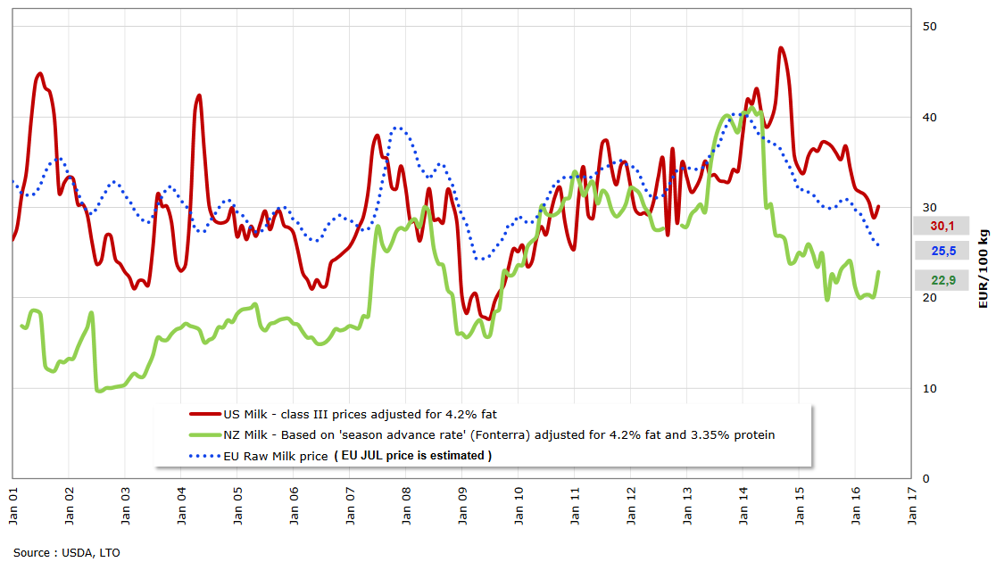
Evolution of milk price in NZ, US and EU http://ec.europa.eu/agriculture/market-observatory/milk/pdf/world-raw-milk-prices_en.pdf
Notes:
15
In most of the developping countries, the price of milk depends on the global market.
This figure presents the evolution of the milk price in New Zealand (green line) USA (red line ) and in Europa (dotted line).
As you can see the milk price is decreasing since more or less two years.
Actually the average price in Europa is 25,7 Euros per tonn.
Last week in France, the first milk company in the world, the group Lactalis has been finally obliged by the farmers to increase to 30 cts by litter the price of milk. It has been a great victory.

Slide 14
Summary
- Milk can be called white gold.
- The goal of the companies is to make profit.
- The challenge of the farmer is to reduce the costs of milk production

Slide 15
Factors influencing milk production
Notes:
The milk production is influenced by three kinds of factors.

Slide 16
Genetic
Notes:
18
The first is genetic

Slide 17
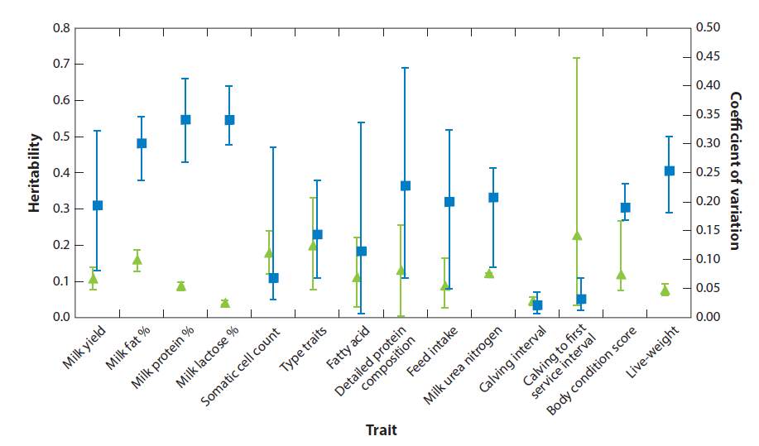
Milk traits are the most heritable
Heritability and coefficient of genetic variations of some traits in cattle
Berry et al. Milk Production and fertility in cattle. Annu.Rev.Anim.Biosci. 2016, 4, 269-290.
Notes:
19
Holstein breed is the most popular dairy cow around the world.
This breed has been after the second war submitted to an intensive genetic selection for several caracters linked to the quantitative and qualitative aspects of milk production and also reproduction.
This caracters have an heritability coefficients relatively differents. The heritability of milk yield, percntage of milk fat, protein and lactose is rather high and between 0.3 and 0.6.
Somatic cell count, type traits, fatty acid feed intake or urea have an heritability between 0.1 and 0.3 more or less the same than the body condition score and live weight.
Heritability of reproduction parameters is rather low less than 0.1.

Slide 18
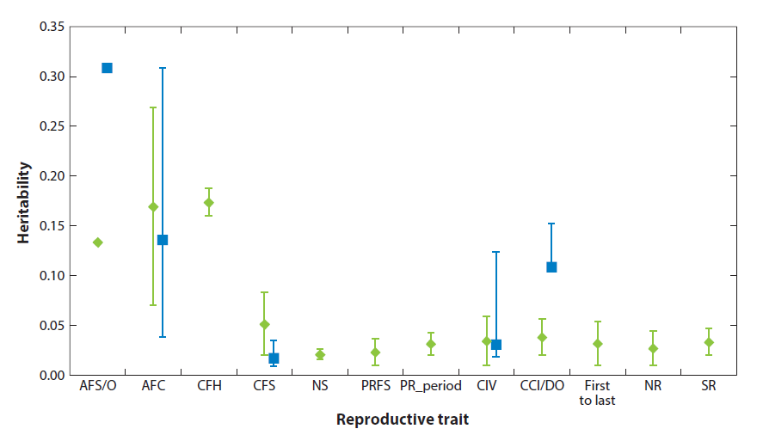
Reproduction parameters have a rather low heritability
AFS : Age first service
AFC : Age first calving
CFH : First calving First heat
NS : Number of services
PRFS : Pregnant first service
PR : Time to be pregnant / Start reproduction period
CIV : Calving interval
CCI/DO : Days open
Fist to last : Time elapsed between first and last AI
NR : Non retourn rate
SR : Submission rate
Beef
Dairy
Berry et al. Milk Production and fertility in cattle. Annu.Rev.Anim.Biosci. 2016, 4, 269-290.
Notes:
20
This low heritability of reproduction parameters have been observed for dairy and beef cattle

Slide 19
Genetic
Nutrition
Notes:
21
The second group of factors influencing the milk production are related with nutrition.

Slide 20
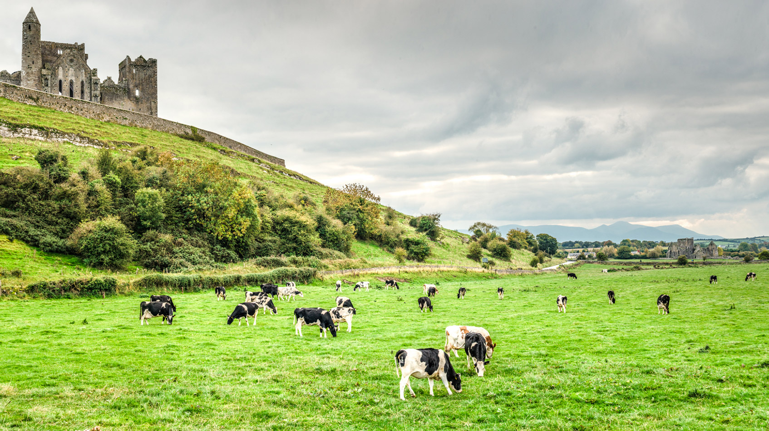
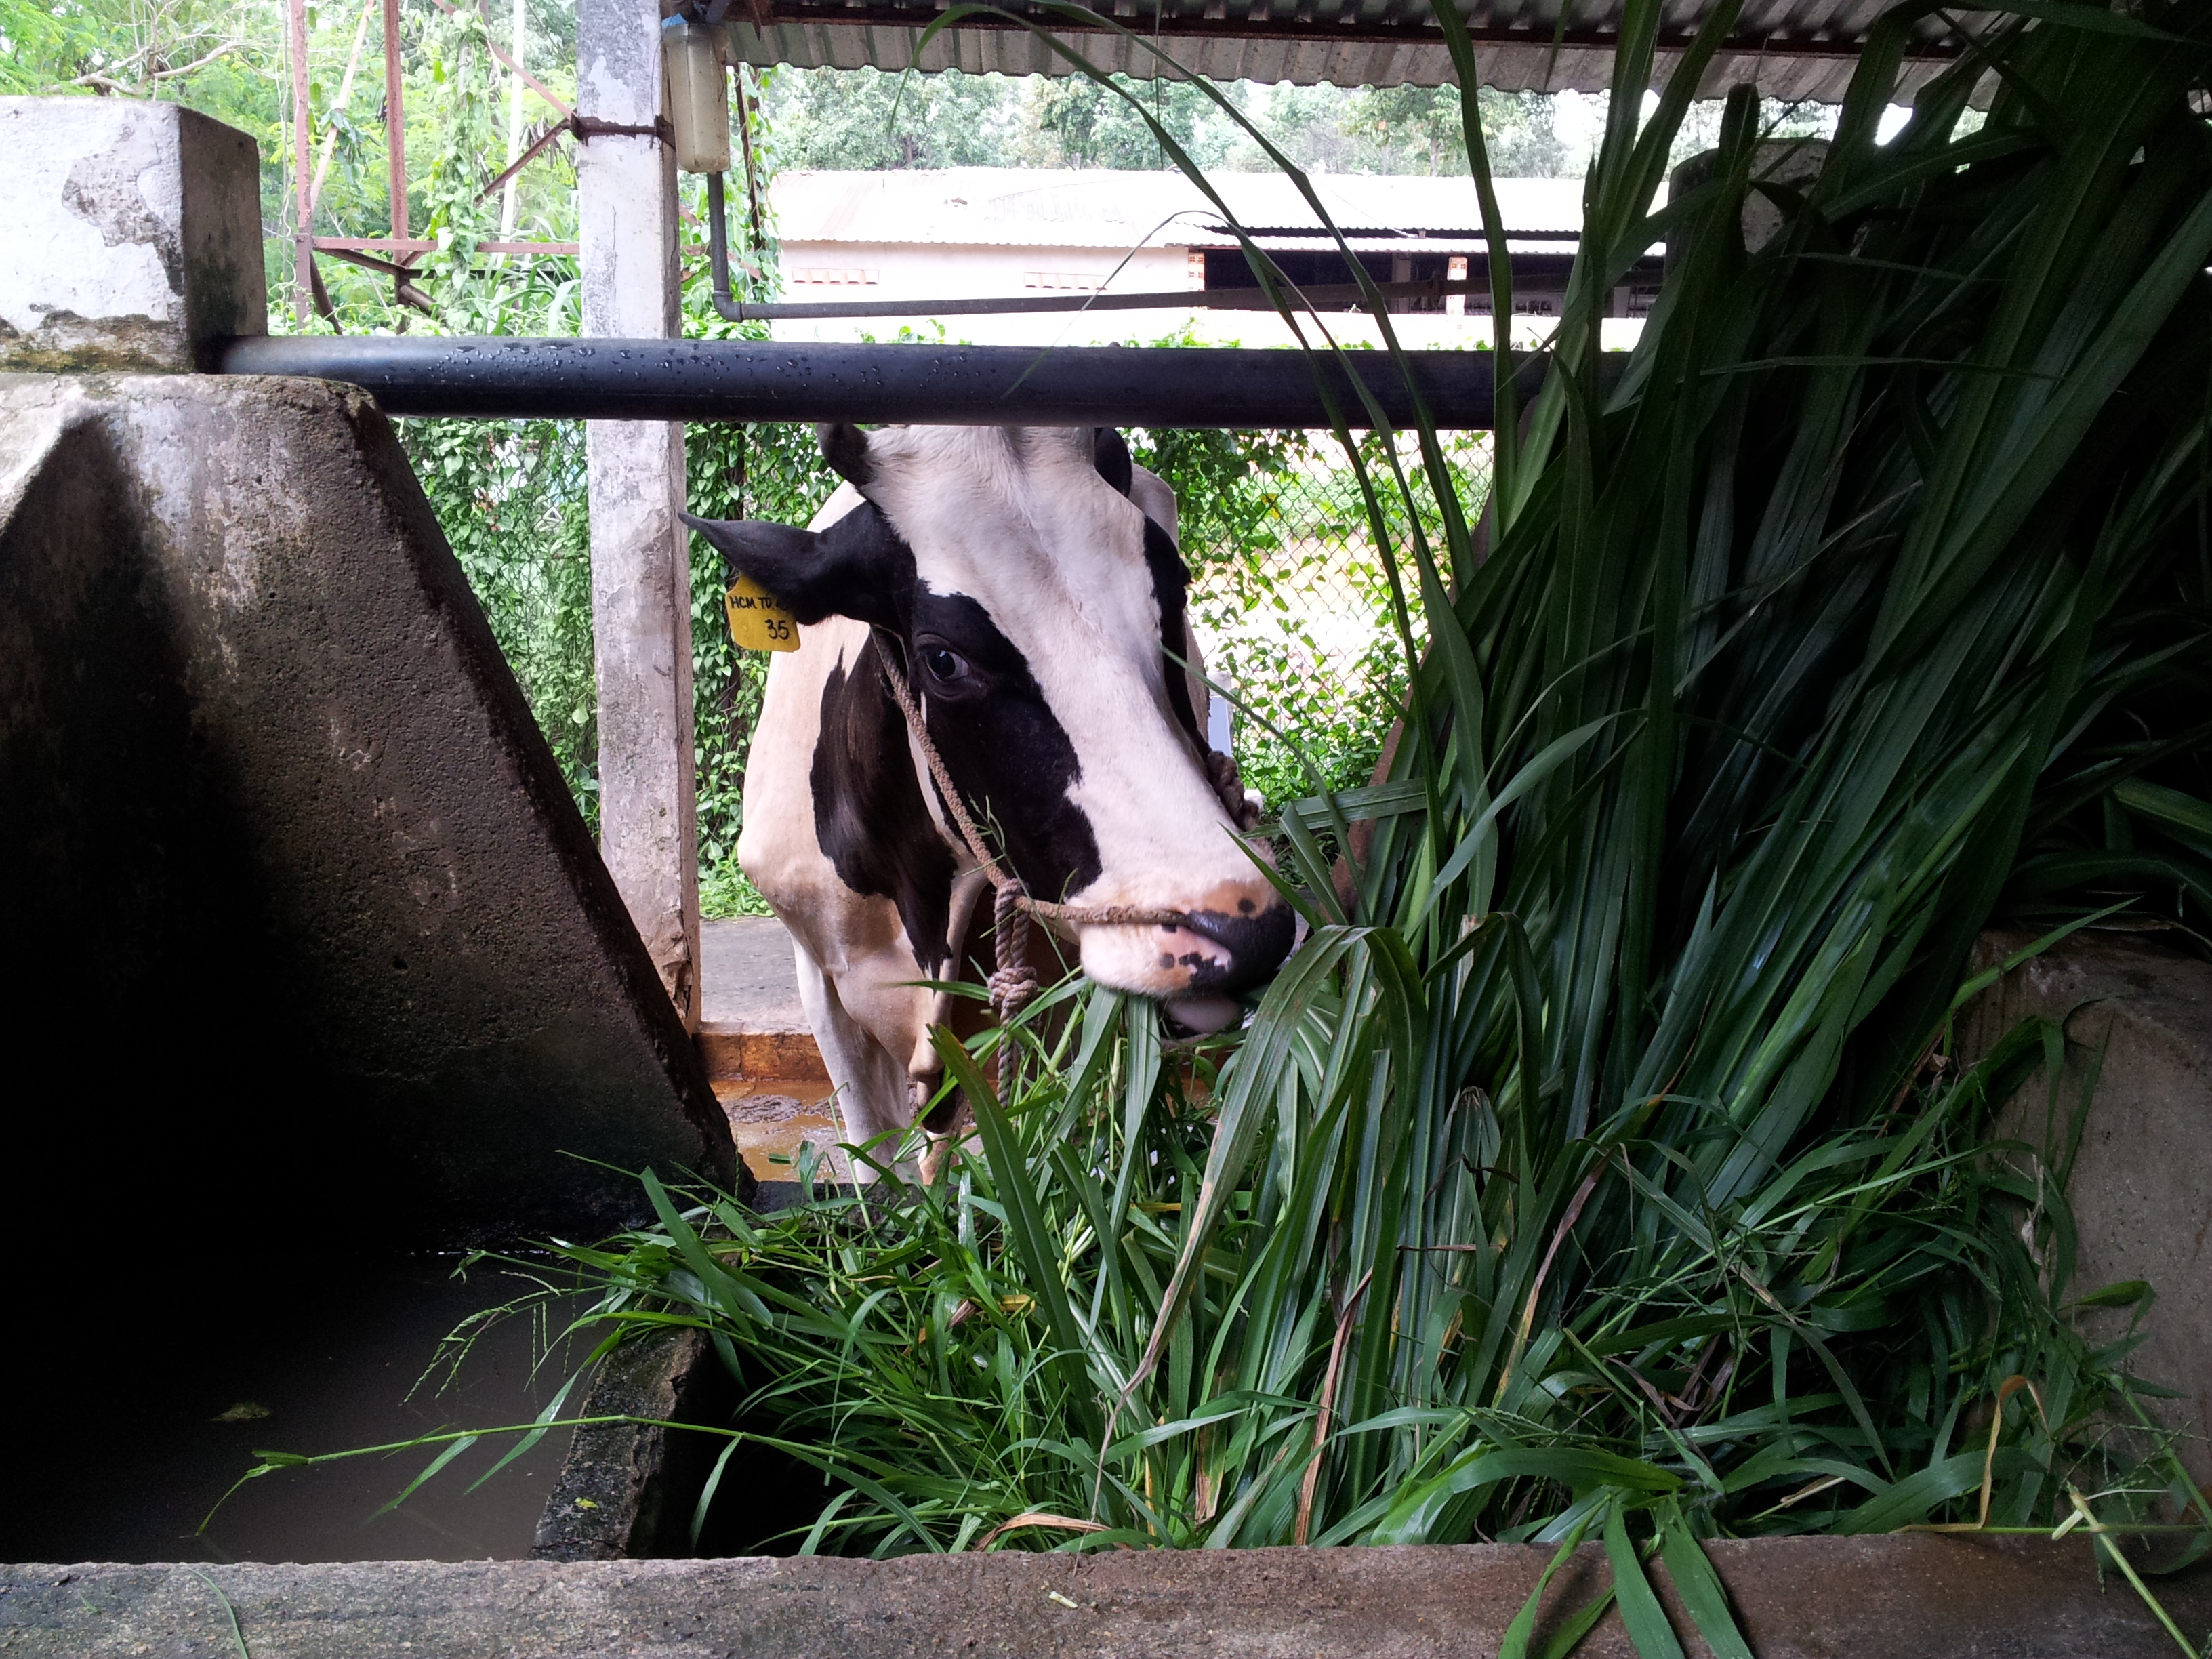
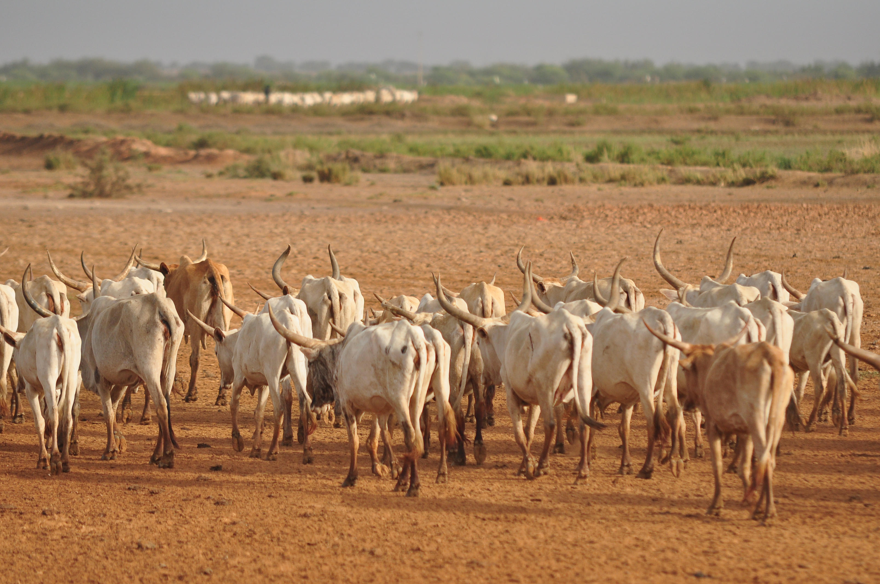
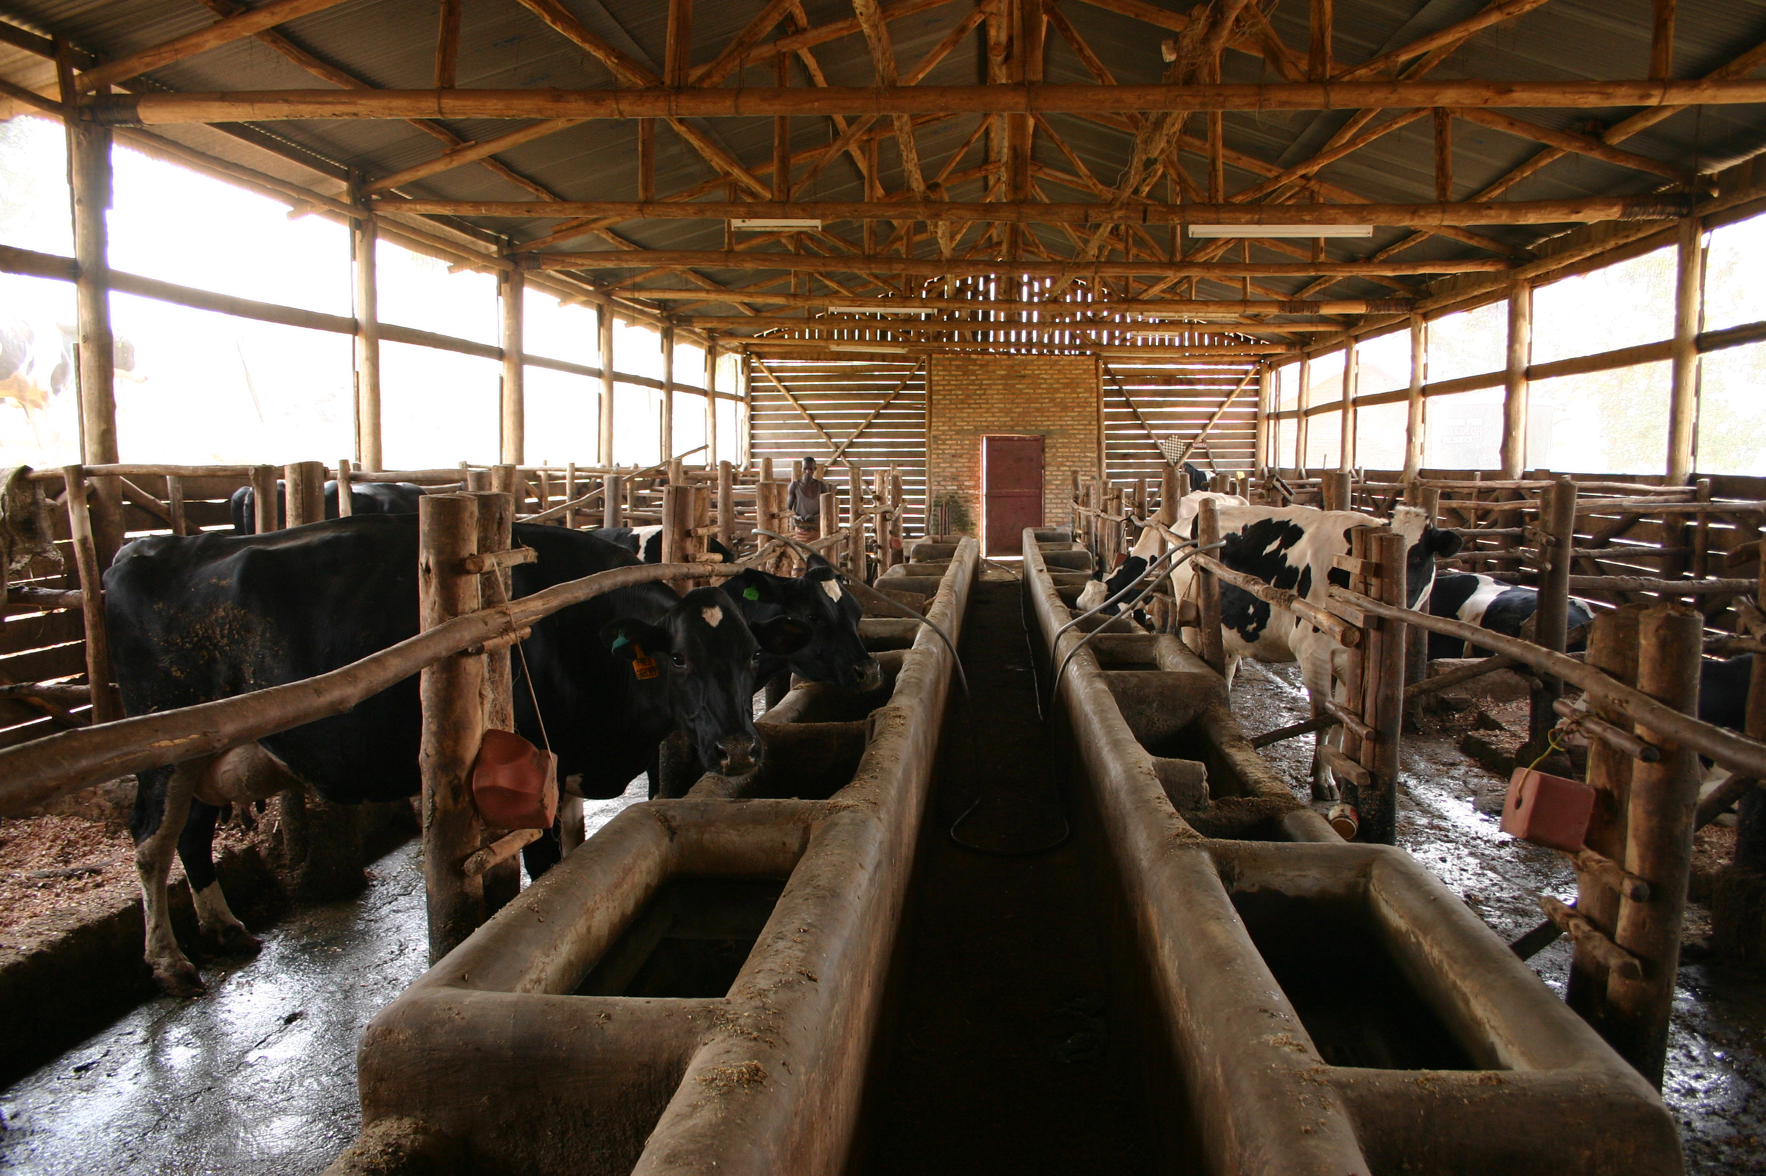
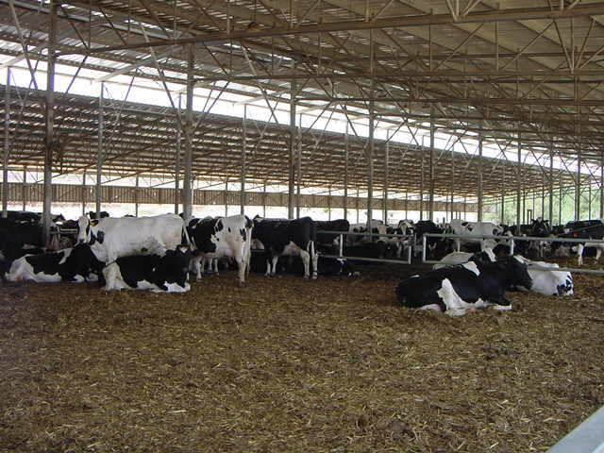
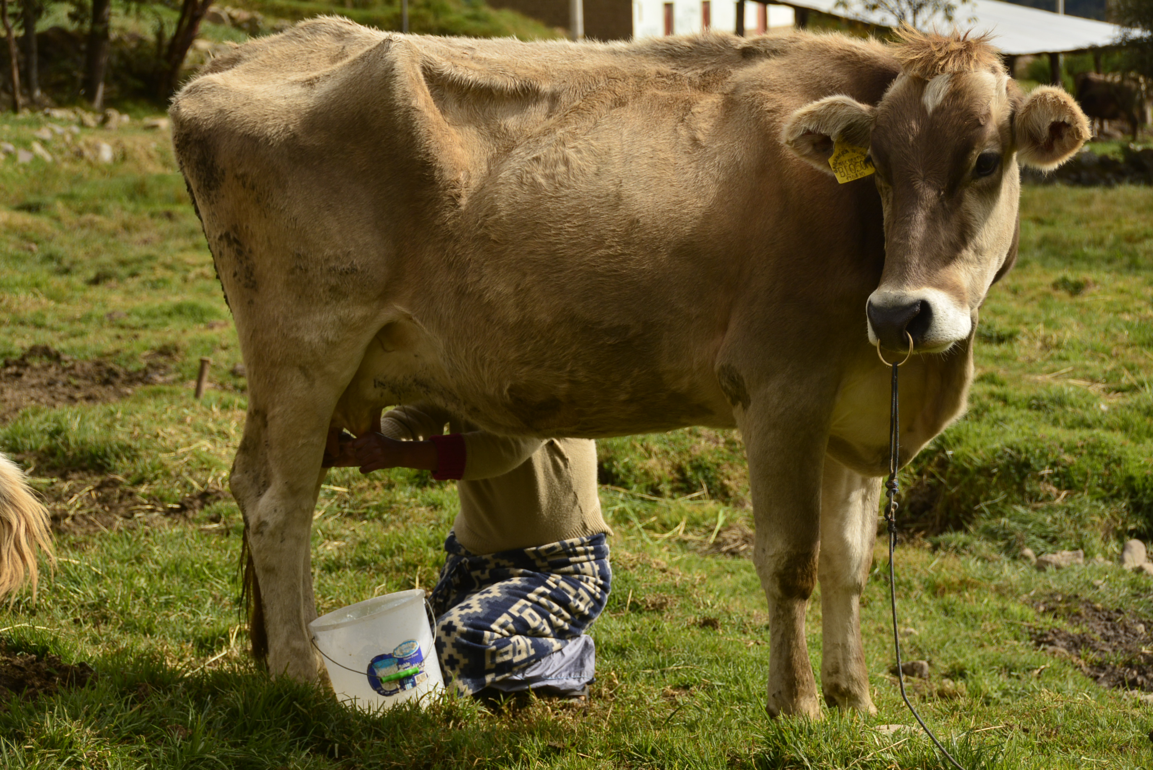
Cows in Senegal
Pastures in Ireland
Cow in a small farm (HCM district)
All are dairy cows but so many differences in nutrition
Small farm in Rwanda
Big farm in Israel
(without a grazing area)
A cow at 2800 m (Andes Peru)

Slide 21
Genetic
Nutrition
Diseases
Notes:
23
The third group of factors concerns the diseases.

Slide 22
Factors influencing milk production
Dystocia
Placenta
retention
Infectious
Mastitis
Uterine
infections
Diseases
Parasitic
Reproduction
Anoestrus
Infertility
Metabolic
Lameness
Pregnancy
losses

Slide 23
Reproduction : a key tool in milk production

Slide 24
Fertility : number of AI to obtain a pregnancy
Infertility if > 2 AI
Conception
AI1
Birth
C1
C2
C3
Cn
Culling
Waiting period
Last AI
Reproduction period
Fecundity : time to obtain a pregnancy or a calving
Days open or calving interval
Pregnancy period
24 months
365 days
What’s the life of a dairy cow ?
Notes:
27
What’s the life of a dairy cow ?
The period of time between birth and culling is divided in different intervals between calving. On average a cow will calve 2,8 times during this period. So the longevity of a cow is rather low.
The interval between birth and the first calving is divided in different subperiods. The first is called waiting period. It’s the interval beween birth and the first service. This period is followed by the period of reproduction. It’s interval between the first and the last insemination. If we obtained a fecundation, this period is followed by the period of pregnancy.
The same subperiods can be observed after each calving. The waiting period of a cow is the interval between the previous calving and the first nsemination. The waiting period is followed first by the reproduction period and after by the pregnancy period. These three subperiods can be observed after each calving.
Sometimes, a pregnancy can’nt be obtained from an insemination and the farmer can decided to cull the cow after a more or less long period of lactation.
Different thresholds have been define to distinguish a normal and a abnormal cow.
Some parameters define the fecundity of a cow. They express the concept of time : time between birth and first pregnancy or first calving or time between calving and pregnancy (days open) or between two calvings. Normally interval between birth and fist calving needs to be 24 and 26 months and interval between two calvings between 365 and 380 days.
The fertility of a cow is express by the number of insemination necessary to obtain a pregnancy. In a normal cow the number needs to be less than 3. If the cow has been inseminated more the 2 times, she will be declared infertile.

Slide 25
Reproduction and milk production
(ex 6 to 7000 by 305 d)
Normal cow
Abnormal cow
Pregnancy
Pregnancy
C
C
C
C
80 d
285 d
120 d
285 d
Dry
period
Dry
period
Lactation
Lactation
305 d
60 d
305 d
100 d
365 d
405 d
Notes:
28
According to the usual goals defined for reproduction, a normal cow needs to calve every year or using an other parameter needs to be pregnant 85 days after last calving since the lenght of pregnancy is 25 days
A normal cow has a lactation of 305 days. This lactation is followed by a dry period of 60 days.
An abnormal cow has a calving interval higher than 380 days. In our exemple this calving is 405 days. Its gestation period is always 285 days and its lactation 305 days.
Due to these figures, we can observe two main changes. The first is the increase of the number of days open (days between calving and the beginning of pregnancy). This increase induces an increase of the lenght of the dry period.
Finally, by day of life, the production of milk is decreased.

Slide 26
Effect of reproduction on milk production
Normal cow
1460 days (4 x 365 days if calving interval is optimal
Abnormal cow
Notes:
29
Finally, by day of life, the production of milk is decreased.
For a normal cow, we will have in 4 years, four lactations.
In an abnomal cow, we will have 3,3 lactations.

Slide 27
The calving is a key moment in the life of a cow
Peak of lactation
(4 to 6 weeks)
Calving
End of the
previous
lactation
HIGH
RISK
Period of lactation
Dry period (45 to 60 d)
Period of pregnancy
Puerperium : waiting period
Reproduction
Preg
Transition period (40 d)
20
+
60
+
20
=
100
100 days to obtain a new pregnancy
Notes:
30
The calving is a key moment in the life of a cow
Before to calve, the cow present a dry period of time if she was in lactation before. This period coincides with the end of pregnancy.
The period of lactation begins at calving.
During the first weeks, the milk production dramatically increases until the peak of lactation. A progressive decrease is observed after.
The waiting period is followed by the reproduction period, itself followed by the pregnancy period.
We need also to mention the transition period. She begins more or less three weeks before calving and ends three weeks after. It’a a huge adaptation period for all metabolic, immune, nutritionnal and anatomical process.
In total we have 100 days to obtenin a pregnancy : 20 days before calving, 60 days after calving for the waiting period and 20 days for reproduction period.
The first three weeks postcalving is a high risk period. Mots of the pathologies appears during ths period.

Slide 28
What’s the situation in some tropical and subtropical countries ?

Slide 29
Calving interval in tropical and subtropical countries (dairy breeds, mainly Holstein) (J)

Slide 30
Birth first calving in sub or tropical countries (dairy breeds, mainly Holst) (mths)

Slide 31
To analyze a reproductive problem, its necessary to
Know the right definitions of the pathologies
Know the factors influencing reproduction performances
Understand the links between the pathologies
Use the right propedeutic method to make the diagnosis
Be able to analyse the data at the individual and the herd level

Slide 32
Define the pathologies : why ?
To use the best method of diagnosis
To make comparisons of prevalence
To understand their risk factors
To evaluate the effect of treatments

Slide 33
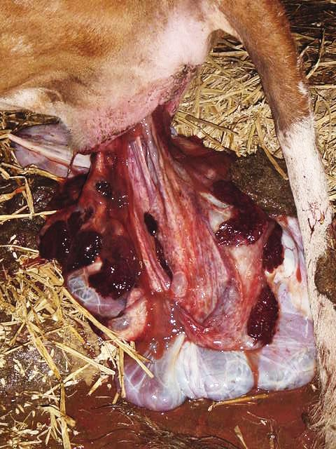
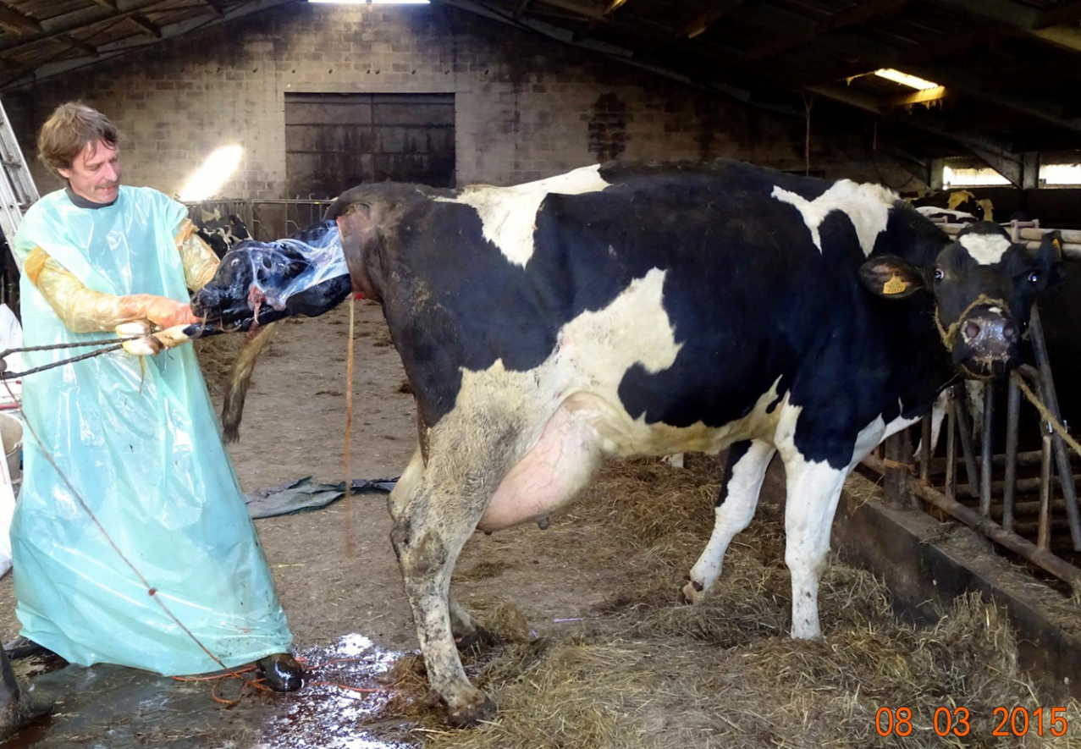
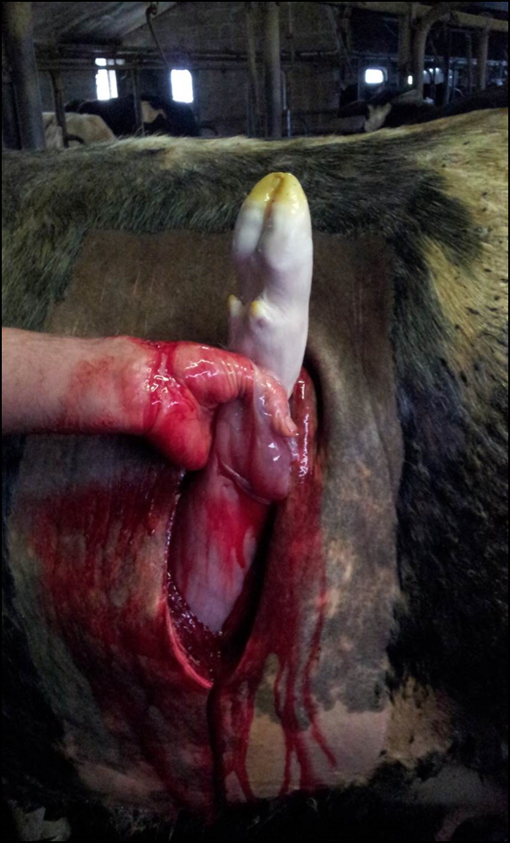
Dystocia (Mee et al. 2008)
Placental retention
In greek : Dys = difficult and Tokos = birth
= all calving which requires a manual intervention
Stage 2 of calving : 70 min on average (30 min to 4 h : Noakes et al. 2001)
= no expulsion of placenta within 24 h after calving
expulsion of the placenta = Stage 3 of parturition
Placental retention is a inflammatory process
Notes:
36
The term dystocia comes fromGreek : dys means difficult and tokos means birth.
So we can define dystocia by a difficult necessiting a non surgical or a surgical (C-section) assistance to pull out the calf.
Conversely, eutocia or normal calving may be defined as a spontaneous calving of normal duration. Taking the appearance of the amnion as the time of onset, calving (stage two) normally takes between 30 minutes and 4 hours with an average duration of 70 min being longer in heifers than in cows.
Most of causes (70 %) of dystocia in the cow are due to fetomaternal disproportion and abnormal presentations, positions or postures of the fetus.
The placenta retentio is defined by the non expulsion of the placenta during usually the first 24 h after calving.

Slide 34
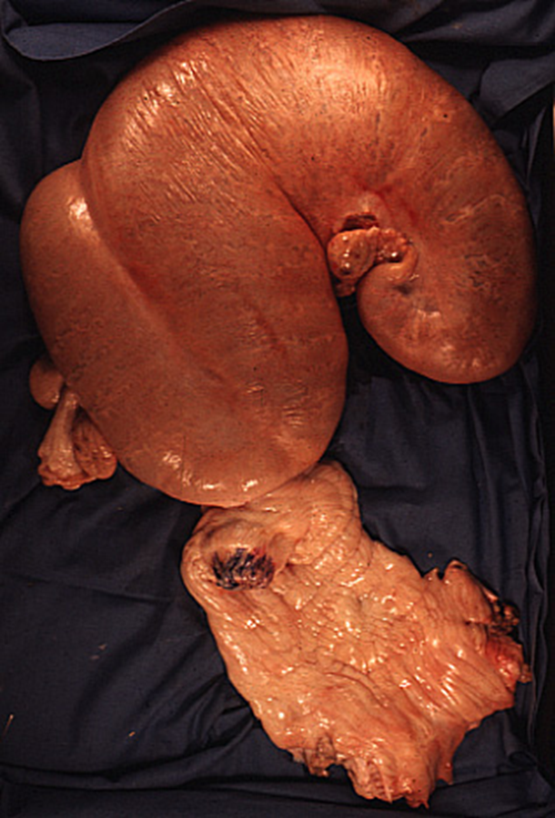
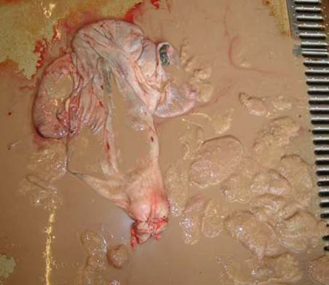
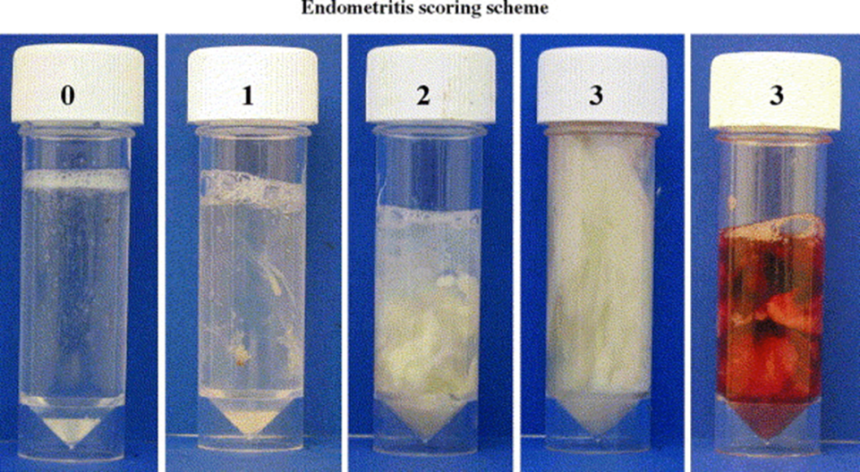
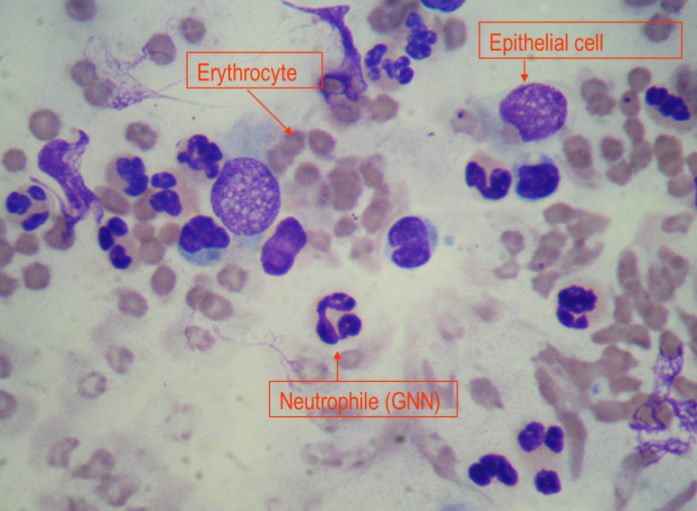
Uterine infections : 4 types (See Sheldon et al. Theriogenology 2006, 65, 1516)
Puerperal metritis
Pyometra
Williams et al. 2005
Clinical endometritis
Subclinical endometritis
Notes:
37
Four kinds of uterine infections can be distinguished : puerperal/acute metritis, clincial and subclinical endometrits and pyometra.

Slide 35
Acute Puerperal metritis (APM)
Usually general and local signs (= Acute puerperal metritis)
During the first 21 days postpartum
Pyrexia (> 39.5°C), dullness, inappetance, anorexia, reduced milk yield
Fetid red-brown watery uterine discharge, enlarged uterus, persistance of the uterine thrill
Pyometra
Accumulation of purulent or muco-purulent material in the uterus who become more and more distended
Cervix is open or not
Usually appears after the begining of cyclicity
Corpus luteum is present (often) or not
Notes:
38
Acute puerperal metritis (APM) is defined as an uterine infection appearing during the first 21 days postpartum. The clinical signs are general (pyrexia more than,39.5°C, dullness, inappetance, anorexia, reduced milk yield)and / or local (Fetid red-brown watery uterine discharge, enlarged uterus, persistance of the uterine thrill).
Pyometra is an accumulation of purulent or muco-purulent material in the uterus. The cervix is or not open. The uterus is enlarged. Such uterine infection usually appears after the beginning of cyclicity and increase of progesterone in the blood. Pyometra is often associated to a corpus luteum on the ovary.

Slide 36


Clinical endometritis
Subclinical endometritis
Williams et al. 2005
No clinical signs
Endometrial inflammation
Absence of purulent material in the vagina
Increase of the % neutrophils in the uterine lumen
Only local signs
After the first 21 days postpartum
Uterine discharge : > 50 % pus, 50% pus and 50 % mucus or <50 % pus (i.e. flakes of pus)
Notes:
39
Clinical endometritis results in local signs only visible after day 21. A uterine discharge can be seen and scored according to the amount of pus (pus more than 50 %, mucopus if 50 % of pus and 50 % of mucus and flakes of pus if < 50 % of pus.
In case of subclinical endometritis, no clinical signs are visible. There is inflammation of endometrium without purulent material in the vagina. His diagnosis can be made counting the percentages of neutrophiles in a sampling done into the uterine cavity.

Slide 37
The postpartum anoestrus in the dairy cow
« Normal »
Abnormal
Waiting period (WP) : 50 – 60 d ?
No or very few estrus signs
No estrus detected by the farmer
Detection
Detection
Functionnal
Manifestation
Manifestation
Pyometra
Physiological
Functionnal
Pathological
Cyst
Until d15-20
No answer to GnRH
No regular follicular growth with ovulation and CL
No regular follicular growth with ovulation and CL after WP
Notes:
40
To define the postpartum anoestrus is relatively complex. The definition depends on the considered parameter: hormonal, behavioral or according to the follicular growth. Moreover absence of cyclicity can quite normal depending the time of postpartum taken in consideration. So it’s possible to distinguished different kinds of postpartum anoestrus before and after the normal waiting period considered of 50 to 60 days.
After calving and during 15 to 20 days, the ovaries of the cow can’t be stimulated by an injection of the hypothalamic hormone called GnRH. It’s a period of physiological anoestrus. After this period and until the end of the normal waiting period, it’s still possible to have any kind of regular follicular growth, ovulation and development of a corpus luteum. . In such situation we define this anoestrus as functional. If such ovarian situation extends until after day 50 to 60 we are speaking on functional pathological anoestrus. Pathological anoestrus can results also from a pyometra or a cyst. In some situations, before and after the end of the normal waiting period, the cow becomes cycled, present an estrus but this estrus has been seen by the farmer. We call this anoestrus detection anoestrus. Finally, and mainly if the milk production is high (more than 40 l per day), the estrus signs can be low and not visible for the farmer : we call this anoestrus a « manifestation » estrus.

Slide 38
Understand the links and the effects between the pathologies
Exemple of the waiting period

Slide 39
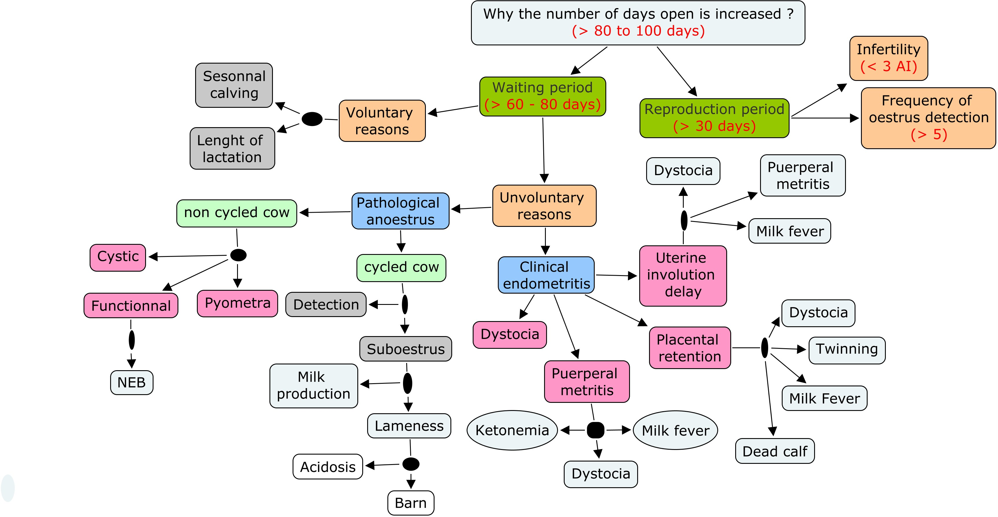
Notes:
42
Two primary hypothesis can explain the increase of the interval between calving and pregnancy in a cow or in a herd of cows.
The first is the increase of the waiting period and the second is the increase of the reproduction period.
Waiting period can be increased for voluntary or involuntary reasons.
Amongst the voluntary reasons, we have the length of lactation : it’s usually the case in the cows with a huge production (more than 12 times the body weight). Sometimes also and for nutritional reasons, the calvings are postponed. So the milk is produced during the best season for nutrition. So Ireland and New Zealand have a pasture based milk production. Such systems are possible if the fertility is very good.
Increase of the waiting period mostly come from unvoluntary reasons. Two groups of pathologies can be distinguished : pathological anoestrus and clinical endometritis. Pathological anoestrus can be observed in non-cycle or in cycled cows. We have seen that in non cycled cows, anoestrus results from an absence of follicular growth, a cyst or a pyometra. Absence of follicular growth results from a negative energy balance: not enough food intake for the milk production.
A cycled cow can be considered also in anoestrus if the heat has not been detected by the farmer or if the signs of heat are to low to be detected. It’s the case in lame or in high milk producer cows due to the increase of catabolism of oestrogens by the liver. Acidosis and barn can be considered has predisposing factors for suboestrus.
Four factors are considered as predisposing factors of clinical endometritis. It’s placental retention, dystocia, acute or puerperal metritis and uterine involution delay.
Ketonemia, dystocia and milk fever are predisposing factors for puerperal metritis.
Dystocia, twinning, dead calf and milk fever are predisposing factors for placental retention
Milk fever, dystocia and puerperal metritis are predisposing factors for uterine involution delay.
The increase of the reproduction period is the consequence of infertility (increase of the number of AI to obtain a pregnancy) and a poor oestrus detection : the cow is inseminated at a wrong moment, the farmer don’t detect when the cow comes back in heat.

Slide 40
All these factors directly or not influence the time
to obtain a pregnancy

Slide 41
Infectious factors
Metabolic factors
Genetic factors
Environmental factors
Social factors
Many different
factors

Slide 42
To have an idea of the prevalence of the different pathologies observed in a determined environment (farm, country, district, method of diagnosis ...)

Slide 43
The prevalence can be quite different according to the environnement
(countries, farms …) but also criteria and methods of diagnosis
Dystocia : 2 to 7 %
Milk fever : 5 %
Clinical acetonemia : 0,5 to 2,4 %
Subclinical acetonemia : 29 to 58 %
Subclinical acidosis : 19 to 29 %
Placental retention : 8 %
Puerperal metritis : 30 to 40 %
Clinical endometritis : 15 to 20 %
Pyometra : 5 %
Subclinical endometritis 11 to 66 %
Functional pathological anoestrus : 20 %
Cystic pathological anoestrus : 10 %

Slide 44
Some figures in small farms in Vietnam (follow up of 353 calvings
(Nguyen Kien Cuong and Hanzen 2016)

Slide 45
In conclusion : six highlights on the future
of the milk production
Adapted with
http://www.dairyasia.org/file/Proceedings_Dairy-Asia-2016_First-Draft.pdf
Barkema et al. Changes in the dairy industry affecting dairy cattle health and welfare. J.Dairy Science 2015, 98, 1-20.

Slide 46
SIZE OF THE FARM
No consistent and predictable association has been done between herd size and health or welfare of the animals and the revenus of the farmers (see the experience of India : farms of 2-3 animals organized into strong cooperative organisations)
Barkema et al. J.Dairy Science 2015, 98, 1-20.

Slide 47
COSTS OF MILK PRODUCTION
With the decrease of milk price, the farmers attempt to decrease nonessential (for them) inputs and expenses (like veterinary services and HHM)
Barkema et al. J.Dairy Science 2015, 98, 1-20.

Slide 48
WORKERS IN THE FARM
In developed countries work is depends more often on nonfamily labor and insufficient trained (to detect health problems) workers
Barkema et al. J.Dairy Science 2015, 98, 1-20.

Slide 49
ANTIMICROBIAL RESISTANCE
It’s necessary to reduce the use of antibiotics (Netherlands has replaced the blanket dry-cow therapy with selective dry-cow treatment).
Barkema et al. J.Dairy Science 2015, 98, 1-20.

Slide 50
HORMONES
In UK, veterinarians have judged unacceptable the long term use of time AI protocols (TAI) (requiring 2 to 5 injections per insemination) despite a lack of evidence of risk for humans. Such protocols can be replaced by automated activity monitoring systems.
Barkema et al. J.Dairy Science 2015, 98, 1-20.

Slide 51
BIOSECURITY
Northern Europe are ahead (compare to USA) for the control of different diseases like IBR, BVD, neosporosis, paratuberculosis, leptospirosis, leucosis, salmonellosis due to adoption of routine practices by the veterinarians. Attending the risk of other diseases (Q fever, Schmallenberg), it seems reasonable to increase the biosecurity measures for all the visitors of a farm (coveralls, boots…).
Barkema et al. J.Dairy Science 2015, 98, 1-20.

Slide 52
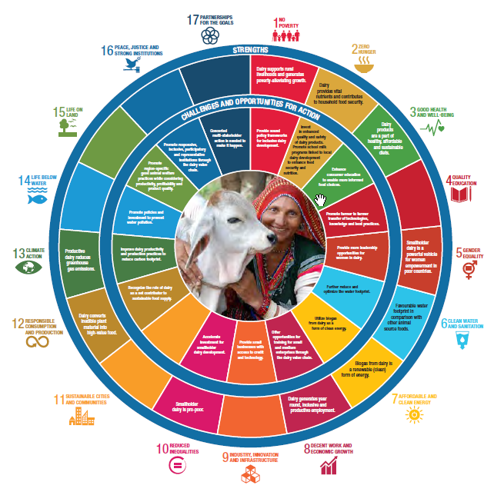
Continue to support the development of a sustainable milk production
Many thanks for your attention and all the best to you

