Slide 1



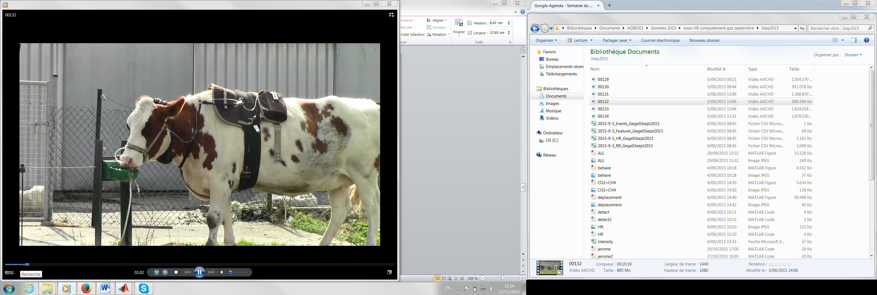
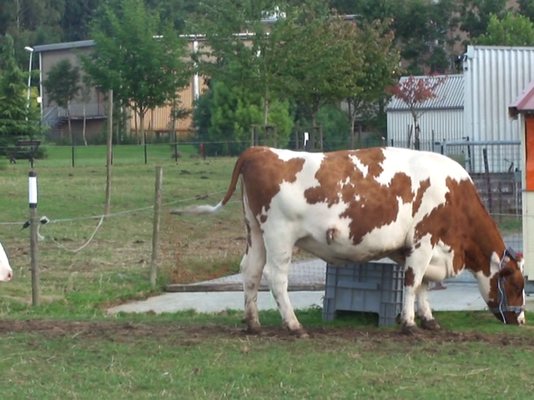
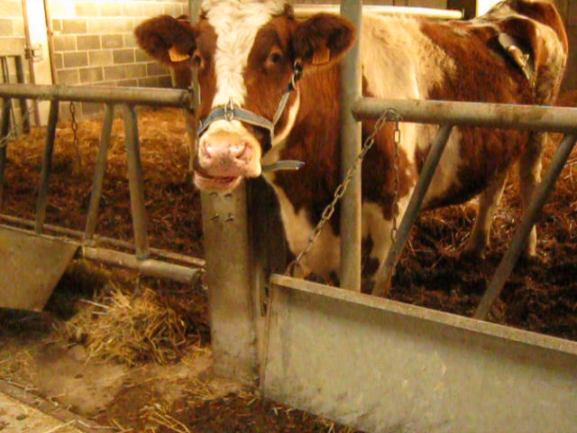
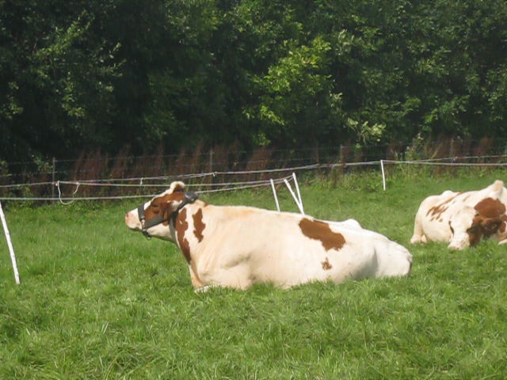
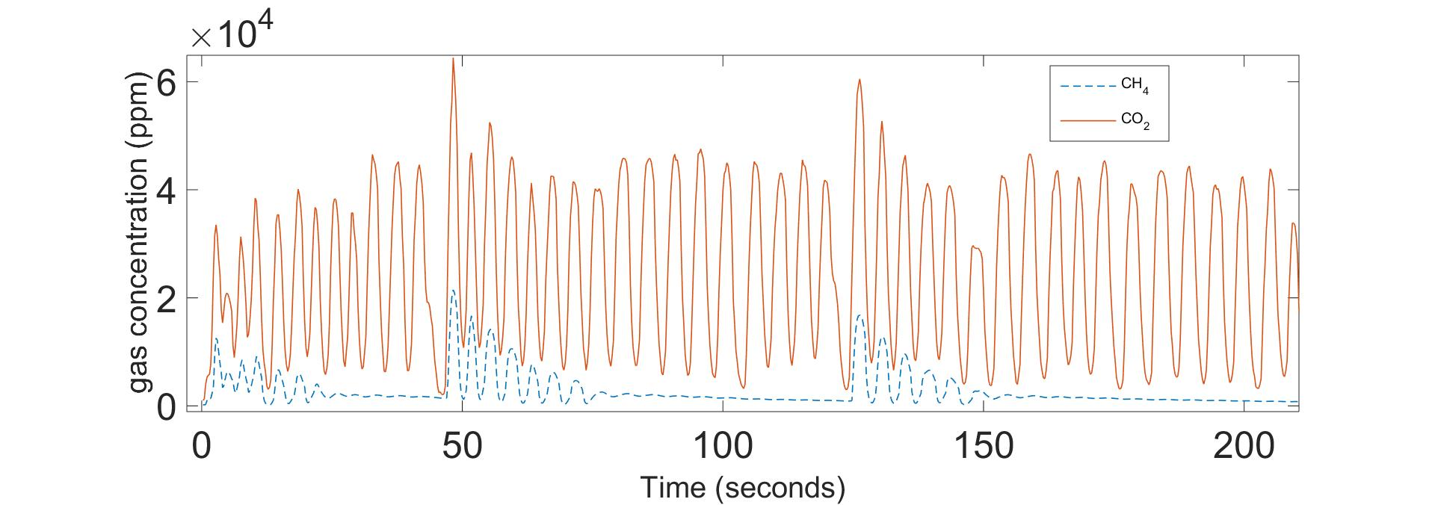
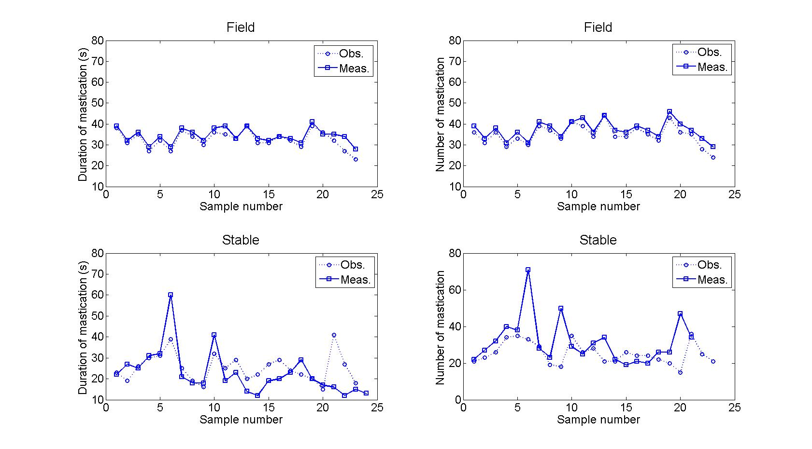
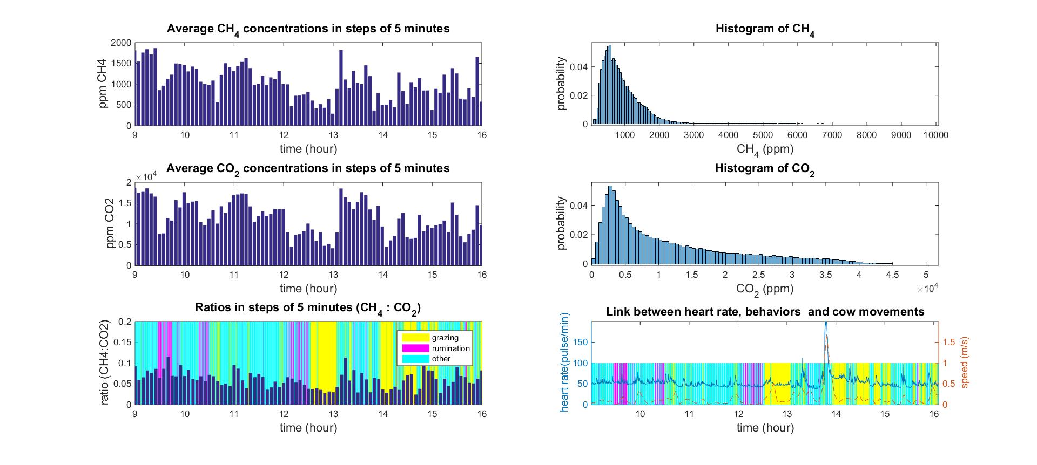


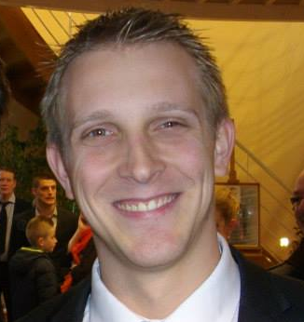



AgriGES
Research projects on Precision Livestock Farming (PLF) :
Analysis of cattle grazing activities and methane production
Andriamandroso A.L.H.^{123*},Blaise Y.^{23¥}, Lebeau F.², Bindelle J.³
AgricultureIsLife Platform¹, Precision Agriculture Unit², Animal Science Unit³
University of Liege, Gembloux Agro-Bio Tech, Passage des Déportés 2, B-5030 Gembloux, Belgium
(*alh.andriamandroso@ulg.ac.be ¥yblaise@ulg.ac.be)
Introduction
Research questions
Numerous methods and tools for detection and classification of cattle grazing behaviors: GPS, accelerometers, pedometers, etc.;
Focus on jaw movements and their importance for grazing features determination (quantity and quality);
Assessment of instantaneous CH4 emission of grazing cattle and linkage with emission intensities to the animal behavior.
Accurate localization of grazing bites and eructation peaks
Use of iPhone IMU for precision monitoring of grazing and rumination patterns
Effect of pasture characteristics on cattle’s grazing behavior?
Screening of the diurnal cycle of CH4 production for animals in rangelands
Dynamics of CH4 emission related to behavior measured?
Characteristic of pasture composition on the influence of CH4 emission?
Decision Support for farmers and authorities.
Material and methods
1, Sensors for grazing behaviors detection:
2, Sensors for methane emission
Materials:
inertial Measurement Unit of an iPhone [4]
sampling frequency: 100Hz
data acquisition duration up to 24h with
external battery
video recording of the behaviors
Data analysis:
data classification using movement-based
thresholds and a Boolean algorithm;
detection of biting and chewing activities
during grazing and rumination behaviors using their frequency patterns and local peak detection;
4
1
Materials:
two infrared CH4 and CO2 sensors [1]
sampling frequency: 4Hz
data acquisition duration up to 12h with
external battery
heart rate (HR) sensor [3]
nostril ring allowing a good pump of out coming gas [2]
Data analysis:
synchronization between behaviors, gas concentration and HR;
ratio CH4:CO2 calculation and its dynamic.
2
3
Results
Behavior analysis
Methane dynamics analysis
Grazing Ruminating Others
Ratio CH₄:CO₂ by steps of 5 minutes
- The whole accuracy ranges between 84% and 99%
Detection of bites during grazing
Detection of chewing during rumination
Breathing and CH₄ eructations are detected and follow a specific pattern.
Diurnal ratio of CH₄:CO₂ production for animals in rangelands is screened
There is a dynamic a the CH4 emitted but there is still no link to behaviors
Analyses of postprandial time are necessary
Presence of a peak in frequency patterns of grazing and rumination behaviors representing bites frequency (between 1,4 and 2 Hz)
Possible estimation of number of biting and chewing jaw movements and their location in the time-domain acceleration signal
Conclusion
The use of an IMU to classify accurately grazing and ruminating behaviors is relevant. Deeper analysis are also possible for jaw movements detection and differentiation.
The dynamics of methane emission are not steady along the day, however the behaviors do not influence at short term this dynamic.
INVOLVED STAFF
Frédéric Lebeau
Rudy Schartz
Yannick Blaise
Naina Andriamandroso
Jérôme Bindelle
François Debande
Precision Agriculture Unit
PhD students
Precision Livestock Farming and nutrition Unit

