Slide 1

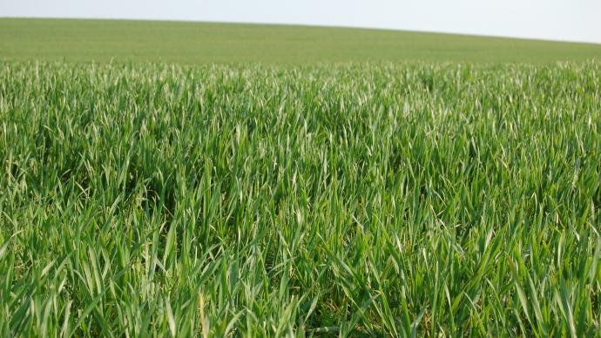
Quantification of Nitrogen Stress on Winter Wheat by Multispectral Vision based on Reflectance Measurements and Textural Descriptors
MARLIER Gª., GRITTEN Fª., FRAIPONT G^{b}., LEEMANS V^{ac}., DUMONT B^{bc} ., DESTAIN M-Fª., MERCATORIS B^{ac}.
ª : Université de Liège – Gembloux Agro-Bio Tech. Biosystems Engineering Dept. Precision Agriculture unit.
^{b} : Université de Liège – Gembloux Agro-Bio Tech. AgroBioChem Dept.,
Engineering Plant Production and Valorization Unit
^{c} : Université de Liège – Gembloux Agro-Bio Tech. TERRA Research unit,
AgricultureIsLife

Slide 2
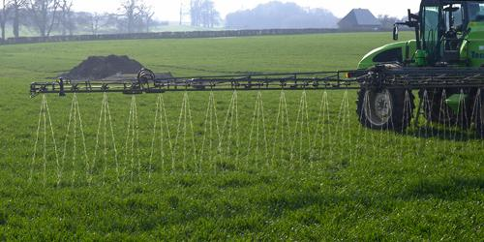
Context
Context
State of the art
Materials and methods
Results
Conclusions
Objective
Precision Agriculture
Spatial and temporal variability on field
Nitrogen optimizing
Essential and limiting element for plants
Measurement and sensors
Design support system
Equipment optimization

Slide 3
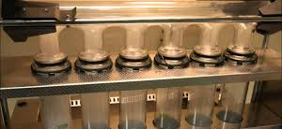
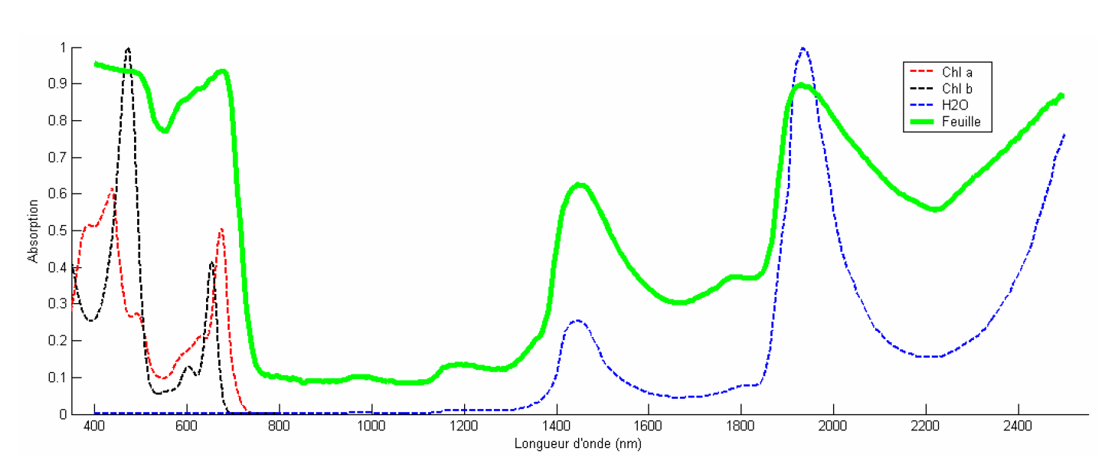
State of the art
Context
State of the art
Materials and methods
Results
Conclusions
Objective
Estimation of nitrogen content
Tissue analysis
Kjeldahl method or Dumas combustion
Reliable BUT destructive and time consuming
Optical analysis
Transmission, absorption and reflection
Depend on leaves components and wavelengths

Slide 4
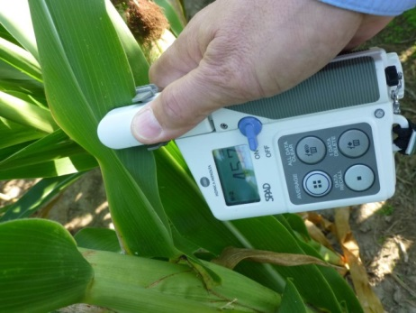
Optical methods
Context
State of the art
Materials and methods
Results
Conclusions
Objective
Leaf level
Canopy level
Hand-held device
Measurements of small part of leaf
Reflectance
Ranking
Absorbance
Reflection
Chlorophyll
Nc
Water
Remote
Proxi
Satellite – Drone – Ground
Hyperspectral
Multispectral
Active
Passive
Light source

Slide 5
Objective
Context
State of the art
Materials and methods
Results
Conclusions
Objective
Determination of the nitrogen concentration in leaves with multispectral device
Need measurement
Fast
All growing season
Optical device
Canopy level
Multispectral
Reliable and accurate
Continuous
Non-destructive
Passive
Image analysis
Wavelengths selection
Parameters selection

Slide 6
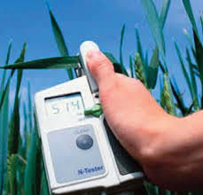
Materials and Methods (AgricultureIsLife)
Context
State of the art
Materials and methods
Results
Conclusions
Objective
Field experiment (Gembloux, Belgium, Temperate climate, Lat. : 50.56°N., Lon. : 4.68°E.)
Growing season 2013-2014 (3 outputs on field) and 2015-2016 (until now 1 output on field)
Winter wheat : Triticum aestivum L.
Estimation of nitrogen content in leaves
Reference method
Kjeldahl method
Process : Digestion (sulfuric acid). distillation and titration for NH₄+ estimation.
0.2g of dry matter (leaves)
Selection of leaves visulized by camera
1 sample by plot
M SPAD measurements (only for 2014 season)
Hydro N-Tester. Yara international ASA.
Norway.
Transmittance in 650 nm and 950 nm
15 leaves measured in each plot

Slide 7
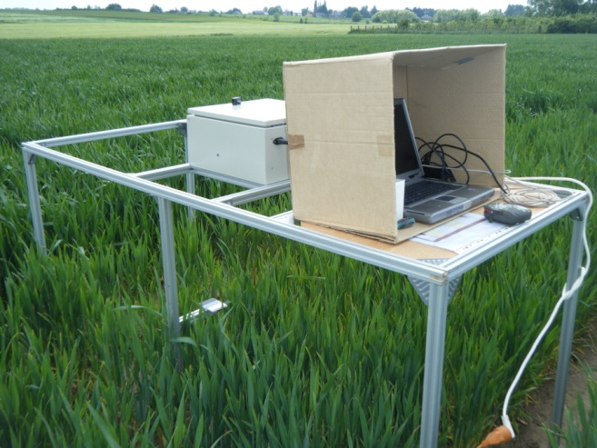
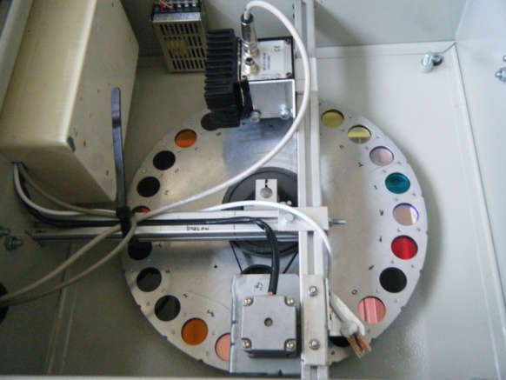
Multispectral device
Context
State of the art
Materials and methods
Results
Conclusions
Objective
Filter wheel: 450 nm to 950 nm and 2 width bands (≈50 nm and ≈100 nm)
Monochrome camera (CMOS, BCi5, C-Cam Technologies, Belgium)
White reference: Taking into account variation of natural illumination ➔ regulation of integration time

Slide 8

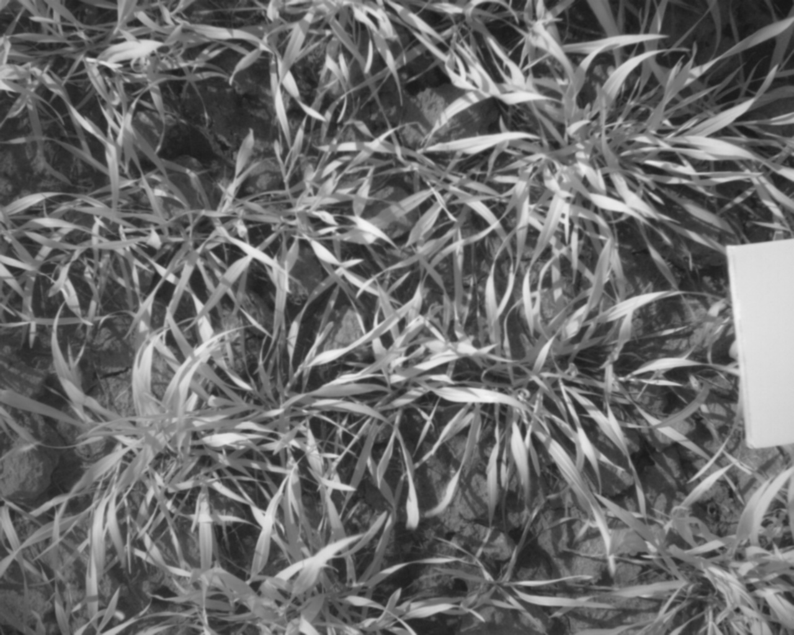
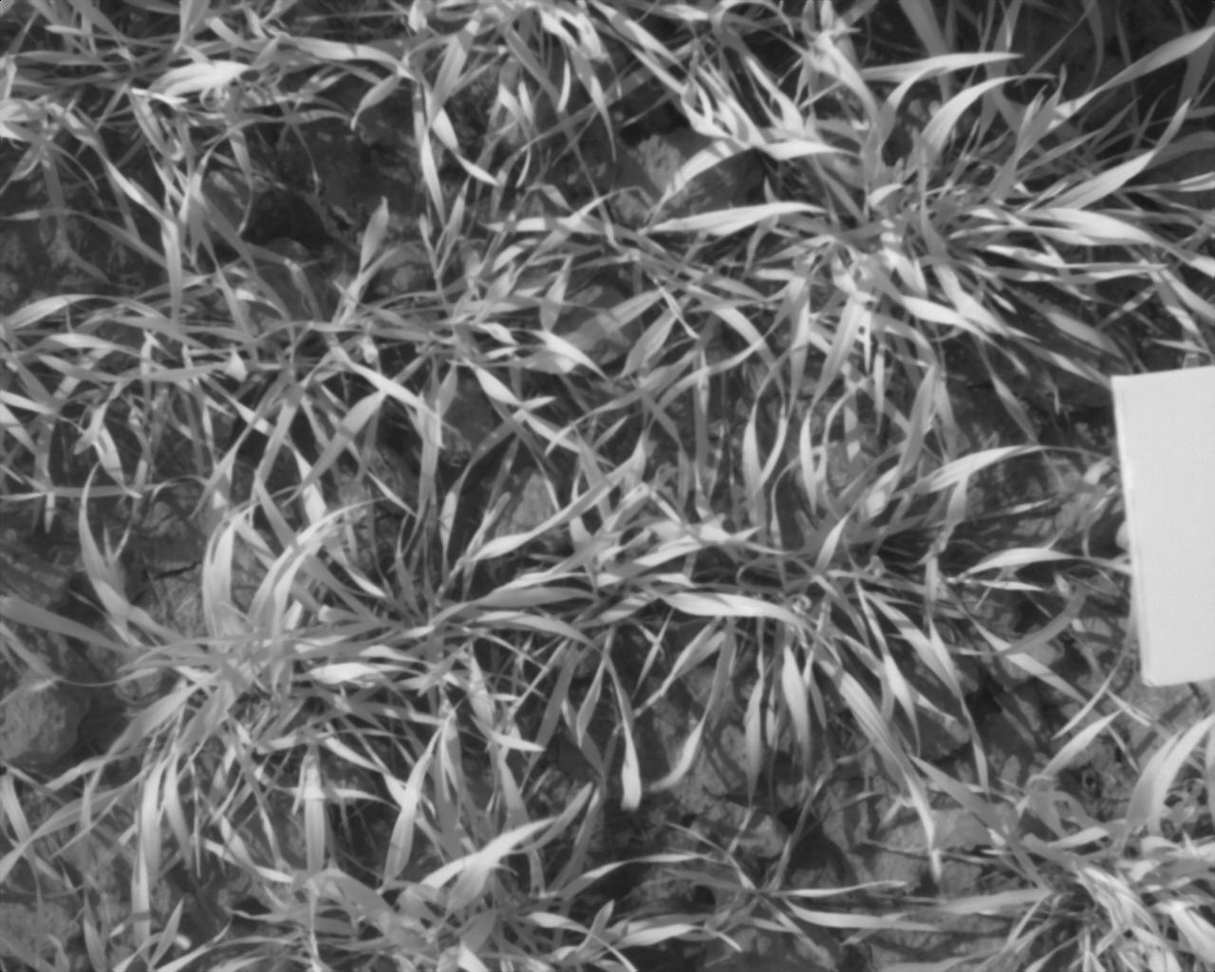
Image pretreatment
Context
State of the art
Materials and methods
Results
Conclusions
Objective
Background correction
Reference
Raw image
Corrected image

Slide 9
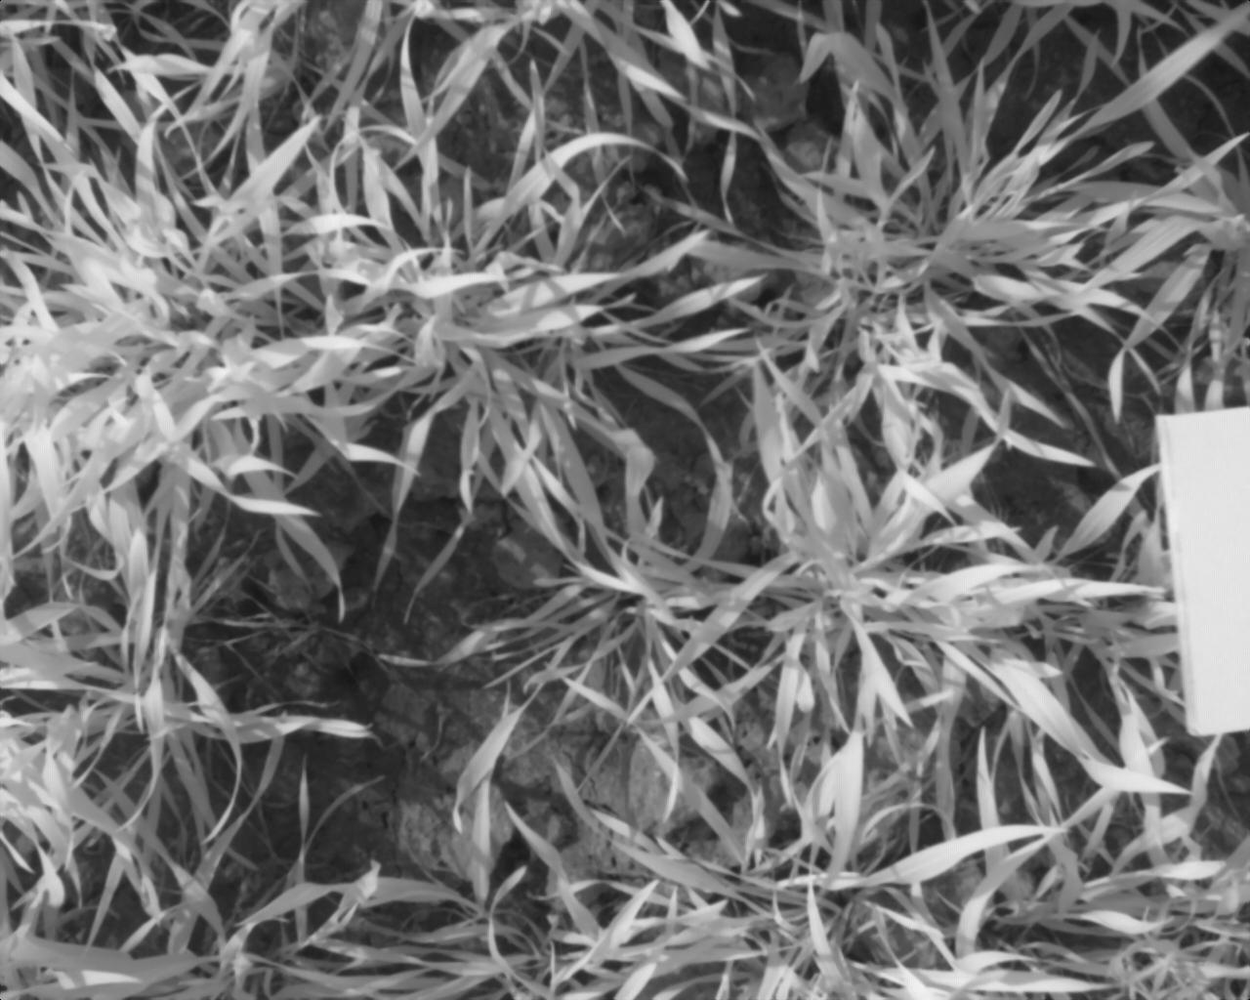
Image pretreatment
Context
State of the art
Materials and methods
Results
Conclusions
Objective
Segmentation
Discrimination of PAL (Photosynthetically Active Leaves) by using Bayes’ Theorem
Image
Segmented image
White reference
PAL
Soil

Slide 10
Image Analysis
Context
State of the art
Materials and methods
Results
Conclusions
Objective
Leaf :
mean of reflectance of PAL
Canopy :
Leaf area
Textural parameter
Gray Level Co-occurrence Matrix (GLCM)
Contrast
Correlation
Energy
Homogeneity
Fourier transform (FFT2D)
Standardized dispersion coefficient derived from frequency content of images on X axis and Y axis

Slide 11
Gray Level Co-occurrence Matrix (GLCM)
Context
State of the art
Materials and methods
Results
Conclusions
Objective
Contrast
Range [0 65025]
Correlation
Range [-1 1]
Energy
Range [0 1]
Homogeneity
Range [0 1]
E=0,5
H=0,0039

Slide 12
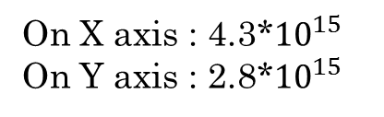
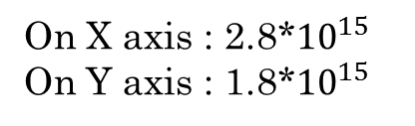
Fourier Transform 2D
Context
State of the art
Materials and methods
Results
Conclusions
Objective
Standardized dispersion coefficient
Image
Amplitude of FT2D
On X axis : 2.8*${10}^{15}$
On Y axis : 1.8*${10}^{15}$
Unit : intensity*pixel²
On X axis : 4.3*${10}^{15}$
On Y axis : 2.8*${10}^{15}$

Slide 13
Data analysis
Context
State of the art
Materials and methods
Results
Conclusions
Objective
Partial Least Square regression (PLS) :
Determination of the correlation between Nc and the filter response
Transformation of set of 22 filters to smaller set of uncorrelated components
Best Subset regression : Determination of the most relevant filters assessing the Nc

Slide 14
Results
Context
State of the art
Materials and methods
Results
Conclusions
Objective
Leaf Nc through growing seasons
Nc from 1.51 % to 3.92%
2014 growing season
2016 growing season

Slide 15
Results (in 2013-2014)
Context
State of the art
Materials and methods
Results
Conclusions
Objective
Relationship between Nc and M SPAD values
Determination coefficient: R²=53%
R² improving by computing indices

Slide 16
Results
Context
State of the art
Materials and methods
Results
Conclusions
Objective
Mean reflectance of PAL in function of wavelengths

Slide 17

Results
Context
State of the art
Materials and methods
Results
Conclusions
Objective
Leaf area
Regression analysis of nitrogen content in function of leaves area
$Nc=−0.035+4.083 leavesArea$ (R²=40.5%)

Slide 18
Results
Context
State of the art
Materials and methods
Results
Conclusions
Objective
Partial Least Square regression
Partial Least Square regression (PLS)
Parameters | Number of components for optimal model | Determination coefficient (R²) (%) | Determination coefficient predicted (R²pred) (%)
Reflectance | 7 | 92.41 | 89.79
Contrast | 10 | 87.88 | 84.18
Correlation | 6 | 83.8 | 79.7
Energy | 3 | 80.7 | 71.5
Homogeneity | 5 | 92.3 | 91.8
Standardized dispersion coefficient on X (FFT2D) | 5 | 92 | 90.4
Standardized dispersion coefficient on Y (FFT2D) | 5 | 92.2 | 90.7

Slide 19
Results
Context
State of the art
Materials and methods
Results
Conclusions
Objective
Best Subset Regression
Best Subset Regression
Parameters | 4 relevant filters | determination coefficient (R²) (%) | determination coefficient predicted (R²pred) (%)
Reflectance | 450±40; 700±25; 800±50;850±50 | 89.1 | 88.5
Contrast | 450±25;550±25; 850±50;900±20 | 80 | 78.7
Correlation | 450±40;600±40; 850±20;900±20 | 81.1 | 78.6
Energy | 500±20;650±40; 750±20;750±40 | 83.6 | 82.7
Homogeneity | 500±20;600±40; 650±40;800±25 | 91.6 | 91.1
Standardized dispersion coefficient on X (SDCX) | 450±25;500±40; 700±25;750±40 | 88.5 | 88
Standardized dispersion coefficient on Y (SDCY) | 450±25;500±40; 700±25;750±40 | 88.9 | 88.4

Slide 20
Results
Context
State of the art
Materials and methods
Results
Conclusions
Objective
4 chosen filters : 450±40nm; 600±40nm; 700±25nm and 850±50nm
Regression analysis : step by step
Optimal model :
Filters | Parameters
 | Reflectance | Contrast | Correlation | Energy | Homogeneity | SDCX | SDCY | Leaf Area
450±40nm | X |  |  |  | X |  | X
600±40nm | X | X |  |  | X | X | X
700±25nm | X |  | X | X
850±50nm |  | X

Slide 21
Results
Context
State of the art
Materials and methods
Results
Conclusions
Objective
Actual and predicted nitrogen content
R² = 93.97 %
R²pred = 93.18%
Linear relationship

Slide 22
Conclusions
Context
State of the art
Materials and methods
Results
Conclusions
Objective
Estimation of Nitrogen content in leaves at canopy level
Selection of relevant filters
Reflectance
Textural parameters
Gray level Co-occurrence Matrix (GLCM)
Standardized dispersion coefficient from frequency content of image
Determination coefficient of model built
R² = 93.97 %
R²pred = 93.18 %
Further work : increasing set of data

Slide 23
Thank you for your attention
Precision Agriculture unit
Pr. Dr. Ir. DESTAIN Marie-France
Dr. Ir. LEEMANS Vincent
Dr. Ir. MERCATORIS Benoit
Engineering Plant Production and Valorization unit
(Crop Science in temperate regions)
Dr. Ir. DUMONT Benjamin
Ir. FRAIPONT Guillaume
Guillaume Marlier
PhD Student. Université de Liège. Gx Agro-Bio Tech
E-mail: Guillaume.Marlier@ulg.ac.be

