Slide 1

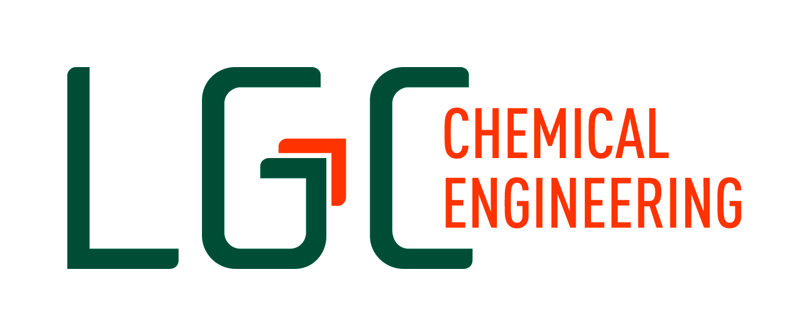
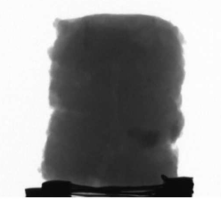
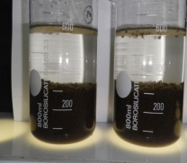
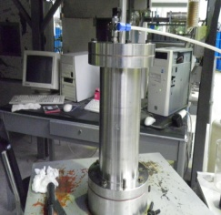
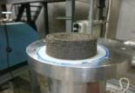
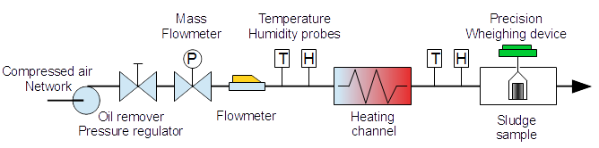
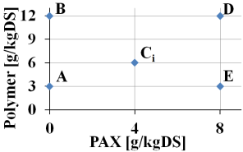
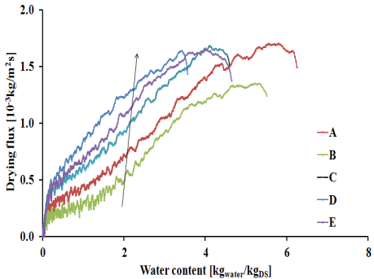
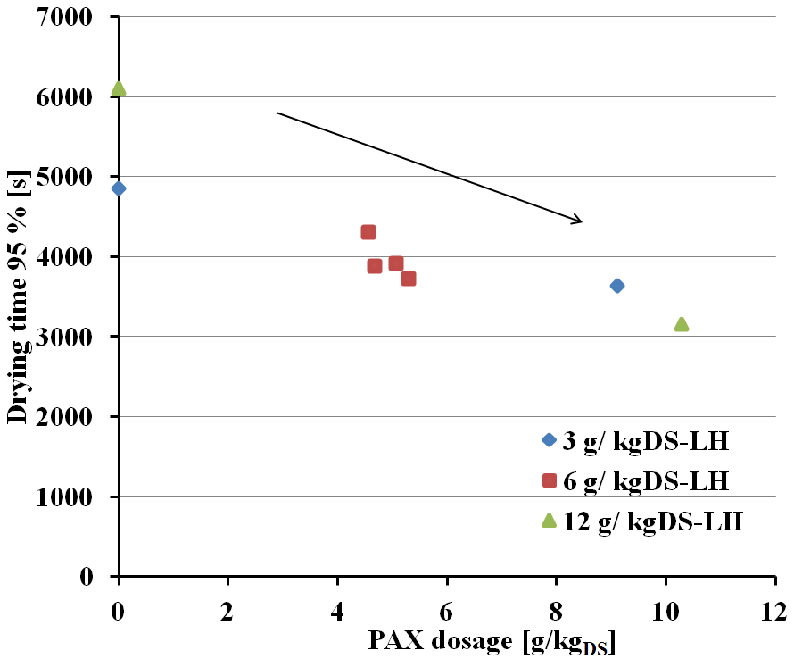
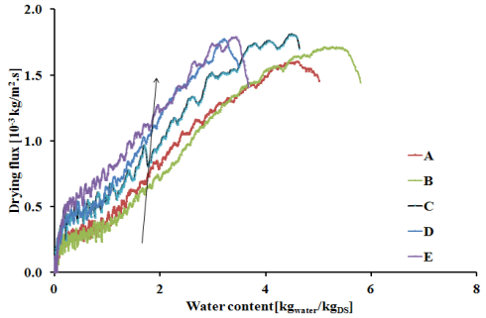
Enhanced sludge dewatering and drying comparison of two linear polyelectrolytes co-conditioning with Polyaluminium chloride
Y.B Pambou, T. Salmon, L. Fraikin, M. Crine, and A. Léonard Laboratory of Chemical Engineering, University of Liège, Sart-Tilman B6c, 4000 Liège, Belgium
E-mail of the corresponding author: yvon-bert.pambou@student.ulg.ac.be
Context
Annual production of sewage sludge in Europe is estimated at more than twelve million tons of dry matter. Use in agriculture and incineration are the main ways of valorization. In this context, sludge drying appears as an essential step after mechanical dewatering. It reduces the costs of storage and transport, allows the stabilization and the hygienization of sludge while increasing its calorific value. However, at the end of waste water treatment process, liquid sludge is a colloidal system in which particle form a stable suspension in water, making him difficult to be separated from water. The addition of polyelectrolyte chemical is necessary to help the sludge particles to agglomerate into large flocs that can be separate by mechanical dewatering. This work investigated the influences of Polyaluminium chloride (PAX-14) co-conditioning with two linear polyelectrolytes on the sludge dewatering and drying performances comparisons, by using experimental design methods.
Materials and Methods
Sludge samples conditioning
WWTP Grosses Battes, Liège, Belgium
600 mL of sludge + PAX/ Polymer
Polymer: LH or CT (6 g/kg_{DS})
Flocculation in Jar test device:
Step 1: 120 rpm, 1 min
Step 2: 40 rpm, 3 min
Mechanical dewatering in a normalized filtration-expression cell
Applied pressure = 5 bar
Cake dryness = 15-25 %_{DS}
Convective drying tests
T = 130 °C, V = 1 m/s, Y = 0.005 kg_{water}/ kg_{DA}
Cylindrical samples :
Height = Diameter = 14 mm
Initial weight = 2.5 g
Experimental design
Experiments days design
Impact of sludge conditioning on the dewatering process
MONDAY | CST [s]
TUESDAY | C₁
WEDNESDAY | A
THURSDAY | B
FRIDAY | C₂
MONDAY | CST [s]
TUESDAY | C₃
WEDNESDAY | D
THURSDAY | E
FRIDAY | C₄
Conditioning type | Trials | Cake dryness [%] | SRF [10¹³ m/kg]
PAX LH | A | 13.21±0.12 | 2.57
 | B | 14.86±0.03 | 1.02
 | D | 21.40±0.40 | 16.1
 | E | 17.30±0.20 | 7.46
 | C | 17.30±0.20 | 4.71
PAX CT | A | 15.96±0.01 | 0.59
 | B | 14.43±0.33 | 1.49
 | D | 21.40±0.30 | 11.3
 | E | 20.60±0.10 | 6.63
 | C | 17.60±0.10 | 1.19
Increasing of cake dryness for both series tests in presence of PAX addition
SRF values of PAX/CT tests are lower than PAX/LH
Best filtration performances were obtained with PAX/CT conditioners!
[PAX] : without, the maximum operational concentration and the middle
[Polymer] → Capillary Suction Time : CST_{min} = trial C, the half and the double
Results
Impact of conditioning on drying flux: PAX/ LH and PAX/ CT set up
Impact of dual conditioning on drying time
PAX/ LH drying time curve
PAX/ LH versus PAX/ CT
Trials | Time 95 % [s] |  | Ratio t_{CT}/t_{LH}
 | PAXLH | PAXCT
A | 4850 | 5030 | 1.04
B | 6100 | 5265 | 0.86
D | 3155 | 3615 | 1.15
E | 3640 | 3450 | 0.95
C₁ | 3920 | 3885 | 0.99
C₂ | 3720 | 3360 | 0.90
C₃ | 4310 | 3490 | 0.81
C₄ | 3880 | 3715 | 0.96
The dual PAX/Polymer has a benefit effect on drying by increasing drying rate
A best enhancement of drying rate was obtained in the case of PAX/CT conditioning
Reduction of drying time when the couple/ polymer dosage increase
This positive effect of PAX is most remarked with high linear molecular weight
The corresponding benefit effect on drying time reduction = 12 %
→PAX/Flocculant contribute to decrease energy consumption
D point seems to be an overdosage of chemicals
Conclusion and Prospects
Based on a considered design, this work aims to put in evidence the impact of sludge co-conditioning by Polyaluminium chloride and linear molecular weight polymers on both dewatering and drying behaviors. Higher molecular weight polyelectrolyte improves flocculation and dewatering process relative to the lower molecular weight one. PAX appears to be profitable to contribute at this mechanism.
Concerning drying, the positive effect of PAX/ polymer addition is shown by the drying kinetics. Consequently a decrease of drying time is observed. Better results are obtained with high linear weight polymer.
Future works will focus on the study of using cross linked polymer and their relationship with textural rheological properties.

