Slide 1
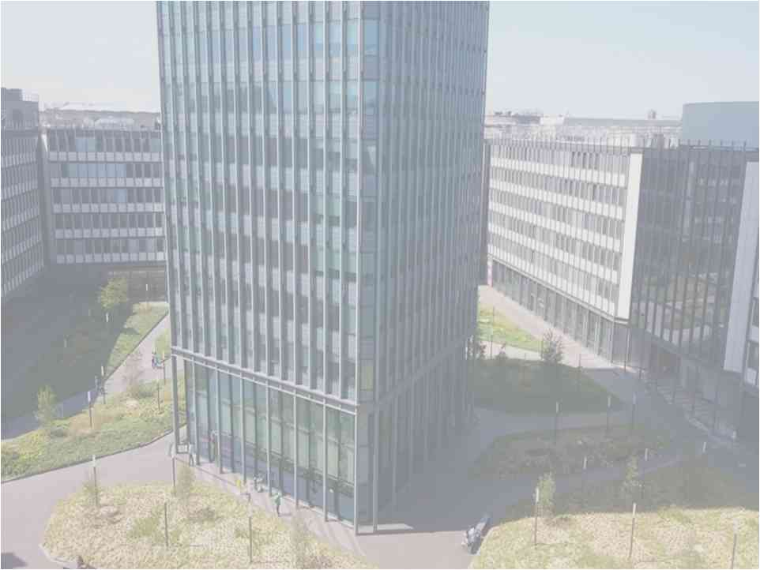






IRWG/TCCON 2016 Meeting
Jeju, South Korea, 30 May - 3 June 2016
Comparison of surface and column carbon monoxide at a high altitude, a megacity and a southern hemisphere site
Yao Té¹, Pascal Jeseck¹, Bruno Franco², Emmanuel Mahieu², Nicholas B. Jones³, Dave W.T. Griffith³, Rebecca R. Buchholz⁴, Juliette Hadj-Lazaro⁵ and Christof Janssen¹
yao-veng.te@upmc.fr
¹LERMA , ²IAG, ³CAC, ⁴ACMOL, ⁵LATMOS

Slide 2
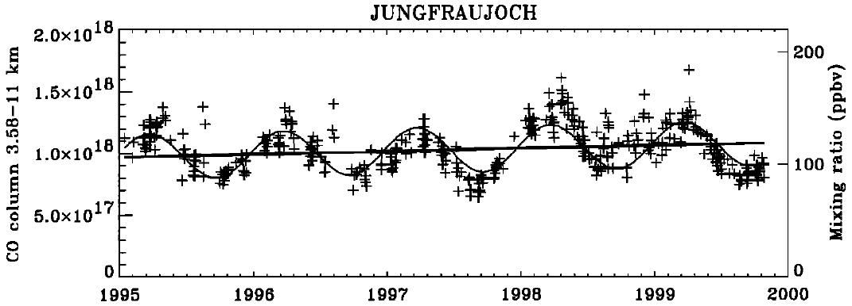
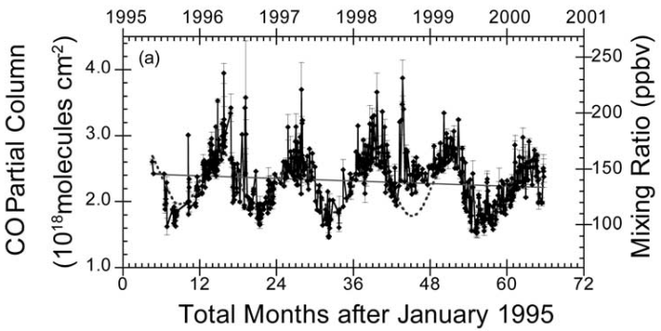
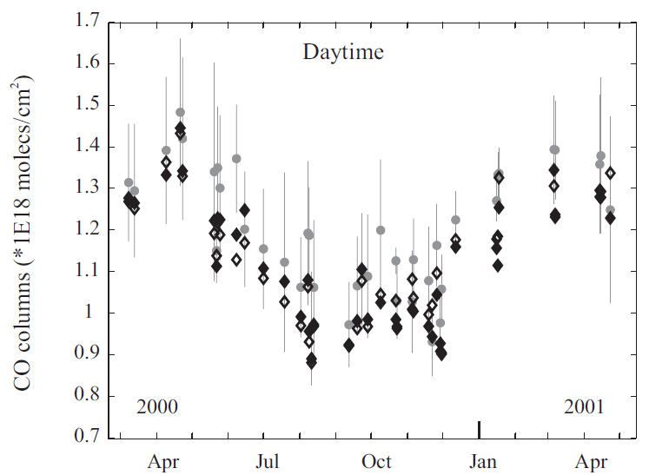
Motivations (1/2)
- CO is an important trace gas (toxicity and impact on air quality)
- Global increase of CO ⇨ global decrease of OH
⇨ increase of other harmful trace gases
(atmospheric pollutants, greenhouse gases sensitive to oxidation as methane)
- Many scientific studies have shown the seasonal variability of CO
- What can be learned from still another study ?
Rinsland et al., JGR, 2000
Zhao et al., JGR, 2002
Barret et al., ACP, 2003
IRWG/TCCON 2016, June 2nd, Jeju, South Korea

Slide 3
Motivations (2/2)
Here
- CO seasonal variability between 2009 and 2013
@ Paris site (NH)
@ Jungfraujoch site (NH)
@ Wollongong site (SH)
Might not be the same
- Comparison to satellite measurements (IASI-MetOp & MOPITT)
- Comparison to GEOS-Chem model simulations
Seasonality from CO columns obtained from FTIR measurements
Seasonality from surface in situ measurements
VERSUS
IRWG/TCCON 2016, June 2nd, Jeju, South Korea

Slide 4
The sites

Slide 5
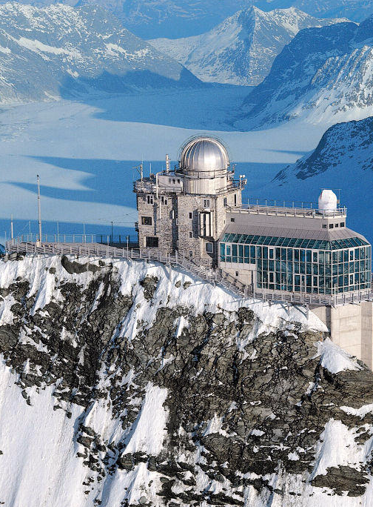
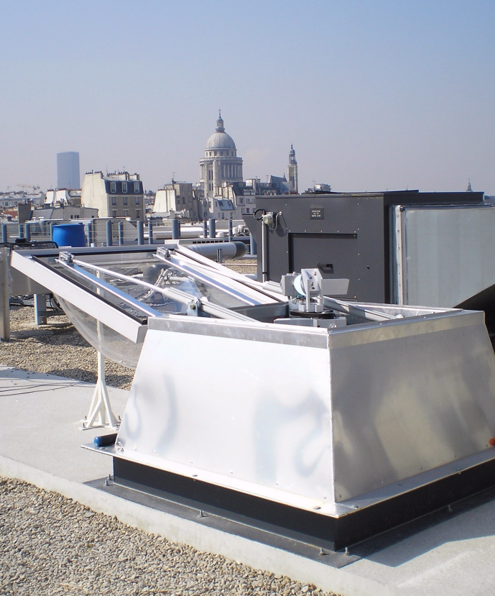
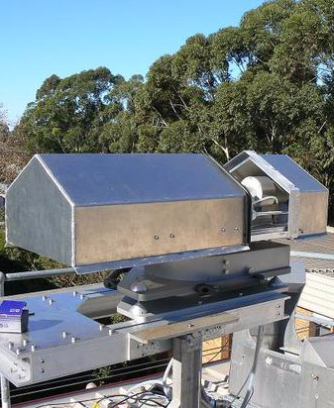
The three ground-based FTIR sites
FTS-Paris
Jungfraujoch FTIR
Wollongong FTIR
- Located at the UPMC University in the center of Paris
- Urban megacity site
- TCCON station
- Located at Wollongong University
- Moderate pollution site
- NDACC & TCCON station
- Located at the ISSJ
- Remote high-altitude site
- NDACC station
IRWG/TCCON 2016, June 2nd, Jeju, South Korea

Slide 6
CO total column data

Slide 7
Total column seasonal variability (1/2)
Consistency of the observed CO seasonality with previous FTIR studies (Rinsland et al., Zhao et al., Barret et al., …)
IRWG/TCCON 2016, June 2nd, Jeju, South Korea

Slide 8
Satellite instruments and GEOS-Chem model
IASI-MetOp
- Onboard MetOp
- FTIR instrument
- MetOp-A launched on October 2006
- MetOp-B launched on September 2012
- Footprint 4×∅12 km
- Data from ESPRI website
(+ additional PBL and free troposphere partial columns data)
MOPITT
- Onboard TERRA
- Gas-filter correlation radiometer
- Launched on December 1999
- Footprint 22 km × 22 km
- Data from NASA website
GEOS-Chem (v9.02)
- Meteorological fields from NASA GMAO
- Full chemistry simulation
- EDGAR (v3.2) emission inventory
- RETRO & EMEP anthropogenic emissions inventories
- GFED v3 for global biomass burning
- MEGAN v2.1 for global biogenic emission
- Daily averages smoothed by FTIR AVKs
IRWG/TCCON 2016, June 2nd, Jeju, South Korea

Slide 9
Total column seasonal variability (2/2)
Good agreement between ground-based FTIR, satellites and GEOS-Chem for the CO seasonal variability
But underestimation of about 20% by the model
(probably due to the currently implemented inventories)
IRWG/TCCON 2016, June 2nd, Jeju, South Korea

Slide 10
Surface vs. Column

Slide 11
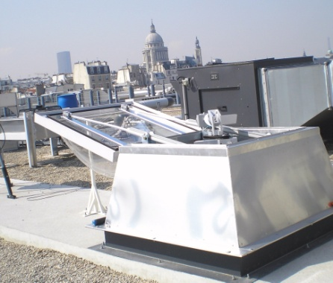
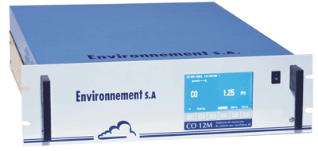
Surface in situ measurement instrument at Paris [CO11M]
⇨Surface CO in situ measurement performed by the CO11M analyser
from Environnement SA (since 2007)
Terrace of 45-46 building
Air sampling
Below experimental room
IRWG/TCCON 2016, June 2nd, Jeju, South Korea

Slide 12
PBL and free troposphere partial columns
- Consistency between FTS-Paris, IASI & GEOS-Chem in the free troposphere
- Consistency between FTS-Paris, CO11M & GEOS-Chem in the PBL
Time-lag of about 2 months between surface and column CO
IRWG/TCCON 2016, June 2nd, Jeju, South Korea

Slide 13
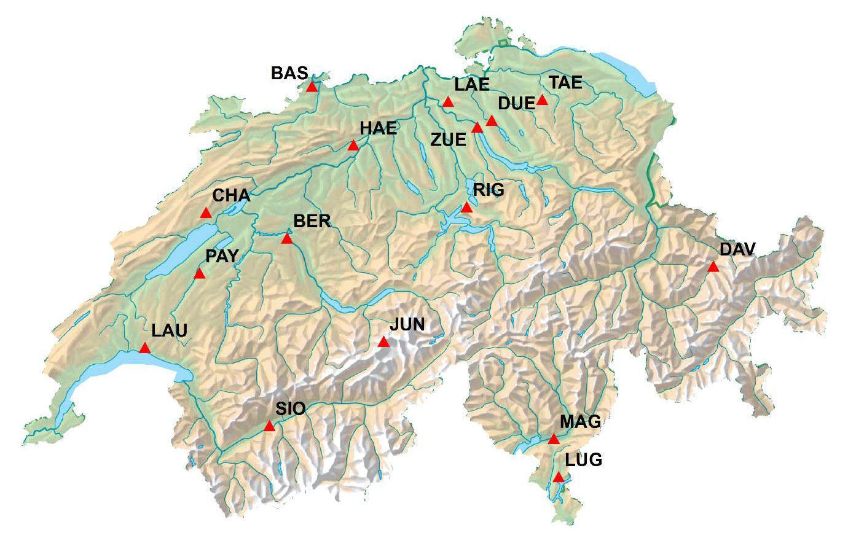
Swiss NABEL network
⇨Surface in situ measurement performed by the Swiss NABEL
network (National Air Pollution Monitoring Network)
urban site
high-altitude site
IRWG/TCCON 2016, June 2nd, Jeju, South Korea

Slide 14
Swiss surface in situ measurement
Same time-lag between urban sites and high-altitude site
IRWG/TCCON 2016, June 2nd, Jeju, South Korea

Slide 15
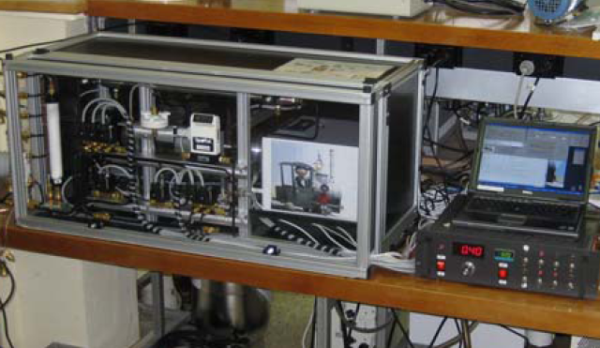
Surface in situ instruments at Wollongong
⇨Surface in situ measurement performed by two high-precision in situ FTIR trace gas analysers (from June 2012 to May 2013)
IRWG/TCCON 2016, June 2nd, Jeju, South Korea

Slide 16
Surface in situ measurements at Wollongong
No significant time-lag observed
IRWG/TCCON 2016, June 2nd, Jeju, South Korea

Slide 17
Identification of emission sources

Slide 18
Specific simulations from GEOS-Chem (1/3)
- To study the impact of the different sources of CO, three specific simulations were performed by turning off individually
⇨ the biomass burning emission sources
⇨ the biogenic emission sources
⇨ the anthropogenic emission sources
IRWG/TCCON 2016, June 2nd, Jeju, South Korea

Slide 19
Specific simulations from GEOS-Chem (2/3)
IRWG/TCCON 2016, June 2nd, Jeju, South Korea

Slide 20
Specific simulations from GEOS-Chem (3/3)
- To study the impact of the different sources of CO, three specific simulations were performed by turning off individually
⇨ the biomass burning emission sources
⇨ the biogenic emission sources
⇨ the anthropogenic emission sources
⇨ The CO seasonality at Paris and Jungfraujoch is mainly driven by local anthropogenic emission
➔ Time-lag of 2 months between surface and column
⇨ The CO seasonality at Wollongong is influenced by remote or uniformly distributed biogenic and biomass burning emission sources
➔ No significant time-lag observed
IRWG/TCCON 2016, June 2nd, Jeju, South Korea

Slide 21



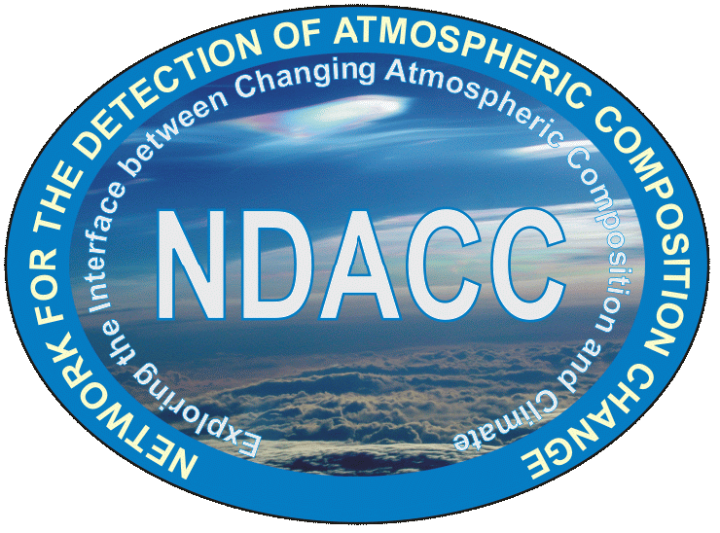


Acknowledgments
Thank you for your attention

