Slide 1
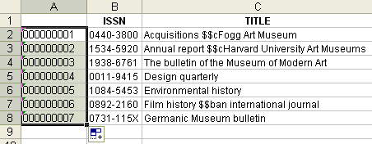
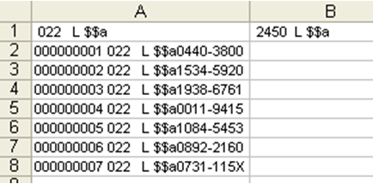
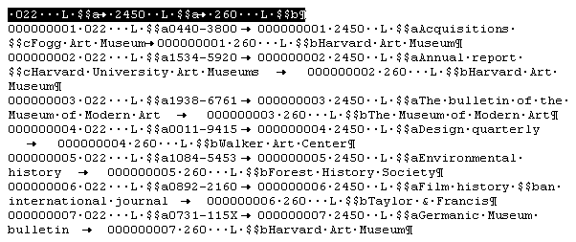
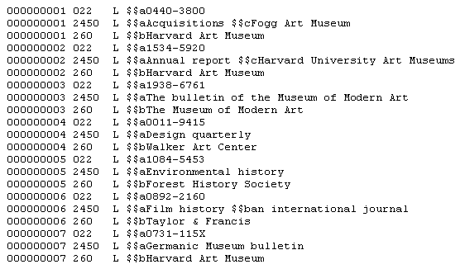
Conversion from Excel into Aleph sequential
IGeLU 2009, Helsinki
by François Renaville & Paul Thirion
Poster available at http://hdl.handle.net/2268/19944
University of Liège Libraries
Grande Traverse 12 (B37) ; 400 Liège (Belgium)
francois.renaville@ulg.ac.be
paul.thirion@ulg.ac.be
Before starting
Try to have uniform contents (print books only or e-books only or serials only… → easier for batch processes).
Your data must be as correct as possible.
Step 1
To make your file more readable:
Call each column with the appropriate Marc field (or subfield) code
or with a clear name (author, title…).
Put the columns in the order you prefer.
Variant, if a $$h[electronic resource] has to be added between $$a and $$b,
try to start from a file like the following:
Step 2
Add a new column (at the beginning, column A) containing incremented system (SYS) numbers. Start from 000000001 (use an initial quotation mark: ‘000000001). → Each line gets a SYS.
Step 3
Add a new sheet. Each column of Sheet2 will get a structured title like the following:
space
+ appropriate Marc tag
+ indicators (or spaces if non defined)
+ space
+ L
+ space
+ subfield preceded by $$
Eg. : ·020···L·$$a
·2450· L·$$a
·85640·L·$$u
Step 4
a. Concatenate now on Sheet2 cells from Sheet1 with title lines of Sheet2.
Eg.: =CONCATENATE(Sheet1!A2;$A$1;Sheet1!B2)
b. After the concatenating procedure, you’ll obtain the following result:
c. By going down the whole column, you’ll get this: d. And so for the whole file, this:
Step 5
a. Save Sheet2 in text (.txt, with “separator:tabulation”). Rename then in .doc and open with your word processor. Delete the first line (= title line).
b. Replace all tabs ( ) by paragraph marks ( ¶ ).
If necessary, replace several paragraph marks by only one.
Step 6
Save in .txt and check that your Aleph sequential is correct.
Finally
Delete extension .txt. Your file is now ready to be used with manage-36 or loaded by manage-18. Use tab_fix and fix_doc_do_file_08 to add fixed fields (LDR, 006...), create the record format, insert punctuation, add new contents (655 0 $$aElectronic journals…), change strings…

