Slide 1
Capacity mechanisms for improving security of supply: quick fixes or thoughtfully rethinking the way electricity is traded?
Prof. Damien ERNST

Slide 2
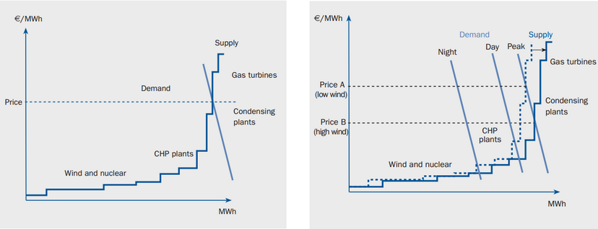
Renewables and drop in electricity prices

Slide 3
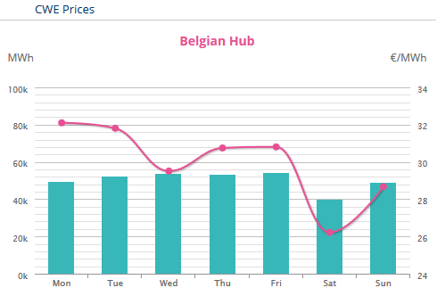
Low electricity prices and investments
Electricity prices become ridiculously low.
Highly dependant on the price of gas.
With the energy-only market, no new investments will be made anymore, except if (i) they are subsidised (ii) they take place in a microgrid-like structure (= no grid fees, no taxes)

Slide 4
The two burning questions in electricity market design
Context: The world is very likely to switch towards a 100% renewable energy mix.
Question 1: How to create a non-subsidised EU (or worldwide) electricity market that synthetises a price signal fostering investments in renewable energy?
wholesale
market price
price cap
With the current market design, prices will increasingly be set by the load and storage, which may lead to (i) low average prices (ii) a highly volatile price signal.
time

Slide 5
Lack of supply
Price set by storage and DSM
price cap
price cap
demand
supply
0
0
MWh
MWh
price cap
Oversupply
0

Slide 6
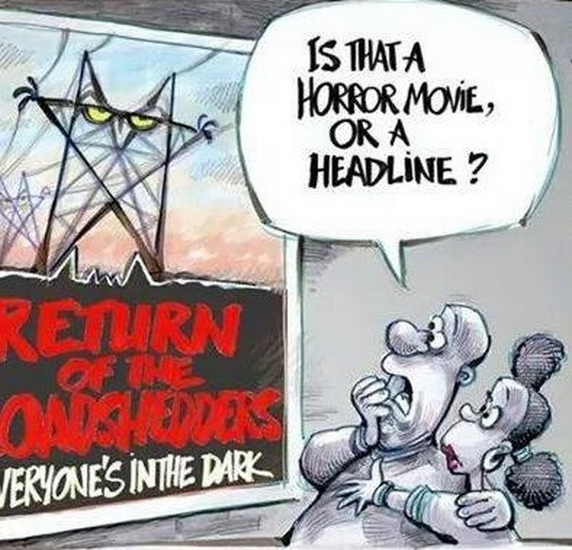
Question 2: How to ensure that there is enough capacity to supply the load at any time?
Current incentives for having enough supply are not sufficient. But what are these current (negative) incentives in Belgium?
(i) A price of 3000 €/MWh for electricity bought on the day-ahead market in case of lack of supply
(ii) An imbalance tarif equal to 4500 €/MWh.
L
E

Slide 7
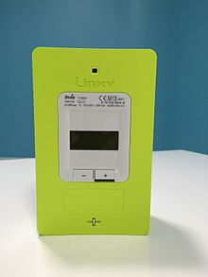
If MWhs were bananas
Retailers cannot buy enough electricity on the wholesale market when there is a lack of supply?
Answer: If the retailer cannot convince his customers to consume less, the TSO reduces its consumption and disconnect them from the grid. IT is possible to do it with smart meters.
Issues: (i) Required technology cannot easily be put in place (ii) Poor people are likely to be frequently disconnected since they will be unable to buy a high level of security of supply (iii) Issues of transparency for customers.

Slide 8
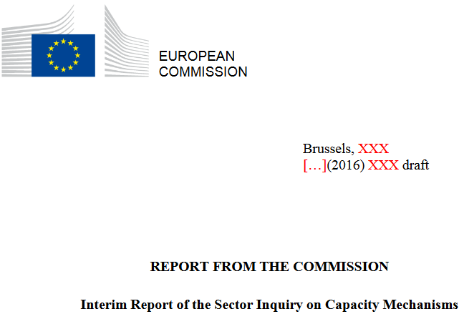
Capacity mechanisms
An increasing number of analysts believe that capacity mechanisms that make separate capacity revenues available to generators and/or demand response are needed to ensure generation adequacy.
As a consequence, several Member States have already opted for the introduction of one or more capacity mechanisms to address perceived residual market failures.
Mechanisms vary widely - they may fall within the category of state aid.

Slide 9
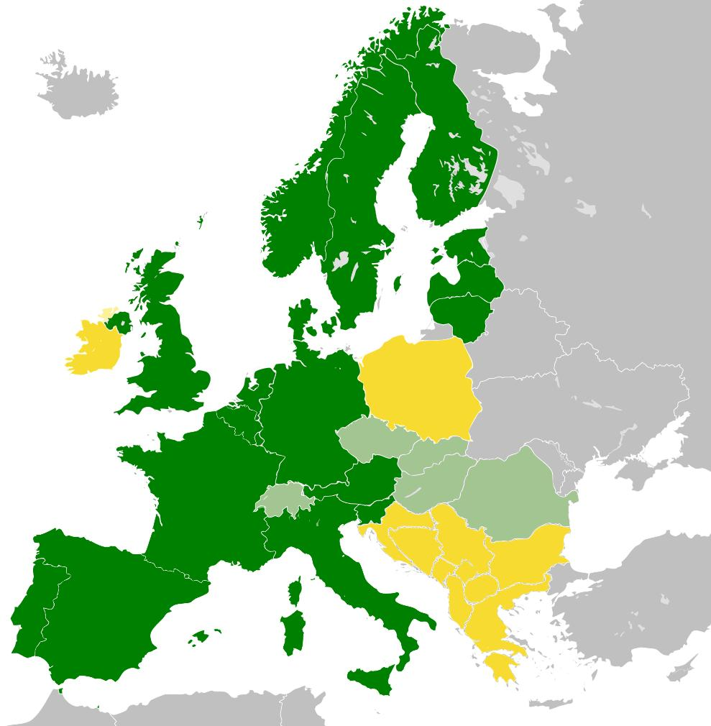
The perfect capacity mechanism: difficulties ahead
(i) Difficulties for loads – especially small ones – to take part to capacity mechanisms.
(ii) Problems of interference between capacity mechanisms and transmission/ distribution networks (loop-flows, congestions at the distribution level, etc.)
(iii) What is the place of renewables/storage within capacity mechanisms?
(iv) What about nuclear energy and capacity mechanisms?

Slide 10
Capacitity mechanisms: the «EU taxonomy »
Targeted
Market-wide
Volume-based
Price-based
Volume-based
Price-based
1. Tenders for new capacity
2. Strategic reserve
5. De-Central
obligation
6. Market-wide capacity payment
3. Targeted capacity payment
4. Central buyer
See: Capacity mechanisms working group, 30 June 2015, HIGH LEVEL COMPARISON OF CAPACITY MECHANISM MODELS AND COMPATIBILITY WITH STATE AID GUIDELINES

Slide 11
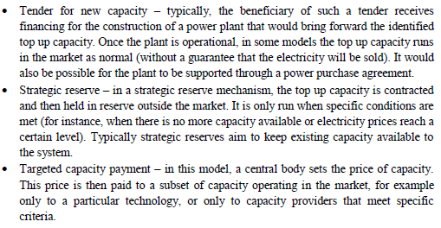
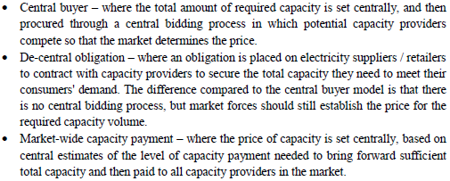
Targeted
Market-wide

Slide 12
What I think of these mechanisms (in short)
1. Tenders for new capacity: May not favour enough emerging technologies like DG + Storage. May be required in case of nuclear phase-out.
2. Strategic reserve: OK as a temporary solution. But why removing the generators of the strategic reserve from the market (except when there is an adequacy problem)?
3. Targeted capacity payment: Simple to put in place but no competition/innovation. Beneficial that the units still stay in the market.
4. Central buyer: Will lead to payments to generators that would still be in activity even without these payments. Problems of market power. Good solution for fostering large-scale investments in generation. Will foster innovation and competition.
5. De-central obligation: Same drawbacks as in the « Central buyer » model, but may favour more competition and innovation. May lead to problems of transparency.
6. Market-wide capacity payment: Does not foster innovation/competition and will lead to payments to generators that are already bankable.

Slide 13
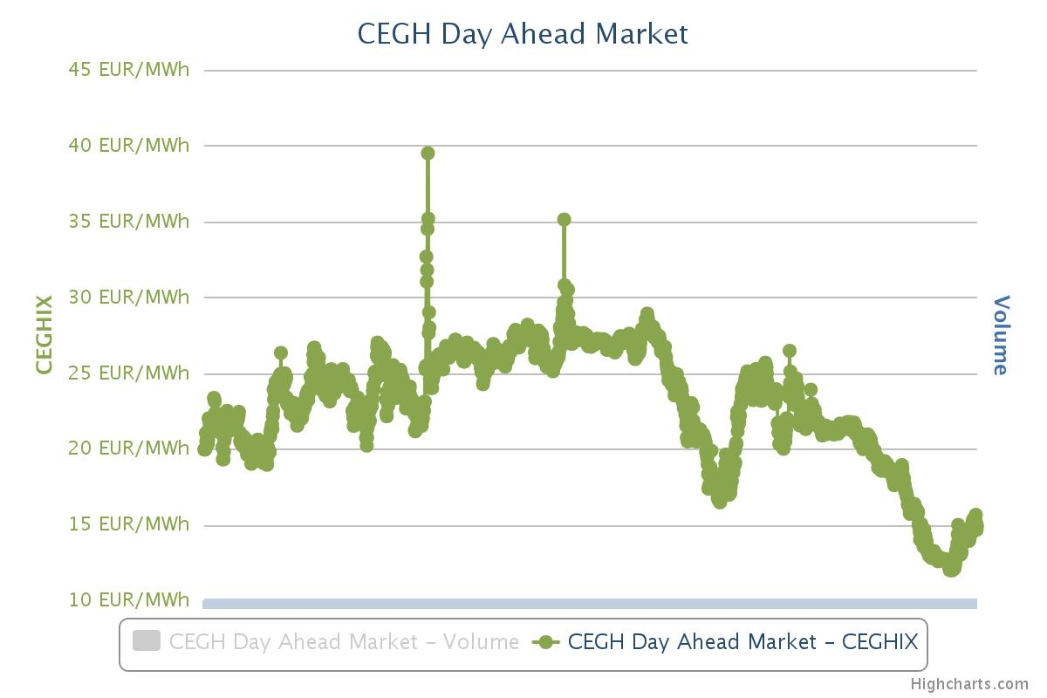
Targeted capacity payment for Belgium?
In Belgium, there are around 4000 MW of gas-fired power plants which are not competitive (now) and at risk of closure. This may create a capacity problem in Belgium. Real risk will occur when Germany proceeds to its nuclear phase out.
Gas prices
June 2010
June 2016
Targeted capacity payments to these power plants would be simple to put in place and effective in avoiding any risk of shortage of supply. The total payments necessary for maintaining them in operation would be around 100 million euros per year. This solution may be the cheapest one for ensuring security of supply in Belgium, even after the German nuclear phase-out.

