Slide 1
Storytelling in Videogames:
From “Narrative” Towards “Fictional Universe”
Poetics of the Algorithm - Narrative, the Digital, and ‘Unidentified’ Media
Fanny Barnabé
Research Fellow – University of Liège
French Literature
fanny.barnabe@ulg.ac.be
Thesis :
Videogames and participatory culture. Misappropriation as a new game paradigm

Slide 2
1. Abstract
This research aims to propose an alternative model for the narratological analysis of videogames. It is based on my master’s thesis: Storytelling and videogame. An exploration of fictional universes (published by Bebooks in 2014)

Slide 3
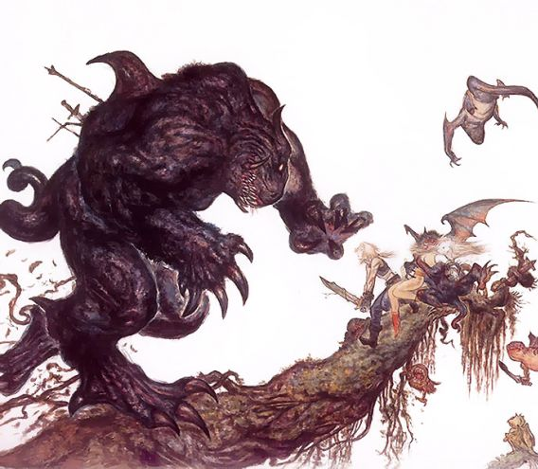
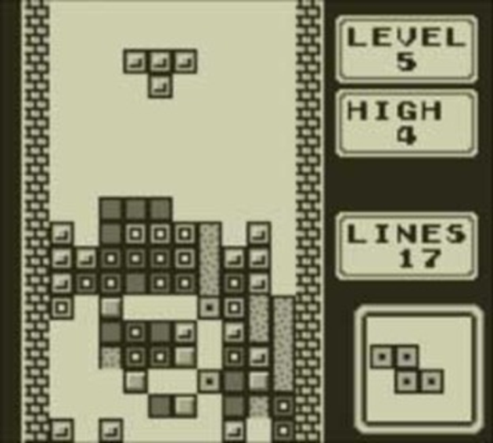
2. Two epistemological conflicts in game studies
Narratologists | ⬄ | Ludologists
(videogame is a new form of narrative that can be studied with the tools provided by literary and film studies) |  | (videogame is not able to represent a story only with its own resources and narrative is not a relevant entry key to analyze this interactive medium)
Ex.: Marie-Laure Ryan, Janet Murray |  | Ex.: Gonzalo Frasca, Jesper Juul, Markku Eskelinen

Slide 4
2. Two epistemological conflicts in game studies
• Refutation of one of the ludologists’ arguments: gaming components (the gameplay, the interface, etc.) can support a part of storytelling
Ex.: Passage (developed by Jason Rohrer in 2007)
Genvo Sébastien, « L’art du game design : caractéristiques de l'expression vidéoludique », Conference E-formes 2 : les arts numériques au risque du jeu, Saint-Étienne, 2008 [online]. URL : http://www.ludologique.com/wordpress/?p=94

Slide 5
2. Two epistemological conflicts in game studies
Game studies | ⬄ | Play studies
(these researchers consider games as closed structures, i.e. as stable formal systems independent of players’ actions) |  | (these researchers study the game not as the property of a finite object but as an experience determined by the player’s playful attitude)
Cf. : Triclot Mathieu, Philosophie des jeux vidéo, Paris, La Découverte, 2011

Slide 6
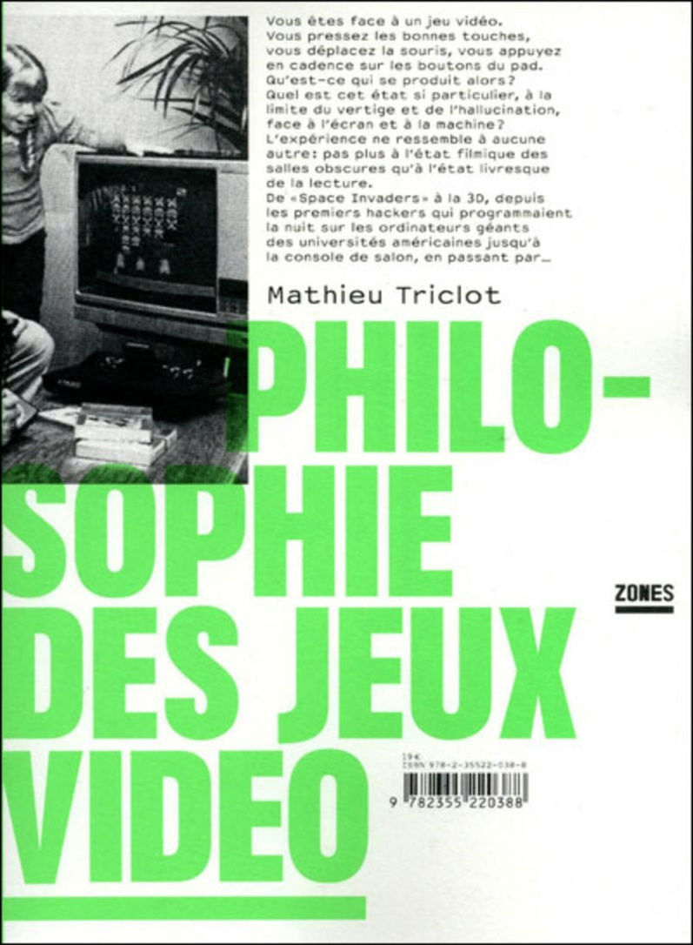
2. Two epistemological conflicts in game studies
“To describe what is happening on the screen, without playing, to objectify the rule system, without playing is never sufficient to characterize the playing experience.
This experience is not defined once and for all by the object, the machine, the discourse on the screen, the narrative, the rule system or the gameplay, but is produced by the player with the help of the game”
(Triclot, p. 19)

Slide 7
3. The narrative: a tricky concept
Theoretical issues raised by these conflicts:
What does the notion of « narrative » exactly cover in videogames?
How to determine what are the “narrative games” since the videogame storytelling is dependent on the player's investment?
How to study in absolute terms a narrative that does not exist apart from the play?
Which concepts could we use to describe a “narrative experience” without erasing the fact that it only exists as a potentiality?

Slide 8
3. The narrative: a tricky concept
Challenging the validity of the concept of “narrative”
To perceive the representation of a story as a linear, organized and finite sequence of events does not reveal all the “narrativity” which exists latently in videogames or the various “narrative experiences” which can be lived through a unique game

Slide 9
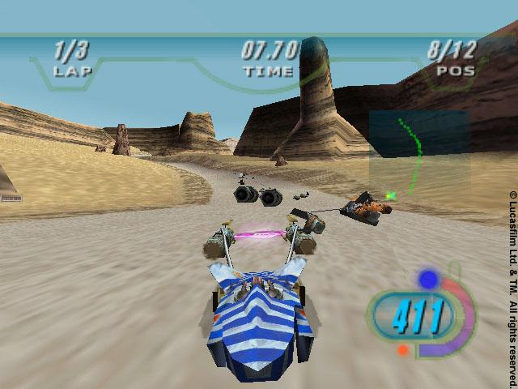
3. The narrative: a tricky concept
Example (borrowed from Genvo¹): Star Wars Episode I: Racer is not a narrative work, but some components of the game relay narrative informations
“shape of the racing track”
“obstacles offered”
“occasional interventions of opponents in some sections of the level”
“Narrativization elements”
¹ Genvo Sébastien, « Transmédialité de la narration vidéoludique : quels outils d’analyse ? », Compar(a)ison, n°2, 2002, pp. 103-112 [online]. URL : http://www.ludologique.com/publis/types_de_narration.html

Slide 10
4. The notion of “fictional universe”
• The videogame “narrativity” does not only amount to the narrative: it rather appears as the activation and then the ordering, by the player, of “narrativization elements” belonging to several levels of the work, but with the common feature to build a fictional universe
Universe:
conglomerate of unranked elements potentially carrying a latent narrativity

Slide 11
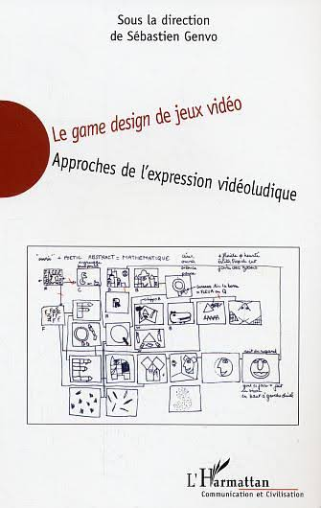
4. The notion of “fictional universe”
• I divided the notion of « universe » into three key concepts, borrowed from Étienne Armand Amato :
Amato Étienne Armand, « Reformulation du corps humain par le jeu vidéo : la posture vidéoludique », in Genvo Sébastien, dir., Le game design de jeux vidéo. Approches de l’expression vidéoludique, Paris, L’Harmattan, 2005, pp. 299-323

Slide 12
Universe
Cosmos
(“the universe as such, supposed to exist by itself, regardless of the player's participation, the plot or the objective of the game”)
Diegesis
(“a cosmos oriented by a story which constructs it as a necessary background”)
Ludiegesis
(“the diegesis as it is ruled by the game”)

Slide 13
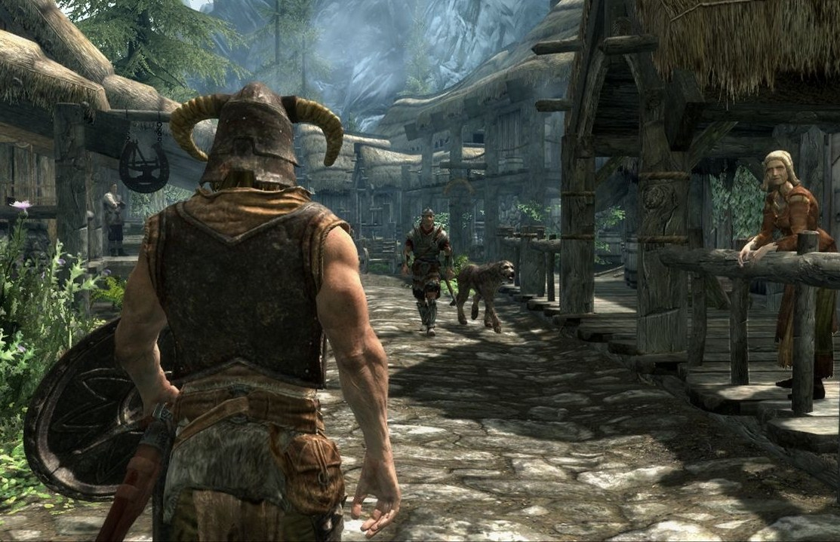
Ex.: the games The Elder Scrolls: one single cosmos, but several diegesis
The Elder Scrolls III : Morrowind
(Bethesda Softwokrs, Ubisoft, 2002)
The Elder Scrolls V : Skyrim (Bethesda Softworks, Ubisoft, 2011)

Slide 14
4. The notion of “fictional universe”
On the basis of this theoretical framework, I identified and studied 14 “narrativization elements”:
1. Cutscenes
6. Paratext
11. Goals
2. Text
7. Interface
12. Sounds
3. Characters
8. Camera
13. Gameplay
4. Avatar
9. Items
14. Choices and settings
5. Intertextual references
10. Environnements

Slide 15
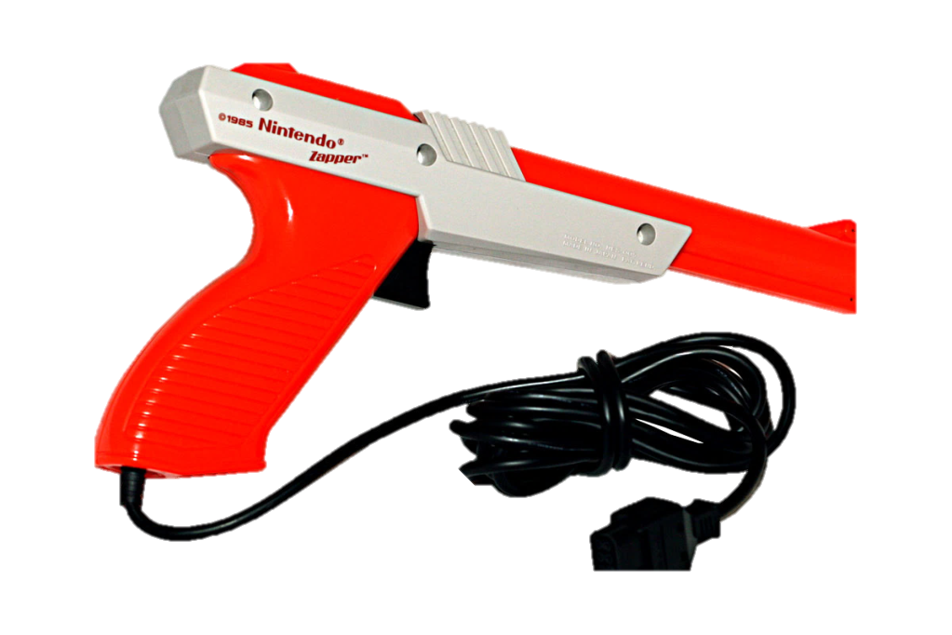
5. An example: which role can the interface play in storytelling?
A « diegetized » interaction device:
The NES Zapper, developped by Nintendo

Slide 16
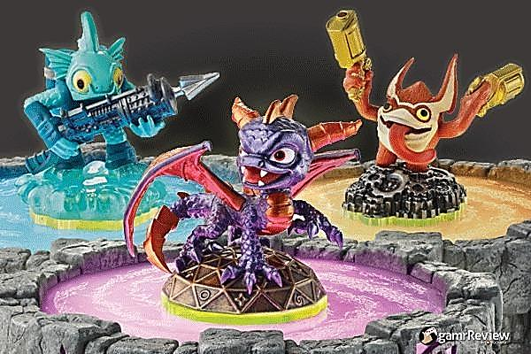
5. An example: which role can the interface play in storytelling?
Interaction devices as diegesis’s foundations:
Skylanders : Spyro’s Adventure (Toys for Bob, Activision, 2011)

Slide 17
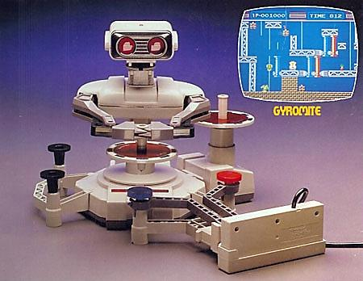
5. An example: which role can the interface play in storytelling?
Interaction devices as diegesis’s foundations:
Robot R.O.B. (Nintendo, 1984)

Slide 18
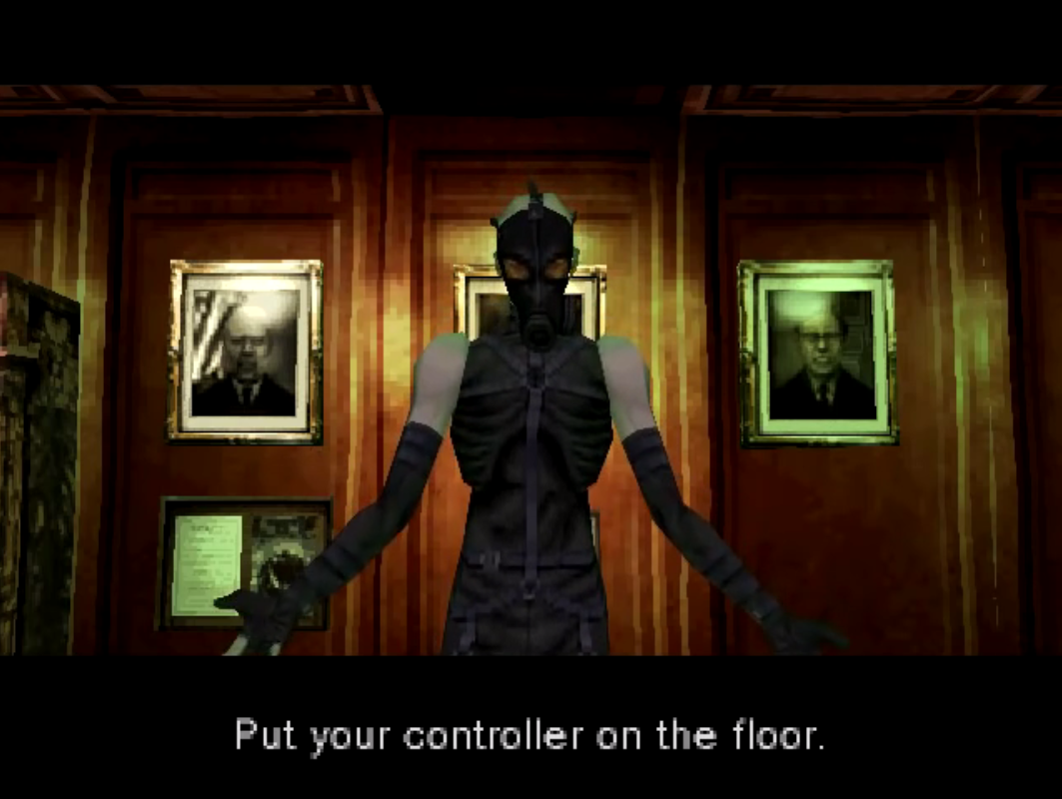
5. An example: which role can the interface play in storytelling?
Manipulation of interaction devices by a character of the diegesis:
Metal Gear Solid (Konami, 1998)

Slide 19
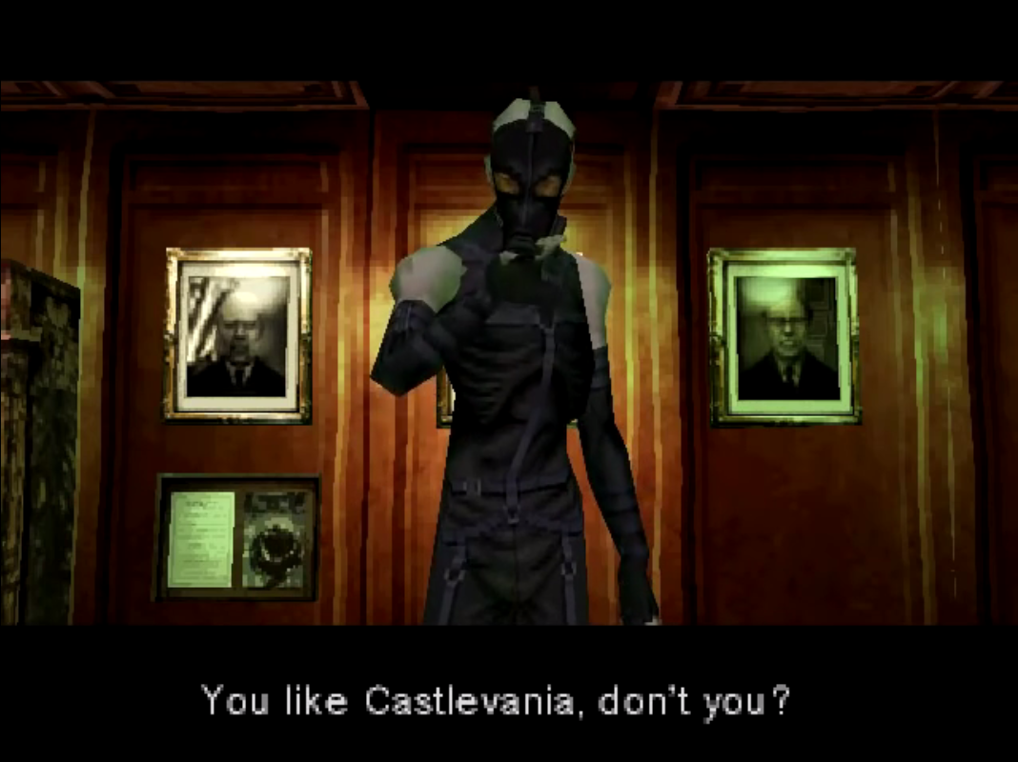
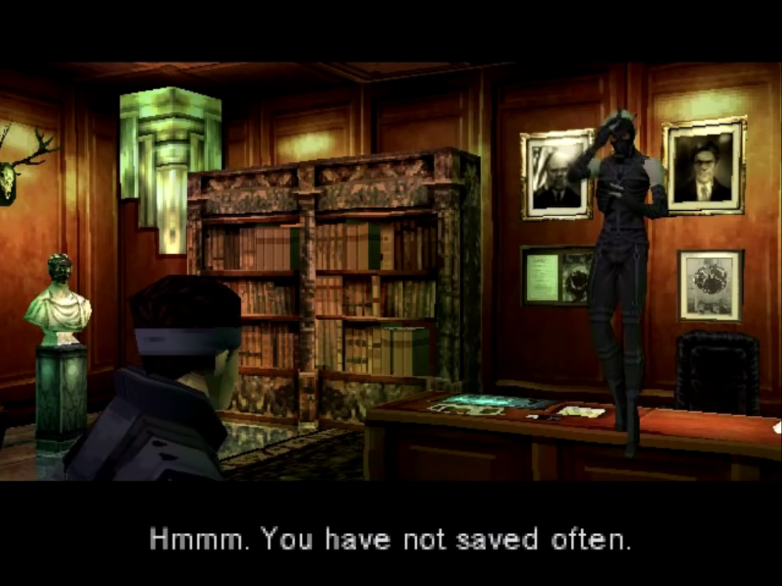
Metal Gear Solid (Konami, 1998)

Slide 20
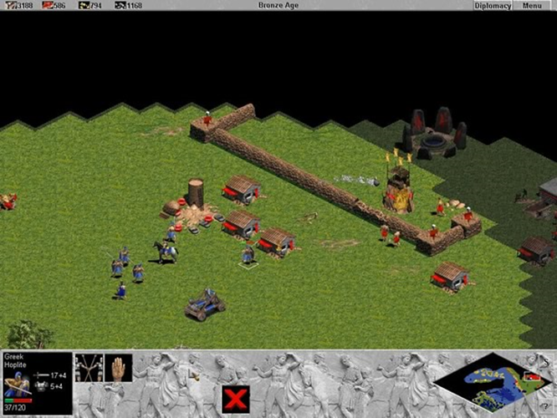
5. An example: which role can the interface play in storytelling?
Narrative “clothing” of a graphic user interface:
Age of Empires (Ensembles Studio, Microsoft Corp, 1997)

Slide 21
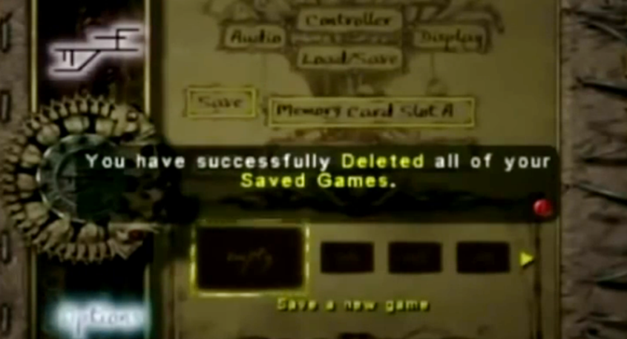
5. An example: which role can the interface play in storytelling?
Contamination of the GUI by the protagonist’s madness:
Eternal Darkness : Sanity’s Requiem (Silicon Knights, Nintendo, 2002)

Slide 22
6. Conclusion
• The notion of universe has two major advantages:
its malleability, because this notion tolerates interactivity (it would incidentally be helpful to take into account the active role of players’ communities in the evolution of fictional worlds)
its opening, because this concept broadens the traditional idea of storytelling considering it as an organization on a higher taxonomic scale which cross various media

