Slide 1


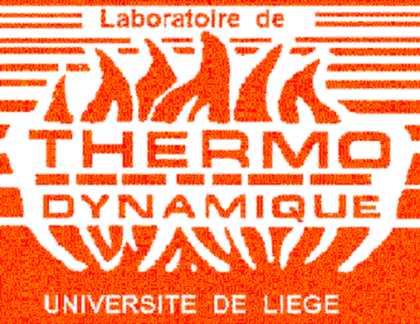
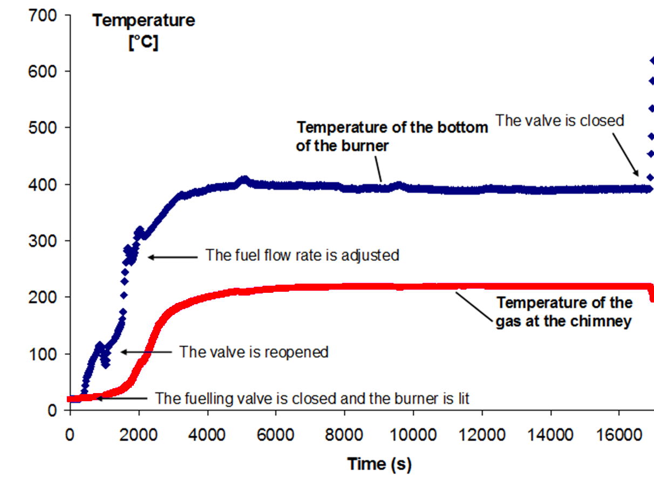
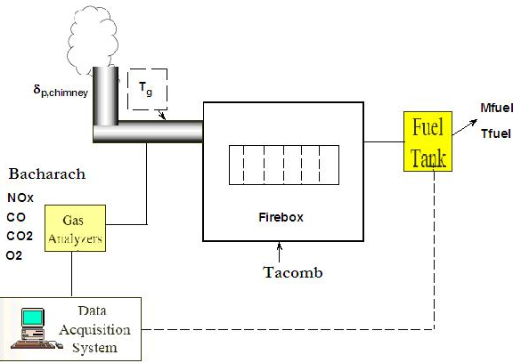
Feasibility study of burning neat jatropha oil into a vaporizing burner for household applications
Introduction
Charcoal is one of the major energy sources for household applications in urban areas of developing countries. It is often made from natural forest and accelerates forest depletion. The aim of this work is to evaluate the use of jatropha oil for combustion in vaporizing burners. This study presents laboratory tests on a burner whose nominal output power is 7.5kW. The pollutants emissions and the thermal performance are analyzed for three firing rates.
Test bench diagram
Example of result (middle-firing rate)
Results and conclusions
 | Unit | High firing rate | Middle firing rate | Low firing rate
Mass flow rate | g/h | 812.5 | 461.5 | 240
CO₂ | % | 7.9 | 4.7 | 2.7
CO | ppm | 43 | 835 | 414
NO_{x} | ppm | 25 | 23 | 20
O₂ | % | 10.8 | 14.9 | 17.5
Bacharach | - | 1 | 3 | 3
Draught | Pa | -10.3 | -8.2 | -6.2
Flue gas temperature | °C | 302.7 | 207.6 | 132.2
Power output | W | 6734 | 3619 | 1965
Efficiency (LHV) | % | 79.7 | 77.8 | 78.8
Efficiency (HHV) | % | 75.5 | 73.3 | 74.5
Start of burner is difficult => use of a wick to help fuel to vaporize and flame to propagate
At high firing rate
Nominal power - 11% due to lower LHV
Burner efficiency of 80%
Emissions lower than EN1 standards for class 2 appliances
At middle firing rate
CO emissions are 12.5% higher than standards limits
At low firing rate
Higher CO emissions and Bacharach index
Emissions lower than EN1 standards for class 3 appliances
Acknowledgment
The financial support of the DG04 of the SPW (Walloon Region - Belgium) is kindly acknowledged. The authors also want to acknowledge the Socomef company for the stove provided without charge.
Kevin Sartor*, Danielle Makaire, Jean-Marie Fontaine and Philippe Ngendakumana
University of Liège, Belgium
Contact: kevin.sartor@ulg.ac.be / +32 (0) 4366 48 20

