Slide 1



Simplified methodology to study soft-bottom macrofauna in Corsica, France
Fish farming influence’s study case
Annick DONNAY
STARESO, FRANCE

Slide 2
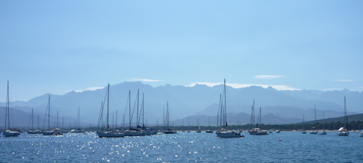
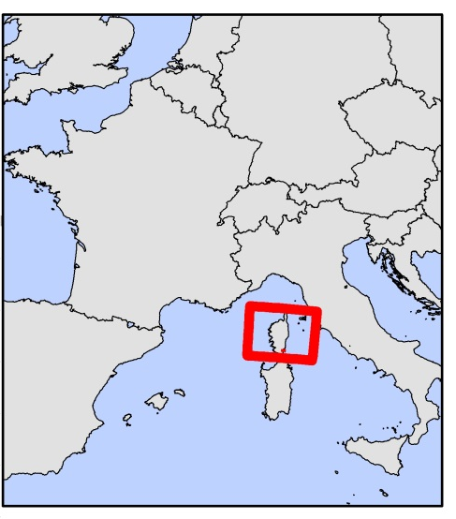
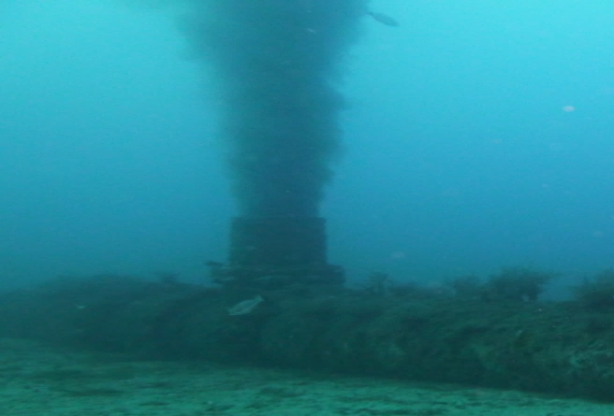
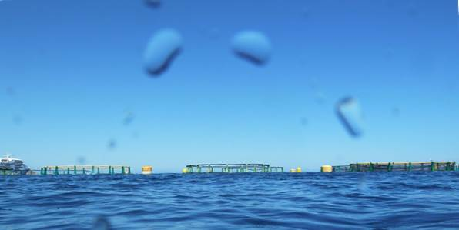
Study area: Corsica
Located in the North-West Mediterranean Sea
Oligotrophic water
Few anthropogenic influences including fish farming
Anchoring area
Sewage outfall area
Fish farming area

Slide 3
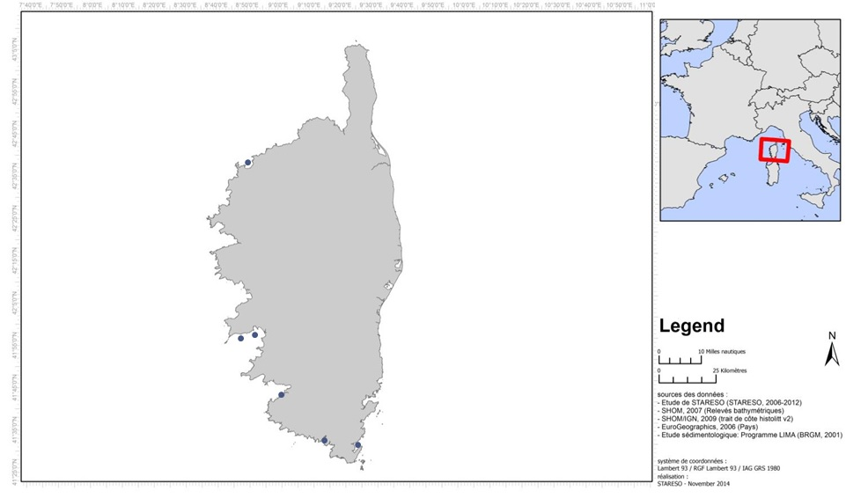
Influence studied : Fish farm
6 located around Corsica
Production between 20 T and 1500 T per year
In open or semi-closed bay
Depth between 10 m and 26 m

Slide 4
Utility of the J’MAMBI
 | J'MAMBI | M-AMBI | AMBI | BENTIX | BOPA | BQI
High | 11 (12,2 %) | 8 (8,9 %) | 8 (8,9 %) | 27 (30,0 %) | 31 (34,4 %) | 36 (40,0 %)
Good | 42 (46,7 %) | 62 (68,9 %) | 79 (87,8 %) | 43 (47,8 %) | 56 (62,2 %) | 32 (35,6 %)
Moderate | 28 (31,1 %) | 17 (18,9 %) | 2 (2,2 %) | 17 (18,9 %) | 2 (2,2 %) | 13 (14,4 %)
Poor | 7 (7,8 %) | 2 (2,2 %) | 0 (0,0 %) | 3 (3,3 %) | 1 (1,1 %) | 7 (7,8 %)
Bad | 2 (2,2 %) | 1 (1,1 %) | 1 (1,1 %) | 0 (0,0 %) | 0 (0,0 %) | 2 (2,2 %)
 | 90 | 90 | 90 | 90 | 90 | 90
BQI taken with care
M-AMBI based on habitat type identified in Corsica
AMBI, BENTIX, BOPA not use of habitat characteristics
Majority of stations is in High or Good quality status
More variability of evaluated status with the J’MAMBI
Fine distinction between ecological situation

Slide 5
Habitat type and J’MAMBI
Habitat type | Nbr of Stations |  | AMBI | Diversity | Richness
SF; [0-35[ | 30 | Bad | 6 | 0 | 0
 |  | High | 0,82 | 5,18 | 74
SM; [0-35[ | 10 | Intermediate | 6 | 1,95 | 37
 |  | High | 0,36 | 4,41 | 16
SG; [0-10[ | 4 | Bad | 6 | 0 | 0
 |  | High | 1,93 | 4,7 | 73
SG; [10-35[ | 4 | Intermediate | 6 | 5,29 | 151
 |  | High | 0,93 | 3,62 | 42
S; sandy clearing | 14 | Intermediate | 6 | 5,73 | 124
 |  | High | 1,2 | 3,19 | 35
SF; [35- | 11 | Bad | 6 | 0 | 0
 |  | High | 1,31 | 5,96 | 108
SM; [35- | 8 | Bad | 6 | 0 | 0
 |  | High | 1,4 | 5,79 | 108
SG; [35- | 9 | Bad | 6 | 0 | 0
 |  | High | 1,02 | 5,88 | 117
8 Habitat types around Corsica based on 428 samples
Reference conditions values for M-AMBI calculation for each habitat based on 90 stations
Ponderation of M-AMBI by the Pielou index J’ = J’MAMBI
 | Seagrass meadow | D<10 m | 10 m≤D<35 m | D≥35 m
X<250 µm | Sandy clearing | Fine sand between surface and 35 m | Fine sand between surface and 35 m | Fine sand deeper than 35 m
250 µm≤X<500 µm | Sandy clearing | Medium sand between the surface and 35 m | Medium sand between the surface and 35 m | Medium sand deeper than 35 m
X≥500 µm | Sandy clearing | Coarse sand between the surface and 10 m | Coarse sand between 10 and 35 m deep | Coarse sand deeper than 35 m

Slide 6
Kind of study and utilities
Fondamental Study
Applied Study
Expertise
Deep knowledge of macrobenthos and the meadow
Time to realise the study
Species level identification, J’MAMBI and others indices
Accessibility
Overview of the situation
Time saving
  Money saving
Help for managers to take quick resolution to preserve the meadow
Taxonomic sufficiency

Slide 7
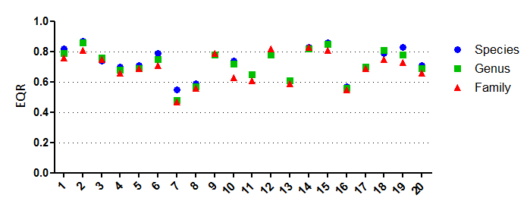
Taxonomic sufficiency
Evaluation based on J’MAMBI values
Comparison between species level and genus or family level
  Family level identification sufficiant for rapid ecological quality status definition

Slide 8
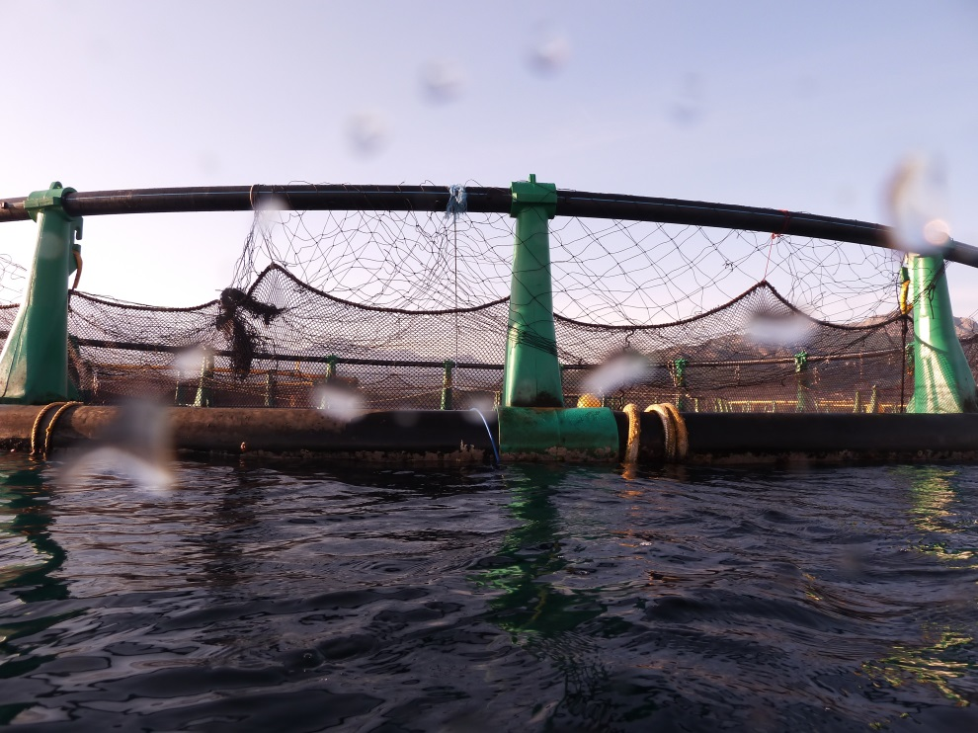
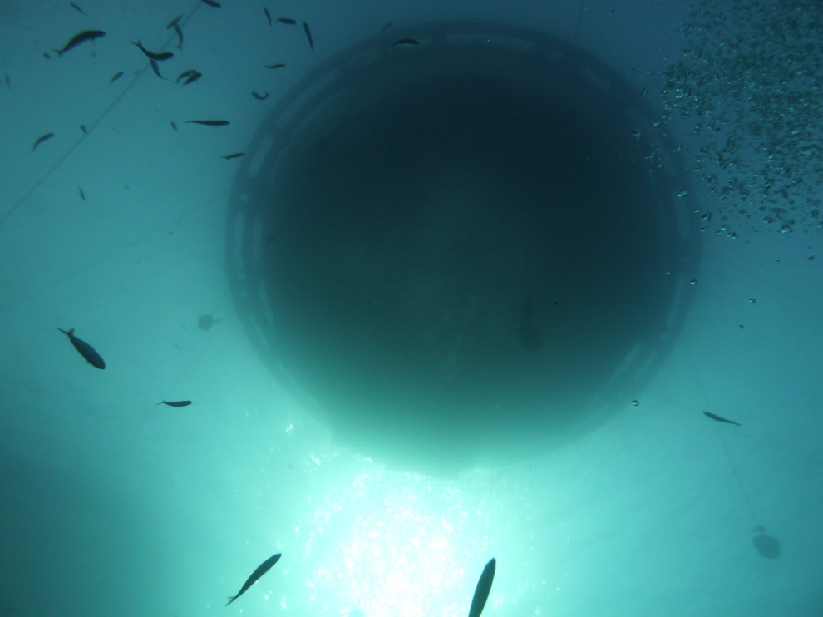
Application: fish farming

Slide 9
Design
Sampling period: spring
2 sampled stations:
  Under the cages
  At 300 m from the cage in the main current direction
Identification until species level
Aggregate at genus and family levels
Comparaison of results between identification levels
Spatial evaluation

Slide 10
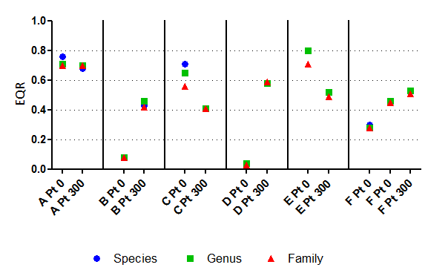
Results
By station:

Slide 11
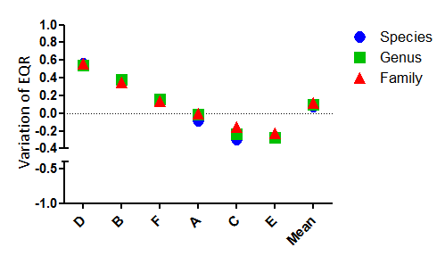
For spatial evaluation of EQR

Slide 12
Conclusions
At station level: no difference between species and family level identifcations’ results
Spatially: no difference between the variation of EQR between the two stations
Family level identification and the use of J’MAMBI by habitat are sufficiant for a rapid evaluation of the Ecological Quality status in the case of fish farming studies

