Slide 1



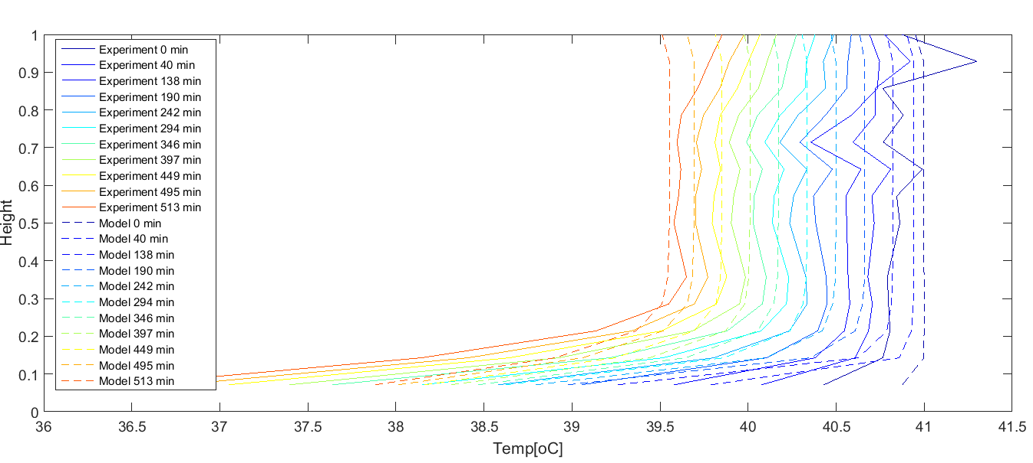
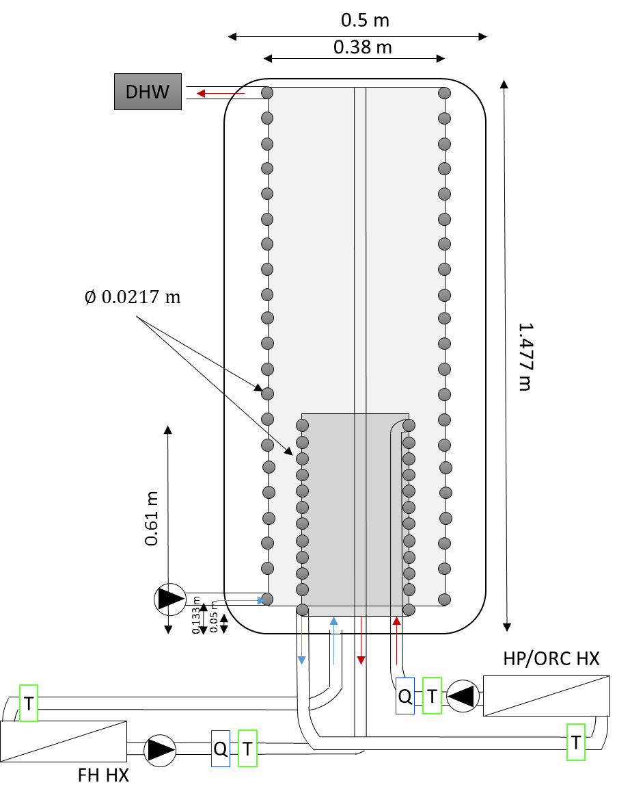
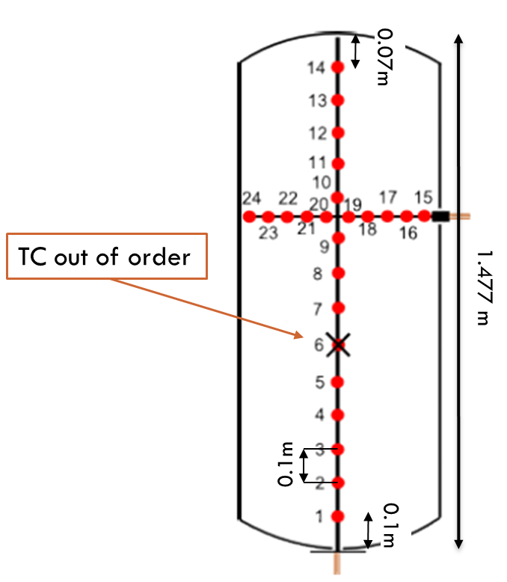
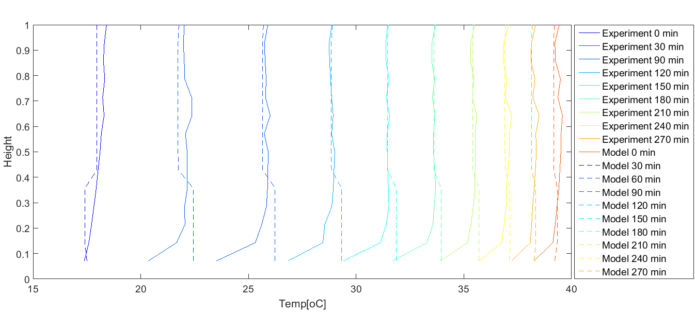
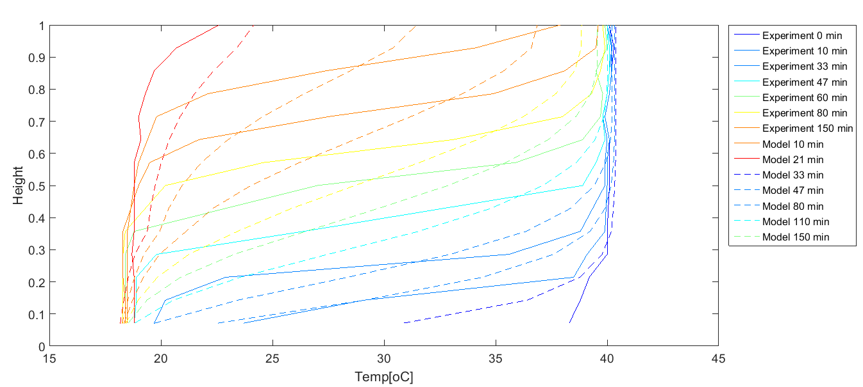
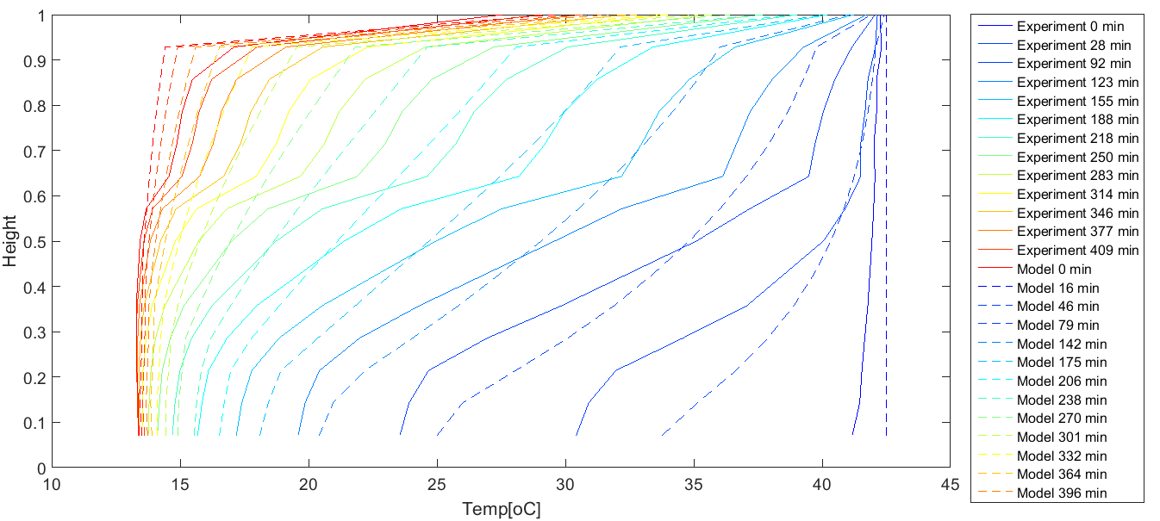
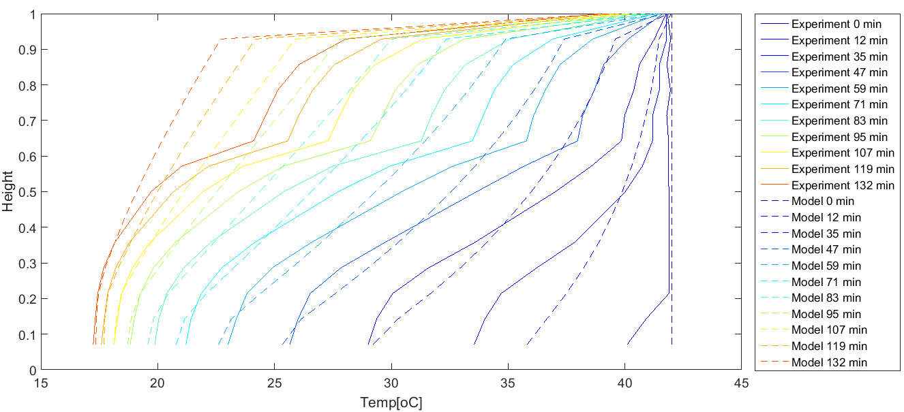
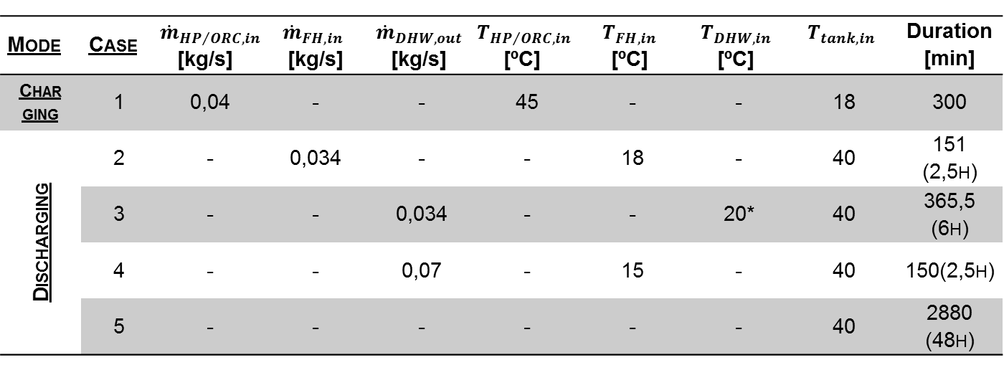
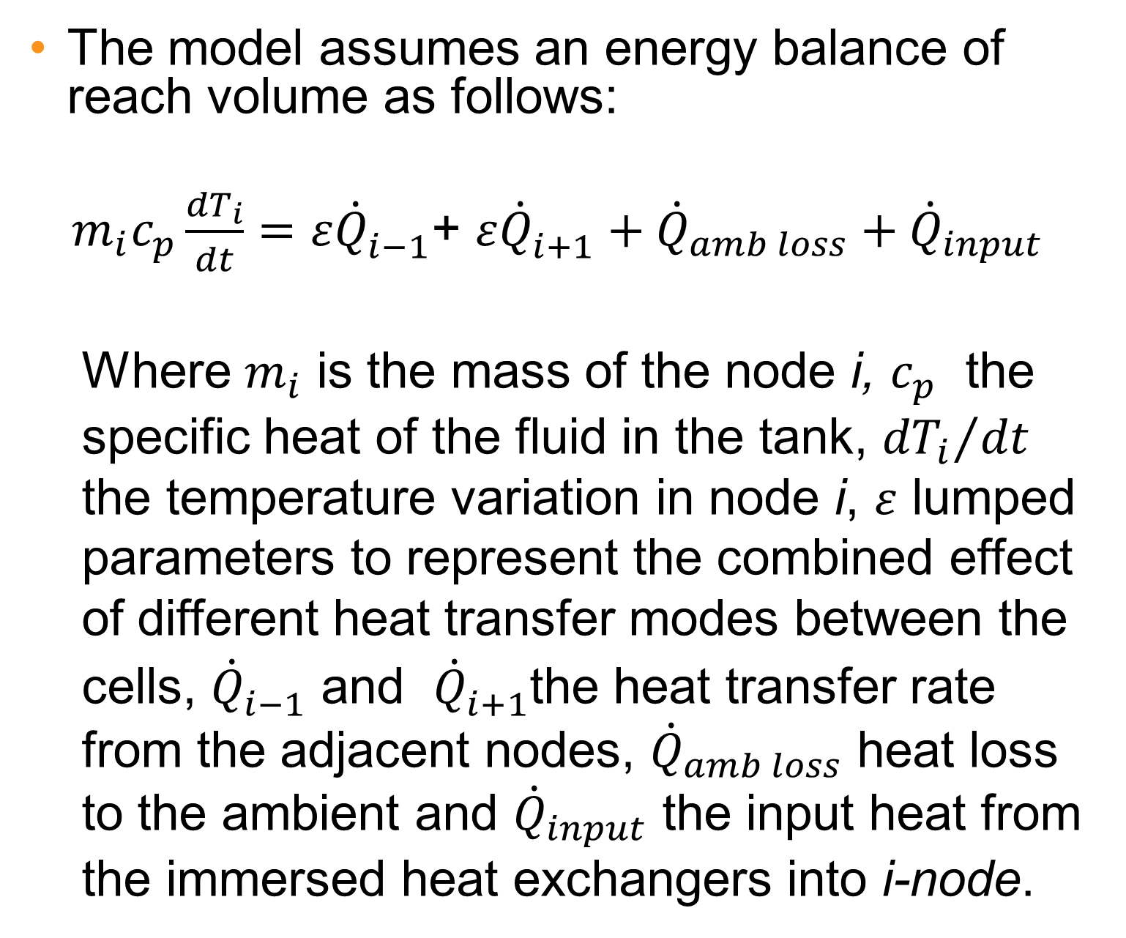
Domestic Thermal energy storage
Carolina CARMO^{(*)}, O. Dumont ^{(****)} ,B.ELMEGAARD^{(**)}, M.P.Nielsen ^{(*)}, N. DETLEFSEN^{(***)}
^{(*)} Aalborg University – Dep. Energy Technology, Denmark ^{(**)} DTU – Dep. Mechanical Eng., Thermal Energy, Denmark ^{(***)} Insero Energy, Denmark
^{(****)} Thermodynamics lab. Univ.Liège
cca@et.aau.dk
Abstract
Experimental tests
Results
The use of stratified hot water tanks in solar energy systems - including ORC systems- is paramount for a better performance of these systems. However, the availability of effective and reliable models to predict the annual performance of stratified hot water tanks coupled with energy system solutions is limited. In this poster, a discretized model of a stratified tank developed in Modelica is presented. The physical phenoma to be considered are the thermal transfers by conduction and convection – stratification, heat loss to ambient, charging and discharging with direct inlet and outlet and through immersed heat exchangers. Results of experimental and numerical investigations in a residential hot water tank with two immersed heat exchangers, one inlet and one outlet are presented and the performance of the model is assessed.
Mode | Case | ${\dot{m}}_{{HP}/{ORC},in}$ [kg/s] | $${\dot{m}}_{FH,in}$$ [kg/s] | $${\dot{m}}_{DHW,out}$$ [kg/s] | $$T_{{HP}/{ORC},in}$$ [ºC] | $$T_{FH,in}$$ [ºC] | $$T_{DHW,in}$$ [ºC] | $$T_{tank, in}$$ | Duration [min]
Charging | 1 | 0,04 | - | - | 45 | - | - | 18 | 300
Discharging | 2 | - | 0,034 | - | - | 18 | - | 40 | 151 (2,5h)
 | 3 | - | - | 0,034 | - | - | 20* | 40 | 365,5 (6h)
 | 4 | - | - | 0,07 | - | 15 | - | 40 | 150(2,5h)
 | 5 | - | - | - | - | - | - | 40 | 2880 (48h)
Model description
Fig. 6 Validation of the stratified hot water tank model under steady-state ambient loss during 48 h (Case 5)
The model assumes an energy balance of reach volume as follows:
$m_{i}c_{p}\frac{{dT}_{i}}{dt}={ε\dot{Q}}_{i−1}^{}$+ $ε{\dot{Q}}_{i+1}^{}+{\dot{Q}}_{amb loss}+{\dot{Q}}_{input}$
  Where $m_{i}$ is the mass of the node i, $c_{p}$ the specific heat of the fluid in the tank, ${{dT}_{i}}/{dt}$ the temperature variation in node i, $ε$ lumped parameters to represent the combined effect of different heat transfer modes between the cells, ${\dot{Q}}_{i−1}^{}$ and ${\dot{Q}}_{i+1}^{}$the heat transfer rate from the adjacent nodes, ${\dot{Q}}_{amb loss}$ heat loss to the ambient and ${\dot{Q}}_{input}$ the input heat from the immersed heat exchangers into i-node.
Experimental setup
Fig. 7 RMSE values between experimental and model during the different test cases
Results
Conclusions
This comparative study provides reasonable proves of the model reliability for long term calculations when coupled with ORC systems
Simulation behavior too uniform in some layers
Temperature variance between measured and calculates values increases if temperature difference of adjacent layer increases- specially with higher flows.
Need to improve mutual influence between adjacent layers correction factor
Fig. 2 Validation of the stratified hot water tank model under charging through small spiral conditions (Case 1)
Fig. 1 Illustrative diagram of the test rig with water temperature and flow measurements (left). Thermocouples position inside the tank (right)
Volume: 250 L
2 immersed spiral heat exchangers
  Heat input unit
  DHW supply
14 vertical thermocouples (type-T) in tank (mounted on PEX pipe)
4 thermocouples (PT-100) for inlets and outlets
2 thermocouples (type-K) for inlets and outletss
3 flow meters
2 electrical heat sources (11kW and 12kW)
Fig. 3 Validation of the stratified hot water tank model under discharging through direct outlet conditions (Case 2 – low flow)
Fig. 4 Validation of the stratified hot water tank model under discharging through immersed spiral conditions (Case 3 – low flow)
Acknowledgments
This work is supported by the Danish Ministry of Science, Technology and Innovation and Insero Energy. We thank the continuous support given by ThermoCycle developers from Thermodynamic Lab., Univ.Liège.
Fig. 5 Validation of the stratified hot water tank model under discharging through immersed spiral conditions (Case 4 – high flow)

