Slide 1

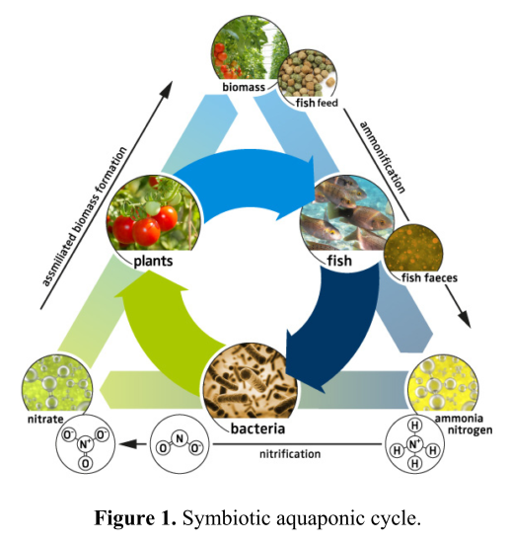
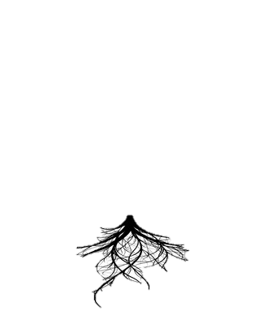
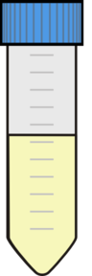
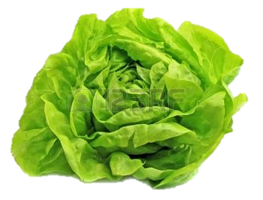
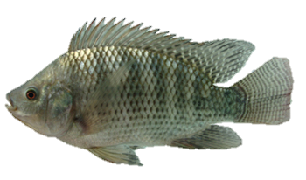
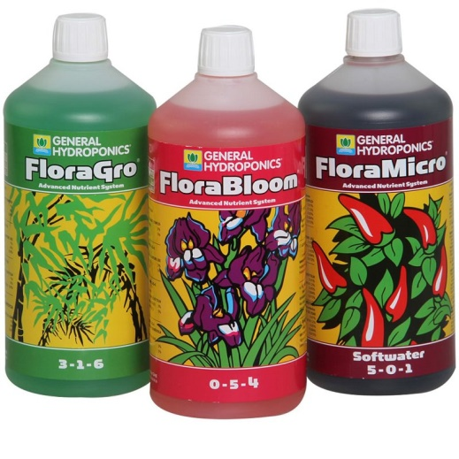
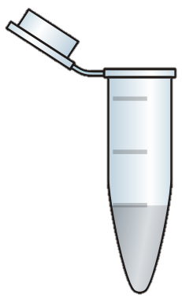
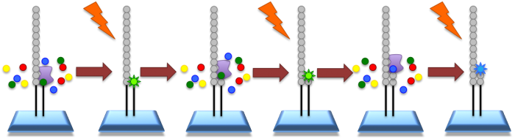
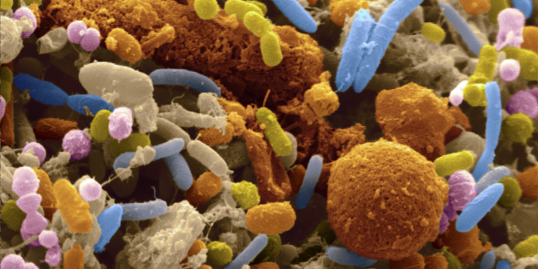
Characterization and biocontrol properties of Lactuca sativa rhizosphere microbiota in an aquaponic system
Stouvenakers Gilles, Massart Sébastien, Jijakli M. Haïssam
Plant Pathology Department - Liege University - Gembloux Agro-Bio Tech, Gembloux, Belgium
INTRODUCTION
Aquaponics is an integrated recirculated system that combines aquaculture and hydroponic plant production. The dissolved nutrients generated by the fish rearing after bacterial activities are used by the plants for their growth. This uptake reduces the accumulation of some molecules which allow a longer water recirculation.
When comparing growth conditions between aquaponics and hydroponics, we observed much lower concentration of several key nutrients in aquaponics. Nevertheless, several experimentations report similar or better yield in aquaponics compared with hydroponics. One explanation of this phenomenon could be linked to microbial actions.
Another possible involvement of microorganisms in aquaponics could be a suppressive action against plant diseases. In fact, some examples of soilless systems show a suppressive effect towards certain root plant pathogens that prove the existence of beneficial microorganisms in hydroponic systems. Furthermore, organic matter is present in aquaponics as in aquaculture systems and could allow a better development of these beneficial heterotrophic bacteria.
Fig : S. Goddek, Delaide B., et al., 2015 Aquaculture Engineering
MODUS OPERANDI
Rhizosphere microbiota characterization
Tests of protection
Nowadays, microorganisms related to aquaculture and hydroponics are well characterized but very little is known about the taxonomy of the microbiota associated with aquaponic system and their roles in the interaction microbiota-plants and microbiota-plant pathogens.
A first article (Gravel et al., 2015) opens the hypothesis of a protective activity of fish effluents microbiota against plant pathogens. The aim of our experimentation is to determine if plants growing in aquaponic conditions are really able to show a biocontrol activity compared with hydroponic plants.
Rhizosphere microbiota collecting
DNA extraction
Aquaponic plants
Hydroponic plants
High throughput sequencing
Pythium sp. inoculation
Shotgun
16S, 18S or/and ITS rDNA
Disease incidence
Symptoms quantification
Yields measures
Roles and properties of the microbiota
Taxonomical characterization of bacteria, fungi and protozoa
?
Better protection of aquaponic plants
Getty Images
Gravel, V. et al., 2015. Fish effluents promote root growth and suppress fungal diseases in tomato transplants. Canadian Journal of Plant Science, 95, pp.427–436.
Notes:
(Rakocy, 2012)
(Goddek et al., 2015)
Postma, J., Os, E. & Bonants, P.J.M., 2008. Ch 10 - Pathogen detection and management strategies in soilless plant growing systemInteraction Between Growing Systems. In Soilless Culture: Theory and Practice. Elsevier B.V., pp. 425–457. Available at: http://dx.doi.org/10.1016/B978-0-444-52975-6.50012-5.
P 490!! Maher, M., Prasad, M. & Raviv, M., 2008. Ch 11 - Organic soilless media components. In Soilless Culture: Theory and Practice. Elsevier B.V., pp. 459–504. Available at: http://dx.doi.org/10.1016/B978-0-444-52975-6.50013-7.

