Slide 1
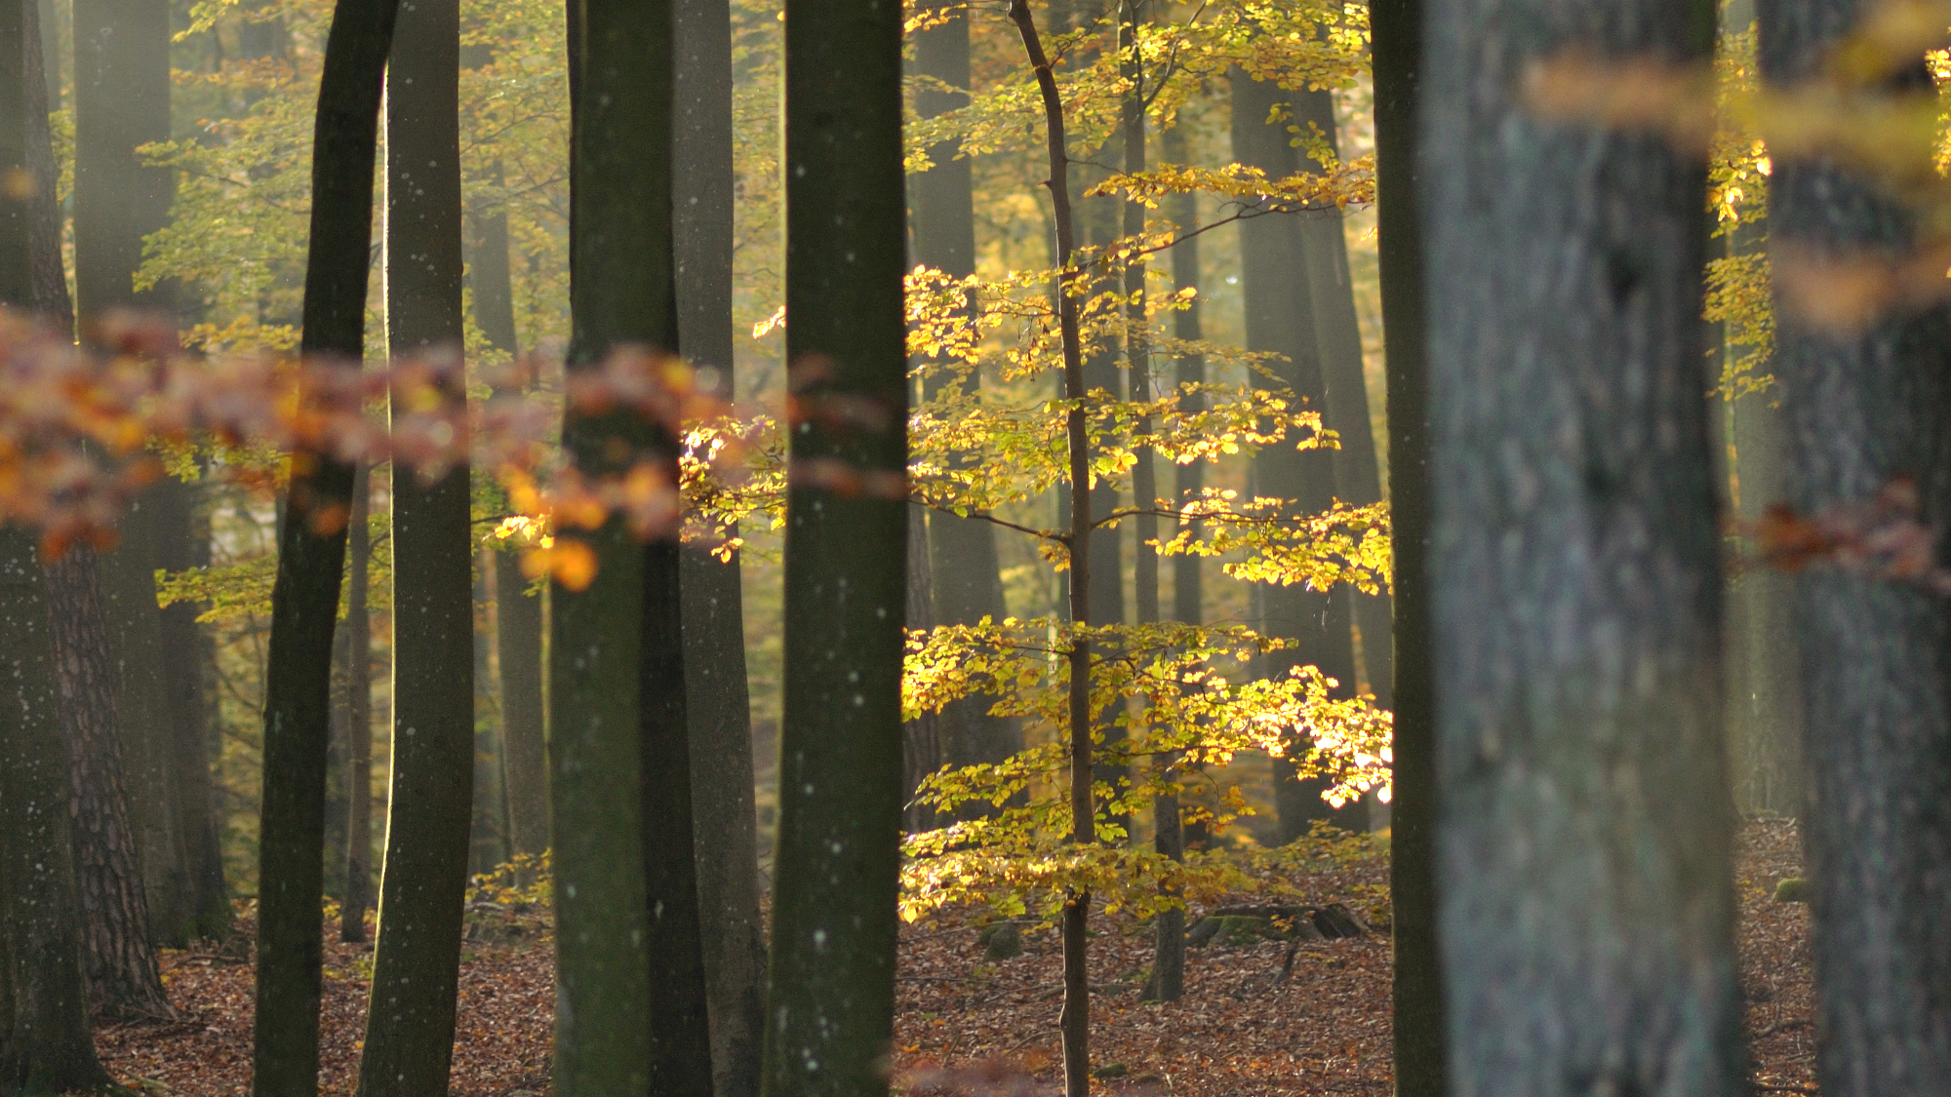
Maintaining the coexistence of forest species of different shade tolerances with uneven-aged silviculture
Gauthier Ligot¹, Philippe Balandier², Benoît Courbaud³, Daniel Kneeshaw⁴, Hugues Claessens¹
¹ Univ. de Liège, Gembloux Agro-Bio Tech, Forest Resource Management, Belgium
² Irstea, U.R. Ecosystèmes Forestiers (EFNO), France
³ Irstea, U.R. Ecosystèmes Forestiers (EFNO), Domaine des Barres, 45290 Nogent-sur-Vernisson, France
⁴ Centre d’Étude de la Forêt, Case postale 8888, succursale Centre-ville, Montreal, QC, H3C 3P8, Canada

Slide 2
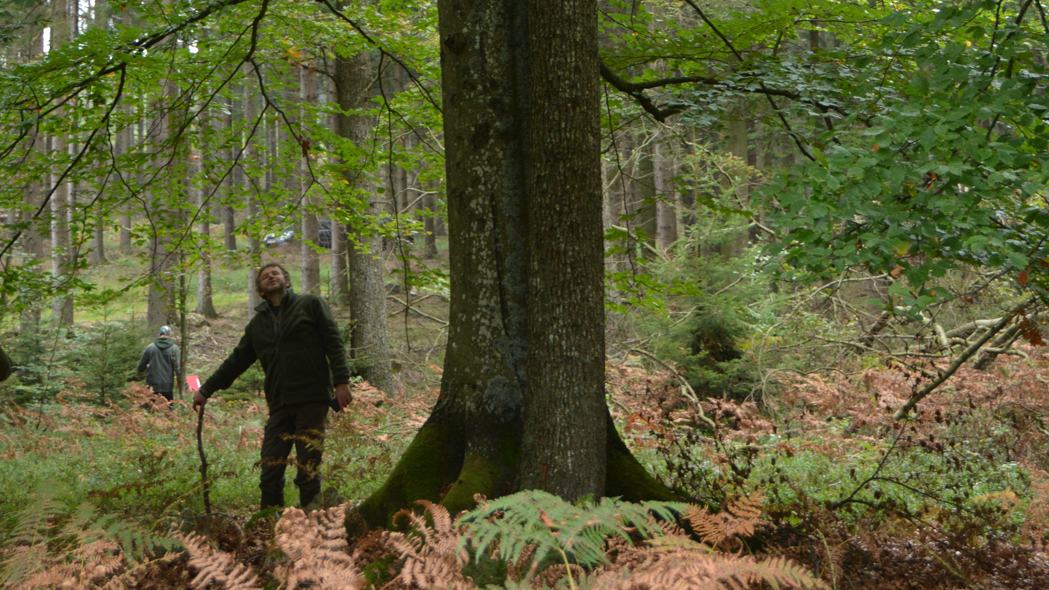
How can we maintain the coexistence of shade-tolerant species and
less shade-tolerant species?
Continuous cover
Tree size and species heterogeneity
Natural regeneration

Slide 3
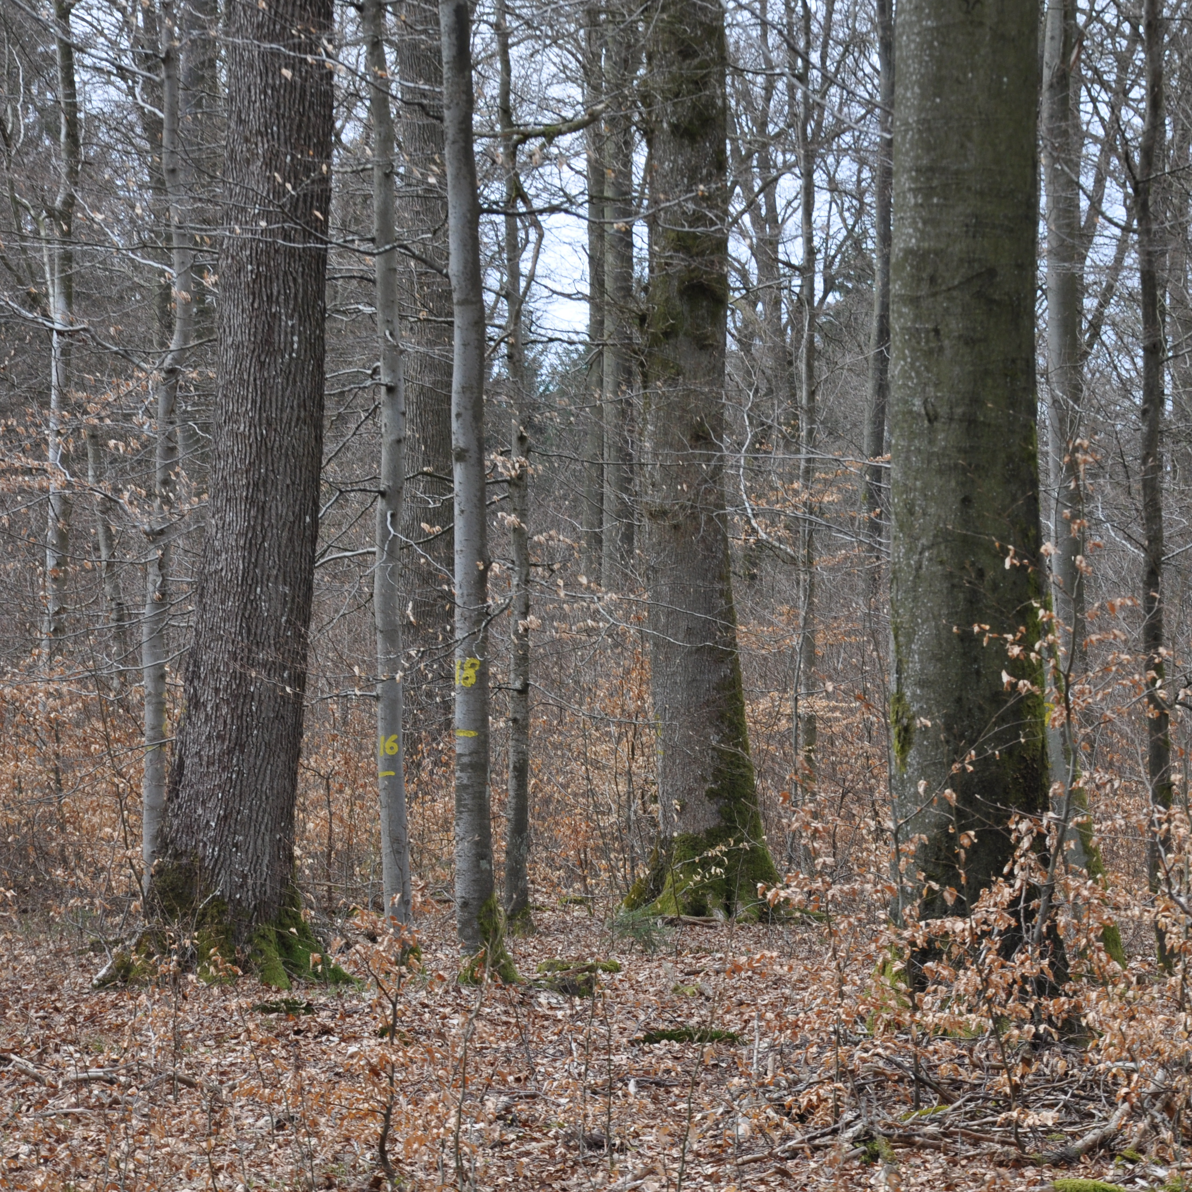
Acidophile beech forests, in the Belgian Ardennes
Sessile oak
Quercus petraea (Matt) Liebl.
Less shade-tolerant
Scarce in natural regeneration
European beech
Fagus sylvatica L.
Shade-tolerant
Invade the understory

Slide 4
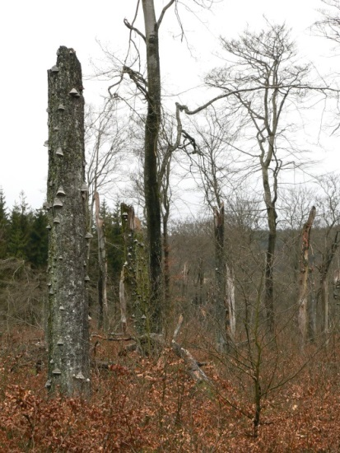

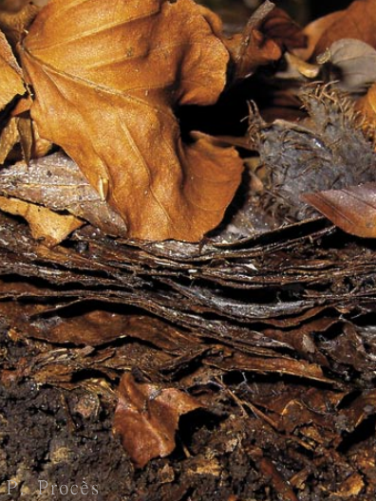
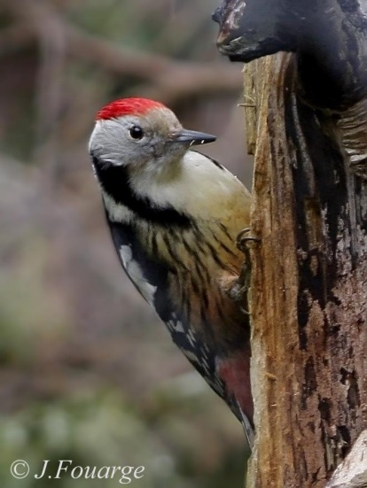
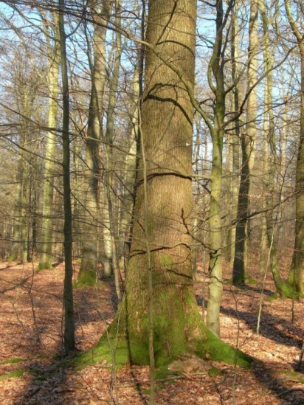
Why maintaining the mixture of oak and beech?
Resilience
Climate change
Fertility
Biodiversity
Timber

Slide 5
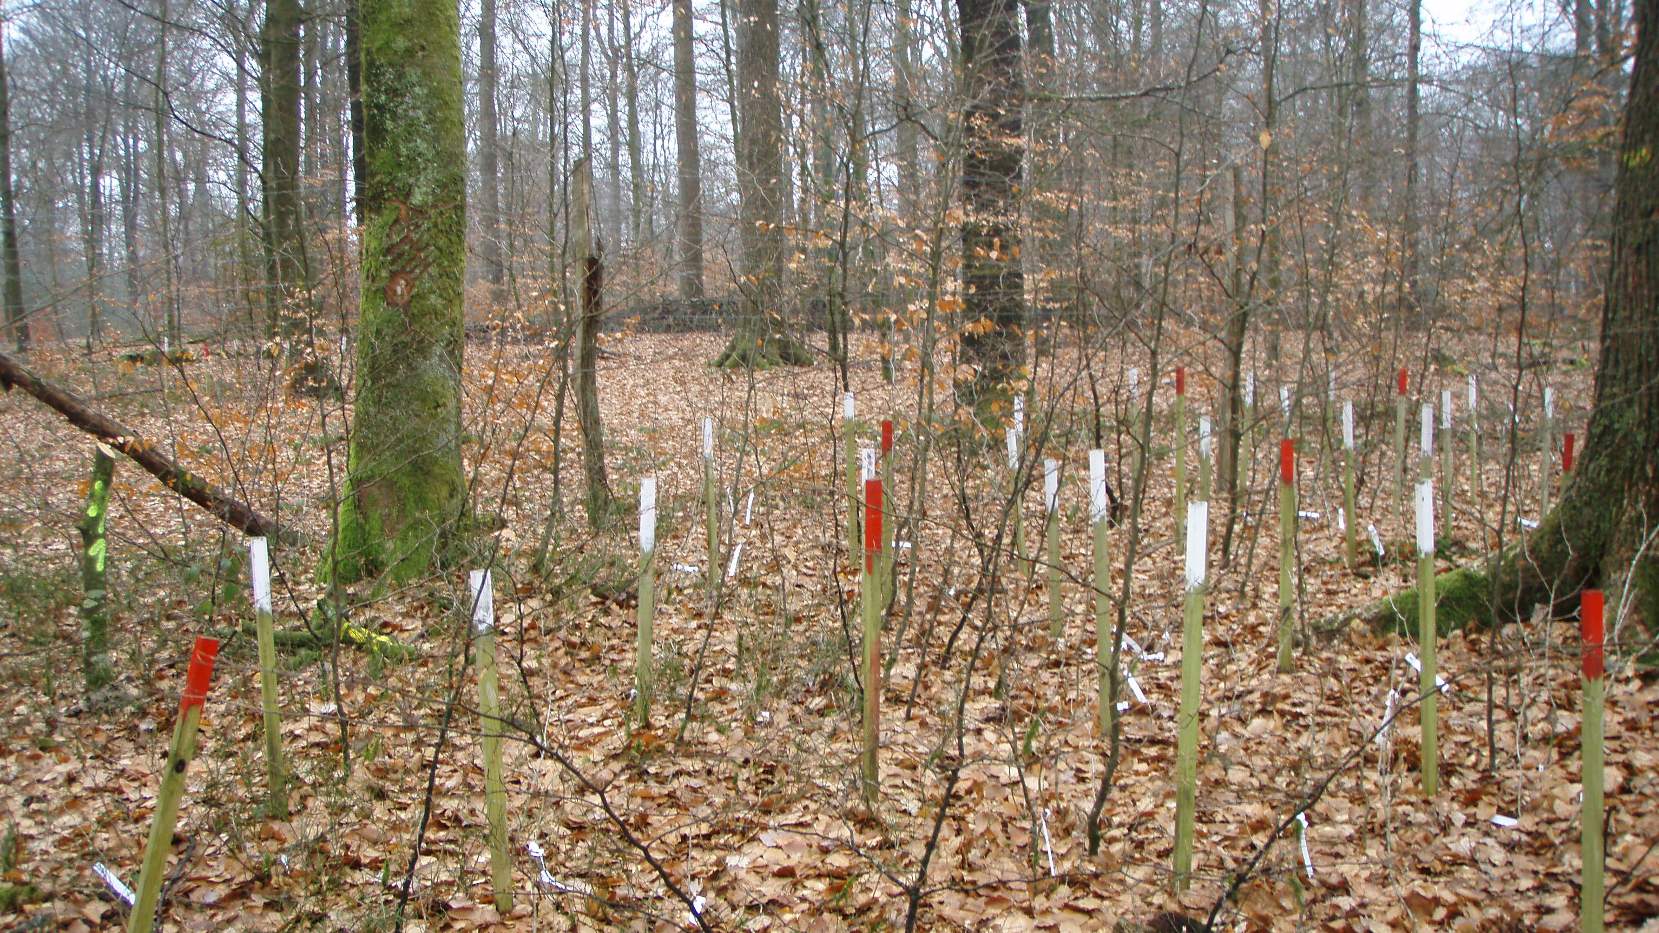
27 fenced sites
From early successional oak forests to late successional beech forests
Square subplots to monitor regeneration

Slide 6
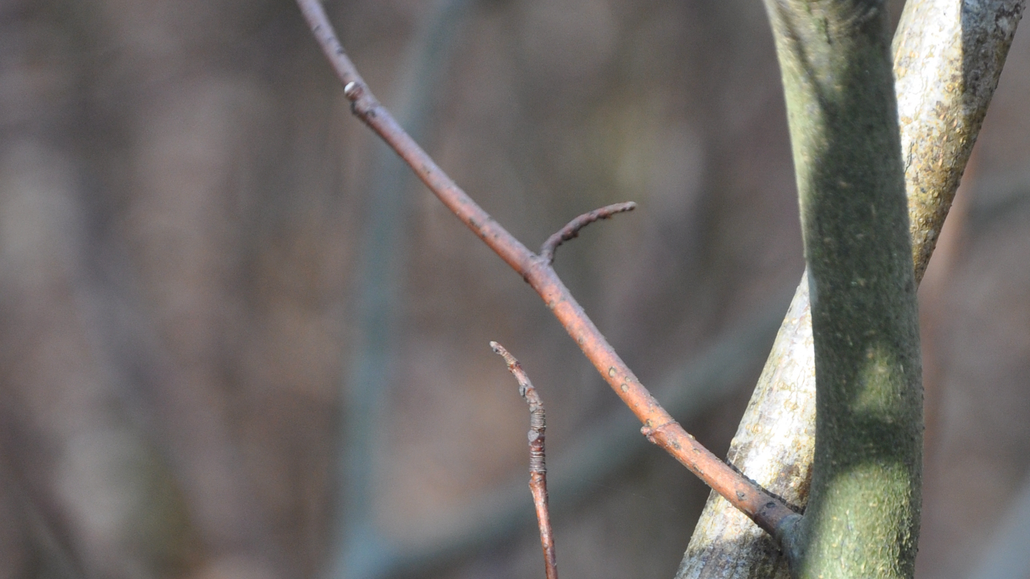
What are the light conditions that promotes regenerations of either shade-tolerant species or less shade-tolerant species?

Slide 7
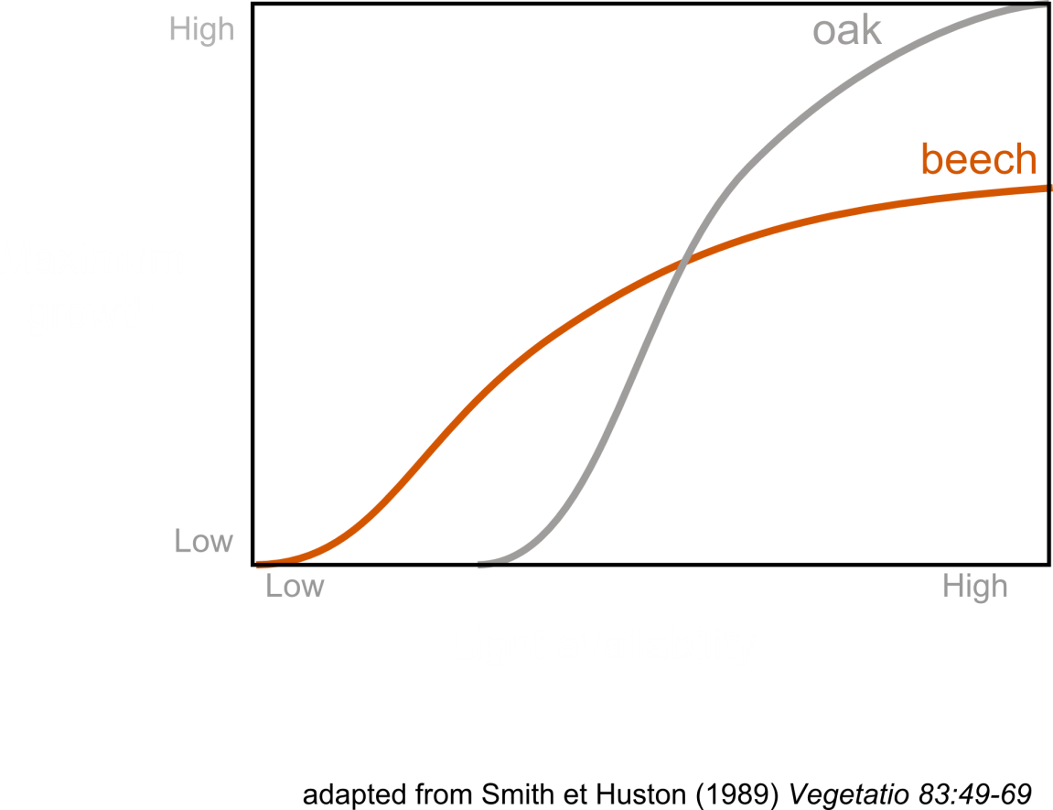
Hypotheses
Tradeoff between survival in shade and growth in high-light conditions
Sapling growth depends mainly on diffuse light rather than direct light

Slide 8
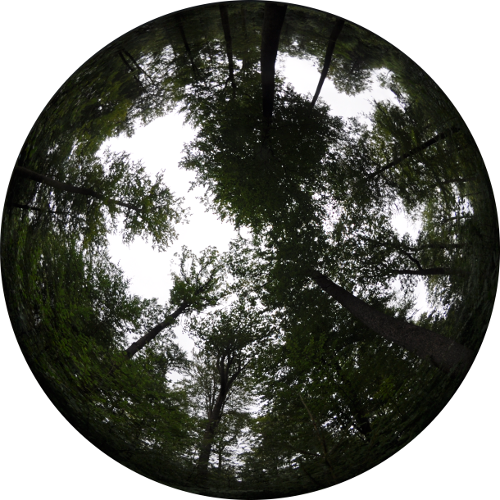
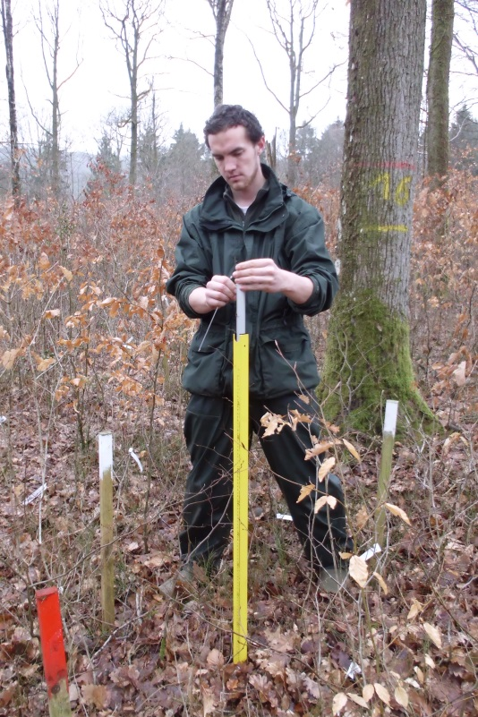
Material and Methods
Heights of the 3 tallest saplings during 3 years
Hemispherical photographs to estimate the percentage of above canopy light (PACL) transmitted to the understory
Non-linear mixed model of the height growth rate as a function of light conditions and initial height

Slide 9
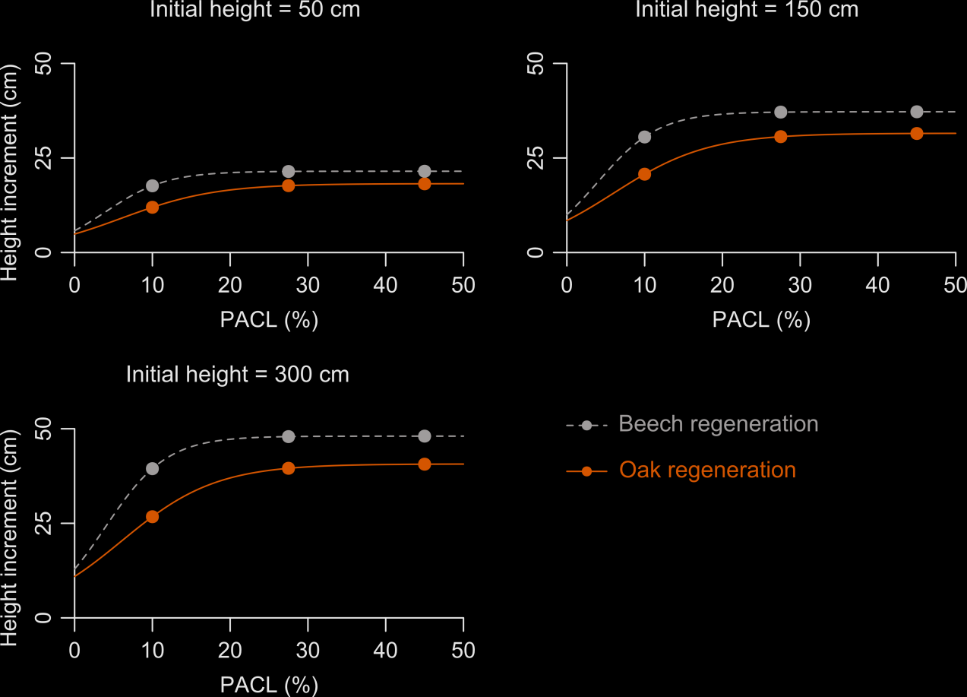
Beech regenerations grow faster than oak regenerations whatever the light conditions
No tradeoff
Oak needs twice more light than beech to reach its optimum growth
Beech responds better to diffuse light
Oak responds better to direct light
Ligot et al. 2013, For. Ecol. Manage. 304

Slide 10
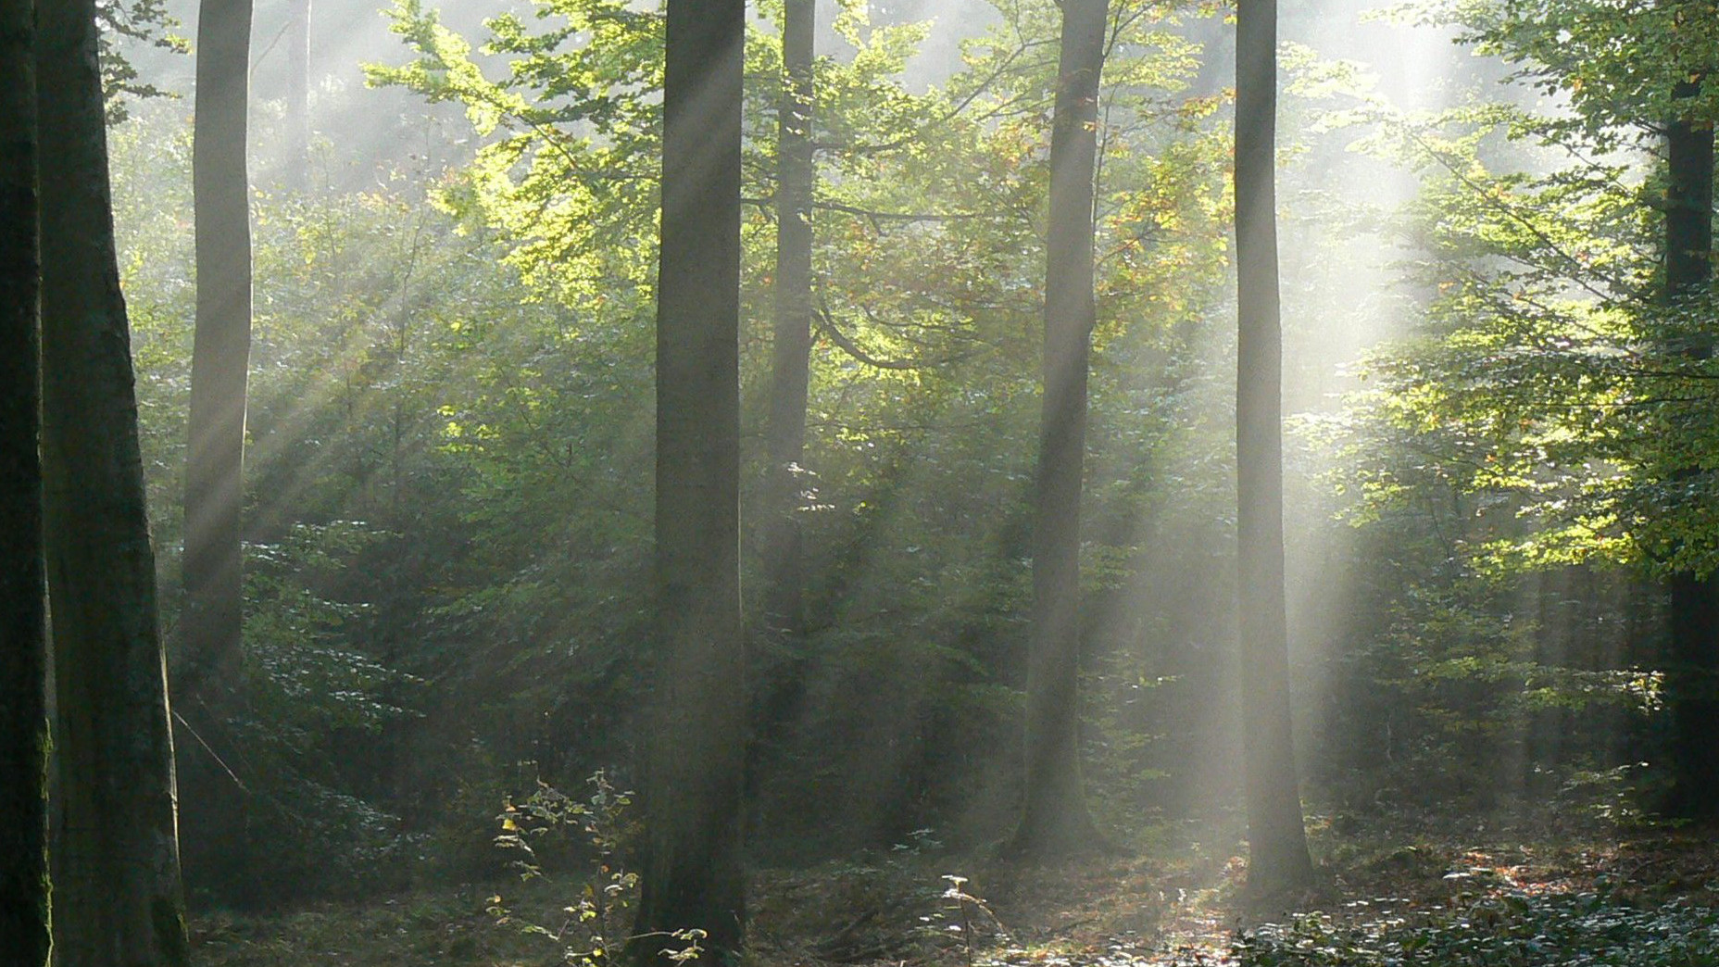
Can understory light be controlled?

Slide 11
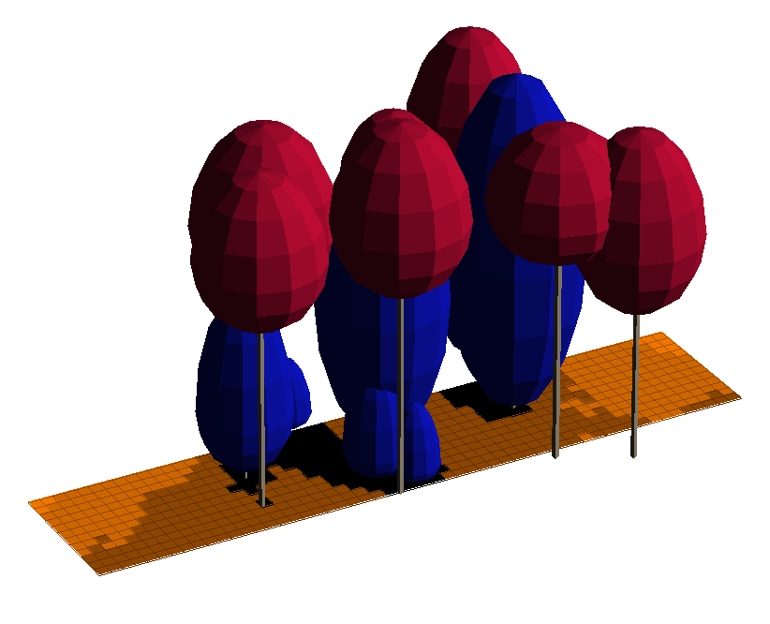
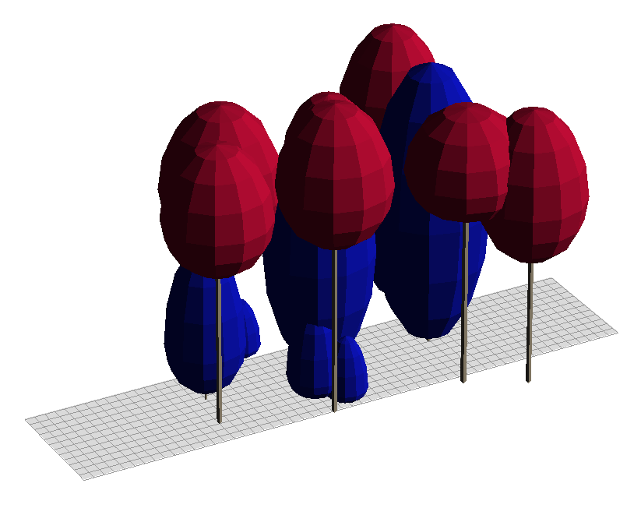
Modeling light interception
Inventory file
Light interception
Percentage of above canopy light
Ligot et al. 2014, Can. J. For. Res. 44

Slide 12
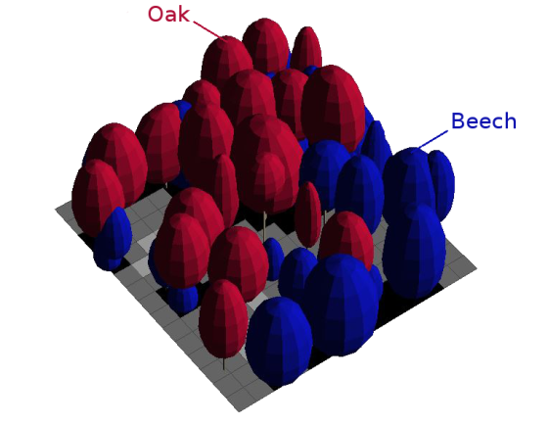
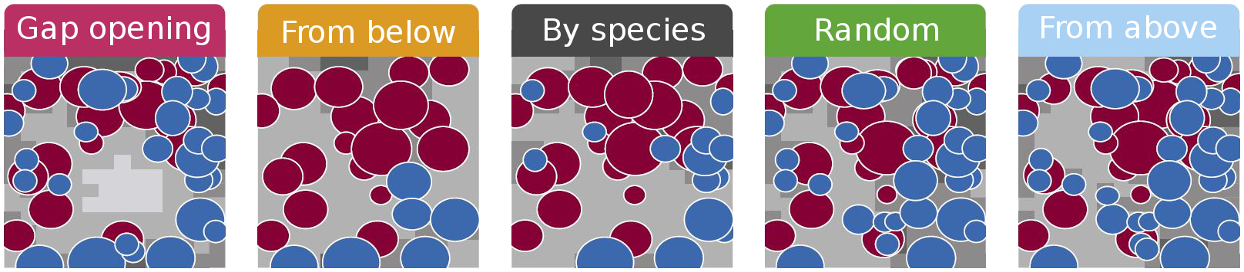
Simulations
Compare 5 cutting scenarios combined with 4 levels of cutting intensity on the 27 sites
  Gain in average transmitted light
  Gain in area favorable for oak (PACL of 20-40%)
Cutting simulation
Ligot et al. 2014, For. Ecol. Manage. 327

Slide 13
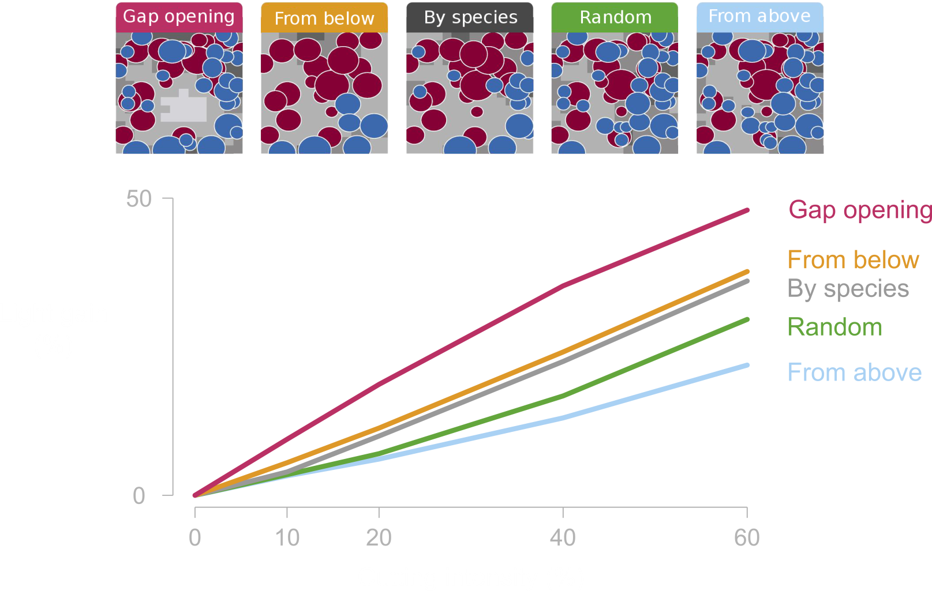
Light gain depends on cutting type
Ligot et al. 2014, For. Ecol. Manage. 327

Slide 14
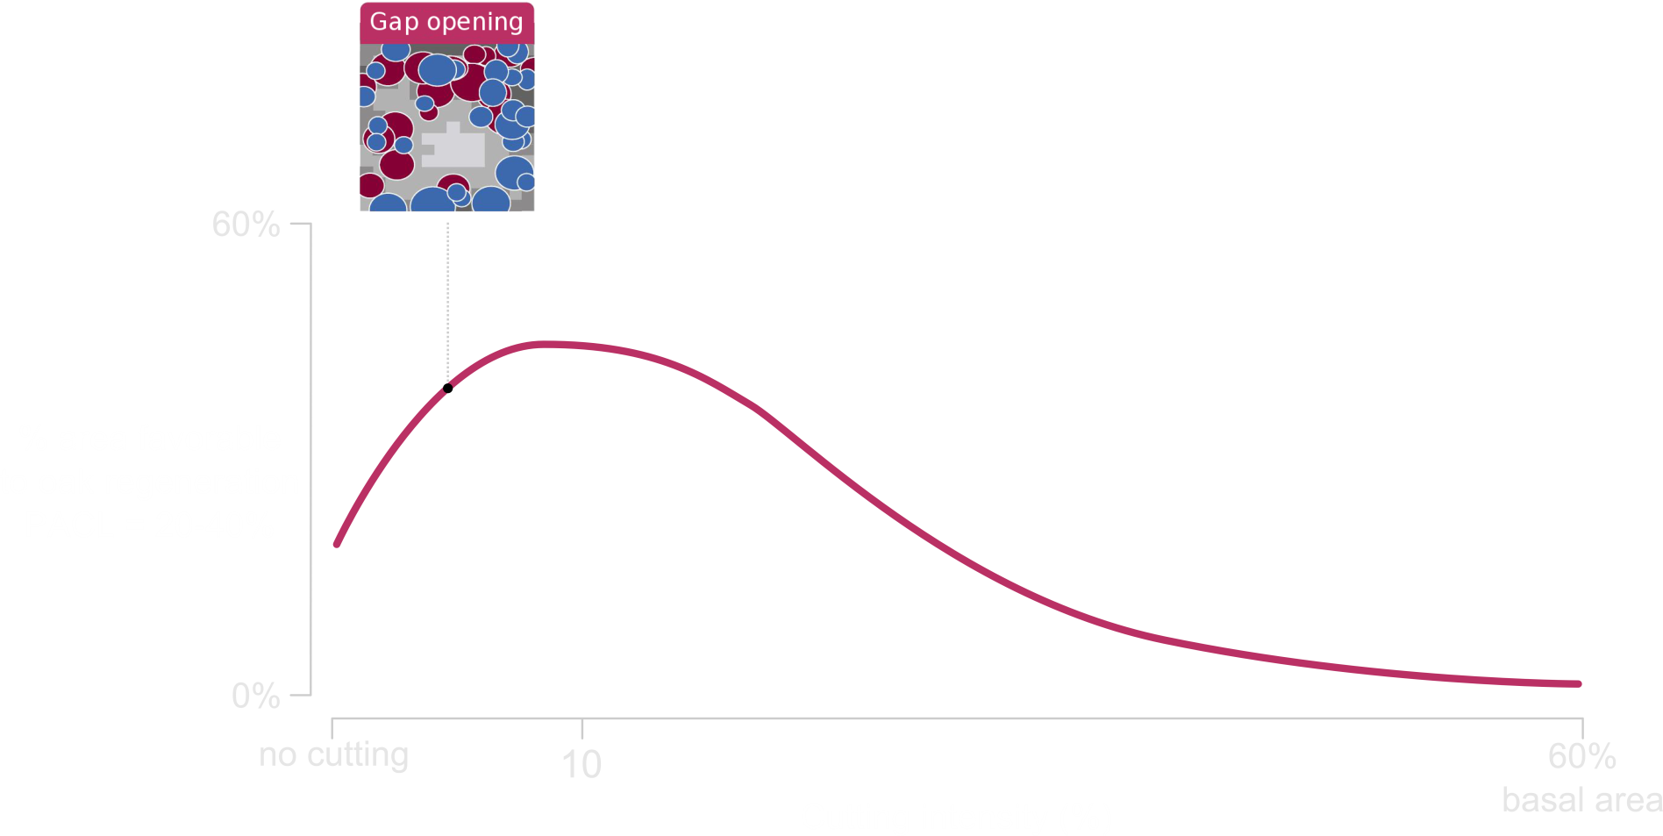
Gap must be of limited size (<500 m²)
If gaps are too wide,
a large part of the understory
receives too much light (>40%)
Ligot et al. 2014, For. Ecol. Manage. 327

Slide 15
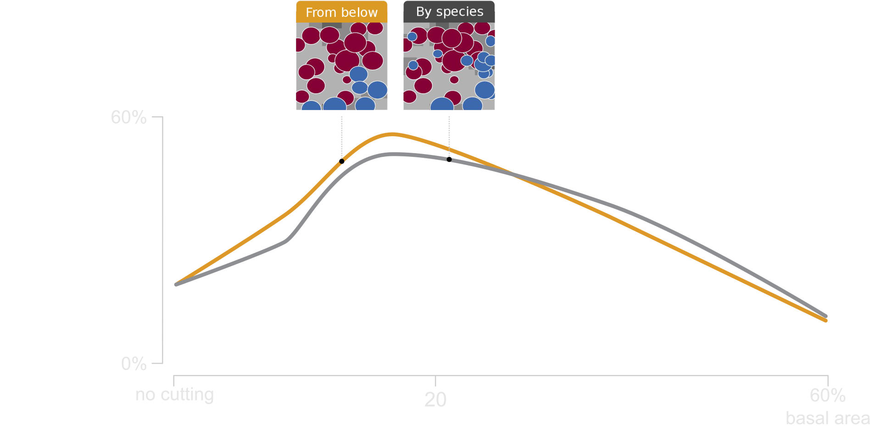
Cutting preferentially small trees maximizes the area favorable for less-shade tolerant species
Ligot et al. 2014, For. Ecol. Manage. 327

Slide 16
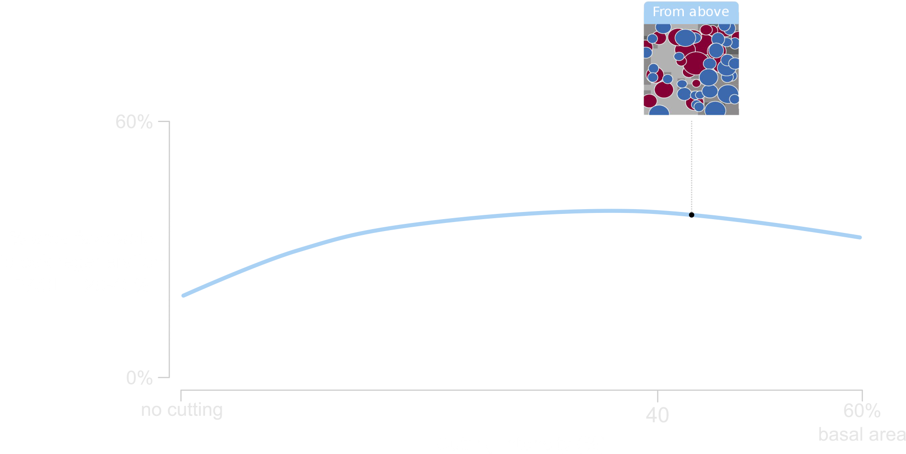
Cutting from above modifies only slightly understory light conditions
Ligot et al. 2014, For. Ecol. Manage. 327

Slide 17
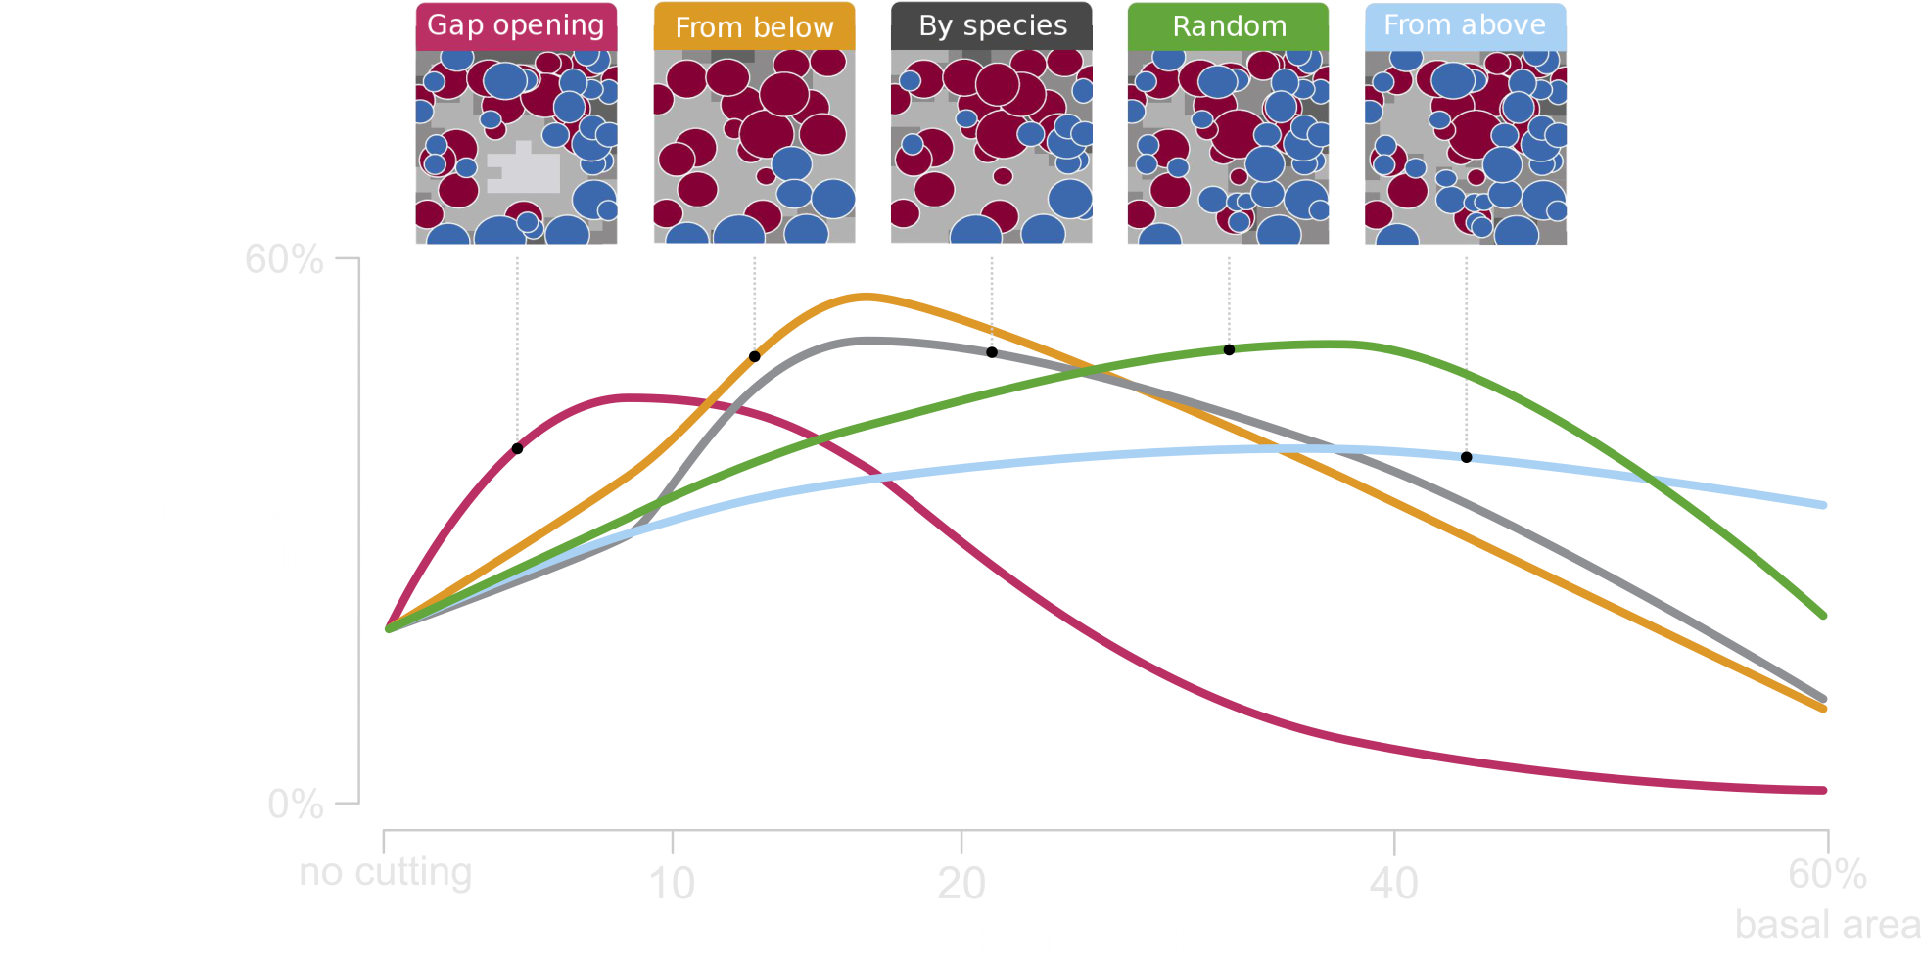
Several options to promote oak regeneration
Ligot et al. 2014, For. Ecol. Manage. 327

Slide 18
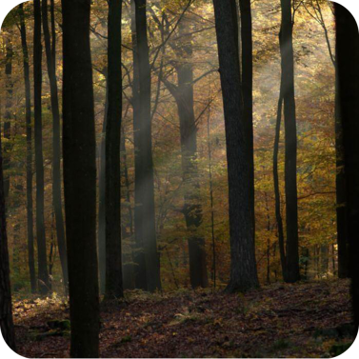
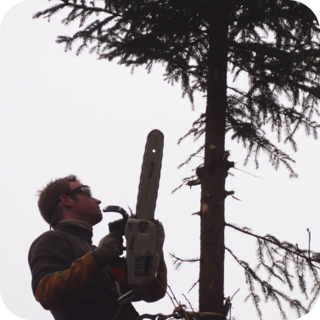
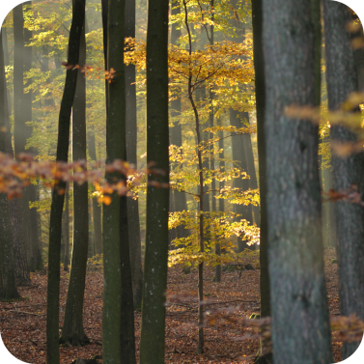
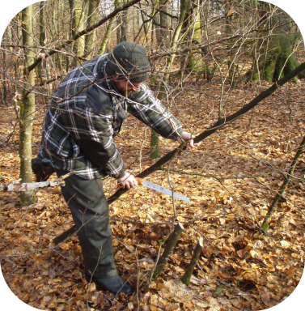
Conclusions
Light drives regeneration dynamics
Control of light is possible with the control of
  density
  spatial structure
  vertical structure
But light is not the only key factor
  Continuous cover forestry maintain a particular microclimate
  Manual control of beech competition
  Oak has been maintained thanks to foresters and its longevity
Maintaining an unstable ecological community is laborious

Slide 19



Thank you
A. André, M. Alderweireld, A. Ameztegui, P. Balandier, Y. Brostaux, H. Claessens, G. Colinet, B. Courbaud, F. de Coligny, E. Dufays, A. Fayolle, J. Goijen, F. Henrotay, M. Jonard, B. Jourez, D. Kneeshaw, F. Lehaire, P. Lejeune, B. Mackels, A. Marquier, C. Mengal, F.J. Parsons, A. Schot, C. Vaianopoulos...

