Slide 1
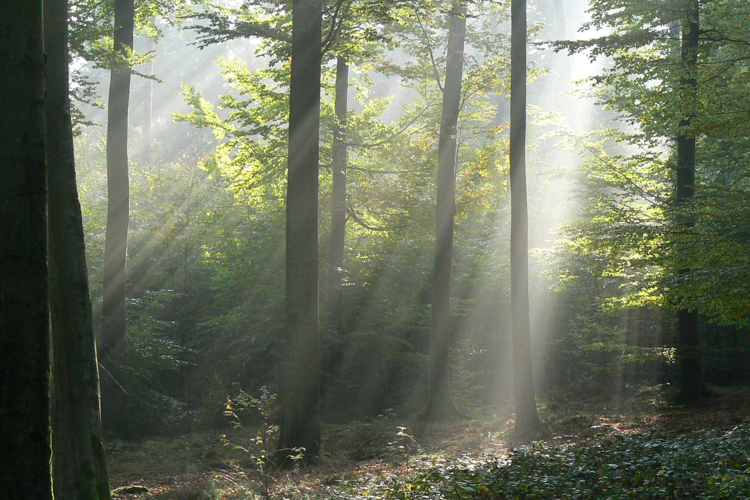
Tree light capture and spatial variability of understory light increase with species mixing and tree size heterogeneity
Gauthier Ligot¹, Aitor Ameztegui^{2,4,5}, Benoît Courbaud³, Lluís Coll^{2,5}, Daniel Kneeshaw⁴
¹ Univ. de Liège, Gembloux Agro-Bio Tech, Unité de Gestion des Ressources forestières, Belgique
² Forest Sciences Centre of Catalonia (CTFC-CEMFOR), Spain
³ Irstea, Mountain Ecosystems Research Unit, France
⁴ Centre d’Étude de la Forêt, Université du Québec à Montréal, Canada
⁵ CREAF, Spain

Slide 2
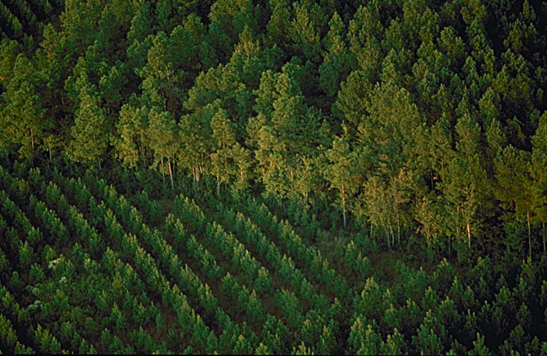
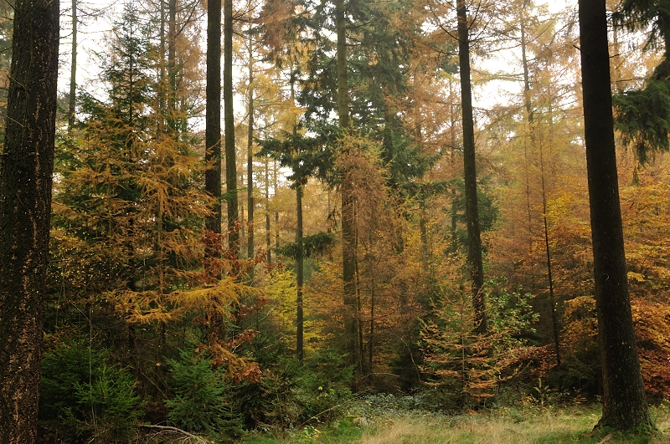
Increasing interest in forest heterogeneity
Resistance
Climate change
Resilience
Soil protection
Biodiversity
Landscape
Recreation
Aesthetics
Timber production

Slide 3
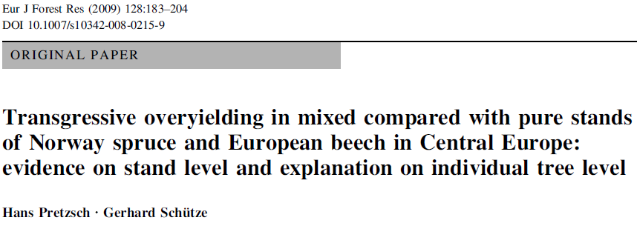
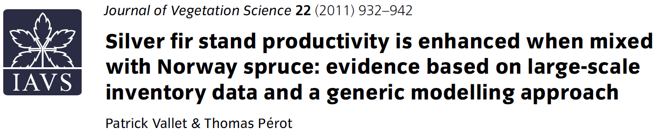
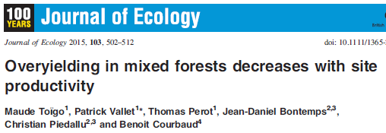
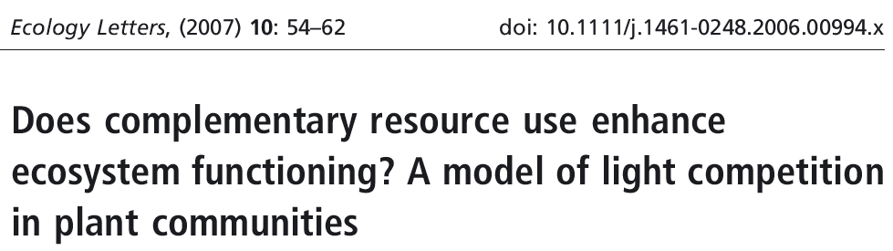
Productivity increases with heterogeneity?
Increased productivity of heterogeneous (mainly mixed) forest have been observed
One possible explanation = an increase in total capture of resources
and particularly of solar radiations

Slide 4
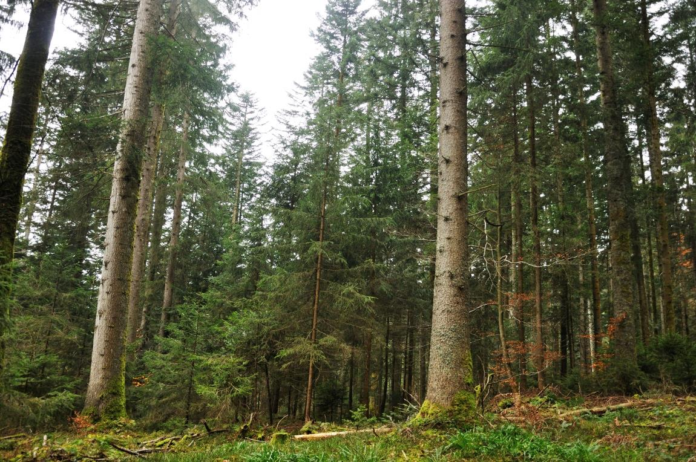
Regeneration & Heterogeneity
Maintaining uneven-aged forests requires:
  Continuous regeneration of various tree species
  Sufficient spatial and temporal variability in understory light conditions
    Shade tolerant species will develop where/when light levels are low
    Less shade-tolerant might develop where/when light levels are higher

Slide 5
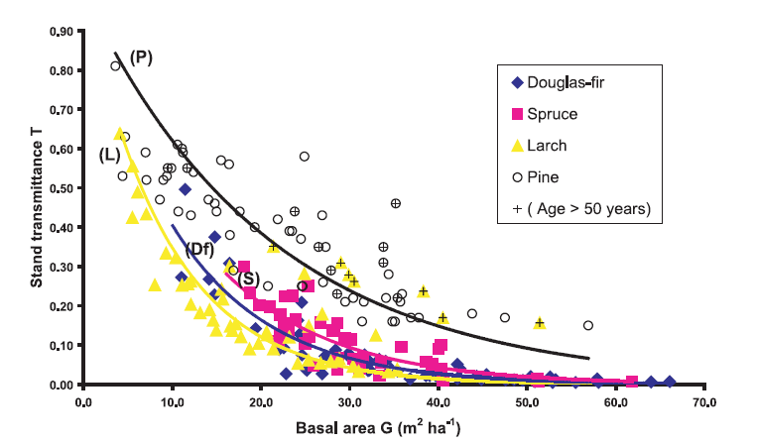
Understory light : mean transmittance
$$Transmittance \left(\%\right)= \frac{Below canopy light}{Above canopy light} ≈ {(canopy light capture)}^{−1}$$
Light transmittance non-linearly decreases with stand basal area or density
+ effect of species composition
+ effect of the spatial structure (abundance and size of gaps)
+ effect of vertical stand structure
Sonohat et al. 2004. Predicting solar radiation transmittance in the understory of even-aged coniferous stands in temperate forests.
Annals of Forest Science 61:629-641.

Slide 6
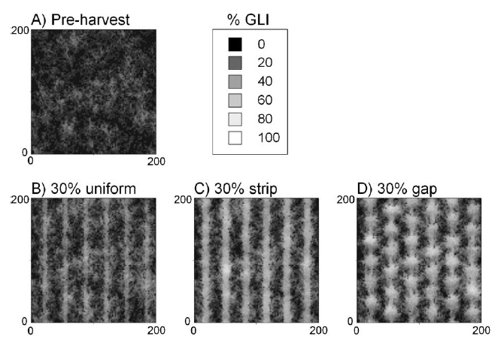
Understory light : transmittance variability
Spatial variability of understory light depends on the spatial distribution of overstory trees (gap creation)
As a general rule: the greater the canopy openings, the greater the mean and the range of understory light levels (Canham et al. 1990)
Beaudet et al. 2011. Forest Ecology and Management 261:84-94.

Slide 7
Hypotheses
Stands composed of trees of multiple species
and multiple sizes intercept more light ?
Light capture
by the overstory trees
Light transmitted
to the understory
Forest heterogeneity
= structural and compositional heterogeneity

Slide 8
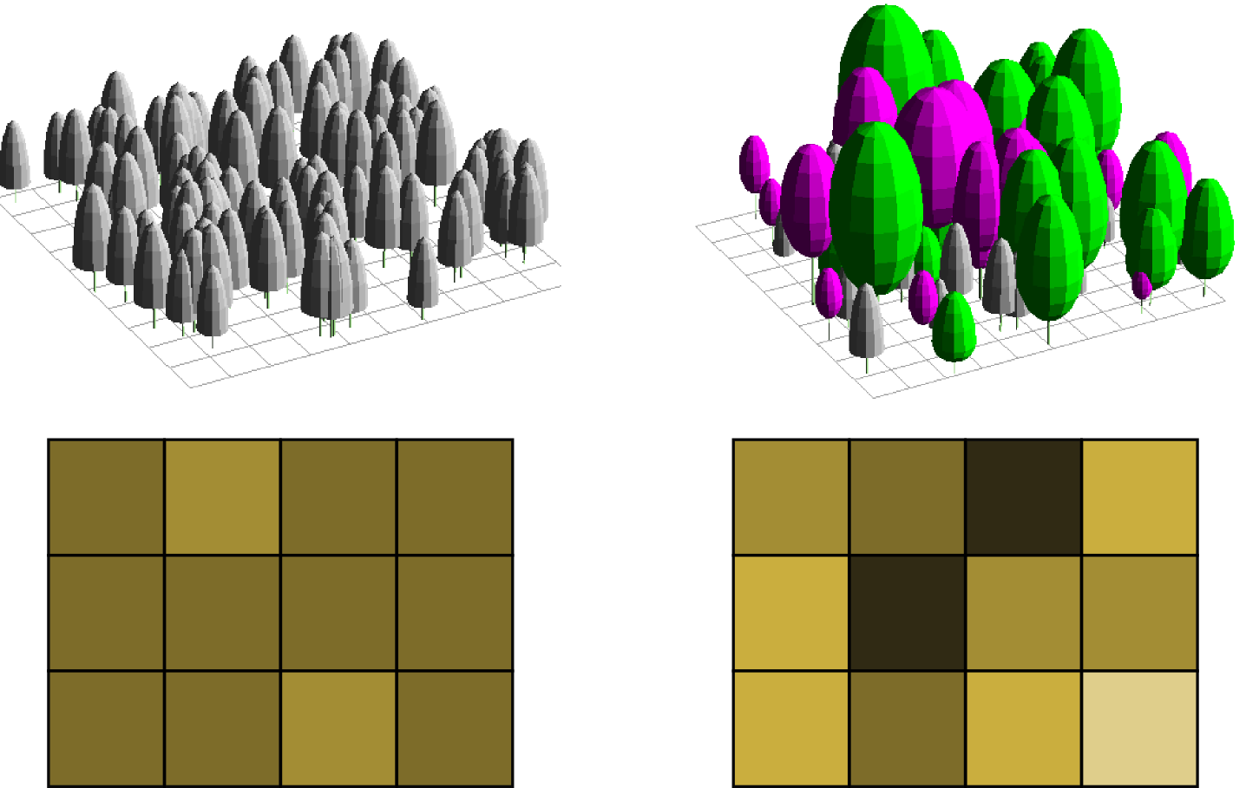
Hypotheses
The variability of understory light conditions is greater
in stands composed of trees of multiple species and multiple sizes
Homogeneous forest
Heterogeneous forest
Spatial variability of
Understory light
(transmittance)

Slide 9
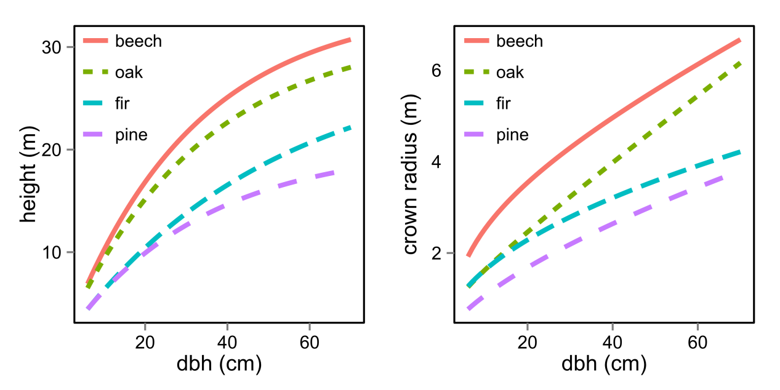
Material and Methods
Modeling virtual forests
4 Study species : European Beech (Fagus sylvatica L.), Sessile oak (Quercus petrara (Matt.) Liebl.), Mountain pine (Pinus uncinata Ram ex. DC), Silver fir (Abies alba Mill.)
Allometric relationships (tree height, crown size, crown height) fitted by two previous studies carried out in the Belgian Ardennes (50°N; 5°E) and in the Spanish Pyrenees (42°N; 1°E)
Ameztegui et al. 2012. Forest Ecology and Management 276:52-61.
Ligot et al.. 2014. Forest Ecology and Management 327:189-200.

Slide 10
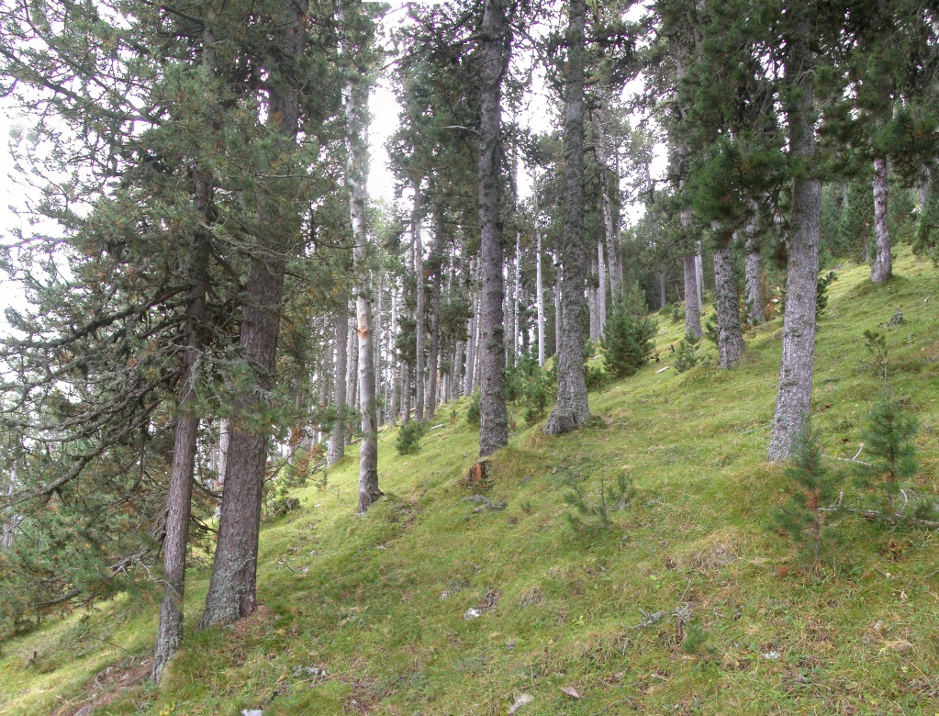
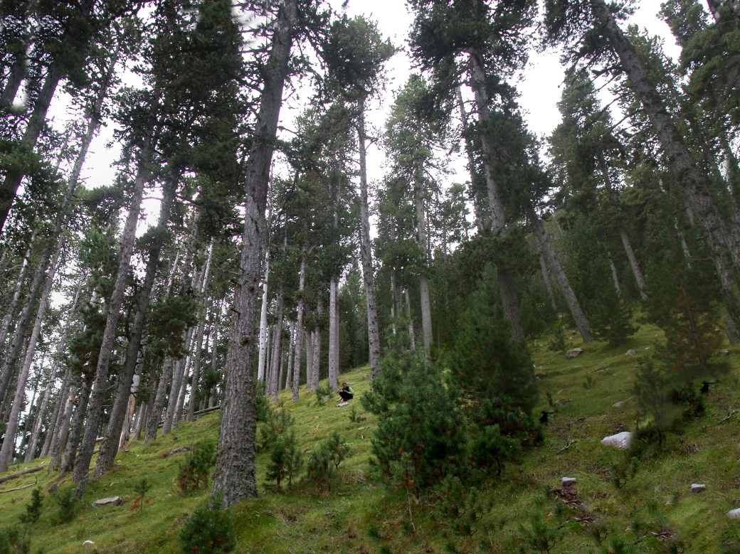
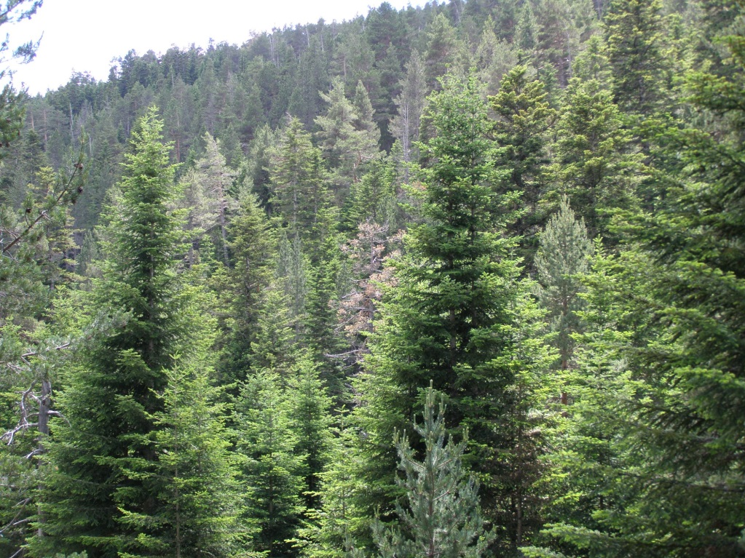
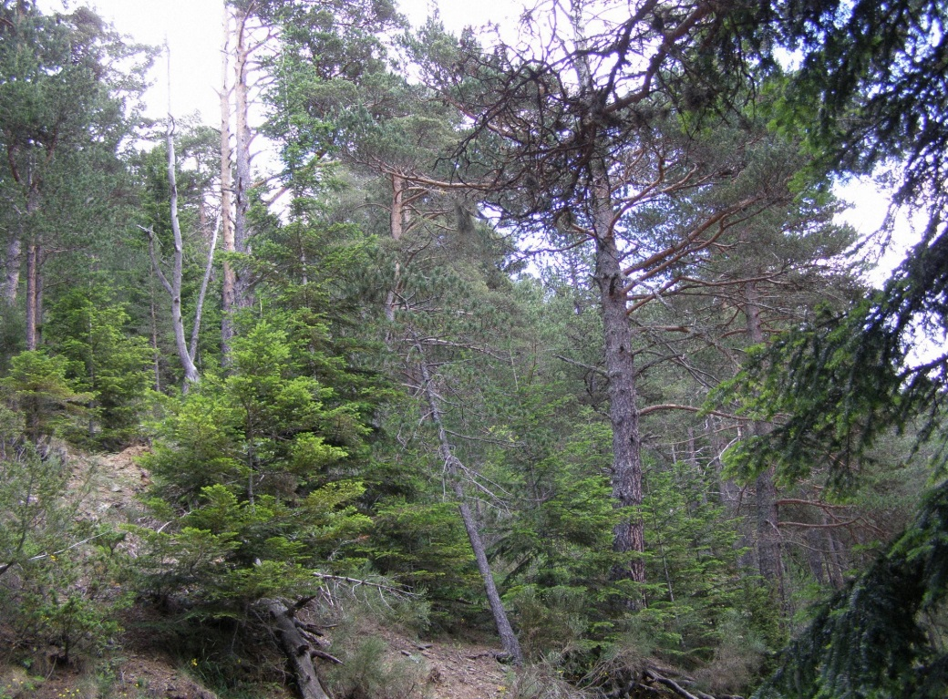

Slide 11
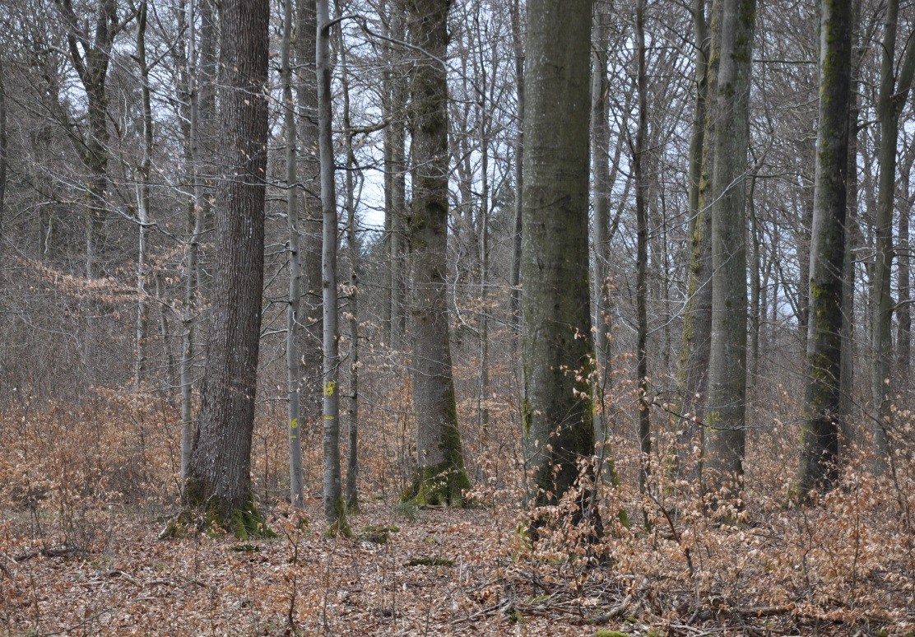
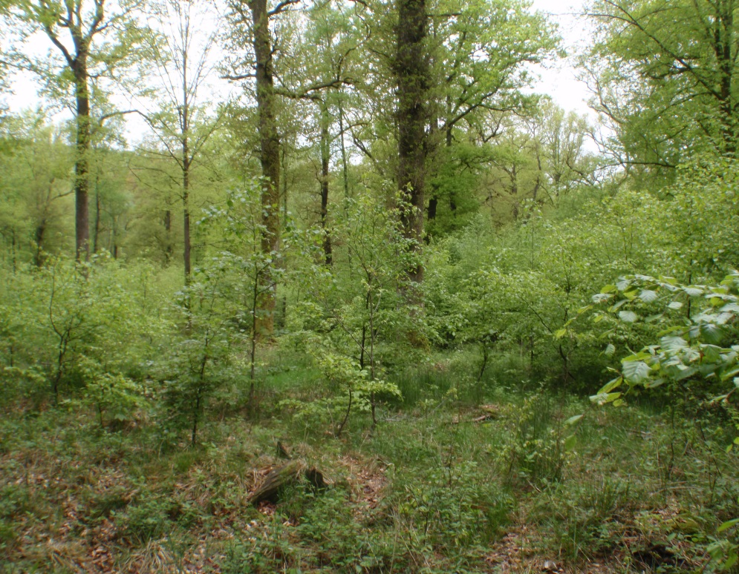
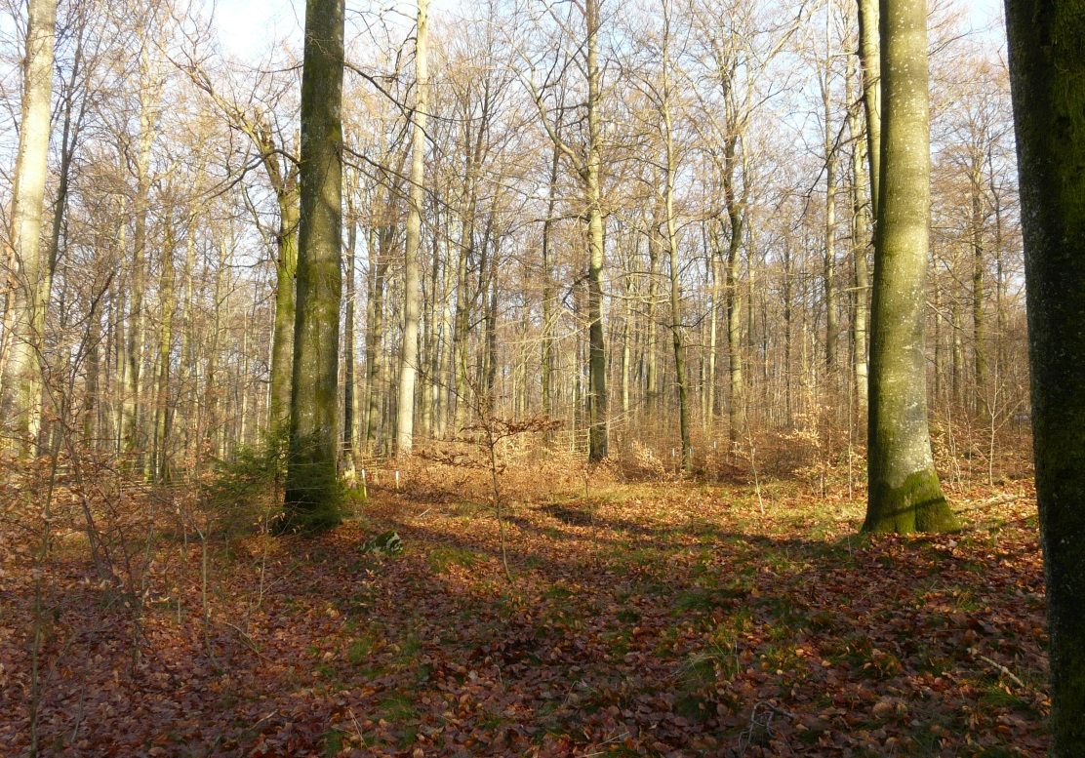
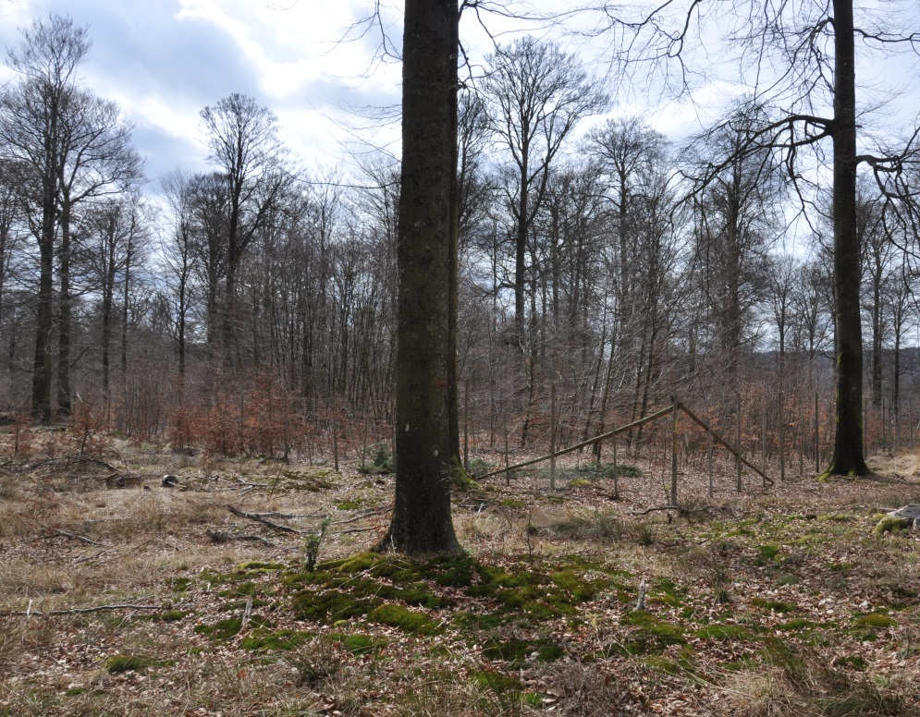

Slide 12
Material and Methods
Species | Nb. of plots | Quadratic mean diameter | Basal area | Clark-Evans | Transmittance
 |  | cm | m²/ha | - | %
Oak-Beech¹ | 27 | 42.4 (30.0-54.9) | 18.0 (7.5-35.0) | 1.1 (1.0-1.3) | 22.8 (0.8-62.6)
Oak-Beech² | 2773 | 36.0 (6.9-87.3) | 20.0 (1.2-70.4) | - | -
Fir-Pine³ | 24 | 30.6 (19.53-42.0) | 23.3 (7.6-44.5) | 0.9 (0.5-1.2) | 35.96 (20.5-71.7)
Ligot et al. (2013) Forest Ecology and Management 327
The permanent inventory of forest resources in Southern Belgium
Ameztegui and Coll (2011) Forest Ecology and Management 276

Slide 13
Material and Methods
Species | Nb. Of plots | Quadratic mean diameter | Basal area | Clark-Evans | Transmittance
 |  | cm | m²/ha | - | %
Oak-Beech¹ | 27 | 42.4 (30.0-54.9) | 18.0 (7.5-35.0) | 1.1 (1.0-1.3) | 22.8 (0.8-62.6)
Oak-Beech² | 2773 | 36.0 (6.9-87.3) | 20.0 (1.2-70.4) | - | -
Fir-Pine³ | 24 | 30.6 (19.53-42.0) | 23.3 (7.6-44.5) | 0.9 (0.5-1.2) | 35.96 (20.5-71.7)
Dg = 30 cm is frequently observed
Ligot et al. (2013) Forest Ecology and Management 327
The permanent inventory of forest resources in Southern Belgium
Ameztegui and Coll (2011) Forest Ecology and Management 276

Slide 14
Material and Methods
Species | Nb. Of plots | Quadratic mean diameter | Basal area | Clark-Evans | Transmittance
 |  | cm | m²/ha | - | %
Oak-Beech¹ | 27 | 42.4 (30.0-54.9) | 18.0 (7.5-35.0) | 1.1 (1.0-1.3) | 22.8 (0.8-62.6)
Oak-Beech² | 2773 | 36.0 (6.9-87.3) | 20.0 (1.2-70.4) | - | -
Fir-Pine³ | 24 | 30.6 (19.53-42.0) | 23.3 (7.6-44.5) | 0.9 (0.5-1.2) | 35.96 (20.5-71.7)
Great variability in stand basal area
Ligot et al. (2013) Forest Ecology and Management 327
The permanent inventory of forest resources in Southern Belgium
Ameztegui and Coll (2011) Forest Ecology and Management 276

Slide 15
Material and Methods
Species | Nb. Of plots | Quadratic mean diameter | Basal area | Clark-Evans | Transmittance
 |  | cm | m²/ha | - | %
Oak-Beech¹ | 27 | 42.4 (30.0-54.9) | 18.0 (7.5-35.0) | 1.1 (1.0-1.3) | 22.8 (0.8-62.6)
Oak-Beech² | 2773 | 36.0 (6.9-87.3) | 20.0 (1.2-70.4) | - | -
Fir-Pine³ | 24 | 30.6 (19.53-42.0) | 23.3 (7.6-44.5) | 0.9 (0.5-1.2) | 35.96 (20.5-71.7)
No general evidence of clumped or regular distribution
of trees
Ligot et al. (2013) Forest Ecology and Management 327
The permanent inventory of forest resources in Southern Belgium
Ameztegui and Coll (2011) Forest Ecology and Management 276

Slide 16
Material and Methods
Species | Nb. Of plots | Quadratic mean diameter | Basal area | Clark-Evans | Transmittance
 |  | cm | m²/ha | - | %
Oak-Beech¹ | 27 | 42.4 (30.0-54.9) | 18.0 (7.5-35.0) | 1.1 (1.0-1.3) | 22.8 (0.8-62.6)
Oak-Beech² | 2773 | 36.0 (6.9-87.3) | 20.0 (1.2-70.4) | - | -
Fir-Pine³ | 24 | 30.6 (19.53-42.0) | 23.3 (7.6-44.5) | 0.9 (0.5-1.2) | 36.0 (20.5-71.7)
Transmittance was greater in the studied coniferous forests
than in the studied broadleaved forests
Ligot et al. (2013) Forest Ecology and Management 327
The permanent inventory of forest resources in Southern Belgium
Ameztegui and Coll (2011) Forest Ecology and Management 276

Slide 17
Material and Methods
Simulation of virtual stands 50 x 50 m
  Random spatial distribution of trees
  10 types of forest composition (beech, oak, beech/oak, pine, fir, fir/pine, oak/pine, beech/fir, beech/oak/pine, beech/fir/pine)
  3 levels of stand basal area (15, 25, 35 m²/ha)
  3 vertical stand structure
    Single layered structure: DBH ~ N (μ= 30; σ= 4.5)
    Multi layered structure: DBH ~ N (μ = 25; σ= 3.75), DBH ~ N (μ = 40; σ= 6.0), DBH ~ N(μ = 35, σ = 3.75)
    Reverse J-shaped structure : DBH ~ EXP(1/k = 25))
  Constant quadratic mean diameter : 30 cm
  Constant coefficient of variation of tree diameters : 15 cm
  100 simulation runs for each combination of these factors

Slide 18
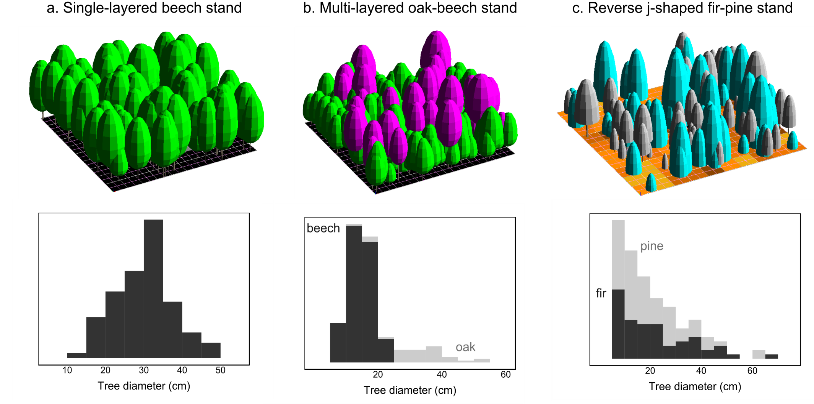
Material and Methods
Examples of virtual stands

Slide 19
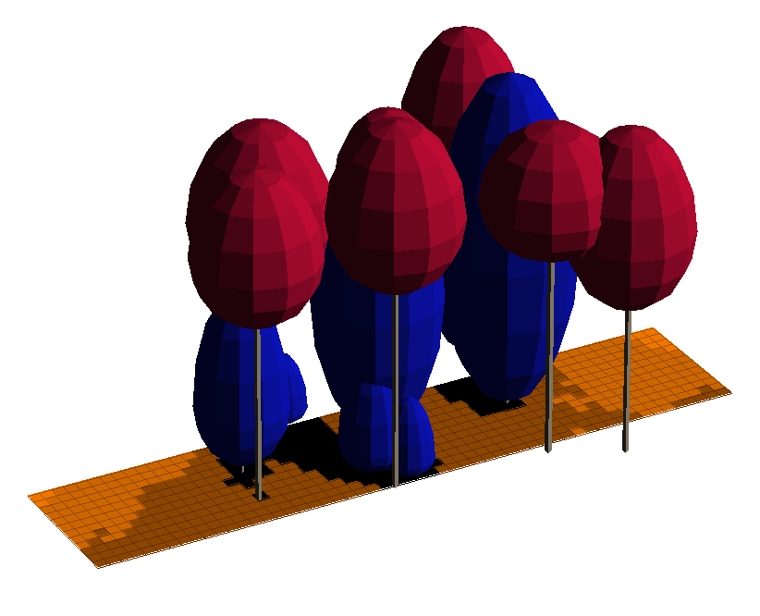
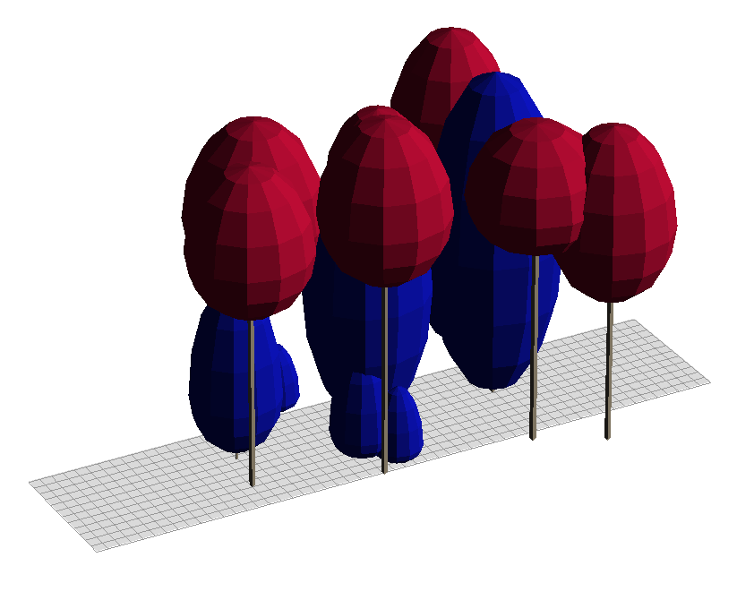
Modeling light interception
Light interception
Y₁ = mean understory transmittance
Y₂ = standard deviation of understory transmittance
Percentage of above canopy light
Ligot et al. 2014, Can. J. For. Res. 44
The software can freely be downloaded at http://orbi.ulg.ac.be/handle/2268/187361

Slide 20
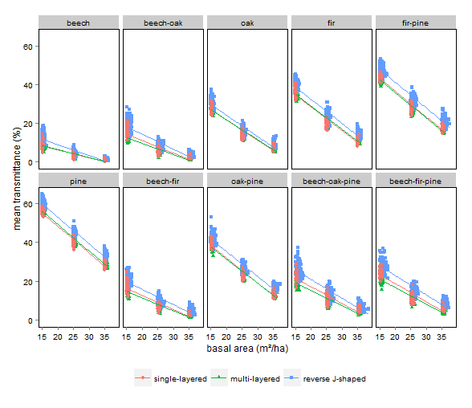

Slide 21
Mean transmittance significantly depended on forest composition(62.5%), basal area (33%) and stand structure (1.4%).

Slide 22
Mean transmittance of mixed stands was always intermediate between the mean transmittance of the corresponding pure stands.

Slide 23
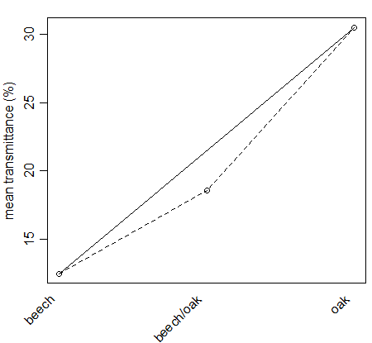
But transmission in mixed stands was always lower than the weighted average of transmittance of the corresponding pure stands
Beech/oak mixtures
Basal area = 15 m²/ha
Reverse J-shaped structure
Difference between observed value
and weighted average:
± 3 % in mixtures of 2 species
± 9 % in mixtures of 3 species

Slide 24
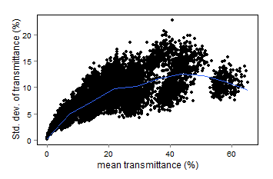
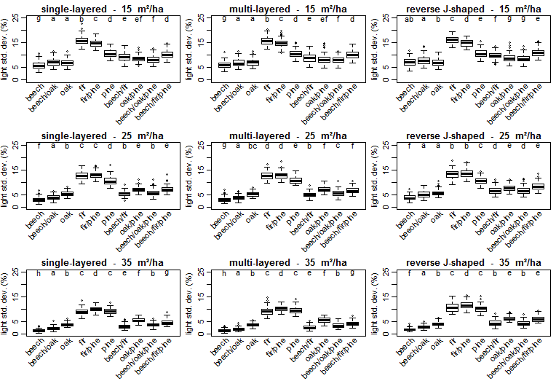
Spatial variability of understory light
Positive correlation between the mean and the std. dev. of transmittance (r=0.76)
Spatial variability of understory light was :
Greater in stands with less shade-tolerant species than with shade tolerant species
Greater in stands of low basal area
Greater in reverse j-shaped structure
But, the relationship was not linear …

Slide 25
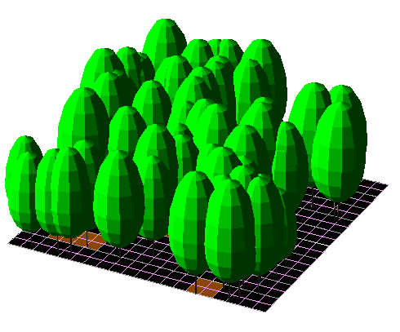
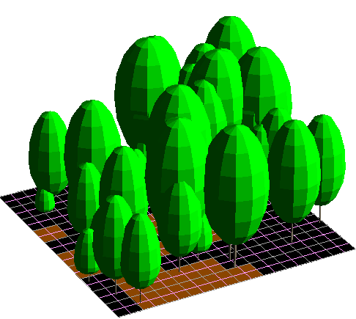
Conclusions
Increasing tree species diversity increase tree light capture and also, in some cases, the variability of understory light conditions
Increasing structural heterogeneity does not increase tree light capture but increases the variability of understory light conditions
Sonohat et al. 2004. Predicting solar radiation transmittance in the understory of even-aged coniferous stands in temperate forests.
Annals of Forest Science 61:629-641.
Even-aged stand
Uneven-aged stand
Greater light
interception
Greater light
variability

Slide 26
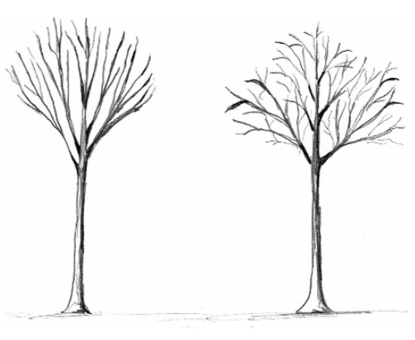
Perspectives
Further work remains to:
Generalize our results for varying mean tree diameter
Other factors and interactions should be considered to explain the timber production
Investigate the importance of crown plasticity
accor
Beech tree
Example of simulated crowns
in pure stands
in mixed stands
(with spruce)
Extracted from :
Bayer et al. 2013. Structural crown properties of Norway spruce (Picea abies [L.] Karst.) and European beech (Fagus sylvatica [L.]) in mixed versus pure stands revealed by terrestrial laser scanning. Trees 27:1035-1047.

Slide 27
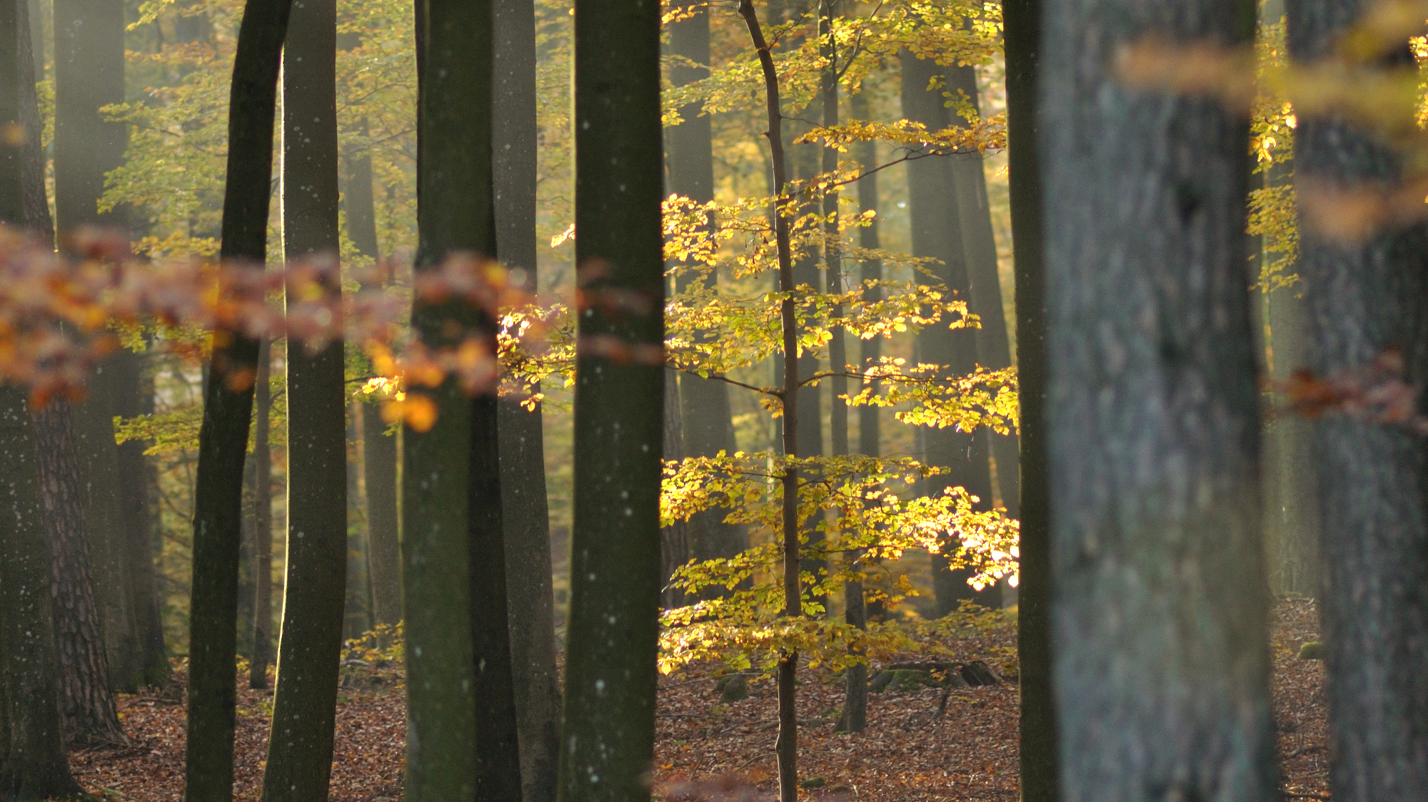
The advantage of heterogeneous forests may lie in opportunities to regenerate various tree species as well as in opportunities to enhance tree light capture
Thank you !
Gauthier Ligot
gligot@ulg.ac.be

Slide 28
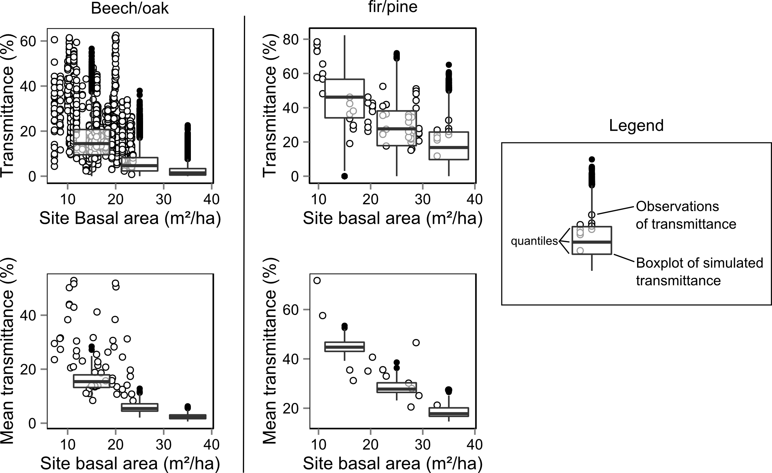
Light simulations and observations

Slide 29
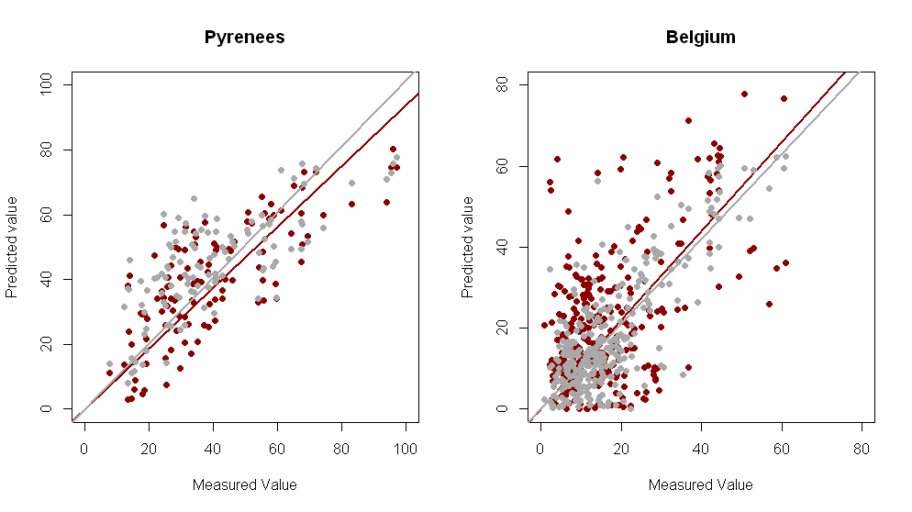
Validation of SAMSARALIGHT model

Slide 30
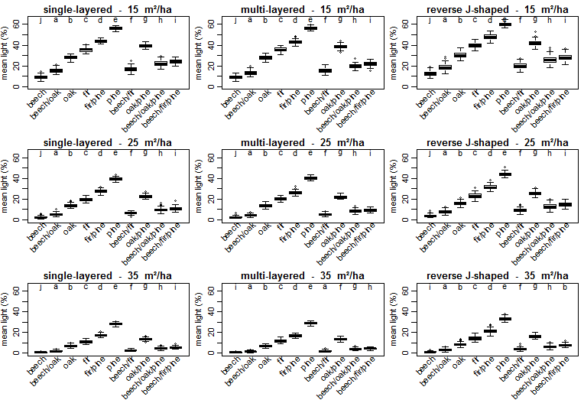

Slide 32
Statistical analyses
Two sets of analyses
Y₁ = mean understory transmittance
Y₂ = standard deviation of understory transmittance
3-way ANCOVAs : lm(Y ~ basal area * composition * structure)
Because of significant interactions : multiple 1-way ANCOVAs
Tukey’s tests (to test differences between factor means)
Graphically check model assumptions

Slide 33
Variability of understory light
Explanations for the non-linear relationships between the mean and the variability of light
At low understory light,
increasing the mean increases the variability
At high understory light, increasing the mean can decrease the variability
frequency
frequency
transmittance
transmittance

