Slide 1
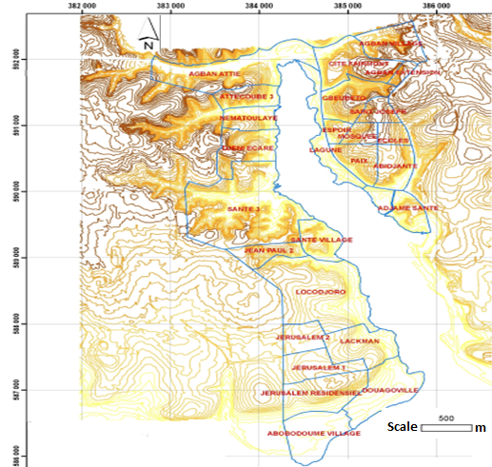


A FIRST DATABASE FOR LANDSLIDE STUDIES IN DENSELY URBANIZED AREAS OF THE INTERTROPICAL ZONE: ABIDJAN, CÔTE D’IVOIRE
F. Gnagne (1,2), A. Demoulin (2,3), J. Biemi (1), O. Dewitte (4), H. Kouadio (1), T. Lasm (1) and G. Aké (1)
(1) F. Houphouët-Boigny University, Abidjan, Ivory Coast , (2) Liege University, Belgium, (3) FRS-FNRS, Brussels, Belgium, (4), Geomorphology Lab, Royal Museum for Central Africa, Tervuren, Belgium
1-Study area
10-25°-steep, <10-m-high slopes in Quaternary sand and mud
Informal constructions on the slopes
1996-2016: ~50 casualties in Attecoube and Abobo
Motivation: Map information and geomorphological characterization are at best restricted, or often simply
lacking.

Slide 2
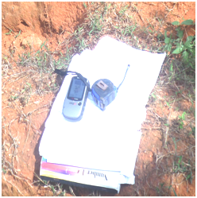
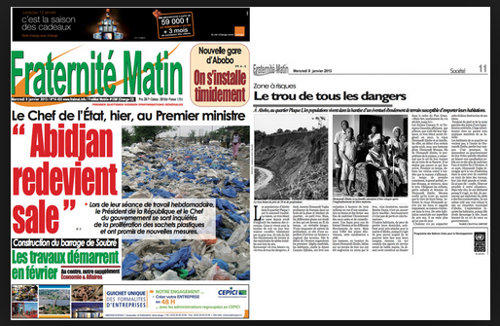
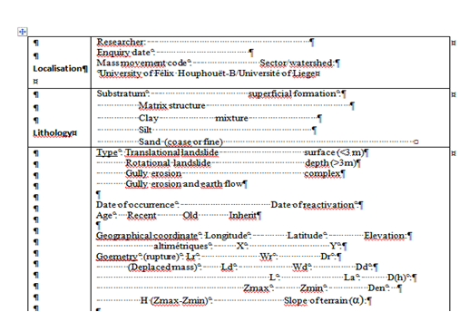


2- Field investigation
GPS+ file measuring
Archives(local journal+ different reports
Enquiry form

Slide 3
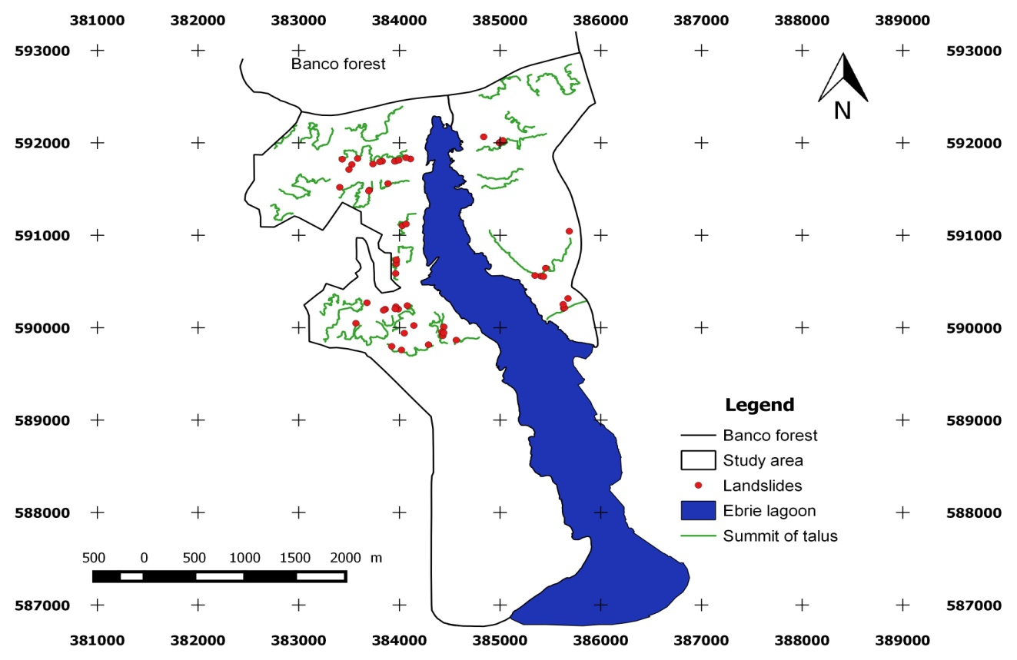
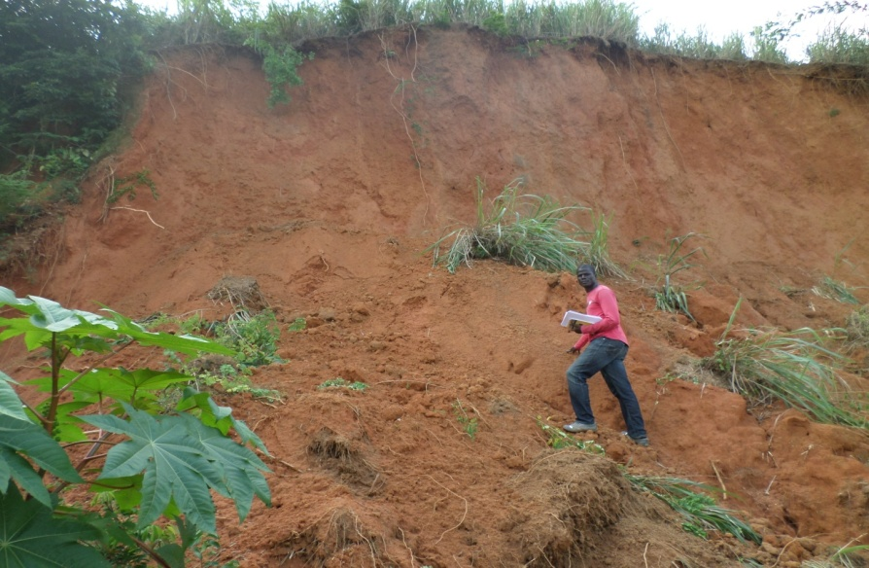
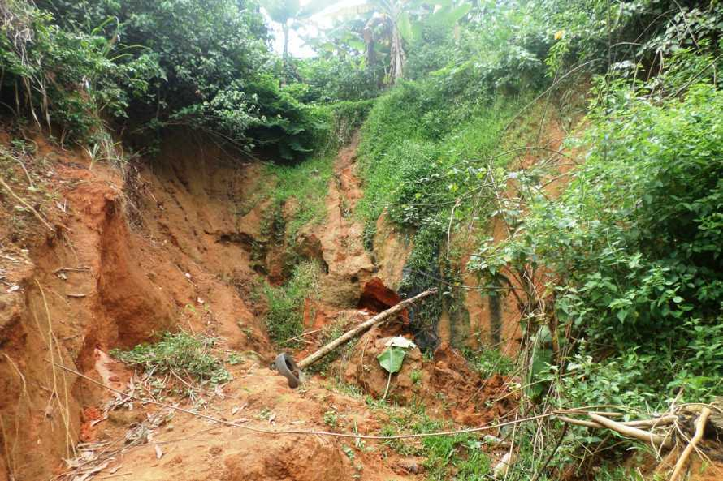


3-Landslides inventory
Translational landslide
Figure 2: Lanslides distribution in study site
Rotational landslide

Slide 4
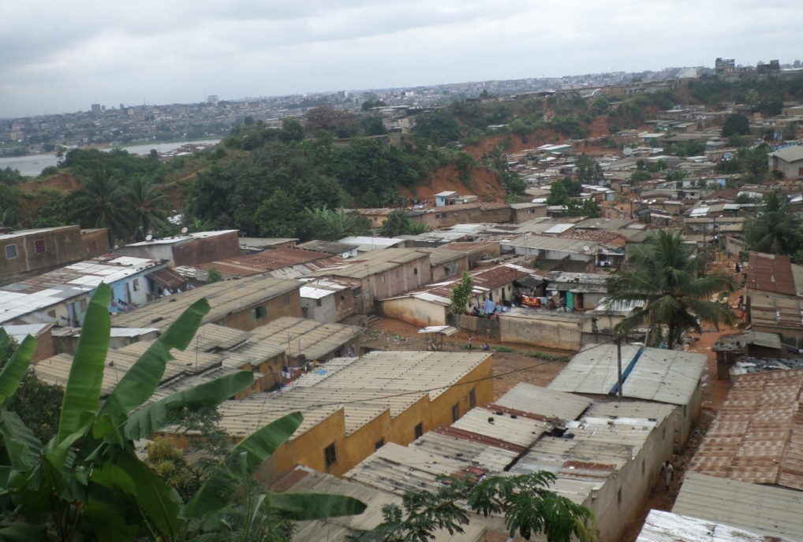
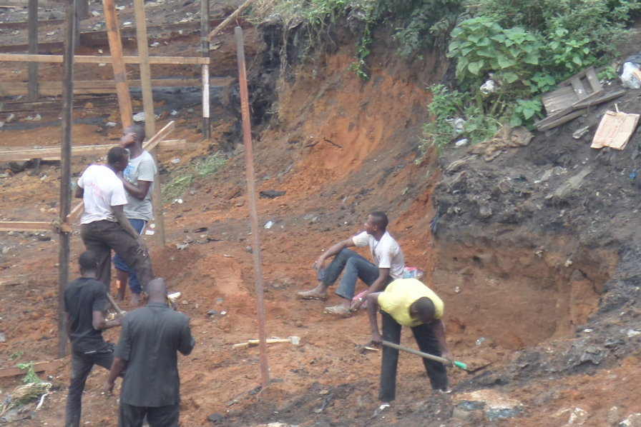
Informal construction downstream of slopes
Slope cutting for new construction
4-Next step of study
Assessing landslides susceptibility using TanDEM-X imagery (12m)

