Slide 1
ENERGY REDUCTION IN PUBLIC BUILDING STOCK: ASSESSING THE IMPACT OF CONTROL STRATEGY OVER EXPECTED ENERGY SAVINGS AND INDOOR COMFORT LEVEL
Ruiz, Roberto
D’Antoni, Matteo
Lemort, Vincent

Slide 2
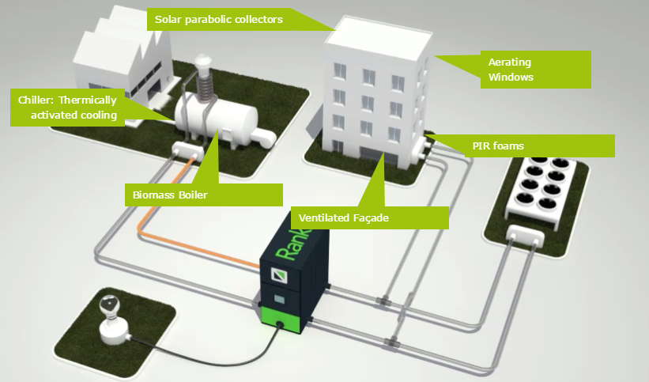
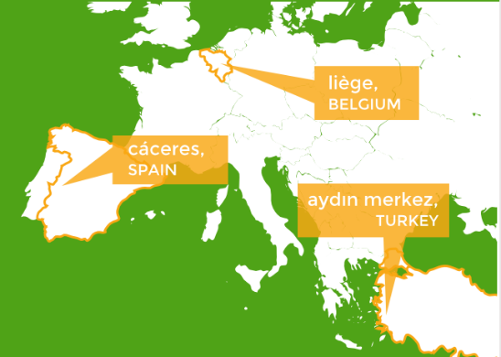
Introduction
The actual control strategy implemented in the Belgian demo of Bricker project is: introduced, compared against an ideal approach and accordingly optimized.
The optimized approach is tested by means of numerical simulations over a base case scenario.
Indoor air temperature distribution and annual specific energy demand over a specific zone are used as main performance indicators.
The BRICKER Project aims to develop a scalable, replicable, high energy efficient, zero emissions and cost effective system to refurbish existing public-owned non-residential buildings to achieve at least 50% energy consumption reduction.
See more at: http://www.bricker-project.com

Slide 3
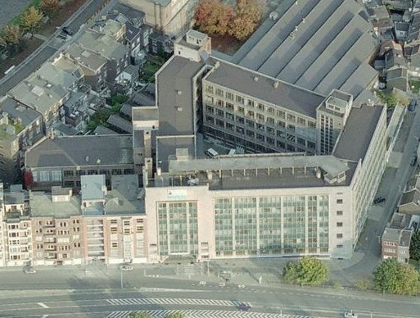
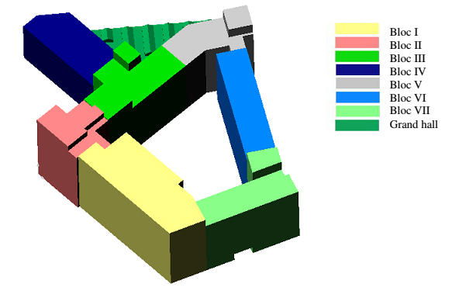
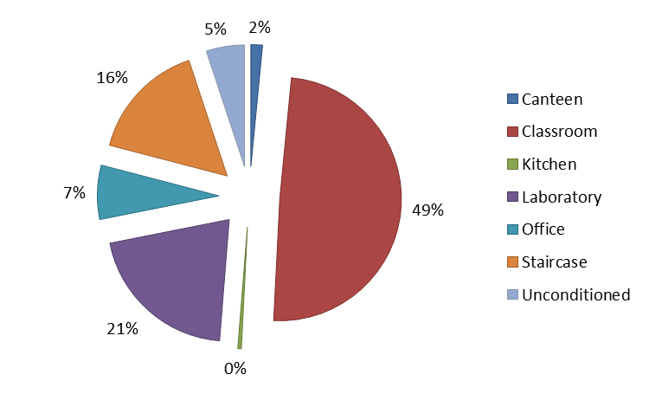
Building Demo
Main characteristics
School building demo located in Liège (Belgium).
It counts with 22,300 m² of usable area.
Poor quality of building assemblies
Gas-fuel boilers
High-temperature heating terminals.
Surface area distribution per space type
Building configuration

Slide 4
Existing Heating System
Secondary System
Distribution + Emission
Primary System
Generation + Heat exchanger
3 natural gas boilers =7.5 [MW]
PI controller

Slide 5
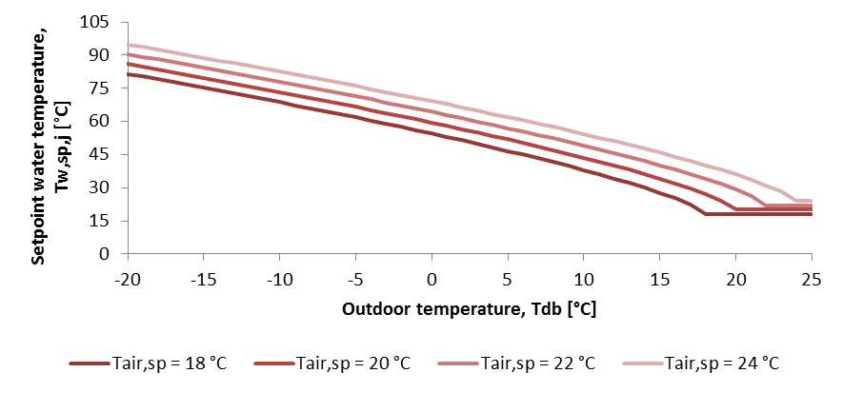
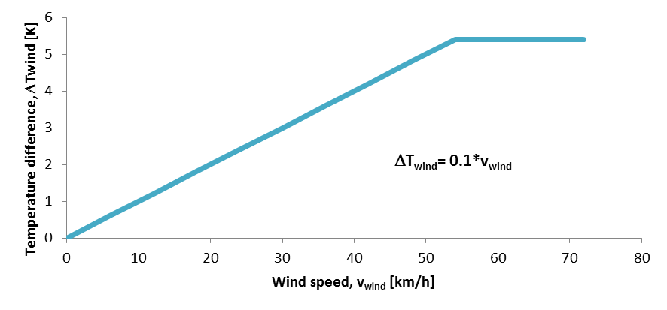
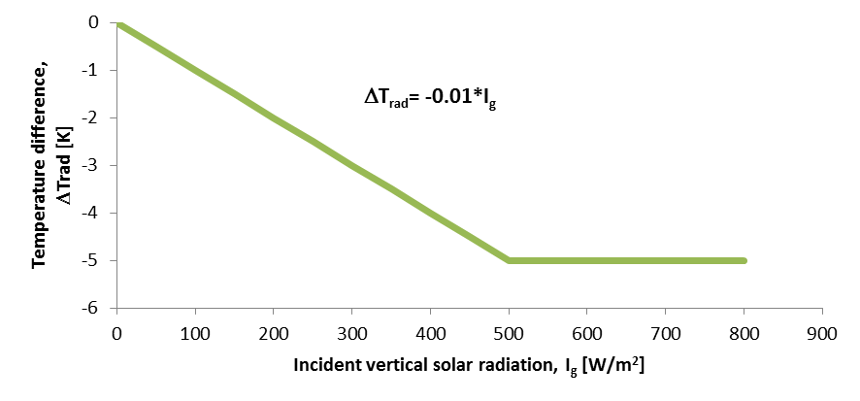



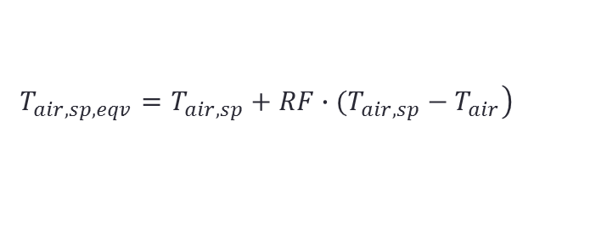




Actual control strategy
Supply water setpoint temperature:
$$T_{w,sp}=T_{w,hc}+{∆T}_{wind}+{∆T}_{sol}+{∆T}_{int}$$
$$T_{w,hc}=T_{air,sp}+ k∙{\left(T_{air,sp}−T_{out}\right)}^{α}$$
$$k=4.272$$
Heating curve (transmission losses):
$$α=0.742$$
Infiltration losses correction:
$${∆T}_{wind}=Min\left(0.1∙v_{wind},5.4\right)$$
Solar gains correction:
$${∆T}_{sol}=Max\left(−0.01∙I_{g},−5\right)$$
Indoor temperature deviation:
$$\left.T_{air,sp,eqv}=T_{air,sp}+RF∙(T_{air,sp}−T_{air}\right)$$
$$RF=1.05$$
$${∆T}_{int}=T_{w,hc}\left(T_{air,sp,eqv}\right)−T_{w,hc}\left(T_{air,sp}\right)$$

Slide 6














Ideal approach: Radiator’s heating curve
2) Over-temperature between radiator & environment
1) Radiator emitted power
3) Water temperature difference
$${\dot{Q}}_{rad}={\dot{Q}}_{rad,N}∙{\left(\frac{∆T}{{∆T}_{N}}\right)}^{n}$$
$$∆T=\frac{T_{w,su}+T_{w,ex}}{2}−T_{env}$$
$${∆T}_{w}=T_{w,su}−T_{w,ex}$$
$T_{env}=T_{air,sp}$
Required water supply temperature
$$T_{w,sp}=T_{air,sp}+{\left(\frac{{\dot{Q}}_{rad}}{{\dot{Q}}_{rad,N}}\right)}^{\frac{1}{n}}∙{∆T}_{N}+\frac{1}{2}∙\left(\frac{{\dot{Q}}_{rad}}{{\dot{Q}}_{rad,N}}\right)∙\left(\frac{{\dot{m}}_{rad,N}}{{\dot{m}}_{rad}}\right)∙{∆T}_{w,N}$$
Energy balance for a thermal zone
$${\dot{Q}}_{rad}={\dot{Q}}_{trans}+{\dot{Q}}_{inf}− {\dot{Q}}_{sol}− {\dot{Q}}_{int}$$
$$T_{air,sp}$$
$${\dot{Q}}_{rad}$$
$${\dot{Q}}_{rad,N}$$
$${\dot{Q}}_{trans}={\dot{Q}}_{UA}+{\dot{Q}}_{stored}$$
$${\dot{m}}_{rad,N}$$
Design parameters
$${∆T}_{N}$$
$${∆T}_{w,N}$$
$${\dot{m}}_{rad}$$

Slide 7

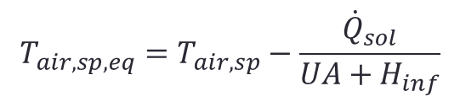
Proposed Approach
One water setpoint temperature and one correction according to the actual state of the indoor temperature.
$$T_{w,sp}=T_{w,hc}+{∆T}_{wind}+{∆T}_{sol}+{∆T}_{int}$$
1) Water supply temperature
$$T_{w,hc}=T_{air,sp}+ k∙{\left(T_{air,sp}−T_{out}\right)}^{α}$$
New parameters k and α are determined from a regression procedure carried out after evaluating the theoretical heating curve by replacing:
$${\dot{Q}}_{rad}={\dot{Q}}_{UA}+{\dot{Q}}_{inf}=(UA+H_{inf})∙\left(T_{air,sp}−T_{out}\right)$$
Solar gain correction can be added by calculating an equivalent indoor temperature setpoint
$$T_{air,sp,eq}=T_{air,sp}−\frac{{\dot{Q}}_{sol}}{UA+H_{inf}}$$

Slide 8
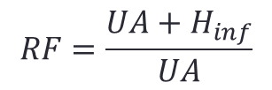
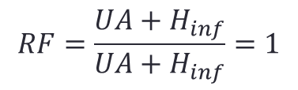
2 ) Indoor temperature deviation correction
$$T_{air,sp,corr}=T_{air,sp,eq}+RF∙\left(T_{air,sp}−T_{in}\right)$$
Only transmission losses in heating curve
Transmission and infiltration losses in heating curve
$$RF=\frac{UA+H_{inf}}{UA+H_{inf}}=1$$
$$RF=\frac{UA+H_{inf}}{UA}$$
$${∆T}_{int}=T_{w,hc}\left(T_{air,sp,corr}\right)−T_{w,hc}\left(T_{air,sp,eq}\right)$$

Slide 9
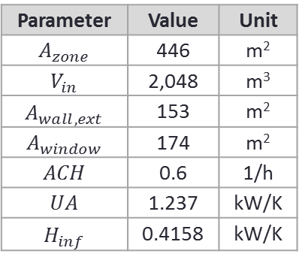
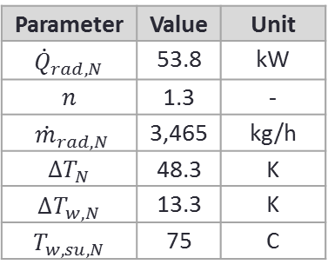
Testing proposed approach
Thermal zone characteristics
Load to cover by installed radiator
Parameter | Value | Unit
$$A_{zone}$$ | 446 | m²
$$V_{in}$$ | 2,048 | m³
$$A_{wall,ext}$$ | 153 | m²
$$A_{window}$$ | 174 | m²
$$ACH$$ | 0.6 | 1/h
$$UA$$ | 1.237 | kW/K
$$H_{inf}$$ | 0.4158 | kW/K
Installed radiator characteristics
Parameter | Value | Unit
$${\dot{Q}}_{rad,N}$$ | 53.8 | kW
$$n$$ | 1.3 | -
$${\dot{m}}_{rad,N}$$ | 3,465 | kg/h
$${∆T}_{N}$$ | 48.3 | K
$${∆T}_{w,N}$$ | 13.3 | K
$$T_{w,su,N}$$ | 75 | C
Required water supply temperature to cover a certain load

Slide 10
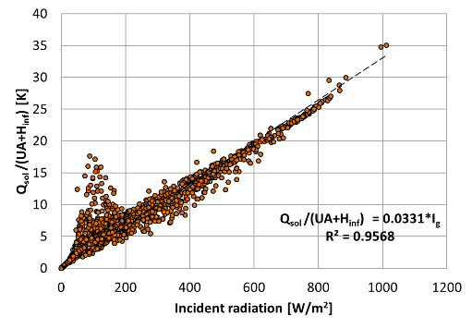
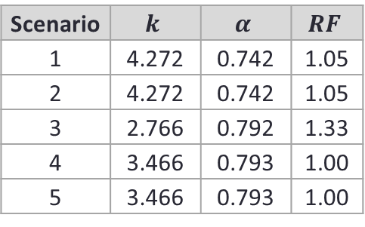
Scenario 1: actual approach.
Scenario 2: actual approach without any correction (solar or infiltration).
Scenario 3: proposed approach considering only transmission losses at steady state. Scenario 4: proposed approach considering transmission and infiltration losses.
Scenario 5: same as scenario 4 integrating correction by solar gains in function of incident radiation.
Control parameters for different scenarios
Scenario | $$k$$ | $$α$$ | $$RF$$
1 | 4.272 | 0.742 | 1.05
2 | 4.272 | 0.742 | 1.05
3 | 2.766 | 0.792 | 1.33
4 | 3.466 | 0.793 | 1.00
5 | 3.466 | 0.793 | 1.00
Solar gain correction

Slide 11
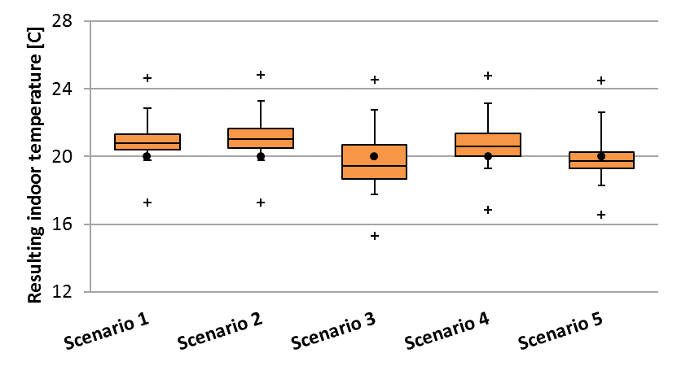
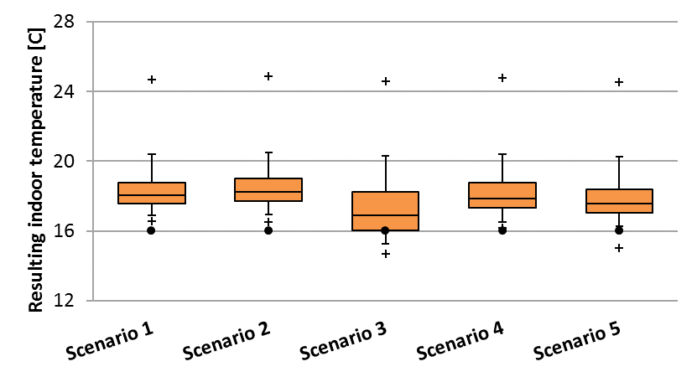
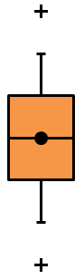
Simulation Results
Box-and-whisker plot of resulting indoor temperature when heating power is needed. Data divided into setpoint hours (left) and setback hours (right).
Scenario | E_{rad} kWh/m²-y | % Diff
1 | 181.4 | -
2 | 185.8 | 2.4%
3 | 157.9 | -13.0%
4 | 178.5 | -1.6%
5 | 167.7 | -7.6%
Maximum
95th percentile
75th percentile
Median / Setpoint (black dot)
25th percentile
5th percentile
Minimum

Slide 12
Conclusions
Actual control strategy implemented in the Belgian demo of BRICKER project was presented, compared against an ideal approach, improved and tested by means of numerical simulation.
5 different scenarios were assessed resulting scenario 3 the most optimal in terms of indoor temperature and specific heating energy demand.
For BRICKER project purposes, the main conclusion of this work is the demonstration that control strategy of energy generation and distribution systems has to be revised whenever deep renovation of passive or active building technologies is undertaken. Contrarily to which, project renovation goals cannot be met.

Slide 13


Roberto Ruiz
r.ruiz@ulg.ac.be
http://www.labothap.ulg.ac.be

