Slide 1







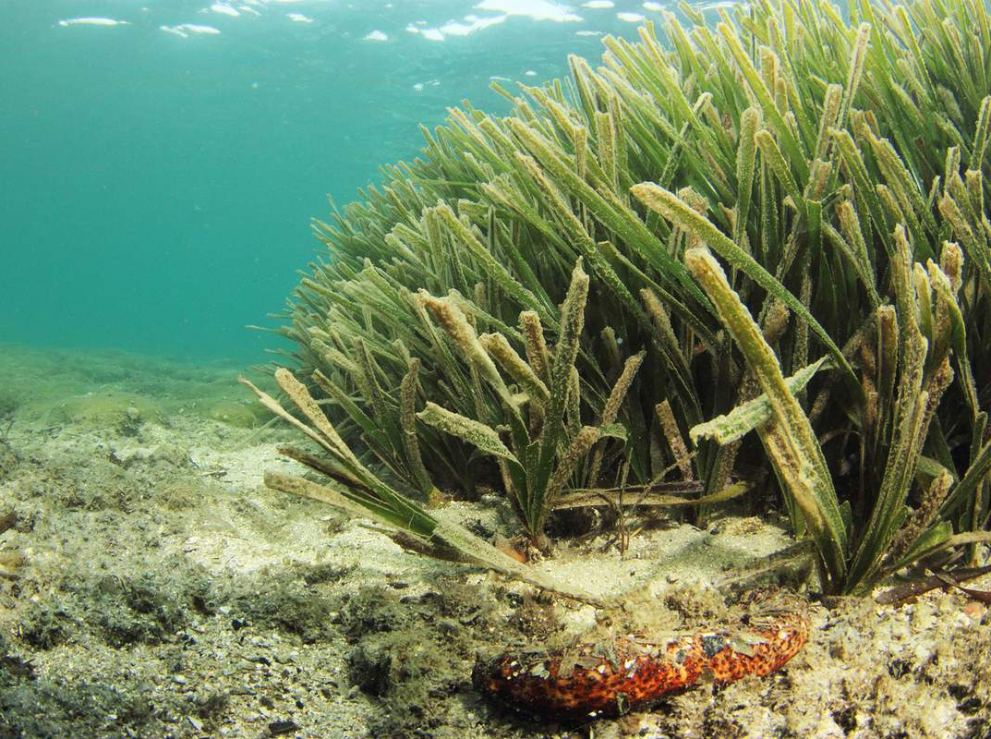
Environmental monitoring: between science and
decision-making
J. Richir, S. Gobert, P. Lejeune, G. Watson and
Ph. Grosjean
CIBIM
13-04-2016
Mons
Notes:
Ladies and gentlemen, I would like to present you, during this talk, a collaborative conceptualization model in order to fill knowledge gaps regarding trace element flows with P. oceanica meadows.

Slide 2
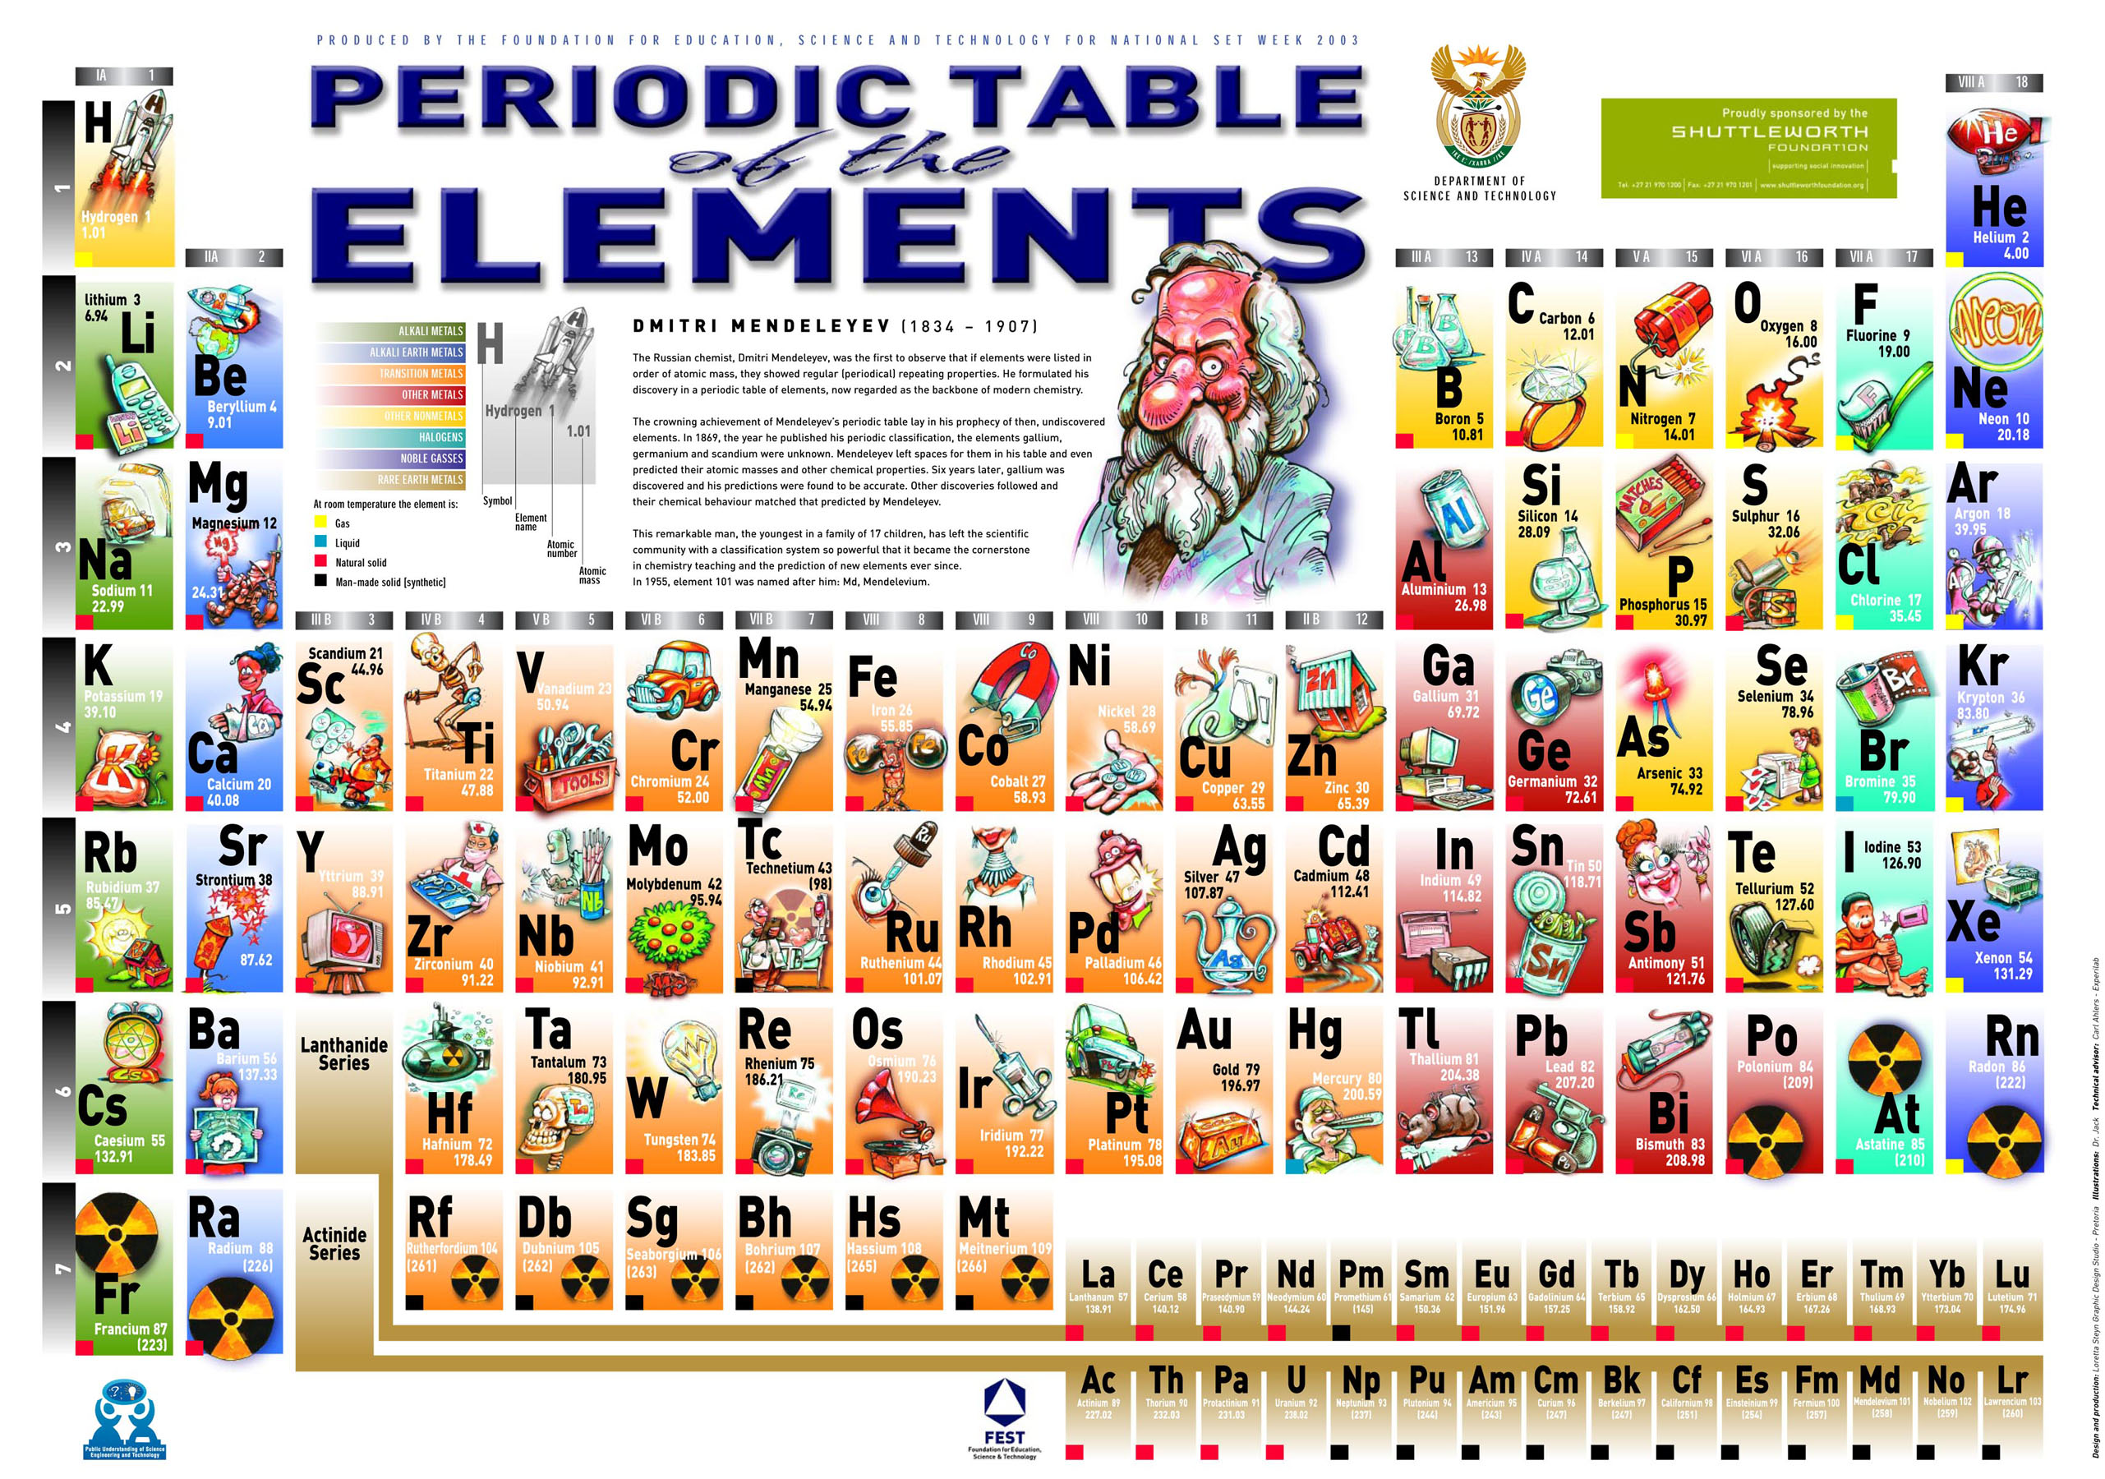

Slide 3





Trace elements
(after Amiard, 2011)
Notes:
Among the diversity of contaminants are trace elements. We use the term trace element since the term heavy metal is meaningless term.
IUPAC (International Union of Pure and Applied Chemistry) definition: Any element having an average concentration of less than about 100 parts per million atoms (ppma) or less than 100 µg g-1.
In parallel to this abundance consideration must be taken into account their essential or non-essential aspect to living organisms.

Slide 4

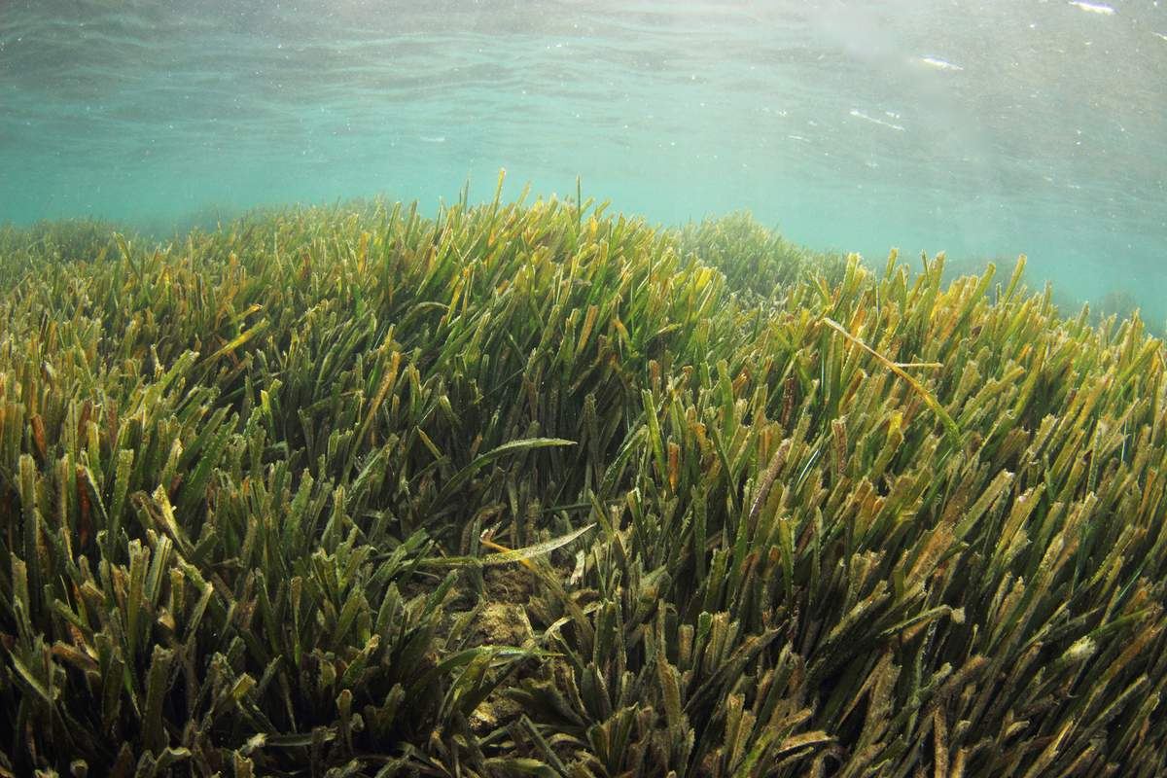
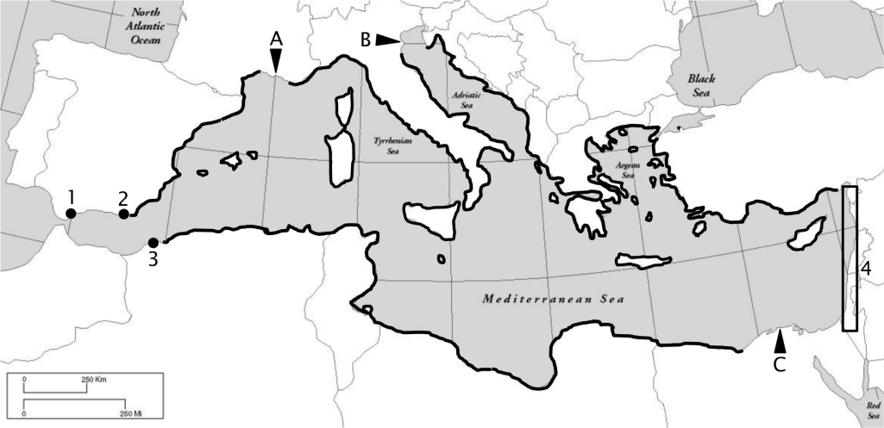
Bioindicator : Posidonia oceanica
Michel, 2012
Notes:
The Mediterranean is submitted to numerous anthropogenic threats, among them the chemical contamination of its densely anthropized coasts. The red circles on this map hilights pollution hot spots along Mediterranean coasts.

Slide 5
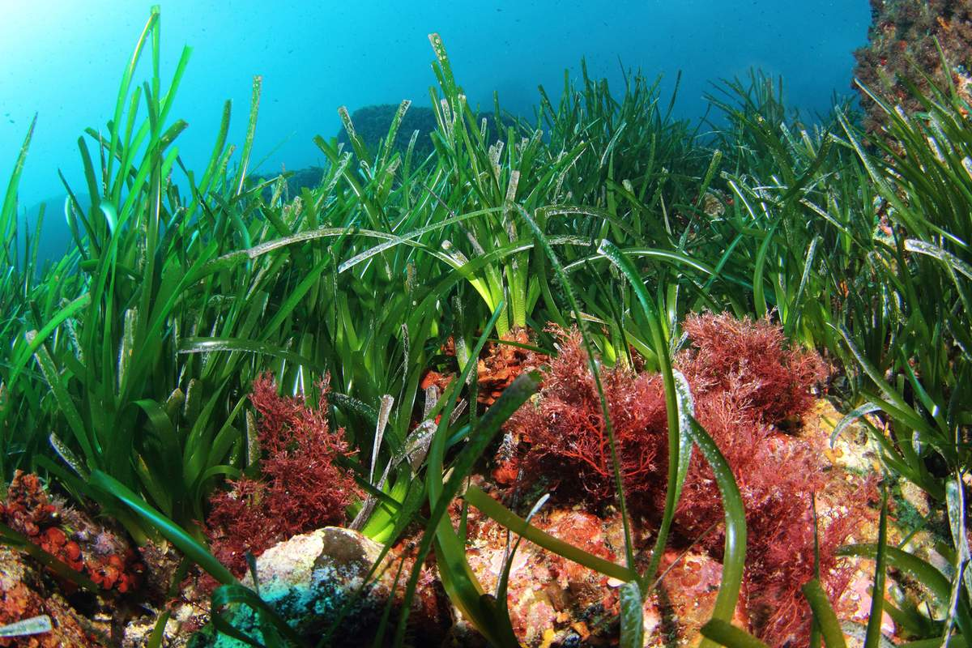
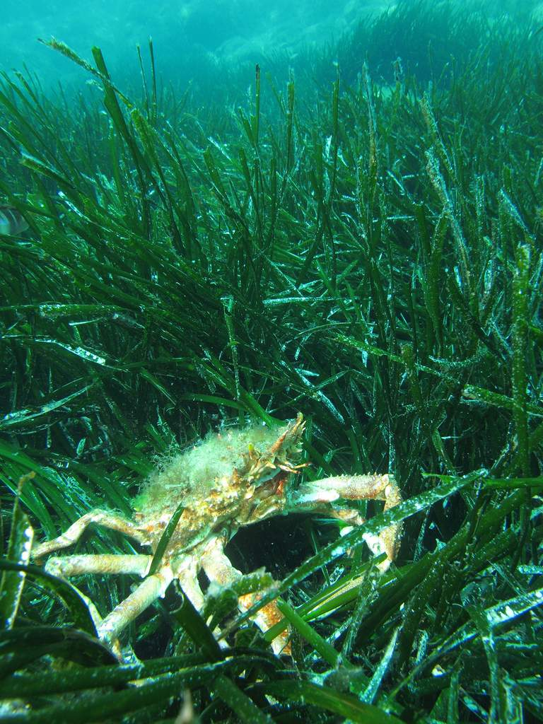
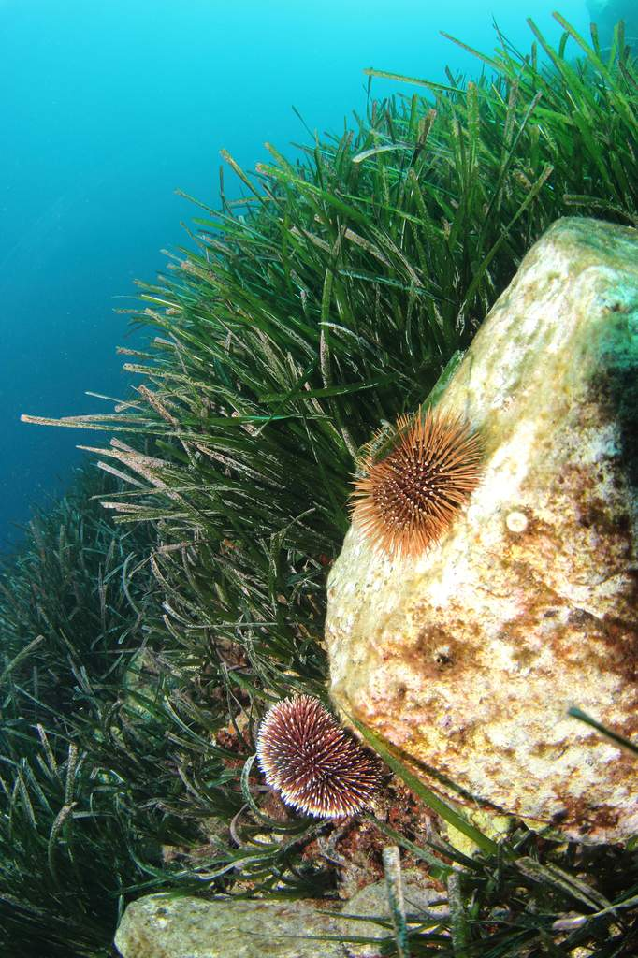
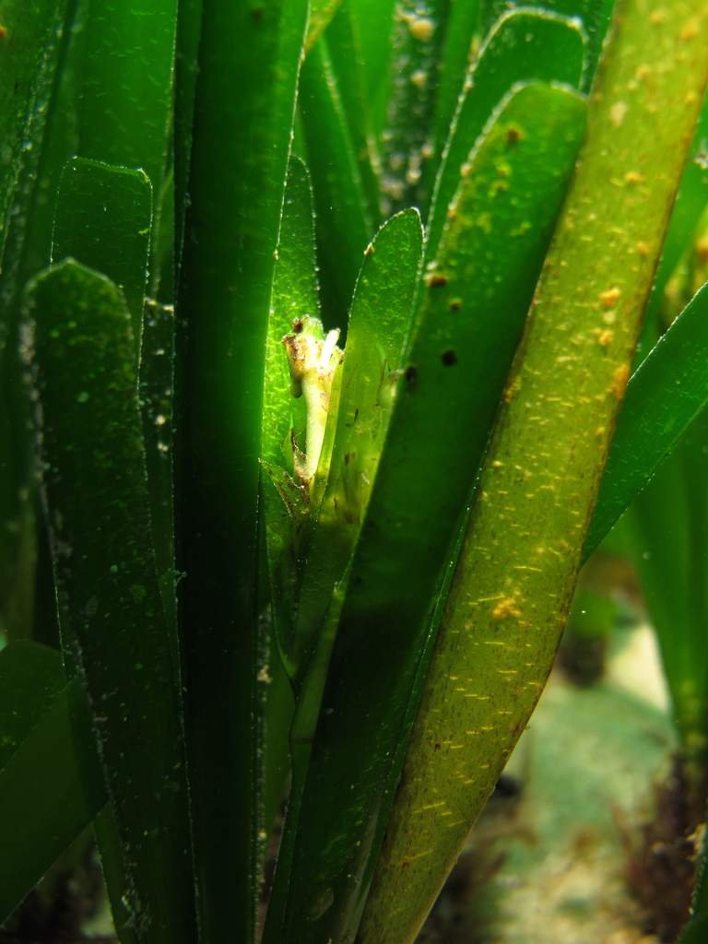
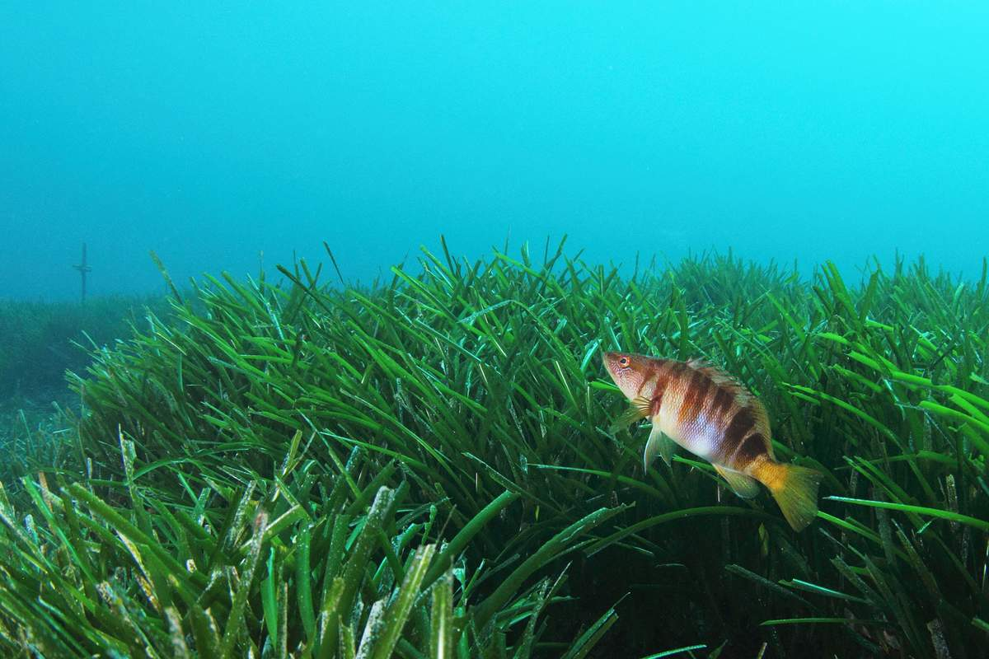

Slide 6
Scale ? Sampling effort ?
TE accumulation in P. oceanica studied at different scales :
2. In a bay (1 km scale)
3. Along the French Mediterranean littoral (10-100 km scale)
1. Along a radial (100 m scale)

Slide 7
Scale ? Sampling effort ?
TE accumulation in P. oceanica studied at different scales :
4. Along the whole Mediterranean coastline (100-1000 km scale)

Slide 8
Scale ? Sampling effort ?
1. Along a radial (100 m)
3. Along the French littoral (10-100 km)
2. In a bay (1 km)
4. Along the Mediterranean coastline (100-1000 km)

Slide 9


Slide 10
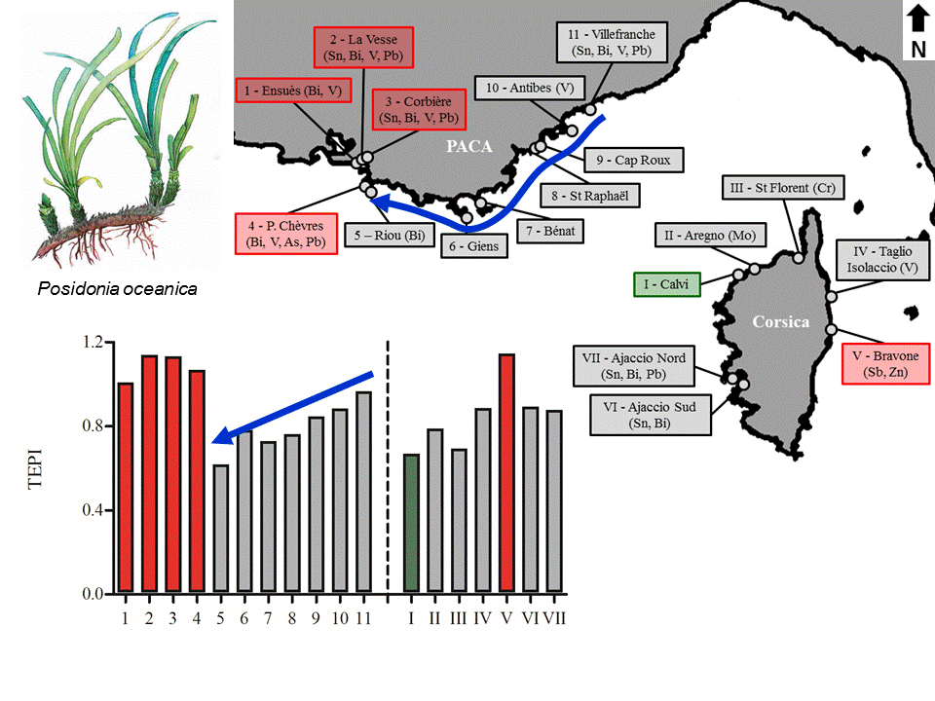
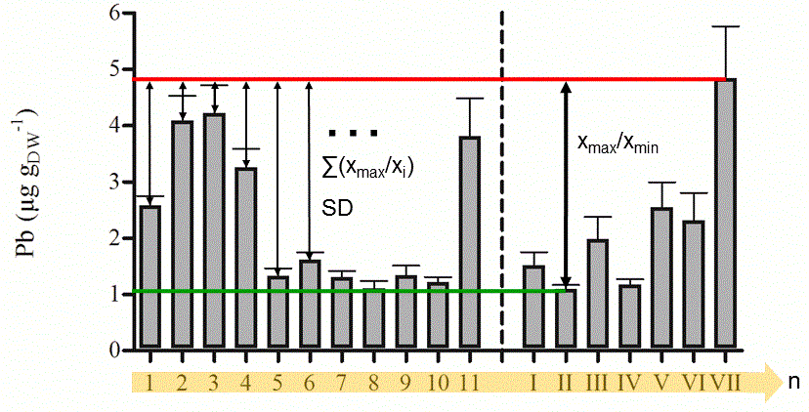
Conclusion
Pollution indices
Trace Element Spatial Variation Index
Trace Element Pollution Index
TEPI = (Cf₁ * Cf₂ … Cf_{n})^{1/n}
TESVI = [(x_{max}/x_{min}) / (∑(x_{max}/x_{i})/n)] * SD
TESVI and TEPI efficient complementary indices to monitor the pollution by TEs. They successfully led:
to the ordering of TEs according to the overall spatial variability of their environmental levels along the French Mediterranean littoral;
to the quantification of the global pollution in TEs between monitored sites.

Slide 11
Spatial variability
Pb
Proportional ordinate scaling between TEs:
Hg
As
Cd
Ag
Cu
Ni
Notes:
One of the most widely used bioindicator species in the Mediterranean is the seagrass Posidonia oceanica (and more precisely the shoots of leaves of that seagrass).

Slide 12
Global contamination
Notes:
One of the most widely used bioindicator species in the Mediterranean is the seagrass Posidonia oceanica (and more precisely the shoots of leaves of that seagrass).

Slide 13

5-level water quality scale
qu. 1
qu. 2
qu. 3
qu. 4
Superior limit of quartiles
5 contamination levels
< 1st qu. mean : very low CL
1st-2nd qu. mean: low CL
2nd-3rd qu. mean: medium CL
3rd-4th qu. mean: high CL
> 4th qu. mean: very high CL
Quartile means
Notes:
One of the most widely used bioindicator species in the Mediterranean is the seagrass Posidonia oceanica (and more precisely the shoots of leaves of that seagrass).

Slide 14
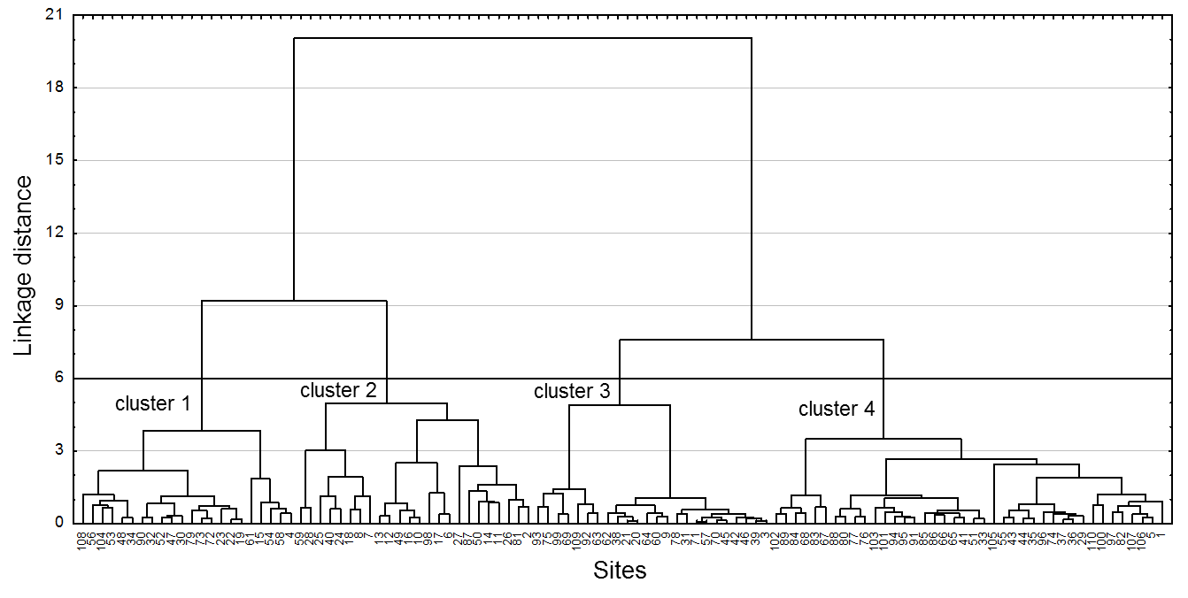
Clustering
sites highly contaminated
sites little contaminated
Notes:
One of the most widely used bioindicator species in the Mediterranean is the seagrass Posidonia oceanica (and more precisely the shoots of leaves of that seagrass).

Slide 15
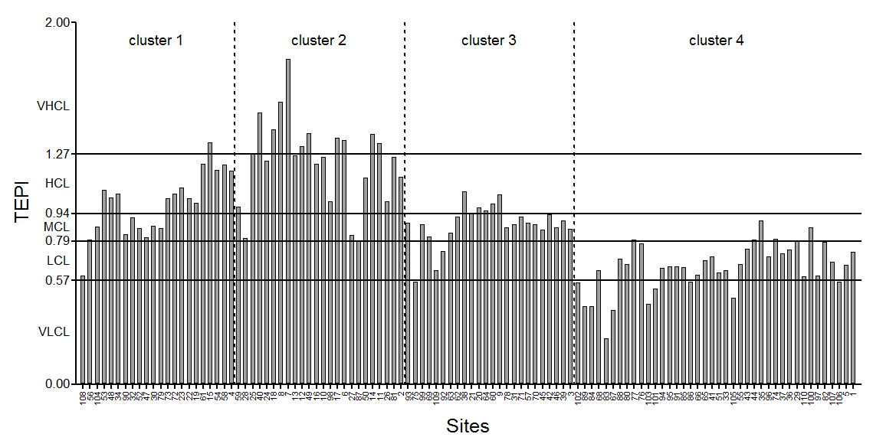
Clustering vs. TEPI
HC by Cd, Ni; LC by As
HC by Ag, As, Pb
LC by TEs overall
Notes:
One of the most widely used bioindicator species in the Mediterranean is the seagrass Posidonia oceanica (and more precisely the shoots of leaves of that seagrass).

Slide 16
Notes:
One of the most widely used bioindicator species in the Mediterranean is the seagrass Posidonia oceanica (and more precisely the shoots of leaves of that seagrass).

Slide 17
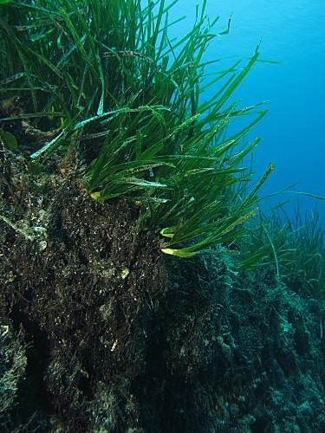
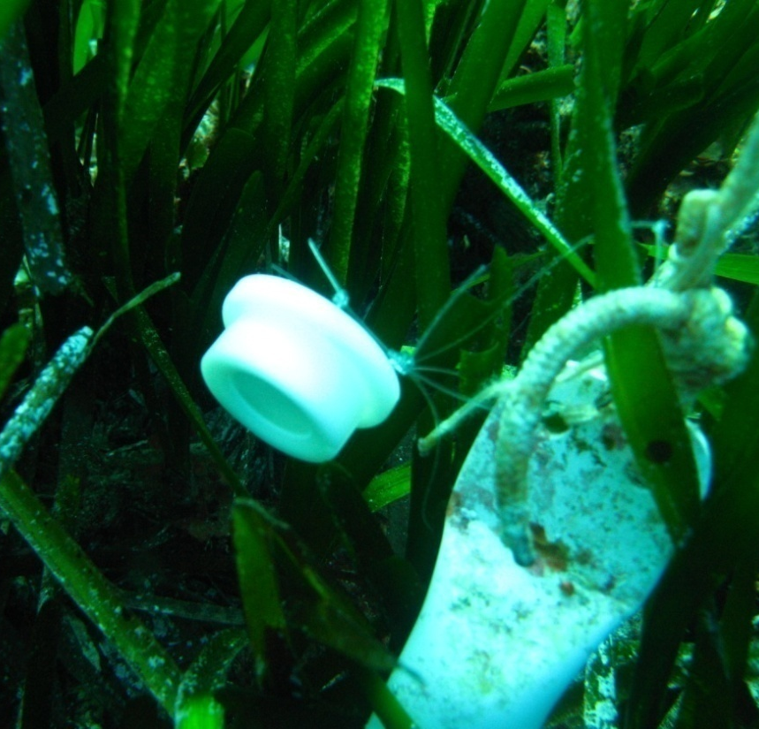

Posidonia oceanica bed
Posidonia oceanica: shoots, rhizomes and roots;
Foliar stratum ◄ water;
Matte ◄ sediments.

Slide 18
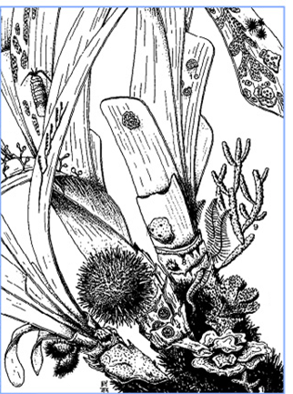
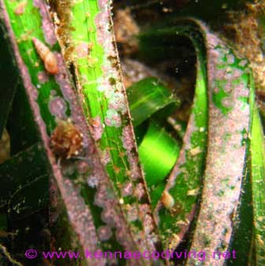
Seagrass meadow components
Seagrass meadows can be conceptualized as the juxtaposition of 5 separate components:
seagrass shoots,
epiphytes,
associated algae and animals,
detritus,
exchanging flows of TEs between themselves and with their environment:
water,
sediment.
(Schroeder and Thorhaug, 1980)
(After Boudouresque and Meinez, 1983)

Slide 19

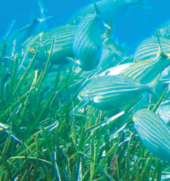
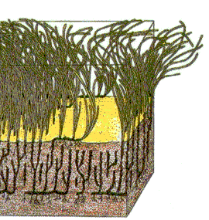
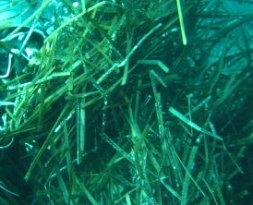
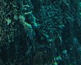

Diagram in energy circuit language
LF4
LF2
UF2
water
LF5
epiphytes
LF1
LF8
TF4
FF2
UF4
LF3
UF1
TF3
FF1
animals
leaves
FF3
P. oceanica
FF4
TF1
CF2
TF2
CF4
UF5
roots
rhizomes
CF1
detritus
UF8
UF6
UF3
CF3
sediment
LF6
algae
LF7
UF7
MF1

Slide 20
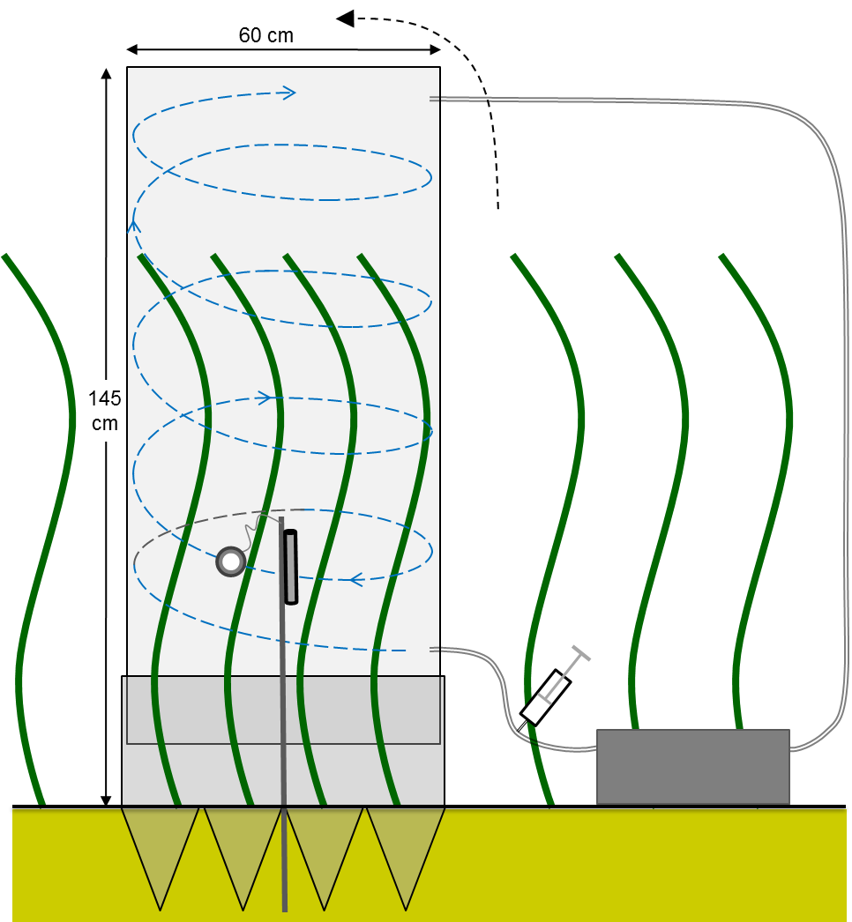
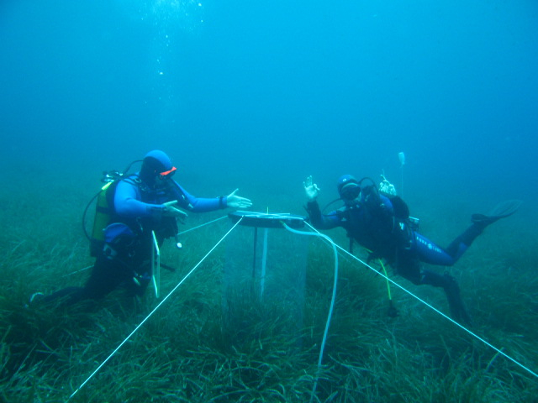
Flows : experimental design
Experimental exposure:
In aquaria;
In situ.
Trace elements:
Contamination with radionuclides;
Enrichment of the less abundant stable isotopes;
High relevant concentrations in pristine conditions.

Slide 21
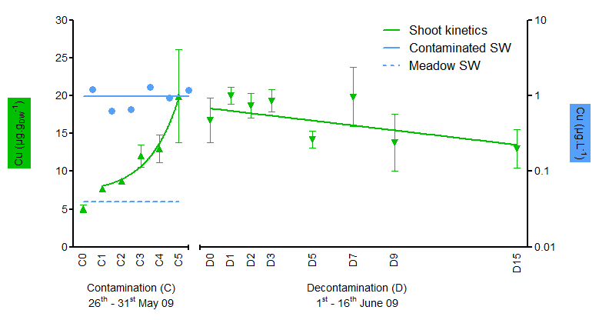
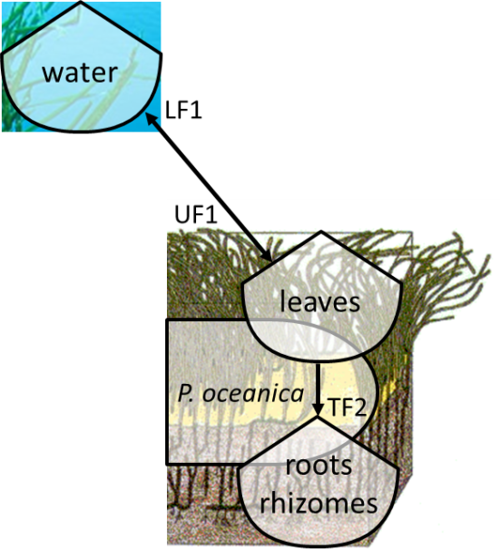
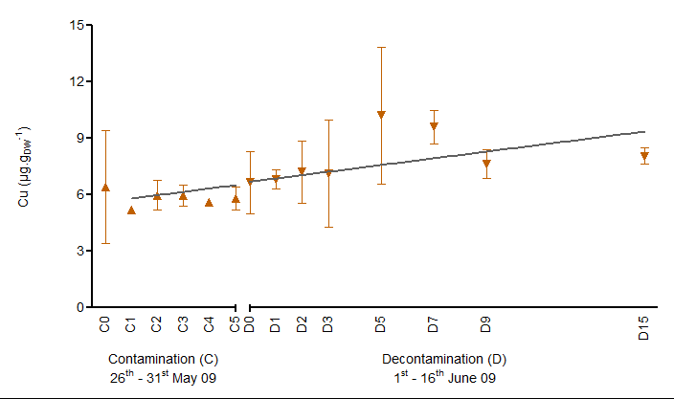
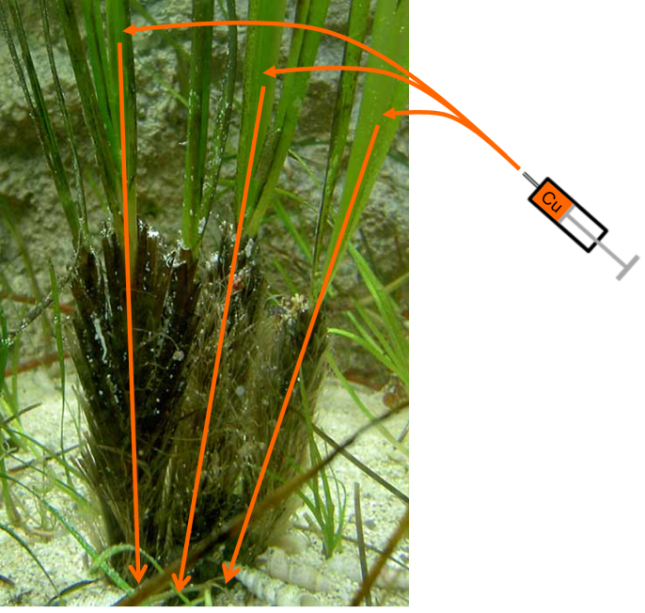
Flows : uptake and translocation
water and leaves
rhizomes

Slide 22
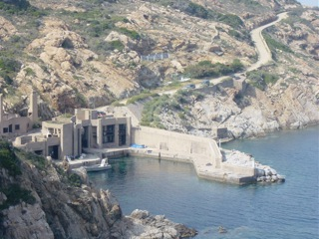
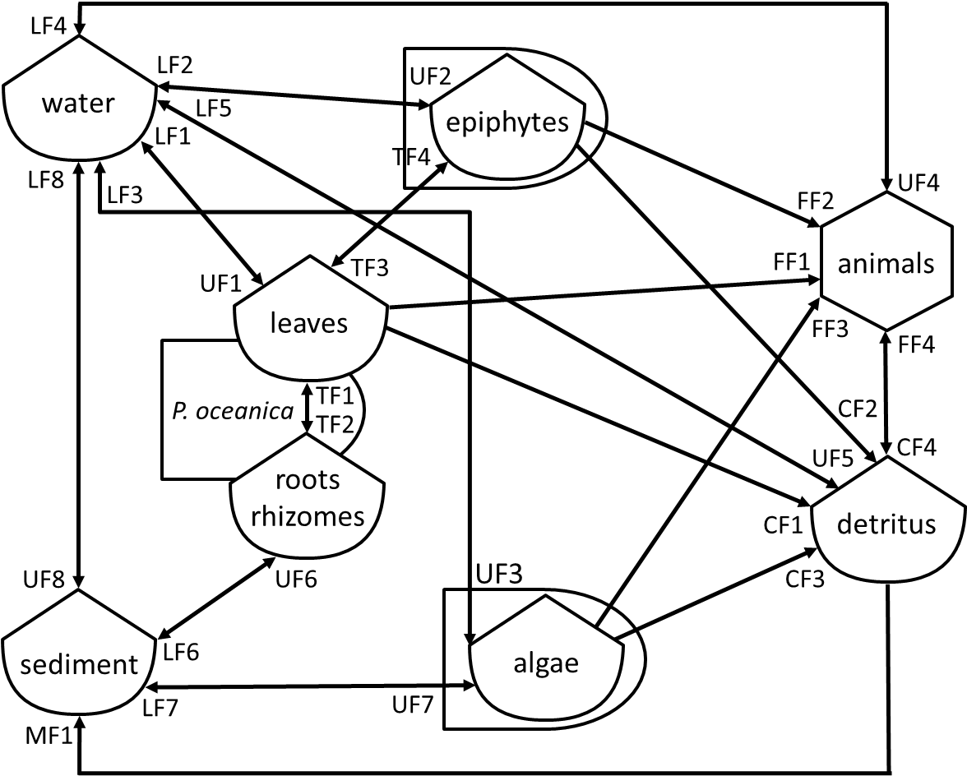
TEs in seagrass meadows
Data compilation for the different components of the model;
Mass balance analyses;
Experiments.
The quantification of the role played by P. oceanica meadows in the coastal biogeochemistry of TEs and their function of biological filter.

Slide 23

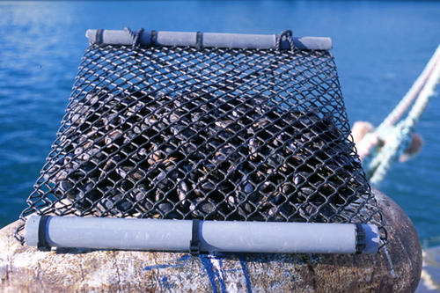
M. galloprovincialis monitoring station
©Ifremer

Slide 24
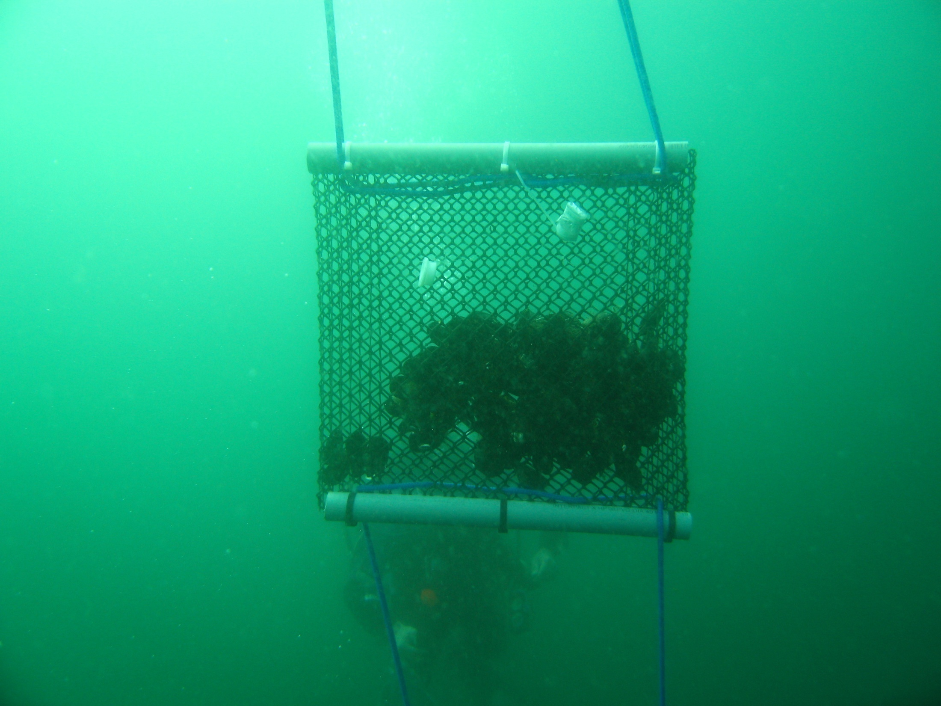

Applications
APPLICATIONS

Slide 26
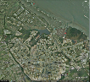
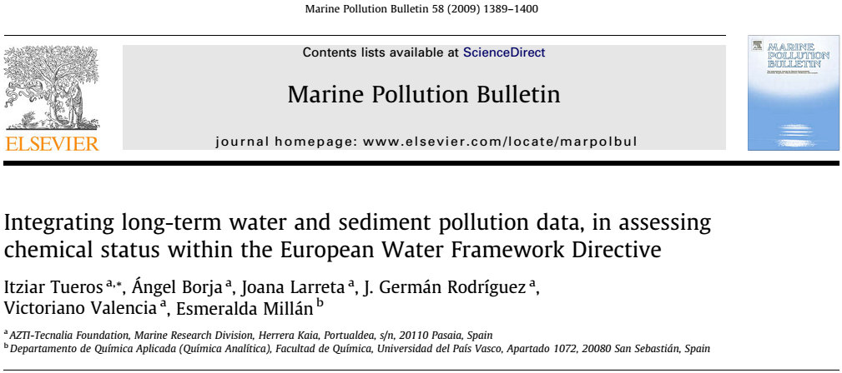
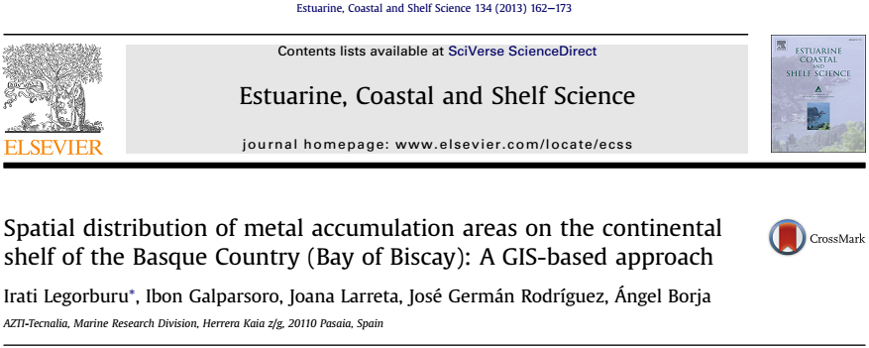
The Department of Environment and Land Action of the Basque Government (Littoral Water Quality Monitoring and Control Network)
A corporative Marine Spatial Data Infrastructure, developed in the Marine Research Division of AZTI-Tecnalia

Slide 27


United Kingdom data bases
http://www.geostore.com/environment-agency/
“Making environmental information available is key to informing decisions, influencing actions and delivering sustained environmental improvements.”
http://www.bodc.ac.uk/projects/uk/merman/
Marine Environment Monitoring and Assessment National database (MERMAN) → a national database which holds and provides access to data collected under the Clean Safe Seas Environmental Monitoring Programme (CSEMP).

Slide 28
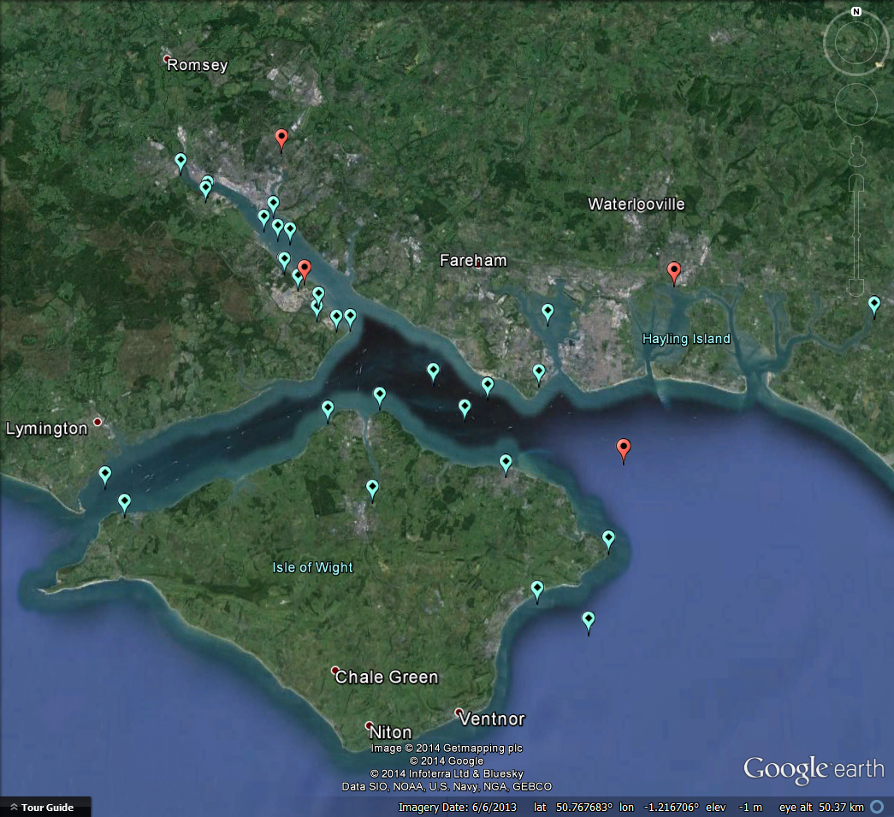
SOUTHAMPTON
PORTSMOUTH

Slide 29
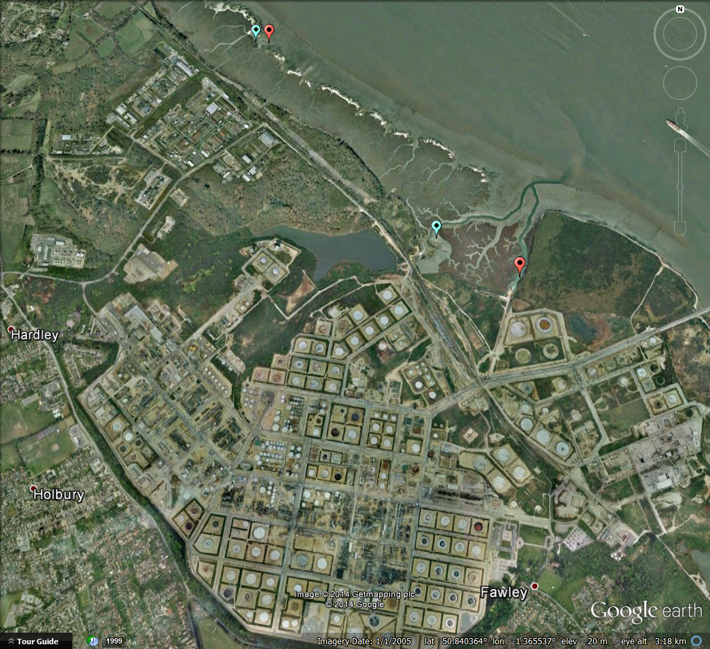

Slide 30
Solent as a case study: oil refinery
Baseline TE levels (BL) (Rainbow et al., 2011);
Canadian Sediment Quality Guidelines for the Protection of Aquatic Life: Threshold Effect Level (TEL) and Probable Effect Level (PEL) (Hübner et al., 2009).

Slide 31
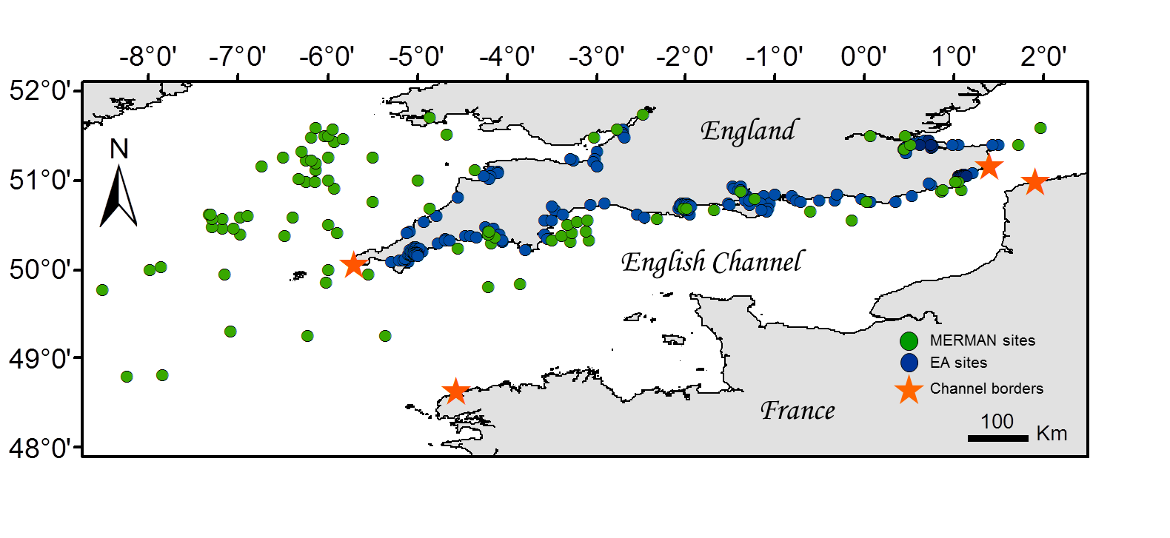
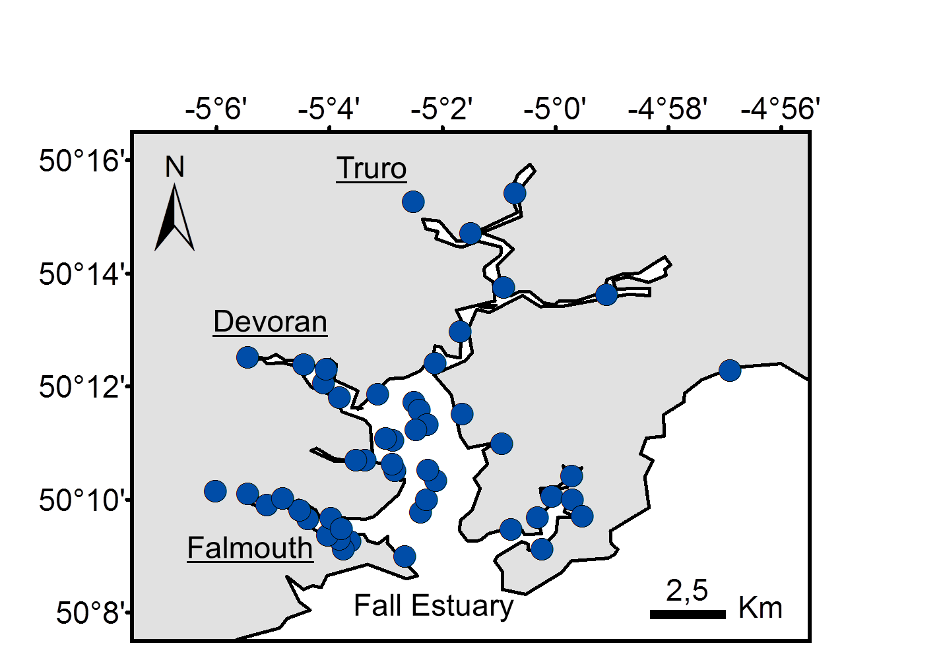
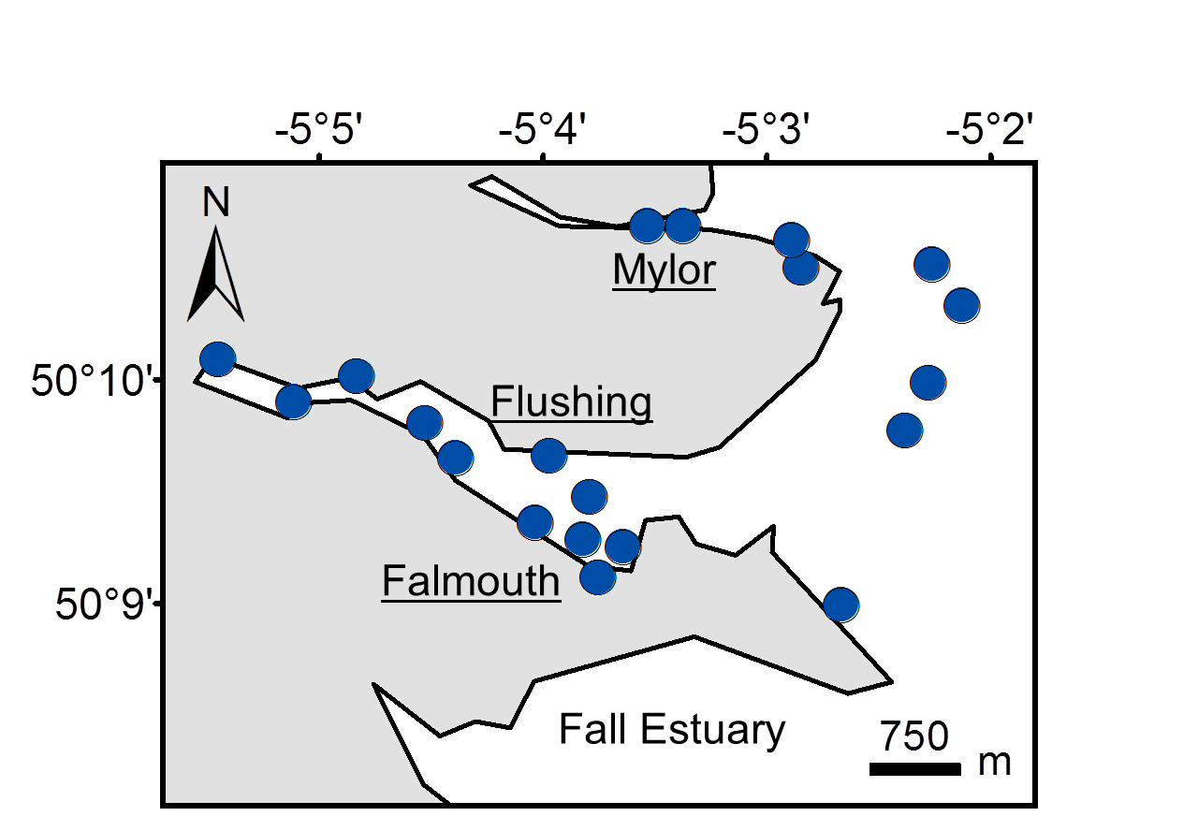
Sediments = environmental archives
Notes:
One of the most widely used bioindicator species in the Mediterranean is the seagrass Posidonia oceanica (and more precisely the shoots of leaves of that seagrass).

Slide 32


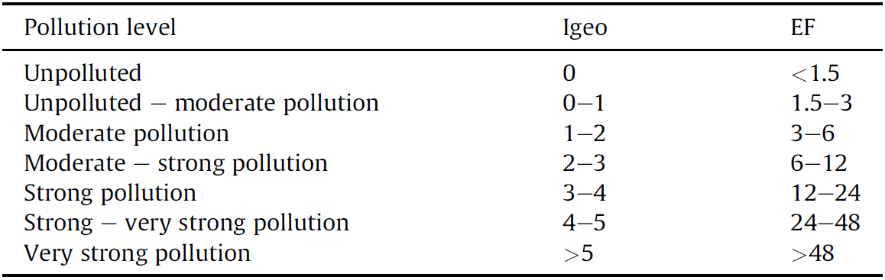
Pollution scale
2 | < 1.5
 | 1.5 - 3
 | 3 - 6
 | 6 - 12
 | 12 - 24
 | 24- 48
 | > 48
Enrichment Factor (EF) of a TE = the ratio between its concentration in the sediment and its natural background concentration (Tomlinson et al., 1980);
Depending upon the Geoaccumulation Index values (I_{geo}), sediments can be classified into 7 classes, according to their level of pollution (Müller, 1979).

Slide 33
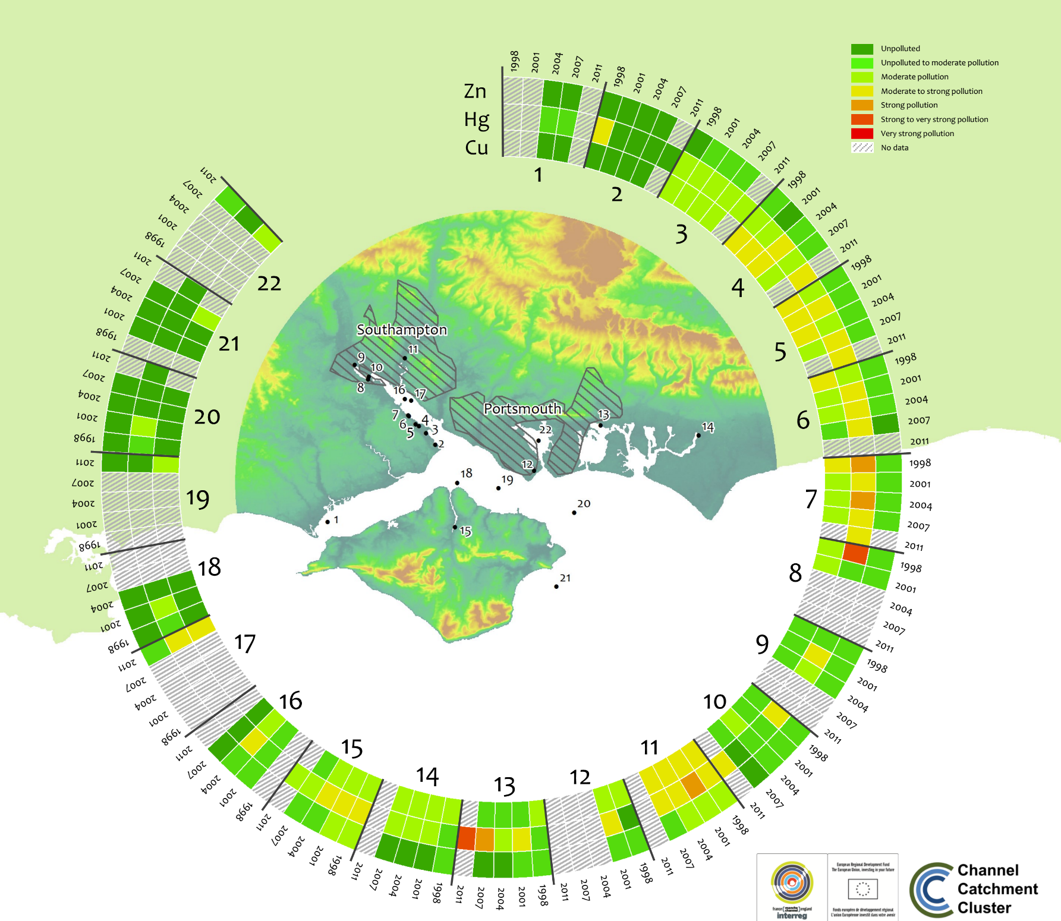
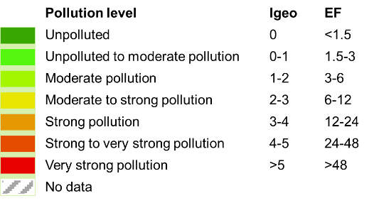

Solent :
case study
Notes:
One of the most widely used bioindicator species in the Mediterranean is the seagrass Posidonia oceanica (and more precisely the shoots of leaves of that seagrass).

Slide 34
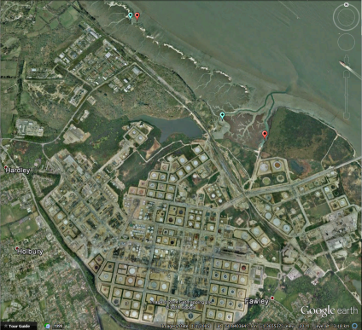
Data mining - Decision tools - Monitoring
Long-term sediment pollution data:
assessment of the chemical
status within the European WFD;
Knowledge transfer from scientists to environmental managers:
develop practical environmental
management tools;
Complementary monitoring approach:
environmental compartments
vs. biota.

Slide 35
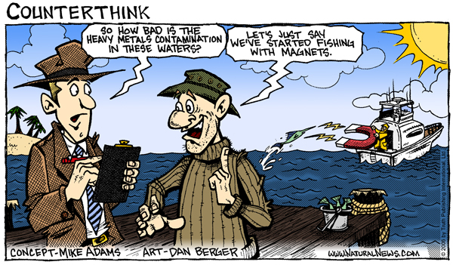
Questions?
… Thank you for your attention …

