Slide 1

Pathologies of the puerperium in the cow
How to define, diagnose, understand and treat
Università degli Studi di Torino
Dipartimento di Scienze Veterinarie
27th may 2016
Prof. Ch. Hanzen
University of Liège
Faculty of Veterinary medicine
Department of Theriogenology
E-mail : Christian.hanzen@ulg.ac.be
Website : http://www.therioruminant.ulg.ac.be/index.html
Publications : http://orbi.ulg.ac.be/
Facebook page : https://www.facebook.com/Theriogenologie

Slide 2
I have 8 questions for you
In which economical context are we working ?
Is puerperium important for the reproductive performance of the cow ?
How to define the pathologies of the puerperium ?
What’s the prevalence of these pathologies ?
How to diagnose the pathologies of the puerperium ?
When to detect these pathologies ?
What kind of relations exist between these pathologies ?
How to treat these pathologies ?

Slide 3
In which economical context are we working ?
1

Slide 4
Distribution (%) by continent of cow milk (%) in 2012 (631,3 millions de tonnes) (Source fil, usda, cniel)

Slide 5
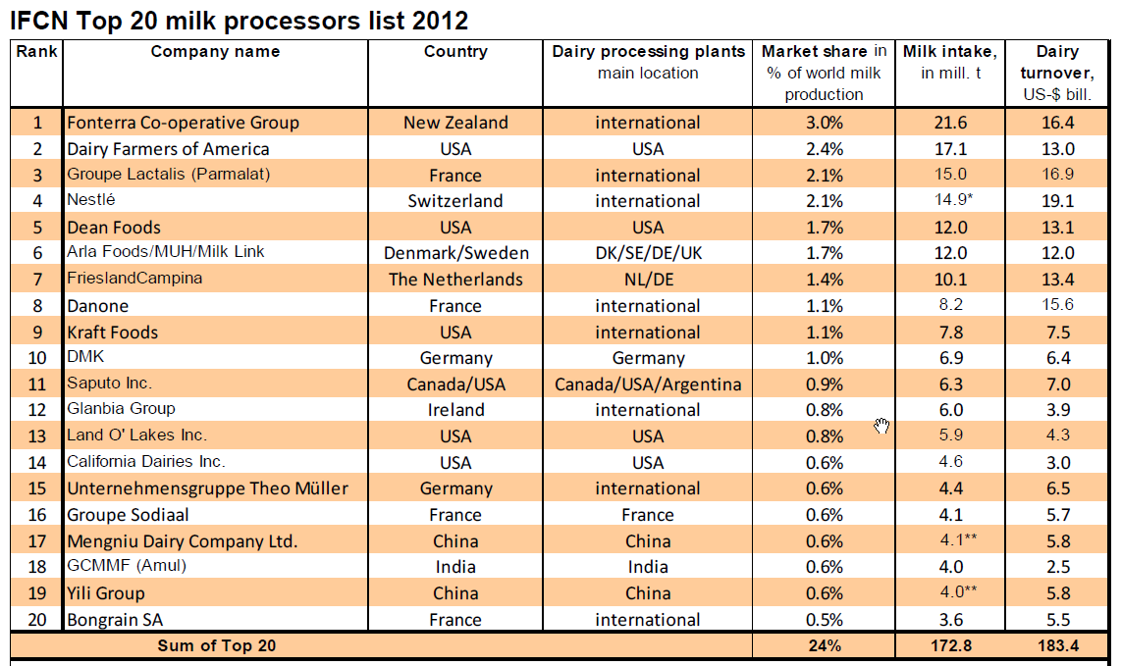
TOP 20 of milk factories in 2012
http://www.ifcnnetwork.org/media/bilder/inhalt/News/DR2012/IFCN-Dairy-Report-2012-press-release-corrected.pdf
Out of 20, 10 are european factories
24 %

Slide 6
Dairy population in Europe (2013) : 23.507.000 cows
Average milk production in some countries (Source CNIEL 2015)
Huge differences in average milk production
Three mains countries in Europe
Notes:
In 2013, European community counted 23,5 millions dairy cows which assume 24 % of the world production of cow’s milk. By comparison, North and central america produce 18 % of the world production. 44 % of the european cows were in Germany, France and Poland. In Europe, the total average milk production was 6627 kgs of milk per cow and per year. Such average covers large differences between the different countries. For exemple, a difference of 3327 kgs is observed between danish cows (8667 kgs) and polish cows (5341 kgs). Such differences ca be explained by differences in genetic, nutritionnal ressources and management including the capacities of the farmers and veterinarian to prevent and treat the different pathologies responsibles of the well being of the animals.

Slide 7
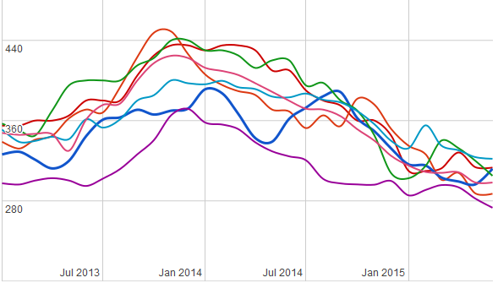
Evolution of the milk prices in different european countries (Euros / T)
Jul 2015
Challenge for the vets : contribute with the farmers to decrease the costs of milk and meat production
Notes:
The aim of each farm is to produce a milk of quality. The recent suppression of milk quota in Europe has introduce a new goal. The new objective for the farmer is not necessarily to produce more milk per cow but to reduce as much as possible the costs of milk production. We can give two exemples. The first concern the costs linked to the growing heifers. In Ontario (Canada), the costs (excluding interests and amortization) are respectively 1254 and 1451 Euros according the age of 24 and 28 months for first calving and respectively 9200 and 8700 kgs of milk during the first lactation. The second concern the economic conséquences of uterine infections. In Europe such pathologies represent a loss of 1,4 milliards d’Euros (Sheldon et al. 2009).
So this reduction of cost of milk production represent for the farmers and veterinarians a challenge even more difficult than the price of milk will continue to decrease during the next months according to what we can observe in different countries in Europe. In this context, the wordl market is not really a problem. It concerns only 7 % of the total milk production because most of the milk production is consumed in the countries where the milk is produced. The problem comes from the profit margins of the big companies

Slide 8
Is puerperium important for the cow reproductive performance ?
2

Slide 9
Puerperium : a period among others
Calving
Period of lactation
Dry period (45 to 60 d)
Period of pregnancy
Puerperium : waiting period (60 d)
Reprod period
Preg
Transition period (40 d)
20
+
60
+
20
=
100
100 days to obtain a new pregnancy
Notes:
Puerperium is can be defined as the period between the calving and the reproduction period (period between the first and the last insemination). This period can be assimilated to the waiting period i.e. the period between calving and the first insemination. The calving follows the end of pregnancy and in case of pluriparous cows the drying off period. Normally, for economic reasons, a new pregnancy need to be observed as early 80 days after the previous calving. This goal can be obtained through a good preventive and if any curative management during the 20 days and 80 days respectively before and after parturition.

Slide 10
Transition period
Puerperium : a period at risk
Calving
Dystocia
« Early » Puerperium
Placental retention
Acute metritis
Milk fever
Acetonemia
Dry period
Period of lactation
Period of pregnancy
Puerperium
Negative energy balance
Failure to resume cyclicity : anoestrus
« Midlle » and « late » Puerperium
Failure to resolve inflammation : endometritis,
subclinical endometritis, pyometra
Uter involution delay
Mastitis
Lameness
Notes:
For different reasons, puerperium is a high risk period for the fertility of the cow. Most of infectious, metabolic hormonal or locomotor patthologies appears during the period. Moreover, milk production increases during this period. At parturition and during the first days after, the dairy cow is at risk of dystocia, infectuois diseases like placental retention or acute metrits, metabolic disease like milk fever aor acetonemia. During the next two to seven weeks, the cow is exposed to a negative energy balance, to different uterine infectious disease like clinical and subclinical endometritis, pyometra, uterine involution delay, anoestru, mastitis, lameness or last but not least anoestrus i.e; this failure to resume a cyclic ovarian activity. All these pathologies interact with one another.

Slide 11
How to define these pathologies ?
3
Definitions are important to
use the best method of diagnosis
make comparisons of prevalence
understand their risk factors
evaluate the effect of treatments
to define a problem at the herd level

Slide 12
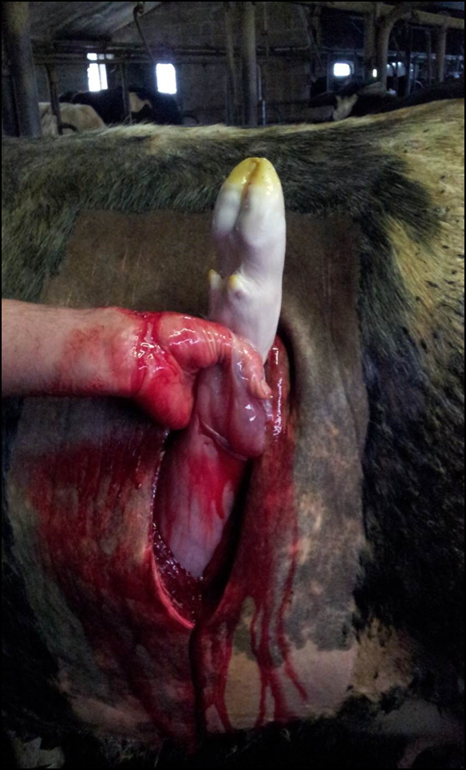
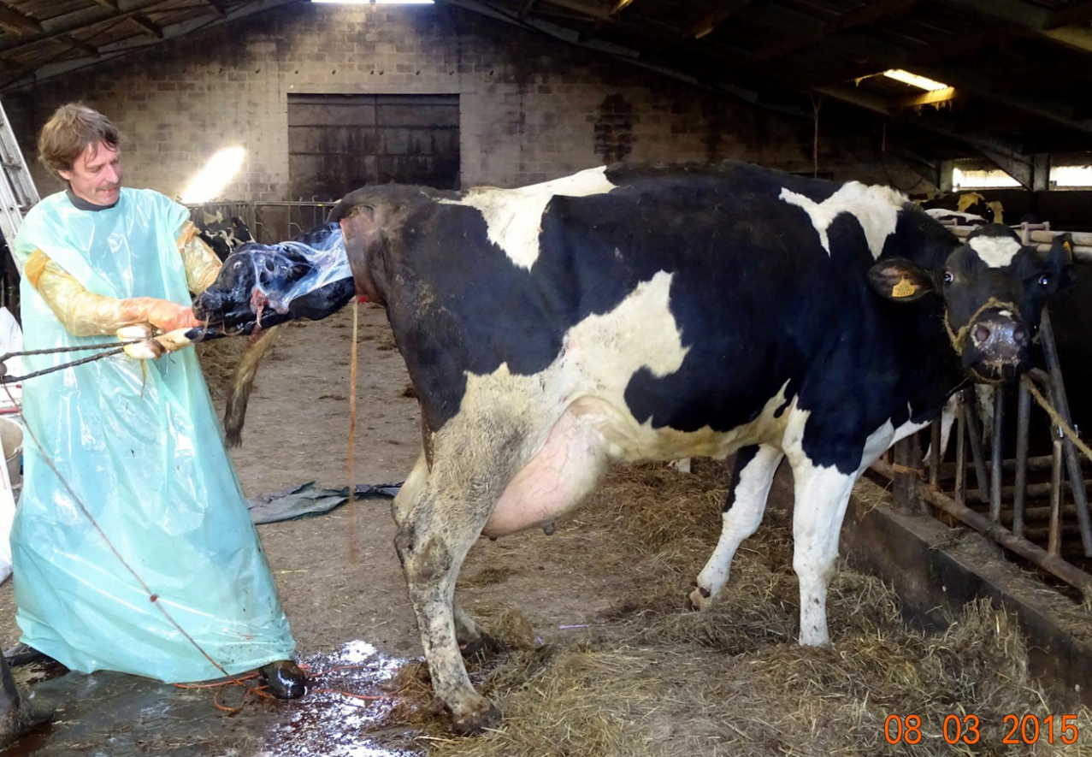
Dystocia : definition and prevalence (Mee et al. 2008)
In greek : Dys = difficult and Tokos = birth
Dystocia = all calving which requires manual intervention
Stage 2 of calving : 70 min on average (30 min to 4 h : Noakes et al. 2001)
Different scoring systems : 2 to 7 points
Notes:
To define as precisely as possible the different pathologies is important to use the best method of diagnosis, to make comparisons of prevalence of the different pathologies, to understand their risk factors and finally to evaluate the effect of their treatments.
The term dystocia from Greek dys meaning difficult and tokos meaning birth may be defined as calving difficulty resulting from prolonged spontaneous calving necessiting a non surgical or a surgical (C-section) assistance to pull out the calf. Conversely, eutocia or normal calving may be defined as a spontaneous calving of normal duration. Taking the appearance of the amnion as the time of onset, calving (stage two) normally takes between 30 minutes and 4 hours with an average duration of 70 min being longer in heifers than in cows. Most of causes (70 %) of dystocia in the cow are due to fetomaternal disproportion and abnormal presentations, positions or postures of the fetus.

Slide 13
Risk factors for dystocia (Noakes 2001)
70 %

Slide 14
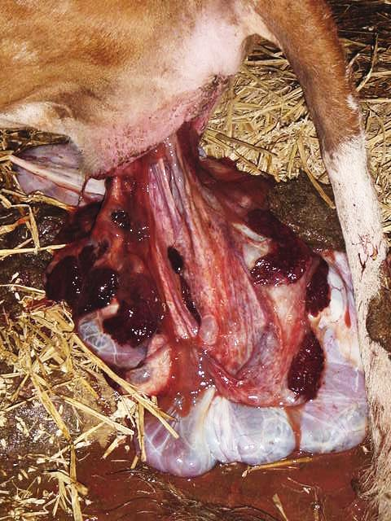
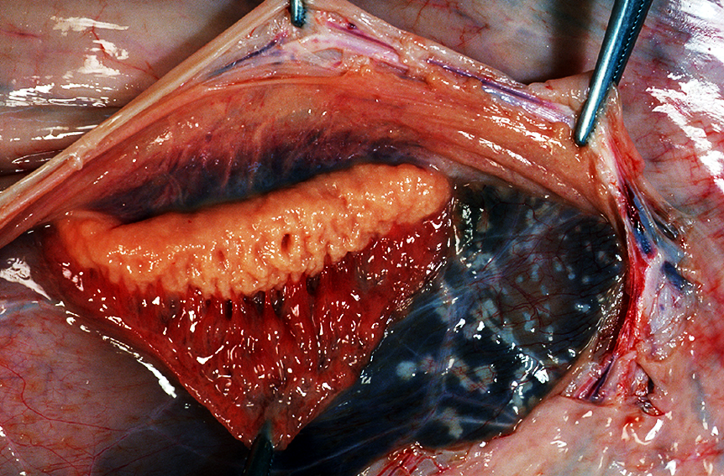
Placental retention : definition and risk factors
= no expulsion of placenta within 24 h after calving
expulsion of the placenta = phase 3 of parturition
maturation of the placenta
Placental retention is a inflammatory process
Photo Lopez-Gatius Lleda 2008
Notes:
In the cow, the placenta is expelled during the phase three of parturition. The retention of the placeta i.e. the fetal membranes is defoned as the failure to expel the fetal membranes within 12, 24 or 48 h after calving. Most of the authors consider a period of 24 hours. The process of expulsion also called placental maturation begins some days before calving. According to the hormonal modifications but also the decrease of activity of the leukocyte namely neutrophils , we can consider the placental retention as an inflammatory process.
There are a number of risk factors associated with placental retention including induced parturition, shortened gestation, abortion, twinning, dystocia, fetotomy, nutrionnal deficiencies like vitamien E, Se and carotene, infectious agents and immunosuppression.

Slide 15
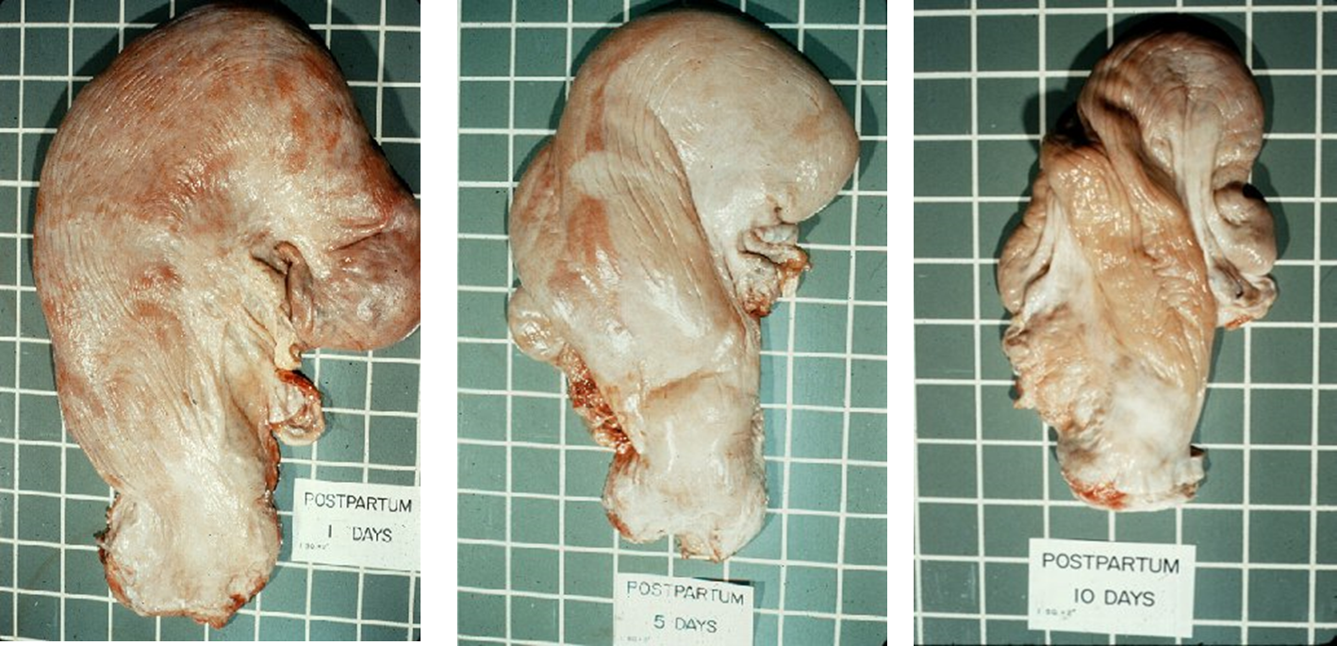
Uterine involution
Anatomical aspects
= process of reduction in size of the uterus after calving due to loss of tissues (lochia), tissue repair and contractions
folds
Elmore 1996
Reduction of length, weight and diameter (d8 and d30) due to contractions
Notes:
Uterine involution can be defined as a process of reduction in size of the uterus after calving due to loss of tissues (lochia), tissue repair and contractions. So different aspects can be distinguished. The first is anatomical aspect. The diameter, length and weight of the uterus decrease in 8 to 30 days due to the uterine contractions.

Slide 16
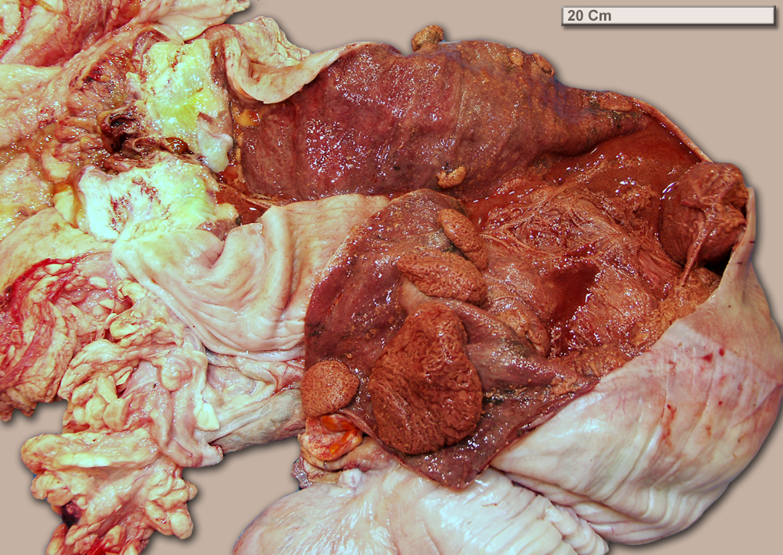
Histological aspects : the lochias
500 to 2000 ml : necrotized uterine caruncles and endometrium, blood (ruptured umbilicus, foetal fluids)…:
no smelling
discharge visible until day 16
endometrium is fully regenerated 6 to 8 weeks after calving
http://loribovinesection.blogspot.be/ : uterus day14 postpartum
Notes:
Histologically , all the endometrium is eliminated and regenerated in 6 to 8 weeks after calving. Lochias are the main clinical sign. Their volume is between 500 to 2000 ml. The are visible until day 16 postpartum. The consist of necrotized uterine caruncles and endometrium, blood from ruptured umbilicus and of foetal fluids.

Slide 17
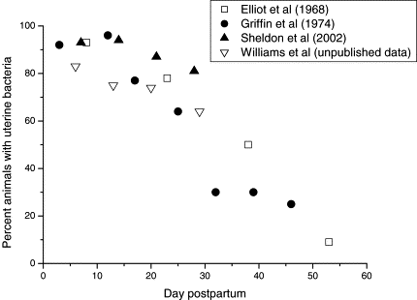
Bacteriological aspects
% of contaminated uterus according to the day of postpartum
Increase of fertility
with the stage of postpartum
Notes:
Elimination of bacteriological content of the uterus represent one of the most important aspect of the uterine involution. The percentage of normally contaminated uterus decrease until day 50 i.e. during all the period of puerperium. Such evolution explain why it not recommended to inseminate too early after calving and to respect at least a waiting period of 50 days.

Slide 18
Biochemical aspects : increase of the catabolism of uterine collagen
Hormonal aspects : see the relation with the beginning of cyclic activity
Prostaglandines (from caronculas > endometrium > myometrium)
  PGF : vasoconstriction and stimulation of contractions
  PGE : relaxation, decrease of immunity and phagocytosis
  LTB4 (leucotriens) : attraction of leucocytes into the uterus, stimulation of phagocytosis and cytokines
Steroidal hormones
  Oestrogens (oestrogens from the follicule) stimulation of defense mechanisms of the uterus
  Progesterone (from corpus luteum : if any) : decrease of the defense mechanims of the uterus
Notes:
During the uterine involution the quantitity of collagen is progressively reduced.
Many hormonal changes can be seen during the involution period. Prostaglandins come mainly from the uterus. Some of them like PGF and leucotrienes promotes the involution. Others like PGE, decreasing the immunity and activity of leucocytes as well as the contractions increase the risk of uterine involution delay. Othe hormones like oestrogens and progesterone come from the ovary. The first are stimulates the uterine defense mechanism. It’s not true for progesterone.

Slide 19
Uterine involution delay
From a clinical point of view :
= palpation of one or both uterine horns with a diameter > 5 cm more than 30 days postcalving
Correlation with the clinical endometritis
Notes:
From a clinical point of view, uterine involution delay can be diagnosed by the palpation of one or both uterine horns with a diameter > 5 cm more than 30 days postcalving.

Slide 20
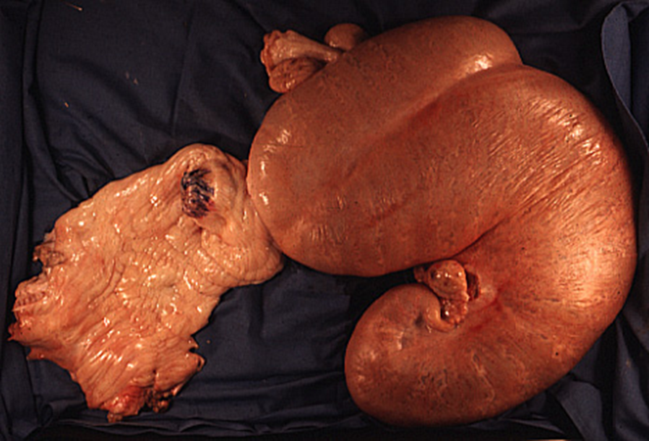
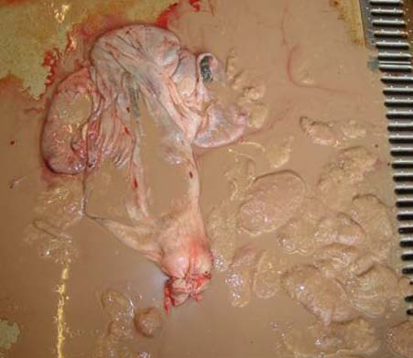
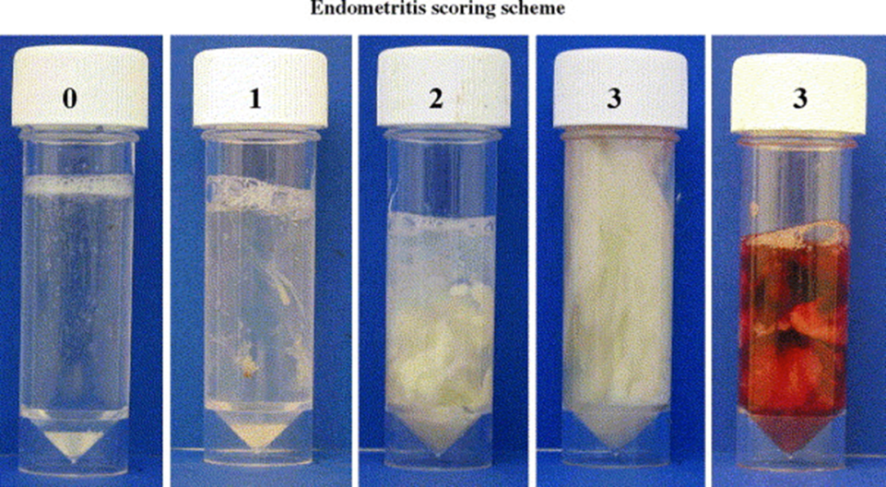
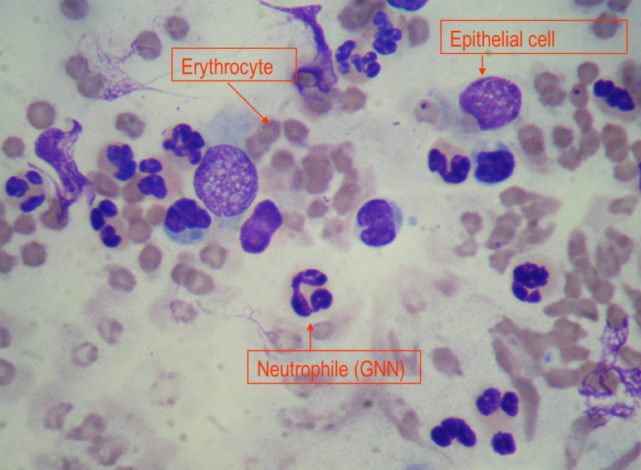
Uterine infections : 4 types (See Sheldon et al. Theriogenology 2006, 65, 1516-1530)
Puerperal metritis
Pyometra
Williams et al. 2005
Clinical endometritis
Subclinical endometritis
Notes:
Four kinds of uterine infections can be distinguished : puerperal/acute metritis, clincial and subclinical endometrits and pyometra.
Acute puerperal metritis (APM) is defined as an uterine infection appearing during the first 21 days postpartum. The clinical signs are general (pyrexia more than,39.5°C, dullness, inappetance, anorexia, reduced milk yield)and / or local (Fetid red-brown watery uterine discharge, enlarged uterus, persistance of the uterine thrill).
Clinical endometritis results in local signs only visible after day 21. A uterine discharge can be seen and scored according to the amount of pus (pus more than 50 %, mucopus if 50 % of pus and 50 % of mucus and flakes of pus if < 50 % of pus.
In case of subclinical endometritis, no clinical signs are visible. There is inflammation of endometrium without purulent material in the vagina. His diagnosis can be made counting the percentages of neutrophiles in a sampling done into the uterine cavity.
Pyometra is an accumulation of purulent or muco-purulent material in the uterus. The cervix is or not open. The uterus is enlarged. Such uterine infection usually appears after the beginning of cyclicity and increase of progesterone in the blood. Pyometra is often associated to a corpus luteum on the ovary.

Slide 21
Acute Puerperal metritis (APM)
Usually general and local signs (= Acute puerperal metritis)
During the first 21 days postpartum
Pyrexia (> 39.5°C), dullness, inappetance, anorexia, reduced milk yield
Fetid red-brown watery uterine discharge, enlarged uterus, persistance of the uterine thrill
Remark = clinical metritis if not general signs
Notes:
Acute puerperal metritis (APM) is defined as an uterine infection appearing during the first 21 days postpartum. The clinical signs are general (pyrexia more than,39.5°C, dullness, inappetance, anorexia, reduced milk yield)and / or local (Fetid red-brown watery uterine discharge, enlarged uterus, persistance of the uterine thrill).

Slide 22

Only local signs
After the first 21 days postpartum
Uterine discharge : > 50 % pus, 50% pus and 50 % mucus or <50 % pus (i.e. flakes of pus)
Williams et al. 2005
Clinical endometritis

Slide 23

No clinical signs
Endometrial inflammation
Absence of purulent material in the vagina
Increase of the % neutrophils in the uterine lumen
Subclinical endometritis

Slide 24
Pyometra
Accumulation of purulent or muco-purulent material in the uterus who become more and more distended
Cervix is open or not
Usually appears after the begining of cyclicity
Corpus luteum is present (often) or not

Slide 25
The postpartum anoestrus in the dairy cow
« Normal »
Abnormal
Waiting period (WP) : 50 – 60 d ?
No estrus signs
No estrus detected by the farmer
Detection
Detection
Functionnal
Manifestation
Manifestation
Pyometra
Physiological
Functionnal
Pathological
Cyst
Until d15-20
No answer to GnRH
No regular follicular growth with ovulation and CL
No regular follicular growth with ovulation and CL after WP
Notes:
Define the postpartum anoestrus is relatively complex. The definition depends on the considered parameter: hormonal, behavioral or according to the follicular growth. Moreover absence of cyclicity can quite normal depending the time of postpartum taken in consideration. So it’s possible to distinguished different kinds of postpartum anoestrus before and after the normal waiting period considered of 50 to 60 days.
After calving and during 15 to 20 days, the ovaries of the cow can’t be stimulated by an injection of the hypothalamic hormone called GnRH. It’s a period of physiological anoestrus. After this period and until the end of the normal waiting period, it’s still possible to have any kind of regular follicular growth, ovulation and development of a corpus luteum. . In such situation we define this anoestrus as functional. If such ovarian situation extends until after day 50 to 60 we are speaking on functional pathological anoestrus. Pathological anoestrus can results also from a pyometra or a cyst. In some situations, before and after the end of the normal waiting period, the cow becomes cycled, present an estrus but this estrus has been seen by the farmer. We call this anoestrus detection anoestrus. Finally, and mainly if the milk production is high (more than 40 l per day), the estrus signs can be low and not visible for the farmer : we call this anoestrus a « manifestation » estrus.

Slide 26
The anoestrus of the postpartum in the dairy cow
Clinical relations with the follicular growth

Slide 27
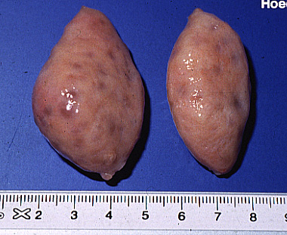
Anoestrus type I (« inactive ovaries »)
Identification by echography of small follicles (< 9 mm)
without corpus luteum
mm
20
No development of these follicles until
deviation or dominance stage
19
18
17
16
Etiology : severe undernutrition
and lack of FSH stimulation for follicular growth
15
14
12
12
11
10
9
8
7
6
Norme : < 10 % of cows
5
4
3
2
Notes:
According to follicular and luteal ovarian activity four kinds of anoestrus can be distinguished during the postpartum period.
In anoestrus type I only recruited follicles with a diameter less than 8 mm can be observed by ultrasonography. At palpation such ovaries appears as smooth or granular. These follicles do not develop and therefore can not reach the point of deviation. Such situation results from a lack of luteinizing hormone (LH) needed for the final growth of the follicle. This lack is results from a severe undernutrition state. This situation should occur in less than 10% of cows in a herd.

Slide 28
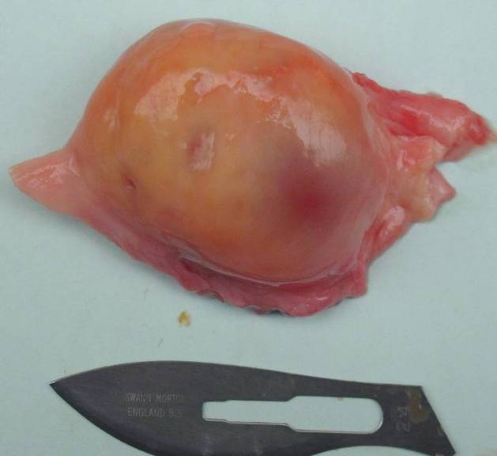
Anoestrus type II
Follicular growth continues until the deviation
and dominance and atresia : no ovulation
Atresia is followed by a new wave of growth
within 2 to 3 days
mm
20
19
18
17
16
15
14
12
12
11
10
9
8
7
6
5
4
3
2
Notes:
During anoestrus type II, there was a follicular growth that continues until that stage of the deviation and the emergence of a dominant follicle.
This growth is then followed by regression of the follicle. Two or three days later a new wave of growth can appear. Some times, nine waves can succeed before reaching ovulation. This lack of ovulation after follicular growth regularly is probably be due to an insufficient synthesis of estradiol by the follicle growth or a lack of his positive feedback on the release of luteinizing hormone. At palpation, it’s quite possible to palpate a follicle without presence of cyst or corpus luteum.

Slide 29
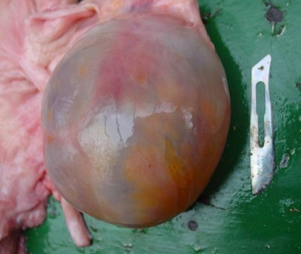
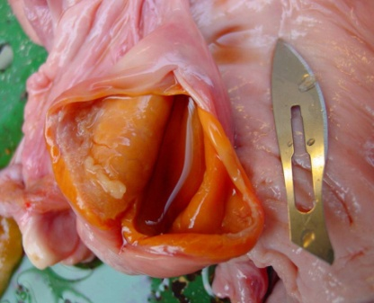
Anoestrus type III (« Cystic anoestrus»)
mm
KF
KF
20
19
18
17
16
KFL
15
14
12
12
11
A
10
9
8
7
6
B
5
4
3
2
Notes:
The anoestrus type III is characterized by the presence of a follicular cyst. This cyst can continue to growth or can evolve to a luteinized follicular cyst. In presence of a cyst, follicular growth can be or not inhibited.

Slide 30

Anoestrus type IV
mm
20
19
18
17
16
15
14
Pyometra
12
PGF
12
11
10
9
8
7
6
5
4
3
2
Notes:
In the anoestrus in type IV, the dominant follicle continues to grow until ovulation.
This ovulation is followed by the development of a corpus luteum but corpus luteum does not regress and persist on the ovary.
This lack of reduction involves an alteration of the luteolytic process. It is possible that the synthesis of estradiol by the follicle growth was not sufficient for inducing the formation of oxytocin receptors in endometrium and thus prevent and the pulsatile release of PGF2a. It is also possible that the synthesis of PGF2a was not sufficient because of extensive endometrial lesions induced by a pyometra. At palpation uterus is usually enlarged and the cervix is or not open. So pus can or not be seen by vaginoscopy.

Slide 31
What’s the prevalence of these pathologies ?
4

Slide 32
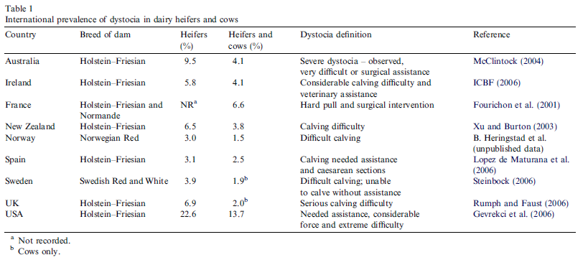
Dystocia : prevalence (Mee et al. 2008)
2 to 7 % in dairy cows : threshold 5 %
Notes:
The prevalence of these different pathologies are quite different according to the countries, the breed of cows, their managment conditions, the stage of postpartum and also the definitions and methods used to make the diagnosis. Nevetheless, it’s always interesting to have an idea of the prevalence because all these pathologies need to be investigated also at the herd level.
In dairy cattle, the prevalence of dystocia is between 3 and 23 % and 1.5 and 13.7 % in heifers and cows respectively. A threshold of 5 % can be considered as normal.

Slide 33
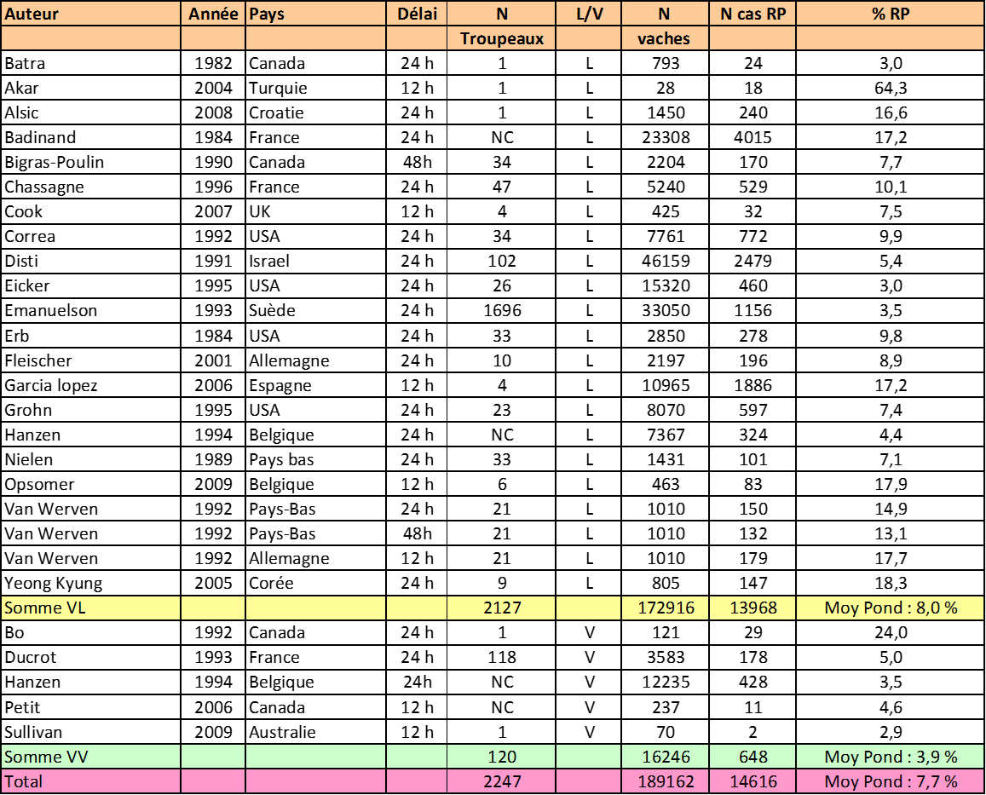
Placental retention : prevalence
Dairy : 8 %, Beef 4 %
Notes:
From a large review of litterature including 1,7 million cows and 2127 herds, the prevalence of placental retention is between 3 and 64,3 % the average being 8 %. This prevalence is twice as observed in beef cattle (3,9 % from )16.246 cows and 120 herds).

Slide 34
Prevalence of uterine involution delay (diameter > 5 cm) in beef and dairy cattle according to the stage of postpartum (Hanzen 1994)
Dairy and beef : < 10 %
Notes:
From a study on 3.690 dairy and 6042 beef cows, we have observed the same prevalence of uterine involution delay between 31 and 50 days in both kinds of cows : 6 %.

Slide 35
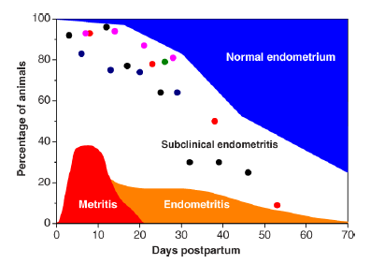
Prevalence of uterine infections (Sheldon et al. 2009)
Pyometra : < 5 %
20 à 40 %
30 %
15 à 20 %
Notes:
As mentionned by Sheldon (2009), the prevalence of puerperal acute metritis, clinical, subclinical endometritis and pyometra are repectively of 20 to 40 %, 15 to 20 %, 30 % and less than 5 %.

Slide 36
Comparaison of uterine infections prevalence (%) according to the stage of postpartum in irish dairy (9531 cows and 387 herds) and beef (484 cows in 109 herds) Fitzgerald et al : Communication de Williams au congrès ESDAR septembre 2013
Notes:
According to an irish study (Fitzgerald 2013), the prevalence of utreine infections is decreasing during the weeks of postpartum in beef and dairy cattle, the highets prevalence being observed during the weeks 3 and 6.

Slide 37
Prevalence of clinical and subclinical endometritis according to the method of diagnosis and stage of puerperium (Adnane and al. Submitted 2015)

Slide 38
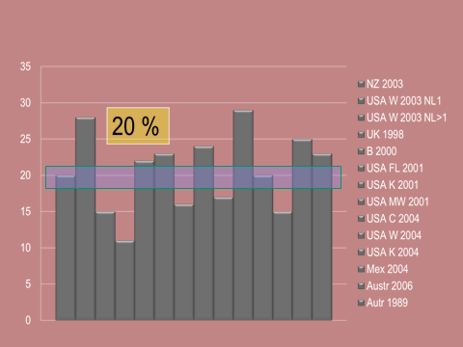
Prevalence (%) of postpartum anoestrus in dairy cows
Notes:
According to different studies conducted in different management systems, one cow out of five (20 %) do’nt present a regular cycling activity during the first two months of the postpartum.

Slide 39
Prevalence of anoestrus (%) in 9 New Zeland dairy herds with more 400 cows and producing 22 kgs of milk per day on average
Diagnosis based on the absence of corpus luteum manually detected by a vet 58 days postpartum on average (Mc Dougall and Compton J Dairy Sci 2005 80 2388-2400)
Large differences between the herds
Notes:
Moreover, according to a new-zealand study, large differences can be seen beween herds.

Slide 40
Prevalence of ovarian cysts
Fourichon et al., 2000 : meta-analyse (20.000 cows from 196 herds) : 12 % (3 à 29 %)
Lubbers 1998 (The Netherlands) : 12.626 lactations during 10 years in 39 herds : 7,2 % (1,9 to 11,3 % according to the herds)
Erb et Martin, 1980 and Kinsel et Etherington, 1998 (Canada)
24.356 lactations : 9,3 %
> 10 % : herd problem
Notes:
Considering studies with huge numbers of cows, the frquency of cysts is between 7 and 12 %. Also, we can consider that at the herd level, the threshold value can be 10 %.

Slide 41
How to diagnose the pathologies of the puerperium ?
5
Notes:
As usual, the sensitivity or specificity but also the positive or negative predictive value of any propredeutical method are important to make a correct diagnosis and a a good treatment. As usual too it’s necessary to detect as soon as possible any kind of pathology to decrease their consequences on fertility. In such context we can recommand to adopt a preventive and systematic approach of the herd to detect abnormal cows.

Slide 42


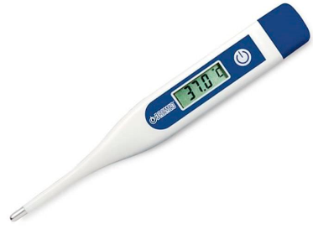
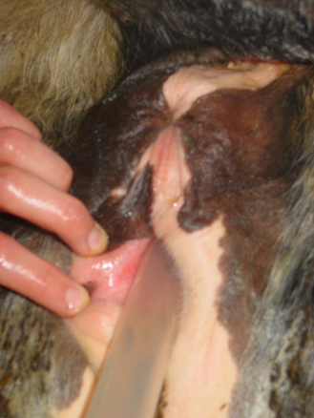
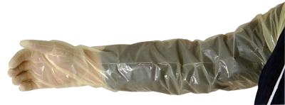
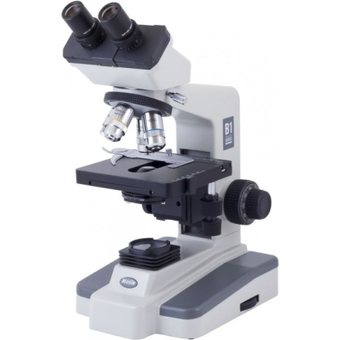
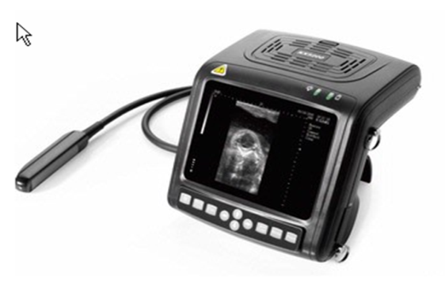
Dystocia
Placental retention
Puerperal metritis
Uterine involution delay
Clinical endometritis
Subclinical endometritis
Anoestrus
(functionnal, cystic,
pyometra
Different tools
Notes:
The farmer and the veterinarian has different tools. It’s important to know how and what to see to detect for example dystocia or a placental retention. Thermometer is important to detect the cows suffering from puerperal metritis. It’s recommended to take temperature on any cow presenting a placental retention. Vaginoscopy is still the best method to detect puerperal or clinical endometritis. A transrectal examination is very usefull to make the diagnosis and to treat dystocia, placental retention, puerperal metritis, clinical endometritis and anoestrus. A microscope is necessary to make the diagnosis of a subclinical endometritis. Ultrasound is sometimes required to make a differential diagnosis of the different anoestrus.

Slide 43
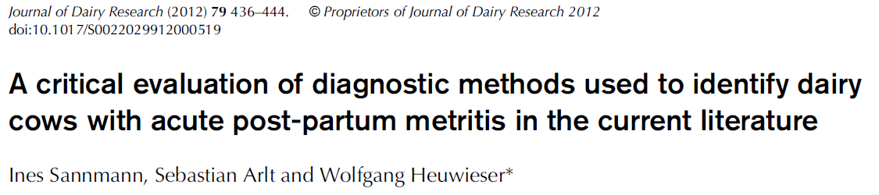
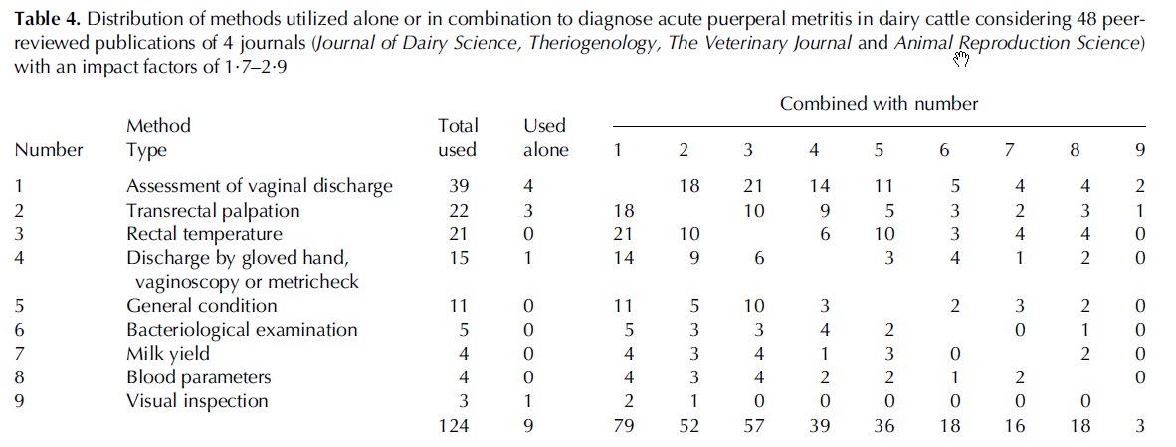
Which methods are used for the diagnosis of puerperal metritis ?
Assessment of vaginal discharge is the main diagnosis method used alone or
in combination with another method
Notes:
De la qualité du diagnostic revue au travers de 48 publications
Qui fait le diagnostic : non spécifié dans 60 % des cas. Quand la personne responsable est précisée, ce diagnostic est posé dans 21 % des cas par un vétérinaire.
Quand le diagnostic est-il posé : l’information est renseignée dans 69 % des cas.
Quelles méthodes ont été utilisées ? Seule ou en association, 124 méthodes ont été utilisées (2,6 en moyenne (2 à 7 en cas d’association 75 % des publications). Dans 79,2
La plupart % des cas les méthodes utilisées ne font pas référence à une publication décrivant la méthode.
Fréquence des méthodes utilisées.
L’examen vaginal (main couverte d’un gant, spéculum et Metricheck) a été utilisé dans 81 % des cas et le cas échéant les caractéristiques des secrétions ont été précisées dans 79,5 % des cas.
La palpation rectale a été utilisée dans 45,8 % des cas seule ou en association avec une autre méthode. Le cas échéant, les symptômes observés par cette méthode ont été décrits dans 73 % des cas.
La température rectale a été mesurée dans 44 % des publications et un seuil défini dans 75 % des cas.
L’état général de l’animal a été précisé dans 22,9 % des études.
Un examen bactériologique a été effectué dans 10,4 % des études.
La chute de la production laitière a été analysée dans 8,3 % des études.
Une analyse des paramètres sanguins (haptoglobine, fibrinogène, glycoproteines, glucosaminidase) a été effectuée dans 8,3 % des études.
L’inspection visuelle de la queue et de la région perinéale n’a été réalisée que dans 6,3 % des études.
Moralités
Le manque de clarification des méthodes utilisées ou de référence à une méthode déjà décrite et publiée remet en question la pertinence des observations réalisées. Il en est de même lorsque ces observations ont été réalisées par le personnel non vétérinaire de la ferme ou lorsque le moment du diagnostic n’a pas été mentionné. Le manque de spécification de l’origine et de la nature (couleur, odeur, viscosité) des écoulements observés peut également constituer un biais du diagnostic d’une MAP (Métrite aigüe puerpérale). La palpation transrectale tout comme l’évaluation de l’état générale revêt une part de subjectivité trop importante que pour être réellement valable. Le recours à la seule température rectale augmente le risque d’erreur de type 1 (l’animal est en hyperthermie mais n’est pas malade) et de type II (l’animal a une température normale mais est malade). Les erreurs de type 1 induisent une surconsommation possible de traitements anti-infectieux. Il semble essentiel de définir la sensibilité et la spécificité de la prise de température rectale d’autant que celle-ci peut présenter des variations physiologique au cours des trois première semaines du postpartum. A défaut, il semble essentiel de combiner cette méthode avec une autre méthode.
Une chute de production laitière peut être observée lors d’un état inflammatoire utérin subclinique. Ce qui remet en cause la validité de la méthode. Les auteurs semblent être d’accord pour dire qu’une concentration en haptoglobine supérieure à 100 mg/L confirmerait la présence d’une MAP qui cependant n’en serait pas la seule cause.
En l’absence d’une méthode gold standard d’identification d’un état inflammatoire de l’utérus au cours des trois premières semaines du postpartum, il est bien difficile de caractériser la sensibilité et spécificité des méthodes proposées voire l’augmentation attendue de la combinaison de ces méthodes.

Slide 44
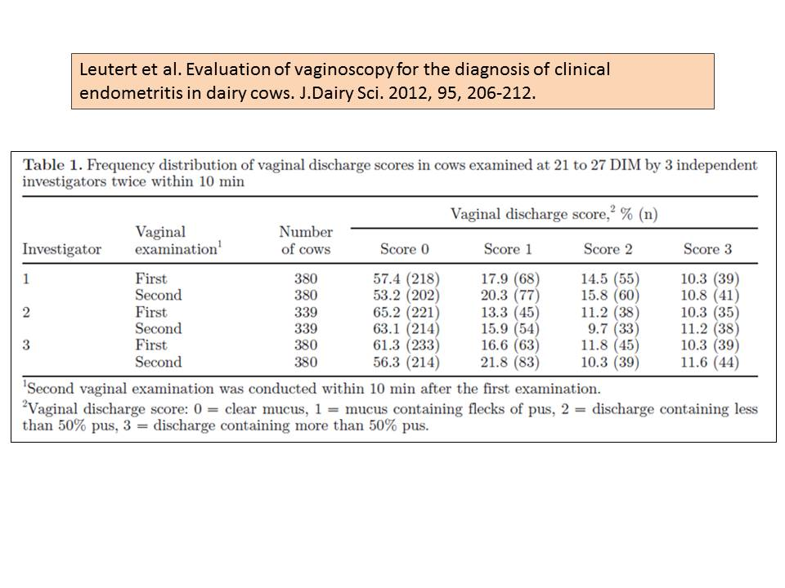
Which is the interest of vaginoscopy for the diagnosis of clinical endometritis ?
Prevalence of endometritis : 42 %
Good correlation between the two pratitionners independently on their experience
No effect of rectal palpation before vaginal examination

Slide 45
When detect these pathologies ?
6
When to diagnose these pathologies of the puerperium ?
As early as possible: that the interest of a preventive and systematic approach

Slide 46
Detection of endometritis
and NEB
Detection
of metritis
Cows with PR
BCS
After
calving
1-3 d
Check
all the cows
Ovarian status
Check BCS,NEFA,pH
Uterine status
After
calving
30-50 d
Vaginoscopy
Detection
of NEB
Before
calving
Ratio fat:prot
Lameness
Pneumovagina
Pregnancy
Waiting (Puerperium) period
BCS
Cows not
seen in heat
at 50- 60 d
Detection
of anoestrus
Ovarian status
Uterine status
Notes:
All the pathologies need to be detect as soon as possible. It’s possible to organize different systematic examination of the cows at risk. Before calving, the cows can be checked for their body condition score and their concentration in non esterified fatty acid (to detect a negative energy balance) or their pH of urine. During the first 1 to 3 days postpartum, any cow with a placetal retention or hyperthermia (> 39.5°C) need to be examined. Later after calving i.e. between 30 and 50 days postpartum, we need to realize a transrectal and vaginal examination to evaluate the ovarian, uterine and vaginal status. Locomotion score and body conditions score need also to be determined. Analyse of the ratoion between fat and proteins in the milk could be also very usefull to detect subclincal acetonemia ,and/or acidosis. If the cow has not been seen in heat during the first two months after calving, the palpation of the genital tract need to be done to determine the etiology of anoestrus.

Slide 47
What kind of relations exist between these pathologies?
The example of uterine infections
7

Slide 48
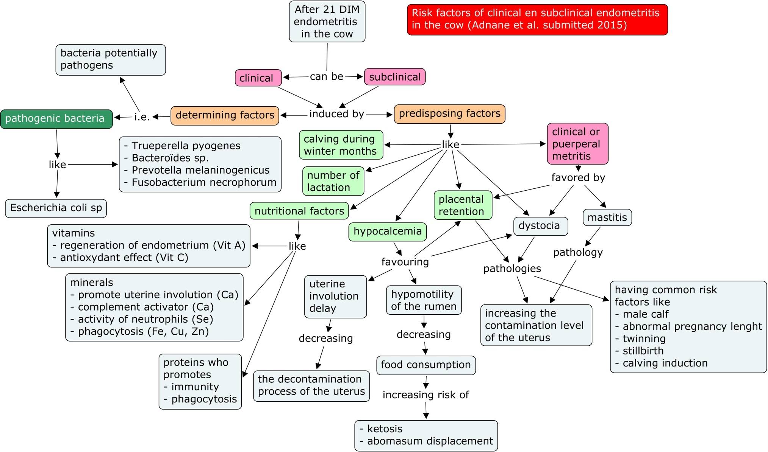
Risk factors of uterine infections
Notes:
As others pathologies, uterine infections depend on determining and predisposing factors. Bacteria are considered as determining factors. The bacteriology of the uterus after calving is very complew and different kind of bacteria can be found. Some of them are contaminant, other can become pathogens and finally we can detect bacteria rreazlly pathogen like E.coli, Truperella pyogenes, Prevotella melanogenicus of Fusbacterium necrophorum. Different types of predisposing factors can influence the possibility for the cow to develop early or latter an uterine infection. Calving during the winter months increase the infection pressure. The risk of uterine infection decreases with the number of lactation, primiparous cows being mor at risk of dystocia. Nutritionnal factros like vitamins, minerals or proteins have been involved in uterine infections. Hypocalcemia is related to nutrition. Such clinical or subclinical pathology promotes uterine involution delay and so decreases the decontamination process of the uterus; Hypolacemia has also been involed in hypomotility of the rumen. As consequence, food consumption is decreased and the risk of acetonemia and abomasum displacement are increased. Moreover hypocalcemia can also promotes dystocia and placental retention. Puerperal metritis is a predisponsing factor for a clinical and subclinical endometritis. The pathology result from dystocia, placental retention or mastitis, all conditions promoting the contamination level of the uterus. Dystocia and placental retention have some commons predisposing factors like male calf, abnormal pregnancy lenght, twinning, still birth or calving induction.

Slide 49
Bacteriology of uterine infections (Williams EJ ESDAR congress Bologna 2013)
Pathogen
Potentially pathogenic
Opportunist, Contaminant
Escherichia coli
Trueperella pyogenes
Fusobacterium necrophorum
Fusobacterium nucleatum
Prevotella spp
Acinetobacter spp
Bacillus licheniformis
Enterococcus faecalis
Haemophilus somnus
Mannhiemia haemolytics
Pasteurella multocida
Peptostreptococcus spp
Staphylococcus aureus
Streptococcus uberis
Aeropcoss viridans
Clostridium butyricum
Clostridium perfringens
Corynebacterium spp
Enterobacter aerogenes
Klebsiella pneumoniae
Micrococcus spp
Providencie rettgeri
Providencia stuartii
Proteus spp
Propionobacterium granulosa
Staphylococcus spp (coag -)
A- haemolytic streptococcus
Streptococcus acidominimus
E coli : mainly during the 1st week PP
T pyogenes : mainly during the 2nd week PP

Slide 50
How to treat these pathologies ?
8

Slide 51
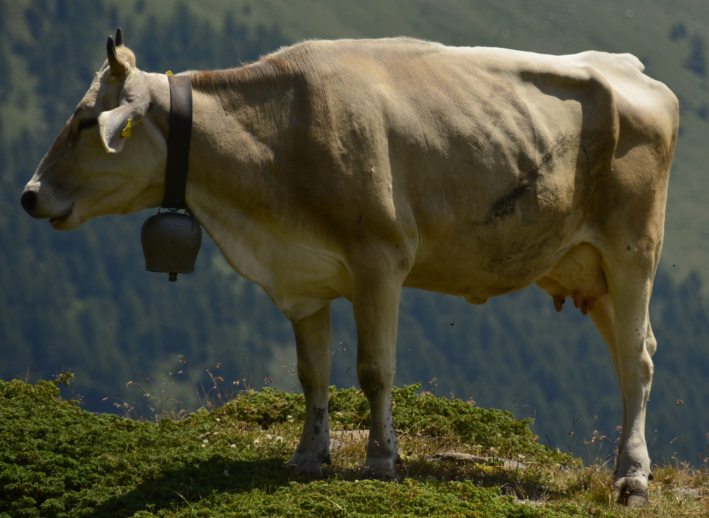
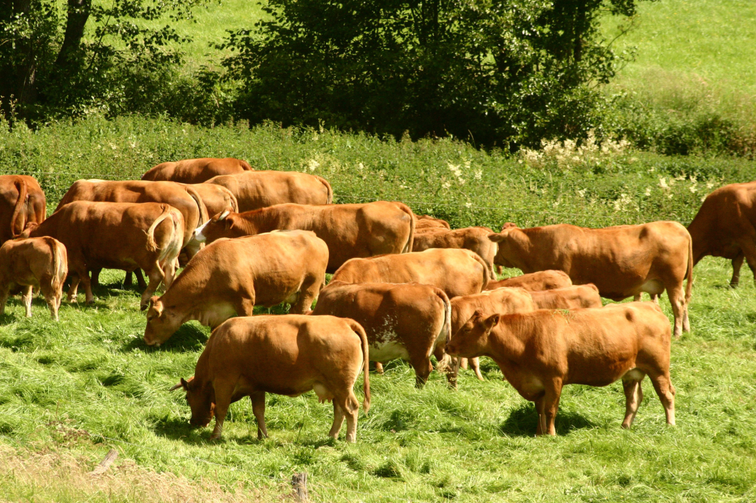
Strategy of therapeutics depend on the problem
Individual problem
Herd problem
Identify the risk factors and
make the right diagnosis to apply
a preventive and curative treatment
Make the right diagnosis
to apply a curative treatment
Notes:
Therapeutical strategies will depend on the importance of the problem. If the problem is individual, it’s important to make the right diagnosis using the best method. Different usual recommandations can be done. If the herd is concerned (see the prevalences of the different pathologies), it becomes very important to take in consideration the different risk factors. It’s impossible to solve the problem of puerperal metritis if the problem of placental retention has not been solved. In suc case it would be necessary to combine a preventive and a curative approach.

Slide 52
The uterine infections
Some preliminary observations
Uterine infections are inflammation (including placental retention) and inflammation is a defense mechanism for the cow
During the first weeks postpartum uterine cavity is contaminated by a quite large number of bacterial species
Few data on in vitro susceptibilities of bacteria isolated from the bovine uterus are available
Selection of an antibiotic is usually made on an empirical basis
Under field conditions, bacteriological sampling of the uterus is usually not feasible

Slide 53
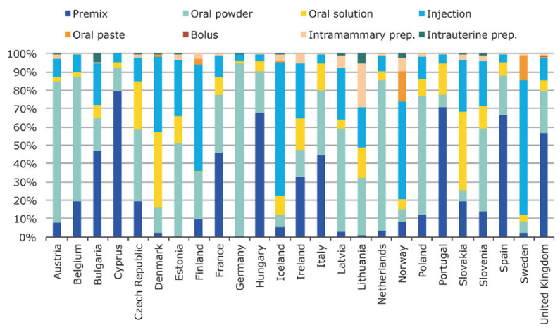
Antibiotics are not used by the same way in the different countries
AB is a worldwide public health challenge
Distribution of sales of veterinary antimicroblial agents for food-producting animals (including horses) in mg per population correction unit (mg/PCU) by pharmaceutical form in 25 european countries in 2011 (European Medicine Agency 2013) (Pyorala et al. Reprod Domest Animal 2014)

Slide 54
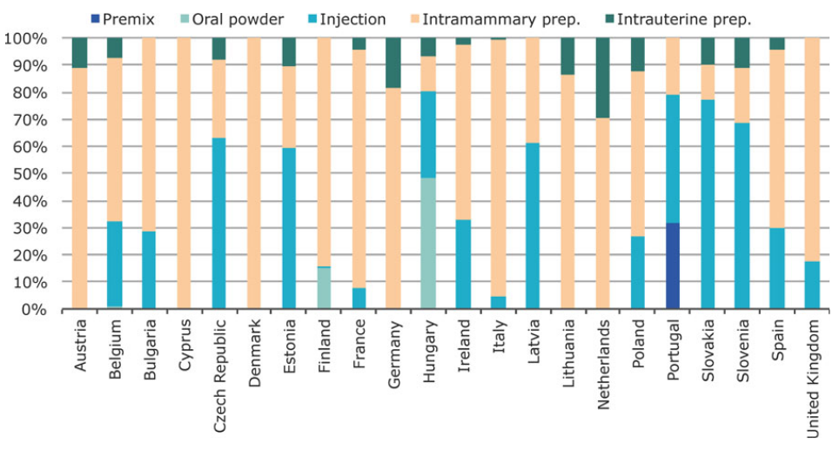
Distribution of sales by pharmaceutical for for 1st and 2nd generation cephalosporins in mg/PCU in 22 european countries in 2011 (EMA 2013) (Pyorala et al. Reprod Domest Animal 2014)
The use of antibiotics is quite different between countries :
example of cephalosporins
Notes:
From Toutain
Première génération (Gram + )
Céfalexine (Rilexine * , Virbac)
Cefalonium (Cepravin*,MSD)
Céfapirine (Céfatar * , MSD)
Céfazoline (Cefovet* ,Merial)
Deuxième génération (spectre intermédiaire )
Troisième génération (spectre accru sur les Gram - )
Ceftiofur (Exenel * , Pfizer)
Céfopérazone (Pathozone * , Pfizer)
Céfovécine (Convenia, Pfizer)
Quatrième génération
Cefquinome (Cobactan*, Intervet)

Slide 55
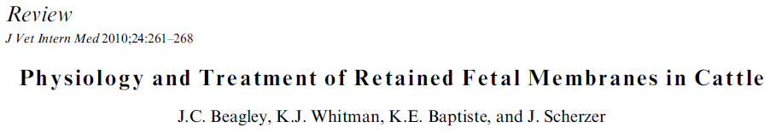
The placental retention
No effect or harmful effect after treatment by manual removal associated or not with local antibiotics (bolus or infusion) or with parenteral antibiotics.
No effect at all of oxytocic agents (Oxytocine, carbetocine, PGF2a)
Recommandations :
  Follow-up of temperature and clinical condition
  treat only cows who develop puerperal metritis

Slide 56
The uterine infections : the puerperal and clinical metritis
Classically, puerperal metritis (local and systemic signs of illness) and clinical metritis (puerperal metritis without systemic illness) are treated with penicillin (20 to 30.000 IU /Kg 2 x /day), ampicilline and ceftiofur (1 mg/Kg 2x /day) associated or not with intrauterine injection of oxytetracycline (3 to 6 g in a water solution), ampicillin or cloxacillin.
No effect of PGF2a.
(Pyorala et al. Reprod Domest Animal 2014 (Suppl3) 49, 16-26)

Slide 57
The uterine infections : the puerperal and clinical metritis
Some observations from Evidence Based Medicine
(Haimerl and Heuwieser J.Dairy Sci. 2014, 97, 6649-6661)
21 publications with sufficient evidence level
18 published after 2000
17 studies have tested ceftiofur
  7 (out off 13) studies have seen a clinical improvement
  0 (out off 7) have seen an improvement of reproductive performances
  3 studies have described the possibility of selfcure (15 % < 5d and 55 % < 14d)
We need
  to define a standard gold method
  more research about selfcure
  to test alternative methods of treatment
  to defined better the ratio cost-benefits

Slide 58
The uterine infections : how to « modulate » inflammation ?
Some observations (Bradford et al. J.Dairy Sci. 2014)
Non Steroidal Anti-inflammatory Drugs some effects (if any)
  Flunixin : increase the involution of the uterus if metritis or no effect
  Salicylates given in early lactation : increase of milk production
  Meloxicam : decrease the risk of culling if mastitis
  Carprofen : increase time spent eating after dystocia
Non Steroidal Anti-inflammatory Drugs some negative effects
  Suppression of inflammation mechanism (parturition induction and placenta maturation)
  Presence of residues (milk removal for 3 to 5 days)
LPS vaccination
Bioactive fatty acid (flaxseed)
Anti-oydants (Vit E, Se) to neutralize ROS and decrease inflammation

Slide 59
The uterine infections : the clinical endometritis
= Local signs after 21 days
PGF2a is the best treatment if a corpus luteum is present.
Many antimicrobial compounds used for local treatment (tetracycline, penicillin, cephapirin, chloramphenicol, iodine, gentamycine, spectinomycin, sulphonamides, nitrofurazone, chlorhexidine ) are no longer approved and their efficacy has not been demonstrated.
One exception : cephapirin (500 mg) (1st generation cephalosporin).
Few effect (if any) of parenteral treatment with ceftiofur (3rd generation cephalosporin).
(Pyorala et al. Reprod Domest Animal 2014 (Suppl3) 49, 16-26)

Slide 60
The uterine involution delay
No specific treatment
Control the risk factors (uterine infections)

Slide 61
The treatments of postpartum anoestrus
Notes:
The treatments of postpartum anoestrus can be considered in two aspects. The first concerns the non cycled animals and the second the cycled animals.
Some general recommendations need to be taken in account. (1) It’s necessary to make a good differential diagnosis of the different post-partum anoestrus with anamneses, manual palpation, echography, BCS and vaginoscopy. (2) It’s unnecessary to treat with hormones any anoestrus (except pyometra) during the first 50 to 60 days post-partum. (3) Again, it’s important to detect and to treat as soon as possible the uterine infections (including pyometra). (4) we need to avoid to treat with hormones, the cows having a BCS lower than 2.5. The effects of the different hormones are quite different. So PGF2a can induce (one cow) or synchronize (several cows) oestrus is the heifer/cow has a corpus luteum. The progestogens (progesterone, norgestomet) can induce (one cow) or synchronize (several cows) oestrus is the heifer/cow in absence of corpus luteum and GnRH can induce (one cow) or synchronize (several cows) ovulations is the heifer or cow has a dominant follicle i.e. a follicle with a diameter > 8-10 mm.
Some general recipes can be proposed according to the type of anestrus in non cycled animals. There is no hormonal treatment for anestrus type I. We need try to increase the body condition score. Anestrus type II can be treated with progestogens associated or not with with GnRH or G (Equine Chorionic Gonadotropin). Anestrus type III (ovarian cysts) will be treated with PGF2a in case of luteal cyst) and by GnRH, hCG, or progestagens in case of follicular cyst. Anestrus type IV (pyometra) will be treated with PGF2a.
Many different treatments have been proposed to induce and / or to synchronise cycled animals. All of them are using the PGF2a associated or not to GnRH or progestagens and sometimes to esters of oestradiol (elsewhere than in Europe). One of the most known is the Ovsynch protocol who associates GnRH (Day 0) , PGF2a (Day 7) and GnRH (Day 9). Before using any treatment with PGF2a, be sure the heifer/cow has a corpus luteum bigger than 2 cm (PGF2a has effect during metoestrus, prooestrus or estrus ), and be sure that the cow is not pregnant (between day 6 and 150). Moreover, earlier PGF2a is injected during diestrus, smaller is interval between injection and beginning of estrus. Usually, the use of PGF2a (with or without GnRH) don’t increase the fertility but reduce the waiting period. It’s necessary to adopt a good policy of insemination : timed artificial insemination (TAI) or insemination done after an observed estrus. Finally take also in account the costs of labor and hormone administration when selecting this form of reproductive technology for routine use.

Slide 62
First recommandation
Make a good differential diagnosis of the different post-partum anoestrus with anamnese, manual palpation, echography, BCS and vaginoscopy
Second recommandation
Avoid to treat with hormones any anoestrus (except pyometra) during the first 50 to 60 days post-partum.
Third recommandation
Detect and treat as soon as possible uterine infections (including pyometra).
Fourth recommandation
Avoid to treat with hormones, cows with a BCS lower than 2.5

Slide 63
Anoestrus type I (« inactive ovaries »)
pathological functionnal anoestrus grade 1
No hormonal treatment :
increase the BCS
Anoestrus type II : follicular growth but no ovulation (pathological functional anoestrus grade 2)
Progestagens
with GnRH, eCG
Anoestrus type III (« Cystic anoestrus»)
PGF, GnRH, hCG, Progestagens
Anoestrus type IV : (pyometra)
PGF
Detection anoestrus (cycled animal )
PGF (different protocols
Any use of oestradiol is forbidden in Europe
GnRH alone has no effect to treat anoestrus type 1 and II

Slide 64
Remember
PGF2a can induce (one cow) or synchronize (several cows) oestrus is the heifer/cow has a corpus luteum.
The progestagens (progesteron, norgestomet) can induce (one cow) or synchronize (several cows) oestrus is the heifer/cow in absence of corpus luteum.
The GnRH can induce (one cow) or synchronize (several cows) ovulations is the heifer.cow has a dominant follicle i.e. a follicle with a diameter > 8-10 mm.

Slide 65
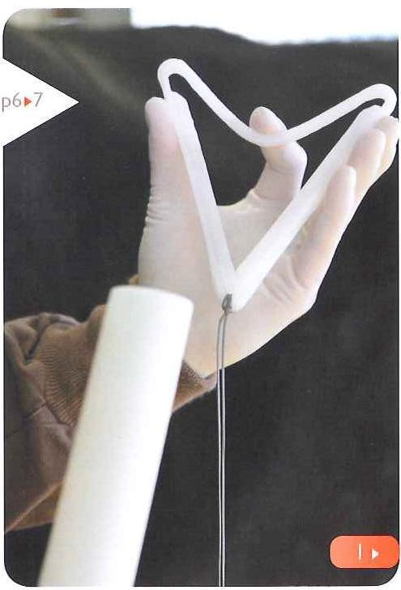
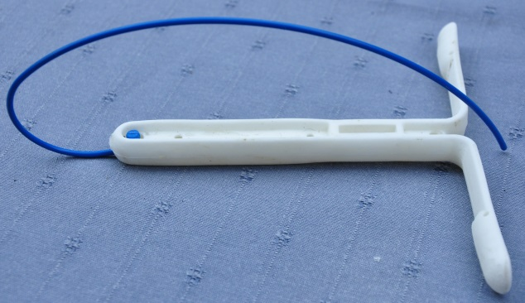
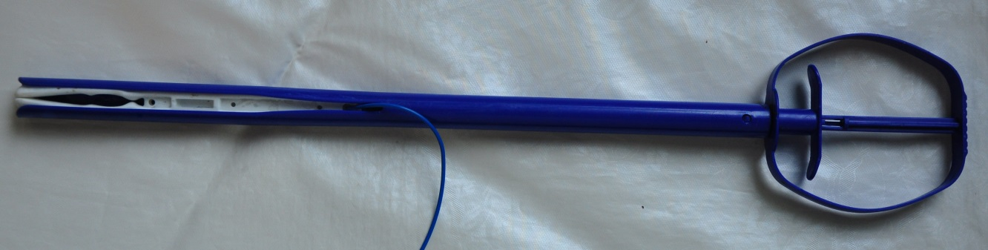
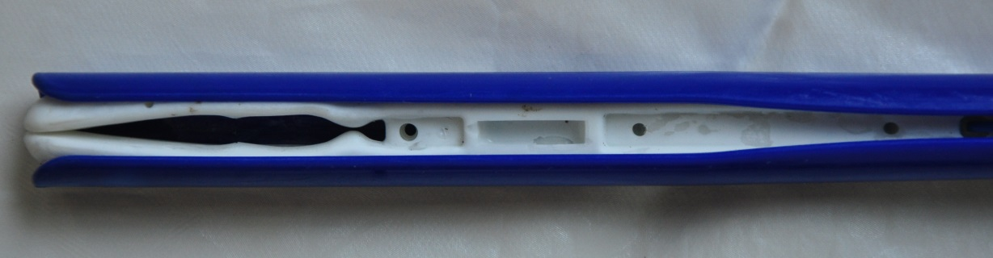
What intravaginal systems in Belgium ?
Easi-breed CIDR Zoetis
(Controlled internal drug
releasing device : P4 1,38 g)
PRID CEVA (progesterone
relasing intravaginal device :
P4 1,5 g)

Slide 66
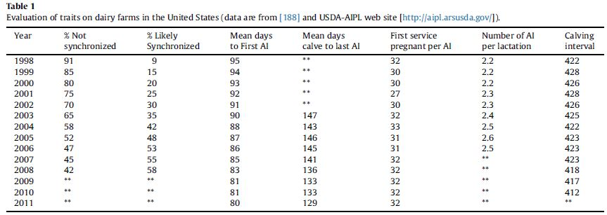
In USA (and in Europe ?) increase of the use of induction/synchronisation protocols (PGF/GnRH)
Such strategy has reduced the number of days open with no effect on fertility
In Wiltbank et Pursley Theriogenology 2014 81 174-185
Notes:
L’examen de la figure permet de constater que l’augmentation importante du recours à la synchronisation avec les années. Il en est résulté une diminution importante (15 jours) de la durée de la période d’attente sans que pour autant le taux de gestation en 1ère IA en soit modifié avec cependant une légère augmentation de l’index de fertilité. L’effet de réduction sur l’IV est donc surtout imputable à la réduction de la PA qui s’est également traduit par une diminution de 18 jours de l’intervalle entre le vêlage et la dernière IA
Une étude récente (Souza et al. JDS 2013 96 390) a cependant montré que le recours à une TAI augmentait la PA (67,5 vs 49,6 jours)

Slide 67
Many protocols…
J0 IA
IA 6 à 24 h post GnRH
33
32
26
20
19
18
17
16
15
10
9
8
7
6
5
4
3
2
1
0
G
OVSYNCH 7J
P
G -16h
IAS
1
P
P
G
PRESYNCH/OVSYNCH
P
G -16h
IAS
2
P
G
G
G6/OVSYNCH
P
G -16h
IAS
3
G
P
G
G
DOUBLE OVSYNCH
P
G -16h
IAS
4
G P4 (CIDR 1/2) P
G
IAS
5
G
OVSYNCH 5J
P
P 12h
6
BO P4 (8/9 J CIDR ) P CO
IAS
7
BO
P
CO
G
COSYNCH (48 /72h)
P
G
IAS
8
P
P
G
PRESYNCH/COSYNCH
P
G
IAS
9
G
G
G/OVSYNCH
P
G -16h
IAS
10
G : GnRH,
P : PGF2a,
P4 : progestérone,
BO benzoate oestradiol,
CO : cypionate oestradiol
G
HEATSYNCH
P
CO
IAS /IAC
11
G
SELECTSYNCH
P
IAS /IAC
12
IAS : IA systematic
IAC : IA on detected oestrus
Notes:
Ref 1 Pursley et al. Theriogenology 1995 44 915-923
Ref 2 Presynch-Ovsynch : Moreira et al. JDS 2001 84 1646-1659; Navanukraw et al. JDS 2004 87 1551-1557, Galvao et al. JDS 2007 90 4212-4218; El-Zarkouny et al. JDS 2004 87 1024-1037 : Initialement la 2ème injection de PGF2a du presynch était réalisée 12 jours avant la 1ère injection de l’Ovsynch (Moreira et al. 2001). On a ensuite proposé le délai de 14 jours (pour la facilité du calendrier). Il est actuellement recommandé d’avoir un intervalle de 11 jours (Galvao et al. 2007). Le principal inconvénient des ces protocoles de presynchronisation est le % élevé de vaches en anoestrus en fin de période d’attente.
Ref 3 Bello et al JDS 2006 89 3413-3424, L’injection d’une GnRH 6 voire 4 ou 5 jours avant l’ovsynch et 2 jours après une injection de PGF2a ovsynch avait pour raison d’être d’augmenter le % de vaches réceptives au 2ème ovsynch en essayant de récupérer des vaches en anoestrus à fin de période d’attente.
Ref 4 dans le même but de récupérer des vaches en anoestrus, un double ovsynch a été proposé (Ayres et al Theriogenology 2013 79 159-164. Ce protocole a contribué à augmenter le % de gestation chez les primipares mais pas chez les pluripares (Souza et al. Theriogenology 2008 70 208-215 ). D’autres études sont venues confirmer l’amélioration de la fertilité (Herlihy et al. JDS 2012 95 7003-7014, Ribeiro et al. JDS 2012 95 2513-2522) . Ce protocole serait donc à réserver aux troupeaux présentant un % élevé d’anoestrus et le presynch serait à conseiller si ce % des plus faible.
Ref 5 : l’administration de P4 sous la forme d’un IVP4 contribue à augmenter le % de gestation (34,2 vs 29,6 v%) quelque soit le taux de P4 au moment du début du protocole Ovsynch (Bisinotto et al. JDS 2014 suppl 1 in press abs) (cfr metaanalyse) : le taux de gestation reste néanmoins inférieur si les vaches ne sont pas cyclées lors de la 1ère injection de GnRH. Cet IVP4 augmente de 0,8 à 1 ng la concentration de P4 (Cerri et al. Animal Reproduction Science 2009 110 56-70; Lima et al. JDS 2009 92 5436-5446 . La mise en place de deux IVP4 (CIDR) augmente la concentration de 2,65 ng et permet d’obtenir des taux de gestation comparables à ceux d’animaux cyclés (Bisinotto et al. JDS 2013 96 2214-2225; Lima et al. 2009, Denicol et al. 2012 95 1794-1806)
Ref 6 : Bridges et al. 2008
Ref 7 Pereira et al. 2014
Ref 8 Co-synch : injection de la GnRH au moment de l’IA : Geary et Whittier Prof Anim Sci 1998 14 217-220 ; Cosynch 48 : Vasconcelos et al. Biol reprod 56 Suppl1 1997 140: Cosynch 72 : Portaluppi et Stevenson JDS 2005 88 914-921, Santos et al. 2010, Colazo et al. Reproduction Fertility and Development 2004 16 128 Le système Cosynch permet de réduire les manipulations d’animaux puisque l’injection est réalisée en même temps que l’IA
Ref 10 : Lopes et al. JDS 2013 96 3788-3798 , Bruno et al. JDS 2013 97185-194, Dewey et al. JDS 2006 93 4086-4095
Les traitements de presynchronisation ont pour intérêt d’augmenter la possibilité d’injecter une PGF2a quand la P4 est élevée (cfr Ref 2,3, 5 et 6) mais on multiplie le nombre d’injections nécessaires. Il est donc nécessaire de réduire leur nombre pour des raisons de manipulations des animaux et de couts des traitements
L’effet des traitements de synchronisation dépend notamment de l’intervalle entre l’injection de PGF2a et l’ovulation cad en fait du degré de développement du follicule au moment de l’!injection de la PGF2a. Ainsi si le follicule est toujours en phase de croissance, cet intervalle sera de 4,5 jours mais de 3 jours s’il est en phase statique (8 mm) (Cartmill et al. JDS 2001 84 1051-1059)

Slide 68
If you have decide to use PGF2a, don’t forget
Be sure the heifer/cow has a corpus luteum with a diameter bigger than 2 cm : use echography
  No effect during metoestrus, prooestrus or oestrus
  Be sure that cow is not pregnant
Earlier PGF2a is injected during dioestrus, smaller is interval between injection and beginning of estrus
Usually, the use of PGF2a (GnRH) don’t increase the fertility but reduce the waiting period : check the cows not been seen in heat during the first 60 days
Adopt a good timing of insemination
Take in account the costs of labor and hormone administration when selecting this form of reproductive technology for routine use.

Slide 69
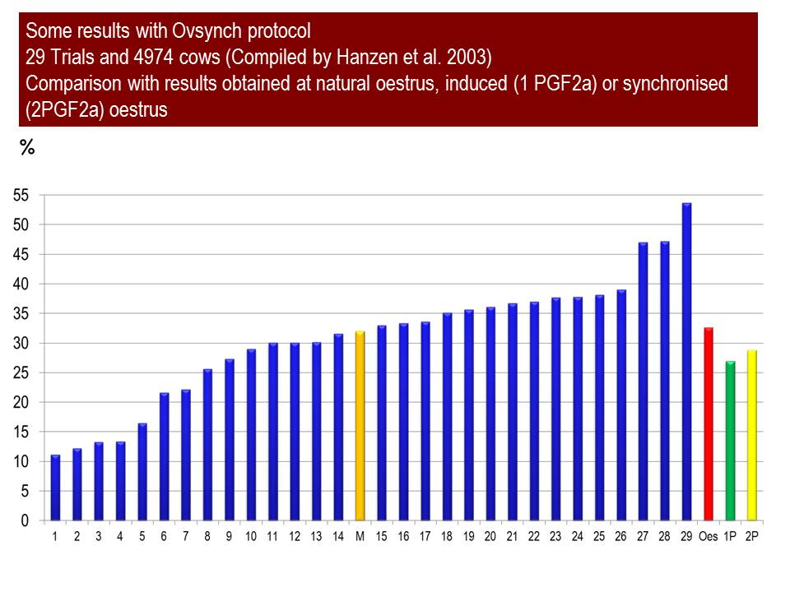

Slide 70
Finally what have you learn ?
9
5 True/False questions

