Slide 1
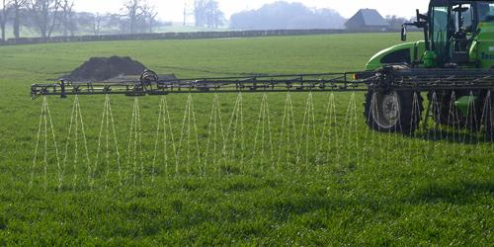
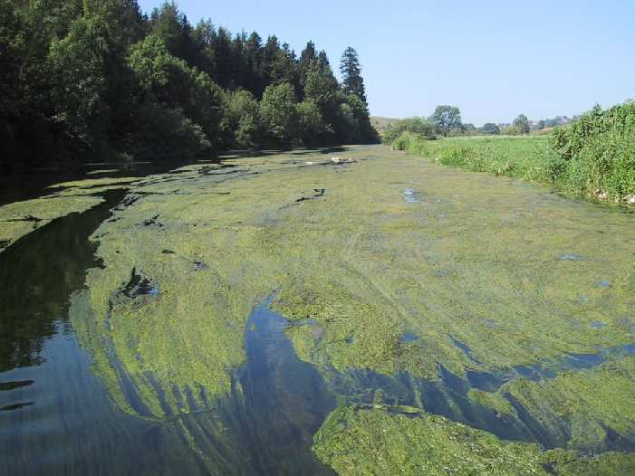
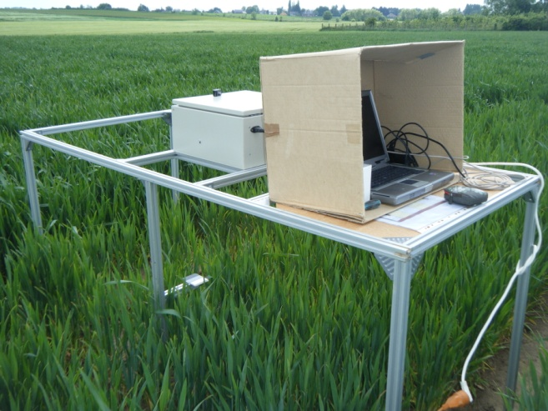
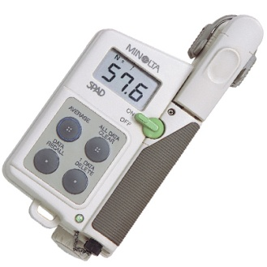
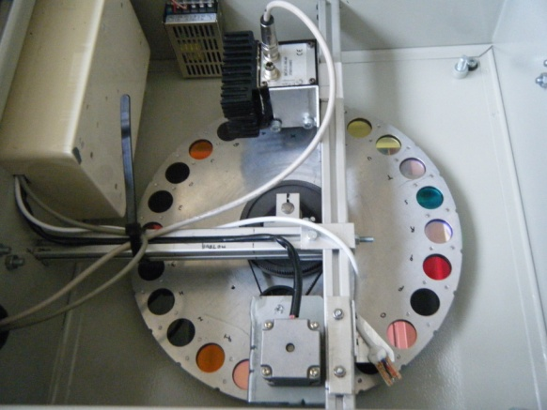
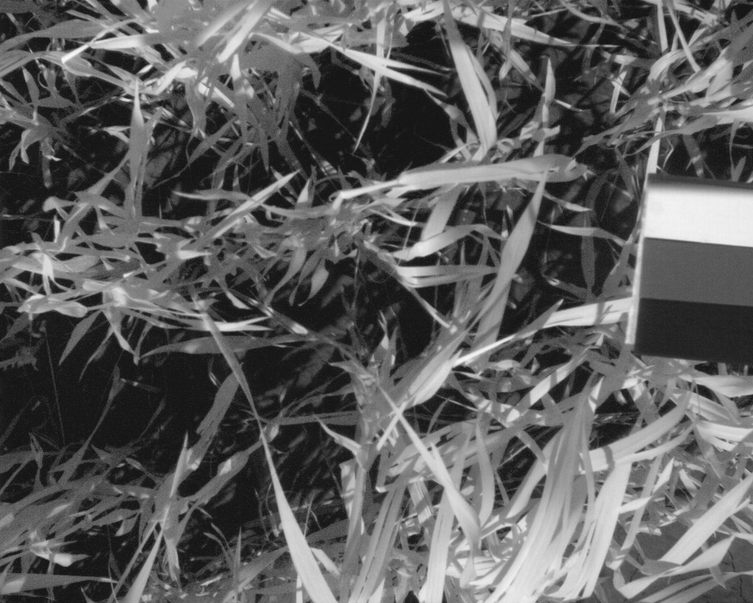
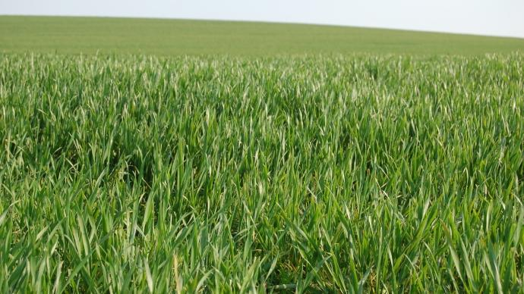
Selection of wavelengths for quantification of nitrogen concentration in winter wheat by multispectral vision
MARLIER Guillaume, LEEMANS Vincent, DESTAIN Marie-France, MERCATORIS Benoit
Department of Biosystem Engineering, Gembloux Agro-Bio Tech, University of Liège, 2 Passage des Déportés, 5030 Gembloux (Belgium)
CONTEXT
In a context of sustainable and precision agriculture, accurate measurement of nitrogen content in leaves (Fig.1) is required in order to optimize the N-fertilizer management and avoid environmental pollution (Fig.3) due to over-fertilization (Fig.2). Machine vision allows non-destructive measurements giving real-time assessment of nitrogen status of plants. However, optical devices are sensitive to environmental conditions such as soil color and light conditions. The objective of this work is to identify appropriate wavelengths for the characterization of leaves nitrogen concentration taking into account the environmental variabilities.
Figure 1 : Chemical components in a leaf [2].
Figure 2: Over-fertilization in order to increase yields.
Figure 3: Environmental pollution due to over-fertilization.
MATERIALS AND METHODS
Table 1 : nitrogen fertilizer input.
Experimental approach:
Experiment : from April to July at Gembloux (Belgium).
Winter wheat : Sown 29 October 2015 with a density of 300 grains / m².
Five different N fertilizer inputs (Table 1).
Materials and Measurements
Two types of vision systems are tested on field :
A mobile multispectral vision system (Fig. 4) composed of several components :
A monochrome camera (BCi, C-Cam Technologies, Belgium).
Filters wheel : 22 filters (Fig 5) from 450 nm (blue) to 950 nm (NIR) by step of 50 nm and with 2 bandwidths.
A programmable stepper motor for filter selection
A white reference to avoid bright outdoor fluctuation
A RGB/NIR camera (AD-130GE, JAI Technologies).
The comparison between these devices will bring information about sophistication degree of camera and the number of required filter to estimate nitrogen content.
The vision systems are installed at 1 meter from the soil and acquired an image which covers a crop area of 0,25 m². In this context, the nitrogen content in leaf is studied at the canopy level.
Reference Measurements
Kjeldhal : Destructive and time-consuming chemical measurement of the N concentration.
Indice SPAD (Hydro N-tester) (fig.6). This instrument measures the transmission through leaf in red (650 nm) and NIR (920) spectral regions at leaf level to deduce the N concentration.
Statistical approach
Two statistical methods are used to estimate nitrogen concentration by means of reflectance of leaves.
A Partial Least Square regression allows determining the degree of correlation between N concentration and the set of filters
A best subset regression allows determining the most relevant filters assessing the N concentration
 | N fertilizer input [kgN/ha]
 | tillering | stem elongation | flag leaf just visible | total
1 | - | - | - | 0
2 | 60 | 60 | 60 | 180
3 | 30 | 60 | 90 | 180
4 | 30 | 90 | 60 | 180
5 | 90 | 30 | 60 | 180
Figure 4: Mobile multispectral vision system on field.
Figure 6: Hydro N-tester (Yara)
Figure 5: Representation of wheel filter and its 22 filters. The monochrome camera is in the upper part of the picture and the stepper motor in the lower part.
RESULTS
Image segmentation
The segmentation process (Fig.7) allows separating the Photosynthetically Active Leaves (PAL) from soil based on Bayes approach [4].
Preliminary results
Results of previous study have shown that:
➔ Coefficient of determination of PLS method = 63,4 %
Coefficient of determination of 4 relevant filters with best subset method = 59,8%
➔ Coefficient determination obtained with indice SPAD = 52,9%
Figure 7: NIR image (800 nm) (left) and its segmented image (right). White in segmented image represents the reference, grey represents leaves and black represents soil and black reference.
CONCLUSION
Bibliography
Preliminary results selected 4 filters by the best subset statistical analysis (450, 600, 650 and 950 nm). The combination of these filters gave a determination coefficient of 60 % which seems to be superior to commercialized device based on SPAD indices.
Multispectral machine vision could bring an efficient monitoring of crops and N fertilizer management
[1]: MUÑOZ-HUERTA R.F., GUEVARA-GONZALEZ R.G., CONTRERAS-MEDINA L.M. TORRES-PACHERCO I., PRADO-OLIVAREZ J. & OCAMPO-VELAZQUEZ R.V., 2013. A Review of Methods for Sensing the Nitrogen Status in Plants: Advantages, disadvantages and Recent Advances. Sensors, 13, pp. 10823-10843.
[2]:http://fertilisation-edu.fr/nutrition-des-plantes.html
[3]: UNAY D., GOSSELIN B., KLEYNEN O., LEEMANS V., DESTAIN M.F., DEBEIR O., 2010. Automatic grading of Bi-colored apples by multispectral machine vision. Computers & Electronics in Agriculture;
[4]: LEEMANS V., MAGEIN H. & DESTAIN M.-F., 1999. Defect segmentation on ‘Jonagold’ apples using colour vision and a Bayesian classification method. Computer & Electronics in Agriculture, Vol 23, iss.1, pp. 43-53.
E-mail: Guillaume.Marlier@ulg.ac.be

