Slide 1
CASSAVA
LARGE-SCALE PROTEOMICS
Hervé Vanderschuren
ETH Zurich / University of Liège

Slide 2
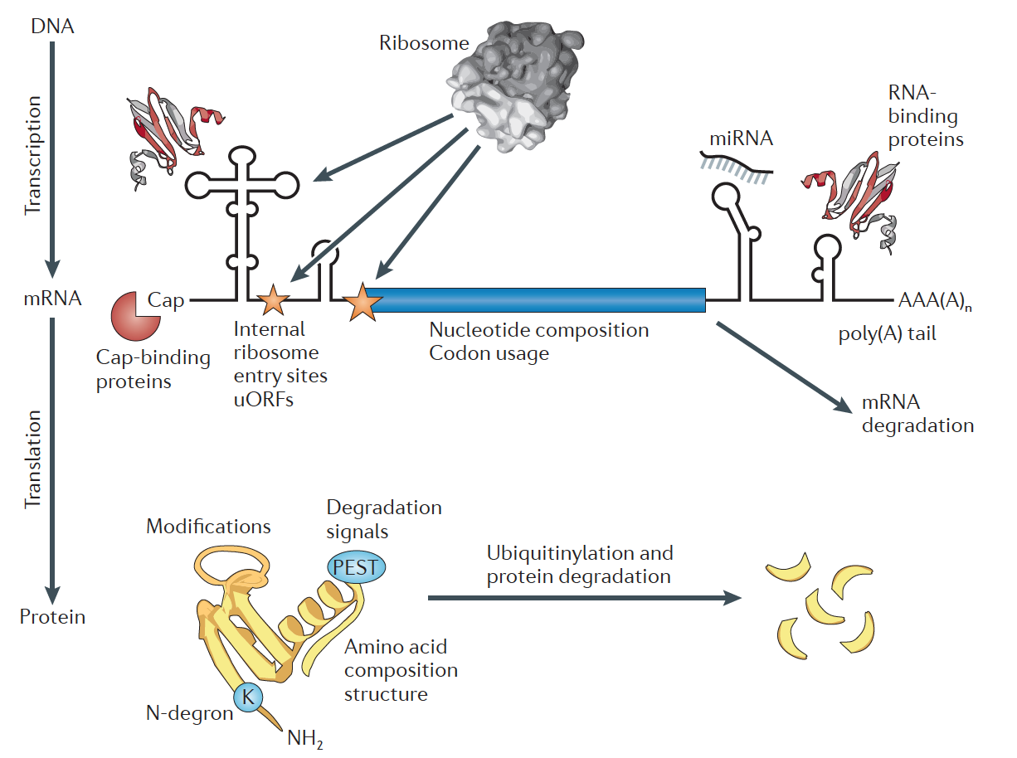
WHY STUDYING PROTEOMES?
Vogel and Marcotte, Nature Reviews Genetics 2012

Slide 3
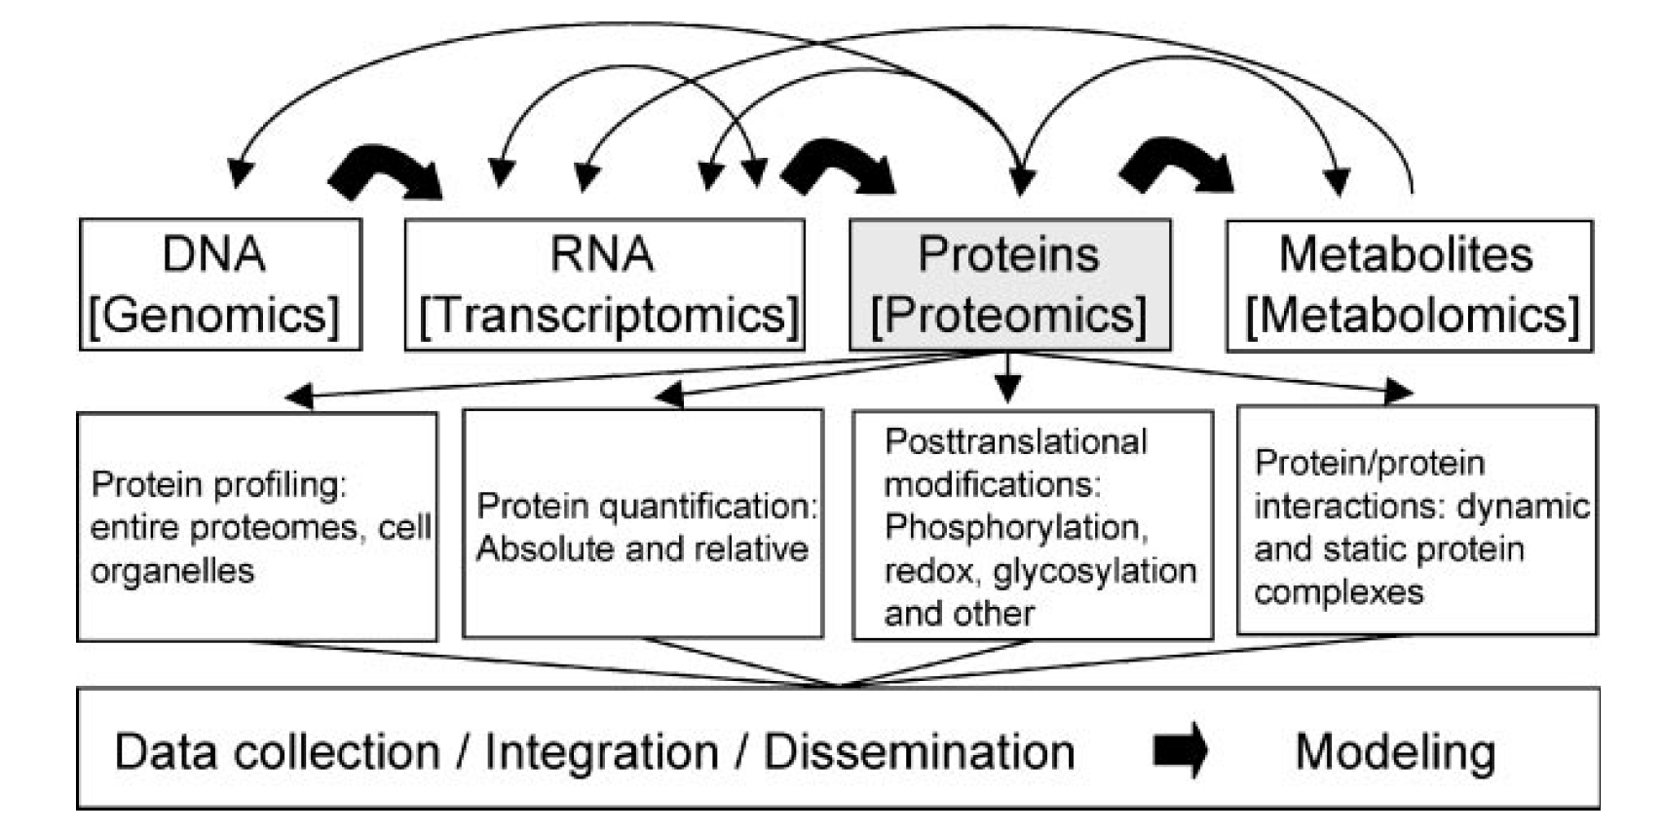
WHY STUDYING PROTEOMES?
Baginsky, Mass Spectrometry Reviews 2010

Slide 4
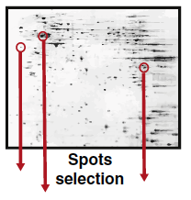
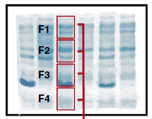
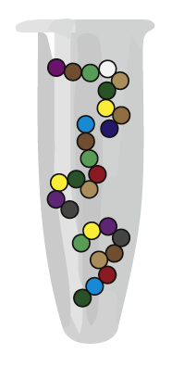

PROTEOMICS TECHNOLOGIES
2-D gel protein separation
/ intensity comparison
1-D gel protein separation
+ in gel digestion
No protein separation
/ in solution digestion
Mass spectrometry for protein identification
PEPTIDES
LABEL
LABEL - FREE
SILAC, ICAT, iTRAQ

Slide 5
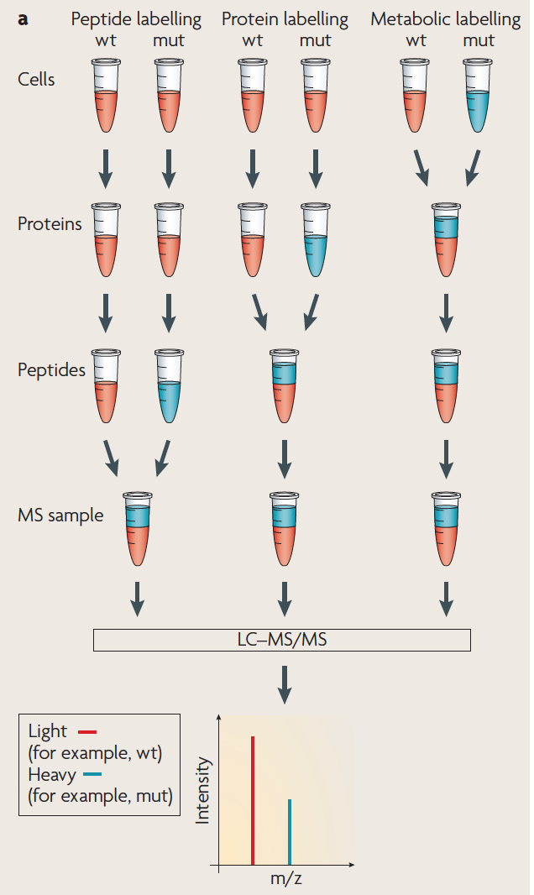
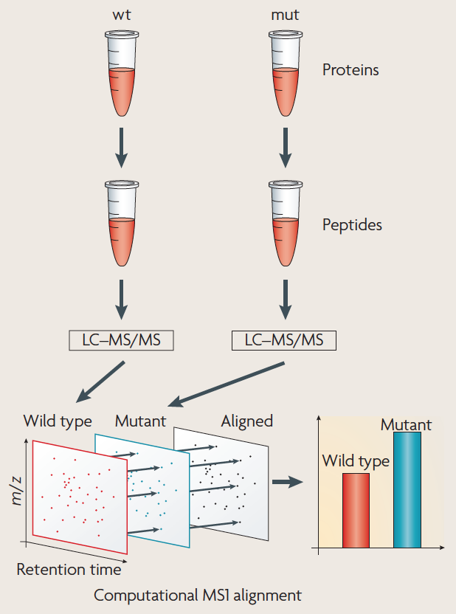
PROTEOMICS TECHNOLOGIES
PEPTIDES
LABEL
LABEL - FREE
Disadvantages: COST, MULTIPLEXING
Gstaiger and Aebersold, Nature Reviews Genetics 2009

Slide 6
CASSAVA QUANTITATIVE PROTEOMICS
Protein identification

Slide 7
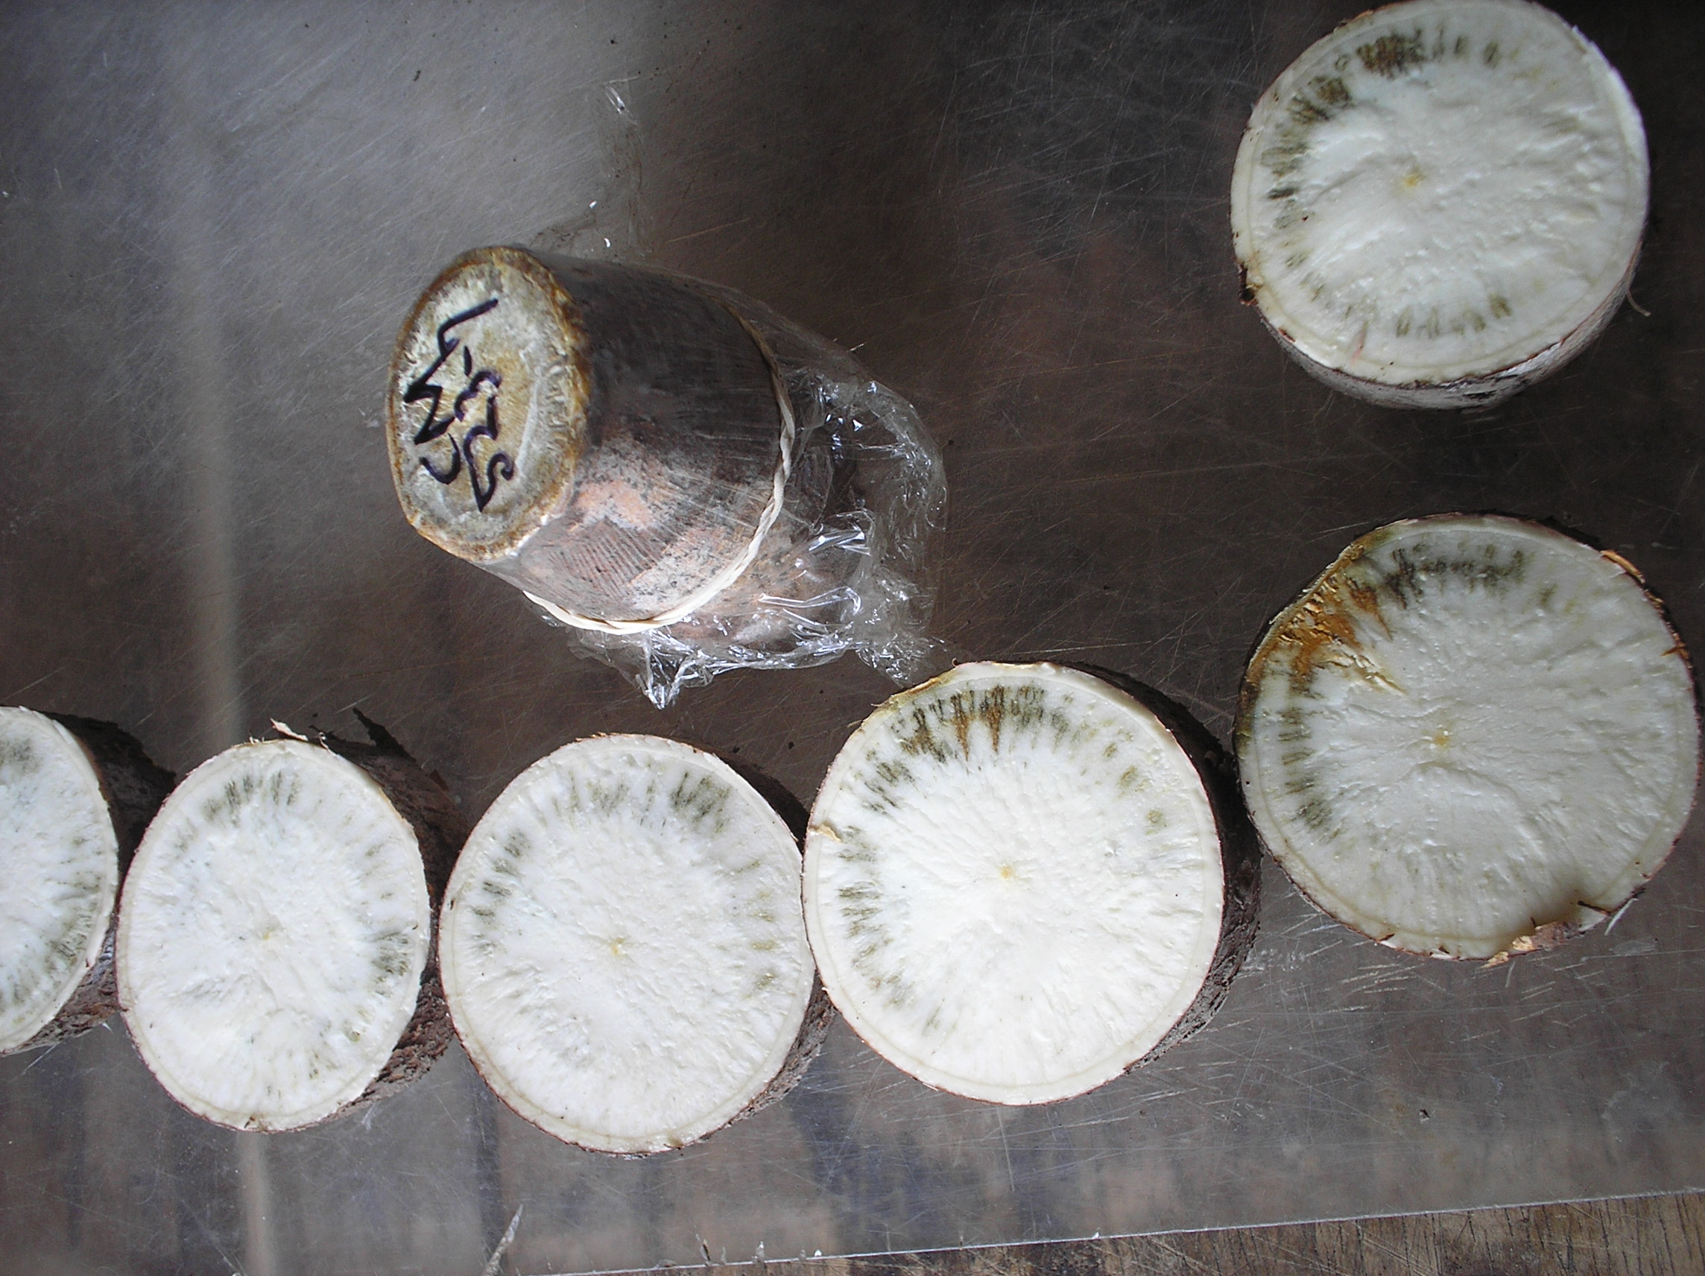
CHARACTERIZING PPD USING
QUANTITATIVE PROTEOMICS
Post-harvest Physiological Deterioration (PPD)
Cassava deteriorates rapidly after harvest
Occurs as a result of wounding during harvesting
Blue / black vascular streaking in cassava storage roots
10 -20% losses associated with PPD
Affects market value and trade // Price mark-up fresh roots (price drops when roots are 2-3 days old)
CM523-7 (CIAT)

Slide 8
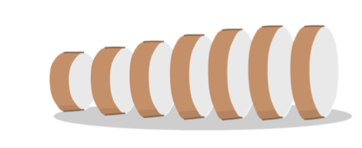
Optimization and standardization of PPD scoring
Development of robust method for PPD tolerance assessment
2. Image-based quantification of PPD symptoms
1. Initiate PPD
0h
6h
12h
24h
3. Confirm uniformity of PPD symptoms in samples
Supplemental File 1. PPD Symptom Score Software.
Plant Cell, 2014

Slide 9
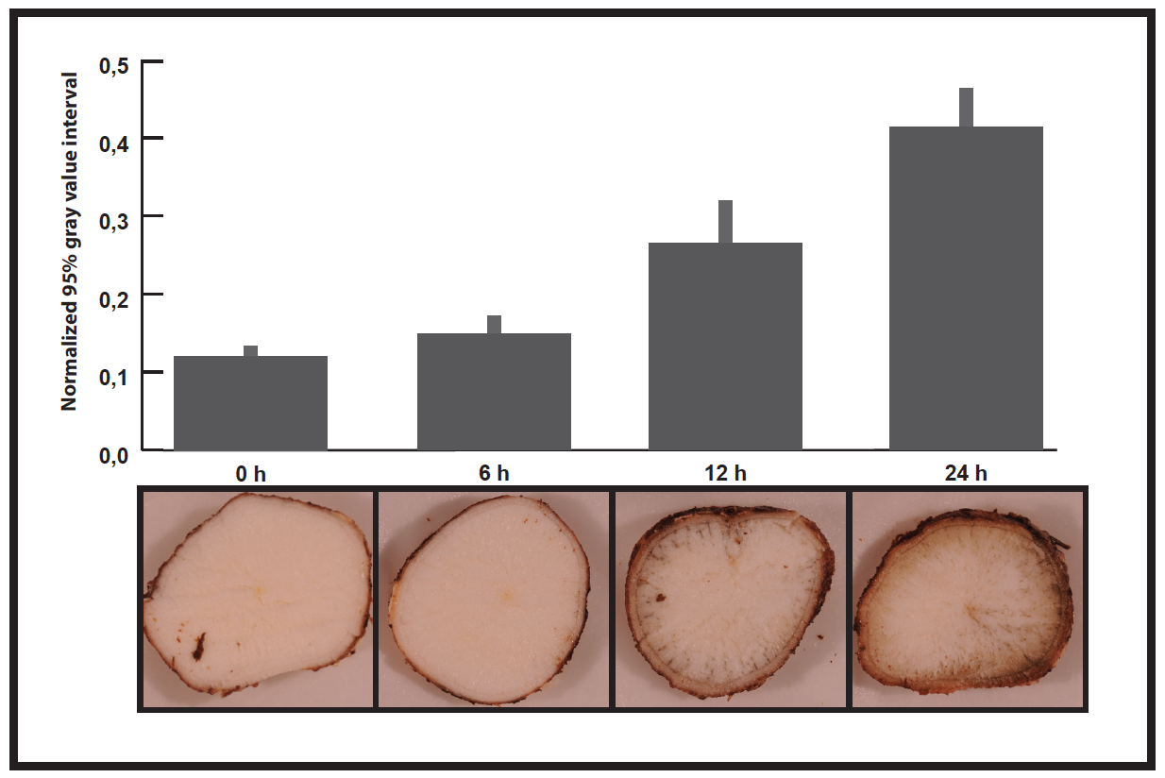
Cassava root samples for proteomics study
n= 6
Plant Cell, 2014

Slide 10
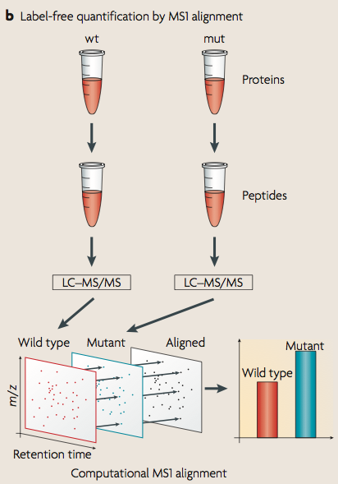
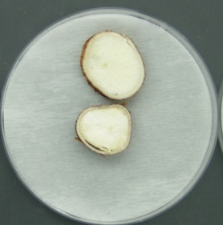
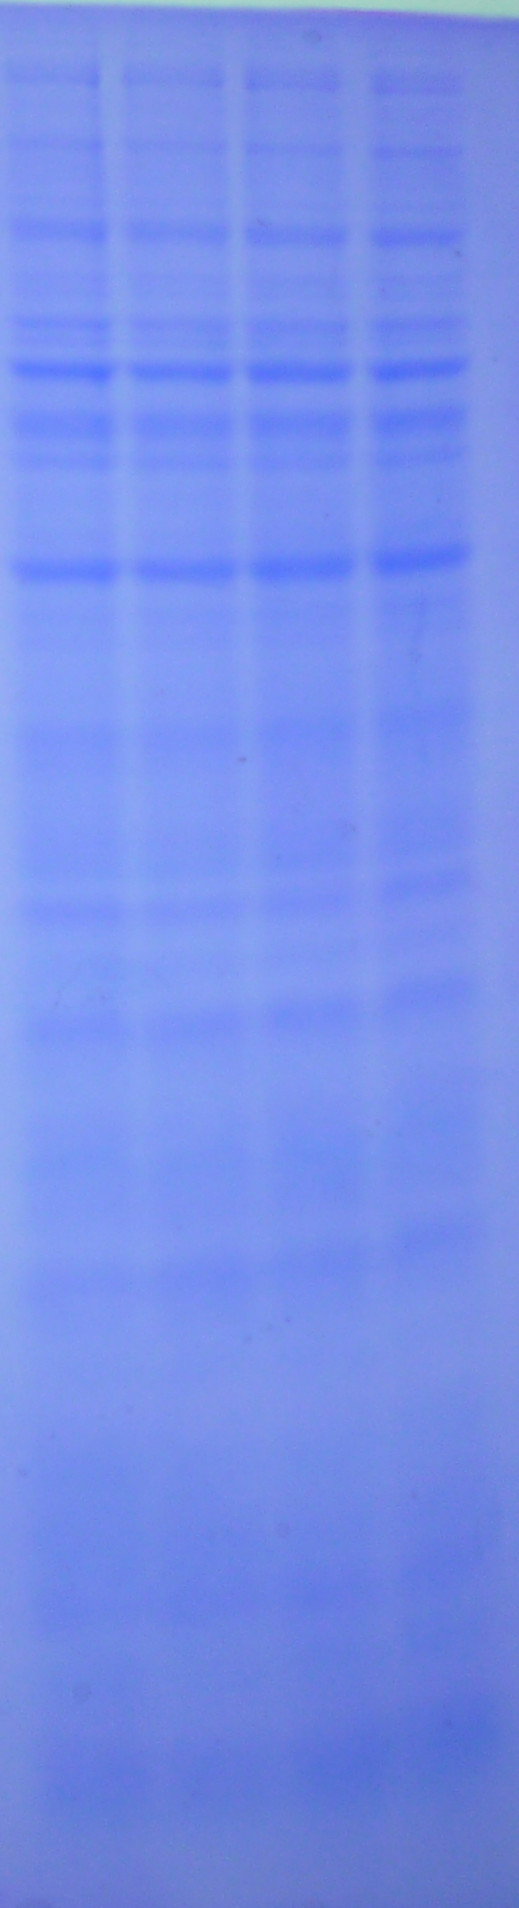
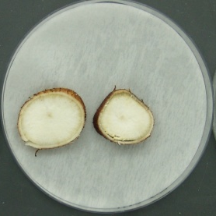
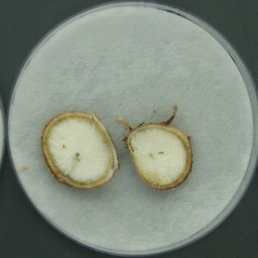
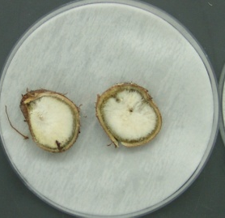
PROTEOMICS ANALYSIS
PPD time course
3 biological replicates
5 fractions
2 MS measurements
Label-free shotgun proteomics
0h
6h
0h
F1
6h
F2
F3
12h
F4
6h
24h
0h
F5
Gstaiger & Aebersold 2009

Slide 11
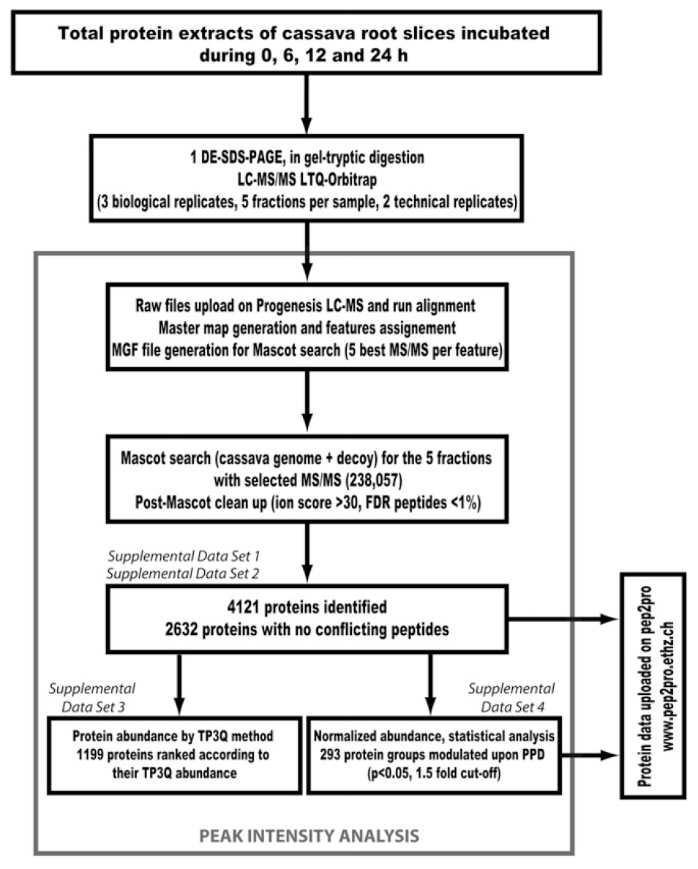
PROTEOMICS ANALYSIS OF PPD TIME COURSE
4121 proteins identified & quantitated
No conflicting peptides
2632 proteins identified & quantitated
High confidence quantitation
1199 proteins identified & quantitated
Plant Cell, 2014

Slide 12
The PRoteomics IDEntifications (PRIDE) database
http://www.ebi.ac.uk/pride/
public data repository for mass spectrometry (MS)-based proteomics data
Centralized
standards compliant
Open access to raw mass spectrometry files

Slide 13
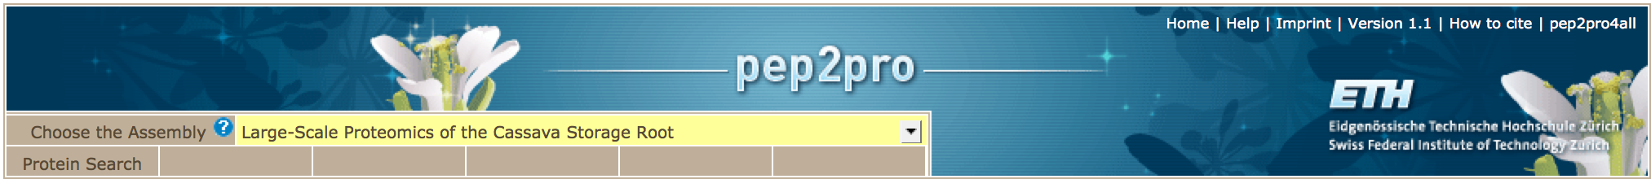
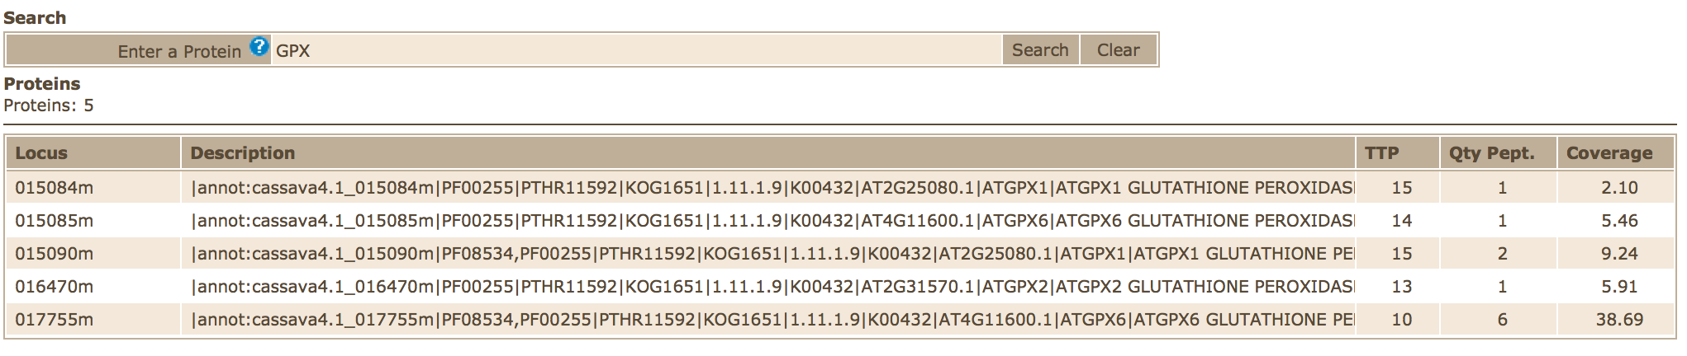
CASSAVA PROTEOMICS DATABASE & VIZUALISATION
www.pep2pro.ethz.ch
Plant Cell, 2014

Slide 14
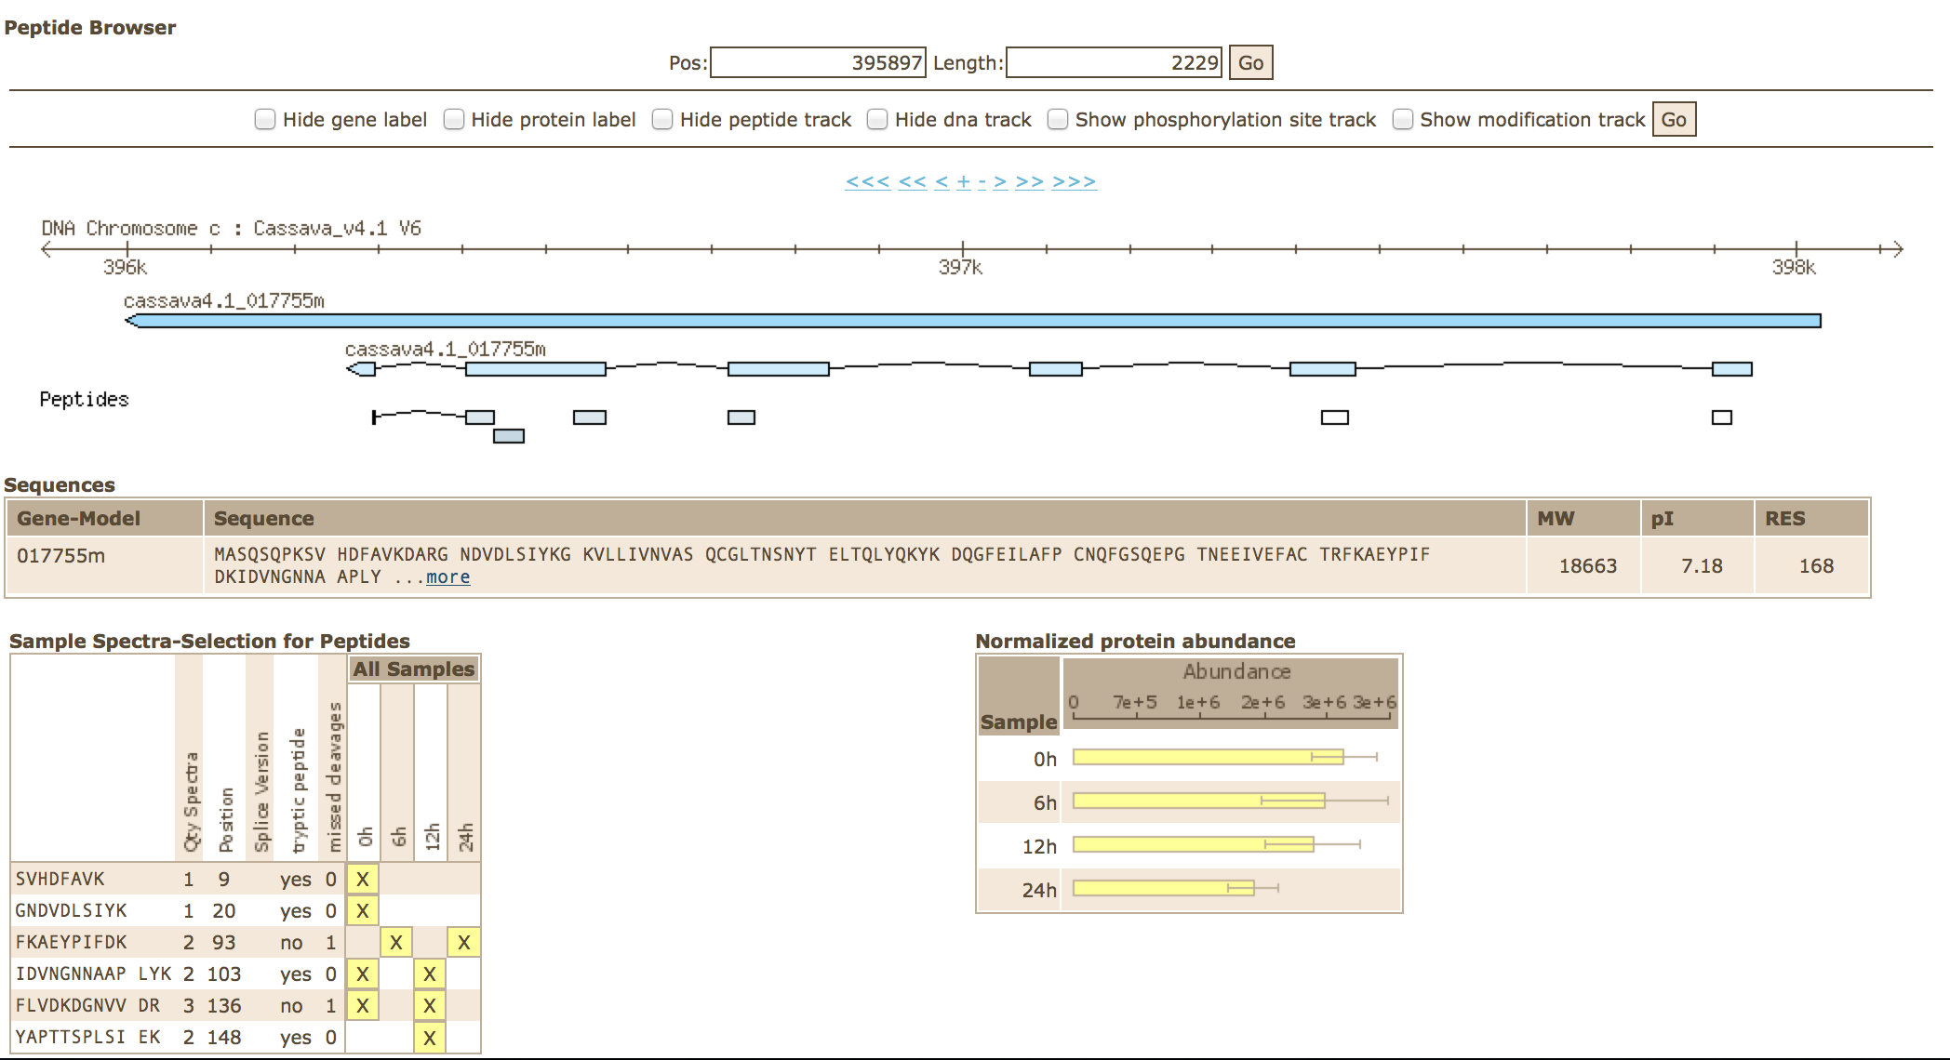
CASSAVA PROTEOMICS DATABASE & VIZUALISATION
www.pep2pro.ethz.ch
Plant Cell, 2014

Slide 15
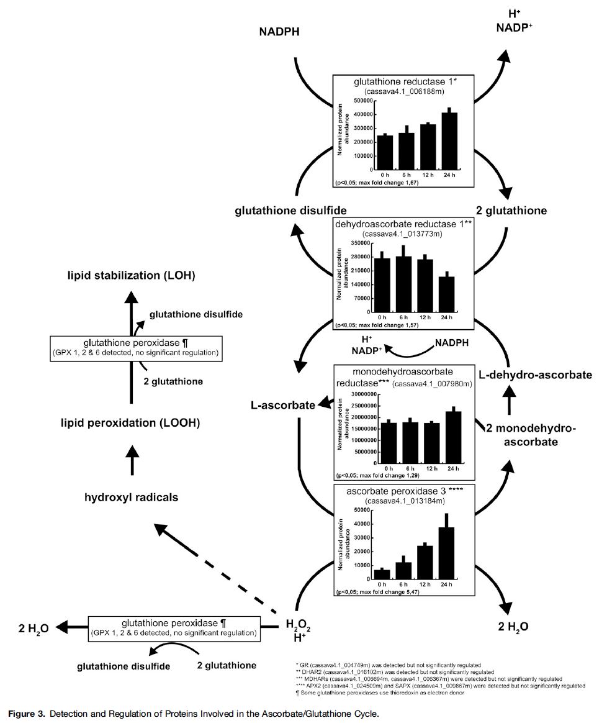
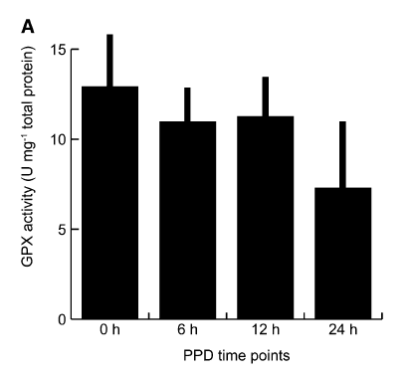
DATA ANALYSIS & INTERPRETATION
GPX proteins remain stable during PPD
GPX activity declines during PPD
Plant Cell, 2014

Slide 16
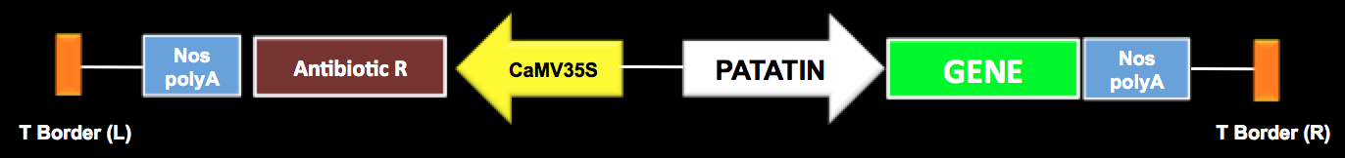
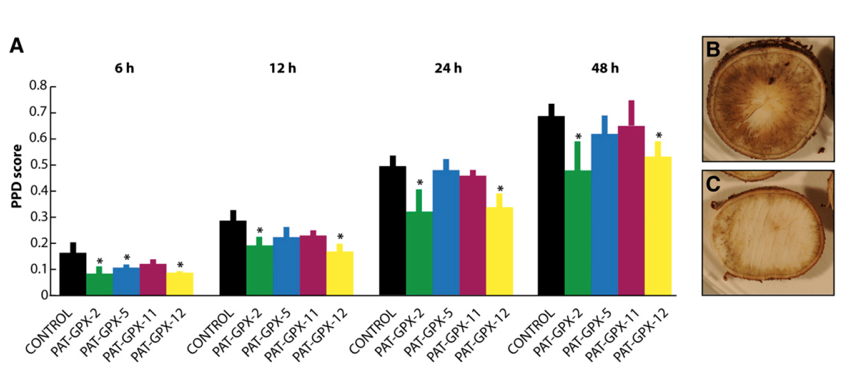
Transgenic approaches – PAT-GPX transgenic lines display delayed onset of PPD
Plant Cell, 2014

Slide 17
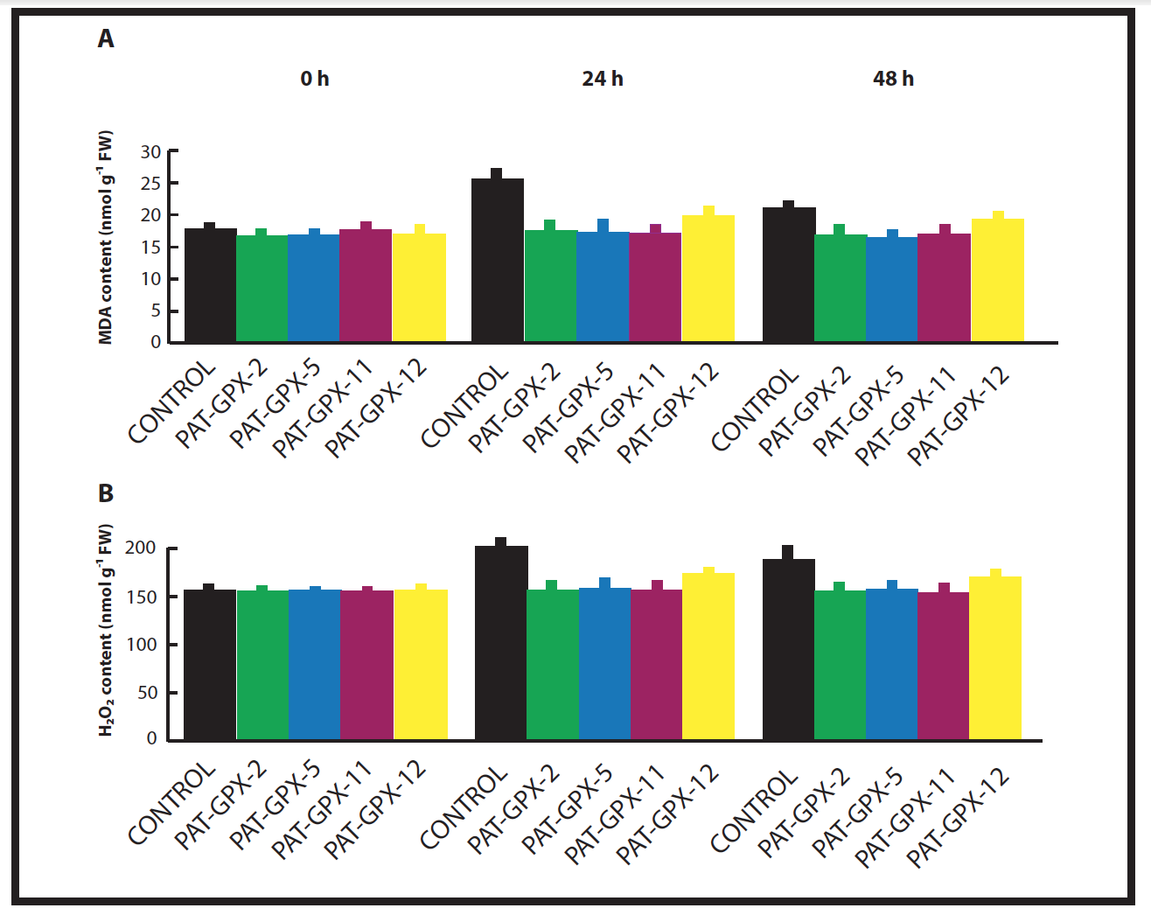
Transgenic approaches – PAT-GPX transgenic lines display delayed onset of PPD
0h
24h
48h
MDA content is reduced in transgenic lines at 24h & 48h
H₂O₂ content is reduced in transgenic lines at 24h & 48h
Plant Cell, 2014

Slide 18
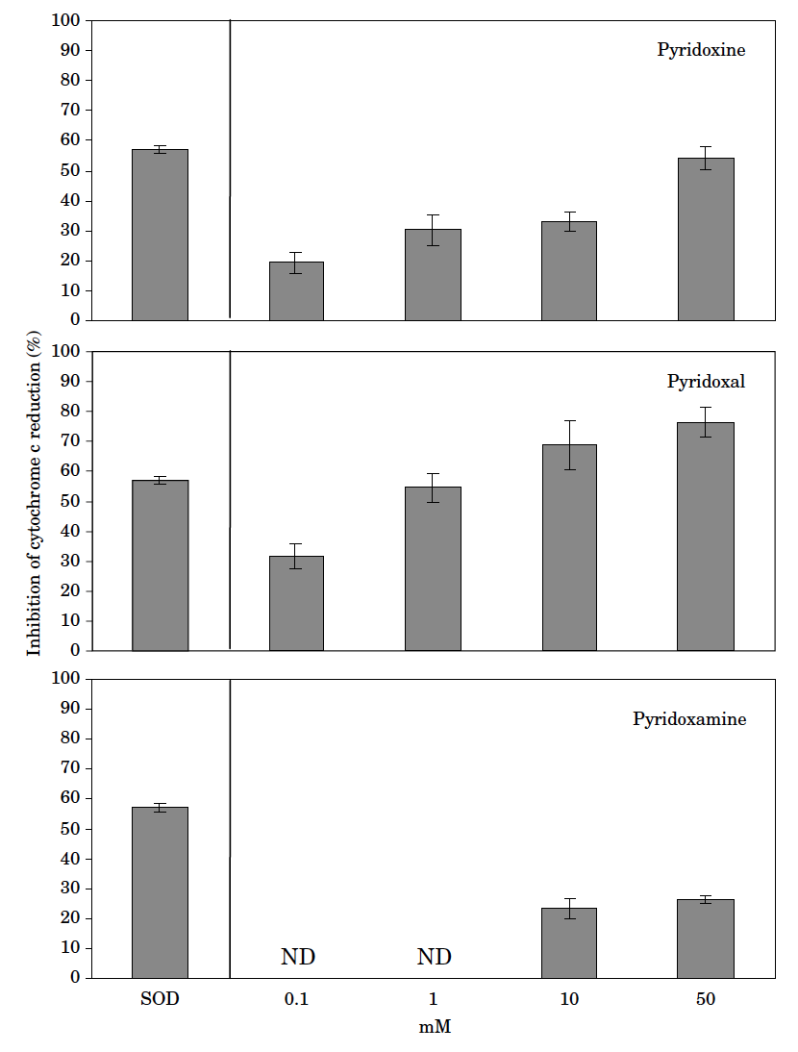
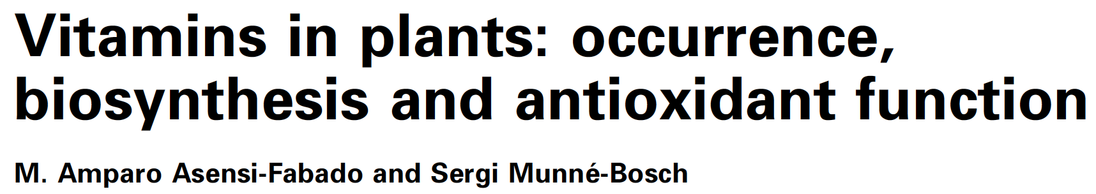
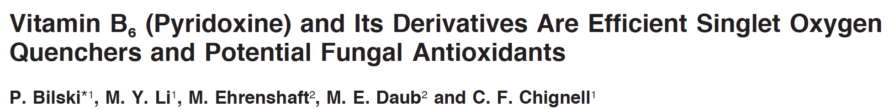
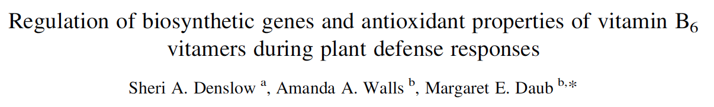
Antioxidant properties of vitamins: the case of B6 vitamers
QUENCHING OF SUPEROXIDE
BY B6 VITAMERS
Pyridoxine
Pyridoxal
Inhibition of cytochrome c reduction (%)
Pyridoxamine

Slide 19
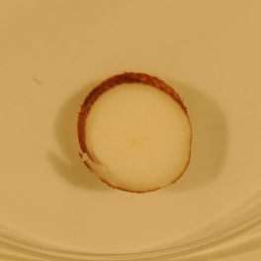
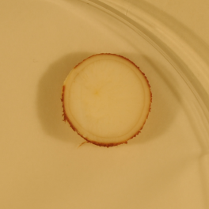
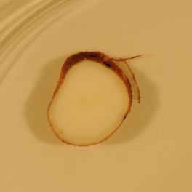
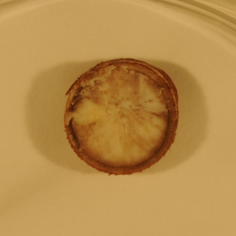
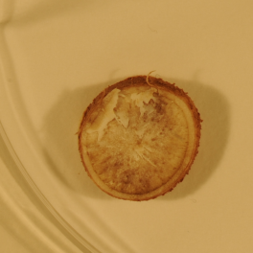
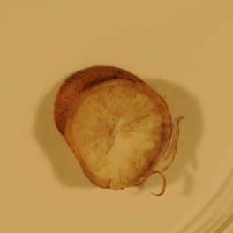
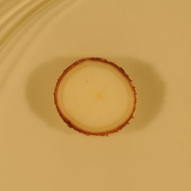
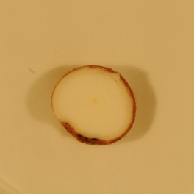
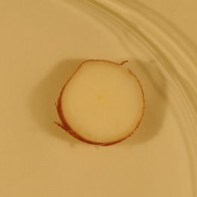
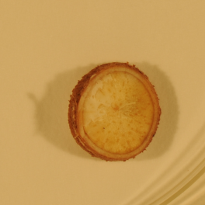
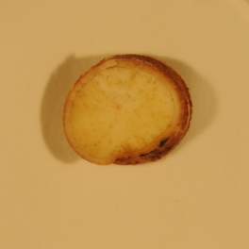
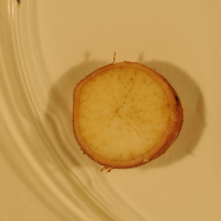
Pyridoxine (B6) application delays PPD
Control treatment
0 hr
24 hr
Pyridoxine (B6, 100mM)
0 hr
24 hr

Slide 20
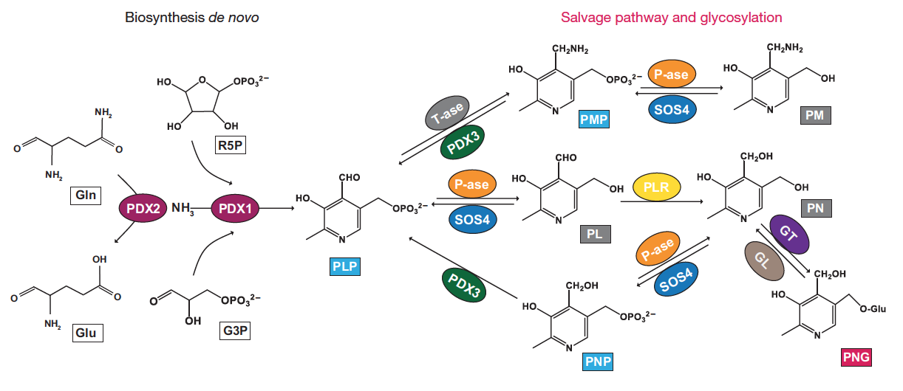
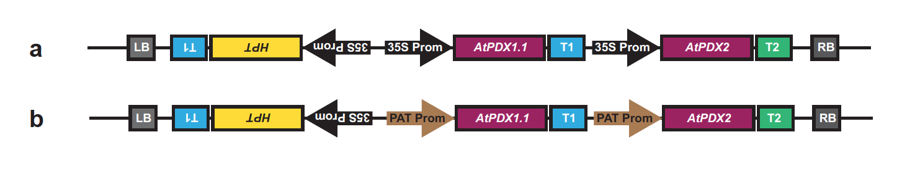
GENETIC ENGINEERING OF VITAMIN B6 PATHWAY
Nature Biotechnology, 2015

Slide 21
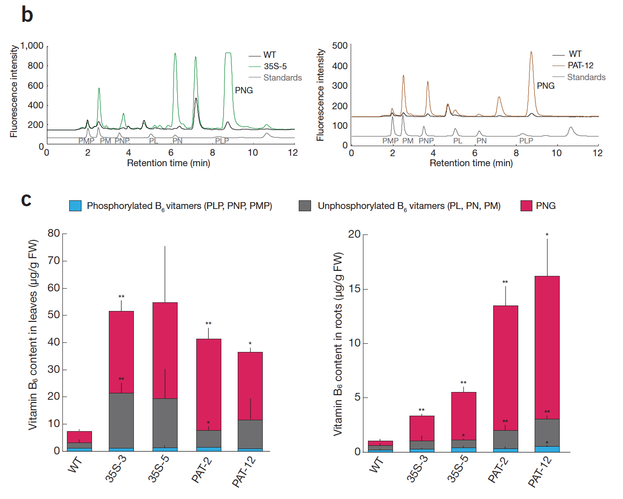
Transgenic PDX1-PDX2 cassava accumulate high levels of B6 in leaves and roots
(up to 9-fold & 16-fold over wild-type levels, respectively)
Nature Biotechnology, 2015

Slide 22
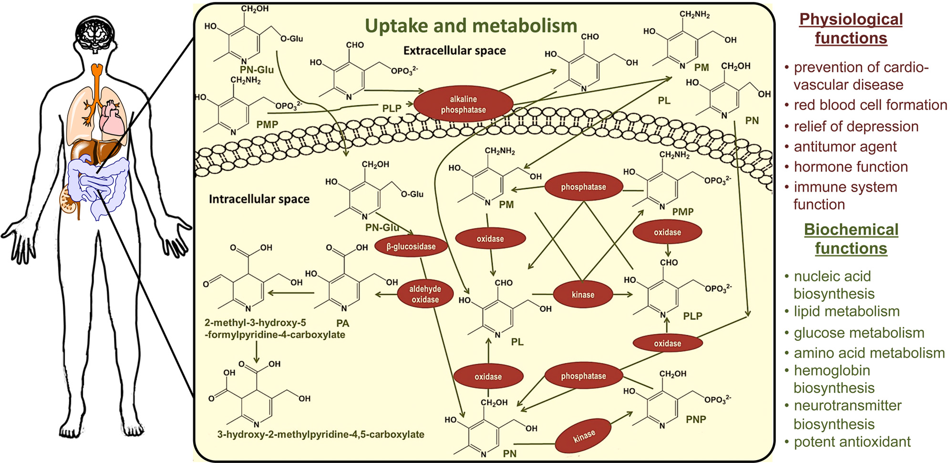
Nutritional Importance of vitamin B6
Frontiers in Plant Science, 2013

Slide 23
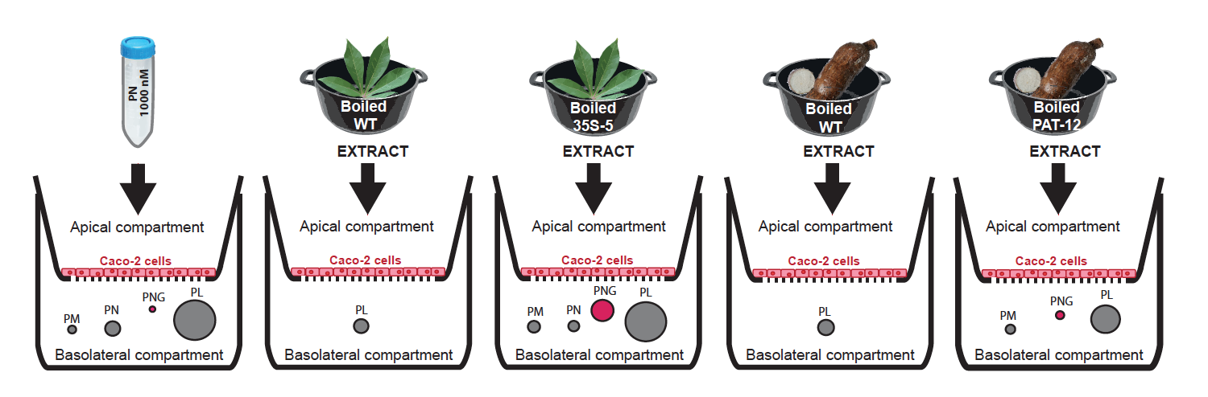
After boiling, transgenic PDX1-PDX2 leaves and roots retain high levels of B6
(up to 22-fold & 9-fold over wild-type levels, respectively)
Based on Caco-2 cells assay, increased vitamin B6 levels in transgenic cassava results in increased amount of bioavailable vitamin B6
500 g of cooked cassava roots or 50 g of cooked cassava leaves per day provide recommended daily intake of vitamin B6
Nature Biotechnology, 2015

Slide 24
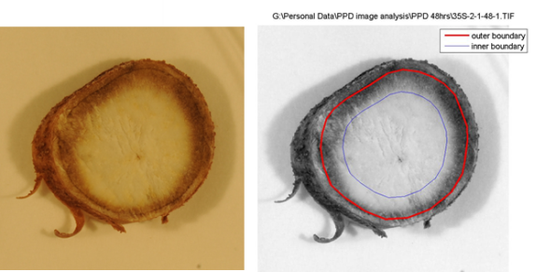
Delayed PPD observation in transgenic PDX1-PDX2 roots is not consistent across experiments
48h
**
**

Slide 25
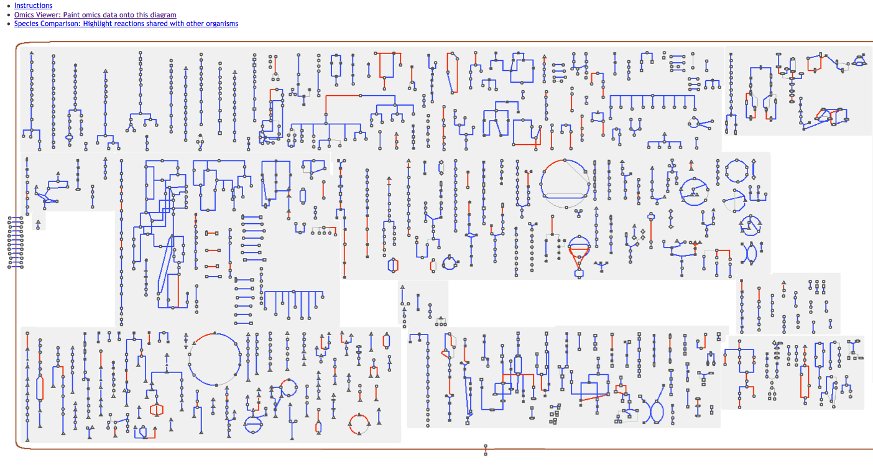
PROTEOMICS ANALYSIS: identification of potential pathways to delay PPD

Slide 26
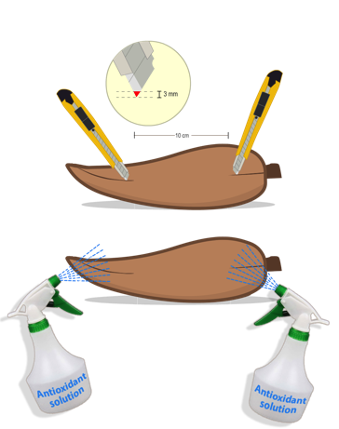
Educated guess based on PROTEOMICS ANALYSIS & LITERATURE
Testing compounds with potential to delay PPD
PPD symptom score
CONTROL
Buffer 1, 2, 3
CONTROL
Buffer 4
CONTROL
Buffer 5
Compound 1
Compound 4
Compound 2
Compound 3
Compound 5

Slide 27
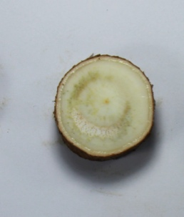













Educated guess based on PROTEOMICS ANALYSIS & LITERATURE
Indonesian cultivar Gebang - CONTROL, 4 DPH
Indonesian cultivar Gebang, Compound 5, 4 DPH

Slide 28
CHALLENGES IN (CASSAVA) PROTEOMICS
Data mining and interpretation
Proteome coverage
Detection of Post-Translational Modifications (PTMs)
Quantitation at the sub-cellular level
Robust and high-throughput quantitation of targeted proteins for trait improvement

Slide 29



PLANT GENETICS LAB
University of Liège

Slide 30





VIRUS INDEXING & SANITATION CENTER
University of Liège
BANANA
CASSAVA
Virus Indexing and Sanitation Center on Musa Germplasm accredited by Bioversity
Certification and GLP
Indexing by IC-PCR and RT-PCR
+
Electron microscopy
Implementation of NGS approaches for routine indexing
Thermotherapy (70%) &
Chemotherapy (30%)
Virus Indexing and Sanitation Center for exchange of cassava germplasm
GLP
Indexing by PCR and RT-qPCR
+
Electron microscopy
Implementation of NGS approaches for routine indexing
Thermotherapy
flickr

Slide 31
ACKNOWLEDGEMENTS
ETH Zürich
Plant Biotechnology Lab
Kuan-Te Li
Evans Nyaboga
Ima Zainuddin
Nathalie Mangel
Judith Owiti
Matthias Hirsch-Hoffman
Katja Baerenfaller
Christophe Laloi
Jacqueline Poon
Wilhelm Gruissem
University of Geneva
Teresa Fitzpatrick
Michael Moulin
UniValle
James Montoya
Jaime Marin
Utrecht University
Monique Albersen
Nanda Verhoeven-Duif
CAS, Shanghai
Peng Zhang
Qiuxiang Ma
ETH Zürich Crop sciences Lab
Achim Walter
Norbert Kirchgessner
FGC Zürich
Peter Gehrig
Jonas Grossman
Paolo Nanni
LIPI Bogor
Enny Sudarmonowati
Ima Zainuddin
FUNDING:
Sawiris Foundation, Swiss National Science Foundation, Swiss Cooperation Agency, Rockfeller Foundation, BioCassavaPlus Phase 1 (BMGF)

