Slide 1
Big Data and Text Analytics
Ashwin Ittoo
QuantOM-Operations
HEC-ULg
6th December 2013

Slide 2
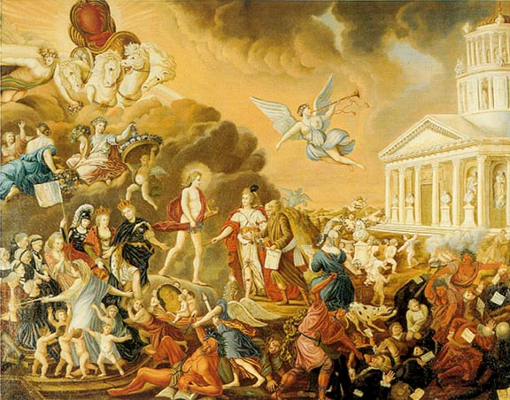

Before we start …
Natural Language Processing, Computational Linguistics
Text Analytics
Notes:
Source: http://members.tripod.com/mr_sedivy/enlite2.html,
http://small-business-concepts.com/community

Slide 3

Agenda
Hourglass Organization
Big Data
Definition, Statistics
Why Data is NOT the Added-Value
The need for Analytics
Natural Language Processing (Text Analytics )
My research
Example Applications
Big Data Applications
Rise of Data Scientists
Challenges, research agenda
Conclusion

Slide 4

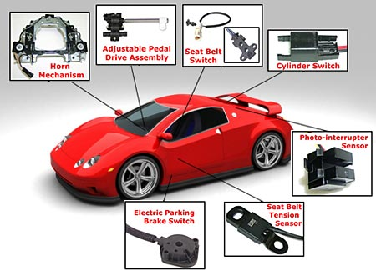

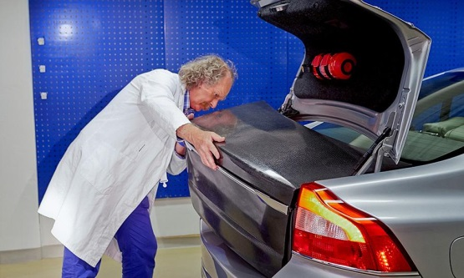
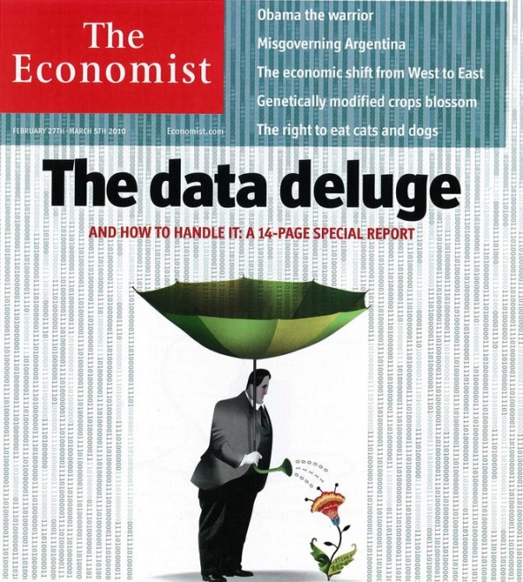
Introducing Big Data
Notes:
Image source:
http://www.autoaftersales.info/2012/12/cars-sensors-system.html
http://www.thedrum.com/news/2013/10/12/third-uk-social-media-users-dont-use-facebook-twitter-youtube-flickr-pinterest
http://www.autoweek.com/article/20131017/carnews/131019811
-the Economist magazine

Slide 5
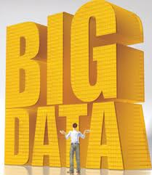

Slide 6






Big Data
Top of corporate agendas
Successful companies
Digital, customer-focused age
Leverage, monetize data
Technological Investments
Harvard Business Review [1]
Data-Driven Decision-Making
Differentiator for competitive edge
5-6% productivity gains

Slide 7
What is Big Data?
Gartner report [2]
~60% of enterprises deploying, planning Big Data projects but …
Uncertain of Big Data, getting value
What is Big Data?
Dan Ariely (Prof of Psychology, Behav. Econ, Duke)
Big data is like teen sex. Everybody is talking about it, everyone thinks everyone else is doing it, so everyone claims they are doing it.

Slide 8
What is Big Data? (cont)
3 main criteria
Large Volume
Petabytes → Exabytes→Zetabytes
Complex Variety
Text (social media chats, blogs), video, audio
High Velocity
Continuous data streams (sensors, RFID, tweets)
1000 | kB
1000² | MB
1000³ | GB
1000⁴ | TB
1000⁵ | PB
1000⁶ | EB
1000⁷ | ZB
1000⁸ | YB

Slide 9
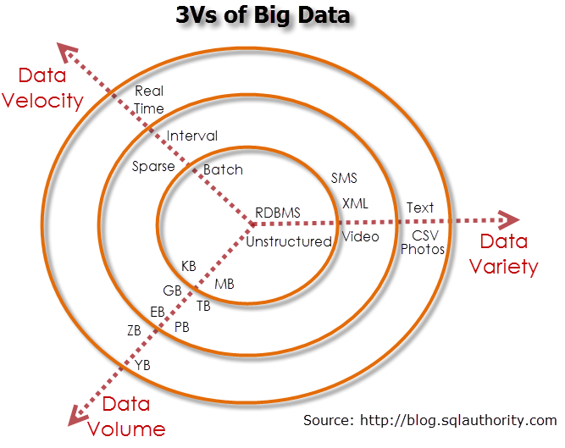
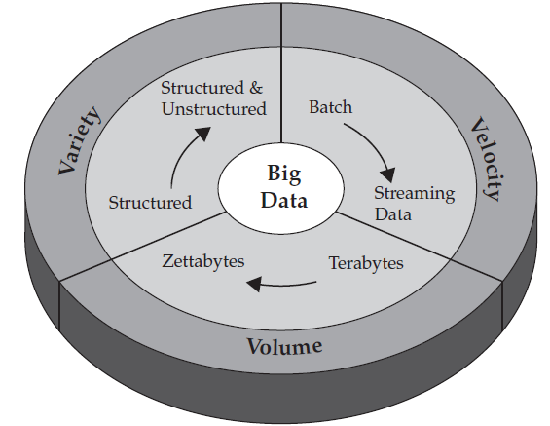
What is Big Data? (cont)
3Vs
Source: [3]

Slide 10
Taxonomy of Big Data
Optional!!!!!

Slide 11
How Big is Big?
IBM estimates [3]
35 ZB by 2020
Twitter >7 terabytes (TB) daily
Facebook 10 TB daily
Enterprise data: terabytes hourly
IDC Digital Universe 2020 study[4]
Digital universe growth factor 2020: 300
40,000 exabytes in 2020
68% of data created by consumers (2012)
<< volume created about consumers
IDC Market Analysis 2012[5]
ICT Big Data tech&services: 39.4% growth
$16.9 billion market in 2015

Slide 12
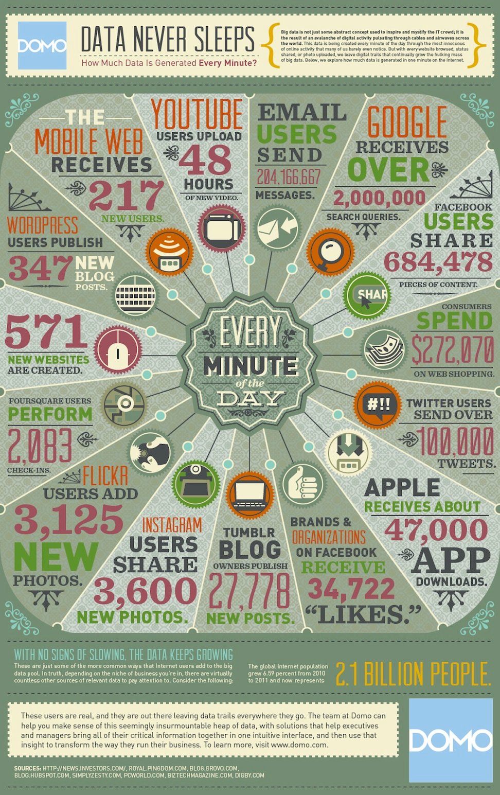
How Big is Big? (cont)
Outdated by now
Notes:
Source:
https://www.topcoder.com/blog/why-this-infographic-on-data-is-astounding-terrifying-and-revolutionary-for-those-who-can-handle-it/

Slide 13
Value in Analytics
Commoditization of data
Paradox
Rise in data volumes
Decline in fraction analyzed [3]
Leads to blind-spot
Real value
Not data…but
Analytics to acquire insights (e.g. consumer behavior) and …
Exploit insights for competitive edge
Notes:
Image Source:
http://www.ways2capital.com/wcblog/commodity-trading-tips-guidelines-for-commodity-markets/

Slide 14
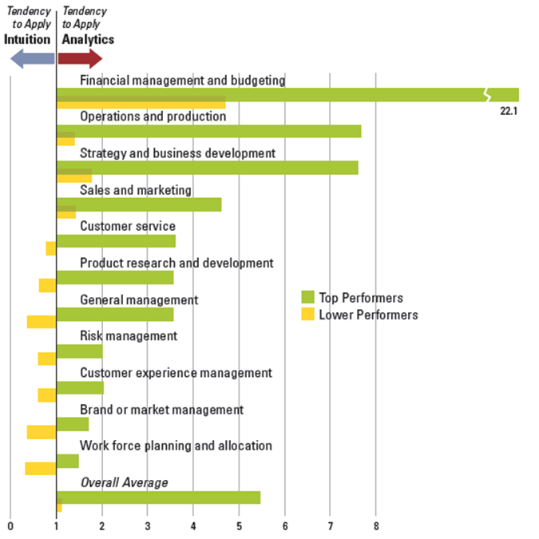
Value in Analytics (cont)
MIT Sloan Management Review [6]
60% organizations have more data than they can analyze
Top-performing organizations 5 times likelier to rely on analytics
ANALYTICS IS KEY

Slide 15
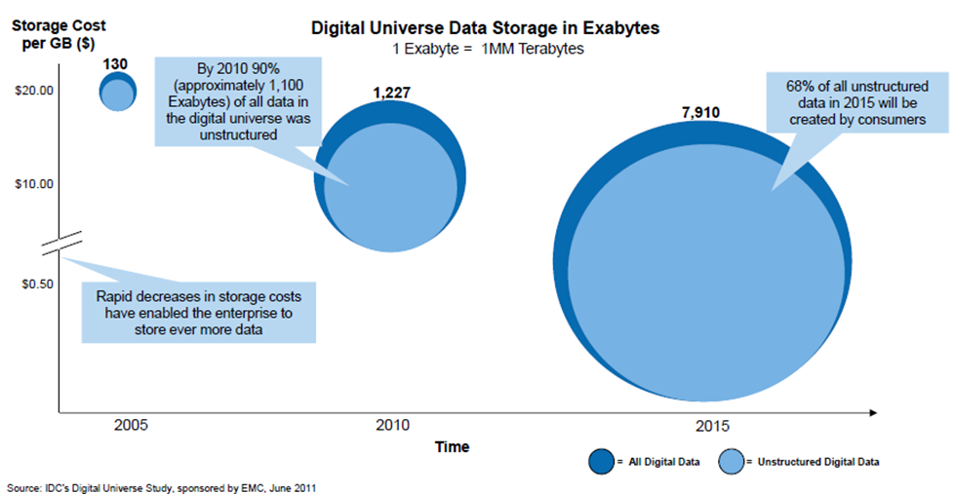
What Data?
Predominantly unstructured format
Facebook messages, Wikipedia pages, Youtube videos, Flickr photos
HP, IBM
90-95% of data in next decade unstructured

Slide 16
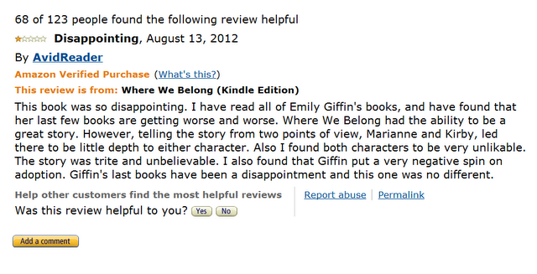
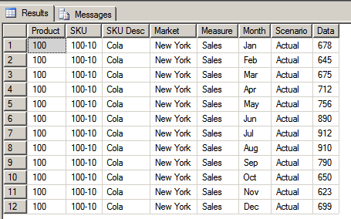
Text
Unstructured texts
Messy
Richer, deeper, more valuable insights
Text: Valuable Insights
Traditional structured data
Neatly organized
Rows, columns
Lacks richness

Slide 17
My Research
Analytics
Text
Natural Language Processing – Text Analytics

Slide 18
Natural Language Processing
Branch of Artificial Intelligence (AI)
Computational Linguistics
Language Technology
Mathematical modeling of human languages
Symbolic (First Order, Predicate Logic)
Empirical (Vector Algebra, Statistics)
Design, development of algorithms
Human language interpretation
Human language generation
Encompasses
AI
Maths: Statistics, (Vector) Algebra
Logics
Linguistics (syntax, semantics, discourse)

Slide 19
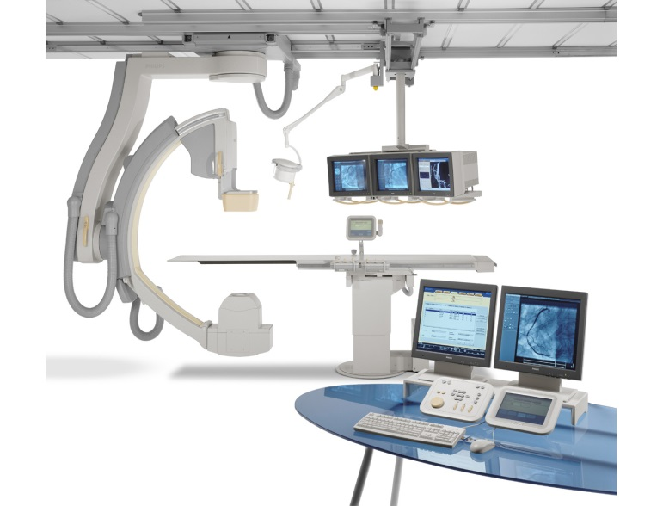
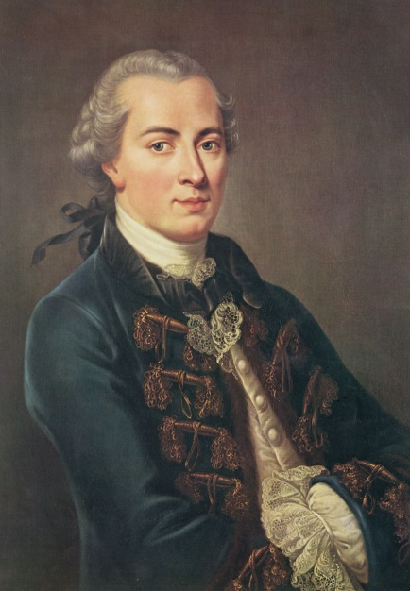
Case 1 : Company X
Market leader in professional healthcare equipment
Preventive, corrective maintenance
Field Service Engineers (FSE)
Job-sheets describe
Observations
Repairs performed
Example job-sheets texts
Messy, unstructured
Find out causes of product failures from job-sheets
“short-circuit caused power disruption”
Causation/causality in philosophy, metaphysics

Slide 20
Case 1 (cont)
Causality: multifarious linguistic patterns/expressions
Algorithm to learn various causal patterns from texts? (ways in which causality is expressed in language)
Challenge 1: Synonymous patterns
overheating is the cause of screen blinking
overheating is the source of screen blinking
overheating result(s) in screen blinking
Challenge 2: Ambiguous patterns
“overheating leads to screen blinking”
“street leads to exit”?
Challenge 3: Implicit causality patterns
“wiring increases the oscillation”
“short circuit destroyed power supply
Language Understanding: lexical → syntactic → semantics

Slide 21
Case 1 (cont)
Algorithm: Detect causality patterns from text documents
Aim
Widest coverage: as many patterns as possible
Generic solution
But job-sheets
Domain specific
Restricted, limited vocabulary
Wikipedia articles
General
Diverse domains, vocabulary

Slide 22
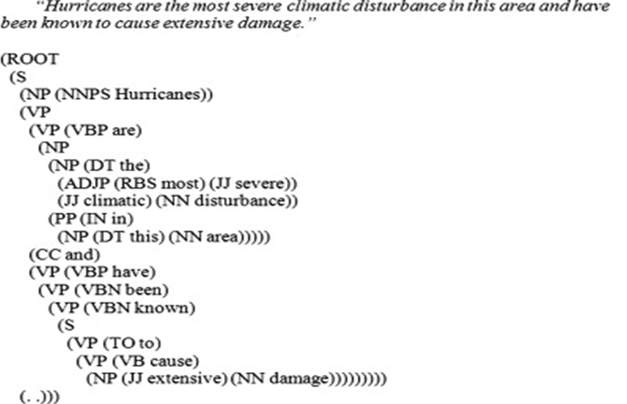
Case 1 (cont)
Wikipedia XML dump
50 GB
2 billions words
Berkley DB
Syntactic parsing
Dependency tree

Slide 23

Case 1 (cont)
Tree traversal: lexico-syntactic patterns
Between pairs, “hurricane-damage”, “poem-stanza”
Express various relationships, causality, part-whole,…
Which patterns express causality?
Minimally-supervised learning

Slide 24
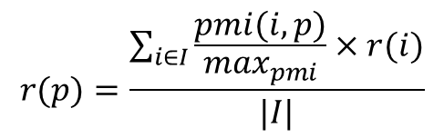
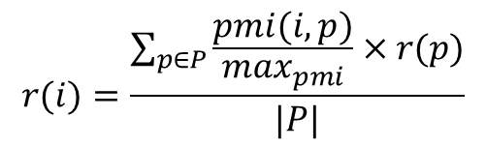
Case 1 (cont)
Minimally-supervised learning
Start with seed causal pair: “hurricane-damage”, “hiv-aids”
Harvest patterns connecting pair:
nsubj <cause> dobj (“cause”)
nsubj <result> prep+in+dobj (“result in”)
…
Estimate pattern reliability
Select top-k most reliable patterns
Bootstrap; harvest pairs connected by patterns: “rain-flood”, “smoking-cancer”
Estimate pair reliability
Select top-m most reliable pairs
Repeat from 2 until “precision” drops
Output: set of patterns reliably expressing causality in Wikipedia
Search for patterns in job-sheet texts
$$r(p)=\frac{\sum_{i∈I}{\frac{pmi(i,p)}{\max_{pmi}}×r(i)}}{|I|}$$
$$r(i)=\frac{\sum_{p∈P}{\frac{pmi(i,p)}{\max_{pmi}}×r(p)}}{|P|}$$

Slide 25
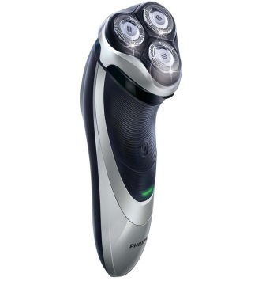
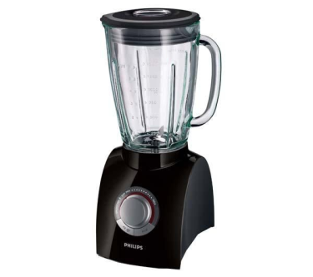

Case 2: Company Y
Large manufacturer of electronic consumer goods
Hard, technical failures
Soft failures
Products not meeting consumers´ expectations
Sentiment, opinions
“However, the Norelco 1150x did NOT shave nearly as close and comfortably…”
Review sites, Amazon, EOpinion
Listen to V-O-C
Consumers´ opinions polarity: positive, negative
Sentiment Analysis application

Slide 26
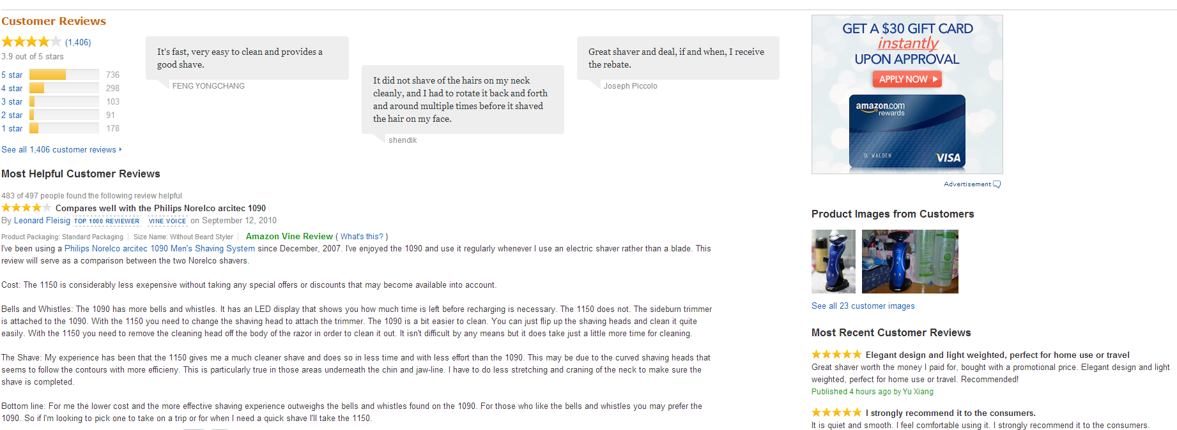
Case 2 (cont)
Crawl Amazon Review website
Focus: shavers
Extract and Clean reviews (text)
Discard HTML tags, images, …

Slide 27
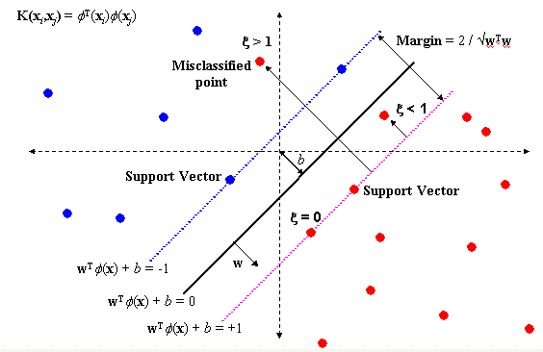
Case 2 (cont)
Support Vector Machines
Predict polarity of opinionated words

Slide 28
Case 2 (cont)
Masters Thesis (Univ of Groningen)
Which phase of NPD are customer opinions most important?

Slide 29
Case 3: Energy Sector
Computational models
Stakeholder behavior from negotiations
Long term
Strategic
Energy Investments
Chats/IM Utterances
Utterances
Fragmented: linking discourse units
Informal, ungrammatical
Multiple topics in 1 discourse unit
S1: i'm seeing contracts from biogas producers that are less than half!
S2:I'm not selling you anything
S3: dont undersell me

Slide 30
Case 3 (cont)
Stakeholders` negotiation behavior
Manifestation of Social Power and Influence
Algorithm
Speech act theory (John Searle)
Other theories in psychology, negotiations, CMC
Linguistic Features from Utterances
Lexical Syntactic Semantic
Socio Linguistic Behavior
Topic Control Directives Questioning Task/Agenda Control
Social Phenomenon
POWER
indicate
predict

Slide 31
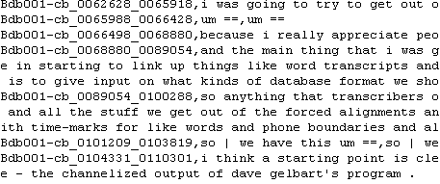
Case 3 (cont)
Behavioral profile per stakeholder
Example Stakeholders: Regulator, Transport (TSO), Factory (Consumer)
Signal Power
Stakeholder | Topic Control | Task Control | Floor Grabbing | Level of Influence
Regulator | 2 | 1 | 3 | 6
TSO | 6 | 4 | 7 | 17
Consumer1 | 5 | 4 | 3 | 12
Chats

Slide 32
Computational Infrastructure
Currently High Performance Computing Centre, Groningen
236 nodes with
12 Opteron 2.6 GHz cores
24 GB memory
16 nodes with
24 Opteron 2.6 GHz cores
128 GB memory
1 node with
64 cores
512 GB memory
In a near future
Calcul Intensif et Stockage de Masse de l'UCL
Consortium des Equipements de Calcul Intensif en Fédération Wallonie Bruxelles

Slide 33
Want to know more?
My ORBI page, especially
Data and Knowledge Engineering (10th /118 Best CS-AI journal)
Expert Systems with Applications (37th /118 Best CS-AI journal)
(Journal and country rankings: http://www.scimagojr.com/index.php)
Stay tuned…
Possible SI of Computers in Industry
Natural Language Processing in Enterprise
Guest-editor

Slide 34
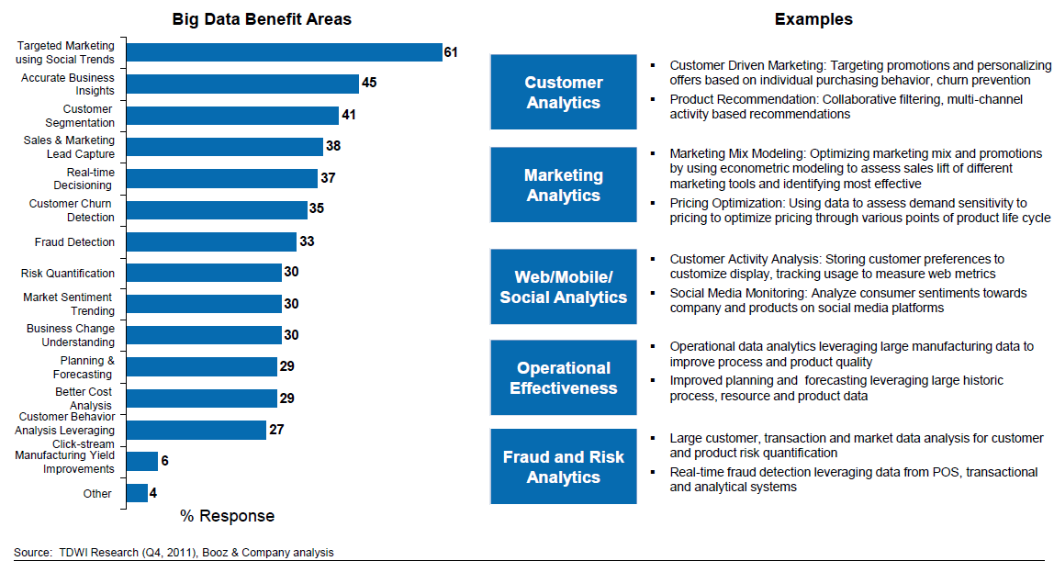
Other Real-Life Applications
Big Data Analytics guide corporate decision-making
Most potential in marketing

Slide 35
Other Real-Life Applications (cont)
Marketing and Sales
“Death of the salesman” [7]
“Marketers let go of your egos” [8]
Fashion Trending [9]
Urban Management [10]
HR [11, 12]
Data-driven hiring, management, promotion, rewarding
Talent Analytics , Datafication of HR

Slide 36
The Rise of the Data Scientist
Need specialized, skilled manpower
Develop analytics technique
Interpret, make sense of data
Multidisciplinary skillsets
Data Mining/Statistics, databases, programming, biology, genomics, marketing, communication, …
Source: http://bloggerchica.com/daa-san-francisco-symposium-recap/

Slide 37
The Rise of the Data Scientist (cont)
HBR: Data Scientists Sexiest Profession of 21st Century [13]
McKinsey&Co predict shortage (US) [14]
140,000 to 190,000 people with deep analytical skills
1.5 million managers, analysts with know-how of Big Data analytics for decision-making
Financial Times [15]
Trend in top US b-schools (MIT, Wharton, Chicago Booth, CMU,…)
Data Analytics in MBAs
Soon at HEC-ULg
Web and Text Analytics…
Taught by yours truly

Slide 38
Challenges
Obstacles as impediments to Big Data, Analytics adoption
Challenge 1: Determining value of reaped from Big Data
Challenge 2: Lack of skilled manpower
Challenge 3: Privacy, security concerns
“Right to be left alone”: privacy vs. better services trade-off
Only 20% of data in digital universe is protected [4]
Challenge 4: Organizational, “people” issues
Technology is not the problem
Make or break Big Data Projects
Analogous to ERP Implementations

Slide 39
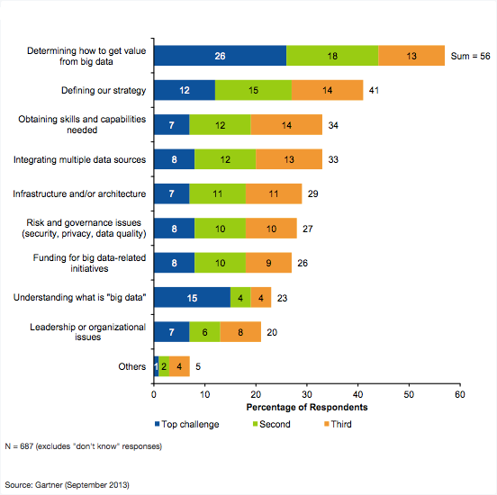
Challenges (cont)
From Gartner[2]

Slide 40
Research Agenda
Technical/Technological
Natural Language Processing, Analytics
Big Data Taxonomies, Ontologies
Semantic Web and OpenLinkedData
Infrastructure (NoSQL, Hadoop-MapReduce)
Assurance
Information Quality, Trust
Social Sciences: Management, Economics, Legal, Marketing
Big Data Implementation Success Factors
ROI and Success of Big Data Investments
Models for cost-per-byte (e.g. surveillance data vs. camera phone data)

Slide 41
Conclusion
Big Data
3Vs
Analytics: Real value of Big Data
Big Data Predominantly Unstructured Data
Text, video, photos
Valuable insights buried within unstructured, messy texts
Text analytics – Natural Language Processing
Discovering causes of product failures from job-sheets
Sentiment Analytics
Computational Modeling of socio-linguistics behavior
Rise of data scientist
Challenges of Big Data and Analytics
Research Agenda

Slide 42
QUESTIONS?

Slide 43
Bibliography
1. A. McAfee & E. Brynjolfsson, «Big data: the management revolution,» Harvard Business Review, vol. 90, 110, pp. 60--66, 2012
2: M. Asay, “Gartner On Big Data” September 2013. Available: http://readwrite.com/2013/09/18/gartner-on-big-data-everyones-doing-it-no-one-knows-why#awesm=~ooLJYN7thZLxbc
3. P. Zikopoulos & C. Eaton, Understanding big data: Analytics for enterprise class hadoop and streaming data, McGraw-Hill Osborne Media, 2011.
4. J. Gantz, & D. Reinsel. The digital universe in 2020: Big data, bigger digital shadows, and biggest growth in the far east. IDC iView: IDC Analyze the Future, 2012
5. IDC, “Worldwide Big Data Technology and Services 2012-2015 Forecast,” 2012.

Slide 44
Bibliography
6. LaValle, S., Lesser, E., Shockley, R., Hopkins, M. S., & Kruschwitz, N. (2011). Big data, analytics and the path from insights to value. MIT Sloan Management Review, 52(2), 21-31.
7. “Death of the Salesmen: The Geeks Did It,” 24 April 2012. Available: http://slashdot.org/topic/bi/death-of-the-salesmen-the-geeks-did-it/.
8. “Marketers, Let Your Egos Go,” Harvard Business Review, 25 April 2013. Available: http://blogs.hbr.org/2013/04/marketers-let-your-ego-go/
9. “HOW BIG DATA IS CHANGING FASHION (RETAIL),” 21 October 2013. Available: http://blog.starbridgepartners.com/2013/10/21/how-big-data-is-changing-fashion-retail/

Slide 45
Bibliography
10 “5 Ways Cities Are Using Big Data,” September 25 2013. Available: http://mashable.com/2013/09/25/big-data-cities/
11 “Big Data in Human Resources Talent Analytics Comes of Age,” 17 Feburary 2013. Available: http://www.forbes.com/sites/joshbersin/2013/02/17/bigdata-in-human-resources-talent-analytics-comes-of-age/.
12 “Big Data in Human Resources: A World of Haves And Have-Nots,” 10 July 2013. Available: http://www.forbes.com/sites/joshbersin/2013/10/07/big-data-in-human-resources-a-world-of-haves-and-have-nots/.
13 “Data Scientist: The Sexiest Job of the 21st Century,” Harvard Business Review, October 2012. Available: http://hbr.org/2012/10/data-scientist-the-sexiest-job-of-the-21st-century/.

Slide 46
Bibliography
14. Manyika, J., Chui, M., Brown, B., Bughin, J., Dobbs, R., Roxburgh, C., & Byers, A. H. (2011). Big data: the next frontier for innovation, competition, and productivity., McKinsey Global Institute.
15 “Business schools’ big data revolution,” Financial Times, 11 02 2013. Available: http://www.ft.com/intl/cms/s/2/c017f2cc-7082-11e2-85d0-00144feab49a.html#axzz2mRfRIOJp

