Slide 1


Gondwanan Palaeozoic plant spores: a review
Philippe Steemans and Philippe GERRIENNE
University of Liège, Belgium
IPSG April 14-16, 2016 Perugia Italy

Slide 2
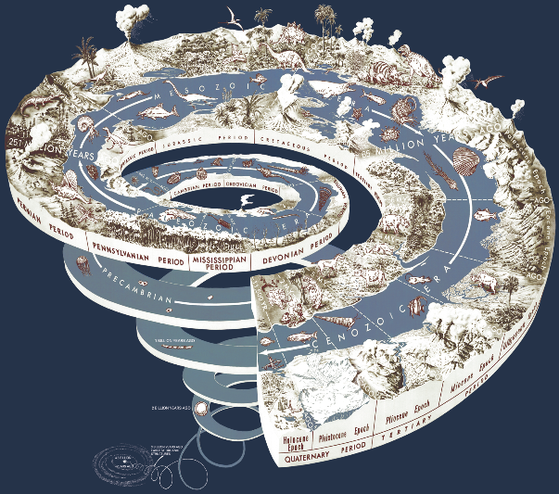
The AGE RANGE concerned by this review
ISC 2014

Slide 3
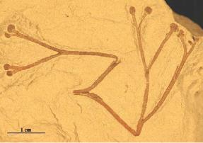
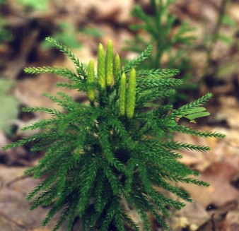
trilete spores
Breuer & Steemans, 2013

Slide 4
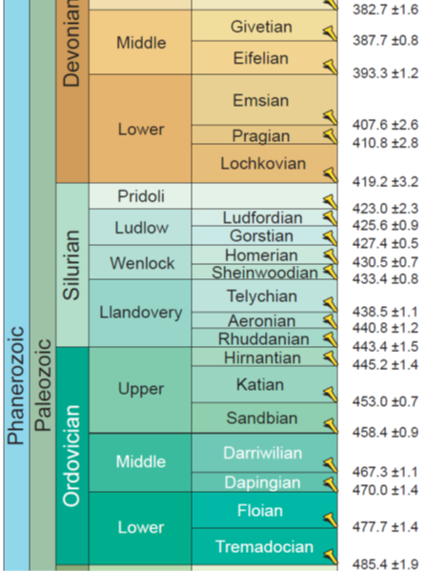
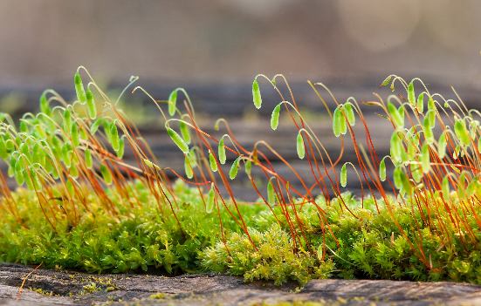
cryptospores
Steemans et al., 2010

Slide 5
Doubtful Middle Cambrian cryptospores from Laurentia
Taylor and Strother, 2009

Slide 6
Dapingian cryptospores from Argentina
Rubinstein et al., 2010

Slide 7
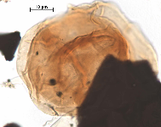
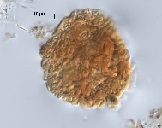
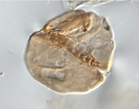
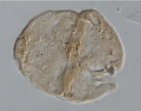

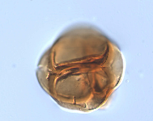
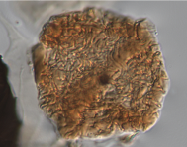
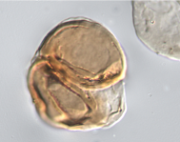
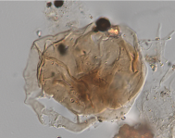
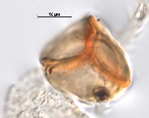
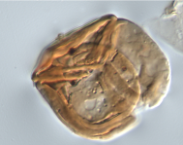
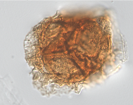
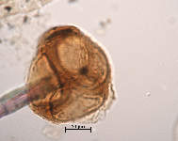
Ordovician cryptospore assemblage
Sphaerasaccus glabellus
Rugosphaera cerebra
Dyadaspora murusattenuata-murusdensa
Tetrahedraletes medinensis
Segestrespora rugosa
Abditusdyadus laevigatus
Segestrespora laevigata
Tetrahedraletes grayii
Rimosotetras caledonica
Velatitetras anatoliensis
Velatitetras retimembrana

Slide 8
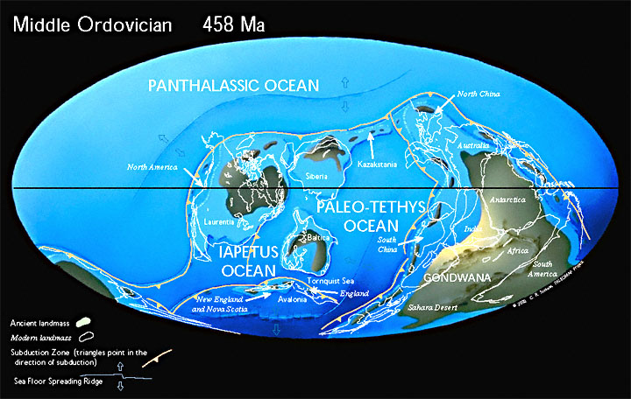
Cryptospore distribution in the UpPer Ordovician
Scotese 2010

Slide 9

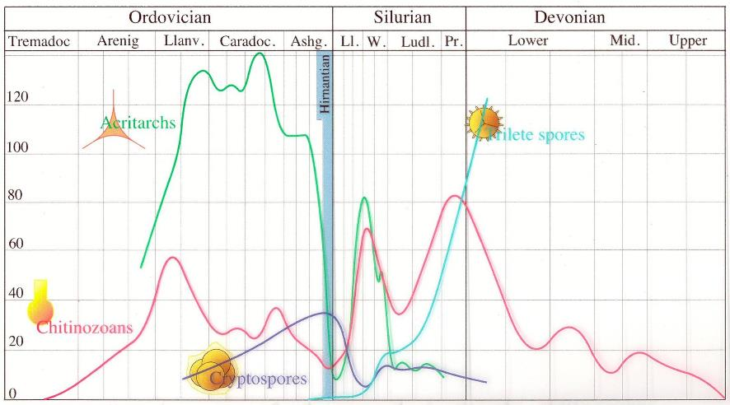
Miospores biodiversity curve

Slide 10

The oldest trilete spores
Steemans et al. 2009

Slide 11
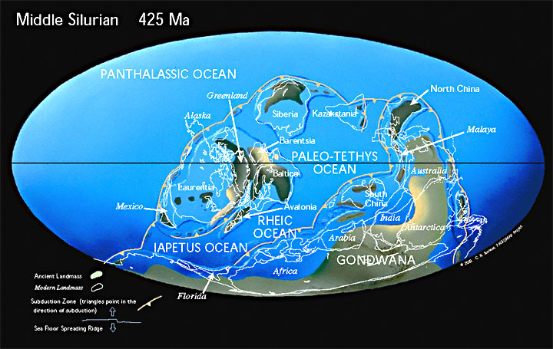
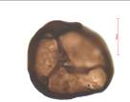
Migration of the trilete spores
Ambitisporites avitus
4 Upper Aeronian
7 Wenlock
2 Hirnantian
1 Katian
6 Telychian?
3 Lower Aeronian
5 Uppermost Aeronian
Scotese 2010

Slide 12
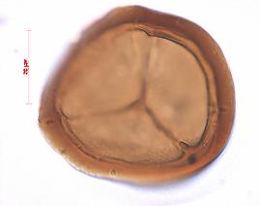
The early Silurian
Archaeozonotriletes chulus Morphon Steemans 1996
Cryptpospores enclosed in a membrane
Trilete spores
Archaeozonotriletes chulus

Slide 13
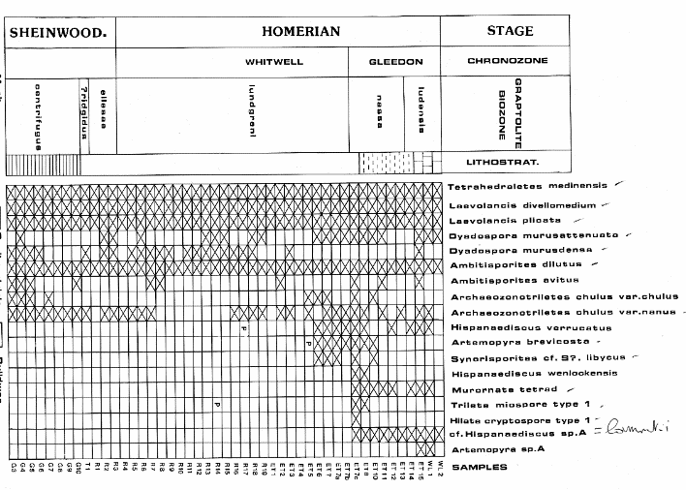
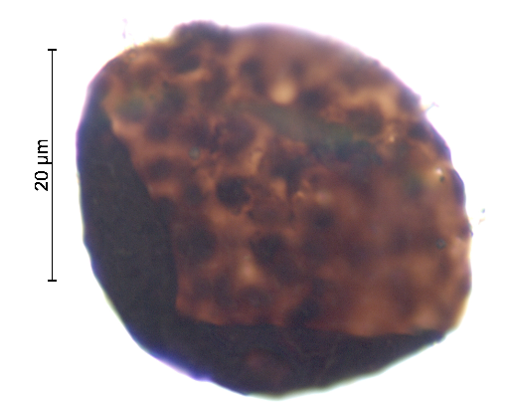
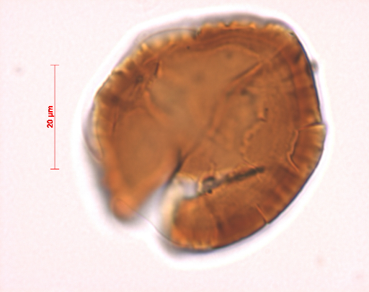
Biozonation (late Ordovician – early Silurian
H. verrucatus
A. brevicosta
A. chulus
Archaezonotriltes
chulus-nanus
verrucatus-
brevicosta
Hispanaedicus
verrucatus
Artemopyra
brevicosta
Burgess, 1991

Slide 14
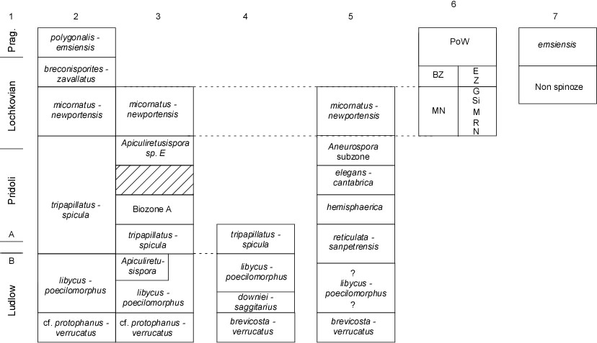
Biozonations
Richardson et al., 2001
Steemans et al, 2008

Slide 15
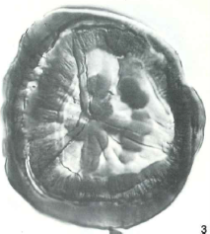
Palaeogeographic position of the IBERIC plate
Streelispora
newportensis
Emphanisporites
splendens
Scotese, 2014

Slide 16
Palaeogeographic position of the IBERIC plate
Scotese, 2014

Slide 17
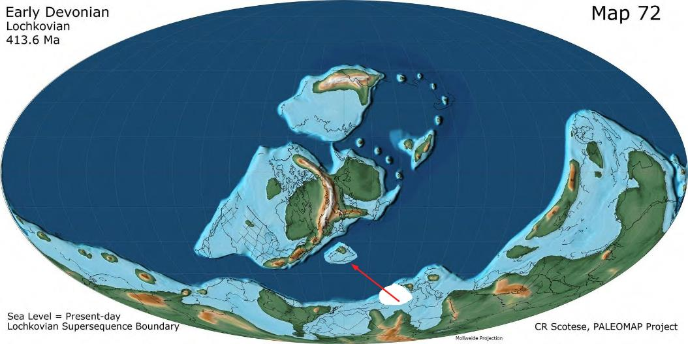
Scotese, 2014

Slide 18
Palaeogeographic position of the Moesian Terrane
Emphanisporites zavallutus var zavallatus
Emphanisporites zavallatus var gedinniensis
Emphanisporites mircornatus var sinuosus
Emphanisporites micrornatus var micrornatus
Scotese, 2014

Slide 19
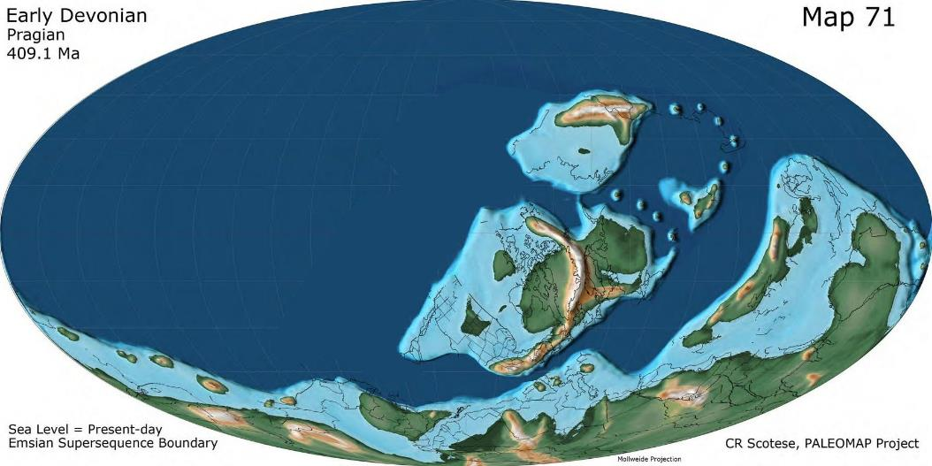
Palaeogeographic position of the Moesian Terrane
Scotese, 2014

Slide 20
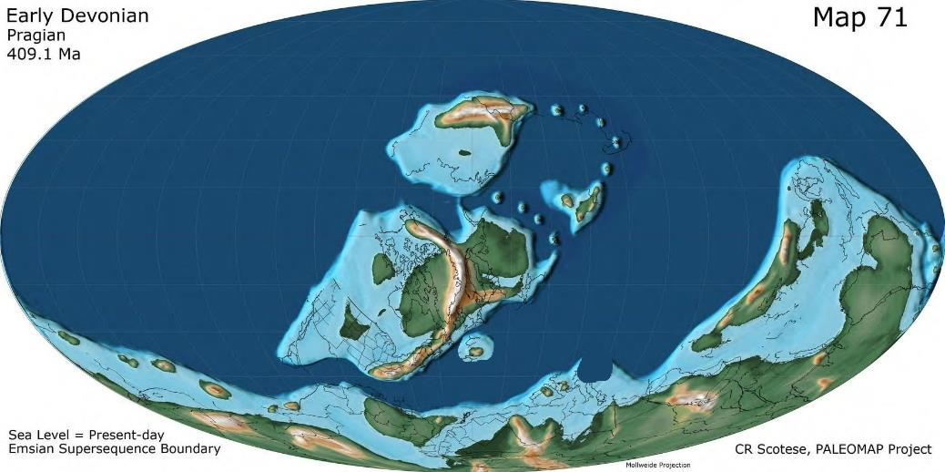
Palaeogeographic position of the MoesiAN terrane
Scotese, 2014
Scotese, 2014

Slide 21
Biostratigraphic scale of the Silurian and the Devonian
Kermandji, 2012

Slide 22
Charts comparing biozonations from North Africa
Breuer & Steemans 2013

Slide 23
CHart comparing biozonation from Saudi Arabia with other charts
Breuer & Steemans, 2013

Slide 24
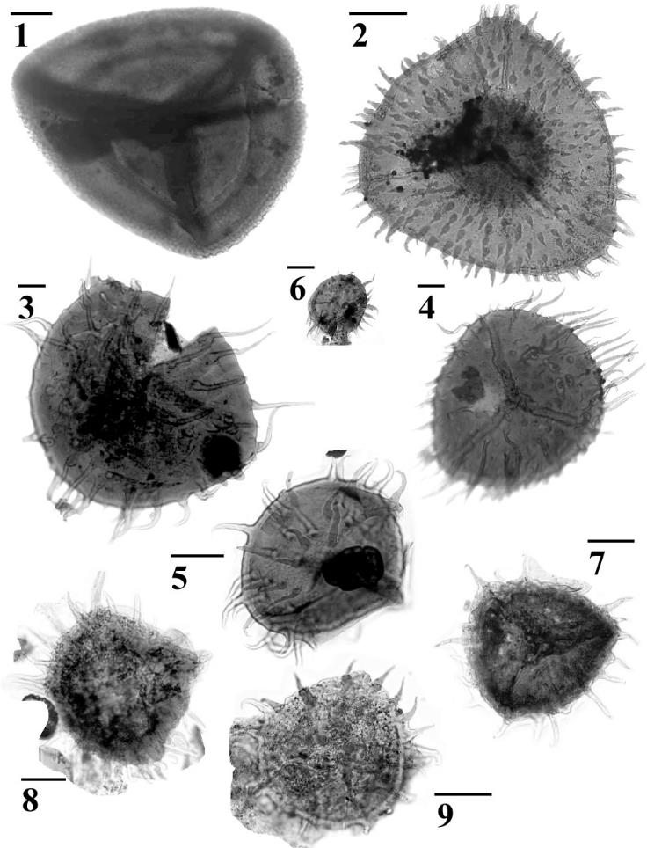

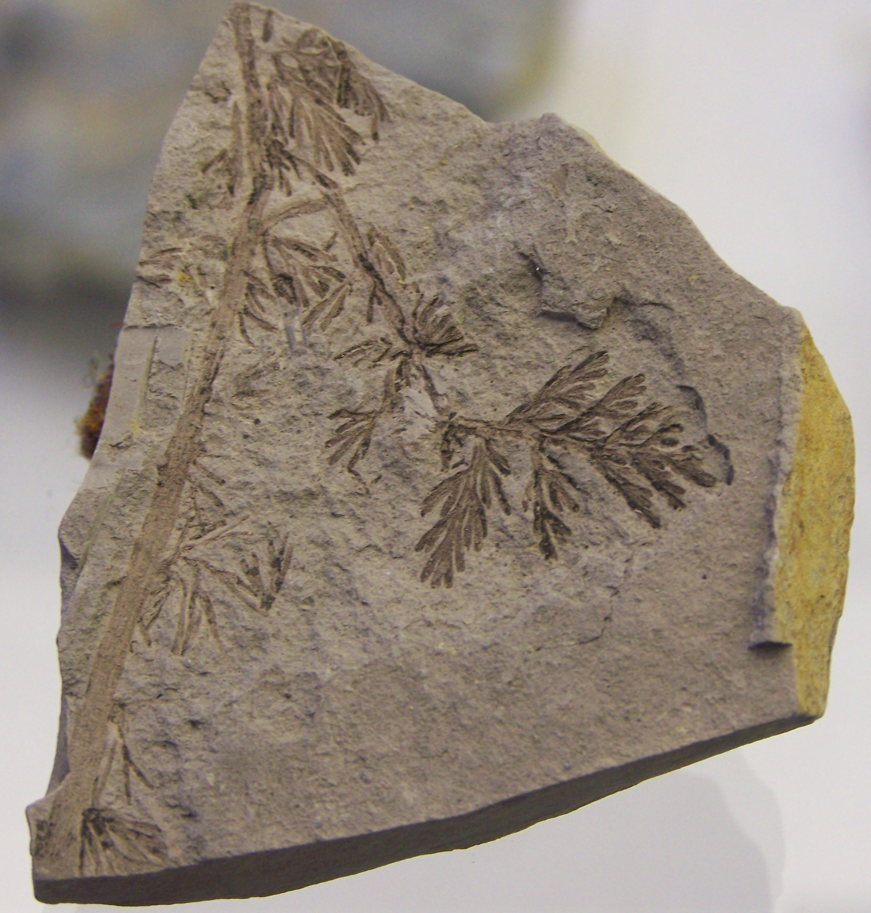
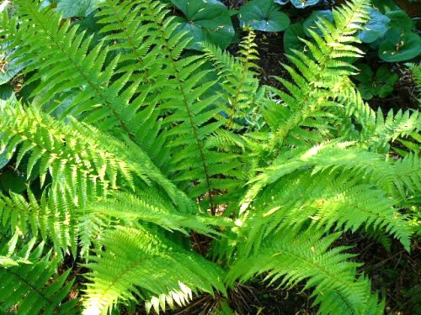
MEGASPORES AND HETEROSPORY
Corystisporites undulates Turnau 1996
50 µm
50 µm
50 µm
Heliotriletes longispinosus Fuglewicz & Prejbisz 1981 var. longispinosus var. nov. Steemans et al. 2011
Steemans et al. 2011

Slide 25
Givetian megaspores
Scotese 2010

Slide 26
Some
examples
of
megaspores
Steemans et al. 2011

Slide 27
Givetian megaspores
Scotese 2010

Slide 28
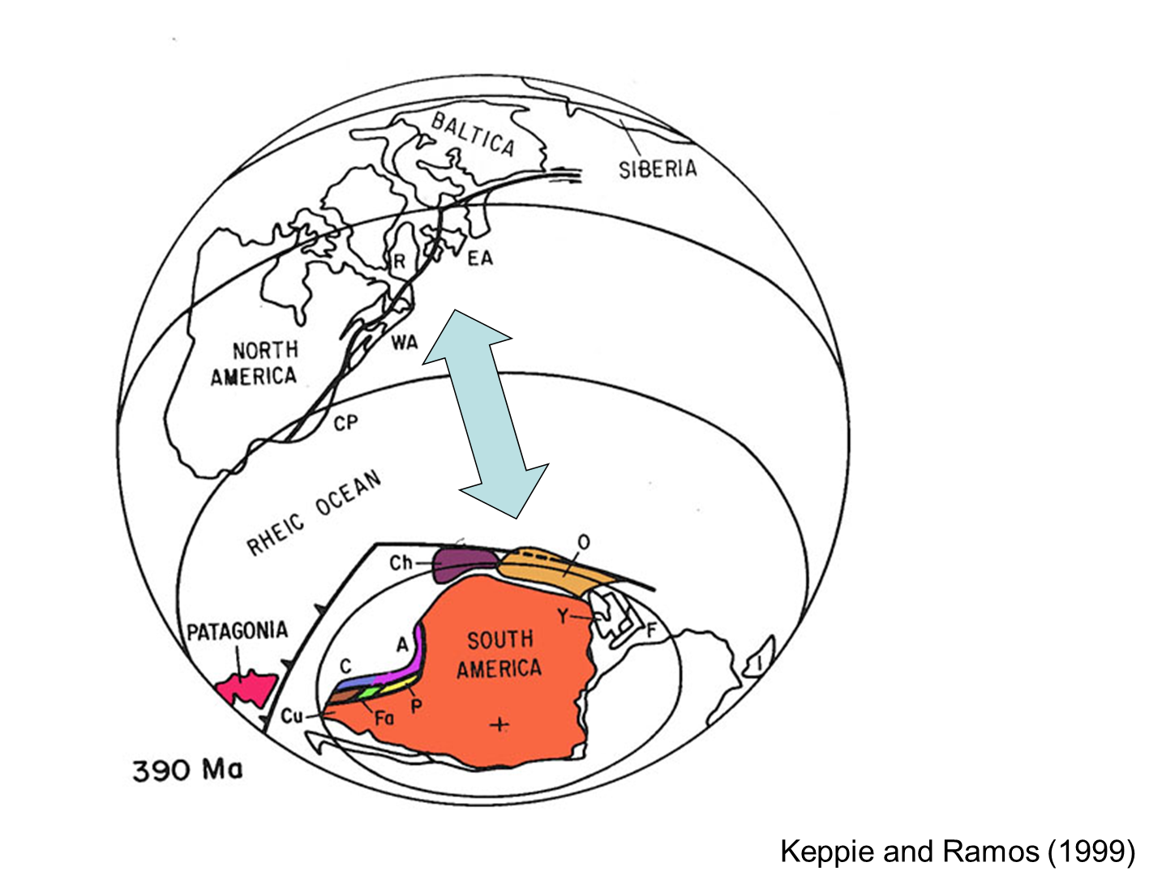

Slide 29
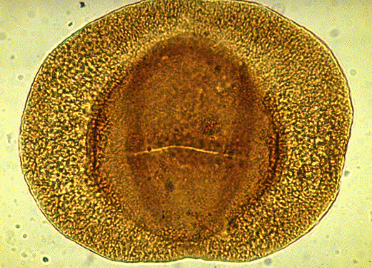
The next step: pre-pollen and pollen … but this is an other story ….
Potonieisporites novicus Bharadwaj 1954

Slide 30


Slide 31
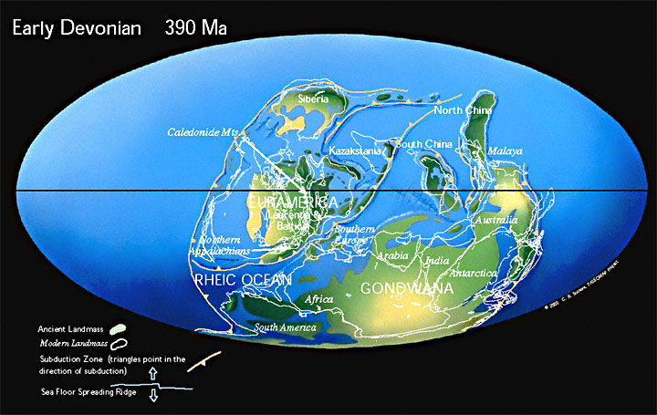

Palaeogeographic position of the Spanish plate
Streelispora newportensis
Emphanisporites splendens
Scotese 2010

Slide 32
Palaeogeographic position of the Moesienne Terrane
Emphanisporites zavallutus var zavallatus
Emphanisporites zavallatus var gedinniensis
Emphanisporites mircornatus var sinuosus
Emphanisporites micrornatus var micrornatus
Breuer et al. 2005
Scotese 2010

Slide 33
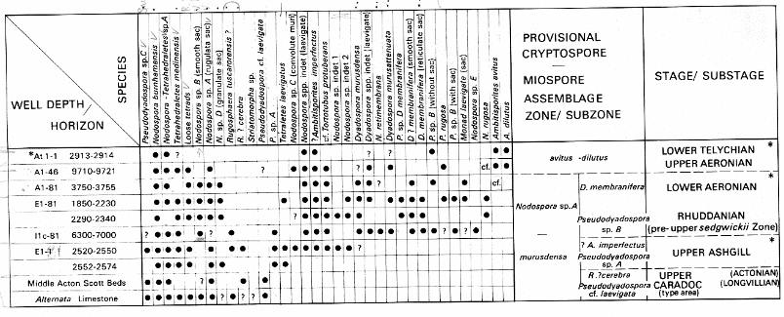
Biozonation (late Ordovician – early Silurian
Richardson, 1988

