Slide 1
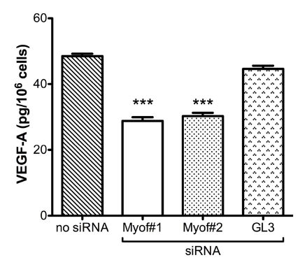
Myoferlin silencing reduces VEGFA secretion
no siRNA
siRNA Myof#1
VEGFA
no siRNA
siRNA Myof#1

Slide 2
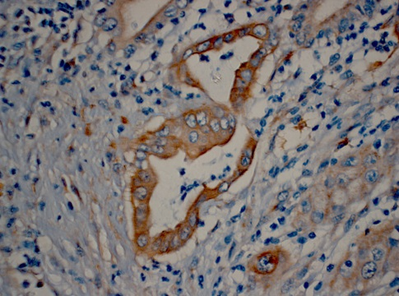
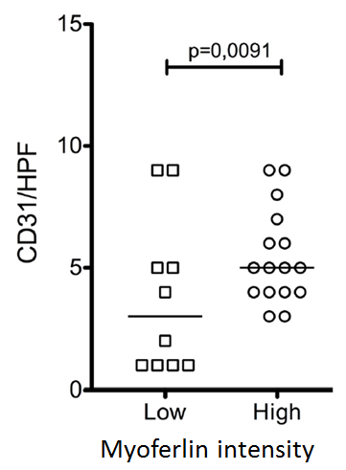
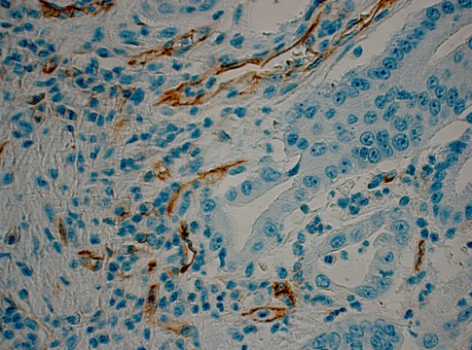
Myoferlin is associated with high MVD in pancreatic cancer
?
Myof
VEGFa
MVD
MYOF
CD31

