Slide 1
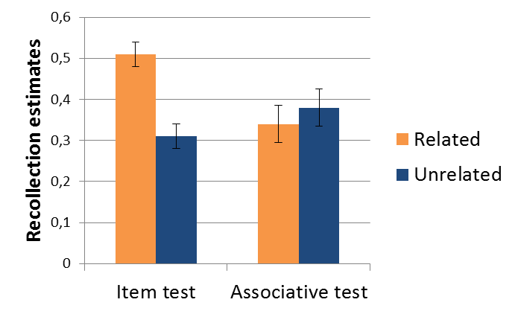
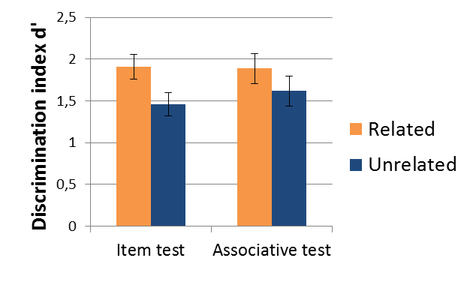
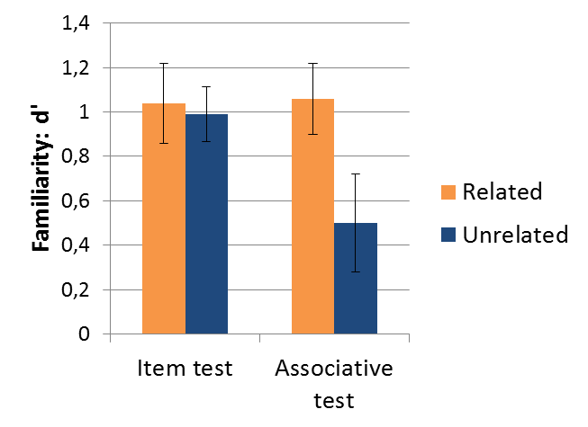
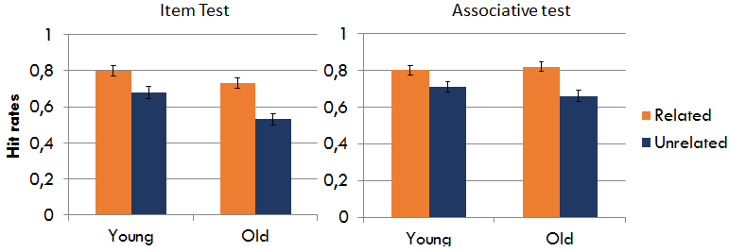
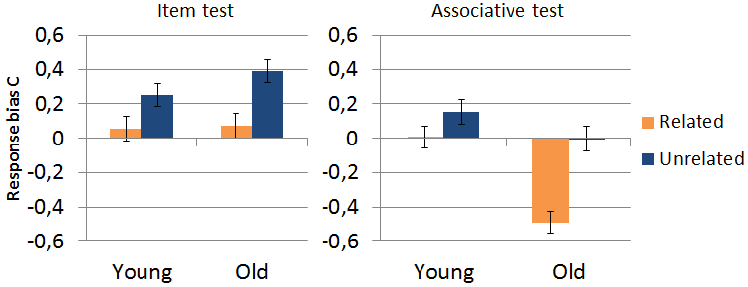
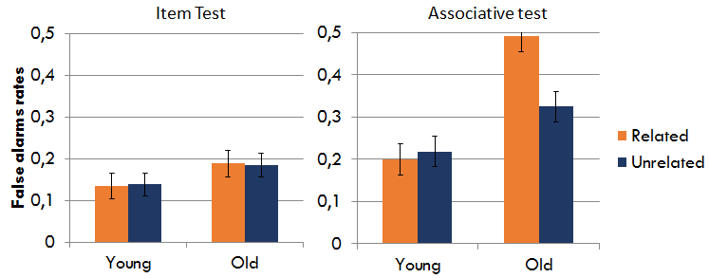
The effect of aging on associative memory for
semantically-related word pairs
Adrien Folville, Emma Delhaye & Christine Bastin
Cyclotron Research Center, University of Liège, Belgium
INTRODUCTION
Older adults’ episodic memory is characterized by difficulties in linking individual elements in a complex memory, reflecting an associative
memory deficit, whereas their memory for individual elements remains relatively preserved (1).
Objectives
Participants
The current study evaluated the impact of the use of semantic prior knowledge on associative memory performance in healthy aging (Study 2). Moreover, we evaluated recollection and familiarity processes involved in such a task through a Remember/Know/Guess (RKG) paradigm in young adults (Study 1) (2).
 | Study 1 | Study 2
 | Young (n=20) | Young (n=24) | Old (n=23)
Age | 21.75 (1.51) | 22.29 (2.11) | 70.47 (4.75)
Education | 15.00 (0.29) | 15.33 (1.73) | 15.60 (2.44)
Mill-Hill | 24.55 (3.36) | 24.16 (4.46) | 27.82 (4.10)*
Mattis | / | / | 137.52 (3.38)
Materials & procedure
Encoding: 60 word pairs , 30 semantically related (categorical relations) and 30 unrelated.
* Significant group difference, p < .01
4 sec
Study 1: results
Item test: 12 related and 12 unrelated ‘old’ targets, 6 related and 6 unrelated ‘new’ lures.
2 (test) x 2 (relatedness) repeated-measures ANOVA:
*
Associative test: 12 related and 12 unrelated intact pairs, 12 related and 12 unrelated recombined pairs.
*
*
Response: Study 1 Study 2
Remember Know Guess
Yes No
Yes No
* Significant difference, p < .05
Study 2: results
2 (group) x 2 (test) x 2 (relatedness) repeated-measures ANOVA:
*
*
CONCLUSION
The results from Study 1 suggest that young participants rely more on familiarity to recognize related than unrelated word pairs. As for older participants, findings from Study 2 suggest that they have difficulties to discriminate intact and recombined related pairs, producing higher false alarm rates and a more liberal bias. This could reflect a greater difficulty to inhibit absolute familiarity due to pre-experimental knowledge.
* Significant group difference, p < .001
REFERENCES
(1) M. Naveh-Benjamin et al. (2008). Psychology and Aging, 23, 104-118. (2) J. Gardiner et al. (1996). Canadian Journal of Experimental Psychology, 50, 114-122.
Cyclotron Research Centre | http://www.cyclotron.ulg.ac.be | Christine Bastin | Christine.Bastin@ulg.ac.be

