Slide 1



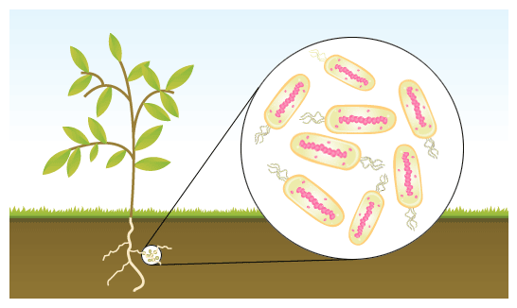
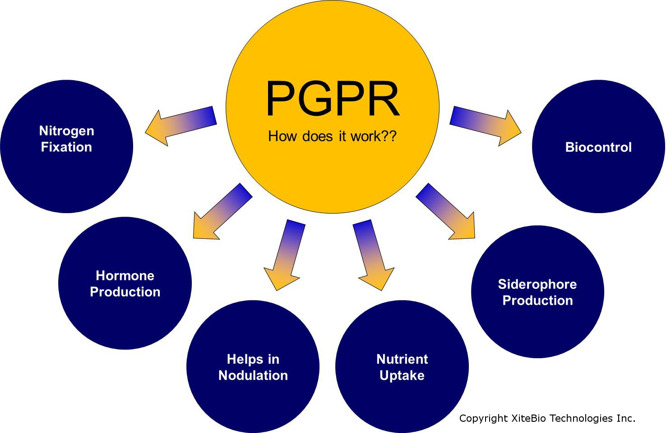
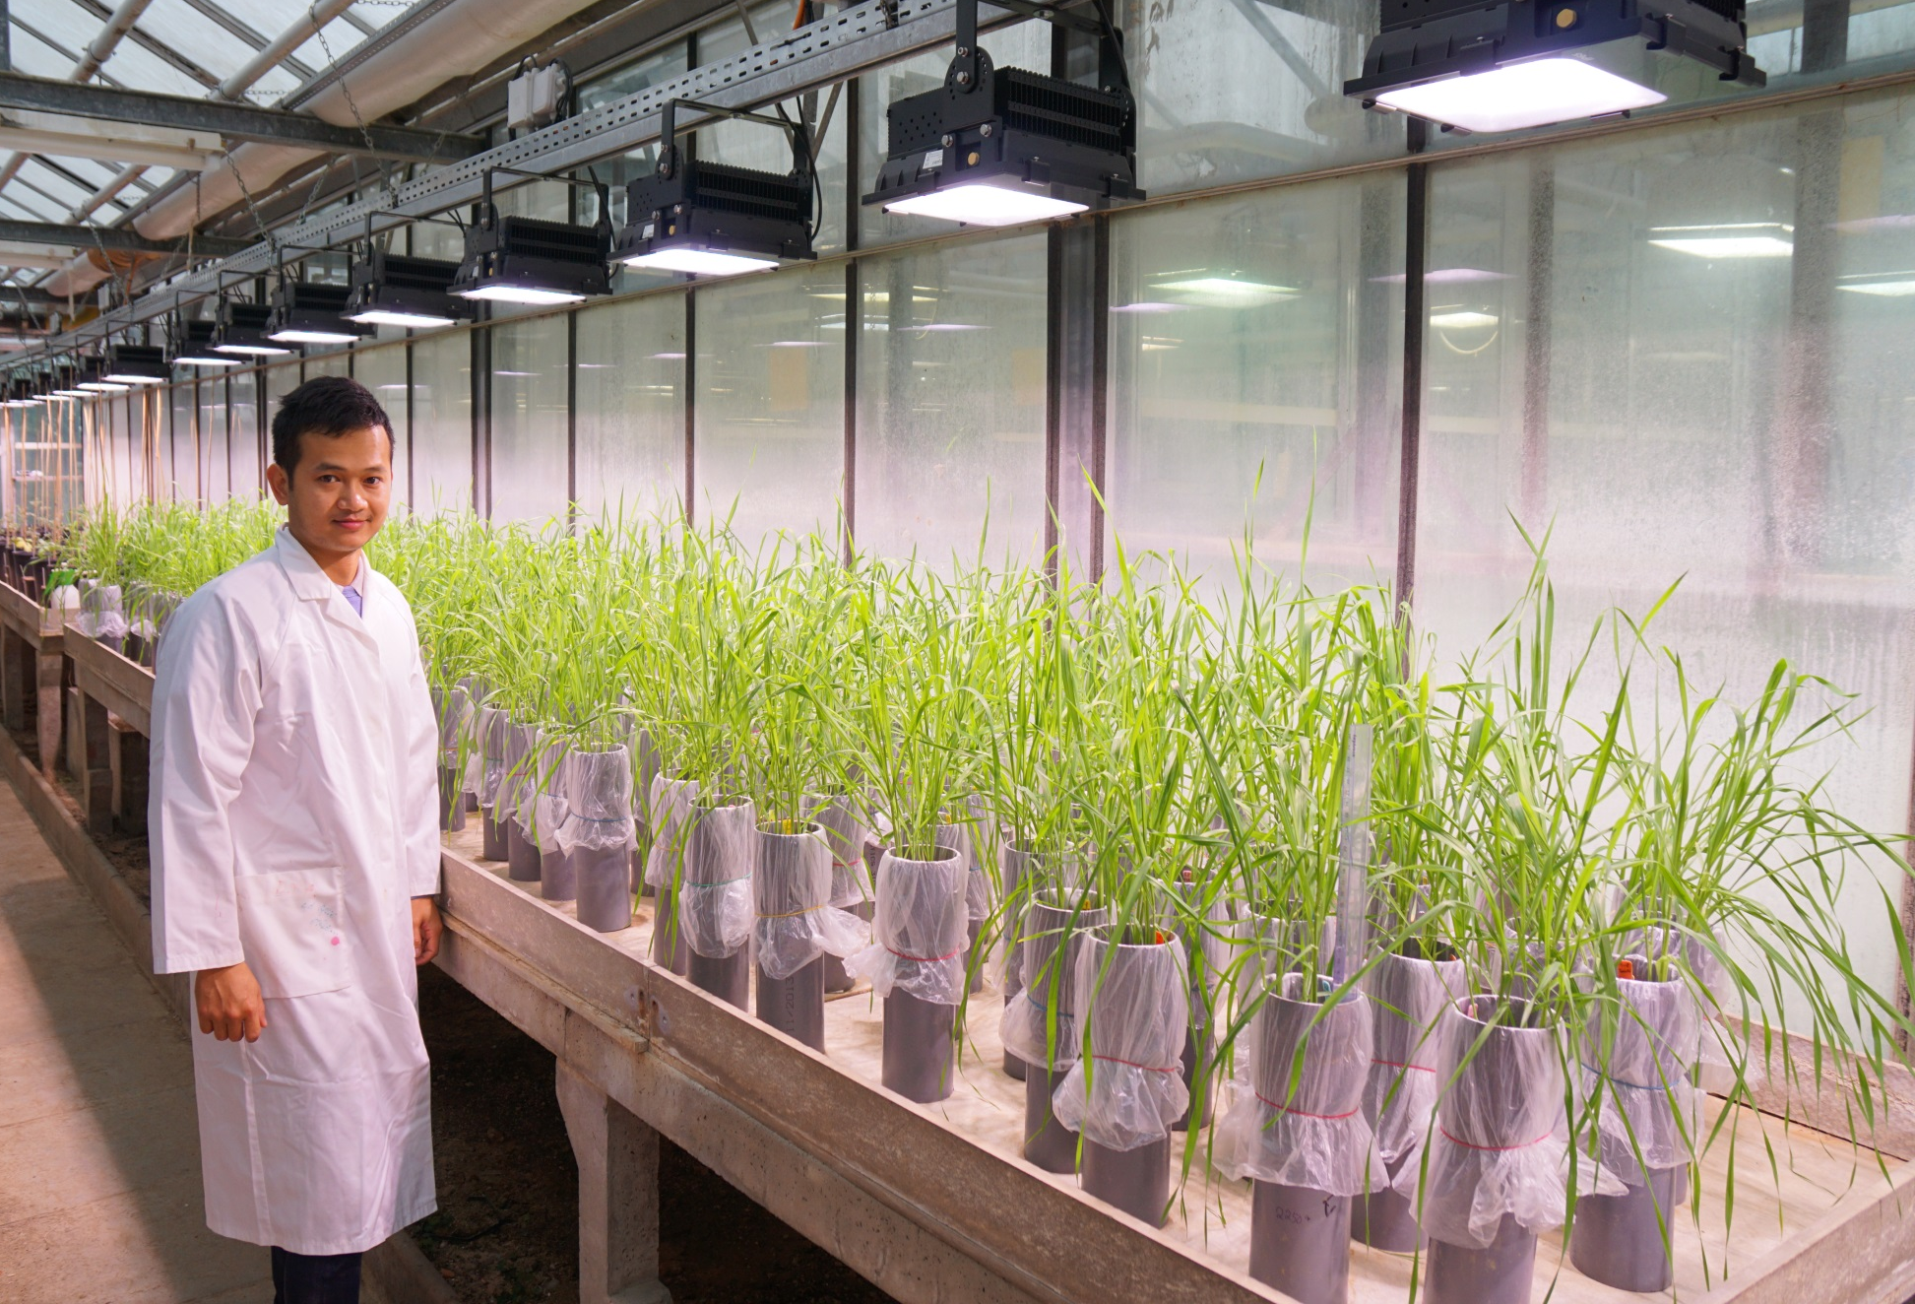
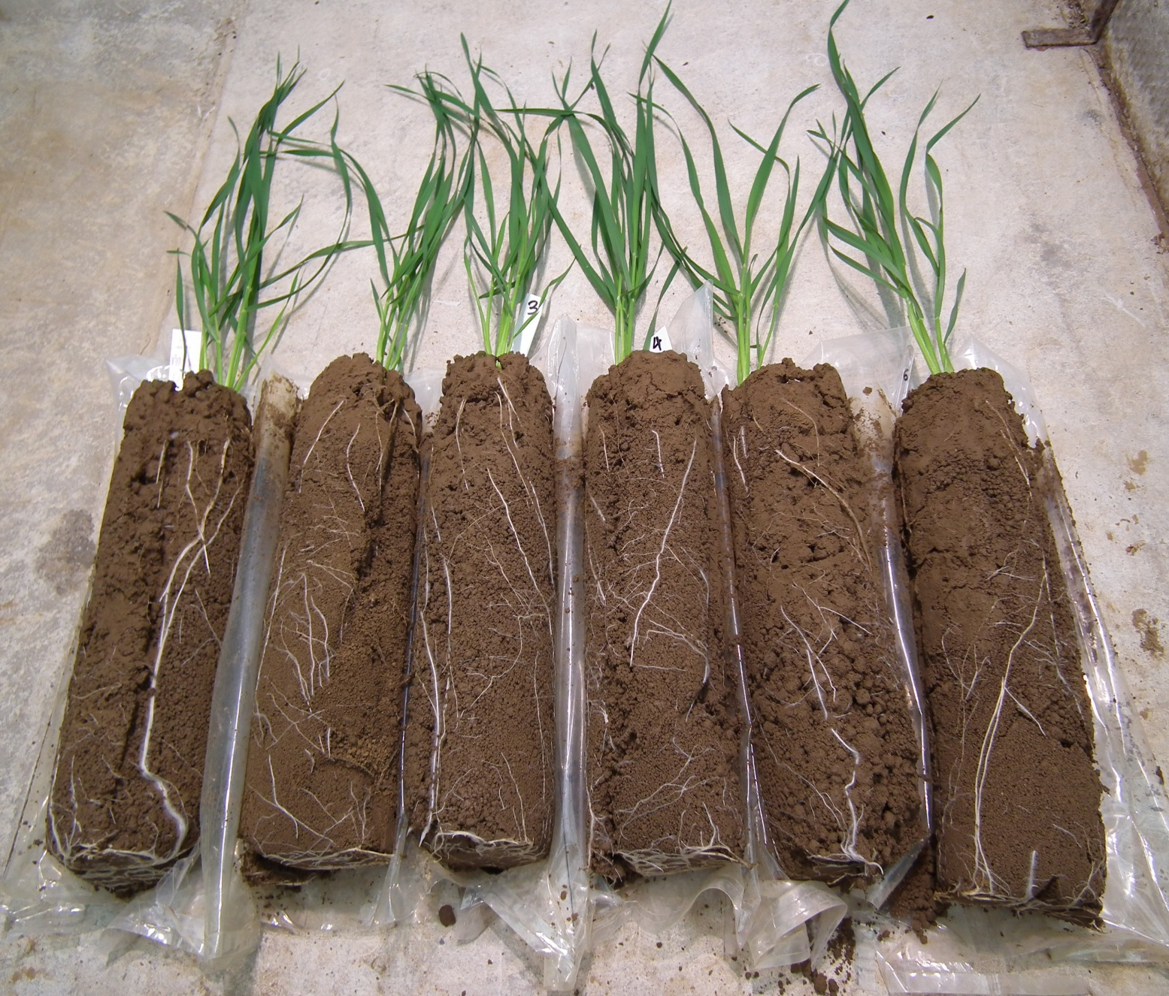
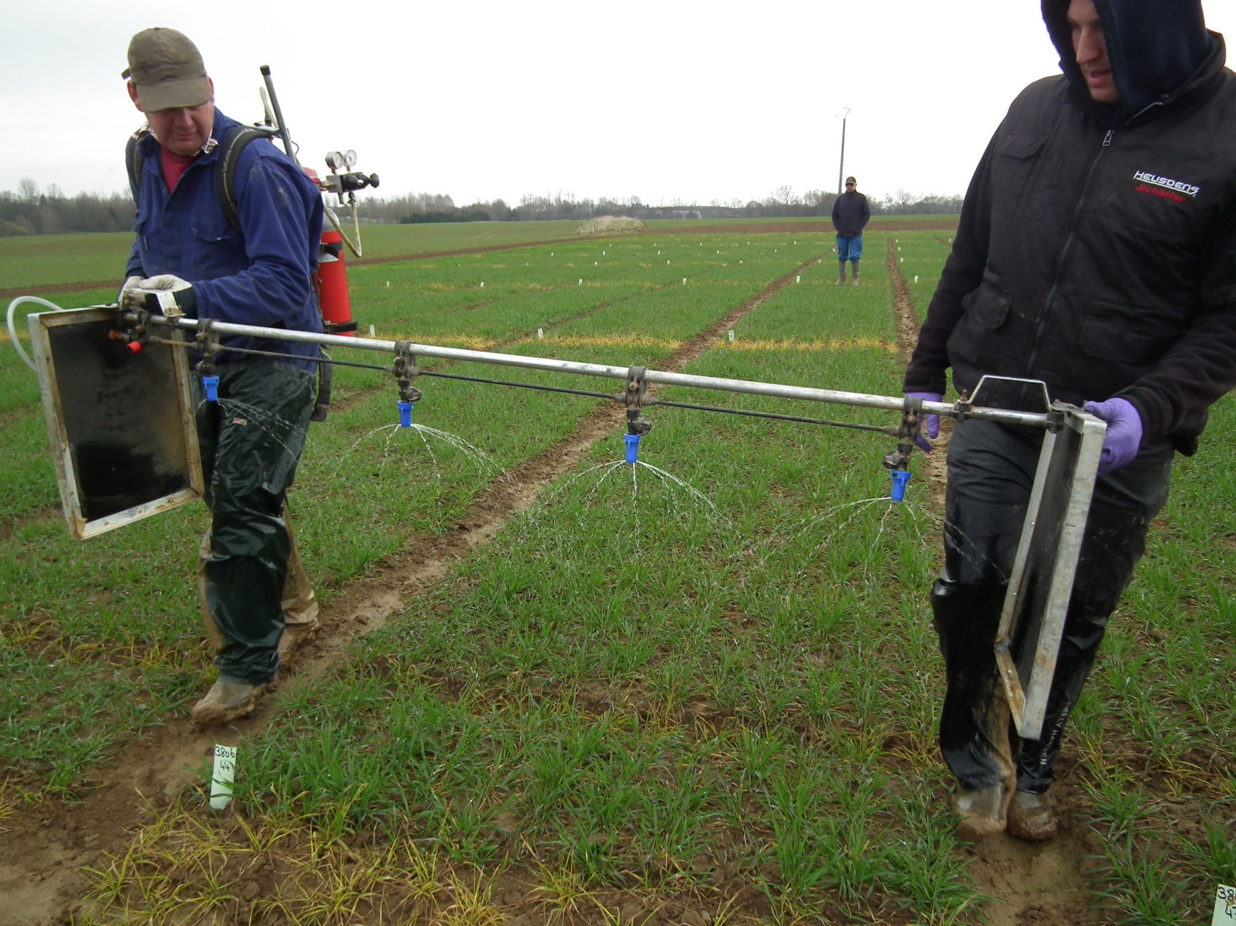
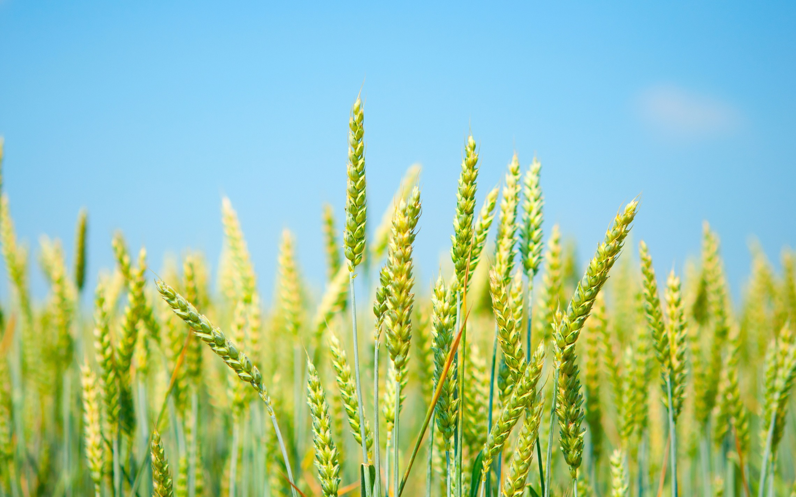
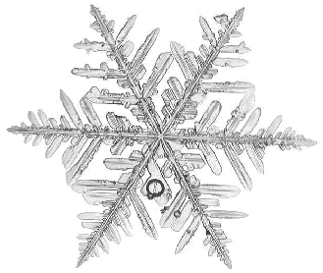

Impacts of Plant Growth-Promoting Rhizobacteria on Wheat Growth under Greenhouse and Field Conditions
Minh Luan Nguyen^{1,*}, Bernard Bodson², Gilles Colinet³, Haïssam Jijakli⁴, Marc Ongena⁵, Micheline Vandenbol⁶, Patrick du Jardin¹, Stijn Spaepen⁷, & Pierre Delaplace¹ University of Liège, Gembloux Agro-Bio Tech: ¹Plant Biology, ²Crop Science and Experimental Farm, ³Soil Science, ⁴Phytopathology, ⁵Bio-Industries, ⁶Animal and Microbial Biology,
⁷Plant Microbe Interactions, Max Planck Institute for Plant Breeding Research
*Contact: ml.nguyen@ulg.ac.be
-
Introduction
Plant Growth-Promoting Rhizobacteria (PGPR)^{(1,2,3)} are well-known for stimulating root growth, enhancing mineral availability, and nutrient use efficiency in crops, and therefore become promising tool for sustainable agriculture. In addition, PGPR are one of the main classes of plant biostimulants⁽⁴⁾.
Objective
1. The aim of this study is to screen PGPR strains to enhance wheat growth and yield in combination with an optimised nitrogen (N) fertilizer dose, and thus finally reduce the use of N fertilizer without decreasing the yield compared to the full recommended N dose. The application methods (e.g. seed coating and/or spraying) and the application growth stage will be optimized.
2. Development of relevant research protocols:
To assess the impacts of PGPR on plant growth and yield under greenhouse and field conditions.
To assess the impacts of PGPR on the microbial communities in the wheat rhizosphere.
To find the suitable agronomical practices to support PGPR performing their best plant growth-promoting capacity.
Materials & methods
PGPR strains include 3 commercial PGPR-containing products which were sprayed for both field tests (2013-2014; 2014-2015): (1) Bacillus amyloliquefaciens a, (2) B. subtilis, and (3) B. amyloliquefaciens b; with additional two strains for 2nd test: (4) Azospirillum brasilense, and (5) Azotobacter chroococcum.
PGPR screening under greenhouse condition: Seeds of a spring wheat, Triticum aestivum (variety Tibalt), were planted in 30-cm depth PVC tubes filled with field soil (maintained at 15% humidity, no added fertilizer) and inoculated with 10⁸ cells/plant under LED lighting (flux: 150 W/m2). After 30d inoculation, plant biomass was measured.
PGPR screening under field condition in combination with different N fertilizer doses: Seeds of a winter wheat, T. aestivum (cv Forum) were sowed on Dec. 2013 and Oct. 2014 in a criss-cross design. Two fixed factors were used: the PGPR treatment and N fertilizer doses (0, 50, 75 and 100%N in 2014; 75%N was excluded in 2015 test). The shoot weight, spike number and grain yield were measured at Zadoks’ stage 39, 69 & 100, respectively.
& Phophorus Solubilization
PGPR screening under greenhouse conditions
Wheat plants grown in soil tubes
Spraying the PGPR-containing products
under field conditions
Results and Perspectives
abc
(1.A)
Field Experiment 2013-2014
c
bc
abc
abc
abc
12/2013
1st Products spraying
2nd products spraying
24/3
23/5
8/2014
22/4
Winter
24/4
27/5
18/6
Time
b
ab
ab
ab
ab
a
AgricultureIsLife
39
Plant stage (Zadoks)
0
31
40
100
Sowing
21
30
1st Biomass
Harvest
69
1st N application
(Tillering)
2nd N appl.
(Stem
elongation)
3rd N appl.
(Last leaves)
2nd Biomass
Harvest
Grain Harvest
Field Experiment 2014-2015
Fig. 2. Effects of PGPR in dry biomass of spring wheat, greenhouse. B. subtilis resulted in the highest root biomass compared to control (ANOVA, p < 0.05)
10/2014
1st Products spraying
2nd products spraying
12/6
05/8/2015
Fig. 3 Effects of PGPR in grain yield increase of winter wheat in field test 2013-2014 (A) and 2014-2015 (B)
(A) B. subtilis increased 15% grain yield compared to control at 0%N dose but non-significance from the control. The concentration of PGPR were used according to manufacturer instructions (B. amyloliquefaciens a at 2x10⁸ cfu/m², B. subtilis and B. amyloliquefaciens at 2x10¹⁰ cfu/m²)
(B) Two concentrations of PGPR were applied in 2014-2015: (1) follow manufacturer instructions (strain_1, as Fig.3A, plus 2.5x10⁹ cfu/m² for 2 additional strains) and (2) normalized concentration at 5x10¹⁰ cfu/m² (strain_2).
However, non significant results were recorded with all PGPR treatments compared to control. This failure can be explained by the low temperature which was below 4ºC and more rain which might cause cells lost at the time of PGPR spraying and in following days.
16/3/2015
15/4
29/4
15/5
Winter
26/3
18/5
Time
(3.A)
0
Z26-29
Z32
Z39
Z69
100
Plant stage (Zadoks)
15% increase
Sowing
1st N appl.
(Tillering)
1st Biomass
Harvest (Z39)
2nd Biomass
Harvest (Z69)
Grain Harvest
(1.B)
2nd N appl.
(Stem
elongation)
3rd N appl.
(Last leaves)
Nitrogen fertilizer doses
PGPR spraying
(3.B)
… 30 May
Fig. 1. (A) Field experiment design and application schemes of PGPR and N fertilizer in 2013-2014 and 2014-2015, (B) Temperature and precipitation were recorded at the time of PGPR spraying and in following days.
Lower temperature (<4ºC) and more rain might cause failure in PGPR application on field in spring 2015 compared to 2014
Perspectives:
Continue to optimise the growth condition (e.g. fertilizer level, mix soil and sand to reduce the nutrient content) and select the proper plant stage to inoculate PGPR efficiently in the greenhouse and field.
It is critical to test the colonization capacity of PGPR in the wheat rhizosphere.
Metagenomic approaches (based on shotgun sequencing of rDNA) should be developed to assess the impacts of PGPR to soil microbial community in greenhouse before testing in the field.
Optimise the materials and shelf-life for the PGPR-coated seed method for field application 2016-2017.
Searching cold-tolerant strains which is necessary for efficient inoculation in early spring when the weather is unpredictable
with low temperature.
References
Ahmad, Pichtel, Hayat (2008); (2) Bhattacharyya, Jha (2012); (3) Pinton, Varanini, Nannipieri (2007); (4) du Jardin, P. (2012).
Acknowledgements
We thank the university of Liège-Gembloux Agro-Bio Tech and more specifically the research platform AgricultureIsLife for the funding of this research project.

