Slide 1














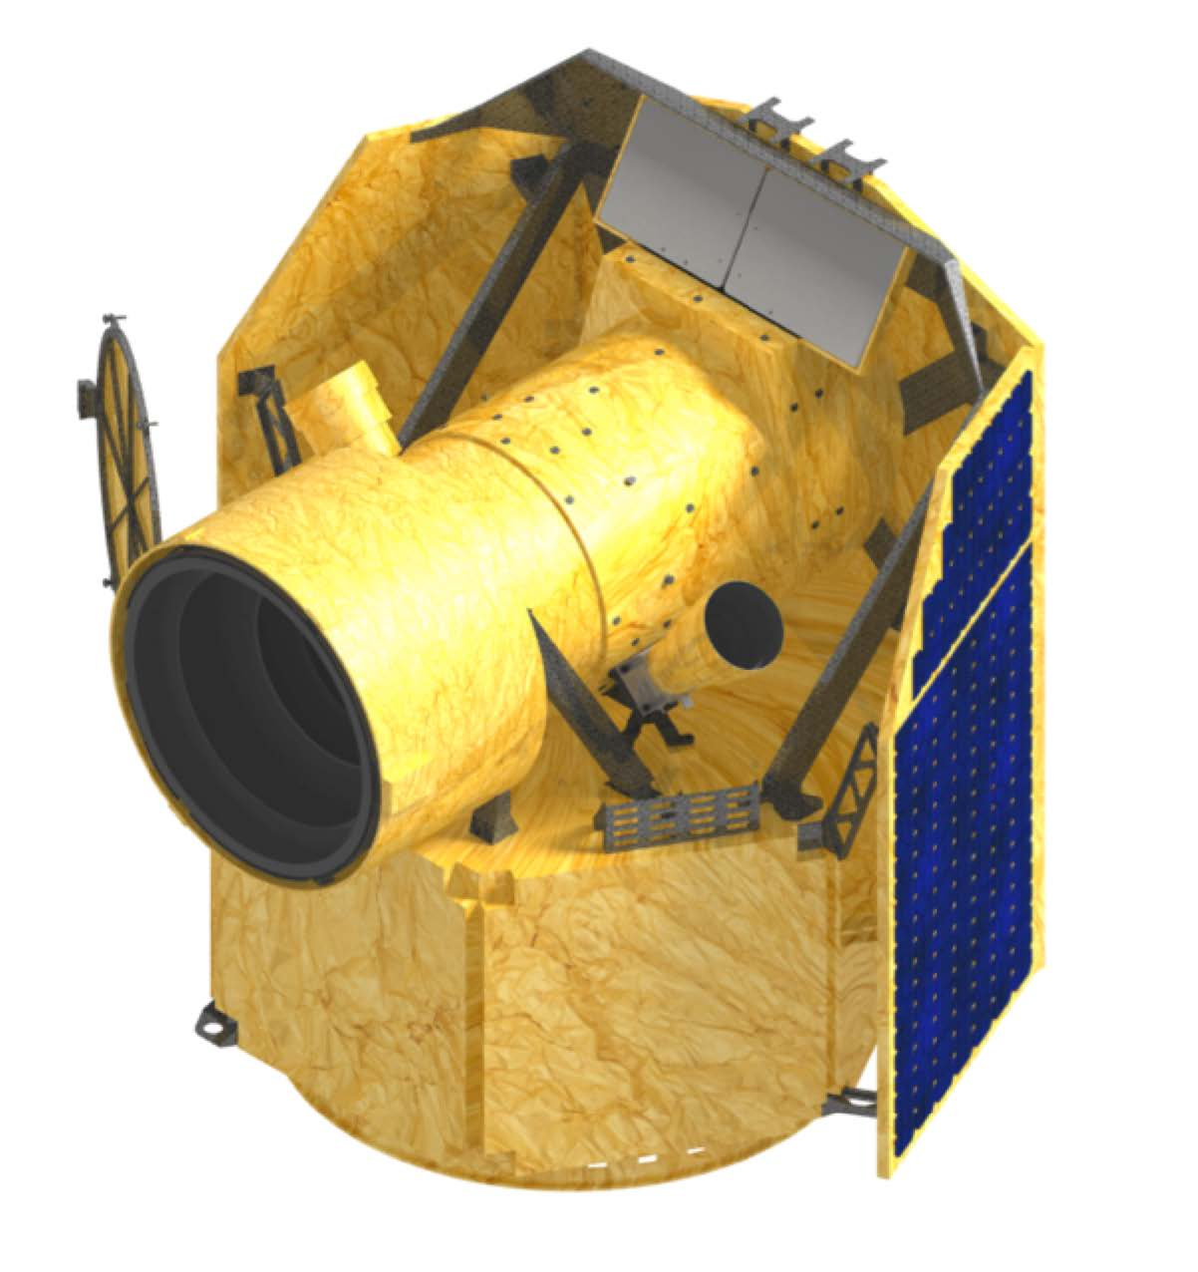
The CHEOPS mission: towards exoplanet characterisation
Valérie Van Grootel
FNRS Research Associate
Université de Liège
and the CHEOPS science team

Slide 2
SCIENTIFIC MOTIVATION

Slide 3
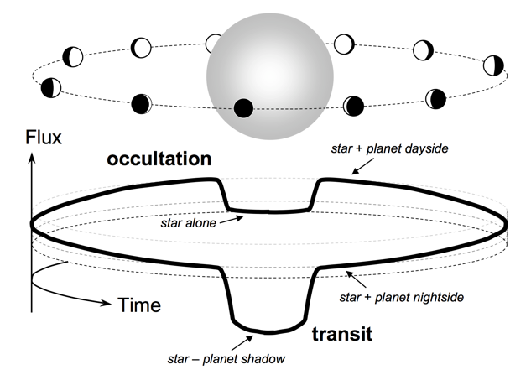
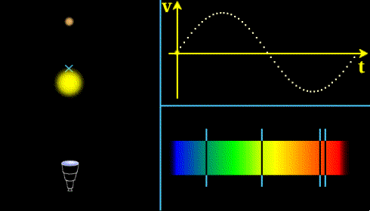
CHEOPS: CHaracterizing ExOPlanet Satellite
The transit technique
(ex. CoRoT, Kepler)
The radial velocity technique
(ex. HARPS, ESPRESSO)
(secondary eclipse)
(primary eclipse)
➨ radius of the planet Rp
➨ minimum mass
Mp sin(i)
Mp & Rp ➨
Planet average density ρ_{p}

Slide 4

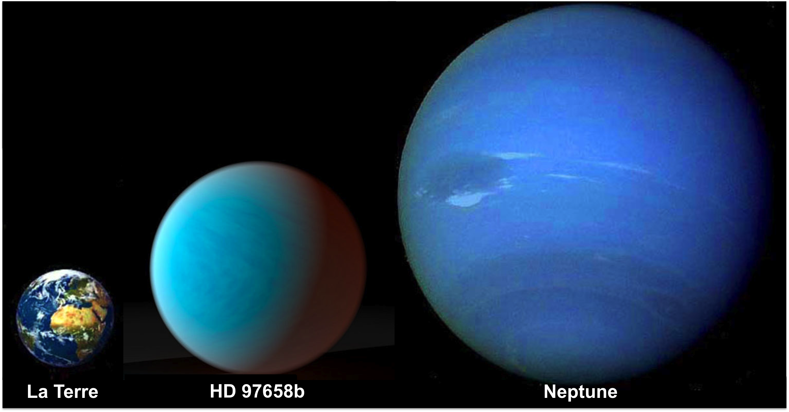

What are exoplanets
made of?
Earths
(~1 R_{T})
Neptunes
Saturnes and Jupiters
(~10 R_{T})
(~4 R_{T})

Slide 5
What are exoplanets
made of?
Super-Earths
(ex. CoRoT-7b,
HD97658b)
Subgiants
(ex. CoRoT-8b, HD149026b)
⬇
⬇
Earths
(~1 R_{T})
Neptunes
Saturnes and Jupiters
(~10 R_{T})
(~4 R_{T})
Notes:
On ne connaît que qques super-Earths avec M+R !

Slide 6
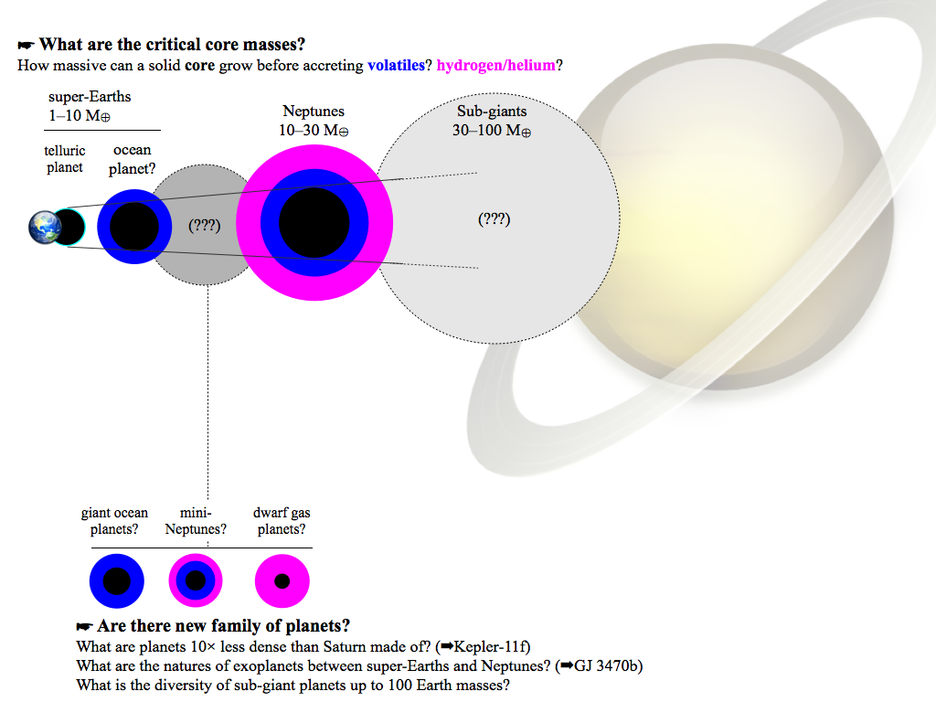
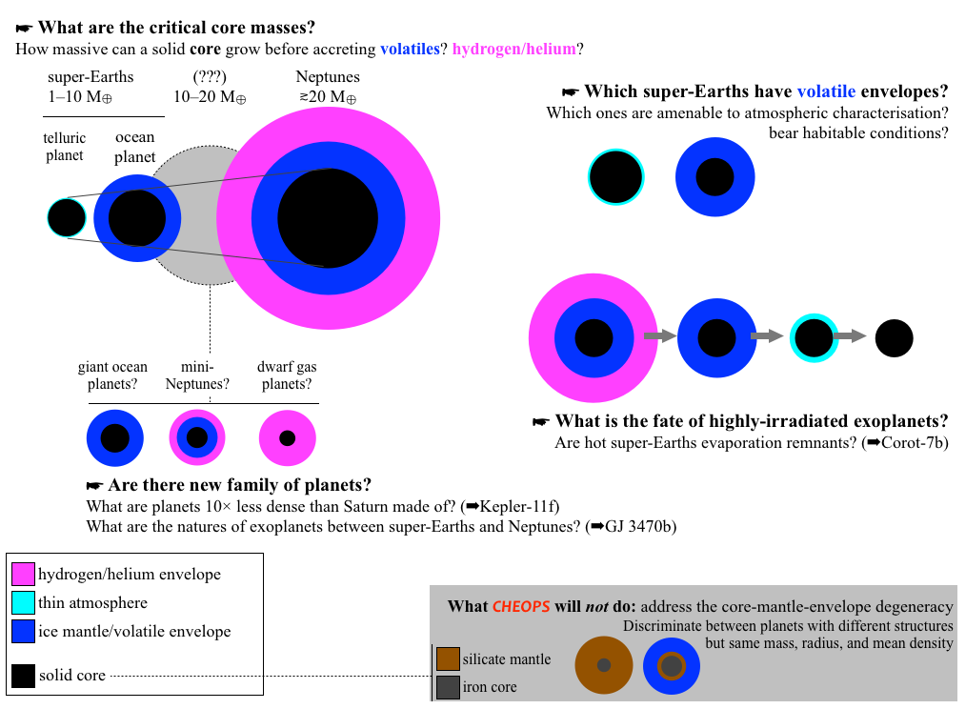
What are exoplanets made of?
Constraints based on bulk densities
⬇
inversion techniques

Slide 7
Ex. the super-Earth HD97658b
Van Grootel et al. 2014, models from D. Valencia
Rocks > 60%
Ices 0-40%
H-He 0-2%
R=2.25 R_{E}

Slide 8
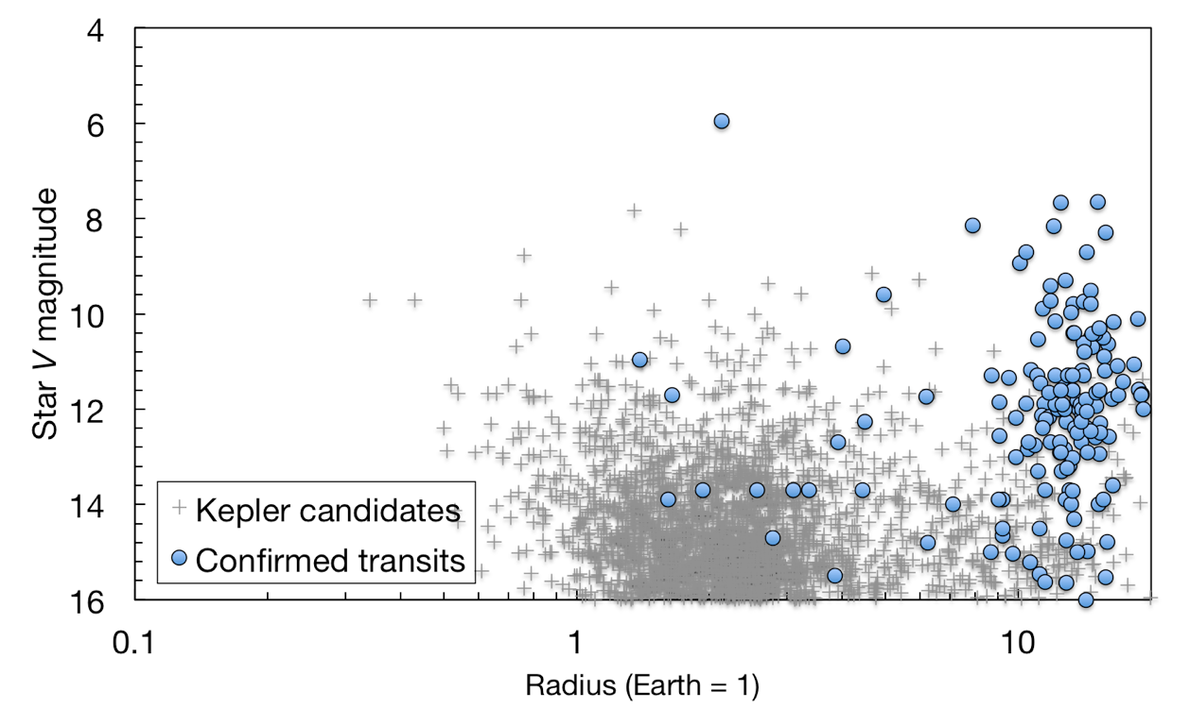
Targets: bright stars
CHEOPS optical bandpass: 400-1100 nm
radial velocity
CHEOPS

Slide 9
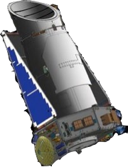
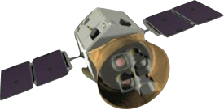
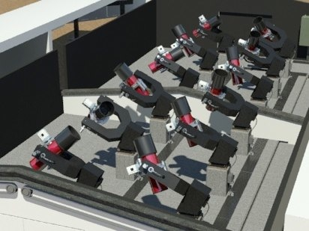
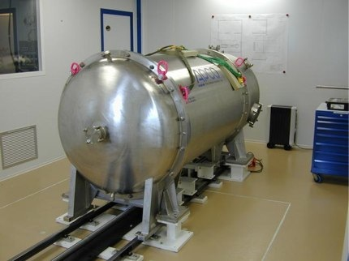
CHEOPS strategy: follow up mission
TESS
(2017)
Measure accurate light curves for Neptunes
Ground-based transit surveys
NGTS (2014)
K2
(2014)
Detect the transit of known super-Earths
Ground-based RV surveys
HARPS, HARPS-N, HIRES, SOPHIE (on going)
ESPRESSO (2017)

Slide 10
CHEOPS: what can we expect?
 | #planets (targets) | #transits
On-going RV surveys | 60–80 | 4–5
Future RV surveys | 105–140 | 5–7
Ground-based transit surveys | ~60 | (~60)
TESS and K2 | ??? | ???

Slide 11
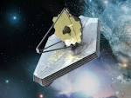
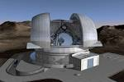
CHEOPS: hoped legacy
Golden targets for future atmospheric characterization
JWST (~2018)
E-ELT, GMT, TMT
(~2020-2025)

Slide 12
How to model the host stars
Mass, radius, and age

Slide 13
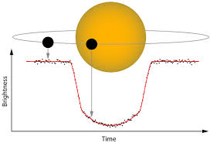
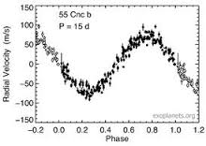
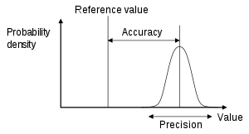
Why is stellar characterization so important?
Main sequence nearby bright solar-like stars (6<V<12): G and K-types
Rp α R*
Mp α M*^{2/3}
Transits
Radial velocities
+ the age of the star is the best proxy for the age of its planets
(Sun: 4.57 Gyr, Earth: 4.54 Gyr)
Direct technique: interferometry (R*)
Indirect techniques: GAIA parallaxes (R*), stellar evolution modeling (M*, R*, age), asteroseismology (M*, R*, age), transit light curve (ρ*)

Slide 14
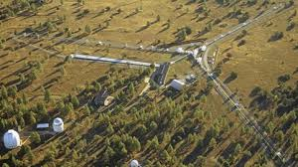
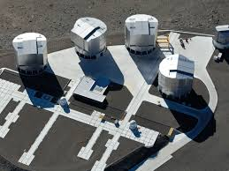
Stellar characterization: Interferometry
To get R* to ~ 1-2%
(depending on size, distance and magnitude of the star)
Available now:
CHARA (Mount Wilson USA, 330-m baseline)
VLTI (Chile, 150-m baseline)
By the launch of CHEOPS: MROI (New Mexico, 400-m baseline)

Slide 15
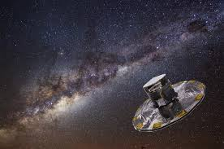
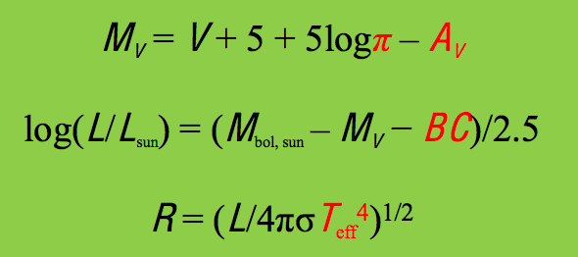
Stellar characterization: GAIA parallaxes
To get R* to ~ 1-2%
(normally not affected by GAIA’s stray light issues)
Independently from interferometry ⇒ increase the accuracy on stellar radius
Π: parallax
Av: interstellar extinction
BC: bolometric correction
T_{eff}: effective temperature
Method:

Slide 16
Stellar characterization: stellar evolution modeling
To get R*, M* and age
Stellar evolution codes: CLES (Liege), MESA (open source),…
Inputs:
T_{eff}, Z (from spectroscopy); Z~[Fe/H] (better if other abundances)
log g (spectroscopy), and/or ρ* (transits), and/or L* (parallax)
Delrez, Van Grootel et al. (2014)

Slide 17
Stellar characterization: stellar evolution modeling
To get R*, M* and age
Pros:
General method, always applicable
Only require spectroscopic information, generally available
Get R*, M* and age
Cons:
Not very precise and model-dependent
Providing ~50 K on T_{eff}, 0.05 dex on [M/H] and 1% on L* (GAIA):
R* to ~ 1-2%
M* to ~ 5-10%
Age to 2-4 Gyr
Main uncertainties: from stellar interiors (helium initial abundance, efficiency of convection, importance of mixing processes)
Will be improved in the coming years from bulk asteroseismic results from CoRoT and Kepler ?

Slide 18
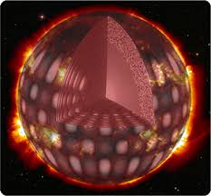
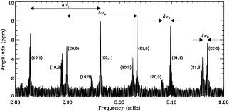
Stellar characterization: Asteroseismology
To get R*, M* and age
Principle:
Use stellar oscillations to constrain stellar interiors and to get structural parameters
For solar-like stars, main seismic indicators:
the large separation Δν (α ρ*), frequency at maximum power ν_{max} (α g/T_{eff}^{0.5}), small separations δν (α age)

Slide 19
Stellar characterization: Asteroseismology
For CHEOPS targets:
Low-quality seismic data: only Δν~ρ* to 5%
ρ* + R* (~1-2% by parallaxes/interferometry)
➔ M* to 8-10%
Mid-quality seismic data: 1-month TESS, ground-based (ESPRESSO)
- Δν~ρ* to 0.5% (V=6) + R* (~1-2% by parallaxes/interferometry)
➔ M* to ~3-4%
- Δν~ρ* to 2% (V=9) + R* (~1-2% by parallaxes/interferometry)
➔ M* to ~5%
Age still difficult to do better than 2-4 Gyr
High-quality seismic data: not for CHEOPS ☹ (waiting for PLATO ☺)
R* ~ 1-2%, M* ~ 2-4%, age ~ 10% (!)

Slide 20
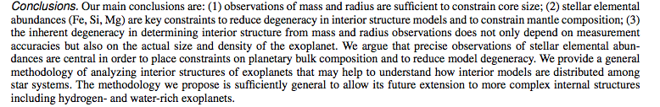
Why is stellar characterization so important?
Progress on this side ?
Dorn et al. 2015, arXiv 150203605D

Slide 21
ESA’s FIRST SMALL MISSION

Slide 22
ESA small mission requirements
ESA S-class mission in Cosmic Vision 2015-2025:
Science: top rated science in any area of space science
Cost:
total cost <150 M€ (~ 110 M€)
cost to ESA: 50 M€ (platform, detector, launch)
Schedule:
developed and launched within 4 years
call issued | March, 2012
proposal due | June, 2012
mission selection | October, 2012
mission adoption | February, 2014
launch | end 2017
Nominal lifetime | 3.5 years

Slide 23

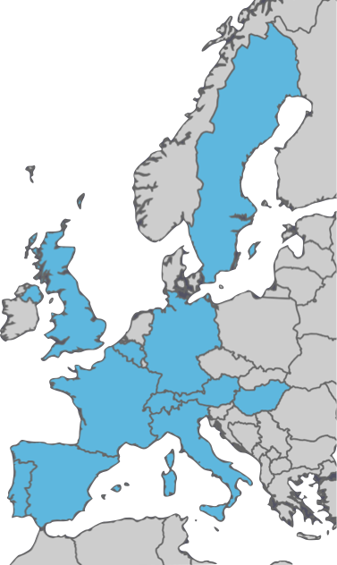











CHEOPS consortium
RINGBERG
WORKSHOP
A. Fortier
Switzerland
Mission Lead
Instrument Team
Science Operations Center
Willy Benz
PI, U. Bern
Sweden Data simulator
Germany Focal Plane Assembly
UK Quick look
Belgium Baffle, Door
Italy Optics
France Data Reduction Software
Austria Digital Processing Unit
Portugal Mission Planning, Archive, & Data Reduction Software
Hungary Radiators
Spain Mission operations centre

Slide 24
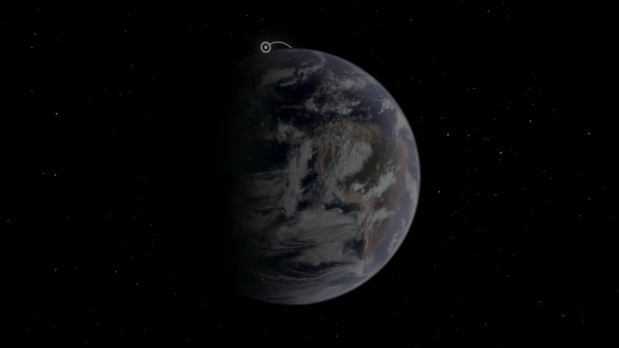

CHEOPS orbit
600—800 km
35°
Sun
OBSERVATIONS
120°

Slide 25
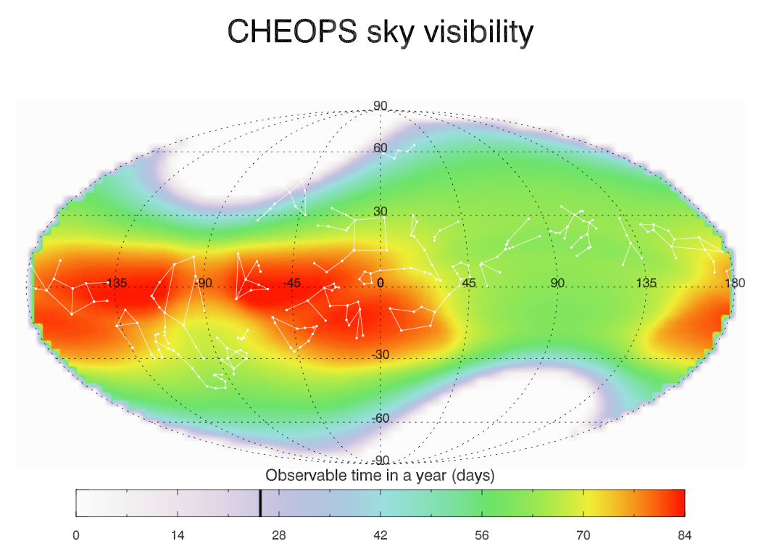
CHEOPS science requirements

Slide 26
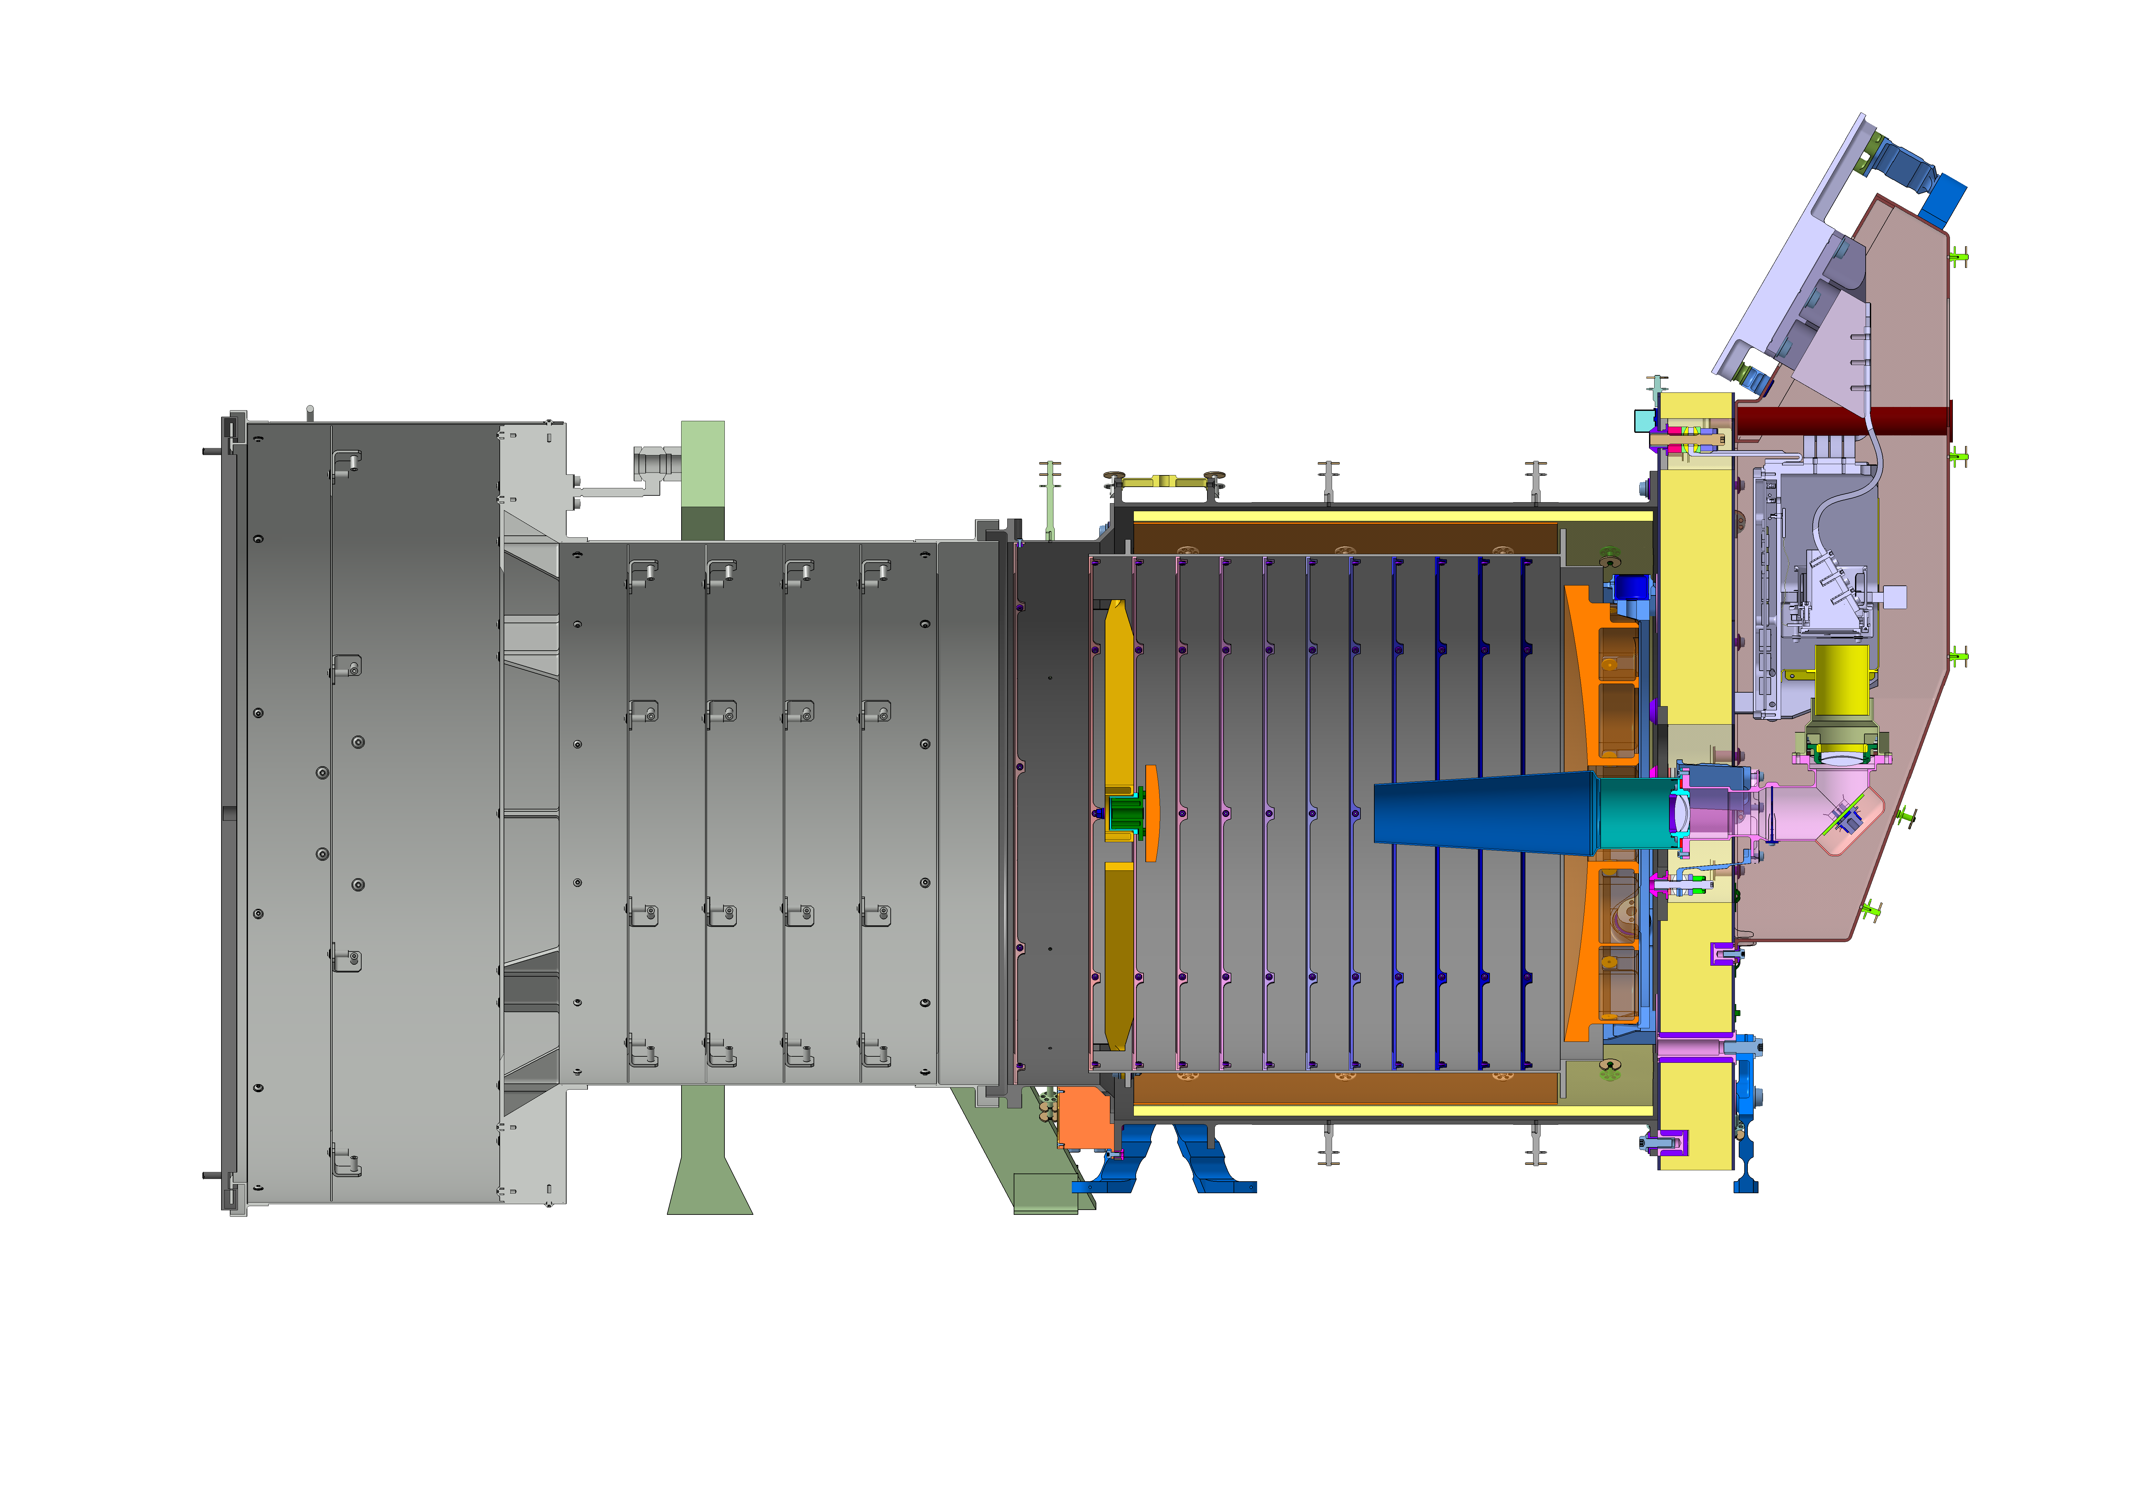

CHEOPS: Instrument
SPIE
CONFERENCE
COSPAR
CONFERENCE
EPSC2014
CONFERENCE
A. Fortier
Instrument Design
radiators
Ritchey-Chrétien telescope
outer baffle
structure tube
FPA
CCD
300 mm
inner
baffle
BEO
primary mirror internal baffle
secondary
mirror
primary
mirror

Slide 27
CHEOPS: Instrument
RINGBERG
WORKSHOP
A. Fortier
Accommodation on the Spacecraft
S/C contractor: ECE-CASA
S-band antenna
On-board data stacking
Measurement cadence: 1 min⁻¹ Telemetry: 1.2 Gbit/day
Body-mounted solar array
Fixed sunshield
Star Trackers Optical Heads
CIS payload
Secondary Structure
Primary structure

Slide 28
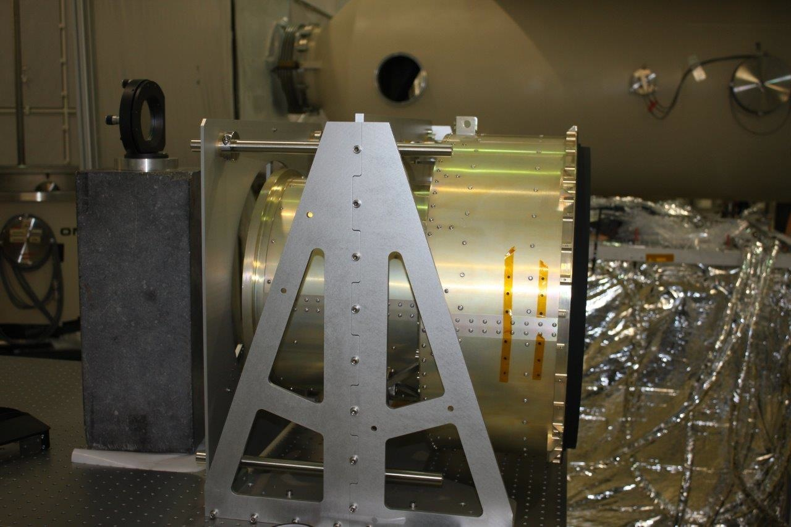
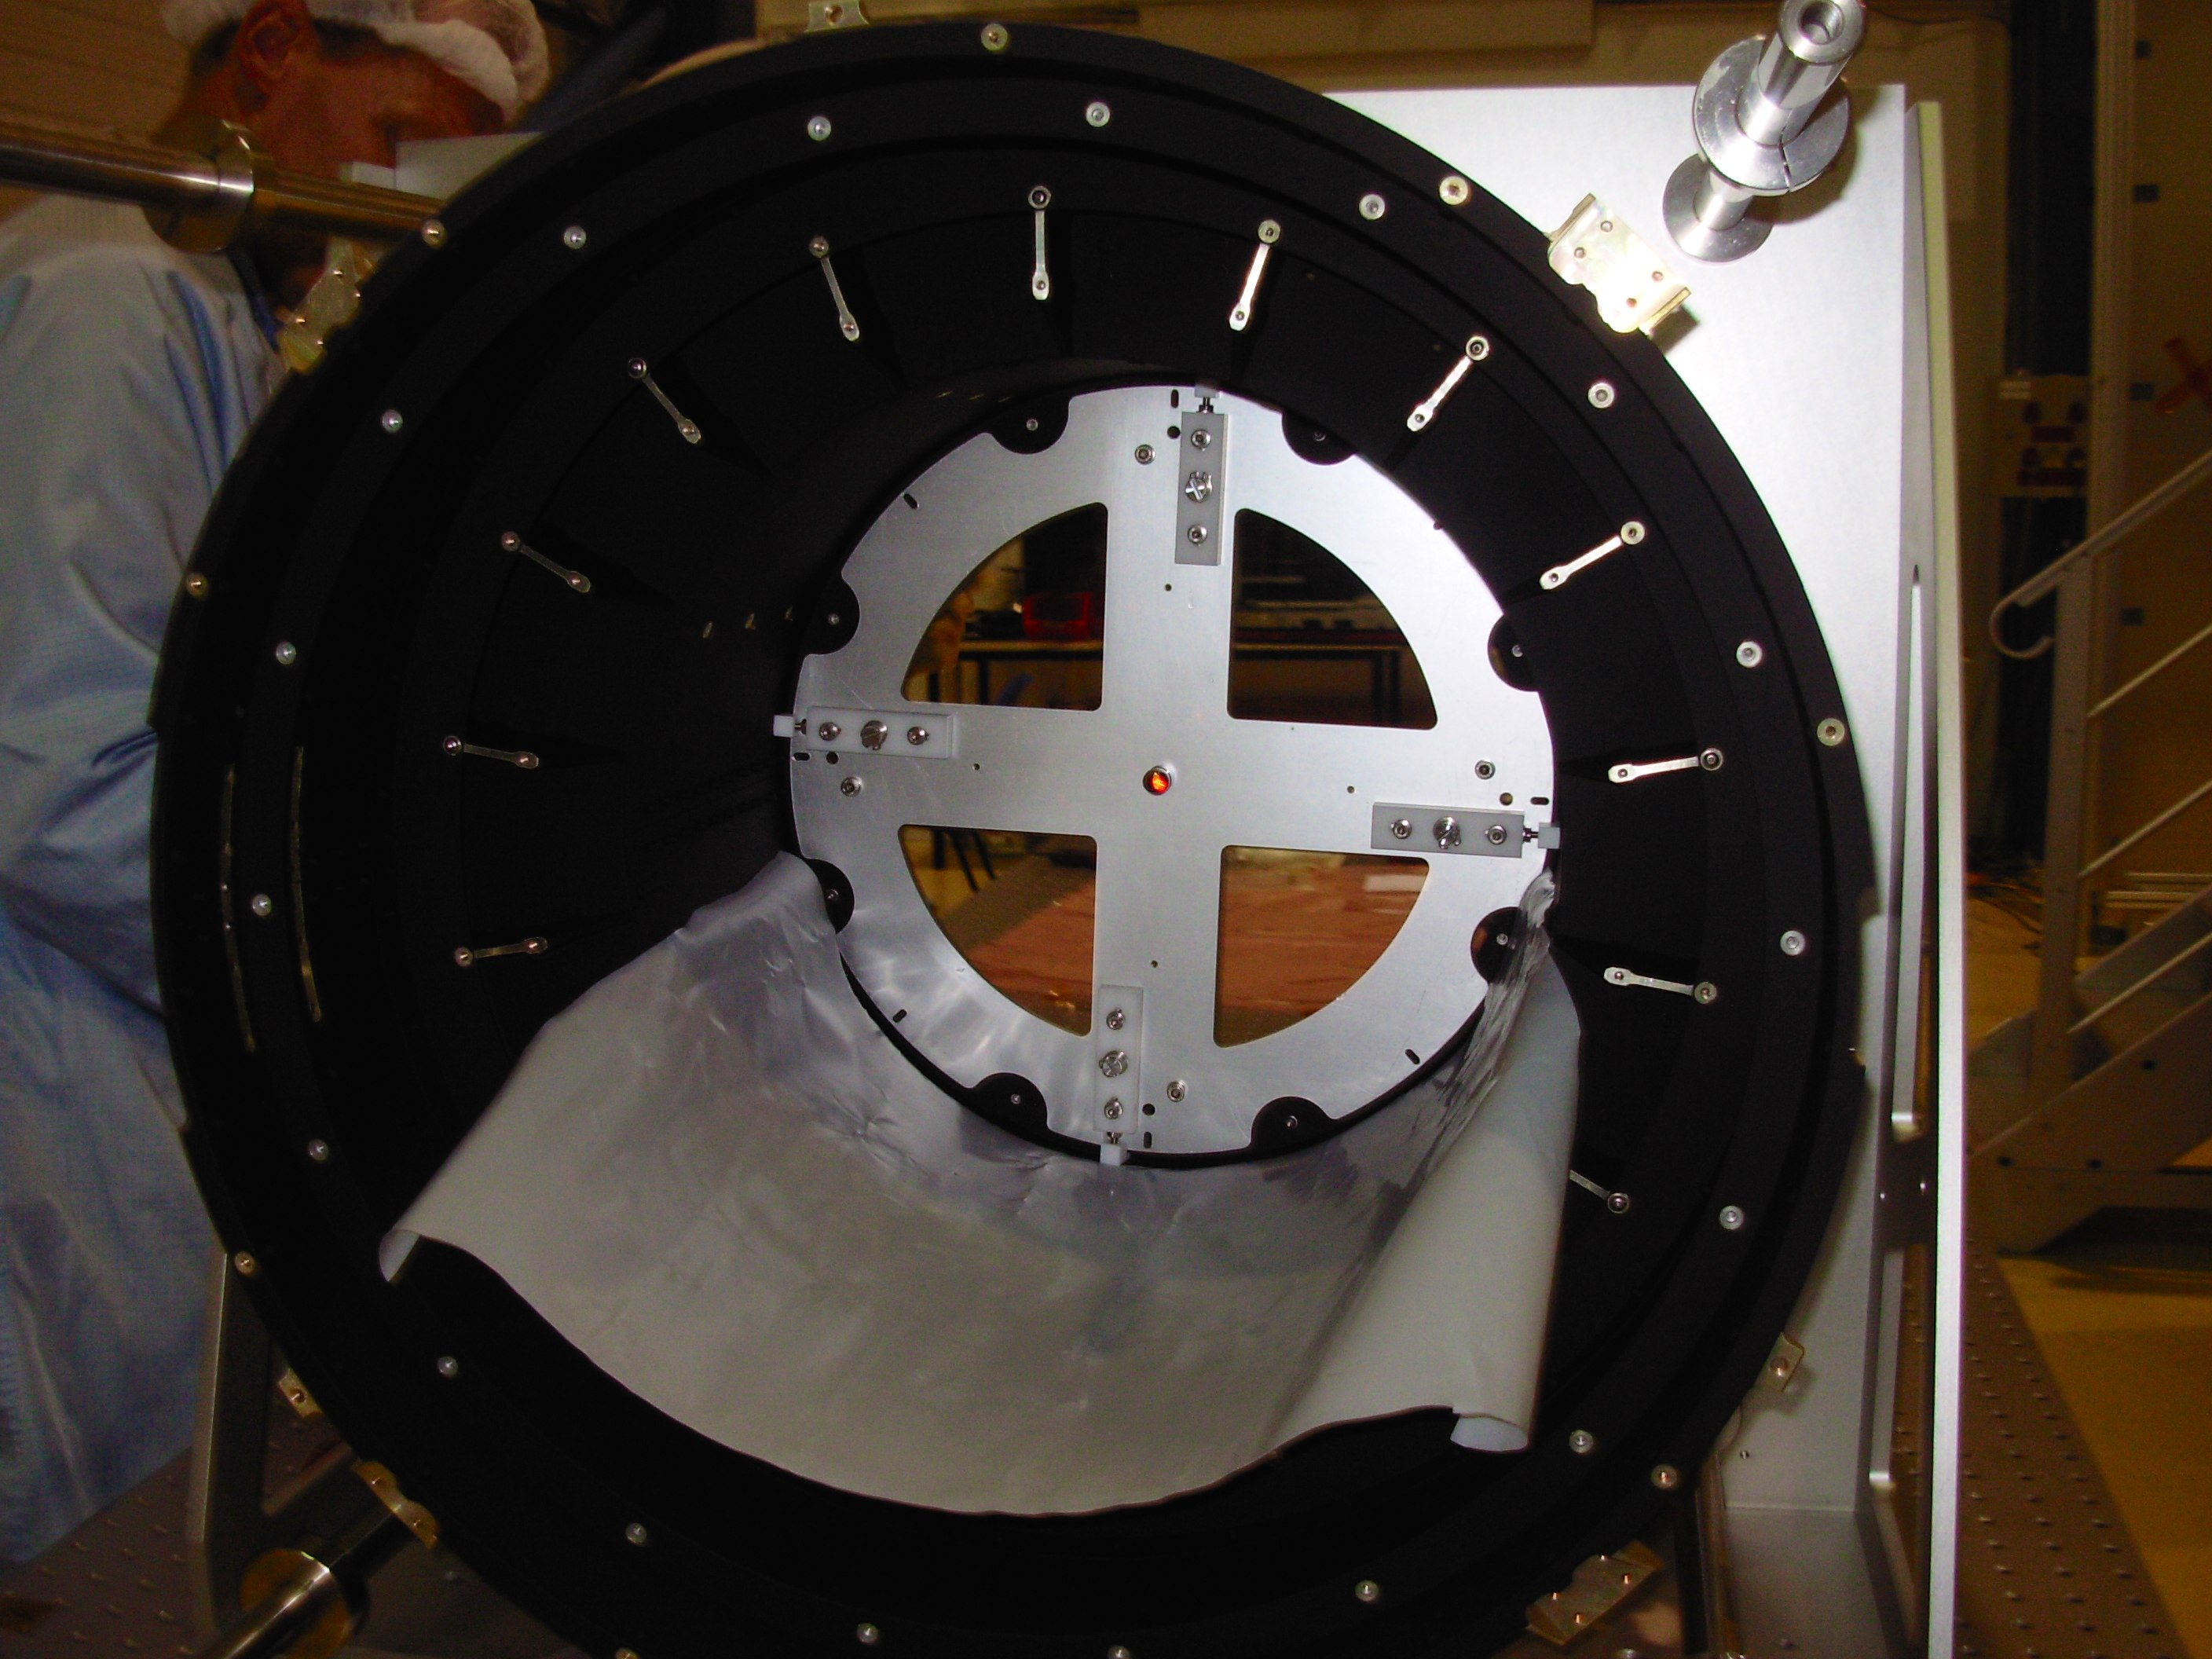
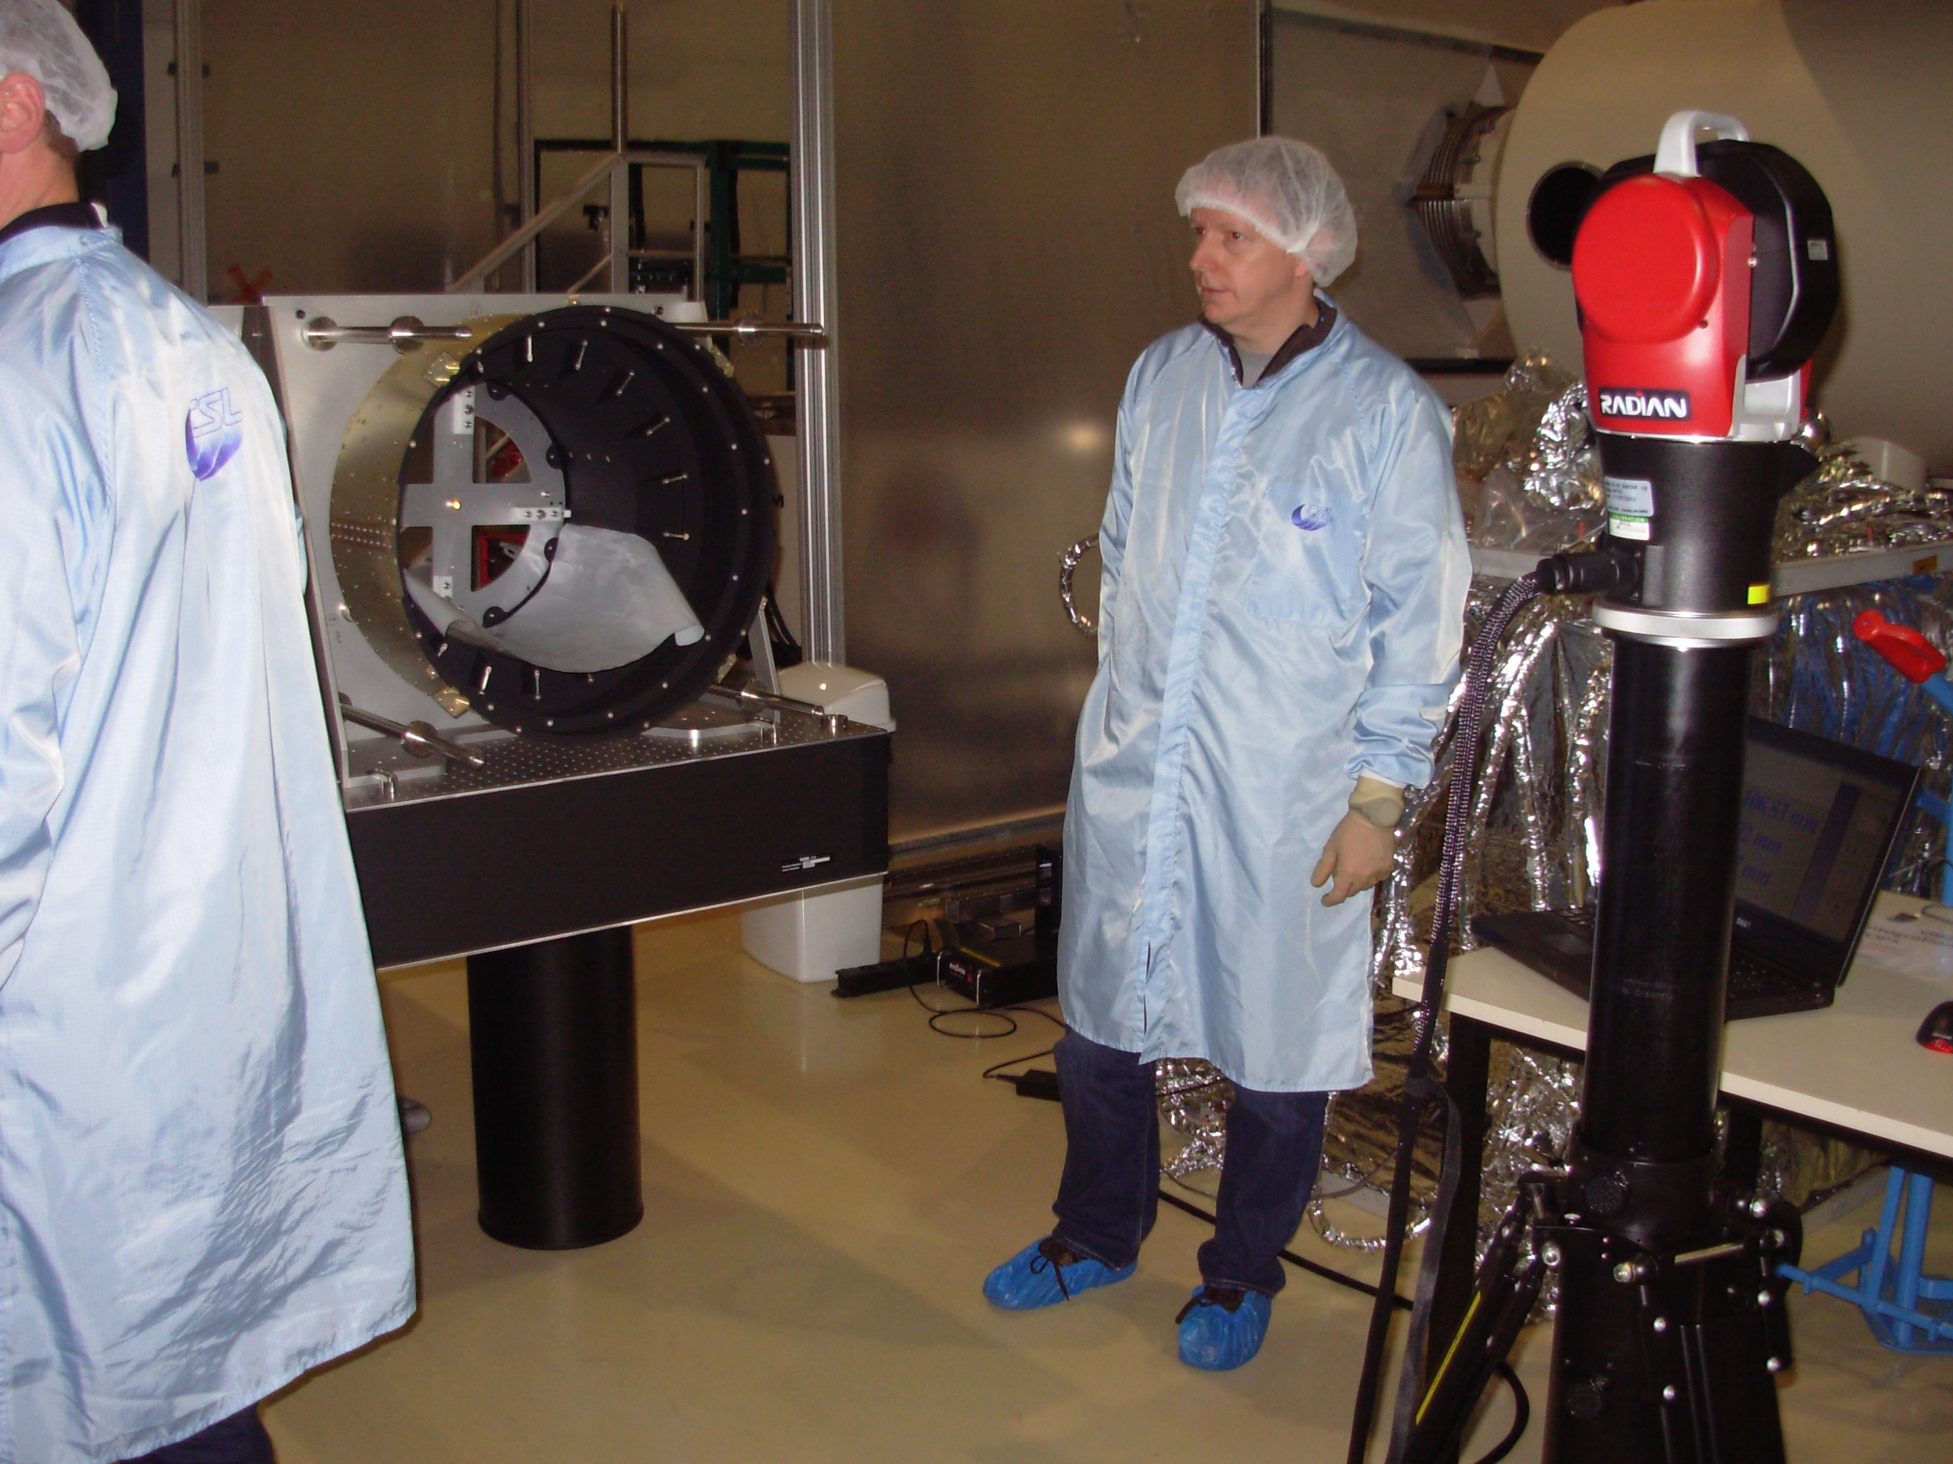
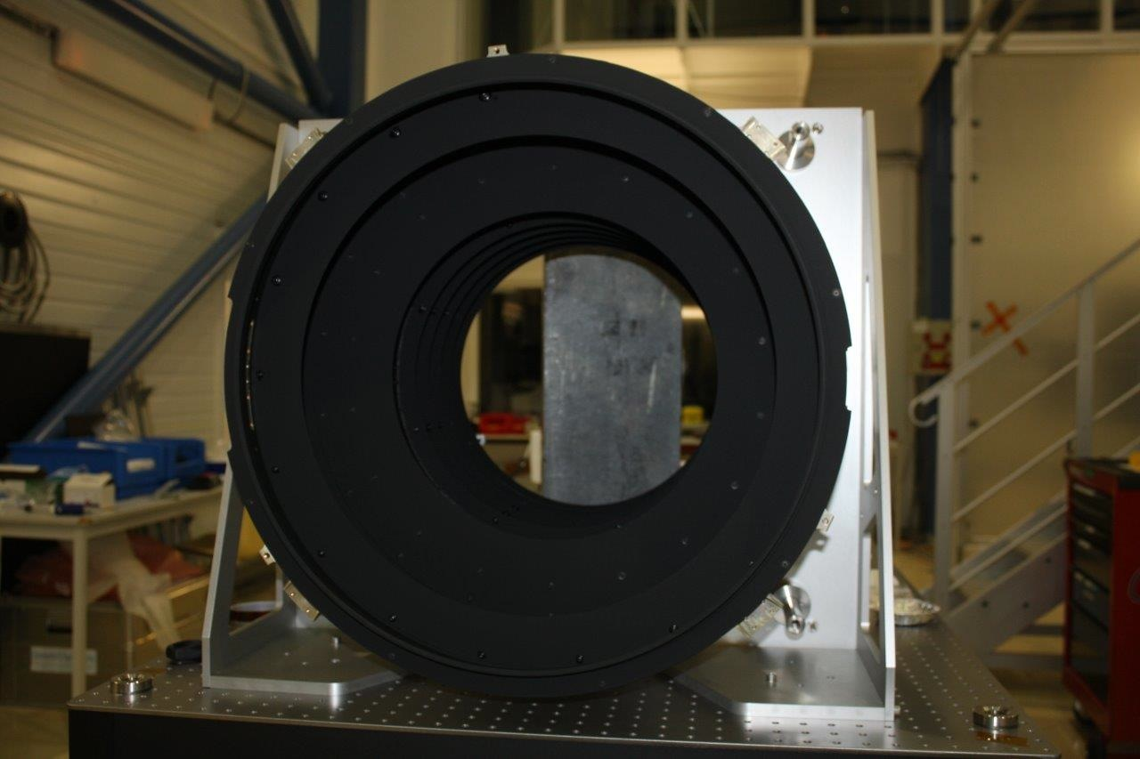
CHEOPS baffle @Centre Spatial de Liègeinstrument
External baffle @Liege

Slide 29
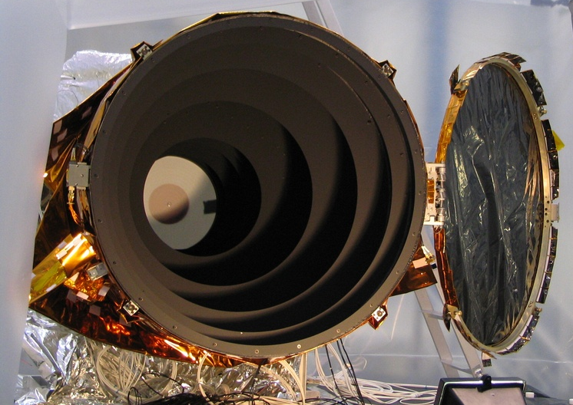
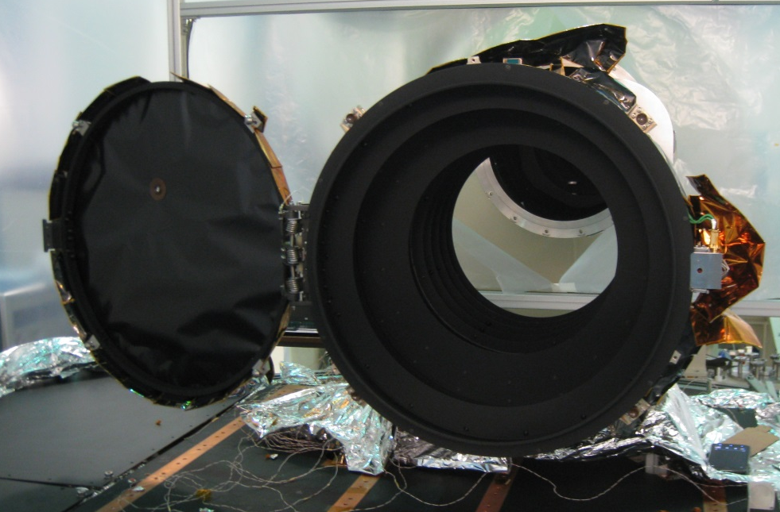
CoRoT (27cm mirror)
CHEOPS (33cm mirror)
Identical pieces

Slide 30
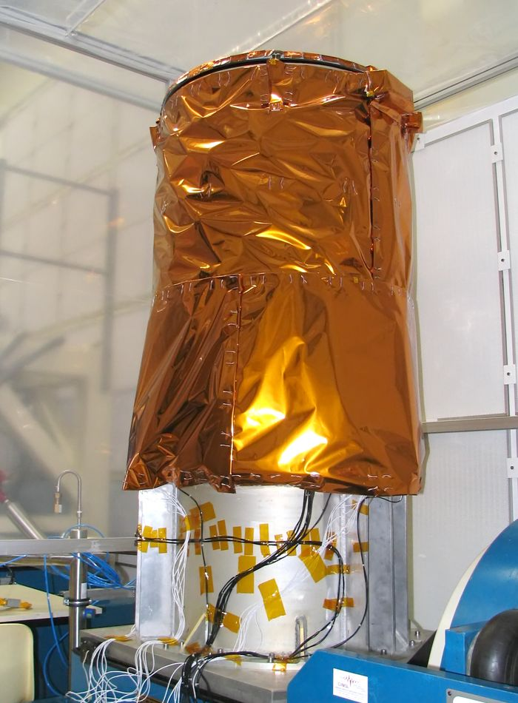
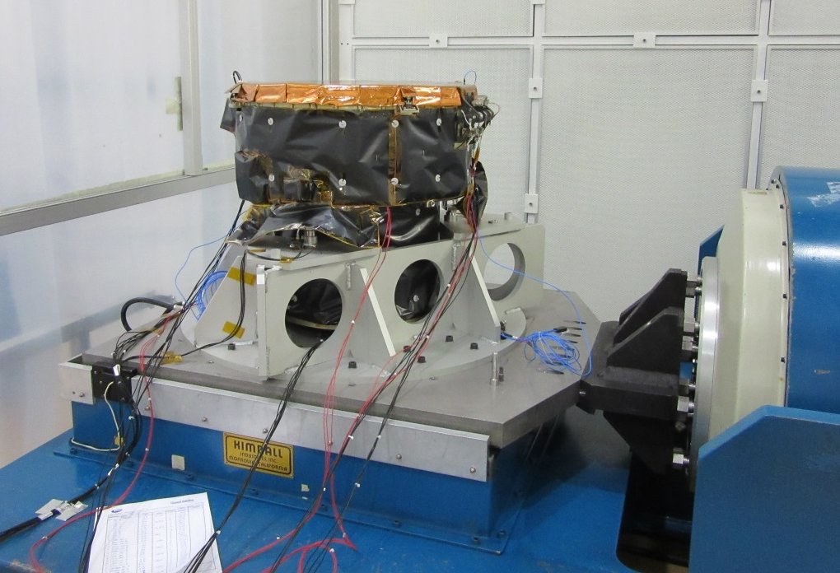
CHEOPS
COROT
On the same shaker @ CSL

Slide 31
Summary
CHaracterizing ExOPlanet Satellite
CHEOPS is Europe’s next exoplanet mission (2017)
CHEOPS is a follow-up machine: Knowing when to look at a star makes CHEOPS extremely efficient: ➡ Provides Mp and Rp for super-Earths, Neptunes and subgiant planets ➡ Collects the golden targets for future in-depth and atmospheric characterization (JWST, E-ELT,…)
More information in:
http://cheops.unibe.ch/
http://sci.esa.int/cosmic-vision/49469-cheops/

Slide 32
CHEOPS: CHaracterizing ExOPlanet Satellite
The transit technique
(ex. CoRoT, Kepler)
The radial velocity technique
(ex. HARPS, ESPRESSO)
(secondary eclipse)
Bright targets are needed!
(primary eclipse)
➨ radius of the planet Rp
➨ minimum mass
Mp sin(i)
Mp & Rp ➨
Planet average density ρ_{p}

Slide 33
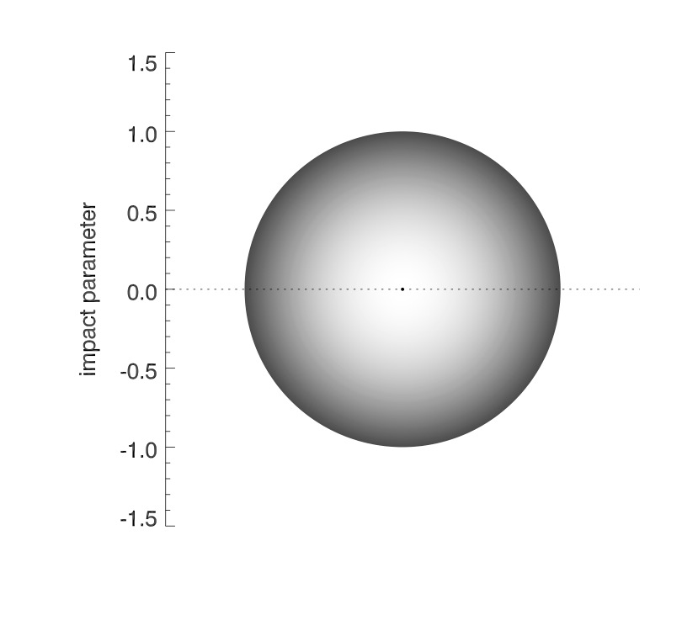
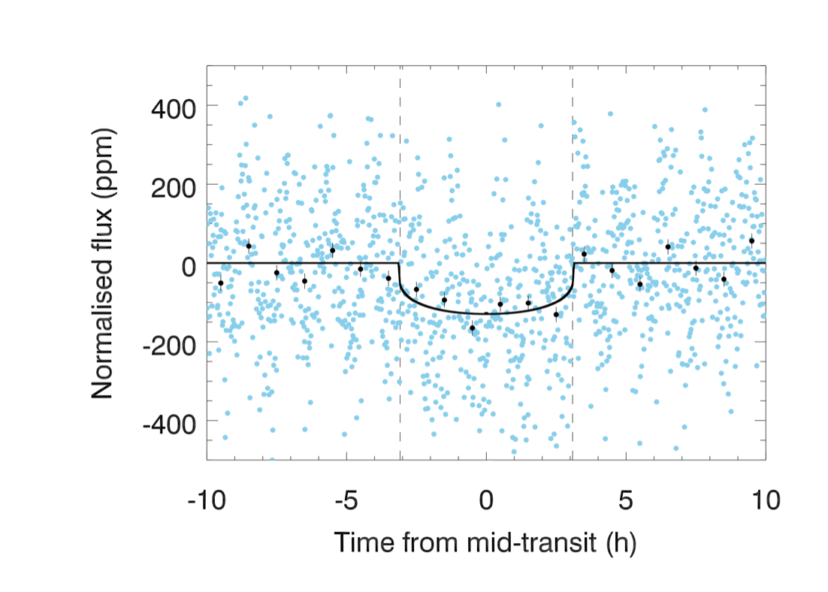
CHEOPS targets
super-earth ➡︎
Photometric accuracy: super-earth detection
6 < V < 9, G5 dwarf stars, Pplanet~ 50 days
100 ppm
6 hours
radius precision up to 10% (bulk density to 30%)
S/Ntransit = 5
☛ Transit detection of super-earths
20-ppm precision over 6-h transit
(w/ 50% interruptions)

Slide 34

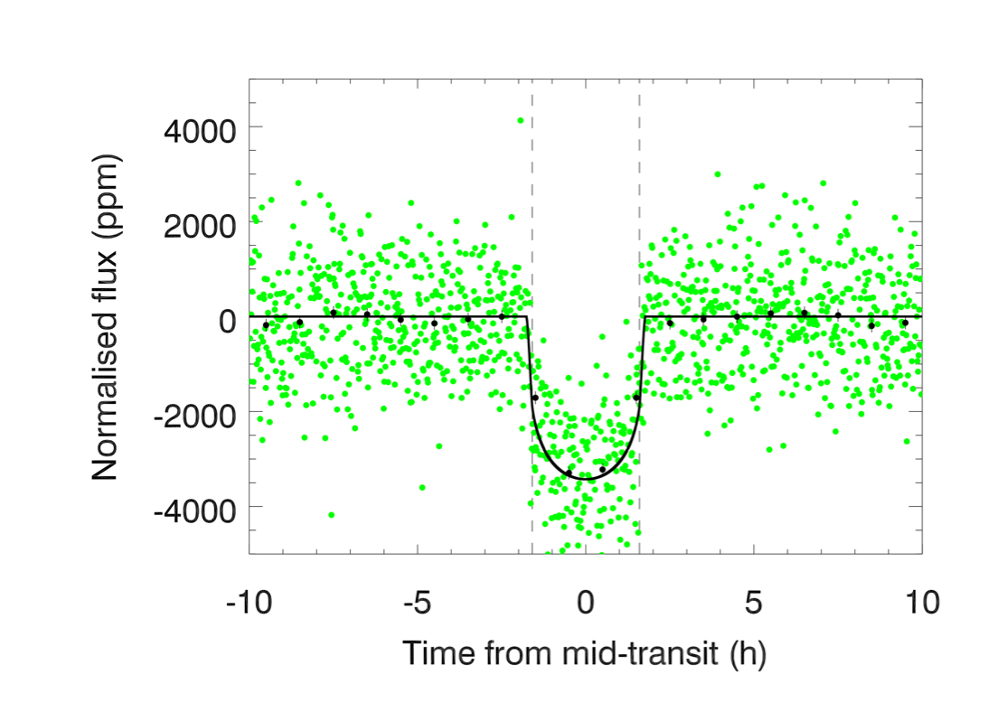
♆
CHEOPS targets
♆
Photometric accuracy: neptune characterisation
9 < V < 12, K dwarf stars, Pplanet~ 13 days
3 hours
2500 ppm
➡ radius better than 10%
➡S/Ntransit = 30
☛ Characterisation of neptune transit light curves
85-ppm precision over 3-h transit (w/ 20% interruptions)

