Slide 1
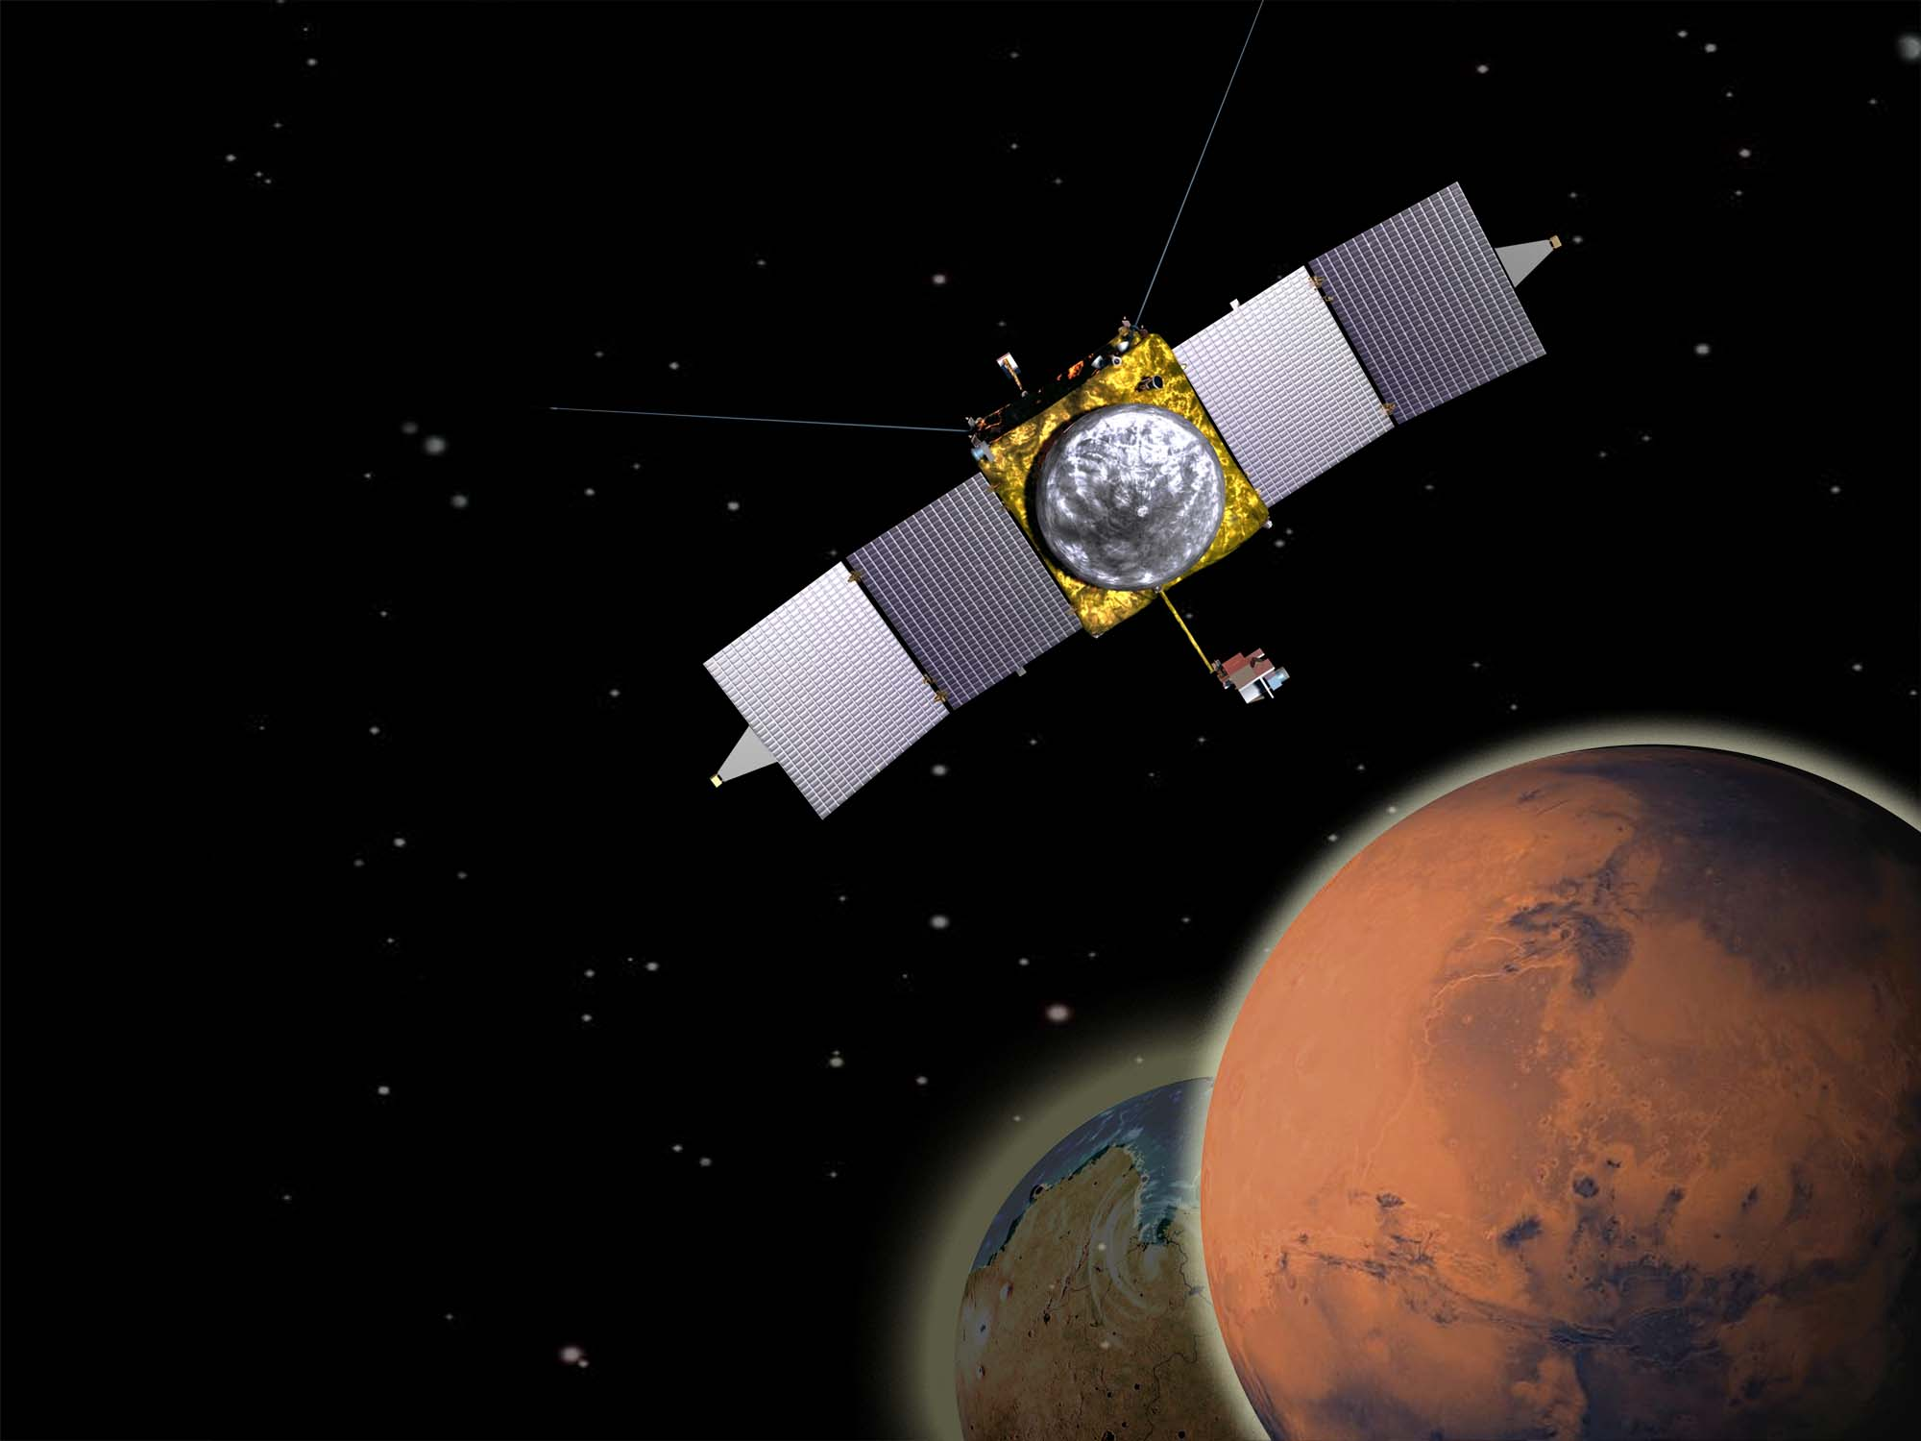

Indiana Jones sur Mars
Arnaud Stiepen
AG December 2015
Notes:
“Exploring Mars’ Climate History” is our official tag line for the mission now.
For those of you giving the talk jointly with somebody else, Dave and I are splitting it after chart 8. I’ll do 1-8 (the more science-y ones), and he’ll do 9-17. Note that the talk for the Centaur stage has one additional chart, on the launch vehicle. That isn’t necessary for the formal mission briefings because there is a separate LV chart.

Slide 2


Archéologie ou Sciences spatiales?
Choisir, c’est renoncer

Slide 3
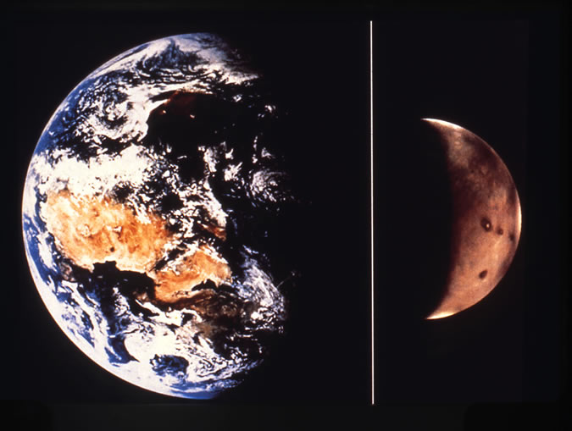
Earth
Mars
Notes:
Comparison of Earth and Mars, to connect Mars up with something that is more familiar. Mars is about 1/10 mass of Earth, ½ diameter of Earth. It’s atmosphere is just less than 1 % as thick as Earth’s, and is predominantly CO2. Mars is about 1.5x as far from the Sun as Earth is. Combination means that Mars is too cold and dry to allow liquid water to be stable on the surface.

Slide 4
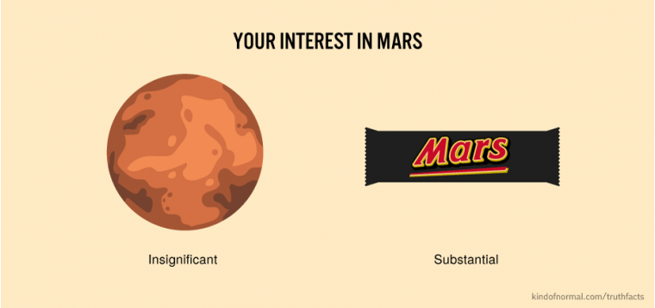

Slide 5
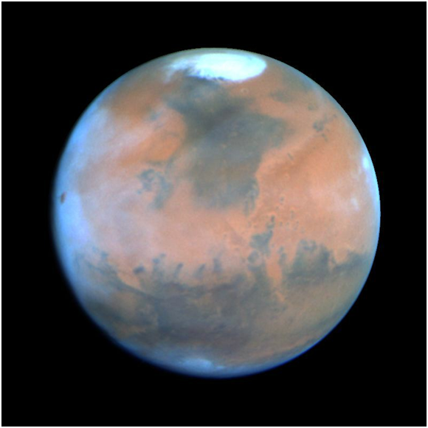
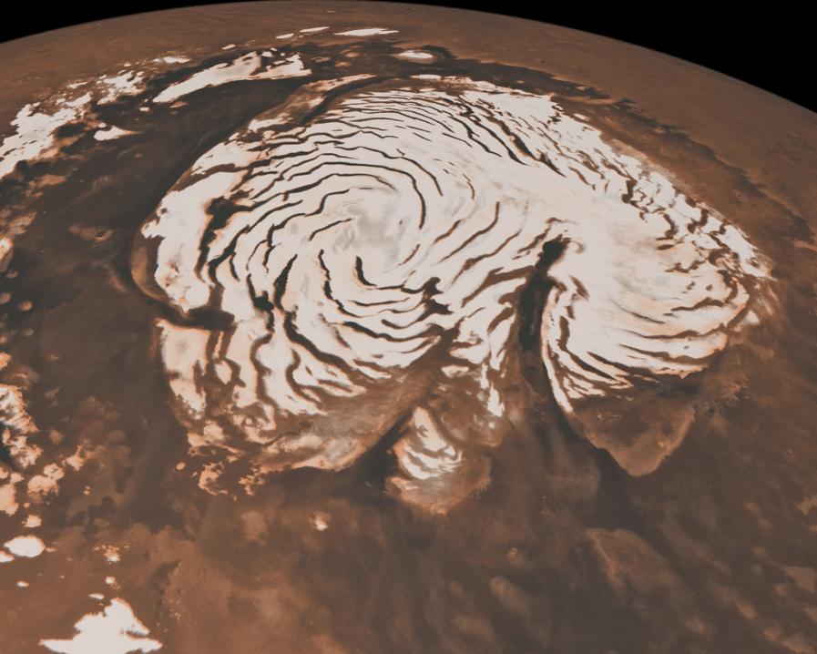
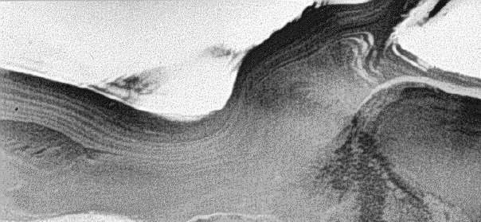
Water Is Present As Ice In The Polar Caps

Slide 6
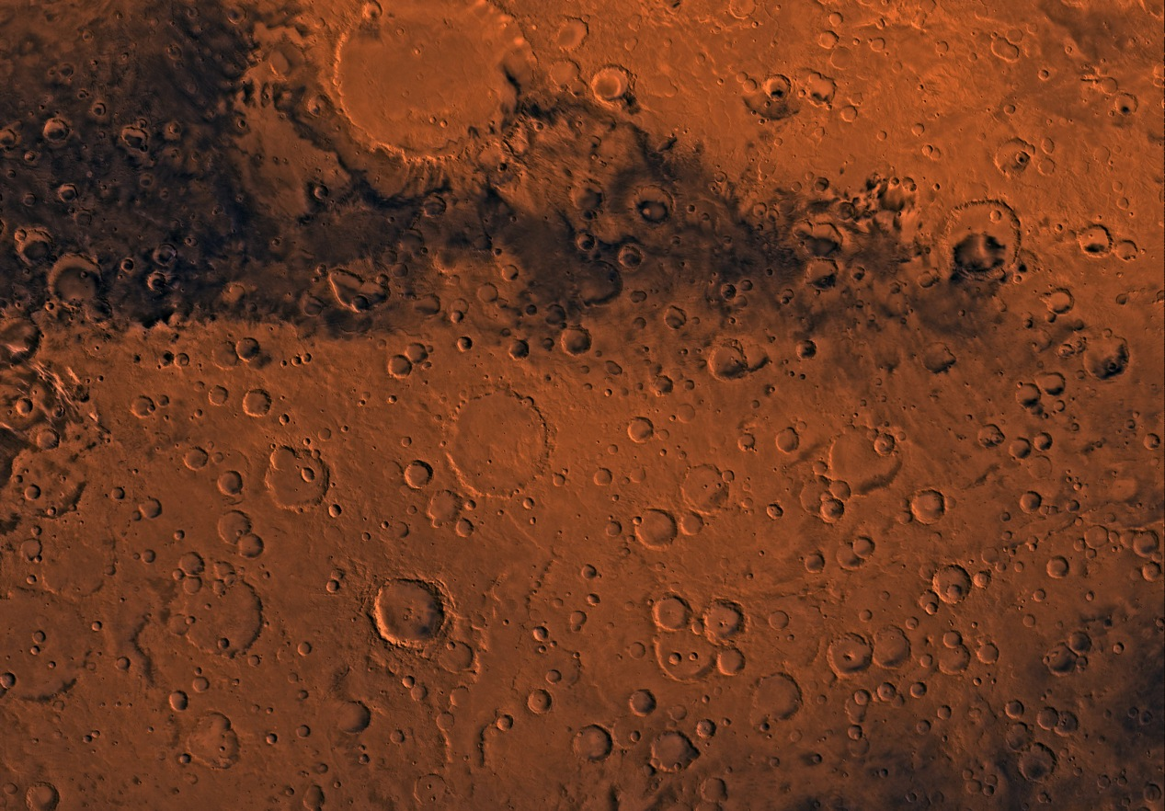
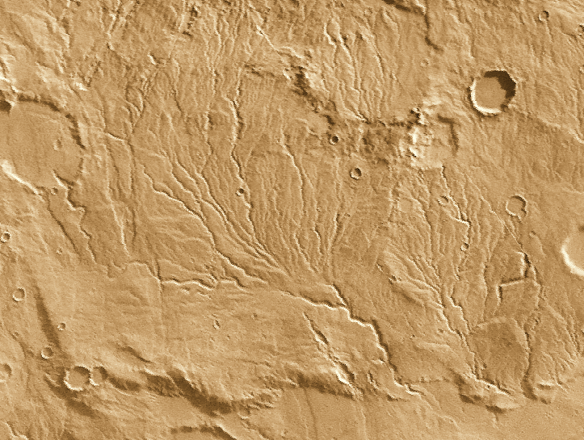
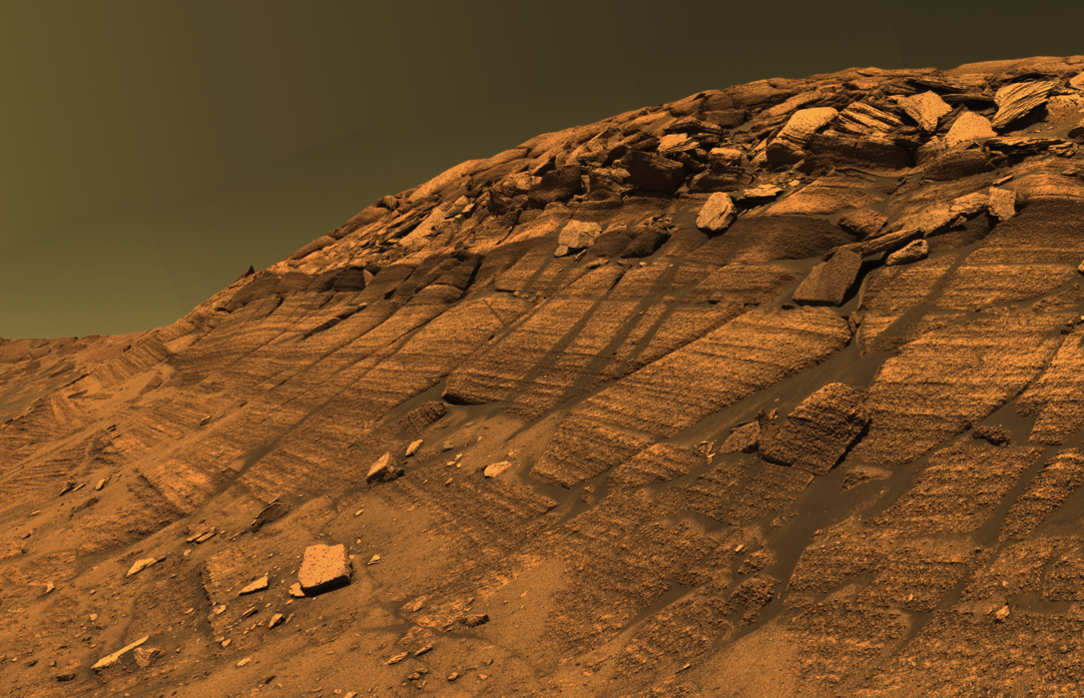
The Mars Climate Has Changed Over The Last 4 Billion Years

Slide 7
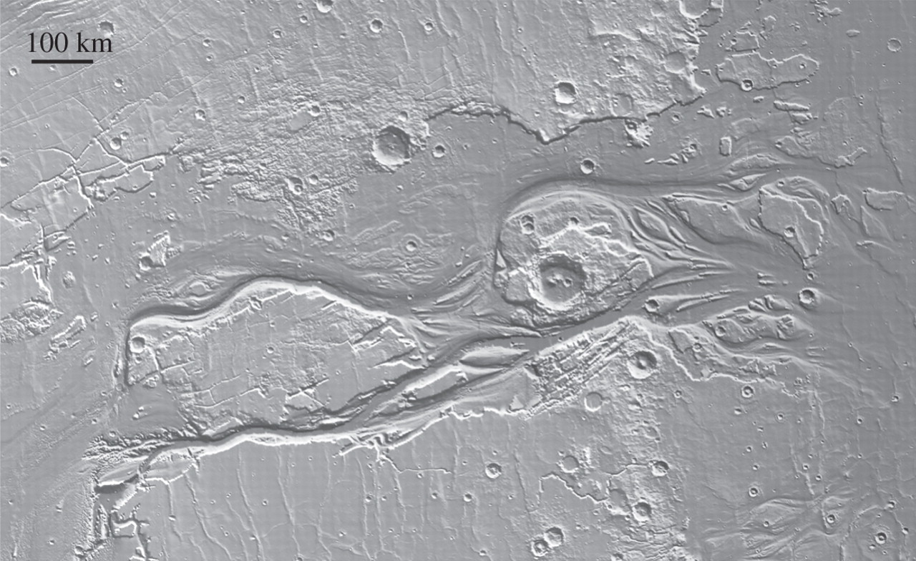
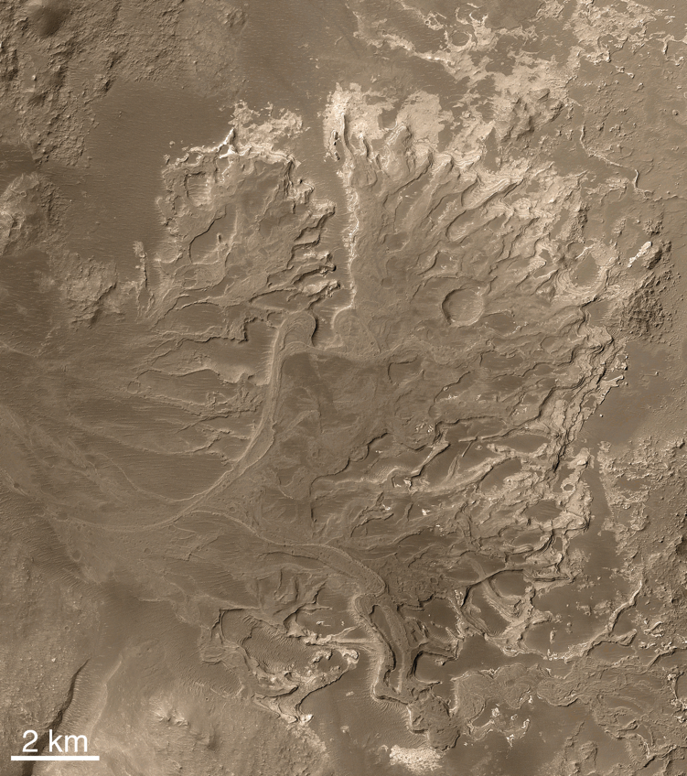
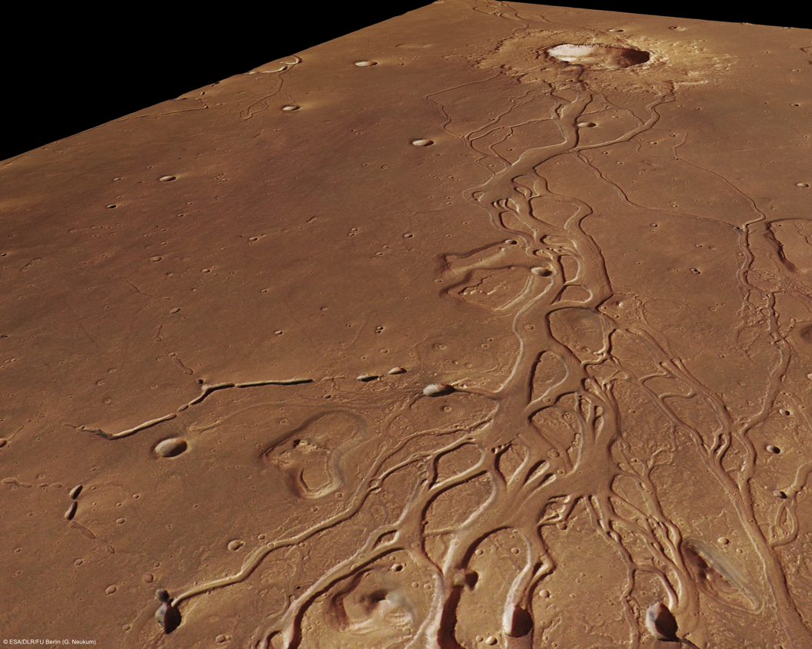
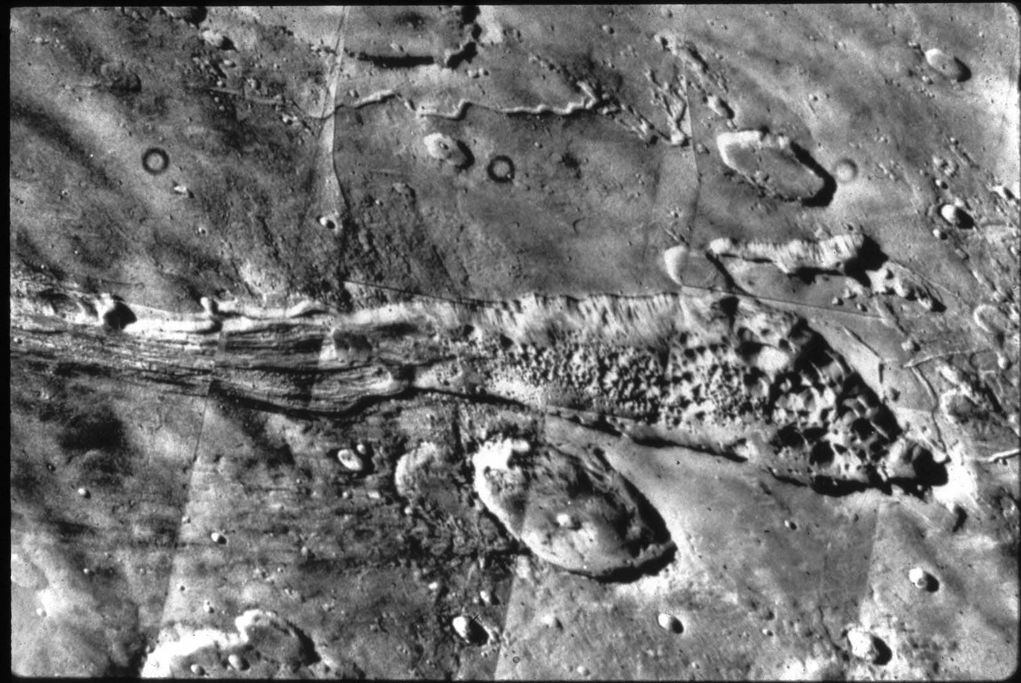
Liquid Water Has Been Present Throughout Mars History

Slide 8
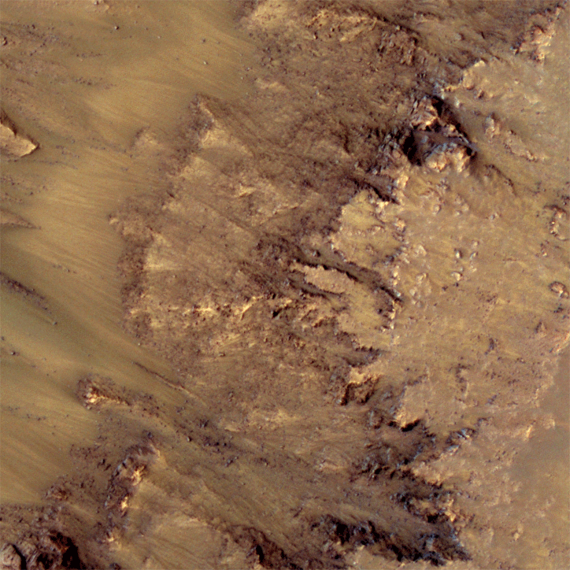
Liquid Water Occurs at the Surface Even Today
C’est chouette qu’on ait découvert de l’eau sur Mars. Dommage que le Pastis soit sur Pluton.
M. Dumont

Slide 9
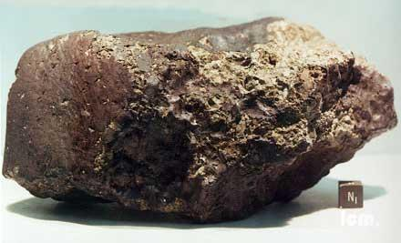
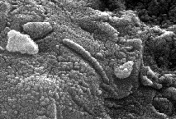
Overarching Question: Did Mars Ever Have Life?
Mars appears to meet or have met all of the environmental requirements for the occurrence of life:
Liquid water
Access to the biogenic elements
Source of energy to drive metabolism
Did Mars ever have life?
How did any life interact with its planetary environment?
How has the habitability of Mars changed over time?

Slide 10
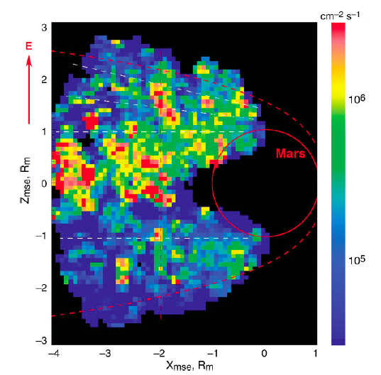
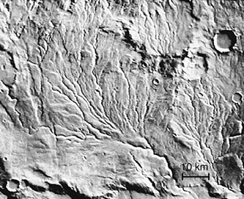
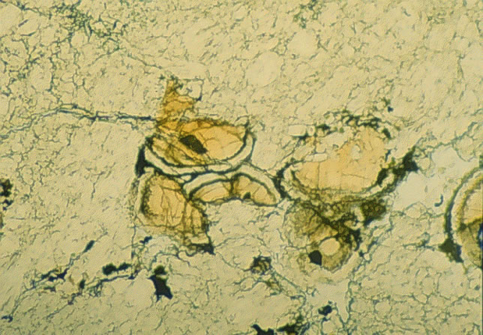
Evidence for Surface Water on Ancient Mars Where Did the Water Go? Where Did the CO₂ Go?
Abundant evidence for ancient water
Volatiles can be lost to space
Escaping ions detected from Mars Express
Volatiles can go into the crust
Carbonate deposits in a Martian meteorite
Notes:
There is abundant evidence for liquid water on ancient Mars. Upper left image shows “runoff channels” that look like river drainage systems. Also seen are geological evidence for ancient lakes filling impact craters and minerals that form only in presence of liquid water. Almost none of that occurs subsequent to about 3.5 or 3.7 billion years ago. Where did the water and CO2 go? Bottom image shows grains inside of ALH84001 meteorite (from Mars, found on Earth), showing that carbonate minerals do exist and some of the CO2 has gone into the crust; not enough to account for thick CO2 atmosphere. Right image shows evidence for atmosphere being removed from Mars to space, from ESA Mars Express mission. We’re going to quantify that loss and understand the processes responsible.

Slide 11
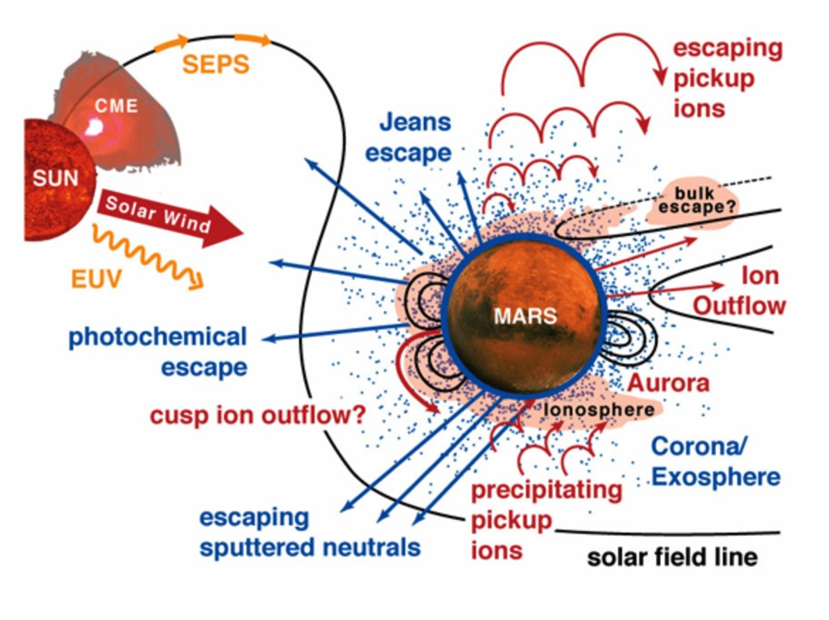
Understanding Escape of Atmospheric Gases to Space
Measure energetic drivers from the Sun, response of upper atmosphere and ionosphere, and resulting escape to space
Understand the key processes involved, allowing extrapolation to loss over Mars history
Notes:
Graphic showing all of the different processes that could be responsible for loss, along with the energetic drivers from the Sun (solar wind, solar energetic particle events, EUV photons). Point of this is that (i) we’ve thought through the possible processes (although we don’t know if they actually operate at Mars), (ii) we selected instruments to be able to understand these, and (iii) we anticipate that we have a robust enough payload that it can decipher whatever we see.
This is a lead-in to the next chart.

Slide 12
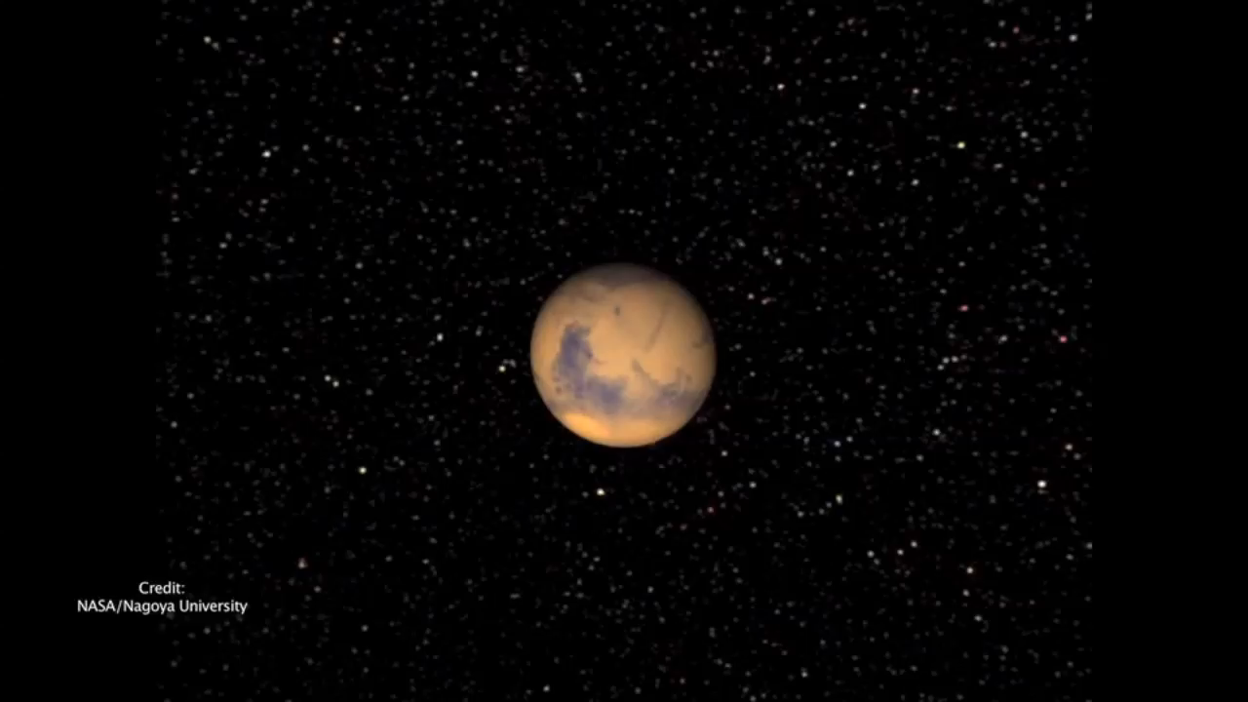
The Solar Wind is Able to Strip Off Gas from the Top of the Atmosphere
Notes:
This one shows one quantitative numerical model of one process, but it shows it very graphically. It’s removal of the upper atmosphere by the solar wind. The change halfway through shows what happens if the solar wind suddenly doubles in intensity (Too much going on and I haven’t been able to specifically refer to that, but wanted to let you know).

Slide 13
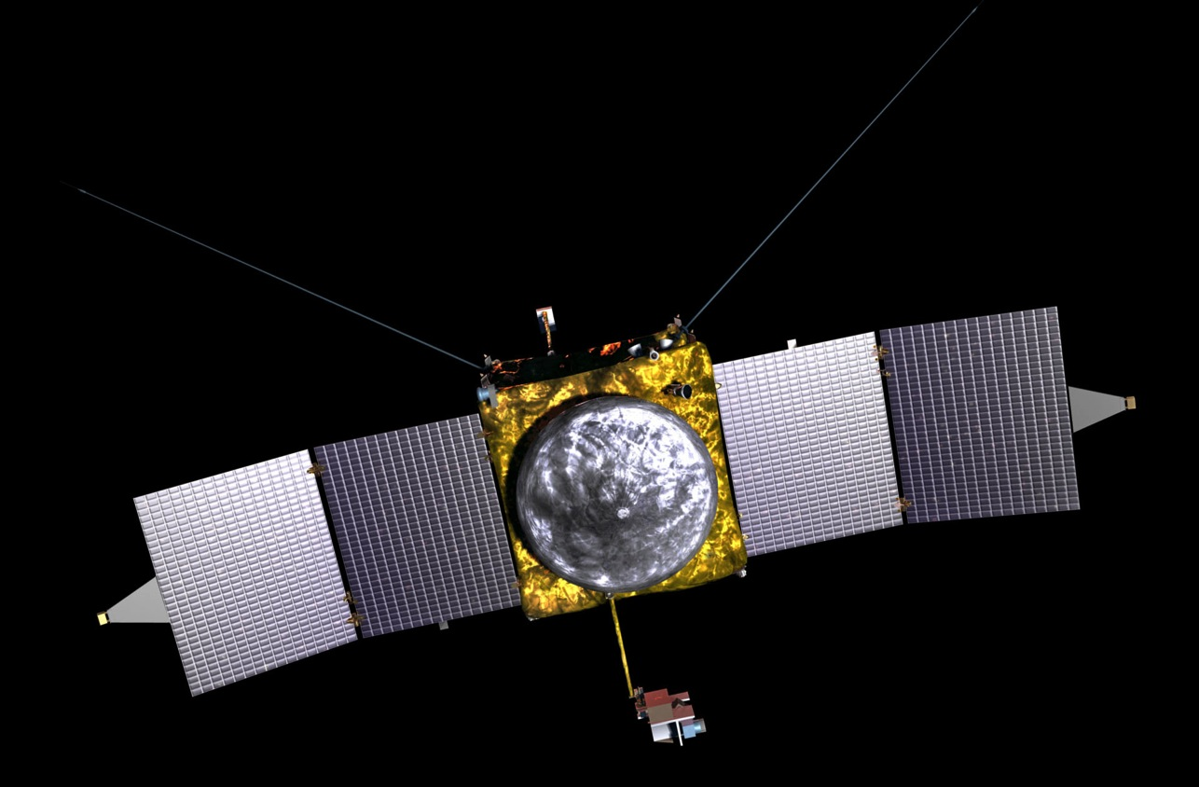
The MAVEN Spacecraft
Launch (Wet) Mass: 2455 kg at launch
Spacecraft Dry Mass: 810 kg at launch
Power: 1135 W at Mars Aphelion
LPW (2)
SWEA
Electra (behind)
SWIA
SEP
“Gull-Wing” Solar Arrays
Fixed HGA
MAG (2)
SEP
Articulated Payload Platform (IUVS/STATIC/NGIMS)

Slide 14

The MAVEN Spacecraft
Launch (Wet) Mass: 2455 kg at launch
Spacecraft Dry Mass: 810 kg at launch
Power: 1135 W at Mars Aphelion
LPW (2)
SWEA
Electra (behind)
SWIA
SEP
“Gull-Wing” Solar Arrays
Fixed HGA
MAG (2)
SEP
Articulated Payload Platform (IUVS/STATIC/NGIMS)

Slide 15
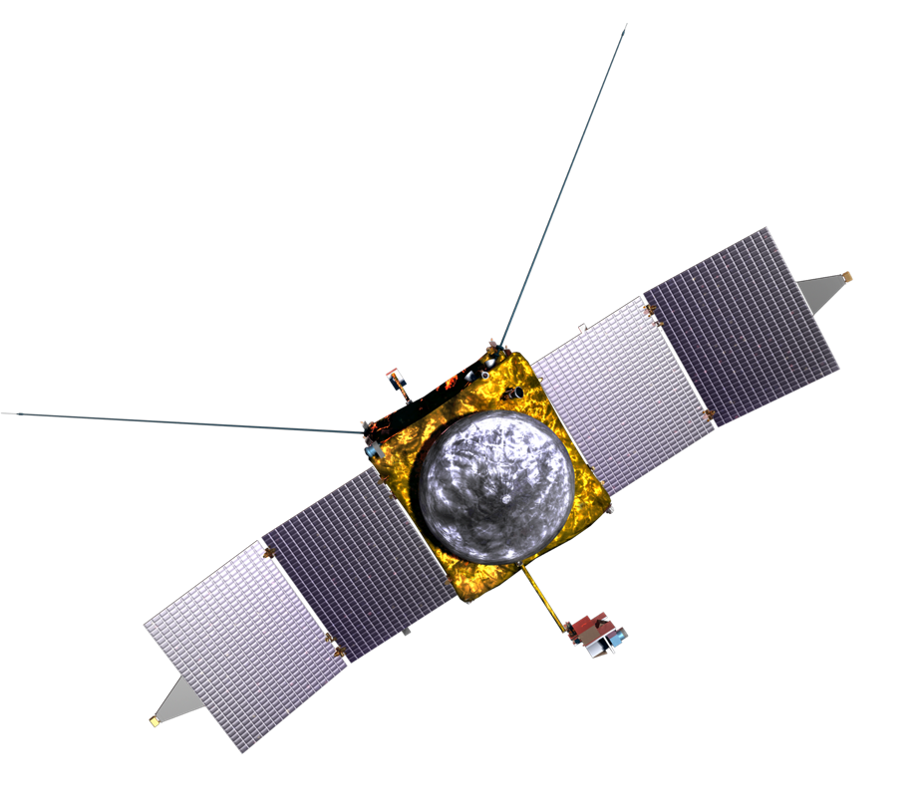
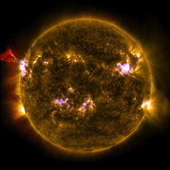




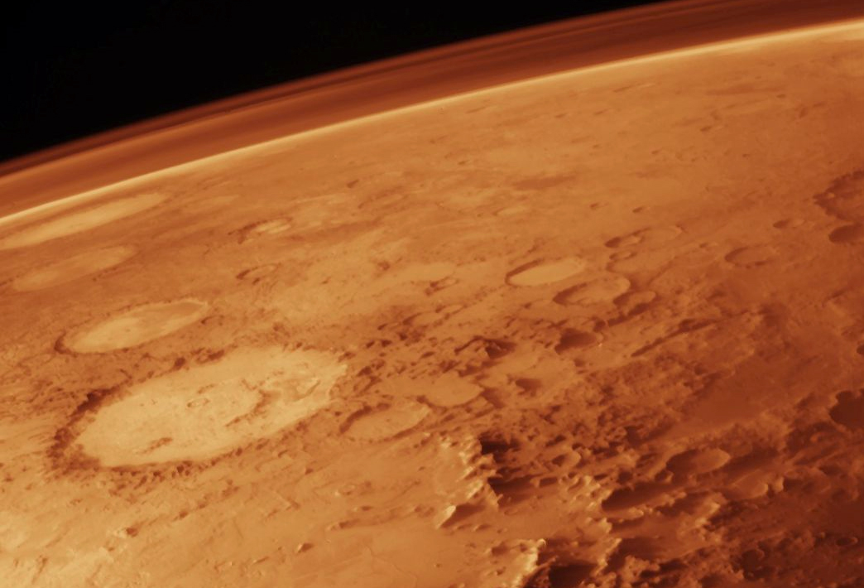
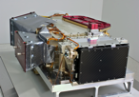




The MAVEN Science Instruments:
Sun, Solar Wind, Solar Storms
SEP
SWEA
EUV
SWIA
Neutrals and Ions Plus Evolution
Ion-Related Properties and Processes
IUVS
NGIMS
STATIC
MAG
LPW
Notes:
MAVEN instruments and spacecraft. The “solar” instruments do other things as well, but I’ve lumped them here for simplicity on the chart and so that each instrument is shown only once.

Slide 16
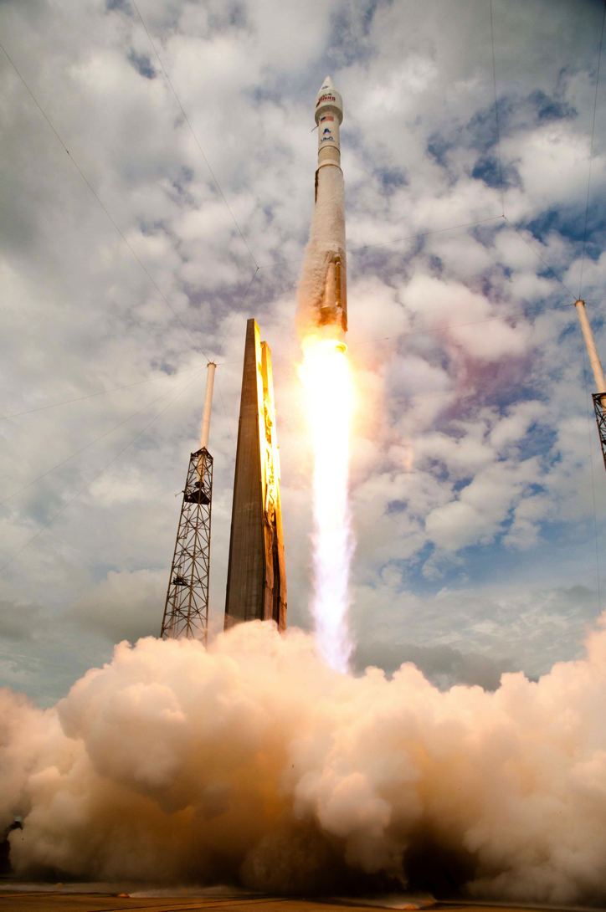
MAVEN Launched in Nov. 2013…

Slide 17
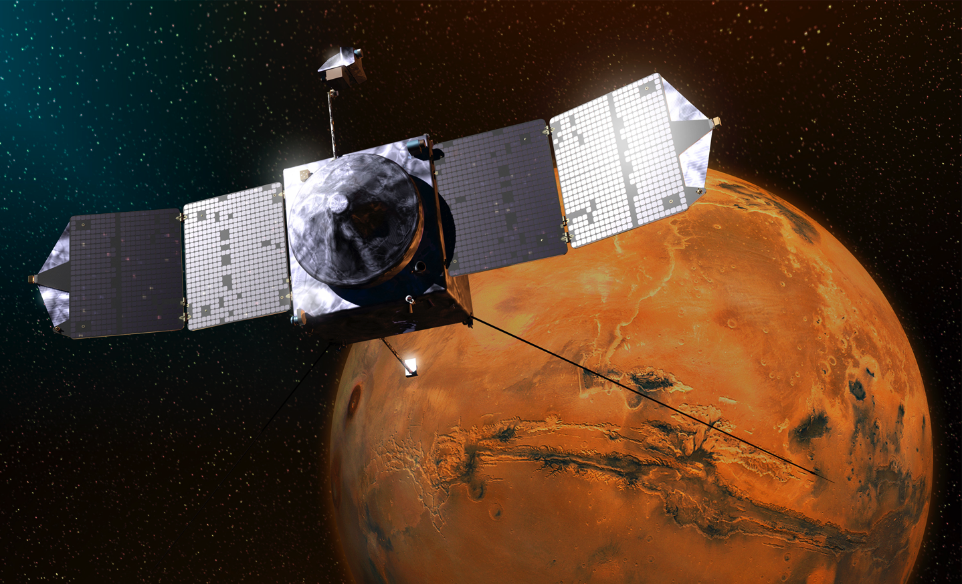
…And Has Been Orbiting Mars Since Sept., 2014

Slide 18
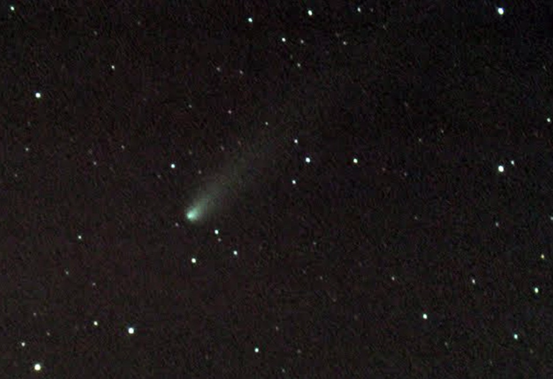
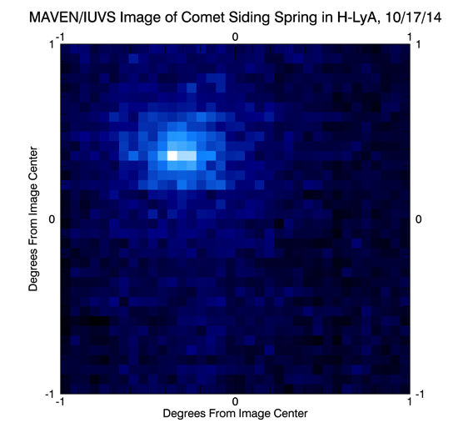
MAVEN’s Close Encounter With Comet Siding Spring
Breckland Skies Observatory
MAVEN IUVS

Slide 19
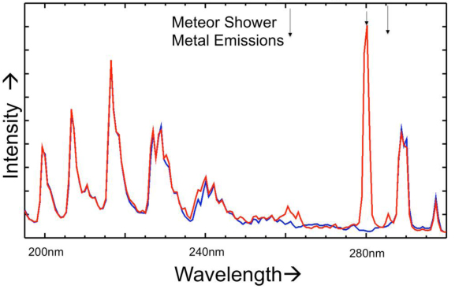
Comet Dust Discovered in Mars Ionosphere

Slide 20
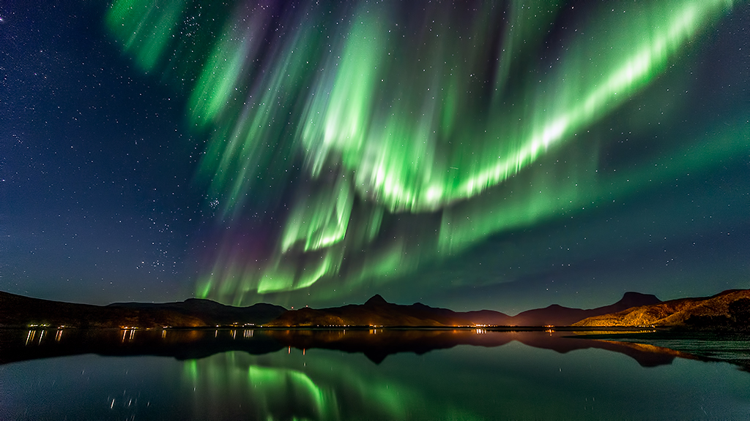
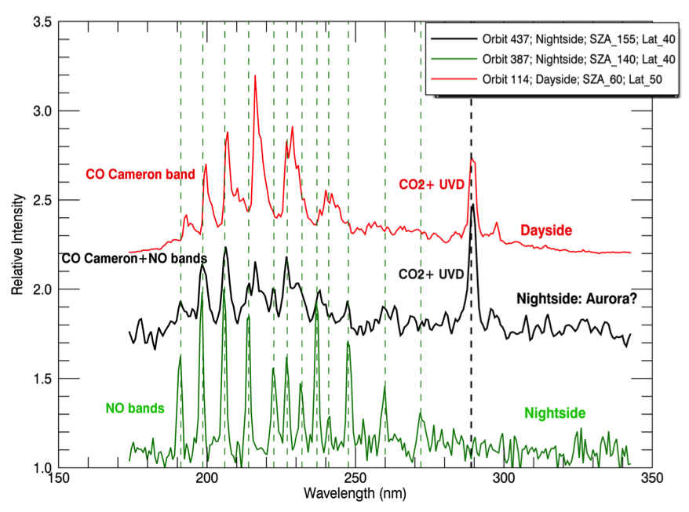
Aurora at Mars

Slide 21
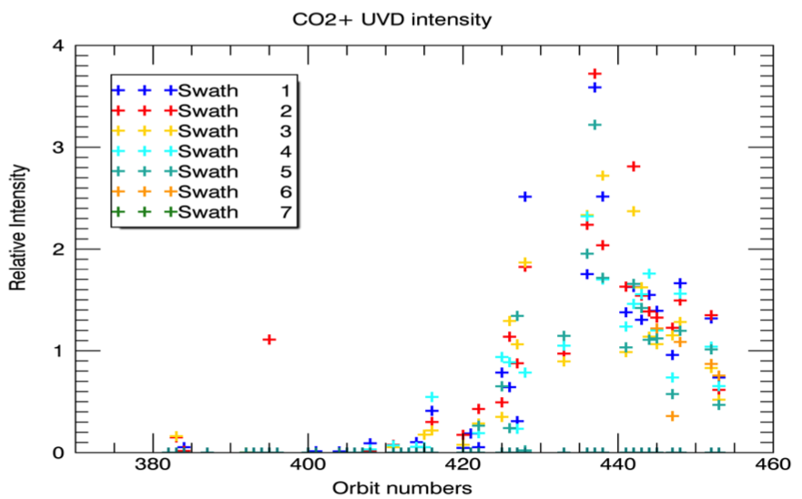
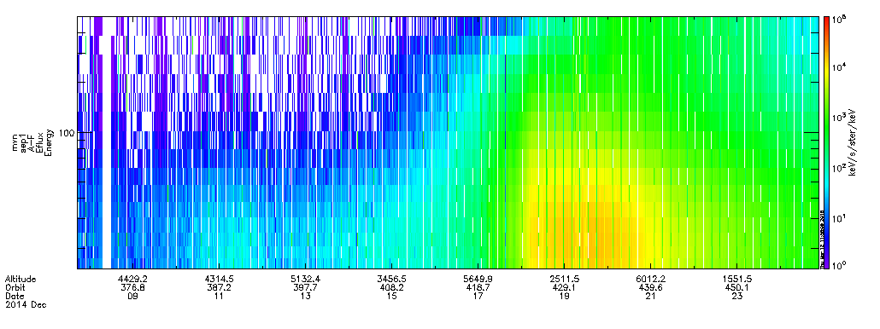
Aurora On Mars Are Connected To Solar Storms
Auroral Intensity
Solar Electron Storm Intensity

Slide 22
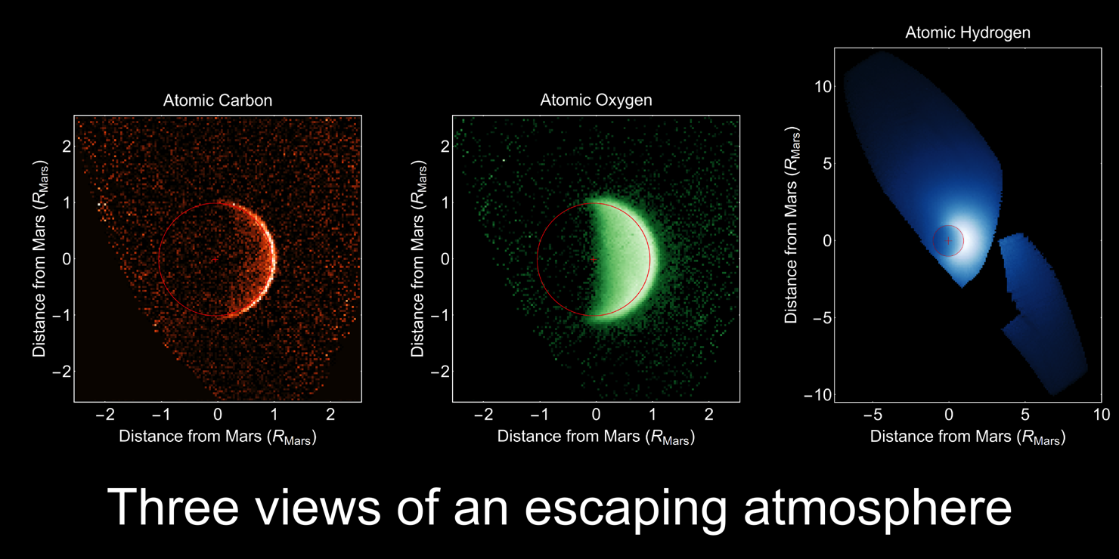
Observations of Atomic Components of H₂O and CO₂ on Their Way to Escaping

