Slide 1



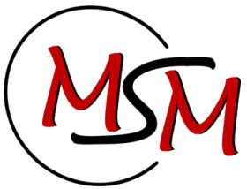

Thermomechanics days 2014 ArcelorMittal
A FEM approach to study phase transformation within bimetallic rolls
Anne Marie HABRAKEN, Ingrid NEIRA TORRES, Jérome TCHOUFANG TCHUINDJANG, Mario SINNAEVE, Jacqueline LECOMTE-BECKERS
Maizières-lès-Metz 5 February 2014

Slide 2

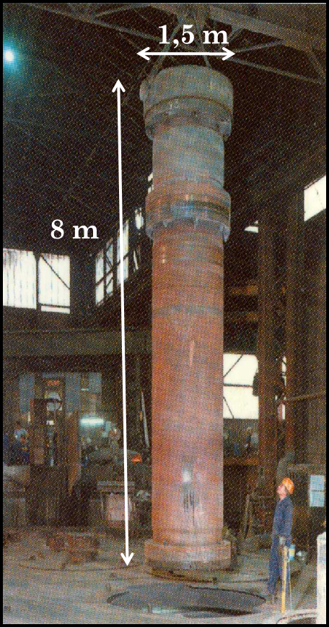
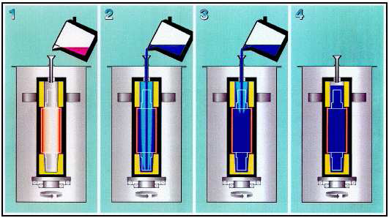
Bimetallic rolling mills
High wear resistance in the shell = High Chrome Steel
(as cast condition: troostite, martensite, residual austenite ,
eutectic carbides at GB + uniformly secondary carbides in the matrix)
High toughness in the core = Spheroidal Graphite Iron
            ( either pearlitic or ferritic one)

Slide 3
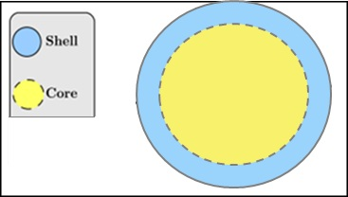
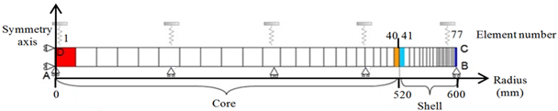
Work motivation
High rate of failure during cooling and heat treatment for radius > 1200mm
for pearlitic core
FE Simulations to find the origin of the crack.
Crack at material interface during heating post treatment → propagation in the core ?
Core crack during cooling
hidden by shell?
Ma
Fe-Pe

Slide 4
Model description
PhD (A.M.Habraken, 1989)
Coupled thermo mechanical metallurgical analysis during the cooling process of steeel pieces (A.M.Habraken, M. Bourdouxhe, Eur.J. Mec A/Solids11(1992)
Temperature
1 Phase transformation
Metallic structure
2 Latent heat
3
Thermal
stress
Variation
of
mechanical
parameters
6
Mechanical induced
transformation
kinetic modification
4
Transformation
strain and
plasticity
Charact.
mixture
law
5
Heat generation
due to deformation
Stress and strain
Totally coupled thermo metallurgic mechanical finite element simulations

Slide 5
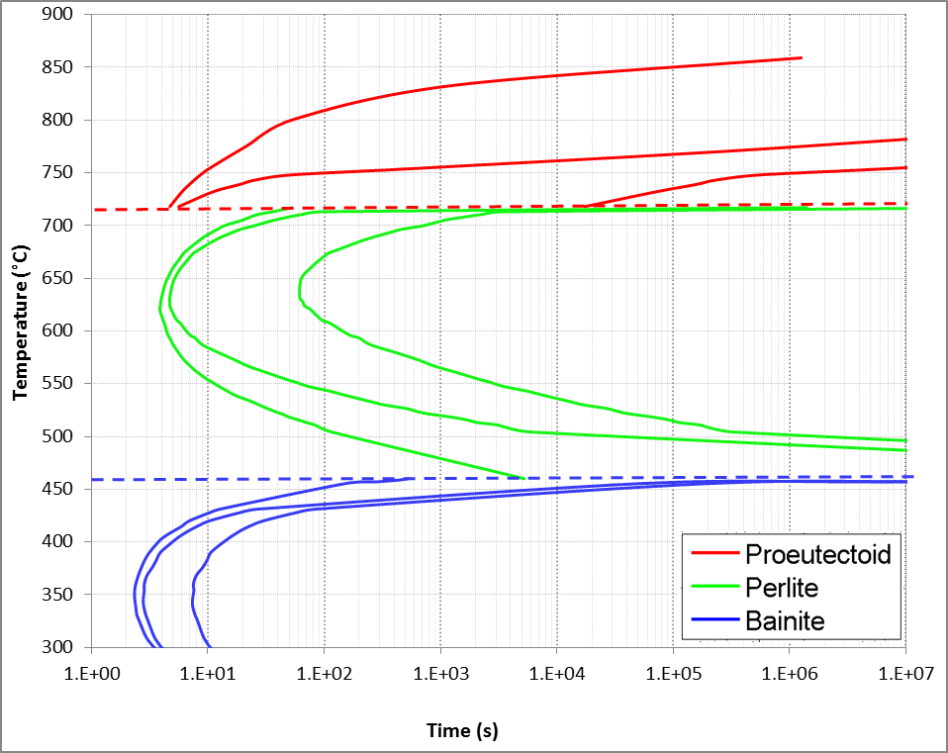

Metallurgical model
Transformations by diffusion (ferrite, pearlite, bainite)
  TTT diagram
  Additivity rule
  Sheil’s sum (nucleation)
  Johnson-Mehl-Avrami law
Martensitic transformation
  Koistinen Marburger’s law

Slide 6
INPUT DATA
FE code
OUTPUT DATA
Thermo physical parameters
α, ρ, λ, C_{p} for each phase f(T)
Stresses
(σ_{x ,} σ_{y ,}σ_{z ,} σ_{xy})
Lagamine
Metallurgical parameters
TTT diagrams (→JMA)
Transformation strain
Plasticity transf strain,
Shift of transformation
Coef of Koist Marburger
Latent heat of transfo
Strains
(ε_{th}, ε_{p}, ε_{ph}, ε_{ptr})
Phase rates
(%Fe, %Pe, %Ma)
Mechanical parameters
(E, ν, E_{t}, σ_{y} for each phase f(T))
Analysis of results
Average values on very heterogeneous material : Galaxy 12 to 15% carbides
strong variation in matrix C contents → scattering in Ms temperature, etc

Slide 7
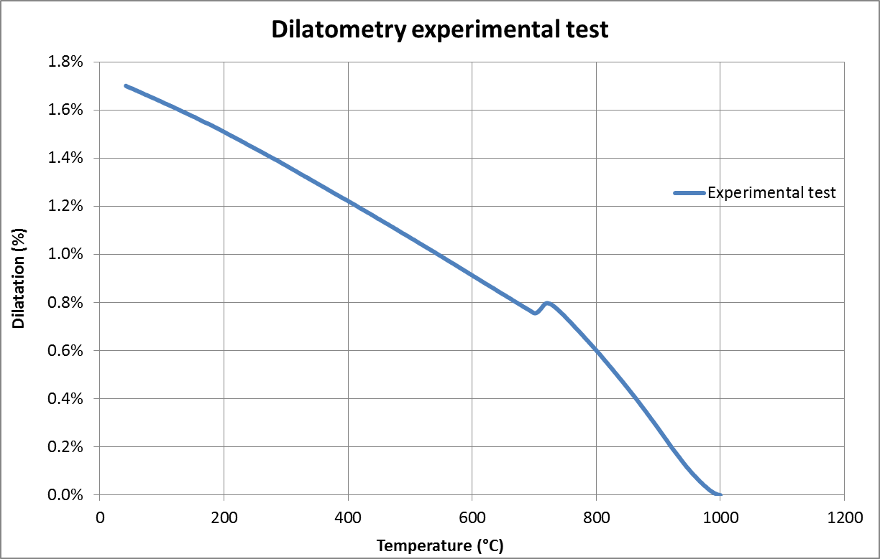
Dilatometry test for core material (cooling)
Pe-Fe
Au
Thermophysical parameters
(α, ρ, λ, C_{p})
Latent heat
TTT diagram
ε_{tr}
Experimental data
Inverse method from CCT diagram
?

Slide 8
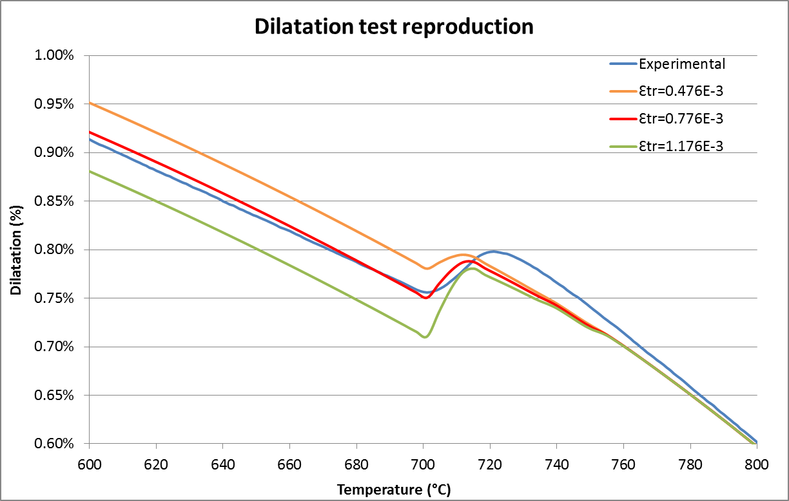
Dilatometry test core material

Slide 9
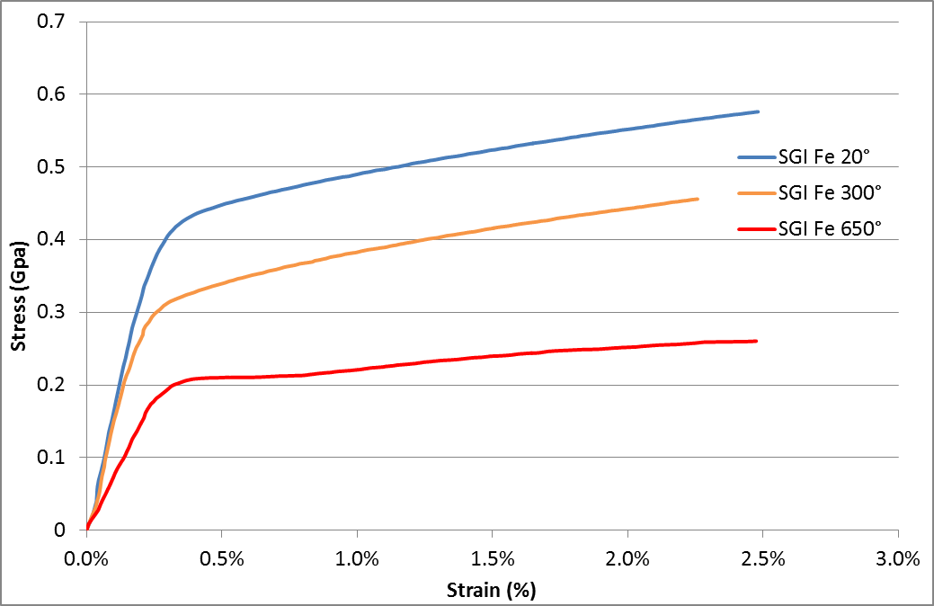
Mechanical data by compression tests
Core
Ferrite for SGI
Similar tests on
Pearlite SGI samples
Austenite Galaxi samples
Martensitic Galaxi samples

Slide 10
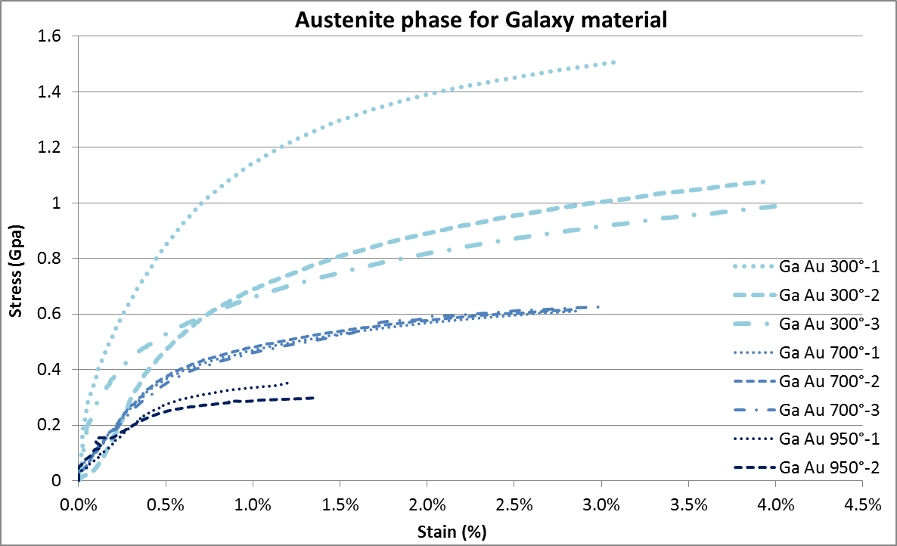
Mechanical data by compression tests
Shell
Strong dispersion for austenite at 300°C ?
Doubts on full austenitic phase tests
bainite apearance
Austenization in furnace shorter for sample 1 compressed at 300°C
Undissolved secondary carbides → hardening
No delamination at grain boundary carbides/ matrix interface (present in sample 2)
Microscop + hardness of samples compressed at 700°C and 300°C or stress free (=T(t)) → bainite presence
Complex effect: stress → bainite transfo earlier but only in well oriented grains,
in other grains transfo inhibited,
stress free samples : more random bainite

Slide 11
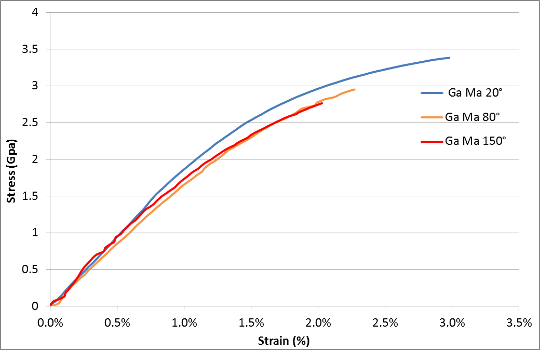
Mechanical data by compression tests
Same behaviour at 80°C and 150°C for 100% of Ma samples ?
Martensite for Galaxi
Shell
Bala Arch of M&M 2009 1st state of tempering in HSS = precipitation of ε transition carbides between 80°C and 300°C
Assumption:
the softening due to stress relaxation with higher Tp°
in competition with the hardening due to precipitation of ε transition carbides

Slide 12
Current simulations
Stress-strain curve forget bainite in austenite Galaxi
Ms transfo based on cryogenic test on Zarya samples
Transformation Induced Plasticity : not identified
No shift of Ms temperature : not identified
(phenomena known from by previous Gleeble tests)
Sensitivity study to check effect (future)
Is the current model able to explain the trends of more cracks for larger rolls?

Slide 13
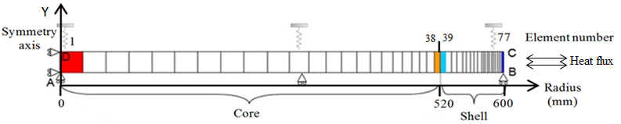
Simulations

Slide 14
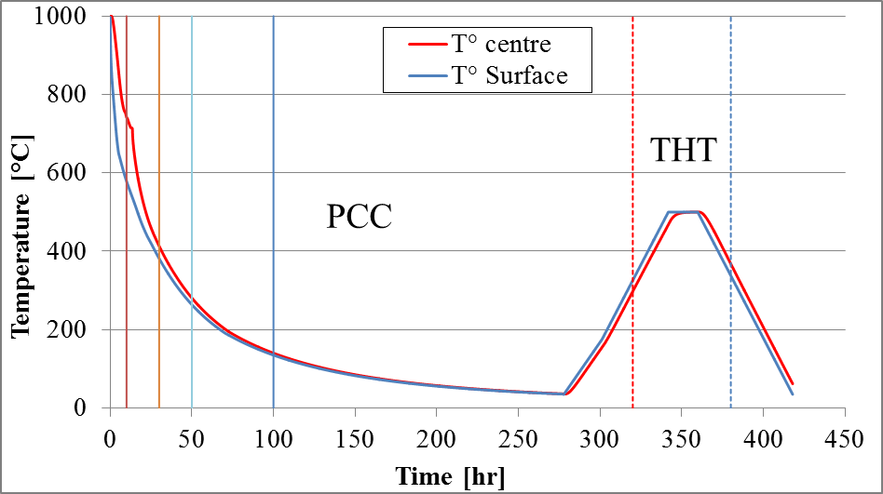
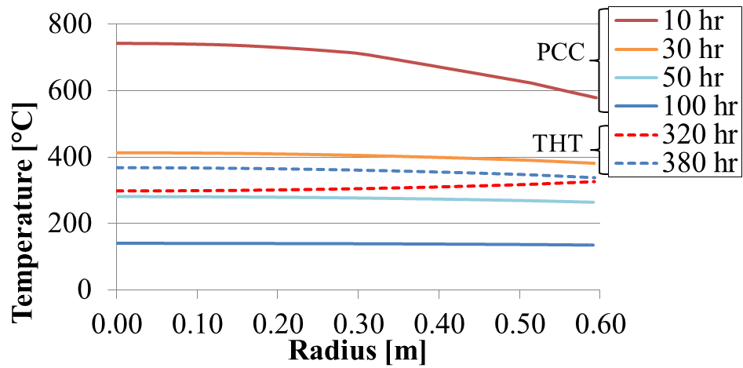
Thermal fields
PPC Post Casting Cooling stage (convection radiation)
THT Tempering Heat Treatment (imposed temperature)
Stronger gradients in cooling than in tempering

Slide 15
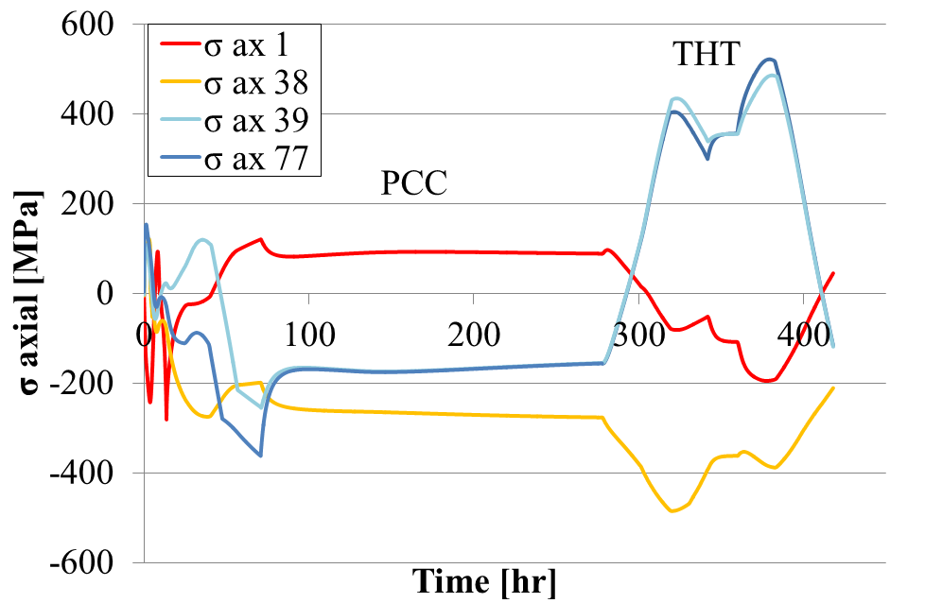
Axial stress f(t)
Center
Interface core
Interface shell
Surface
Higher stress state during THT than PCC
Different stress level in core
No stress gradient in shell
Huge gradient at material interface
PCC
After PCC : last cooled surface in tensile After THT +- idem but tempered MS

Slide 16
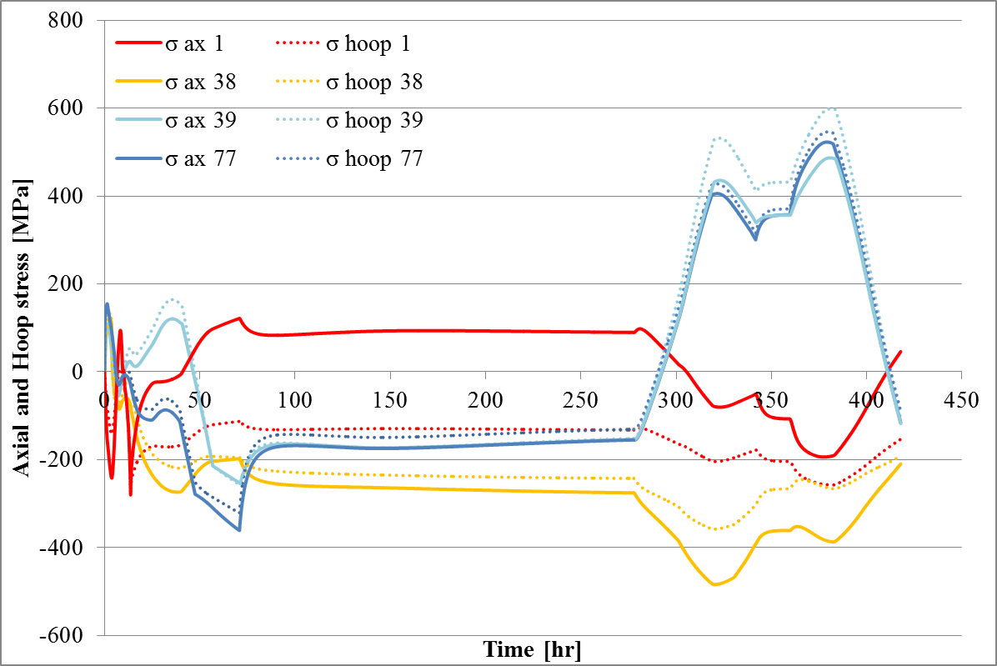
Hoop stress// Axial stress
Non negligeable, not identicat to axial values, info to use in rupture criteria

Slide 17
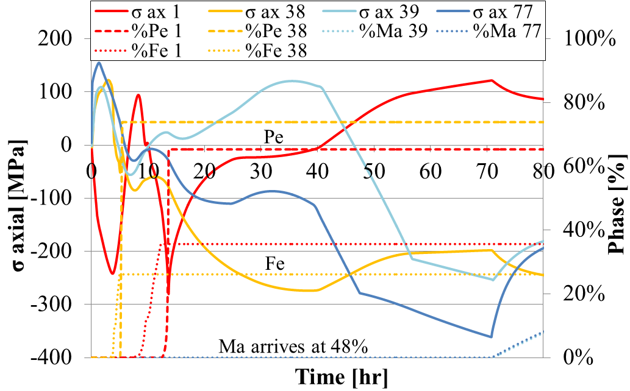
Phase transformation
Red = core
Light = interface
Blue = surface
Thermal gradient surface - centre
Fe+ Pe in
Core interface +..
Fe+Pe in Core Center
Dilatation coef. strongly different in Shell and Core
Martensite transformation in shell

Slide 18
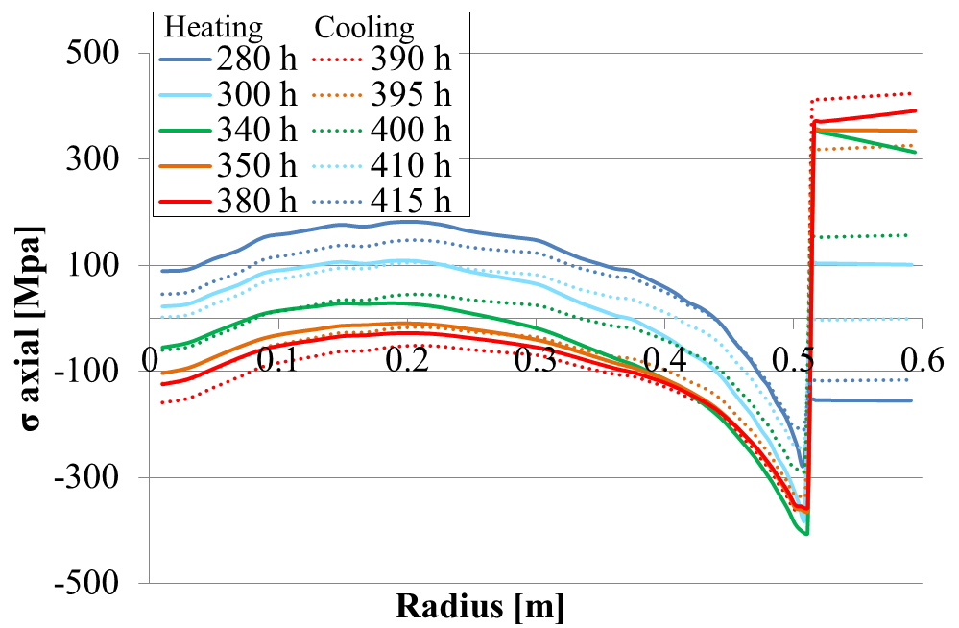
Stress state along radius
During HPT
High tensile state happens in shell
Tensile state in core disappears than is recovered
Effect not explained by temperature gradient
but different dilatation coef.
End of PCC
End of HPT
End of PCC

Slide 19
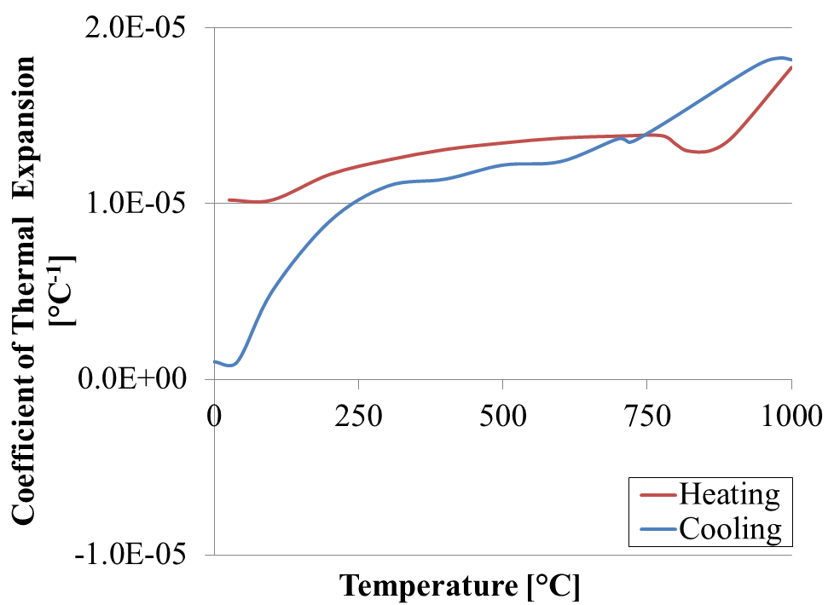
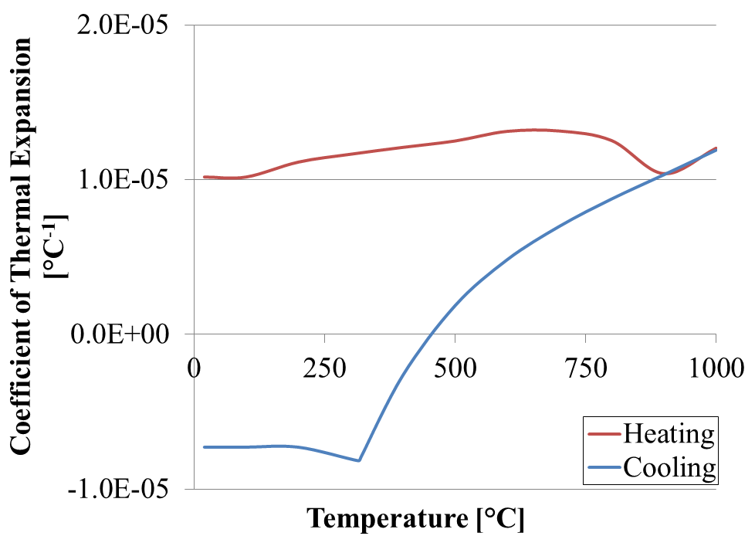
Dilatation coefficients
Core SGI
Fe=Pe
Shell Galaxi
Austenite
Martensite
Austenite
Values > dilatation experiments + identified
Inaccuracy when phase disappears
Fe or Pe transfo : 7.76x10⁻⁰⁴
Martensitite transfo: 3.00x10⁻⁰³

Slide 20
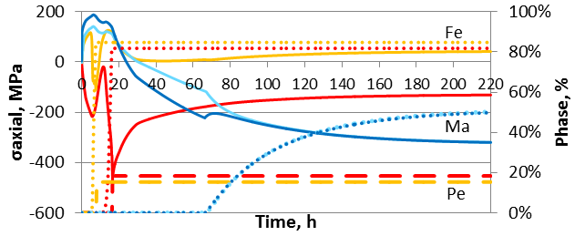
Sensitivity to parameter accuracy
Results with data (Jan 2013) …
Results with data (Jan 2014)
TTT, dilatation coefficients and modified

Slide 21
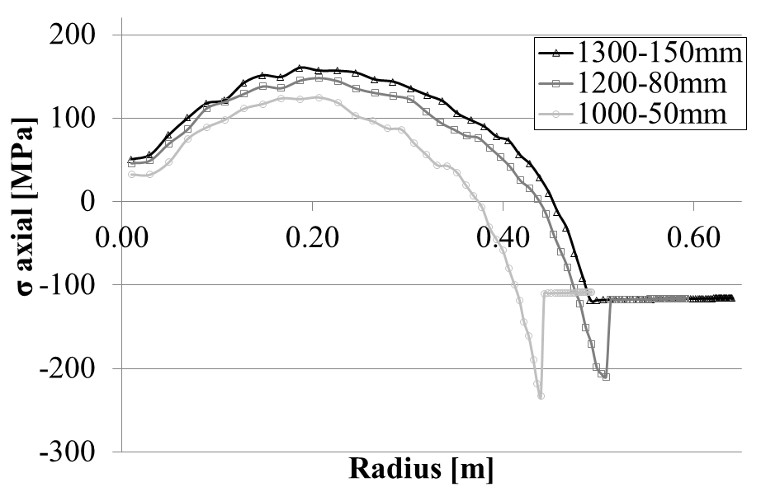
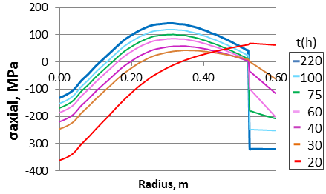
Effect of increased geometry on residual axial strain
Increased
geometry
« Similar »
but higher
residual stresses after HPT
Old input data
PHT : extreme values at interface non proportional to total radius
PCC : in the core
max tensile stress 89 to 183 Mpa when radius

Slide 22
Conclusions
Model helps:to understand better the phenomena
validated on phase percentages
( + in previous study on residual stress level)
on going work: rupture criteria
Input data: very heavy , accuracy modifies results
Phenomena not included because lack of data
Transformation Induced Plasticity,
Shift of transformation due to stress, strain states

Slide 23
Towards more microscopic computation?
Help to improve the classical phase transformation model
Analysis of C contents (Pietrzyk^{Krakow}, Gauthier^{Nancy})
→ interpolation between different TTT diagram
Microscopic analysis (CPFEM Barbe^{INSARouen},
Forest, Cailletaud Centre des Matériaux MINES Paristech)
shift of MS temperature
--> improvement of analytical model possible not yet done

Slide 24
Towards more microscopic computation?
Help to improve the classical phase transformation model
Bacroix^{Paris 13}: use of crystal plasticity and Fast Fourier Transform to investigate Transformation Induced Plasticity → improvement of analytical models
Appolaire^{Onera}, Levitas ^{Iowa State University}, Cho^{Hanyang Univ Seoul}, Viardin^{ACCESS Aachen}: phase fields models (interface propagation) to investigate phase transformation

Slide 25
Thank you for your attention
To appear in Proceedings of ECRS in Troyes 7-10 July 2014
Study of residual stresses in bimetallic work rolls
Ingrid NEIRA TORRES, Gaëtan GILLES, Jérôme TCHOUFANG TCHUINDJANG,
Jacqueline LECOMTE-BECKERS, Mario SINNAEVE, Anne Marie HABRAKEN
Published work
Neira Torres, Ingrid; Gilles, Gaëtan; Tchuindjang, Jérôme Tchoufack;
Lecomte-Beckers, Jacqueline; Sinnaeve, Mario; Habraken, Anne
Computer Methods in Materials Science, 13(1), 84-91. Poland: AKAPIT (2013).

