Slide 1




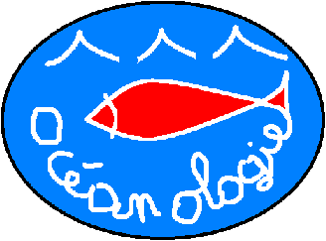


STAtion of Reference and rEsearch on Change of local and global Anthropogenic Pressures on Mediterranean Ecosystems Drifts: The
STARECAPMED project
J. Richir, A. Abadie, M. Binard, R. Biondo, P. Boissery, A.V. Borges, W. Champenois, N. Cimiterra, A. Collignon,
Donnay, C. Fréjefond, A. Goffart,
J.-H. Hecq, P. Lejeune, G. Lepoint,
L. Michel, C. Pelaprat,
Pere, D. Sirjacobs,
J.-P. Thomé,
Volpon and
S. Gobert
Qingdao,
11-08-15
Arnaud Abadie

Slide 2

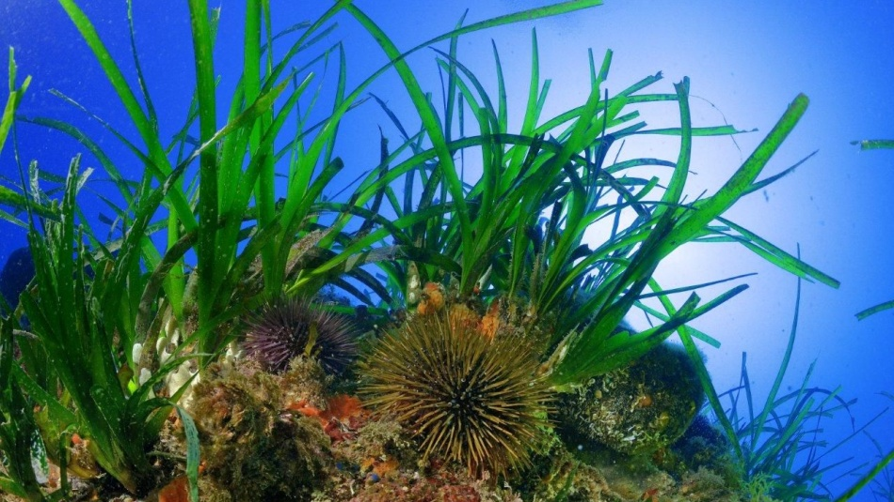
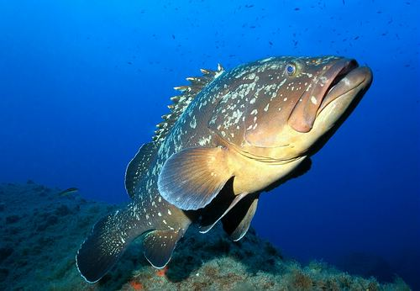
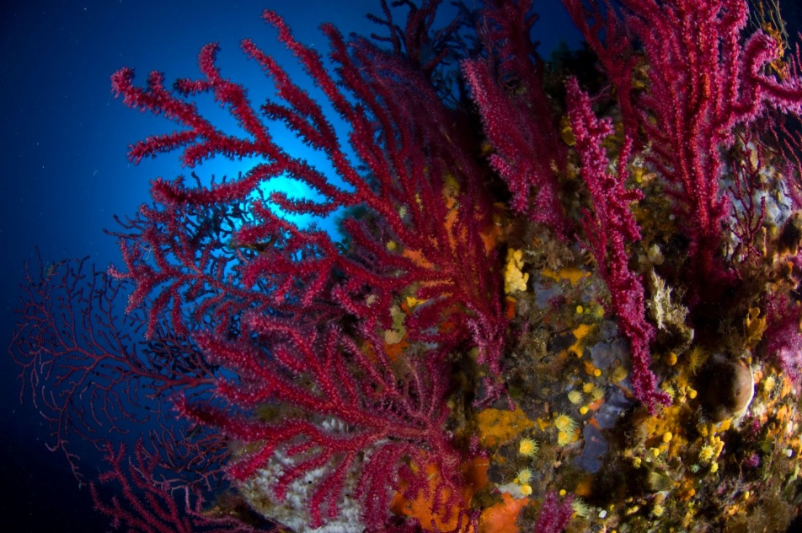
STARECAPMED - Context
The scientific information on marine ecosystems must answer 3 objective issues:
( i) what is the state ?
( ii ) what are the changes ?
( iii ) what are the mechanisms and processes
involved ?
and a more prospective issue:
( iv ) what can we expect and how
can we act ?
Arnaud Abadie

Slide 3
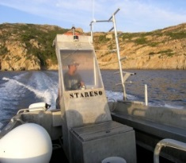
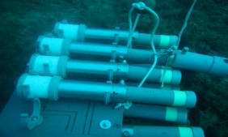
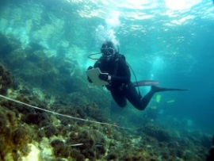
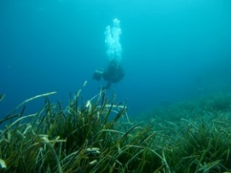

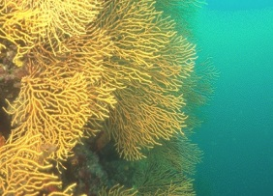
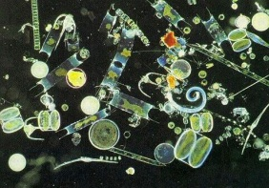
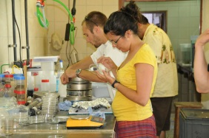
STARECAPMED - Objectives
STAtion of Reference and rEsearch on Change of local and global Anthropogenic Pressures on Mediterranean Ecosystems Drifts
► To understand how human activities can interact with the fundamental processes that govern the functioning of the different coastal ecosystems of a Mediterranean bay.
The understanding of these interactions involves:
the identification of the anthropogenic pressures;
the quantification of their impacts on the ecosystems;
the prioritization of these impacts.
► To confirm the relevance of the use of the Calvi Bay as a reference in the study of local and global pressures and the changes they may cause on the structure and the functioning of Mediterranean coastal ecosytems.

Slide 4
STARECAPMED - The bay of Calvi

Slide 5
STARECAPMED - The bay of Calvi
STAtion of Reference

Slide 6
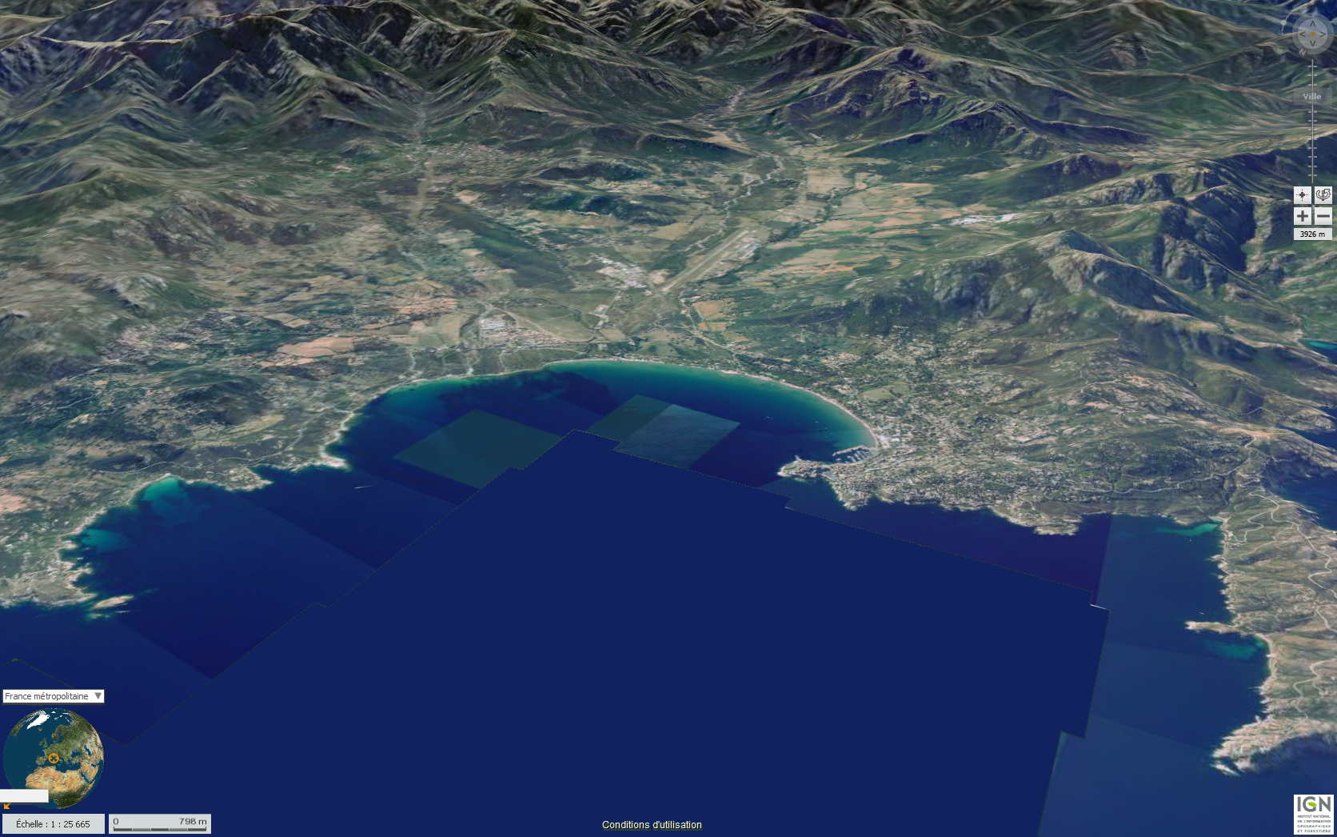
STAtion of Reference - The bay of Calvi
STARESO

Slide 7
STARECAPMED - STARESO
► The Station STARESO is a unique tool in a preserved natural site.
► The Station has archived environmental data for decades.
Water temperature in STARESO (°C) from October 1981 to March 2014

Slide 8
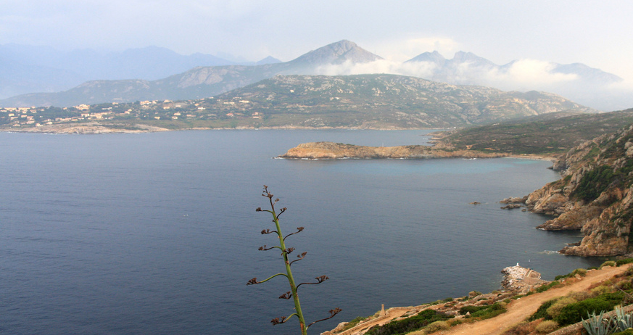
STAtion of Reference - The bay of Calvi
The bay of Calvi includes all the characteristic ecosystems of the Mediterranean littoral.

Slide 9
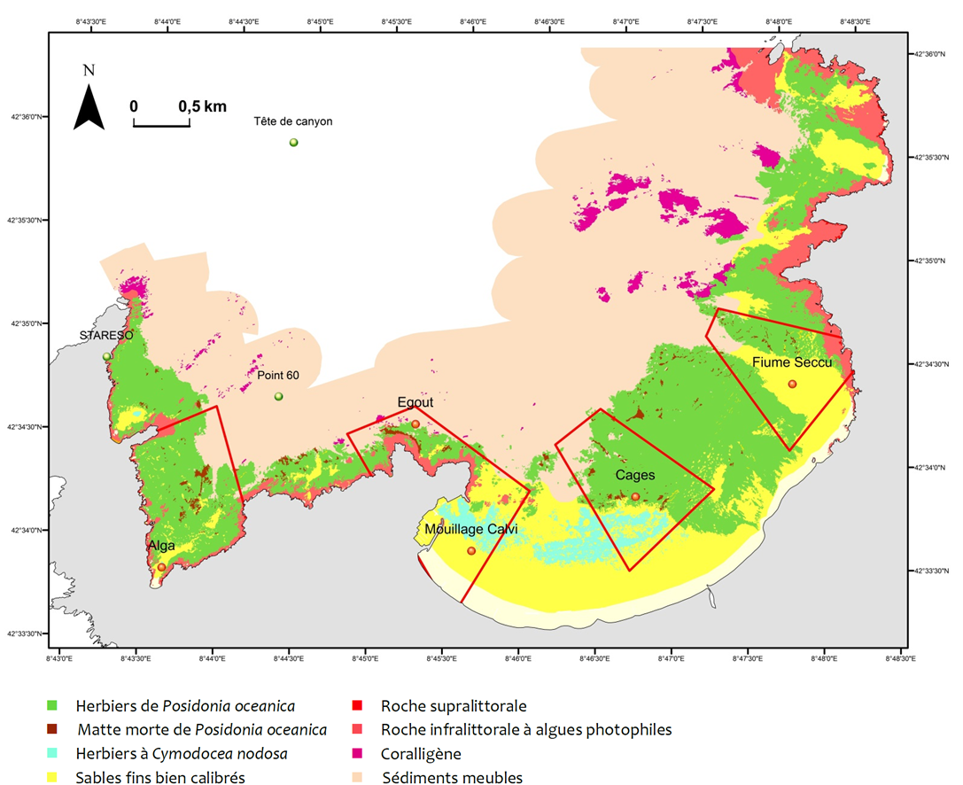
STARECAPMED - The bay of Calvi
3 reference stations
5 pressure points
Posidonia oceanica meadows
Posidonia oceanica dead matte
Cymodocea nodosa meadows
Sandy bottom
Supralittoral rocks
Infralittoral rocks with photophile algae
Coralligenous
Soft muddy bottom

Slide 10
- To study the fundamental processes operating in bay of Calvi.
CO₂
Meteorological forcings
Hydrological forcings
OPEN
SEA
WATERS
PO₄³⁻
SiO₄⁴⁻
NO₃⁻
NO₂⁻
NH₄⁺
Phytoplancton
Nutrients
Zooplancton
CO₂
Ichthyofauna
Hard substrates
P. oceanica meadows
Soft bottom

Slide 11
- To study the fundamental processes operating in bay of Calvi.
- To understand the influence of anthropogenic
factors on these processes.
CO₂
Meteorological forcings
Population
Pleasance
Rivers
Aquaculture
Hydrological forcings
OPEN
SEA
WATERS
PO₄³⁻
SiO₄⁴⁻
NO₃⁻
NO₂⁻
NH₄⁺
Phytoplancton
Nutrients
Zooplancton
Scuba diving
CO₂
Ichthyofauna
Sewage outfalls
Hard substrates
Caulerpa racemosa
P. oceanica meadows
Soft bottom

Slide 12
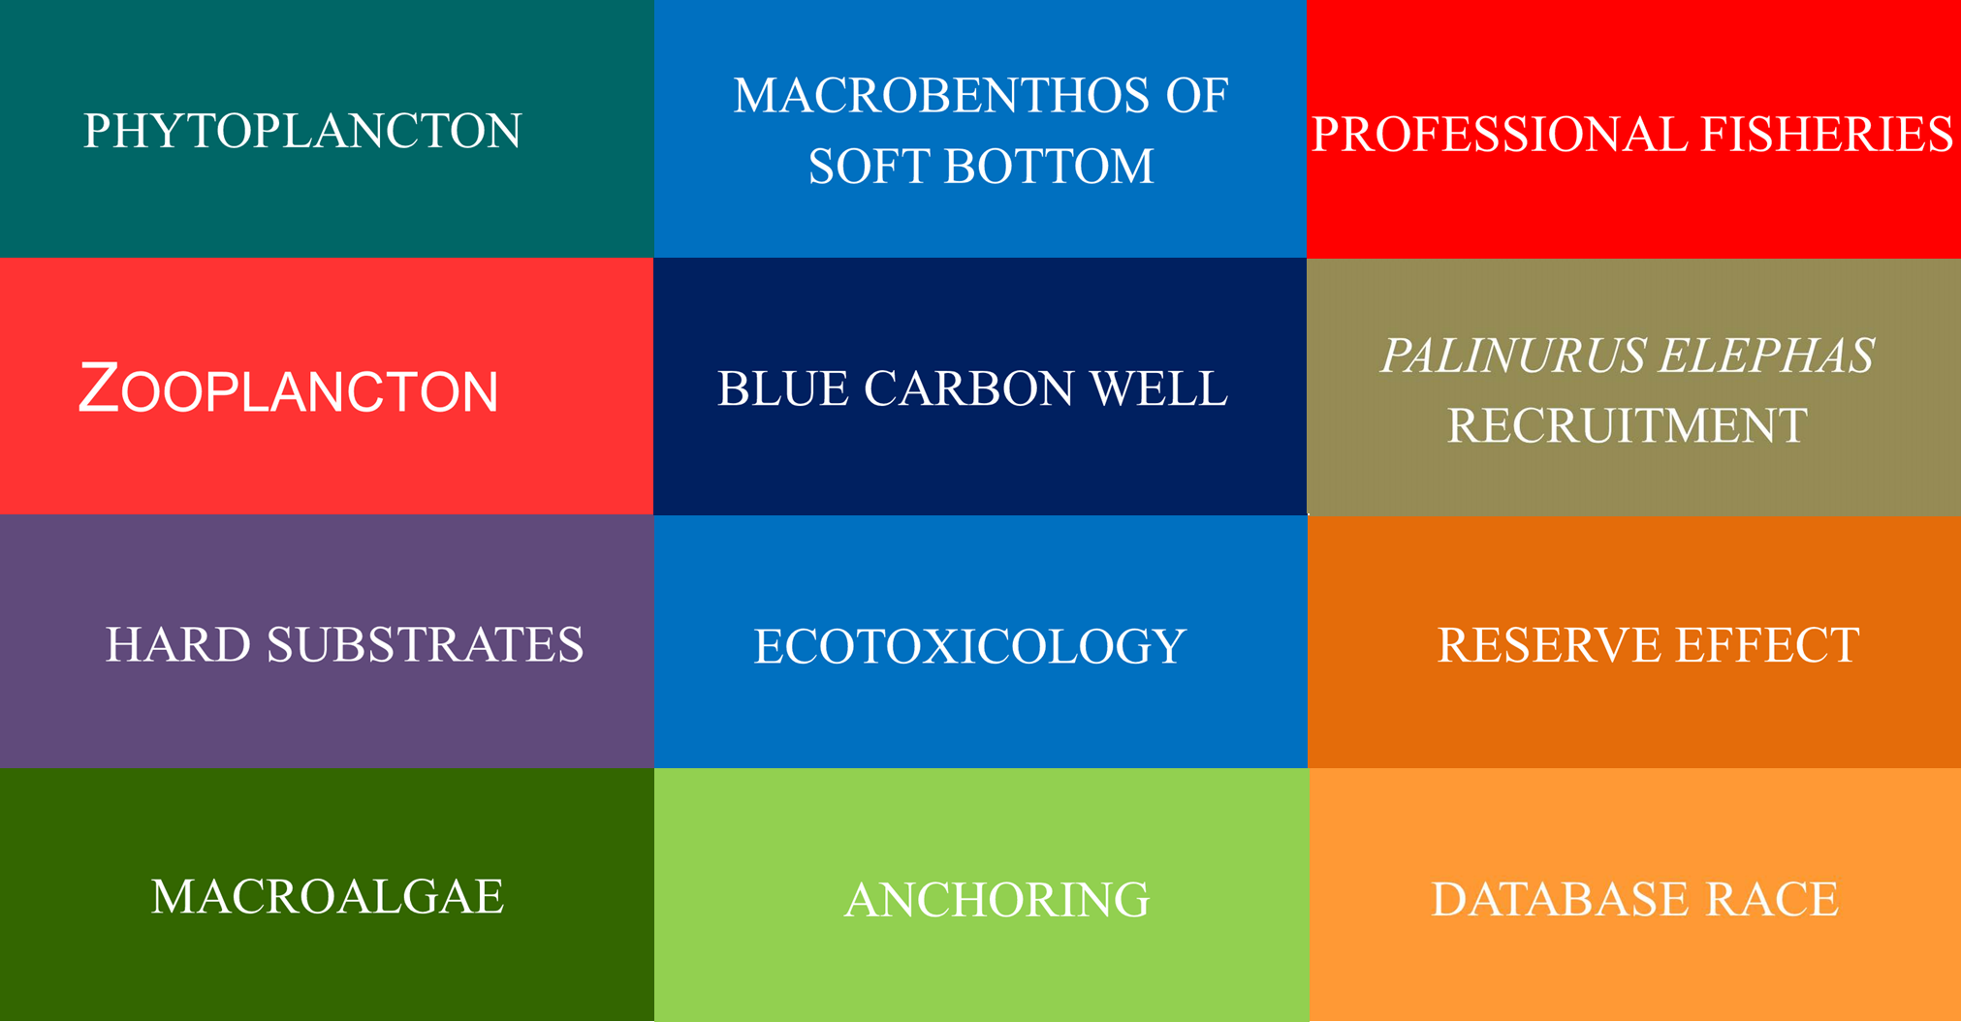
STARECAPMED - Examples

Slide 13
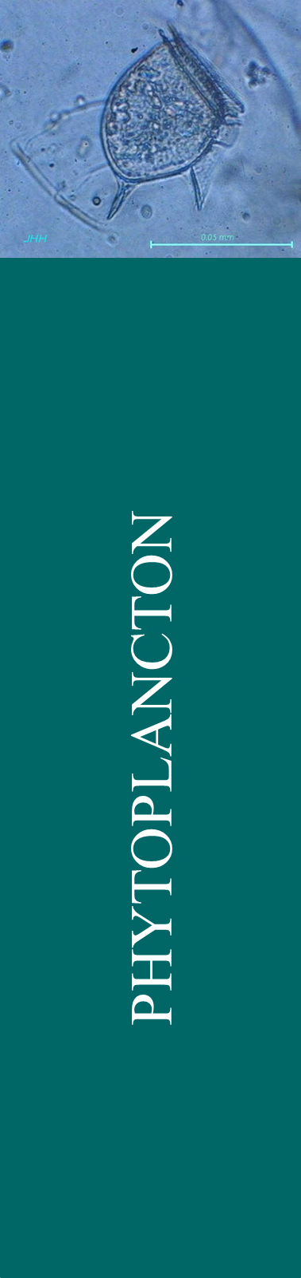
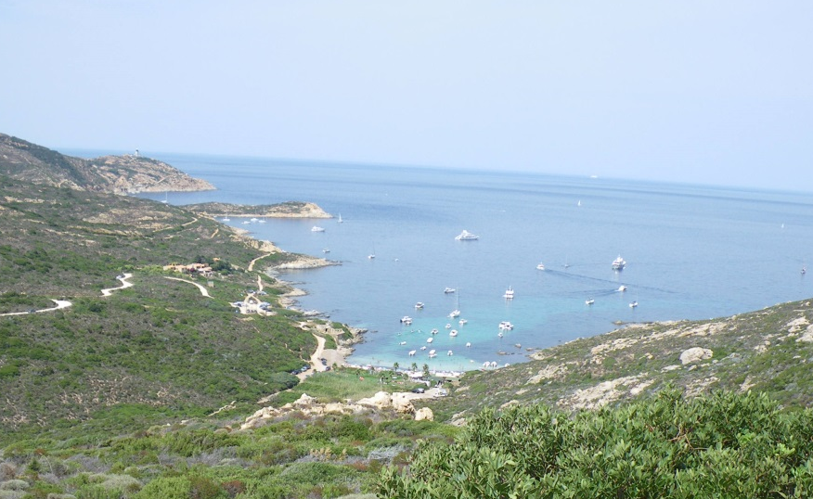
STARECAPMED - Phytoplancton
The Index I_{C Medit}:
uses the pigment signature of the phytoplancton measured by HPLC as quick determination method of the floristic composition.

Slide 14
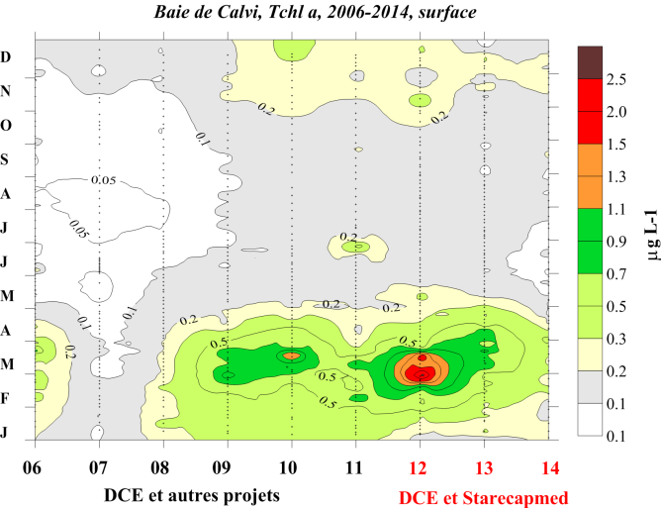
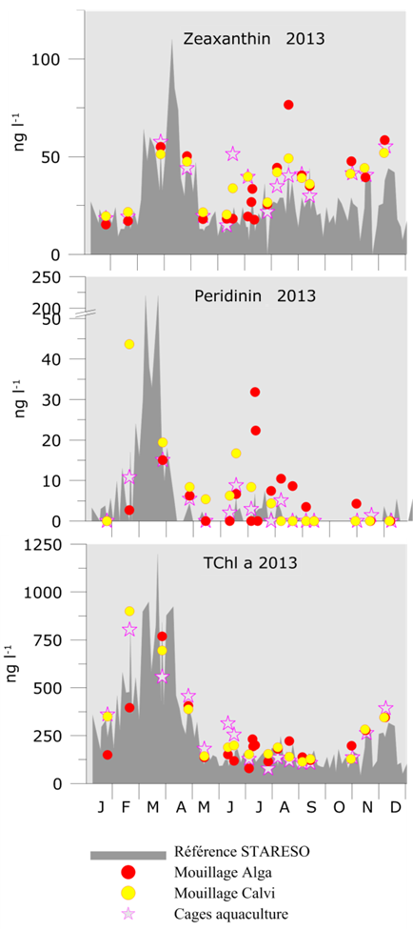
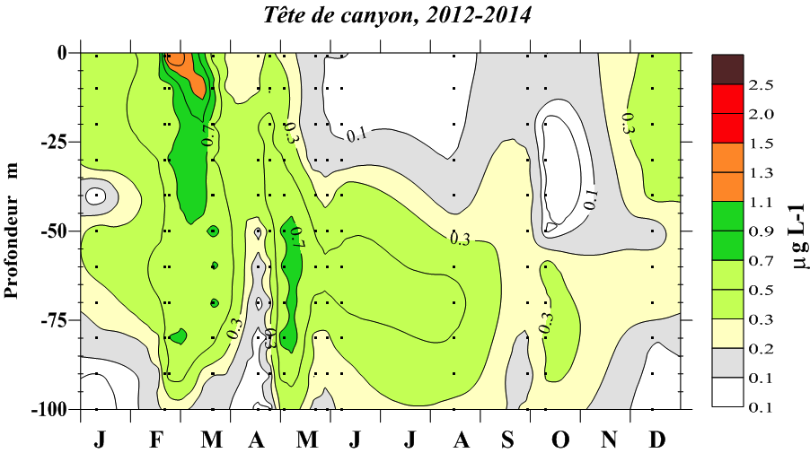
STARECAPMED - Phytoplancton
Calvi bay, TChl a, 2006-2014, surface
DCE and other projects
DCE and other projects
depth m
STARESO – reference
Alga organized mooring
Calvi organized mooring
Aquaculture farm

Slide 15
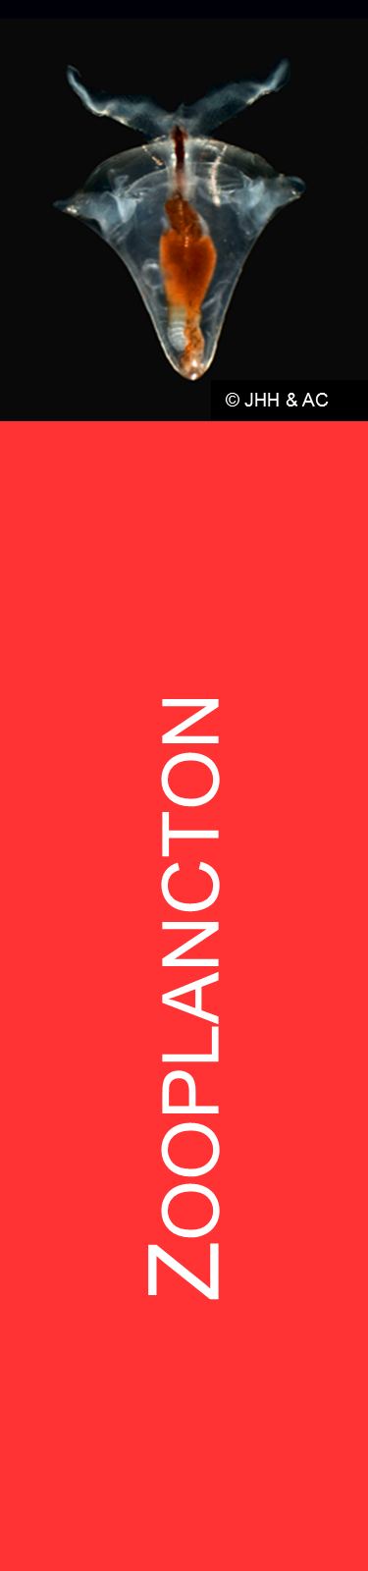
STARECAPMED - Zooplancton
Copepods Acartia clausi
Mesozoo biovolume
anomaly ml m⁻³

Slide 16
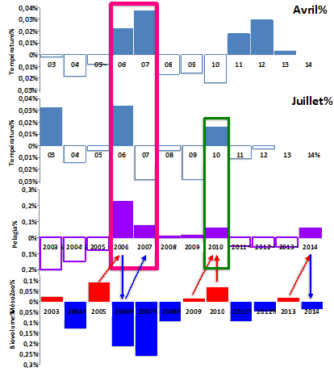
STARECAPMED - Pelagia noctiluca
April
Temperature
July
Temperature
Pelagia
Mesozooplancton

Slide 17
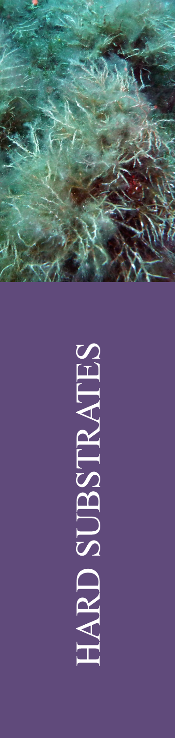
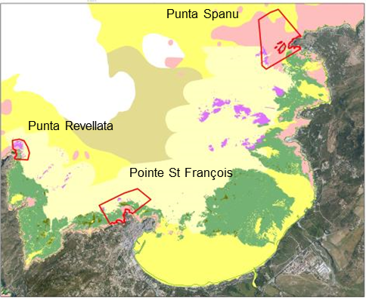
STARECAPMED - Hard substrates
Indices: LIMA, FAST

Slide 18
STARECAPMED - Hard substrates
► The LIMA (Littoral Marin) index developped by STARESO is a rapid and easy method to evaluate the landscape attractiveness and the patrimonial richness of a Mediterranean marine site between 0 and 40m depth.
Landscape index in the bay of Calvi
LIMA index
2005 - 2012
2005 - 2012
2005 - 2012
Revelatta
St-François
Spanu
Water temperature anomaly in STARESO (°C) from October 1981 to March 2014
Tourism growth
Lobster recruitment events
Thalassoma pavo apparition
Wastewater treatment plan creation
Cystocera population restauration
Cystosera population decline
Filamentous algae bloom,
high Gorgonia mortality
Caulerpa racemosa development

Slide 19

STARECAPMED - Macroalgae
CARLIT index: CARtography of the LITtoral
1979 survey
CARLIT index
Average
Good
Very good
1991 survey
Macroalgae monitoring
Vertical transect
CARLIT monitoring stations
2014 survey

Slide 20
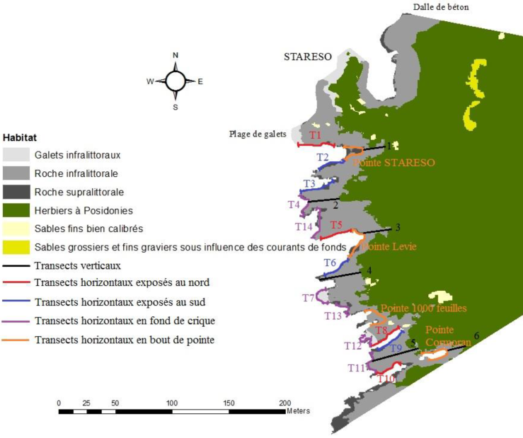
STARECAPMED - Macroalgae
Infralittoral pebbles
Infralittoral rocks
Supralittoral rocks
Posidonia oceanica meadow
Calibrated fine sand
Coarse sand and fine gravels
Vertical transects
North oriented horizontal transects
South oriented horizontal transects
Horizontal transects at the back of creeks
Horizontal transects at points
CARLIT
Index values: 15
of 18 transects have a good to very good status.

Slide 21

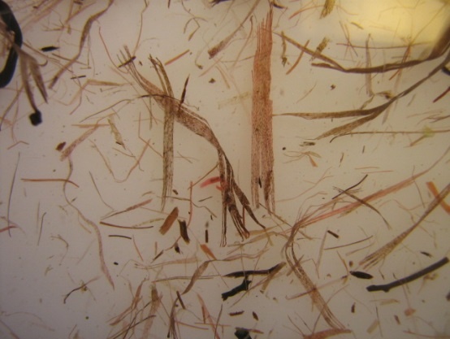
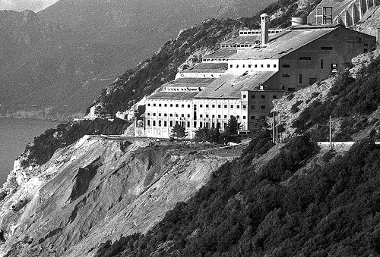
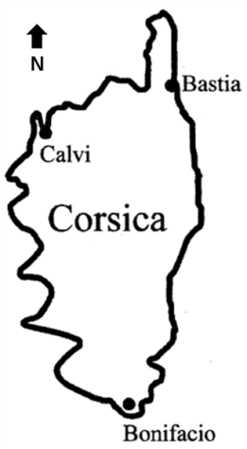
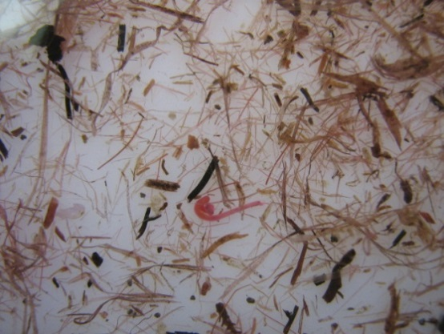
STARECAPMED - Macrobenthos
Development of a method of coloration-decoloration (eosin) for sample with seagrass fibers.
J’MAMBI: ponderation of the M-AMBI by the equitability value, the Pielou index (J’), calculated for each assemblage
Canari abestos mine (flickr.com)
Diversity
Richness
Abestos mine
Good
Medium
Good
Good

Slide 22
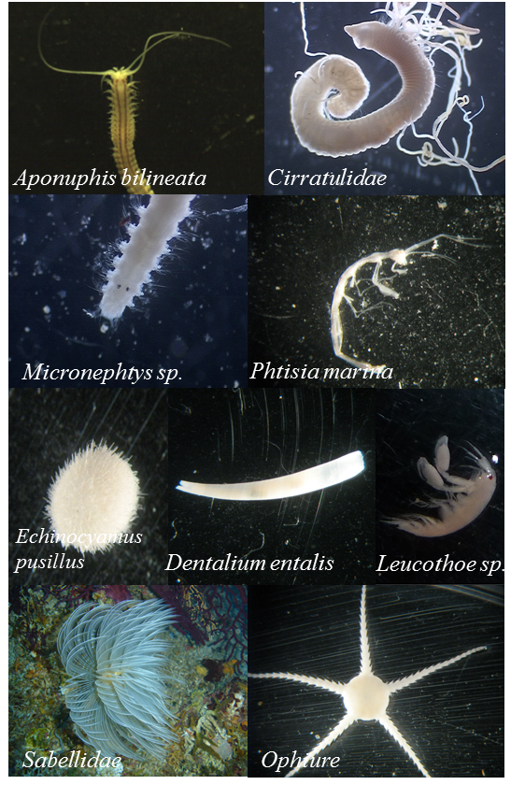
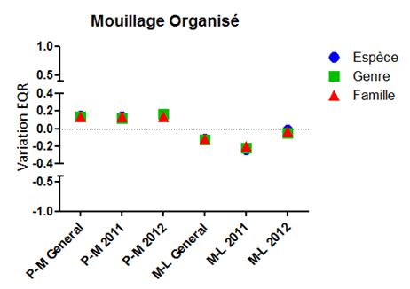
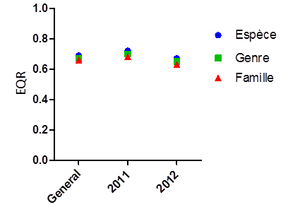
STARECAPMED - Macrobenthos
Soft bottom macrobenthos
Sampled stations
Summer organized mooring site EQR
Species
Gender
Familly
Calvi bay mean EQR
Species
Gender
Familly

Slide 23

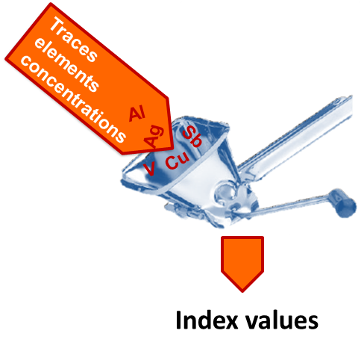
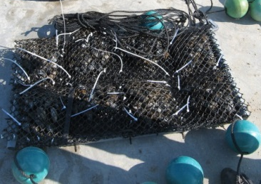
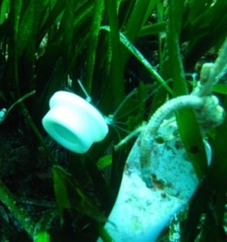
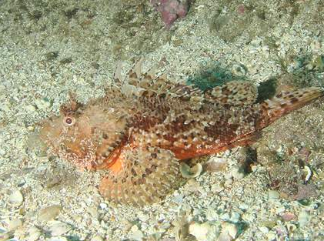
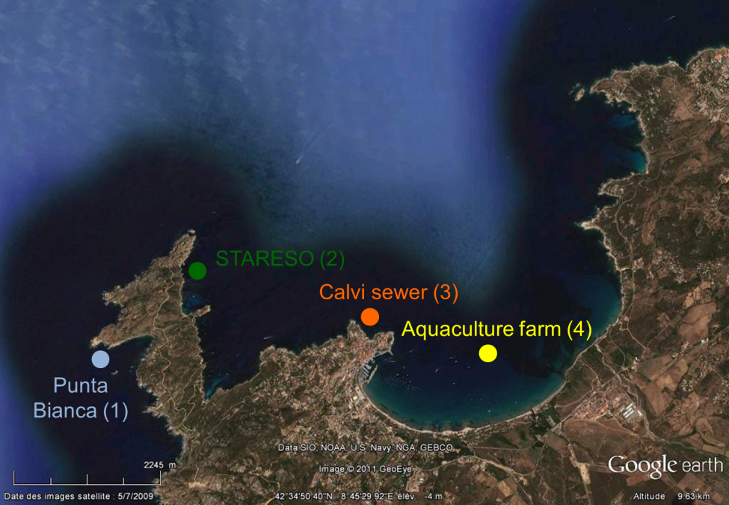
STARECAPMED - Ecotoxicology
Trace Element
Pollution Index:
TEPI =
(Cf₁ * Cf₂ … Cf_{n})^{1/n}

Slide 24
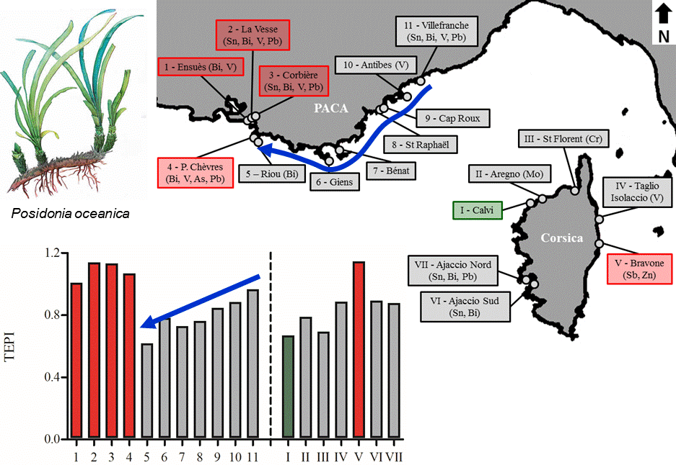
STARECAPMED - Ecotoxicology

Slide 25
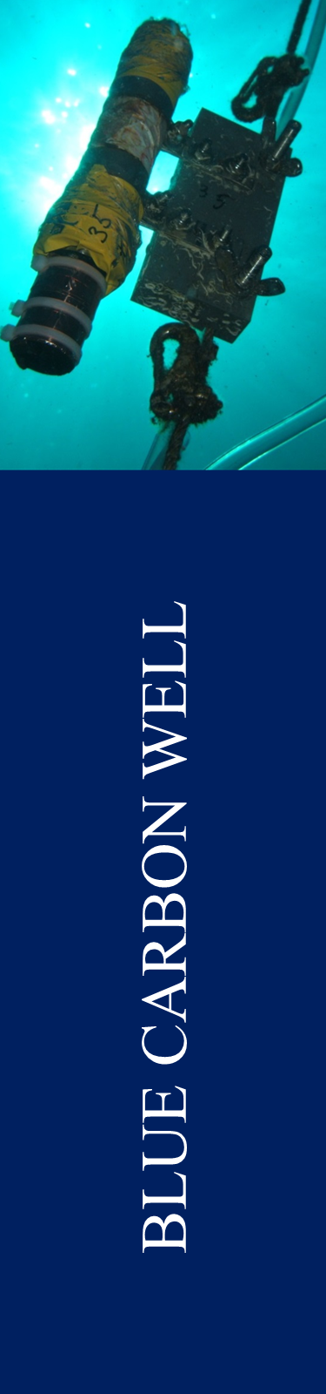
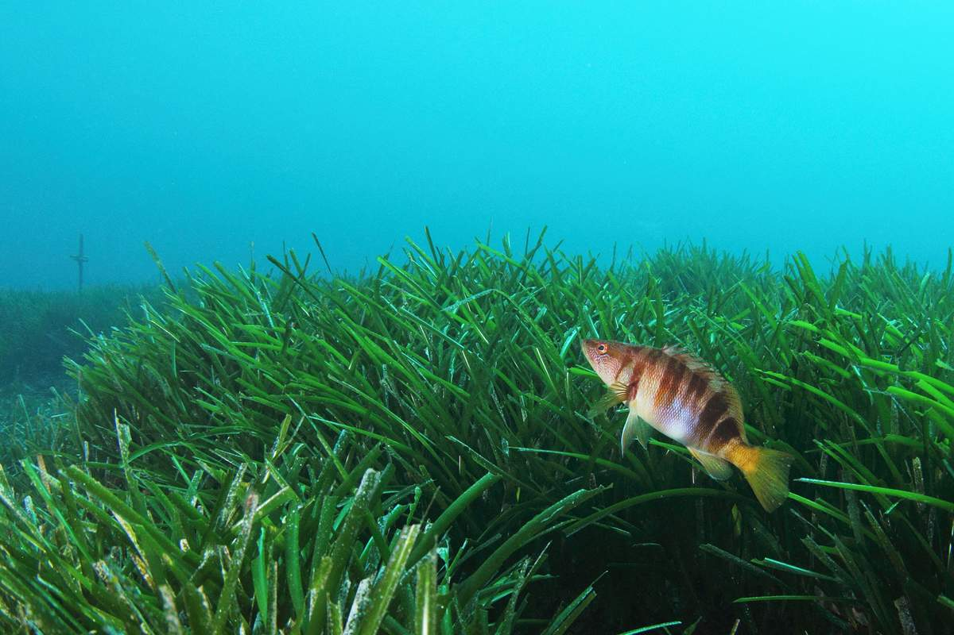
STARECAPMED - Blue carbon well
Rock
Sand
Sand + mud
Mooring

Slide 26
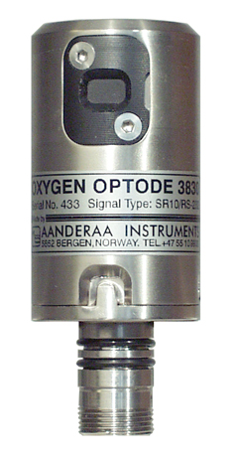
STARECAPMED - Blue carbon well
Temperature (°C)
PPB (nmol O₂ m⁻² d⁻¹)

Slide 27
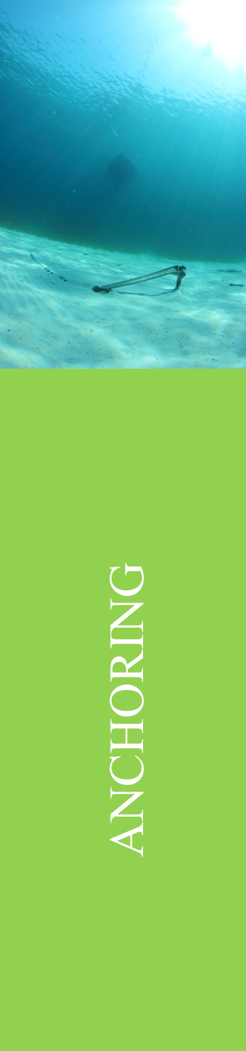
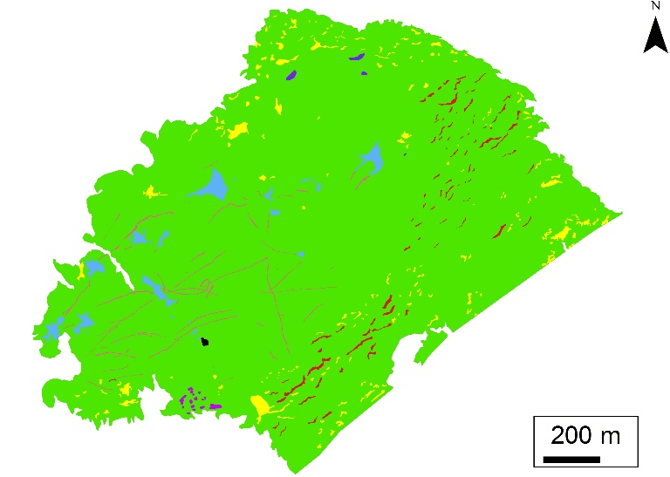
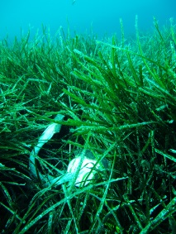
STARECAPMED - Anchoring
Continuous meadow (matrix)
PaSI value
Color code
Patchiness Source Index (PaSI): to assess the origin (natural or induced by human activities) of the patches in P. oceanica meadows, identified with the use of side scan sonar and from the resulting mapping.
Heterogeneous meadow (patches)
Patches of different origins
Patches of different types

Slide 28
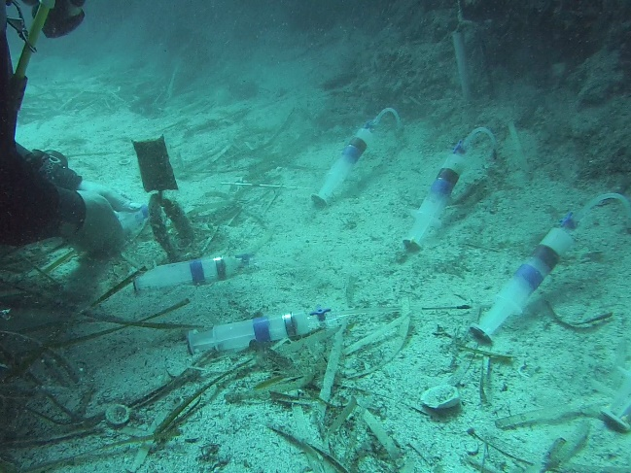
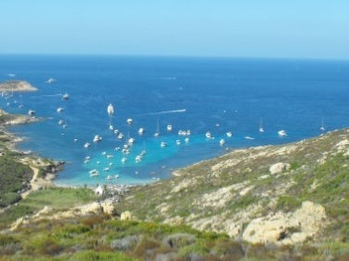
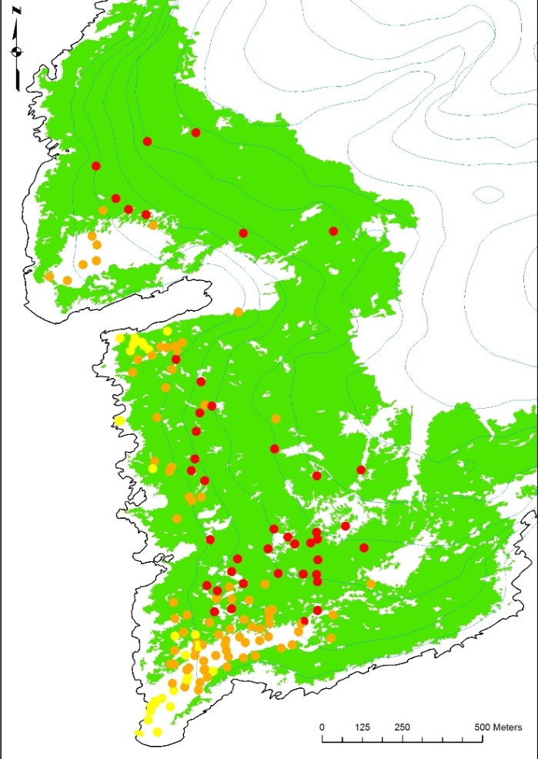
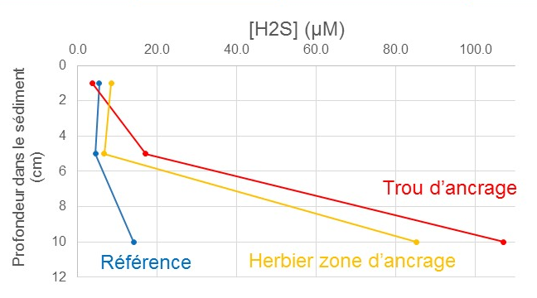
STARECAPMED - Anchoring
Sediment depth (cm)
Anchoring patch
Reference
Meadow in anchoring area
GPS localisation of boats in the Alga bay (yellow: < 10m; orange: 10-20m; red: > 20m). Data are for a two days frequentation period during the summer season.

Slide 29
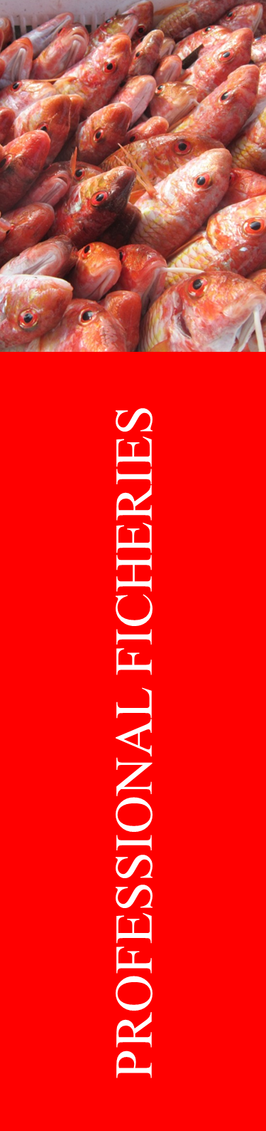
STARECAPMED - Fisheries
Fishing activity intensity estimation (50m net unit by km²) for lobster (left) and fish (right) nets in the area of Calvi.

Slide 30
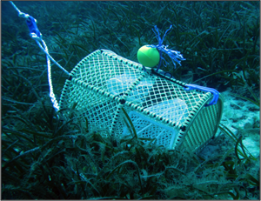

STARECAPMED - Fisheries
Nbr. ind. / E
Nbr. ind. / E
Males
Females
Males
Females
Nbr. ind. / E
Nbr. ind. / E
Males
Females
Males
Females

Slide 31


STARECAPMED - Recruitment

Slide 32







STARECAPMED - Recruitment

Slide 33




STARECAPMED - Reserve
Sciana umbra
Permanent transects vs. FAST index: modifications of the FAST index are under study to adapt it to situations with low reserve effect.
FAST: average index
FAST: prop. large size individuals
FAST: cumulated index
Sum.12 (S+D)
Sum.13 (S+D)
Sum.12 (S+D)
Sum.13 (S+D)
Sum.12 (S+D)
Sum.13 (S+D)

Slide 34
STARECAPMED - Reserve
Diplodus Symphodus Index (all size classes)
Target species mean biomass
g/1000m²
±SD
±SE
Mean
±SD
±SE
Mean
Target species – Density deviation (annual mean) between protected and unprotected zones, for each depth
?
?

Slide 35







DATABASE RACE

Slide 36
STARECAPMED - Examples

Slide 37
- To study the fundamental processes operating in bay of Calvi.
- To understand the influence of anthropogenic
factors on these processes.
CO₂
Meteorological forcings
Population
Pleasance
Rivers
Aquaculture
Hydrological forcings
OPEN
SEA
WATERS
PO₄³⁻
SiO₄⁴⁻
NO₃⁻
NO₂⁻
NH₄⁺
Phytoplancton
Nutrients
Zooplancton
Scuba diving
CO₂
Ichthyofauna
Sewage outfalls
Hard substrates
Caulerpa racemosa
P. oceanica meadows
Soft bottom

Slide 38


anchoring - P. oceanica - C. racemosa - landscape - fish recruitment and fisheries - macroalgae - macrobenthos - ecotoxicology - blue carbon well
➔ Essential to apply an integrative approach such as the one developed in the framework of STARECAPMED

Slide 39


Slide 40
Many thanks for
your attention
J. Richir, A. Abadie, M. Binard, R. Biondo, P. Boissery, A.V. Borges, W. Champenois, N. Cimiterra, A. Collignon,
Donnay, C. Fréjefond, A. Goffart,
J.-H. Hecq, P. Lejeune, G. Lepoint,
L. Michel, C. Pelaprat,
Pere, D. Sirjacobs,
J.-P. Thomé,
Volpon and
S. Gobert
Qingdao,
11-08-15
Arnaud Abadie

