Slide 1
Hydro-mechanical analysis of the fracturing induced by
the excavation of nuclear waste repository galleries
using shear banding
Public defence of doctoral thesis in Engineering Sciences by
Benoît Pardoen
Supervisor: Frédéric Collin
November 2015

Slide 2
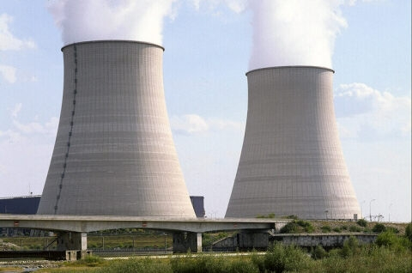
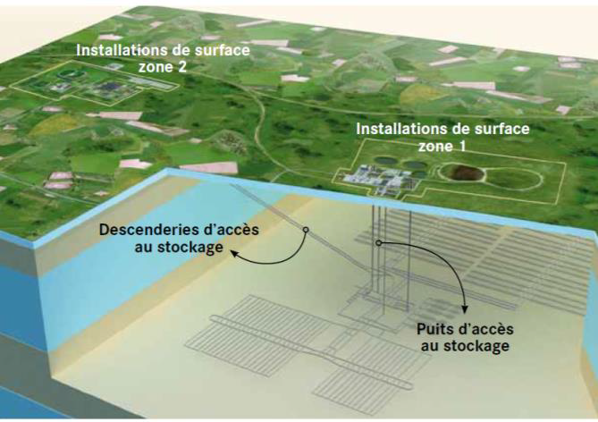
Context
Long-term management of radioactive wastes
Underground structures
= network of galleries
Deep geological disposal
Repository in deep geological media with good confining properties
(Low permeability
K<10⁻¹² m/s)
Intermediate (long-lived)
&
high activity wastes
Disposal facility of Cigéo project in France
(Labalette et al., 2013)
Context | Fracture modelling | Anisotropy | Water transfer | Conclusion | 2

Slide 3
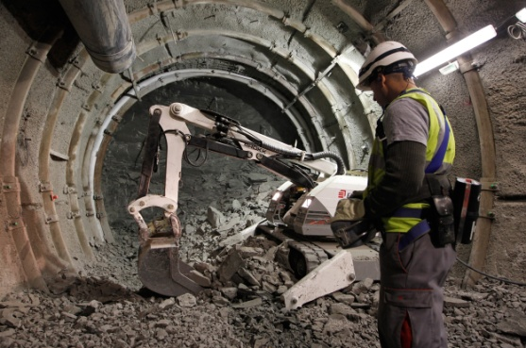
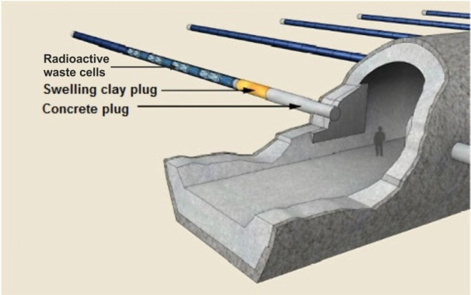
Context
Repository phases
Construction
 | Excavation
Maintenance
 | Ventilation
Repository
 | Sealing
Long term
 | Corrosion, heat generation
Time
Type C wastes (Andra, 2005)
Context | Fracture modelling | Anisotropy | Water transfer | Conclusion | 3

Slide 4
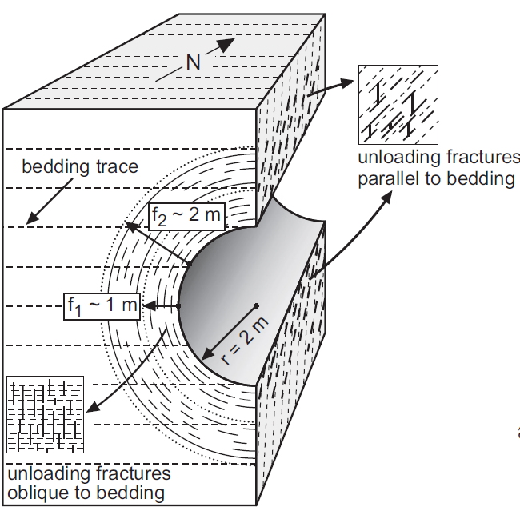
Context
Excavation Damaged Zone (EDZ)
Construction
Maintenance
Mechanical fracturing
Excavation
↓
Stress redistribution
↓
Damage / Fracturing
↓
Coupled processes HM property modifications
↓
Safety function alteration
Water transfer
Galleries ventilation
↓
Air-rock interaction
↓
Drainage / desaturation
↓
Modification of the water transfer
Fracturing & permeability increase
(several orders of magnitude)
Opalinus clay in Switzerland
(Bossart et al., 2002)
Context | Fracture modelling | Anisotropy | Water transfer | Conclusion | 4

Slide 5
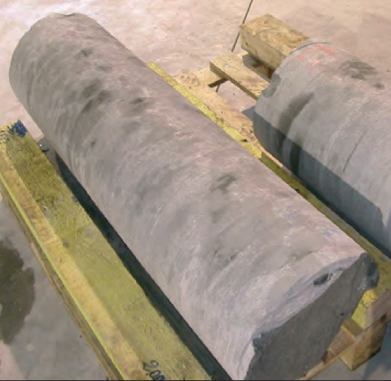
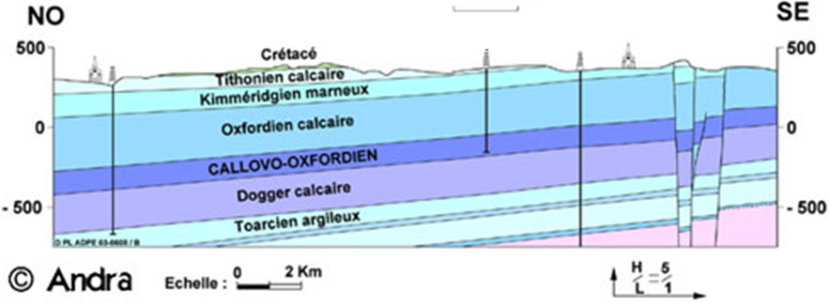
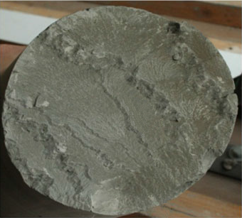
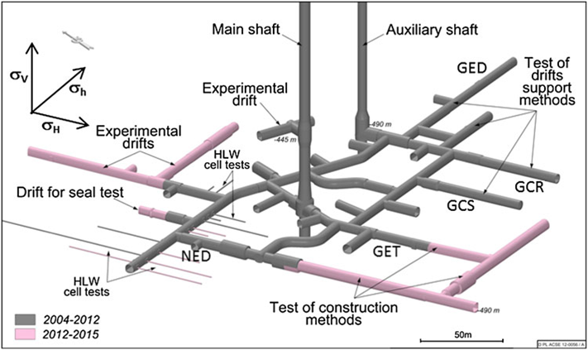
Context
Callovo-Oxfordian claystone (COx)
Sedimentary clay rock (France).
- Underground research laboratory
Feasibility of a safe repository
France (Meuse / Haute-Marne, Bure)
Borehole core samples
(Andra, 2005)
(Armand et al., 2014)
Context | Fracture modelling | Anisotropy | Water transfer | Conclusion | 5

Slide 6
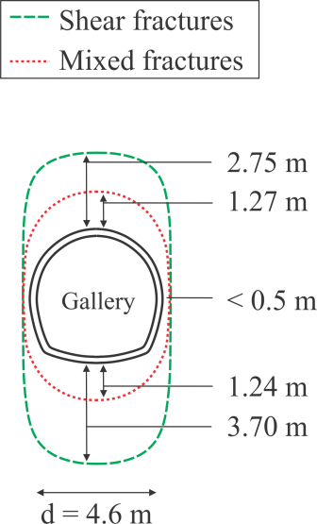
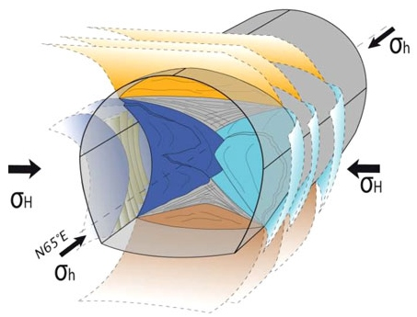
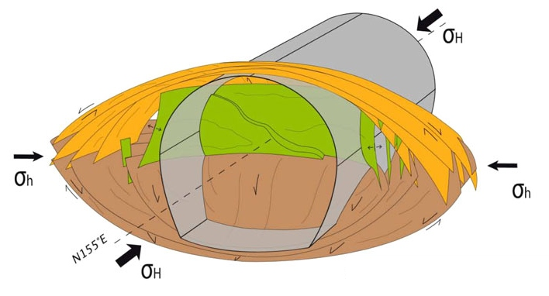
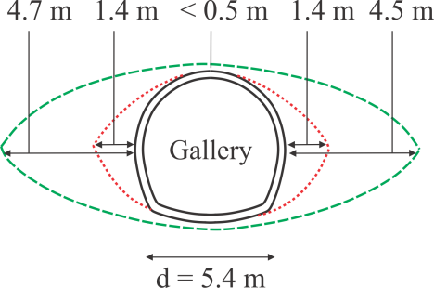
Context
- Fracturing
Anisotropies: - stress : σ_{H} > σ_{h} ~ σ_{v}
- material : HM cross-anisotropy.
Galery // to σ_{h}
Galery // to σ_{H}
Issues : Prediction of the fracturing.
Effect of anisotropies ?
Permeability evolution & relation to fractures ?
(Armand et al., 2014)
Context | Fracture modelling | Anisotropy | Water transfer | Conclusion | 6

Slide 7
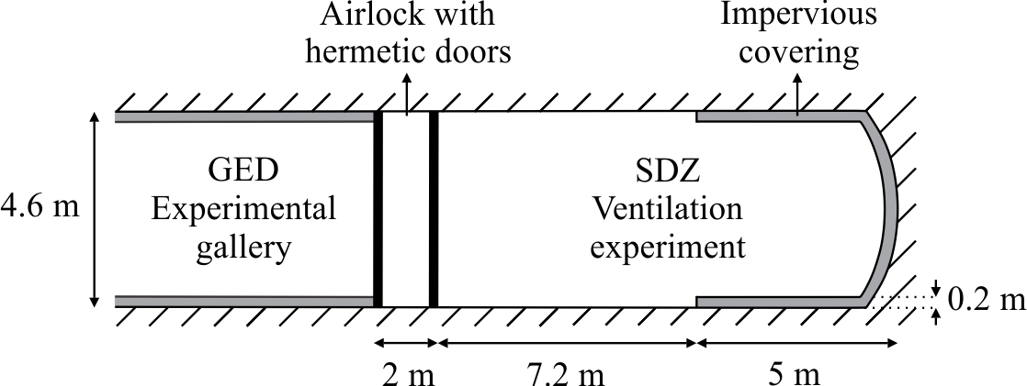
Context
- Air-rock interaction
Large-scale ventilation experiment (SDZ).
Characterise the effect of gallery ventilation on the hydraulic transfer.
Issues: Drainage / desaturation reproduction.
Context | Fracture modelling | Anisotropy | Water transfer | Conclusion | 7

Slide 8
Context
Objectives
Better understand, predict, and model the behaviour of the
EDZ in partially saturated clay rock, at large scale.
Fracture description
Fracturing process.
EDZ development.
Constitutive models
Mechanics:
Anisotropic behaviour.
Influence on fracturing.
Coupled:
Hydro-mechanical coupling
(fractures – hydraulic transfer)
Numerical modelling
Finite element method.
Reproduction of fractures
and EDZ in rock.
Influence of fracturing on water transfer around galleries.
Context | Fracture modelling | Anisotropy | Water transfer | Conclusion | 8

Slide 9
Outline
Context
Fracture modelling with shear bands
Influence of mechanical anisotropy
Permeability evolution and water transfer
Conclusions and perspectives
Context
Fracture modelling with shear bands
Influence of mechanical anisotropy
Permeability evolution and water transfer
Conclusions and perspectives
Context | Fracture modelling | Anisotropy | Water transfer | Conclusion | 9

Slide 10
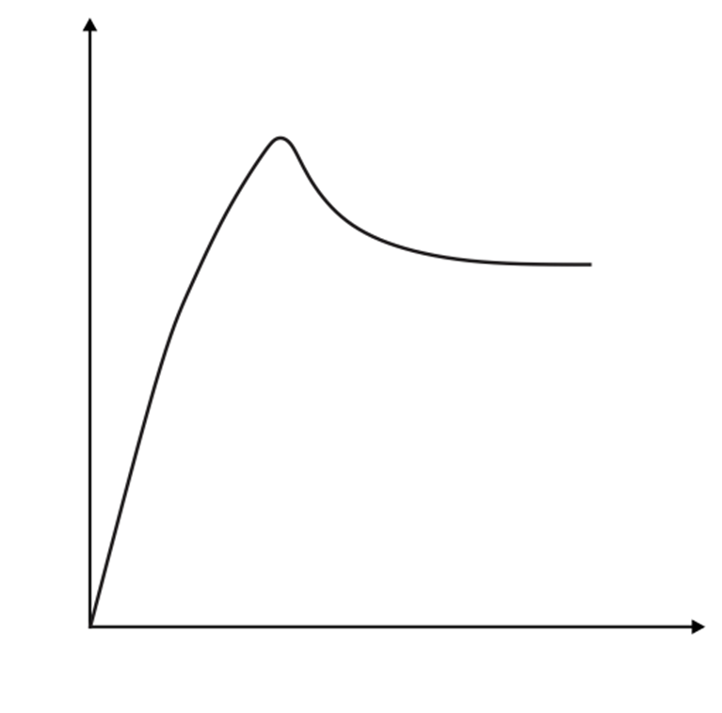
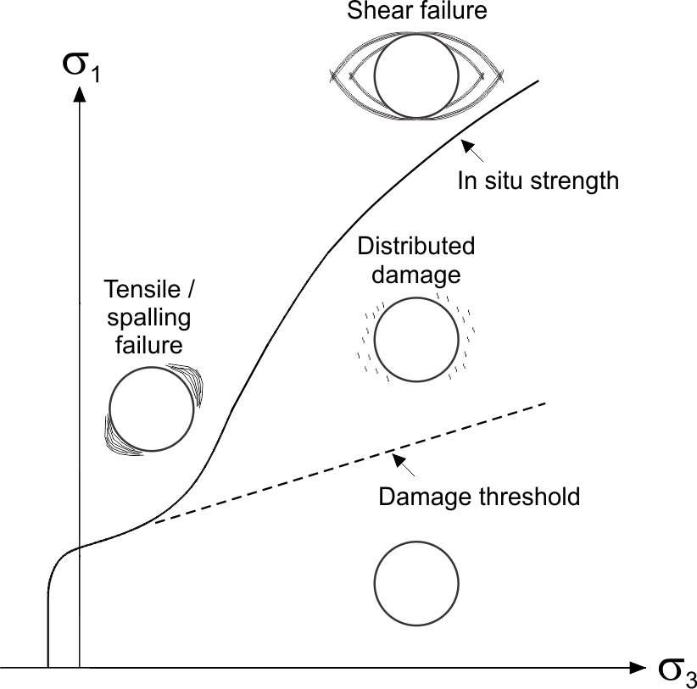
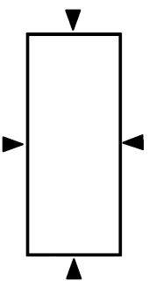
Fracture modelling with shear bands
2.1. Material rupture
- Compression test on small sample
Elasticity – No damage
Microcraks – Distributed damage
Coalescence – Localised strain
Fracture
- Fracture modelling
Shear strain localisation
(continuous approach)
- Mechanisms of rock mass failure around gallery
Axial load, F [N]
F
F_{conf}
H
Axial shortening, ΔH [mm]
(after Diederichs, 2003)
Shear bands are observed
in many geomaterials.
COx : 75% of fractures
in mode II (shear).
Context | Fracture modelling | Anisotropy | Water transfer | Conclusion | 10

Slide 11
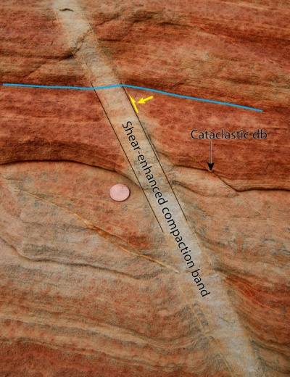
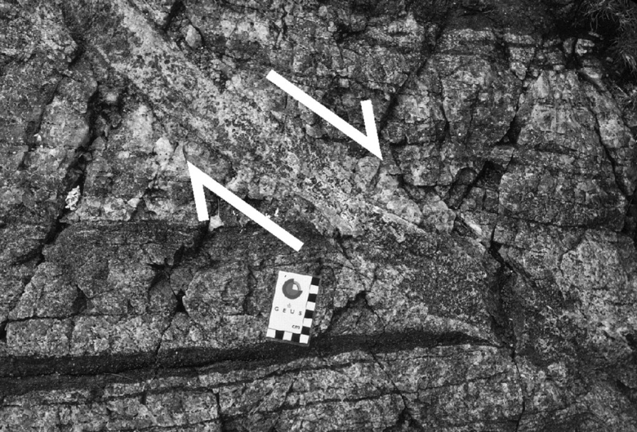
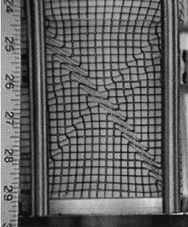
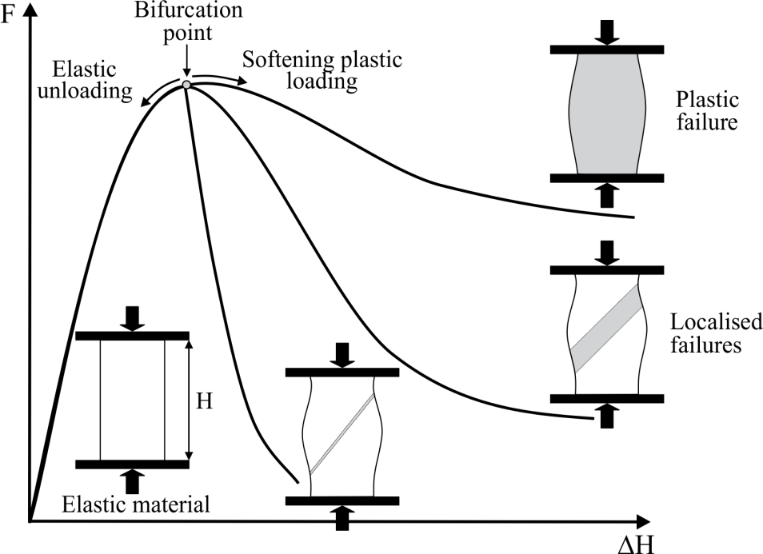
Fracture modelling with shear bands
2.2. Shear strain localisation
Brutal concentration of strain in narrow zones
2.2.1. Bifurcation theory
Loss of uniqueness of
localised solutions
Post-peak behaviour related
to strain localisation
Sand
(Alshibli et al.,
2003)
Sandstones, Muddy Mountains,
Nevada (H. Fossen, 2010)
Ductile shear in quartz and pyroxene
(Christopher et al., 2006)
Context | Fracture modelling | Anisotropy | Water transfer | Conclusion | 11

Slide 12
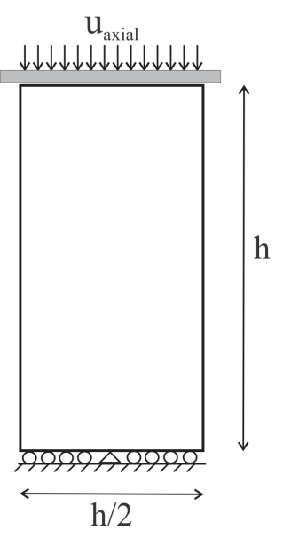
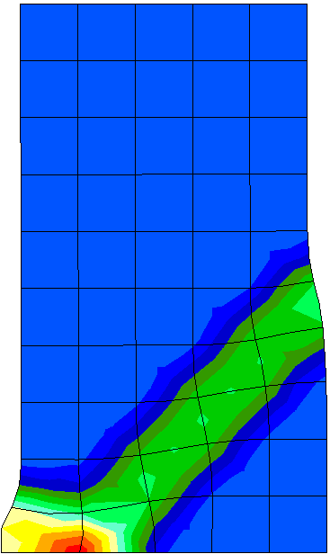
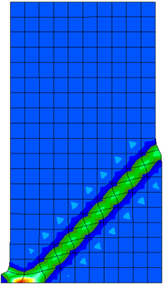
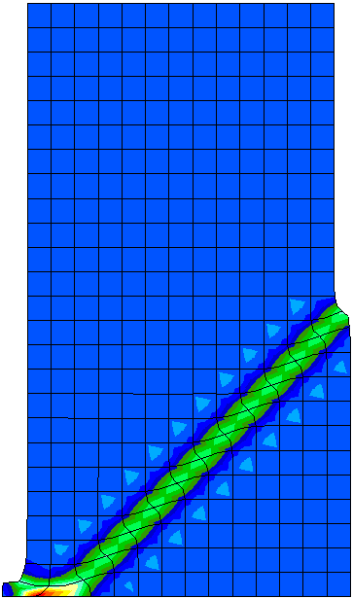
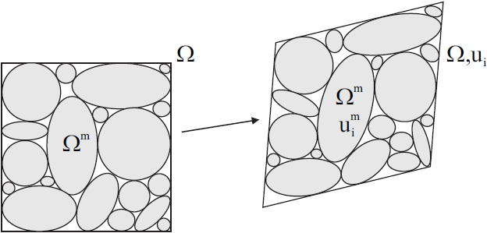
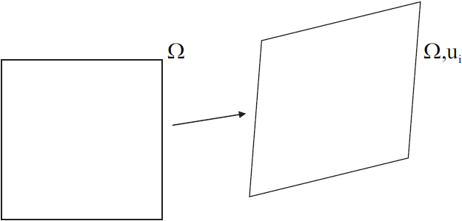
Fracture modelling with shear bands
Equivalent total
deviatoric strain
2.2.2. Finite element methods
- Classical FE
Mesh dependency
Need to introduce an internal length
scale for a correct modelling of the
post-peak behaviour.
- Regularisation
Enrichment of the kinematics :
The continuum is enriched with microstructure effects.
Macro-kinematics + micro-kinematics
Macro Ω:
Micro Ω^{m}:
Context | Fracture modelling | Anisotropy | Water transfer | Conclusion | 12

Slide 13
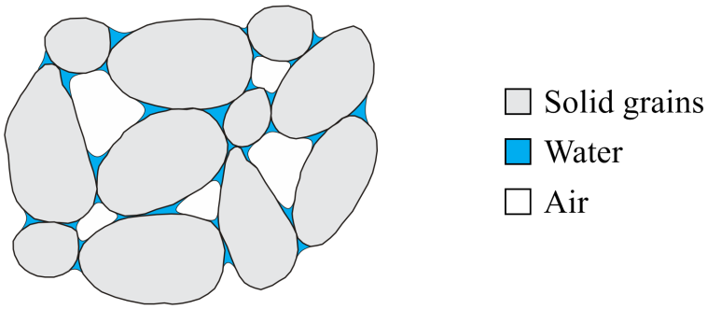
Fracture modelling with shear bands
2.2.3. Coupled local second gradient model
- Balance equations
Porous media, biphasic : solid + fluid (Collin et al., 2006)
Unsaturated condition + compressibility of the solid grains (Pardoen et al., 2015)
Balance equations :
Unsaturated Biot’s effective stress :
Solid grain compressibility :
Microstructure
effects
Kinematic
restriction
Context | Fracture modelling | Anisotropy | Water transfer | Conclusion | 13

Slide 14
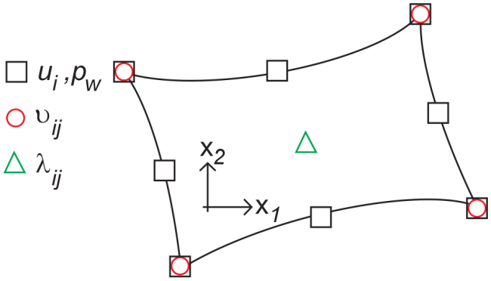
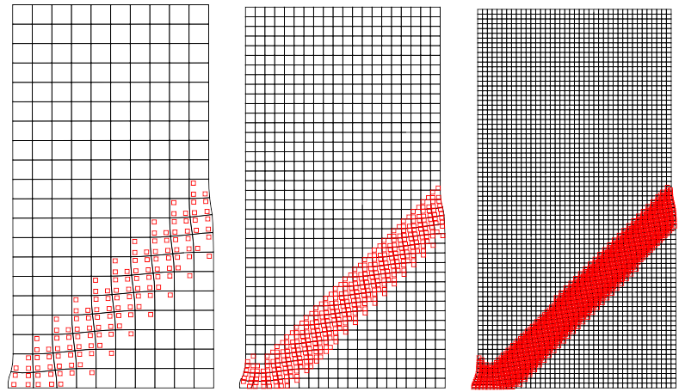
Fracture modelling with shear bands
- Finite elements
Quadrilateral 2D plane-strain
8 nodes for u_{i} and p_{w}
4 nodes for the microkinematic gradient field υ_{ij}
1 node for the Lagrange multiplier field λ_{ij}
- Second gradient mechanical law
The double stress Σ_{ijk} requires a constitutive law.
Linear elastic law function of the (micro) second
gradient of displacement field.
Internal length scale
D represents the physical
microstructure
7 d.o.f.
Unknown
fields
Plasticity
Context | Fracture modelling | Anisotropy | Water transfer | Conclusion | 14

Slide 15
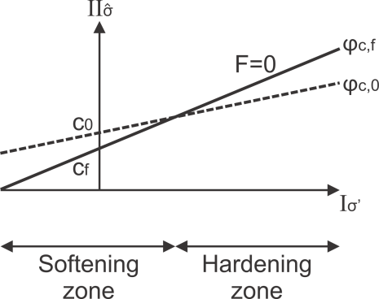
Fracture modelling with shear bands
2.3. Constitutive models for COx
- Mechanical law - 1st gradient model
Isotropic elasto-plastic internal friction model
Non-associated plasticity, Van Eeckelen yield surface :
φ hardening / c softening
- Hydraulic law
Fluid mass flow (advection, Darcy) :
Water retention and permeability curves (Mualem - Van Genuchten’s model)
Strain localisation
Context | Fracture modelling | Anisotropy | Water transfer | Conclusion | 15

Slide 16
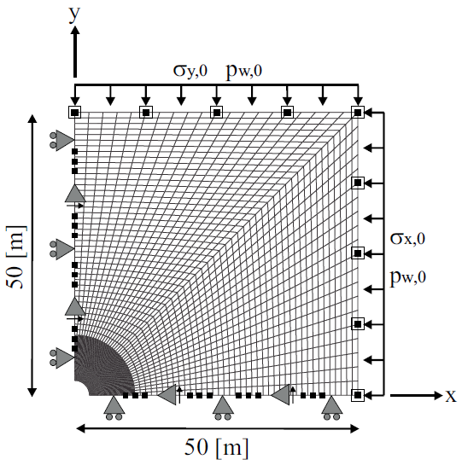
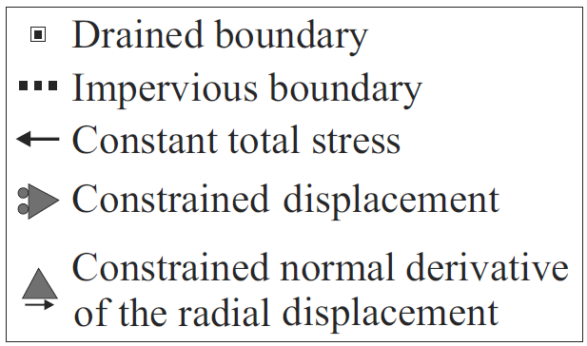
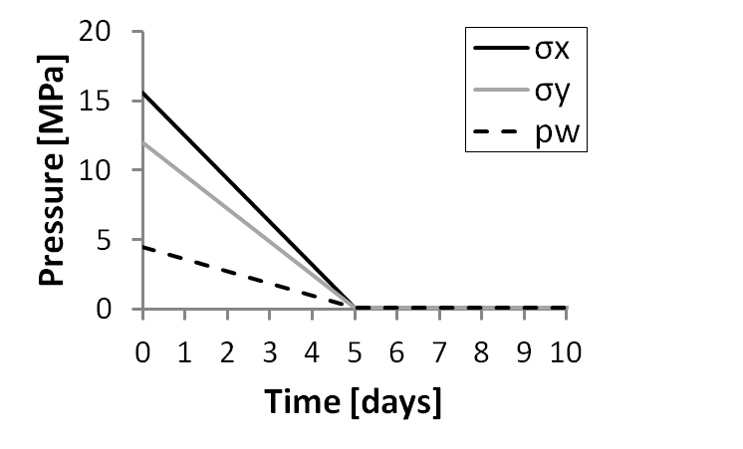
Fracture modelling with shear bands
σ_{v}
2.4. Gallery excavation modelling
- Numerical model
HM modelling in 2D
plane strain state
Gallery radius = 2.3 m
- Gallery in COx // σ_{h}
Effect of stress anisotropy
Anisotropic stress state
p_{w,0} = 4.5 [MPa]
σ_{x,0} = σ_{H} = 1.3 σ_{v} = 15.6 [MPa]
σ_{y,0} = σ_{v} = 12 [MPa]
σ_{z,0} = σ_{h} = 12 [MPa]
σ_{H}
- Excavation
Context | Fracture modelling | Anisotropy | Water transfer | Conclusion | 16

Slide 17
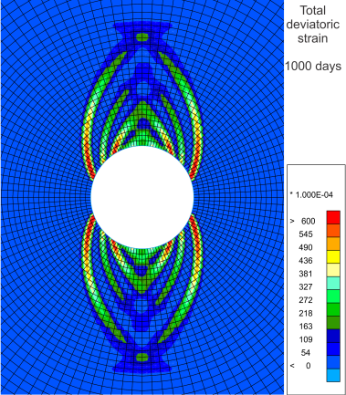
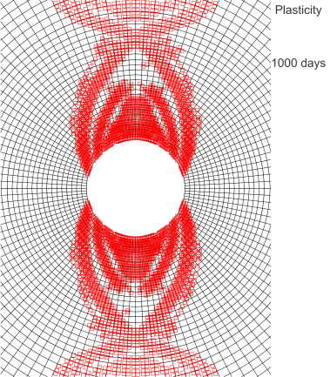
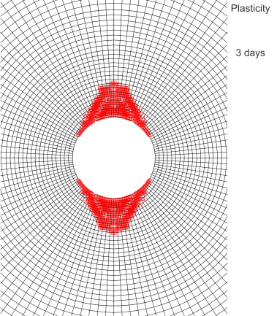
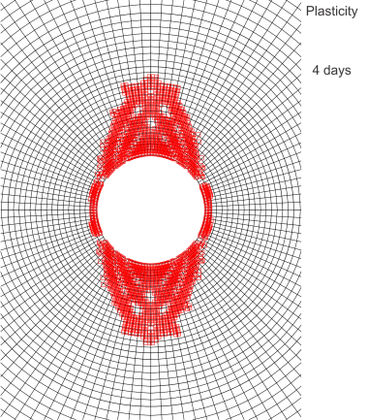
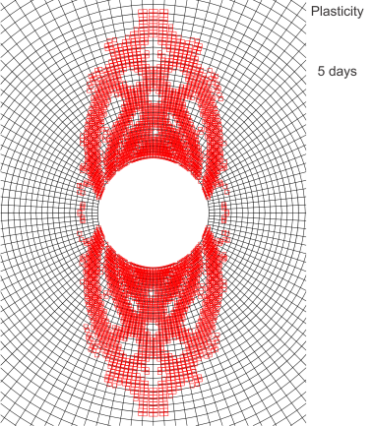
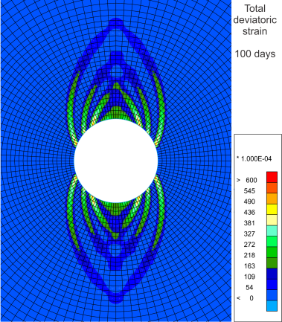
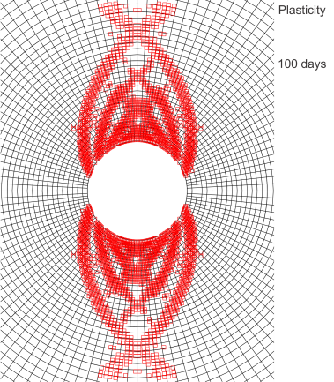
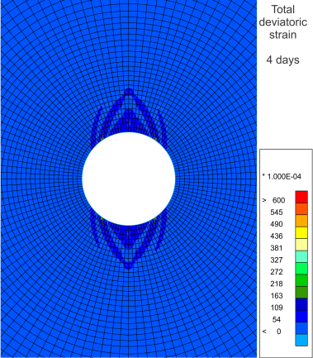
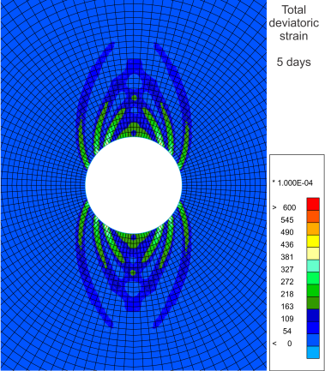
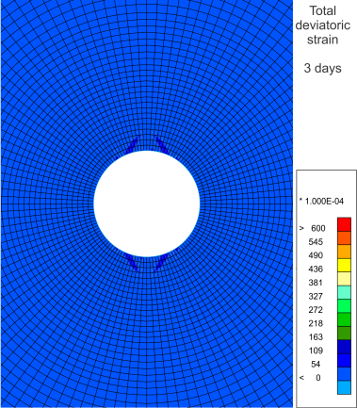
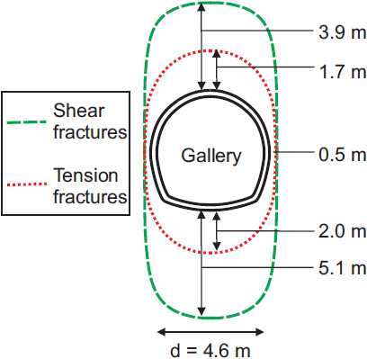
Fracture modelling with shear bands
- Localisation zone
Incompressible solid grains, b=1
→ For an isotropic mechanical behaviour, the appearance and shape of the strain localisation are
mainly due to mechanical effects linked to the anisotropic stress state.
Total deviatoric strain
Plasticity
4.6 m
1000 days
σ/σ₀ = 0.00
100 days
σ/σ₀ = 0.00
5 days
σ_{r}/σ_{r,0} = 0.0
4 days
σ_{r}/σ_{r,0} = 0.2
3 days
σ_{r}/σ_{r,0} = 0.4
0.5 m
End of
excavation
0
0.06
Context | Fracture modelling | Anisotropy | Water transfer | Conclusion | 17

Slide 18
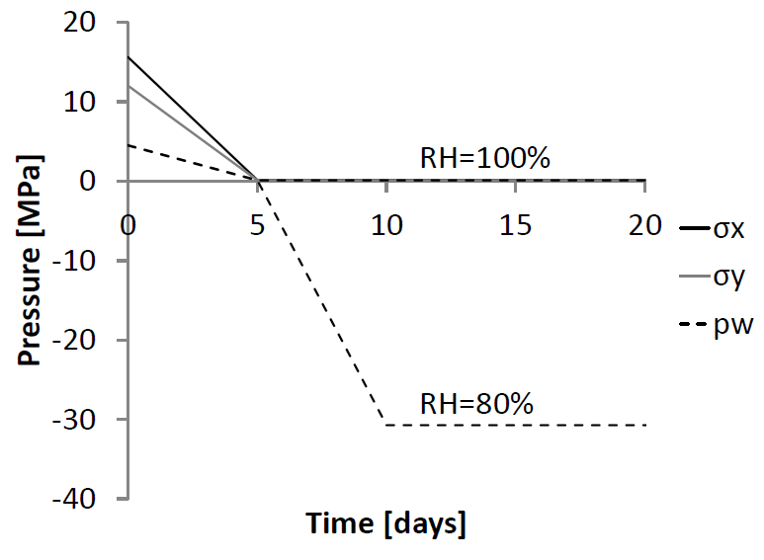
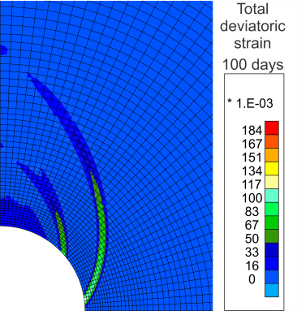
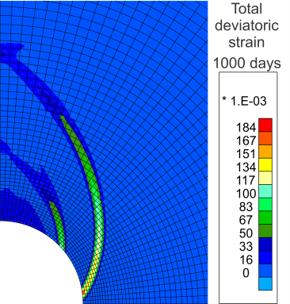
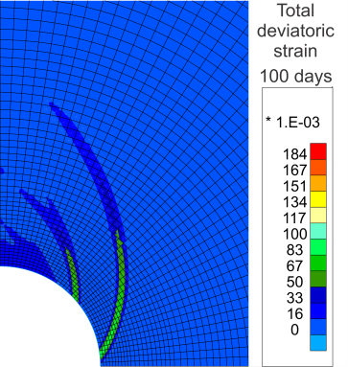
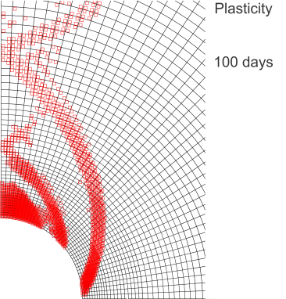
Fracture modelling with shear bands
- Gallery air ventilation :
Water phases equilibrium at gallery wall (Kelvin's law)
Compressibility of the solid grains: b=0.6
No ventilation
p_{w} = p_{atm} [MPa]
Ventilation
p_{w} = -30.7 [MPa]
No ventilation
100 days | 1000 days
Ventilation
100 days | 1000 days
Total deviatoric strain
suction ↑
σ’ ↑
Elastic unloading
Inhibition of localisation
→ Restrain ε
0
0.184
Plasticity
Context | Fracture modelling | Anisotropy | Water transfer | Conclusion | 18

Slide 19
Fracture modelling with shear bands
- Convergence:
Important during the excavation
Anisotropic convergence
Influence of the ventilation
Experimental results (GED - Andra’s URL)
No strain localisation
Calcul with large D or no loc SDZ? If large D ça rigidifie un peu
Shear band position
Shear bands are necessary for anisotropy
Context | Fracture modelling | Anisotropy | Water transfer | Conclusion | 19

Slide 20
Fracture modelling with shear bands
2.5. Conclusions and outlooks
- Conclusions
Reproduction of EDZ with shear bands.
Shape and extent of EDZ governed by anisotropic stress state.
- Next steps …
X Mechanical rock behaviour.
→ Material anisotropy, gallery // σ_{H} .
X HM coupling in EDZ.
→ Influence of fracturing on hydraulic properties.
X Gallery air ventilation and water transfer (drainage / desaturation).
Context | Fracture modelling | Anisotropy | Water transfer | Conclusion | 20

Slide 21
Outline
Context
Fracture modelling with shear bands
Influence of mechanical anisotropy
Permeability evolution and water transfer
Conclusions and perspectives
Context | Fracture modelling | Anisotropy | Water transfer | Conclusion | 21

Slide 22
Influence of mechanical anisotropy
Zion National Park – Utah
3.1. Anisotropic mechanical behaviour
Sedimentary rocks with bedding planes …
→ Cross-anisotropy
Behaviour depends on:
- the microstructure
- the loading direction
riosuerte.com
S. Smith, pbase.com
Context | Fracture modelling | Anisotropy | Water transfer | Conclusion | 22

Slide 23
Influence of mechanical anisotropy
- Linear elasticity :
Cross-anisotropic (5 param.) + Biot’s coefficients
- Plasticity :
Cohesion anisotropy with fabric tensor
Cross-anisotropy
Context | Fracture modelling | Anisotropy | Water transfer | Conclusion | 23

Slide 24
Influence of mechanical anisotropy
3.3. Gallery excavation modelling for isotropic initial stress state
Effect of material anisotropy
Isotropic stress state
σ =12 MPa
- Anisotropy effect on strain localisation
Localisation at the end of excavation
Increase of anisotropy
→ For isotropic stress state, strain localisation is triggered
if a sufficient material anisotropy is considered.
Context | Fracture modelling | Anisotropy | Water transfer | Conclusion | 24

Slide 25
Influence of mechanical anisotropy
- Cohesion evolution
Anisotropy:
Initially : isotropic σ_{ij} →
Excavation : σ_{r} ↓ and σ_{ort} ↑
t = 15.4 days | t = 16.8 days | t = 21 days | t = 21 days
Context | Fracture modelling | Anisotropy | Water transfer | Conclusion | 25

Slide 26
Influence of mechanical anisotropy
3.3. Gallery excavation modelling for anisotropic initial stress state
- Stress state
Major stress in the axial direction σ_{x,0} = σ_{h} = 12.40 MPa
Gallery // to σ_{H} σ_{y,0} = σ_{v} = 12.70 MPa
σ_{z,0} = σ_{H} = 1.3 x σ_{h} = 16.12 MPa
- Shear banding
Total deviatoric strain
→ Shape modification due to σ_{H}
4.5m
- Convergence
→ Long-term deformation
Experimental
Numerical
Horizontal
3m
Vertical
0
0.05
→ Creep deformation
Context | Fracture modelling | Anisotropy | Water transfer | Conclusion | 26

Slide 27
Influence of mechanical anisotropy
- Creep deformation
Permanent strain
In the long term
Under constant stress
below the yield strength
- Viscosity
Time-dependent plastic strain
(Jia et al., 2008; Zhou et al. 2008)
σ₁
σ₃
- Convergence
→ Viscosity
effect
Horizontal
Vertical
Context | Fracture modelling | Anisotropy | Water transfer | Conclusion | 27

Slide 28
Influence of mechanical anisotropy
3.4. Conclusions and outlooks
- Conclusions
Reproduction of EDZ in both directions.
Shape and extent of EDZ governed by:
- anisotropic stress state.
- anisotropic mechanical behaviour.
Long-term convergence with viscosity.
- Next steps …
X HM coupling in EDZ.
→ Influence of fracturing on hydraulic properties.
X Gallery air ventilation and water transfer.
GED
// σ_{h}
GCS
// σ_{H}
Context | Fracture modelling | Anisotropy | Water transfer | Conclusion | 28

Slide 29
Outline
Context
Fracture modelling with shear bands
Influence of mechanical anisotropy
Permeability evolution and water transfer
Conclusions and perspectives
Context | Fracture modelling | Anisotropy | Water transfer | Conclusion | 29

Slide 30
Permeability evolution and water transfer
4.1. Large-scale experiment of gallery ventilation (SDZ)
Characterise the effect of gallery ventilation
on the hydraulic transfer around it.
→ drainage / desaturation
→ exchange at gallery wall
Context | Fracture modelling | Anisotropy | Water transfer | Conclusion | 30

Slide 31
Permeability evolution and water transfer
4.2. Permeability variation in fractured zone
HM coupling in the EDZ.
4.2.1. Saturated permeability in boreholes
Fracture and rock matrix permeabilities
→ Capture k_{w} evolution
→ Relation to fractures
Context | Fracture modelling | Anisotropy | Water transfer | Conclusion | 31

Slide 32
Permeability evolution and water transfer
4.2.2. Evolution of intrinsic water permeability
Various approaches: deformation, damage, cracks…
- Relation to deformation
Volumetric effects = increase of porous space
()(
(Kozeny-Carman)
- Fracture permeability
Cubic law for parallel-plate approach
(Witherspoon 1980; Snow 1969, Olivella and Alonso 2008)
Poiseuille flow (laminar flow)
equivalent Darcy’s media
- Empirical law
Related to strain localisation effect
Permeability variation threshold
Localised deformation
Fracture initiation
Context | Fracture modelling | Anisotropy | Water transfer | Conclusion | 32

Slide 33
Permeability evolution and water transfer
4.3. Hydraulic boundary condition for exchanges at gallery wall
- Classical approach
Instantaneous equilibrium (Kelvin’s law)
- Experimental
Drainage / desaturation → Progressive hydraulic transfer & equilibrium
- Non-classical mixed boundary condition
Liquid water + water vapour
- Seepage flow :
Evaporation flow :
(Nasrallah and Perre, 1988)
S_{r,w} = 1
S_{r,w} < 1
Context | Fracture modelling | Anisotropy | Water transfer | Conclusion | 33

Slide 34
Permeability evolution and water transfer
4.4. Modelling of excavation and SDZ experiment
4.4.1. HM coupling in EDZ
- Gallery excavation
SDZ → GED gallery // σ_{h}
Anisotropic σ_{ij,0} and material
→ Localisation zone dominated
by stress anisotropy
- Intrinsic permeability evolution
Cross-sections
Plastic strain and a part of the elastic one → EDZ extension + k_{w} increase
Plasticity Total deviatoric strain
k_{w,,ij} / k_{w,ij,0} [-]
Context | Fracture modelling | Anisotropy | Water transfer | Conclusion | 34

Slide 35
Permeability evolution and water transfer
4.4.2. Modelling of the SDZ experiment
- Water pressure in the cavity air
p_{w} (suction) corresponding
to RH and T (Kelvin’s law).
Imposed at gallery wall through hydraulic boundary condition.
Excavation (RH=100%) → Initiation phase → Ventilation
Context | Fracture modelling | Anisotropy | Water transfer | Conclusion | 35

Slide 36
Permeability evolution and water transfer
- Drainage / p_{w} reproduction
Oblique 45° Horizontal
Experimental
Numerical
α_{v} = 10⁻³ m/s
Context | Fracture modelling | Anisotropy | Water transfer | Conclusion | 36

Slide 37
Permeability evolution and water transfer
- Desaturation EDZ / w reproduction
Horizontal boreholes
→ Desaturation: overestimation in long term
→ Vapour transfer (α_{v} = 10⁻³ m/s)
At gallery wall
→ Good reproduction at gallery wall
Context | Fracture modelling | Anisotropy | Water transfer | Conclusion | 37

Slide 38
Permeability evolution and water transfers
- Exchanges at gallery wall
Flows:
Water pressure in cavity:
→ Transfer depends on α_{v}
Context | Fracture modelling | Anisotropy | Water transfer | Conclusion | 38

Slide 39
Outline
Context
Fracture modelling with shear bands
Influence of mechanical anisotropy
Permeability evolution and water transfer
Conclusions and perspectives
Context | Fracture modelling | Anisotropy | Water transfer | Conclusion | 39

Slide 40
Conclusions and perspectives
Conclusions
Better understand, predict, and model
the behaviour of the EDZ in partially
saturated clay rock, at large scale.
Contribution : Provide new elements for the prediction and understanding of the HM behaviour of the EDZ.
Innovations : Fracturing process is predicted on a large scale with shear bands.
Strain localisation effects are taken into account in coupled processes (water flow).
Numerical modelling
Shape, extent.
Influence of fracturing, permeability variation, anisotropy.
Water transfer.
Constitutive models
Mechanics: anisotropy, viscosity.
Coupled: fracture influence on permeability.
Fracture description
EDZ with strain localisation.
Context | Fracture modelling | Anisotropy | Water transfer | Conclusion | 40

Slide 41
Conclusion and perspectives
Perspectives
.
Constitutive models
Mechanics:
- Extension criterion.
Coupled:
- Influence of drying on fracturing.
- Permeability in tensile cracks.
Fracture description
Tensile fracture (mode I).
Shrinkage / dessication cracks.
Fracture closing,
sealing / healing.
Numerical modelling
3D modelling with regularisation method.
Extend to other materials and applications.
(Ta, 2009)
Context | Fracture modelling | Anisotropy | Water transfer | Conclusion | 41

Slide 43
APPENDICES

Slide 44
Gallery excavation in 3D
- Fracturation = 3D problem
Fractures pattern around
a gallery in Boom clay
- Mesh:
Mechanical modelling in 3D state.
Classical FE, no regularisation method.
y
12 m
z
x
12 m
R: 2.3 m
5 m
y
x
z
5 m
 |  |  |  |  | 44

Slide 45
Gallery excavation in 3D
- Localisation zone:
Equivalent deformation ε_{eq} during boring.
3 days | 3.25 days | 3.5 days
σ/σ₀ = 0.40 | σ/σ₀ = 0.35 | σ/σ₀ = 0.30
y
z
x
3.75 days | 4 days | 4.25 days
σ/σ₀ = 0.25 | σ/σ₀ = 0.20 | σ/σ₀ = 0.15
0
0.025
 |  |  |  |  | 45

Slide 46
Gallery excavation in 3D
- Localisation zone:
Equivalent deformation ε_{eq} during boring.
3 days | 3.25 days | 3.5 days
σ/σ₀ = 0.40 | σ/σ₀ = 0.35 | σ/σ₀ = 0.30
y
z
3.75 days | 4 days | 4.25 days
σ/σ₀ = 0.25 | σ/σ₀ = 0.20 | σ/σ₀ = 0.15
0
0.025
 |  |  |  |  | 46

Slide 47
Gallery excavation in 3D
- Localisation zone
Equivalent deformation ε_{eq} - for 4.25 days of excavation (σ/σ₀ = 0.15) :
z<0 : excavation zone
z=0 : gallery front
z>0 : rock mass
z=-2.25m | z=-1.25m | z=-0.25m | z=+0.25m | z=+1.25m
y
x
0
0.025
 |  |  |  |  | 47

Slide 48
Compressibility influence on shear banding
Biot’s coefficient: b=0.6
Plasticity
Total deviatoric strain
Plasticity
1000 days
σ/σ₀ = 0.00
100 days
σ/σ₀ = 0.00
5 days
σ_{r}/σ_{r,0} = 0.0
4 days
σ_{r}/σ_{r,0} = 0.2
3 days
σ_{r}/σ_{r,0} = 0.4
End of
excavation
0
0.184
b=0.6 b=1
4 days 5 days 4 days 5 days
 |  |  |  |  | 48

Slide 49
Air ventilation influence on shear banding
- Gallery air ventilation :
Ventilation
100 days | 1000 days
suction ↑
σ’ ↑
Elastic unloading
Inhibition of
localisation
→ Restrain ε
Total deviatoric strain
0
0.184
Plasticity
 |  |  |  |  | 49

Slide 50
Finite element formulation – 2d gradient model
- Spatial discretisation
Matricial form of balance equations:
vector of the unknown increments of nodal variables
- Element stiffness matrix
Unsaturated condition, S_{r,w}
Soild phase compressibility, b
Permeability anisotropy and evolution, k_{w,ij}
7 d.o.f.
Unknown
fields
 |  |  |  |  | 50

Slide 51
Second gradient mechanical law – Influence of the elastic modulus
- Second gradient mechanical law
Linear elastic law function
Independent of p_{w}
Internal length scale
D represents the physical
microstructure
→ D should be evaluated based on experimental measurements
→ Better numerical precision if a few elements compose the shear band width
→ Large scale …
Plasticity
Total deviatoric strain
D = 80 N D = 20 N D = 5 N
 |  |  |  |  | 51

Slide 52
Influence of mechanical anisotropy
Cross-anisotropic elasticity
Linear elasticity (5 param.)
Biot’s coefficients
Micro-homogeneity and micro-isotropy assumptions (Cheng, 1997)
for which K_{s} is homogeneous and isotropic at grains scale.
 |  |  |  |  | 52

Slide 53
Influence of mechanical anisotropy
Anisotropic plasticity with fabric tensor
Cohesion anisotropy with fabric tensor.
c₀ is the projection of the tensor on a generalised unit loading vector :
Deviatoric part:
Generalisation with higher order tensor:
Orthotropy:
Cross-anisotropy:
 |  |  |  |  | 53

Slide 54
Viscosity
Viscosity
Time-dependent plastic strain, delayed plastic deformation
Progressive evolution of the material microstructure or to mechanical properties degradation (damage)
Viscoplastic loading surface and potential surface:
Delayed viscoplastic hardening function:
 |  |  |  |  | 54

Slide 55
Permeability evolution and water transfer
- Reproduction at the end of excavation
(a) Volumetric strain
(b) Equivalent deviatoric
total strain
(c) Equivalent deviatoric
plastic strain
(d) Plastic strain and a
part of the elastic one
→ EDZ extension
→ k_{w} increase
 |  |  |  |  | 55

Slide 56
Permeability evolution and water transfer
- Drainage / p_{w} reproduction
Horizontal Oblique 45°
Vertical Horizontal
α_{v} = 10⁻³ m/s
→ Good matching
→ HM effect - k_{w,h}> k_{w,v}
 |  |  |  |  | 56

Slide 57
Permeability evolution and water transfer
- Desaturation EDZ / w reproduction
At gallery wall
Low vertical drainage
k_{w,h} > k_{w,v :} k_{w,h/v} = 4 10⁻²⁰ / 1.33 10⁻²⁰ [m²]
k_{w,,ij} / k_{w,ij,0} [-]
Vertical
 |  |  |  |  | 57

Slide 58
Mechanical anisotropy
σ_{r}/σ_{r,0} = 0.08
t = 15.4 days
σ_{r}/σ_{r,0} = 0.04
t = 16.8 days
σ_{r}/σ_{r,0} = 0.00
t = 21 days
- Convergence
Total deviatoric strain
Velocity norm
Diametrical
convergence
 |  |  |  |  | 58

Slide 59
Kinetics of drying process – Mixed boundary condition
- Non-classical mixed boundary condition
Progressive thermodynamic equilibrium by vapour transfer.
Vapour transfer in a boundary layer.
- Non-classical mixed boundary condition
Liquid water + water vapour
- Seepage flow :
Evaporation flow :
(Nasrallah and Perre, 1988)
Evaporation and seepage flows at gallery wall for a
constant air ventilation (Gerard et al., 2008).
 |  |  |  |  | 59

Slide 60
Kinetics of drying process – Water vapour transfer
Drying test : saline solutions (control vapour phase & RH), or convective drying tests
Drying flux curve:
Thermo-hydraulic process and exchanges in a boundary layer.
1. Preheating
2. Constant flux : heat totally used for water evaporation, saturated boundary layer, external conditions (RH, T, v).
3. Decrease of the flow : internal resistances restrict the water outflow, desaturation of the boundary layer
→ α_{v} depends on external drying conditions (RH, T, v)
Water mass, M_{w}
Drying vapour flux, E
Surface temperature, T
Time, t
Water content, w
Time, t
 |  |  |  |  | 60

Slide 61
Convergence and HM coupling
Gallery excavation modelling for anisotropic initial stress state
Gallery // to σ_{h}
Vertical cross-section
Close to gallery wall:
Strong effect of the localisation bands
σ^{Γ}=cst, p_{w}↑, σ’↓ , ε^{pl}↑ (on the yield surface)
Convergence keep increasing
In the vertical: similar
 |  |  |  |  | 61

Slide 62
Mine-by experiment
- Displacements
Andra’s URL Mine-by experiment
Borehole – extensometers and pore pressure → Characterise the displacements in the rock mass
 |  |  |  |  | 62

Slide 63
Mine-by experiment
- Displacements
Viscosity based on creep tests
- Convergence
Horizontal
Vertical
Horizontal
Vertical
 |  |  |  |  | 63

Slide 64
Mine-by experiment
- Displacements
Viscosity based on in situ measurements → Viscosity influence
- Convergence
Horizontal
Vertical
Viscosity allows to reproduce the increase
of convergence in the long term.
Horizontal
Vertical
 |  |  |  |  | 64

Slide 65
Mine-by experiment
- Pore water pressure
Mine-by test
After excavation: RH=100% , p_{w} = 0 MPa in the gallery
Horizontal:
 |  |  |  |  | 65

