Slide 1


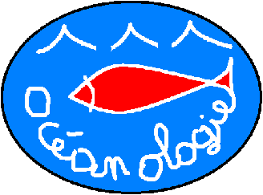


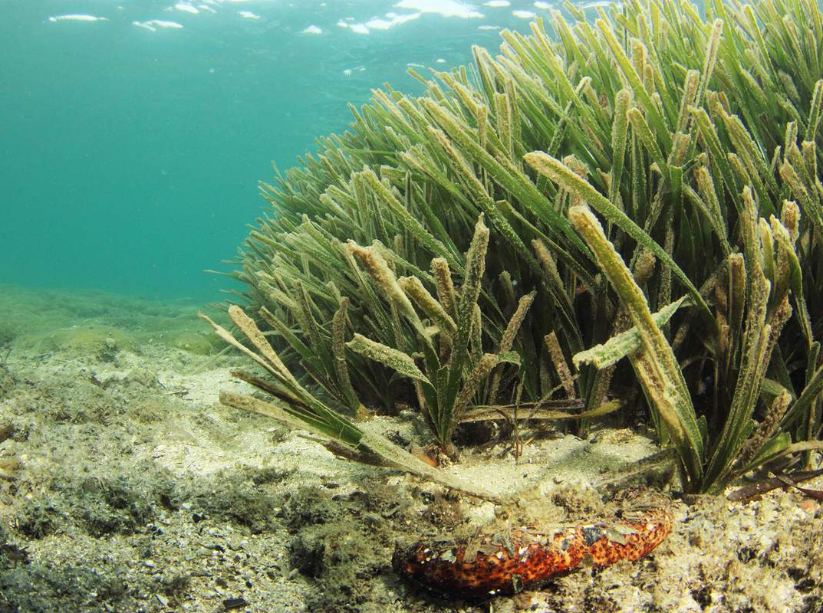

The trace element contamination of coastal waters: A holistic approach to
environmental monitoring
surveys
5th Annual World Congress of
Marine Biotechnology-2015
J. Richir and
S. Gobert
Qingdao,
11-07-15
Arnaud Abadie

Slide 2




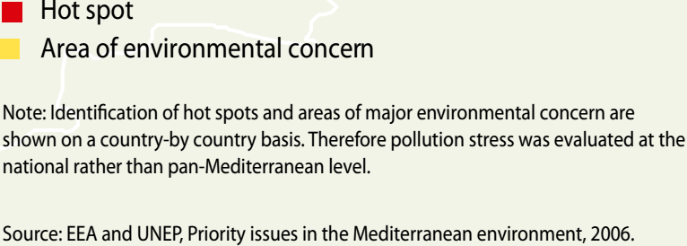
Coastal pollution of the Mediterranean
Southern Europe
Western Asia
Northern Africa
(UNEP/MAP, 2012; State of the Mediterranean Marine and Coastal Environment)
Notes:
The Mediterranean is submitted to numerous anthropogenic threats, among them the chemical contamination of its densely anthropized coasts. The red circles on this map hilights pollution hot spots along Mediterranean coasts.

Slide 3
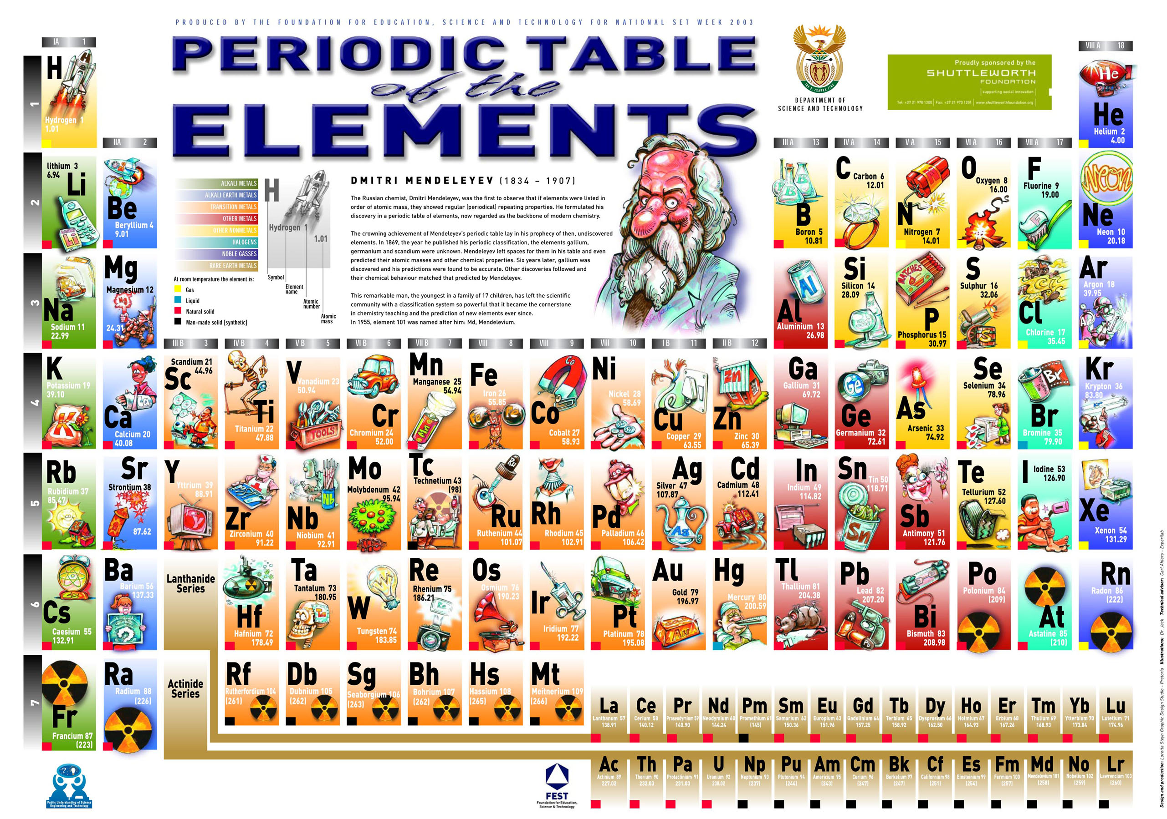

Slide 4
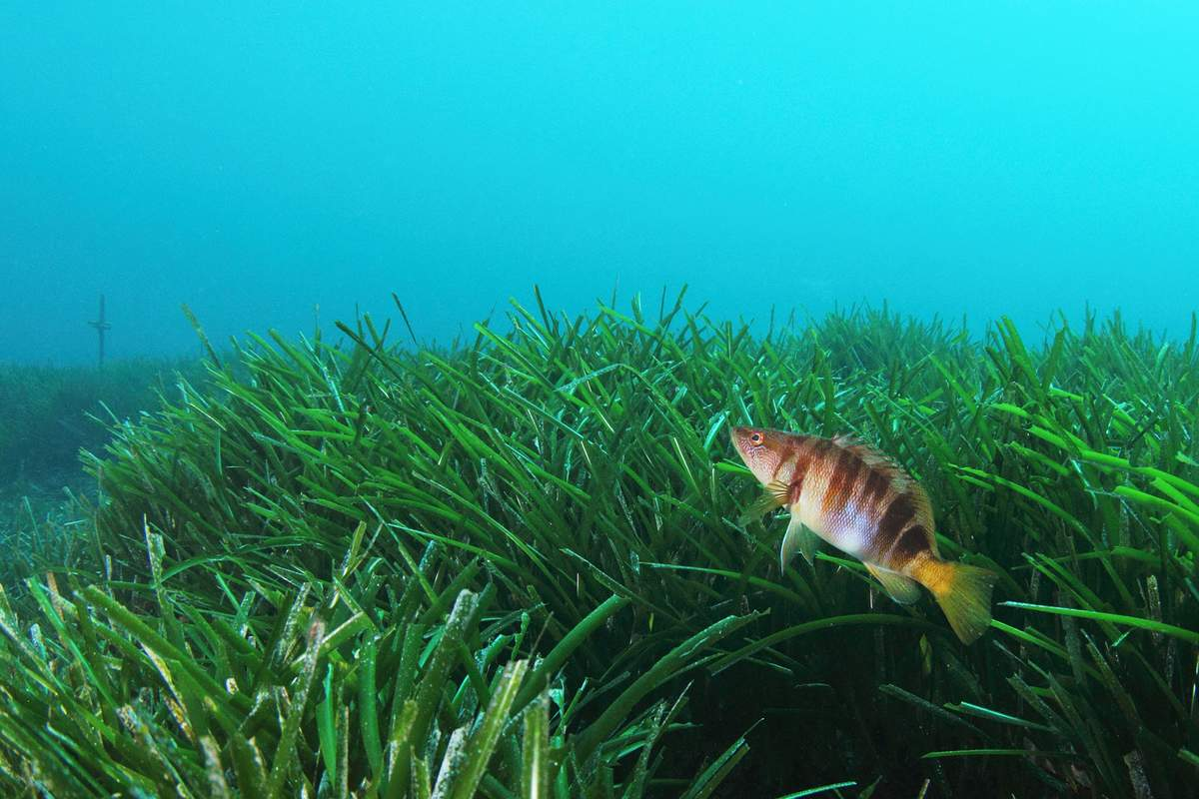
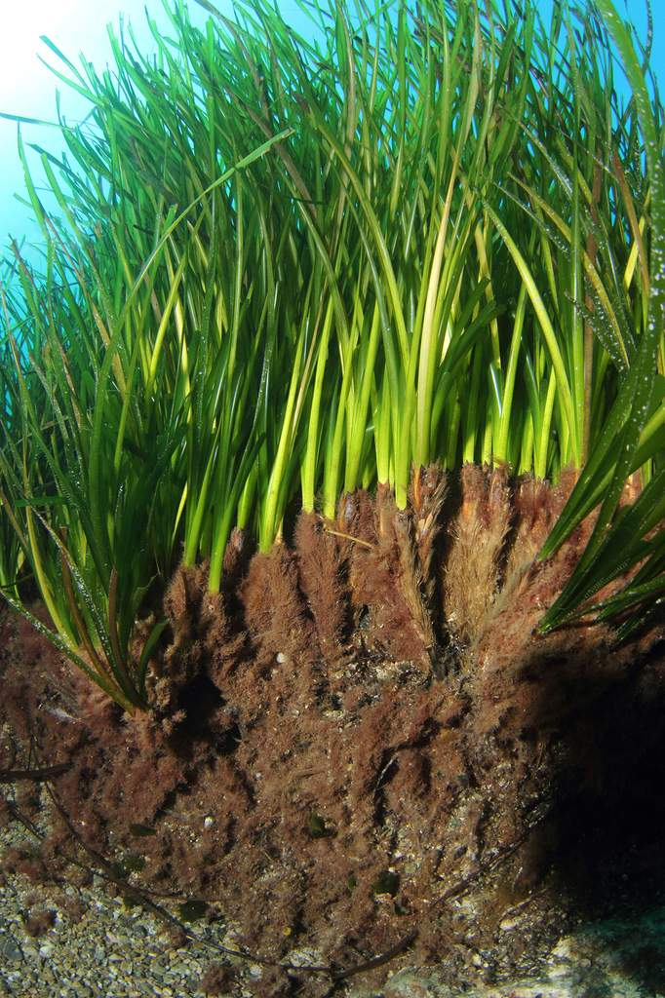
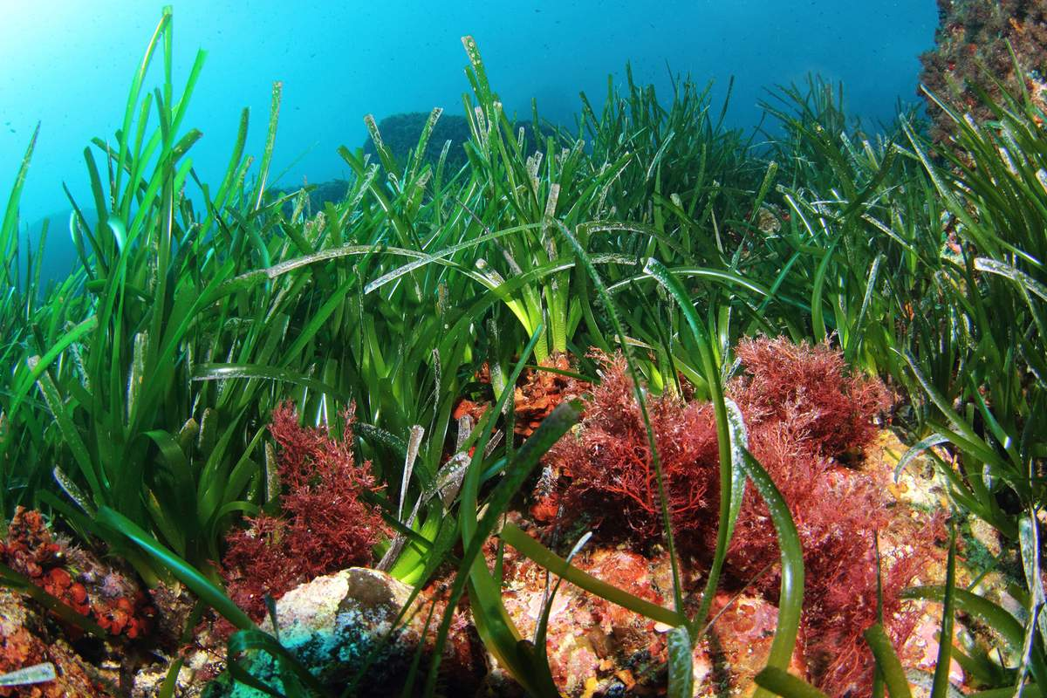
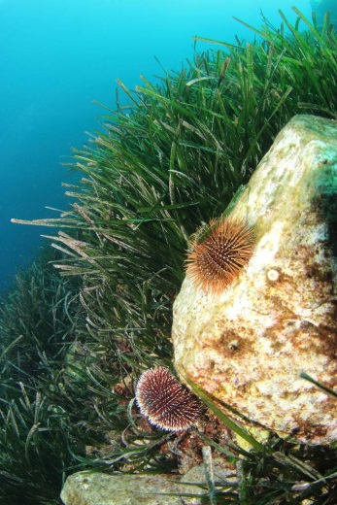
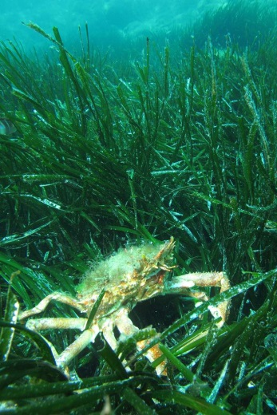
POSIDONIA OCEANICA

Slide 5
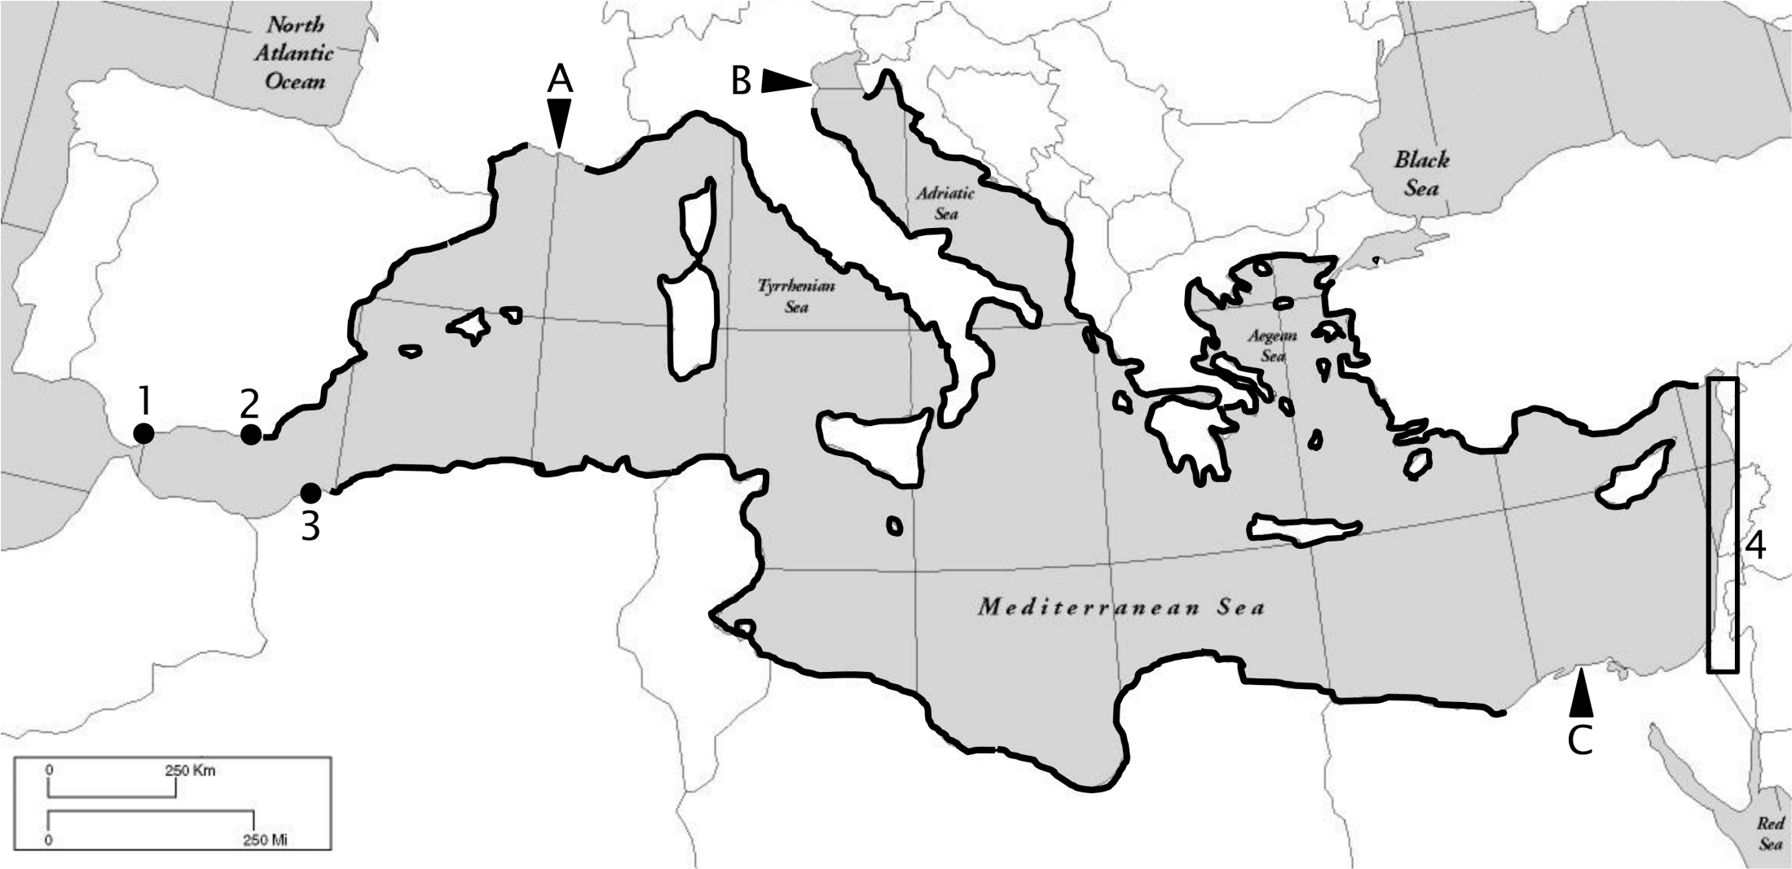
Posidonia oceanica distribution
Geographical distribution of Posidonia oceanica (Michel, 2012; redrawn using data from Lipkin et al., 2003 ; Procaccini et al., 2003; Boudouresque et al., 2006; Gobert et al., 2006; Meinesz et al., 2009). 1: Gibraltar; 2: Almeria; 3: Oran; 4: Coasts of Syria, Israel and Lebanon; A: Rhone estuary; B: Po estuary; C: Nile estuary.
Notes:
Posidonia oceanica is notably an interesting bioindicator because of its nearly circum-Mediterranean distribution. It therefore allows monitoring surveys at very different spatial scales …

Slide 6
Objectives
to assess, for the first time, the TE contamination in the entire Mediterranean biomonitored with P. oceanica;
to propose a new 5-level water quality scale;
to calculate coastal water pollution indices from bioaccumulated TE levels measured in that bioindicator;
to produce, on the basis of these data, accurate maps of the contamination of the Mediterranean by TEs.
OBJECT
I
VES
Overall aim of this work:
to develop a holistic approach in order to provide scientists, stakeholders and decision makers with a global tool to bioassess the TE contamination severity of Mediterranean coastal waters.

Slide 7
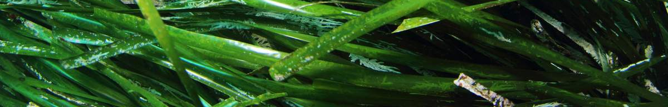
Sampling
110 sites differing by their levels of exposure to contaminants sampled for P. oceanica.
Notes:
… to global scale, i.e. at the scale of the whole Mediterranean:
110 sites sampled for P. oceanica adult leaves.

Slide 8
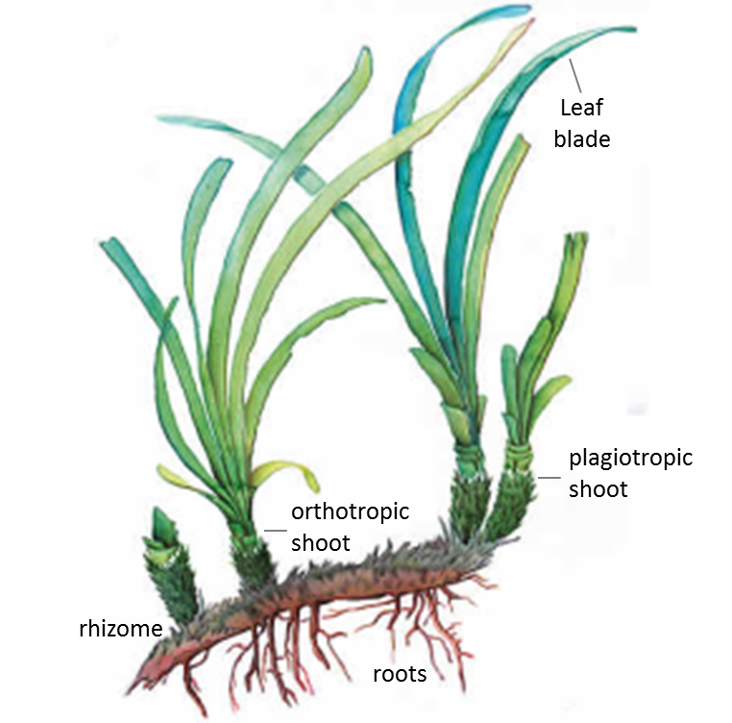
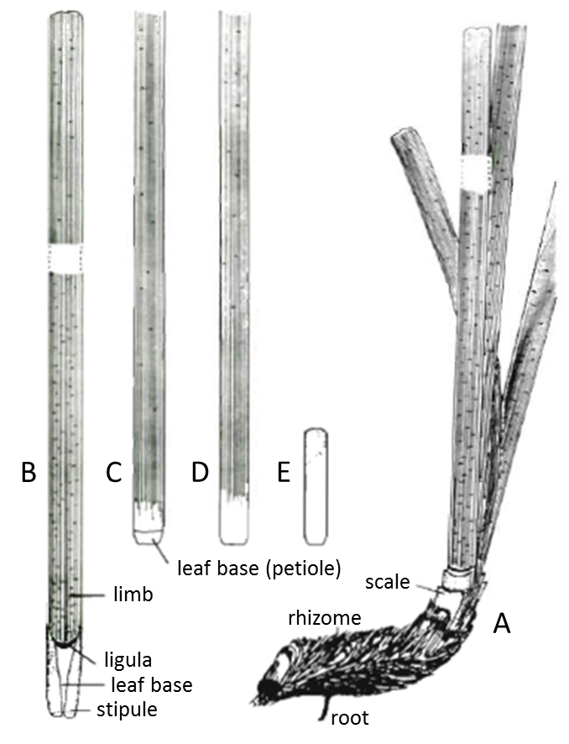
P. oceanica compartmentalization
M
ATER
I
AL
-
METHODS
Left: P. oceanica shoots fixed on a plagiotropic rhizome. Right: (A) shoot of leaves on a plagiotropic rhizome; (B, C) adult leaves; (D) intermediate leaf; (E) juvenile leaf (modified after Libes and Boudouresque, 1987).
Notes:
One of the most widely used bioindicator species in the Mediterranean is the seagrass Posidonia oceanica (and more precisely the shoots of leaves of that seagrass).

Slide 9

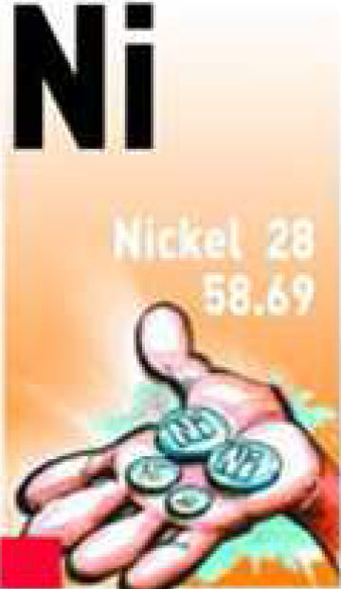
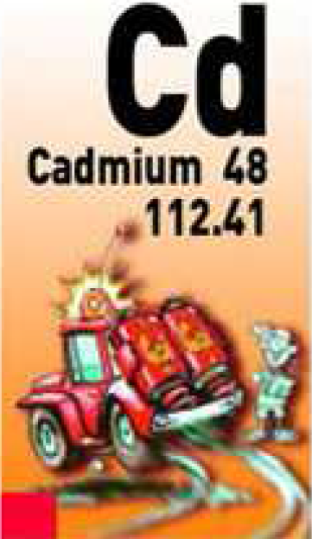

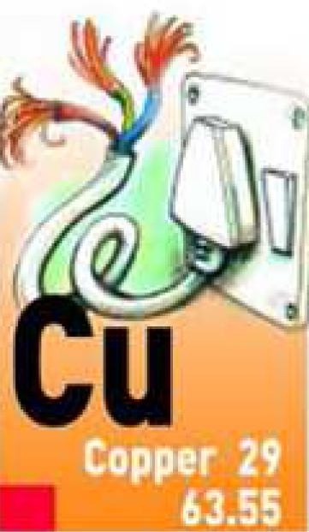

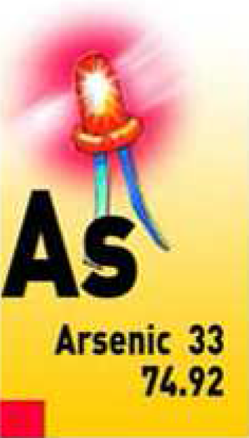
Trace elements monitored
M
ATER
I
AL
-
METHODS
Notes:
One of the most widely used bioindicator species in the Mediterranean is the seagrass Posidonia oceanica (and more precisely the shoots of leaves of that seagrass).

Slide 10
Maths and stats: monitoring
M
ATER
I
AL
-
METHODS
Water quality scale
Contamination indices:
Trace Element Spatial Variation Index (TESVI)
Trace Element Pollution Index (TEPI)
Maths and stats: spatial analysis
GIS mapping
Principal component analysis
Cluster analysis
Correlation analysis
Notes:
One of the most widely used bioindicator species in the Mediterranean is the seagrass Posidonia oceanica (and more precisely the shoots of leaves of that seagrass).

Slide 11

Maths and stats: 5-level water quality scale
qu. 1
qu. 2
qu. 3
qu. 4
Superior limit of quartiles
M
ATER
I
AL
-
METHODS
5 contamination levels
< 1st qu. mean : very low CL
1st-2nd qu. mean: low CL
2nd-3rd qu. mean: medium CL
3rd-4th qu. mean: high CL
> 4th qu. mean: very high CL
Quartile means
Notes:
One of the most widely used bioindicator species in the Mediterranean is the seagrass Posidonia oceanica (and more precisely the shoots of leaves of that seagrass).

Slide 12
Sub-areas differences
RESULTS
-
D
I
SCUSS
I
ON
Notes:
One of the most widely used bioindicator species in the Mediterranean is the seagrass Posidonia oceanica (and more precisely the shoots of leaves of that seagrass).

Slide 13
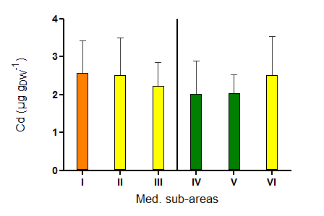
RESULTS
-
D
I
SCUSS
I
ON
Notes:
One of the most widely used bioindicator species in the Mediterranean is the seagrass Posidonia oceanica (and more precisely the shoots of leaves of that seagrass).

Slide 14
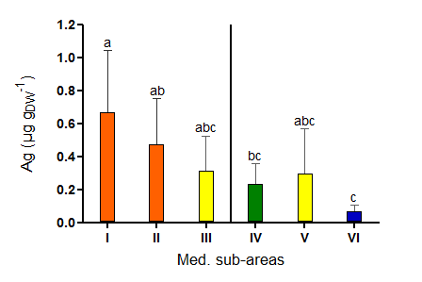
RESULTS
-
D
I
SCUSS
I
ON
Notes:
One of the most widely used bioindicator species in the Mediterranean is the seagrass Posidonia oceanica (and more precisely the shoots of leaves of that seagrass).

Slide 15
Maths and stats: pollution indices

Slide 16

Maths and stats: pollution indices
How to order and to compare TEs according to the overall spatial variability of their environmental levels through the whole of a studied area ?
How to compare global pollution levels in TEs between several monitored sites ?

Slide 17
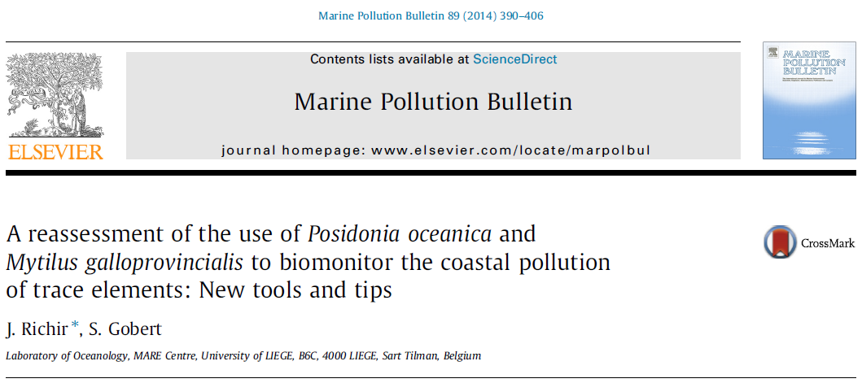
Sampling
Pollution indices developed first for the French Mediterranean littoral.
Notes:
… to global scale, i.e. at the scale of the whole Mediterranean:
110 sites sampled for P. oceanica adult leaves.

Slide 18
11
1
I
P. oceanica sampled in 18 sites at 15 m depth in April 2007
19 TEs analysed by DRC-ICP-MS: Be, Al, V, Cr, Mn, Fe, Co, Ni, Cu, Zn, As, Se, Mo, Ag, Cd, Sn, Sb, Pb, Bi
VII

Slide 19
Trace Element Spatial Variation Index
How to order and to compare TEs according to the overall spatial variability of their environmental levels through the whole of a studied area ?
M
ATER
I
AL
-
METHODS
Trace Element Spatial Variation Index (TESVI)
TESVI = [(x_{max}/x_{min}) / (∑(x_{max}/x_{i})/n)] * SD
where:
x_{max} and x_{min} are the maximum and minimum mean concentrations recorded among the n sites,
x_{i} are mean concentrations recorded in each of the n sites,
SD is the standard deviation of the weighted sum ∑(x_{max}/x_{i})/n.
The highest the index value, the more environmental levels of a TE globally vary (punctual contaminations and overall coastal spatial heterogeneity of TE levels taken into account) through the whole of the studied area the index is applied to.

Slide 20
TESVI value calculation
Trace Element Spatial Variation Index (TESVI)
TESVI = [(x_{max}/x_{min}) / (∑(x_{max}/x_{i})/n)] * SD
TESV
I

Slide 21
TESVI value calculation
Trace Element Spatial Variation Index (TESVI)
TESVI = [(x_{max}/x_{min}) / (∑(x_{max}/x_{i})/n)] * SD
TESV
I
…
∑(x_{max}/x_{i})
SD
x_{max}/x_{min}
n

Slide 22
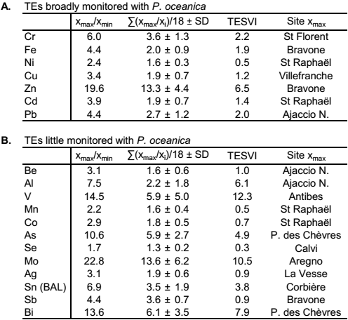
TESVI graphical representation
TESV
I
22.8
TESVI values were listed in ascending order :
Se, Ni, Mn, Co, Sb, Ag, Be, Cu, Cd, Fe, Pb, Cr, Sn, As, Al, Zn, Bi, Mo, V

Slide 23
TESVI graphical representation
* highest x_{max}/x_{min} value
* highest x_{max}/x_{min} value
* highest x_{max}/x_{min} value
* highest x_{max}/x_{min} value
TESVI values were listed in ascending order :
Se, Ni, Mn, Co, Sb, Ag, Be, Cu, Cd, Fe, Pb, Cr, Sn, As, Al, Zn, Bi, Mo, V

Slide 24
TESVI graphical representation
TESVI values were listed in ascending order :
Se, Ni, Mn, Co, Sb, Ag, Be, Cu, Cd, Fe, Pb, Cr, Sn, As, Al, Zn, Bi, Mo, V

Slide 25
Sampling
110 sites differing by their levels of exposure to contaminants sampled for P. oceanica.
Notes:
… to global scale, i.e. at the scale of the whole Mediterranean:
110 sites sampled for P. oceanica adult leaves.

Slide 26
Spatial variability
Pb
Proportional ordinate scaling between TEs:
RESULTS
-
D
I
SCUSS
I
ON
Hg
As
Cd
Ag
Cu
Ni
Notes:
One of the most widely used bioindicator species in the Mediterranean is the seagrass Posidonia oceanica (and more precisely the shoots of leaves of that seagrass).

Slide 27
Trace Element Pollution Index
How to compare global pollution levels in TEs between several monitored sites ?
Trace Element Pollution Index (TEPI)
TEPI = (Cf₁ * Cf₂ … Cf_{n})^{1/n},
TEP
I
a weighted version of the Metal Pollution Index (MPI) of Usero et al. (1996, MPB)
where:
Cf_{n} is the mean normalized concentration of the TE n in a given monitored site.
The highest the index value, the more the monitored site is globally contaminated in TEs compared to the others.

Slide 28
Mean normalization
Random list 1:
Be, Al, V, Cr, Mn, Fe, Co, Ni, Cu, Zn, As, Se, Mo, Ag, Cd, Sn, Sb, Pb, Bi
Random list 5:
Sb, V, Sn, Se, Be, Pb, Ni, Mo, Mn, Fe, Cu, Cr, Co, Cd, Bi, Zn, As, Ag, Al

Slide 29
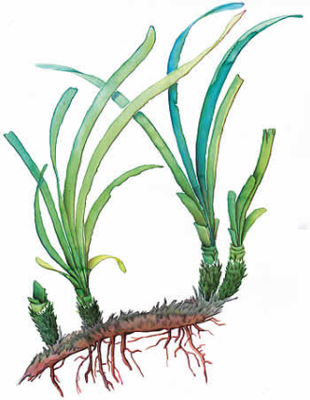
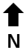
P. oceanica

Slide 30
Sampling
110 sites differing by their levels of exposure to contaminants sampled for P. oceanica.
Notes:
… to global scale, i.e. at the scale of the whole Mediterranean:
110 sites sampled for P. oceanica adult leaves.

Slide 31
Global contamination
Notes:
One of the most widely used bioindicator species in the Mediterranean is the seagrass Posidonia oceanica (and more precisely the shoots of leaves of that seagrass).

Slide 32
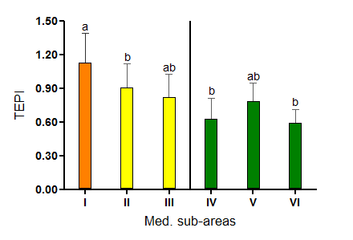
RESULTS
-
D
I
SCUSS
I
ON
Notes:
One of the most widely used bioindicator species in the Mediterranean is the seagrass Posidonia oceanica (and more precisely the shoots of leaves of that seagrass).

Slide 33
Maths and stats: monitoring
M
ATER
I
AL
-
METHODS
Water quality scale
Contamination indices:
Trace Element Spatial Variation Index (TESVI)
Trace Element Pollution Index (TEPI)
Maths and stats: spatial analysis
GIS mapping
Principal component analysis
Cluster analysis
Correlation analysis
Notes:
One of the most widely used bioindicator species in the Mediterranean is the seagrass Posidonia oceanica (and more precisely the shoots of leaves of that seagrass).

Slide 34
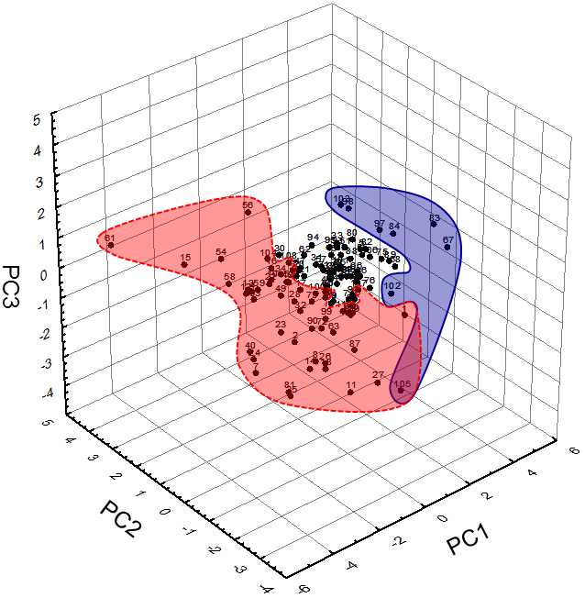
Principal component analysis
RESULTS
-
D
I
SCUSS
I
ON
Hg
Cd
Ag, TEPI
Notes:
One of the most widely used bioindicator species in the Mediterranean is the seagrass Posidonia oceanica (and more precisely the shoots of leaves of that seagrass).

Slide 35






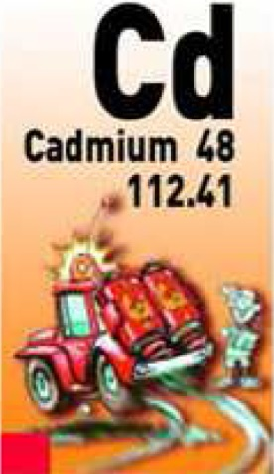
Correlation analysis
RESULTS
-
D
I
SCUSS
I
ON
Correlation matrix of parametric Pearson’s correlation coefficients and non-parametric Spearman’s rank correlation coefficients between TE concentrations and TEPI values in P. oceanica. Correlations significant at p < 0.05 are in bold; correlations significant at p < 0.01 are in bold underlined.
Notes:
One of the most widely used bioindicator species in the Mediterranean is the seagrass Posidonia oceanica (and more precisely the shoots of leaves of that seagrass).

Slide 36
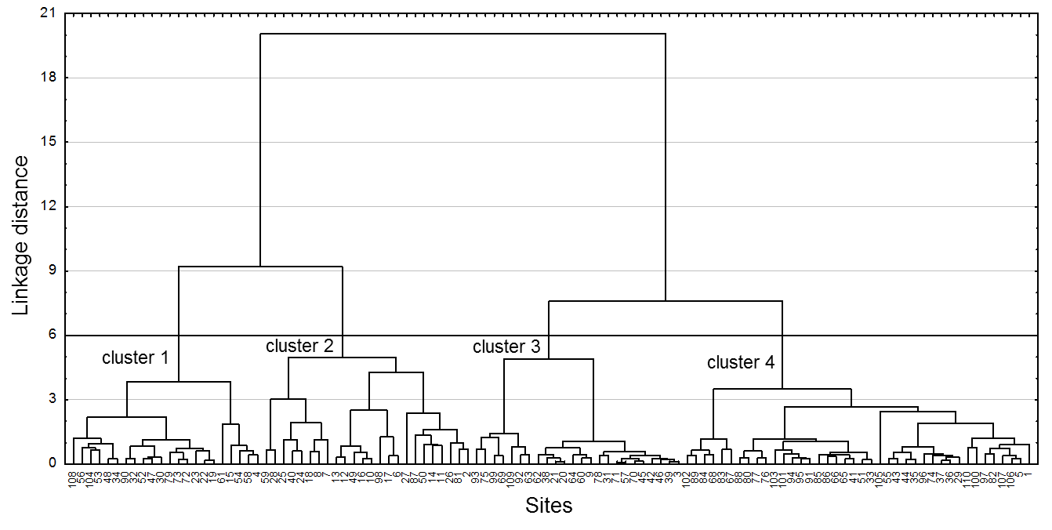
Cluster analysis
RESULTS
-
D
I
SCUSS
I
ON
sites highly contaminated
sites little contaminated
Dendrographic classification after cluster analysis of Ag, As, Cd, Cu, Hg, Ni and Pb concentrations measured in the blades of Posidonia oceanica, and TEPI values calculated from mean normalized TE concentrations.
Notes:
One of the most widely used bioindicator species in the Mediterranean is the seagrass Posidonia oceanica (and more precisely the shoots of leaves of that seagrass).

Slide 37
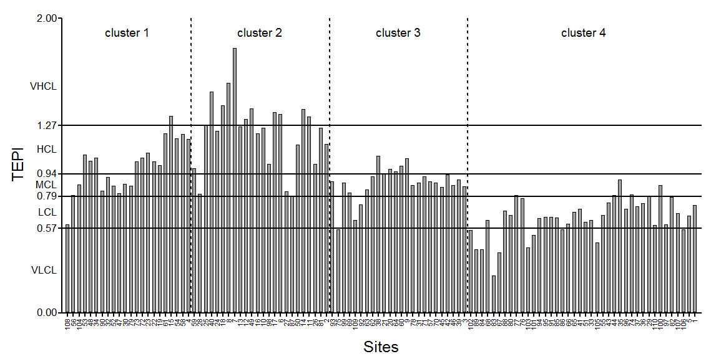
Cluster analysis
HC by Cd, Ni; LC by As
HC by Ag, As, Pb
LC by TEs overall
RESULTS
-
D
I
SCUSS
I
ON
TEPI values calculated from mean normalized Ag, As, Cd, Cu, Hg, Ni and Pb concentrations measured in the blades of P. oceanica adult leaves. Sampling sites are sorted on the graph according to the dendrographic classification after cluster analysis of trace element concentrations and TEPI values.
Notes:
One of the most widely used bioindicator species in the Mediterranean is the seagrass Posidonia oceanica (and more precisely the shoots of leaves of that seagrass).

Slide 38
RESULTS
-
D
I
SCUSS
I
ON
Notes:
One of the most widely used bioindicator species in the Mediterranean is the seagrass Posidonia oceanica (and more precisely the shoots of leaves of that seagrass).

Slide 39
RESULTS
-
D
I
SCUSS
I
ON
Notes:
One of the most widely used bioindicator species in the Mediterranean is the seagrass Posidonia oceanica (and more precisely the shoots of leaves of that seagrass).

Slide 40
Conclusion
Sustainable coastal management requires the development of appropriate contamination classification systems.
Combined utilization of several complementary monitoring tools:
water quality scale;
pollution index (TEPI and TESVI);
spatial analysis (PCA, CA, correlation analysis and GIS mapping).
In the Mediterranean:
To assess TE contamination threats;
To depict contamination gradients;
To monitor TE contamination at regional or local scales.
Conclusion: to privilege such holistic approaches to accurately monitor the TE contamination rate of coastal waters and to transfer relevant information on this composite problem to environmental managers and policy makers.
CONCLUS
I
ON
Notes:
One of the most widely used bioindicator species in the Mediterranean is the seagrass Posidonia oceanica (and more precisely the shoots of leaves of that seagrass).

Slide 41
Acknowledgements
This study was supported by the collaboration of several laboratories from all around the Mediterranean:
Pr Gérard Pergent, Pr Céline Lafabrie, Dr Christine Pergent-Martini, Dr Maylis Salivas-Decaux and Dr Cecilia Lopez y Royo, University of Corte (Corsica, France);
Dr Saïd Belbacha and Dr Rachid Semroud (Algeria);
University of Zagreb, Dr Tatjana Bakran-Petricioli (Croatia);
Melina Marcou and Myroula Hadjichristoforou (Cyprus);
Dr Stéphane Sartoretto, Ifremer Center of Toulon,
Berangère Casalta (France);
Dr Georges Skoufas and Dr Eugenia Apostolaki, Institute of Oceanography, Hellenic Centre for Marine Research (Greece);
Dr Cristina Buia and Dr Pier Panzalis (Italy);
Dr Joseph Borg (Malta);
Robert Turk, Borut Mavric and Lovrenc Lipej (Slovenia);
Boris Weitzmann, Dr Yolanda Fernandez Torquemade, F. Javier Zapata Salgado, Elvira Alvarez Pérez, Dr Javier Romero, Izaskun Llagostera (Spain);
Dr Habib Langar (Tunisia); Dr Baris Akçalı and Billür Celebi (Turkey).
We also thank Steven Barillec, Nicolas Luy and Renzo Biondo for their help.
ACKNOWLEDGEMENTS
Notes:
One of the most widely used bioindicator species in the Mediterranean is the seagrass Posidonia oceanica (and more precisely the shoots of leaves of that seagrass).

Slide 42
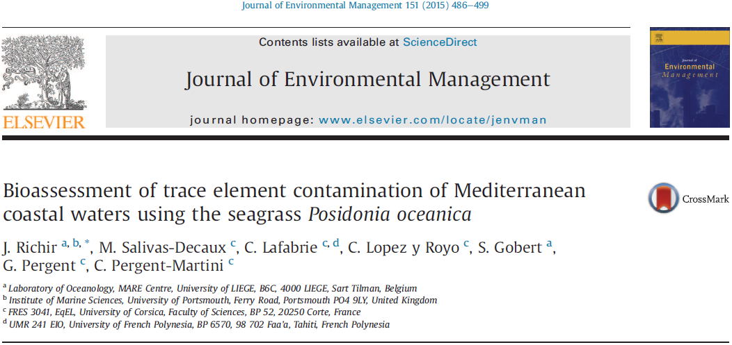
More info …
Notes:
One of the most widely used bioindicator species in the Mediterranean is the seagrass Posidonia oceanica (and more precisely the shoots of leaves of that seagrass).

