Slide 1





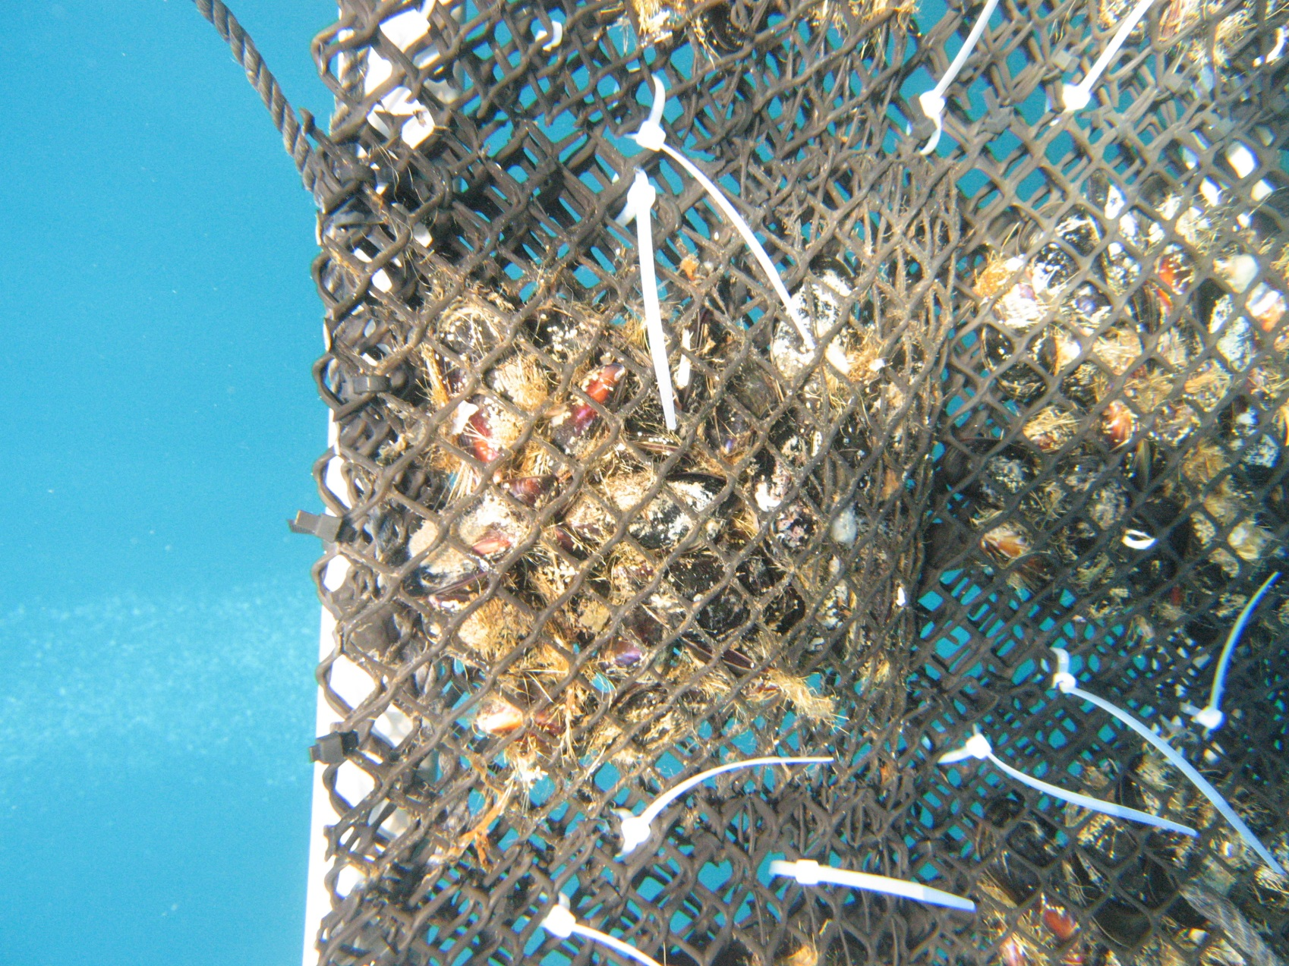
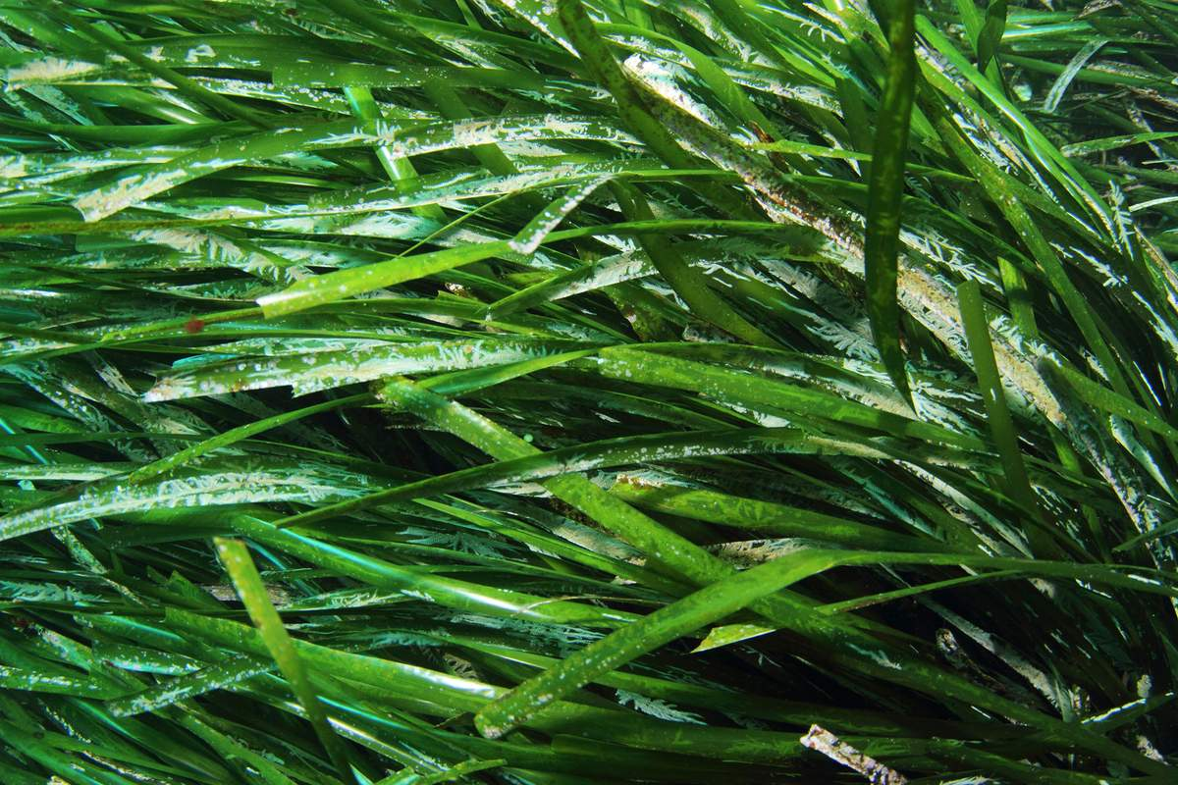
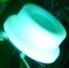


DGTs, A COMPLEMENTARY TOOL TOWARDS MORE EFFICIENT
BIOMONITORING
PRACTICES
J. Richir, G. Lepoint,
Donnay, P. Lejeune,
K. Das, S. Gobert.
Donostia-San
Sebastián
01-10-15

Slide 2




Trace elements
I
N
T
R
O
D
U
C
T
I
O
N
(after Amiard ,2011)

Slide 3
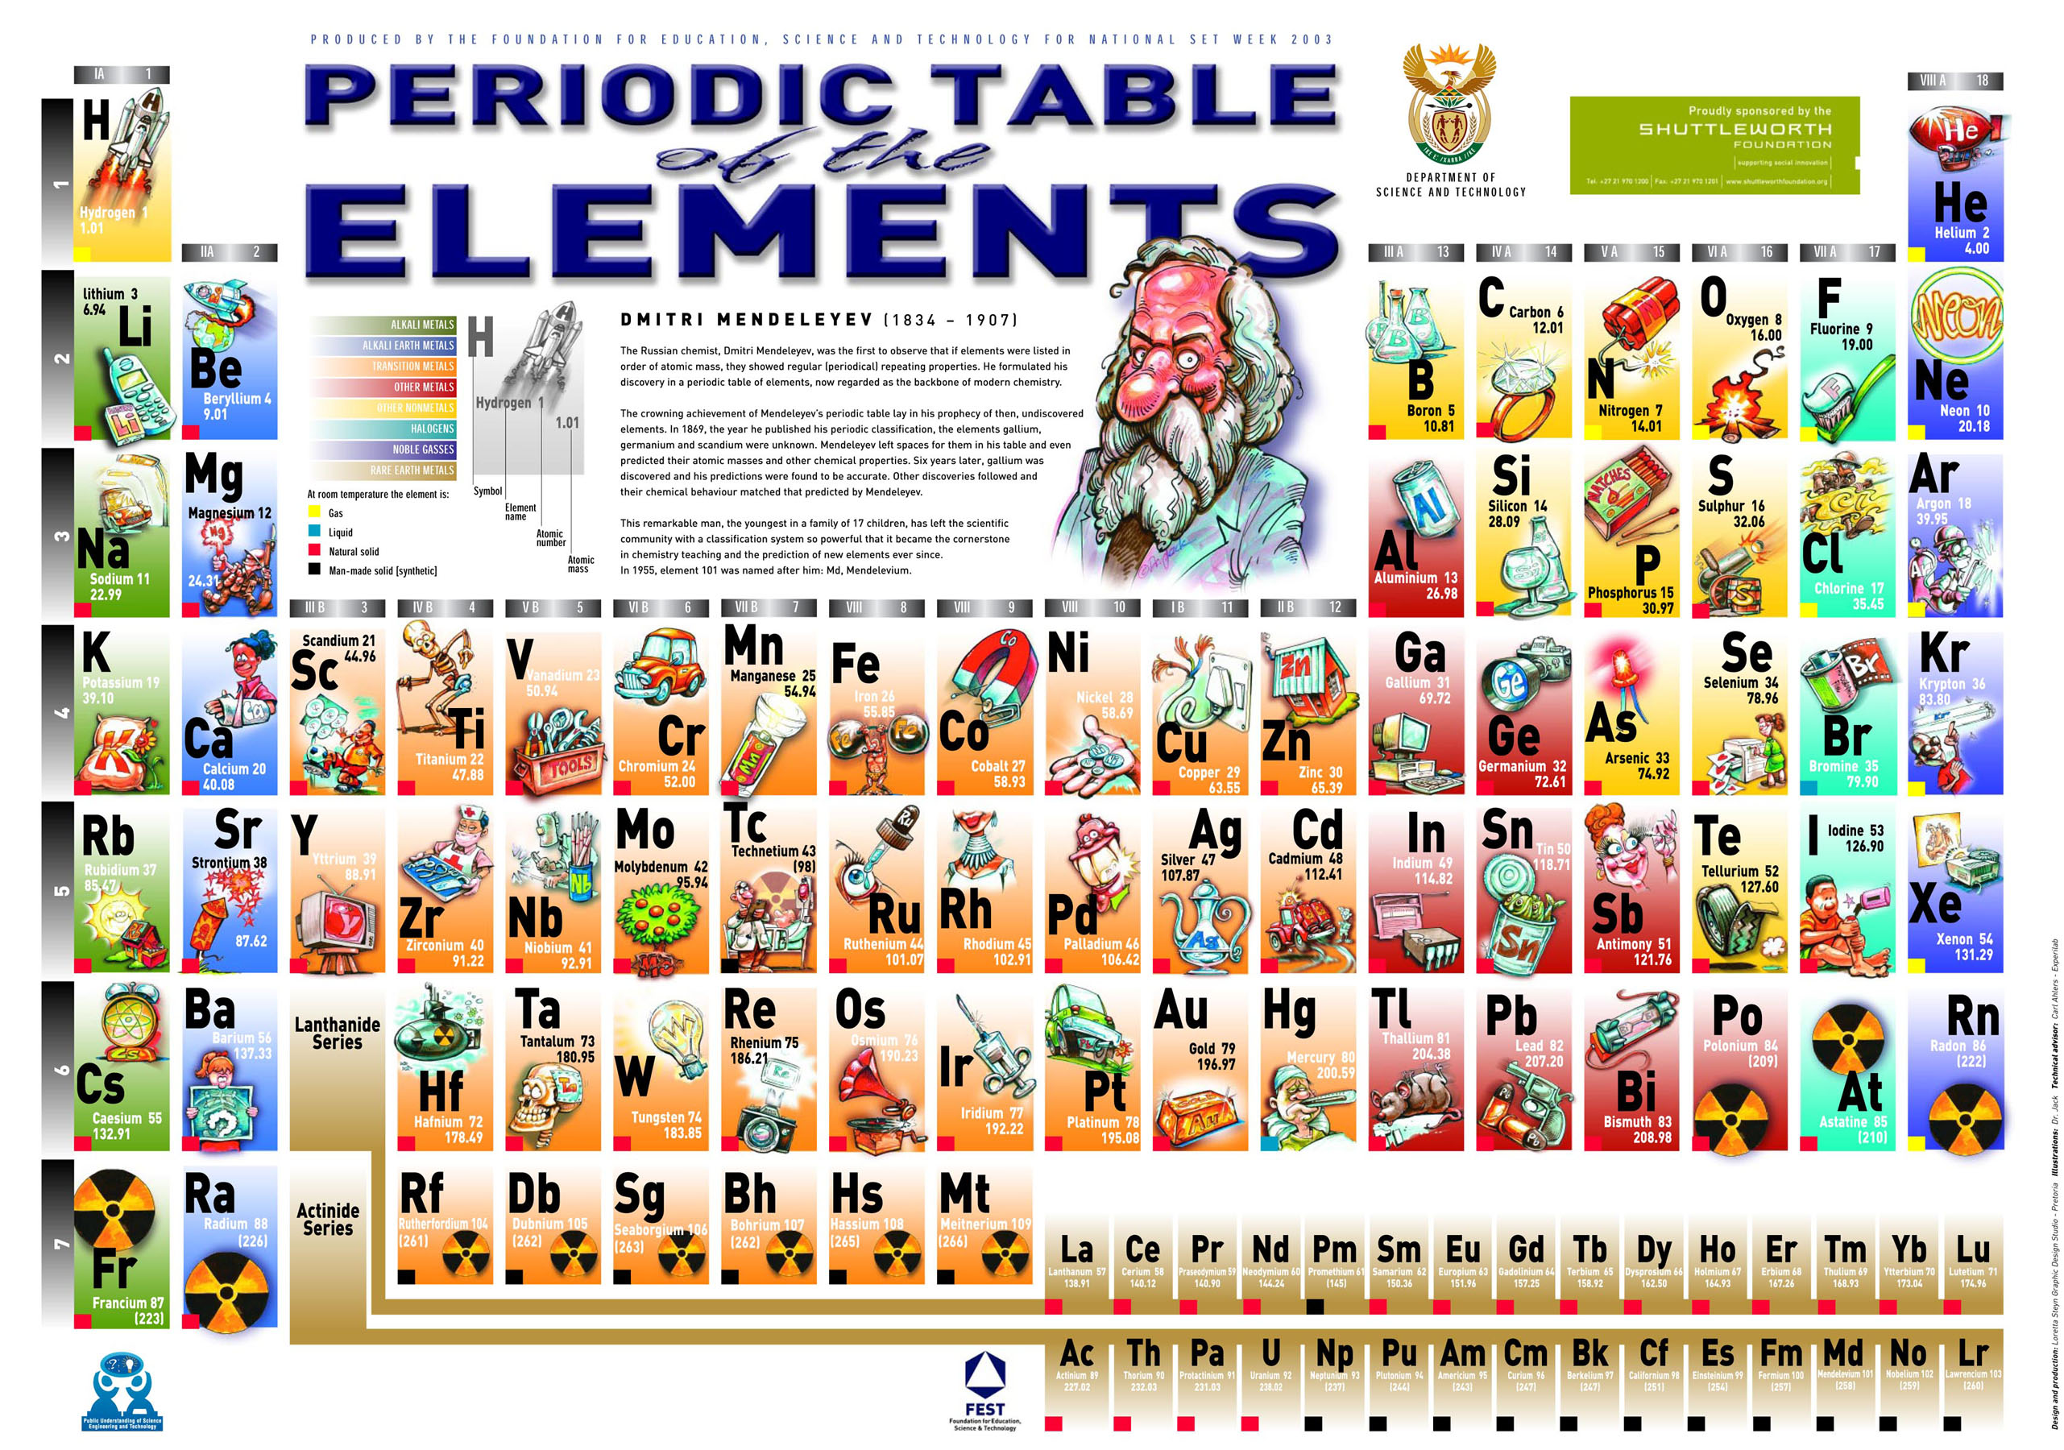

Slide 4
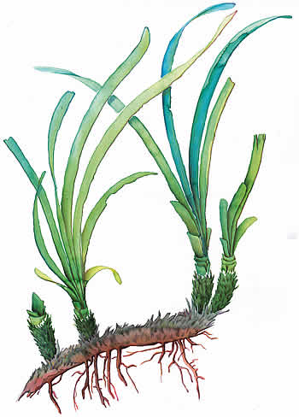
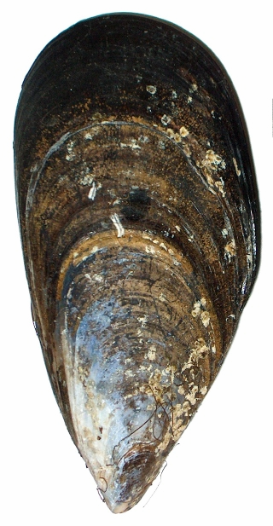
Introduction
Direct measurements in water :
low, punctual and fluctuating concentrations;
preconcentrations;
bioaccessible fraction?
I
N
T
R
O
D
U
C
T
I
O
N
Ecotoxicology :
bioindicators = organisms accumulating pollutants to levels representative of their habitat pollution status.
Posidonia oceanica
Mytilus
galloprovincialis

Slide 5
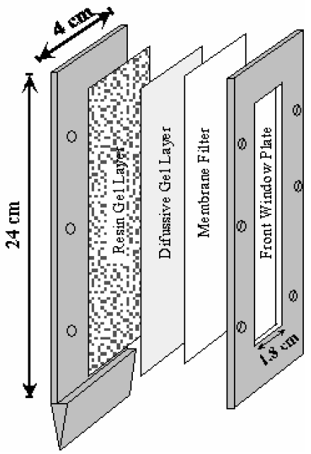
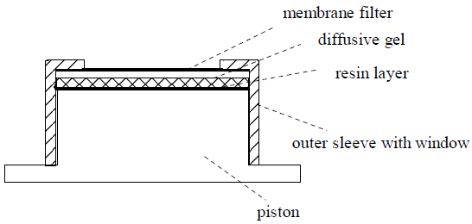
Introduction
Davison and Zhang (1994). In situ speciation measurements of trace components in natural waters using thin-film gels. Nature. 367: 546-548.
(Lancaster University, UK)
I
N
T
R
O
D
U
C
T
I
O
N
DGT = diffusive gradients in thin films
(DGT – for measurements in waters, soils and sediments)

Slide 6
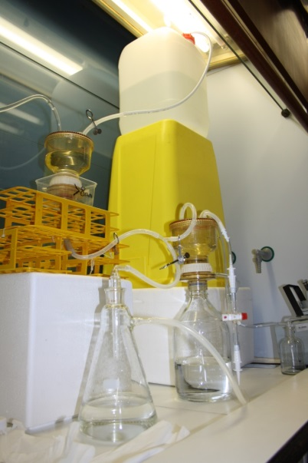


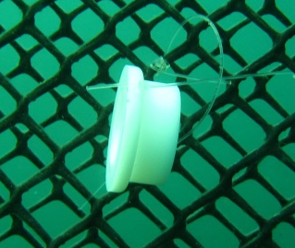
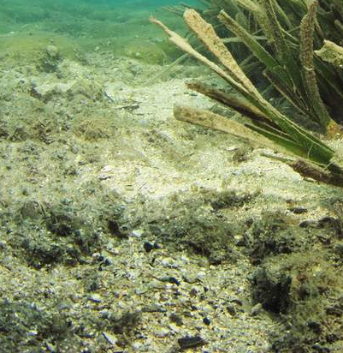

Monitoring
Trace elements
METHODS
Mytilus
galloprovincialis
direct measurements in the environment:
water
sediment
suspended matter
bioindicators
Posidonia oceanica

Slide 7
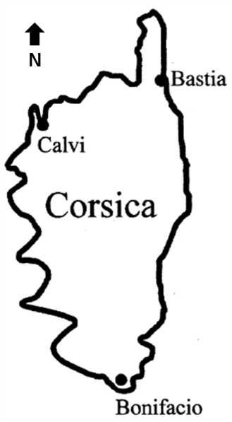
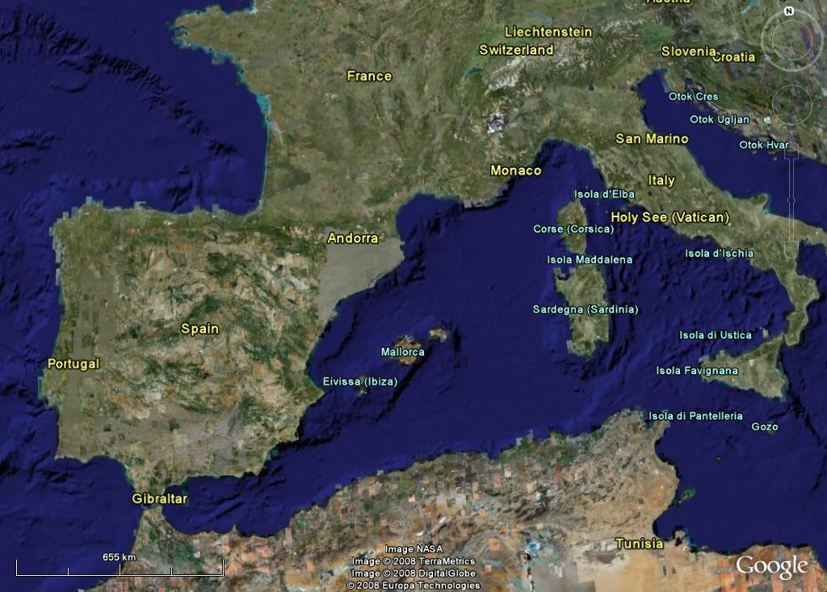
Calvi Bay
SITE

Slide 8
Calvi Bay
APPLICATIONS

Slide 9
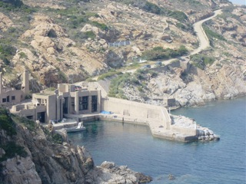
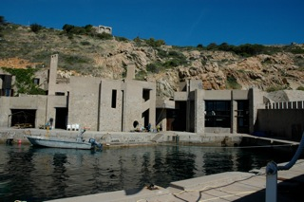
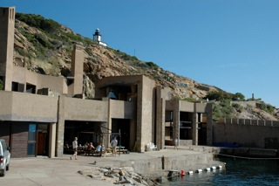

STARESO
SITE

Slide 10
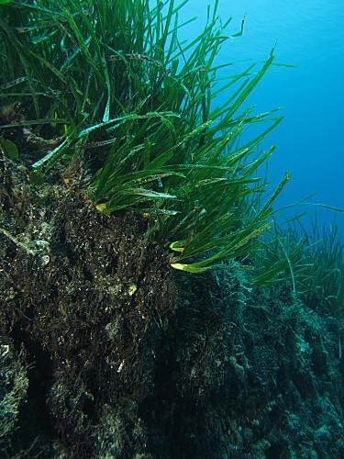
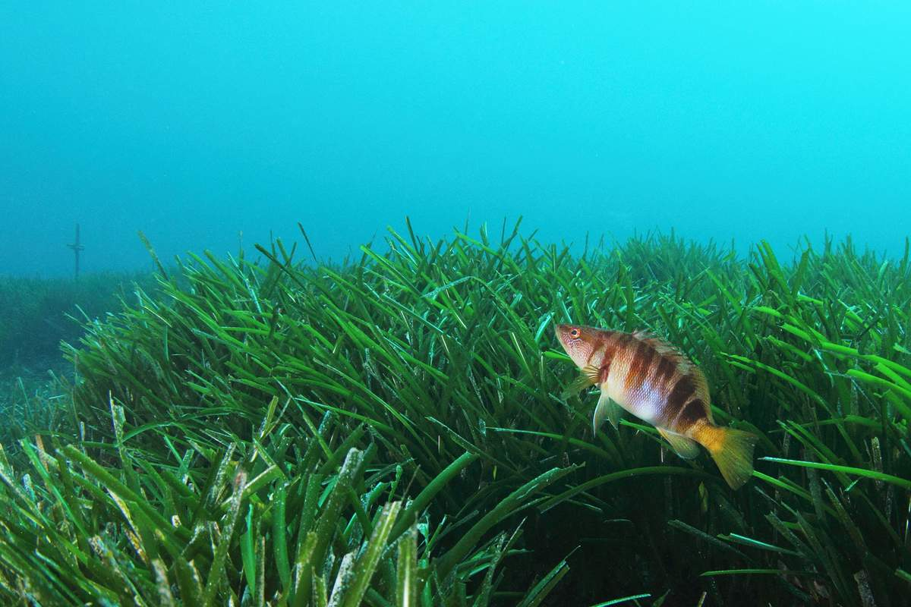

Posidonia oceanica
Posidonia oceanica: shoots, rhizomes and roots;
Foliar stratum;
Matte.

Slide 11
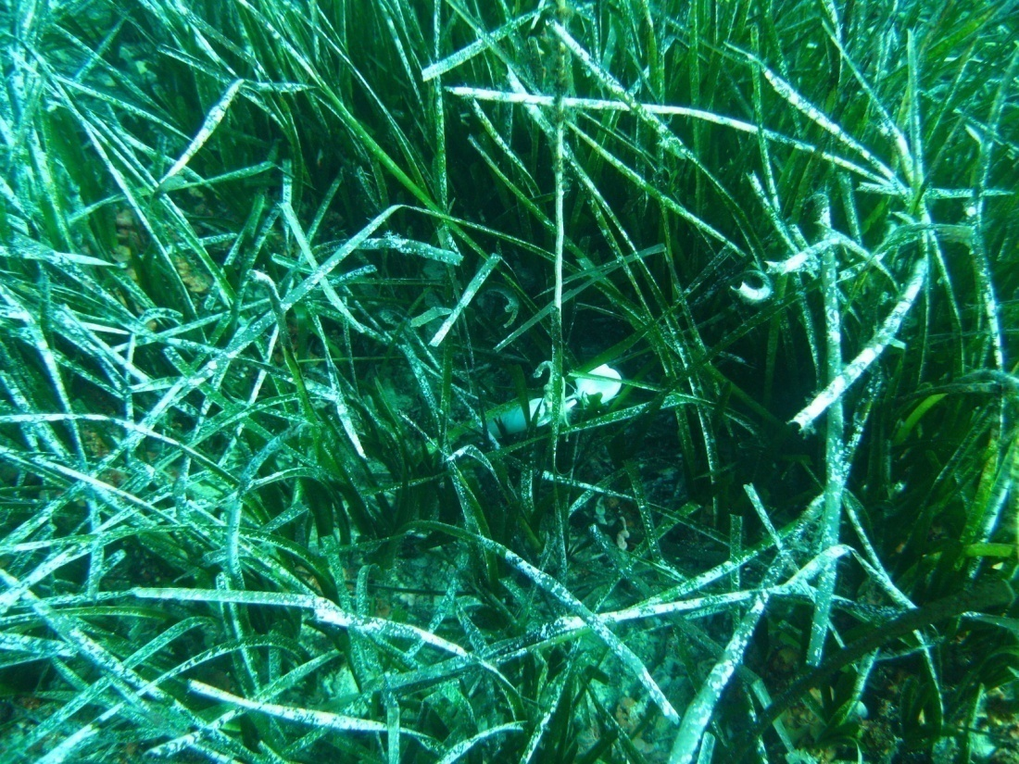
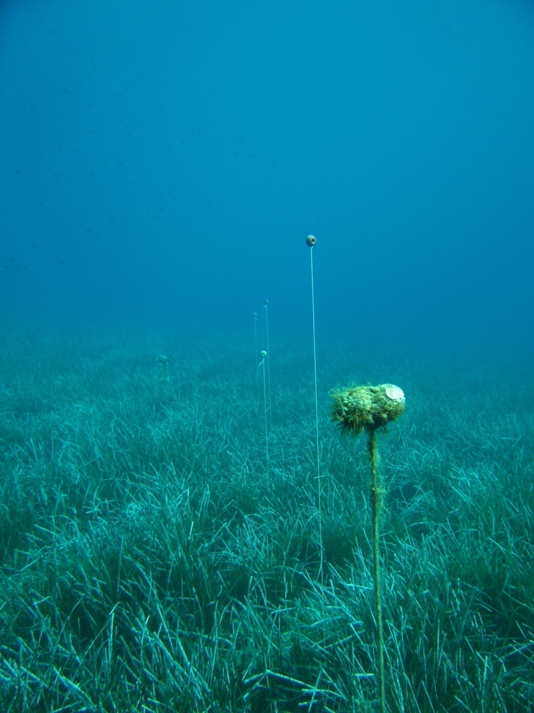

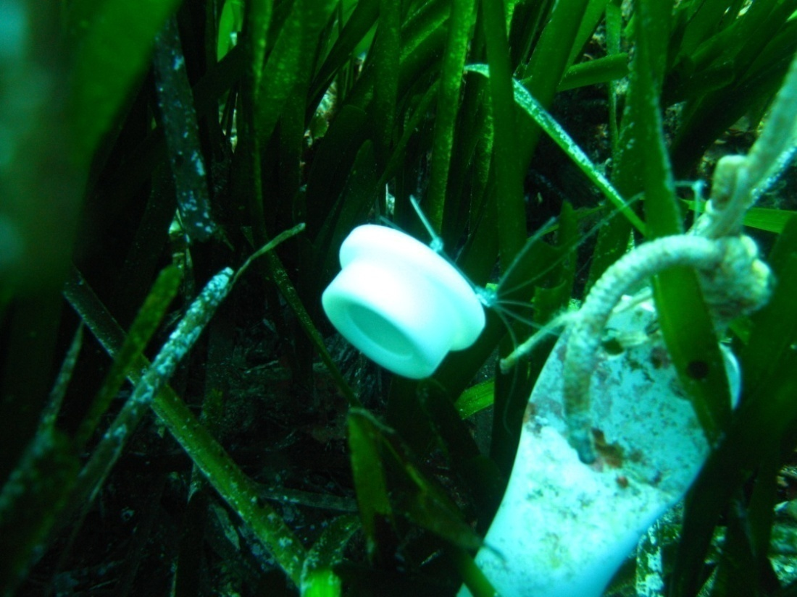
Applications
APPLICATIONS

Slide 12
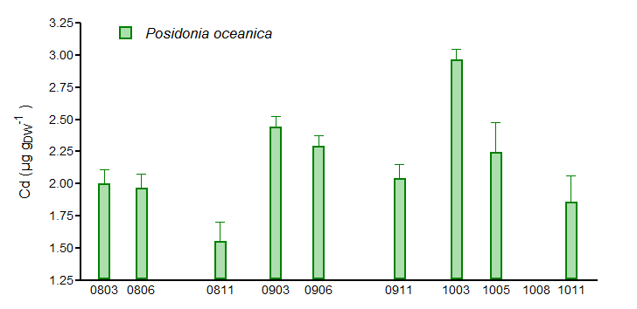
Seasonal variations of P. oceanica [TE]
APPLICATION
1

Slide 13
Seasonal variations of P. oceanica [TE]
APPLICATION
1
x 1,6

Slide 14
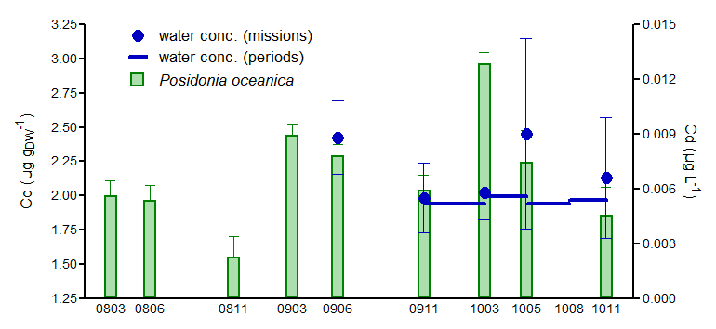
Seasonal variations of P. oceanica [TE]
[Cd] Posidonia oceanica : 10⁶ times > water
APPLICATION
1

Slide 15
In situ contamination of P. oceanica
APPLICATION
2
5 days of contamination;
15 TEs (Pb, Co, Ag, Al, Mn ...);
410L bell-shaped mesocosm;
Contamination every 12 hours (9am-9pm);
15 days of decontamination.

Slide 16
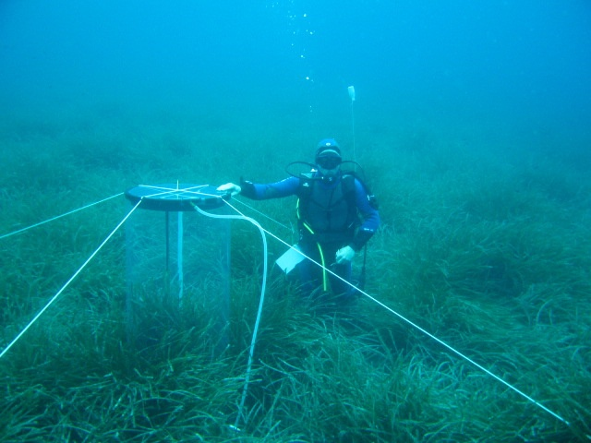

Slide 17
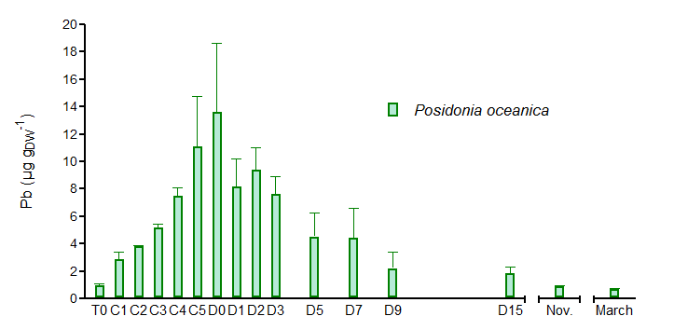
In situ contamination of P. oceanica
seawater average [Pb] : 0.13 µg L⁻¹
contamination level : 5 µg L⁻¹
APPLICATION
2

Slide 18
In situ contamination of P. oceanica
seawater average [Pb] : 0.13 µg L⁻¹
contamination level : 5 µg L⁻¹
APPLICATION
2

Slide 19
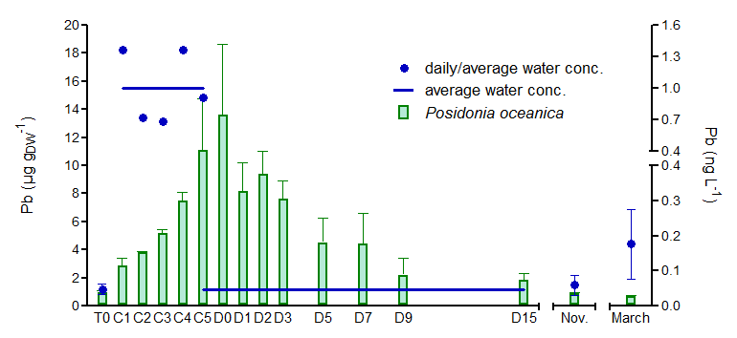
In situ contamination of P. oceanica
seawater average [Pb] : 0.05 µg L⁻¹ (0.13 µg L⁻¹)
contamination level : 1.00 µg L⁻¹ (5 µg L⁻¹)
APPLICATION
2

Slide 20
In situ contamination of P. oceanica
seawater average [Pb] : 0.05 µg L⁻¹ (0.13 µg L⁻¹)
contamination level : 1.00 µg L⁻¹ (5 µg L⁻¹)
APPLICATION
2
x 20
x 15

Slide 21
Porewater TE concentrations
APPLICATION
3
(Jørgensen, 2006)

Slide 22
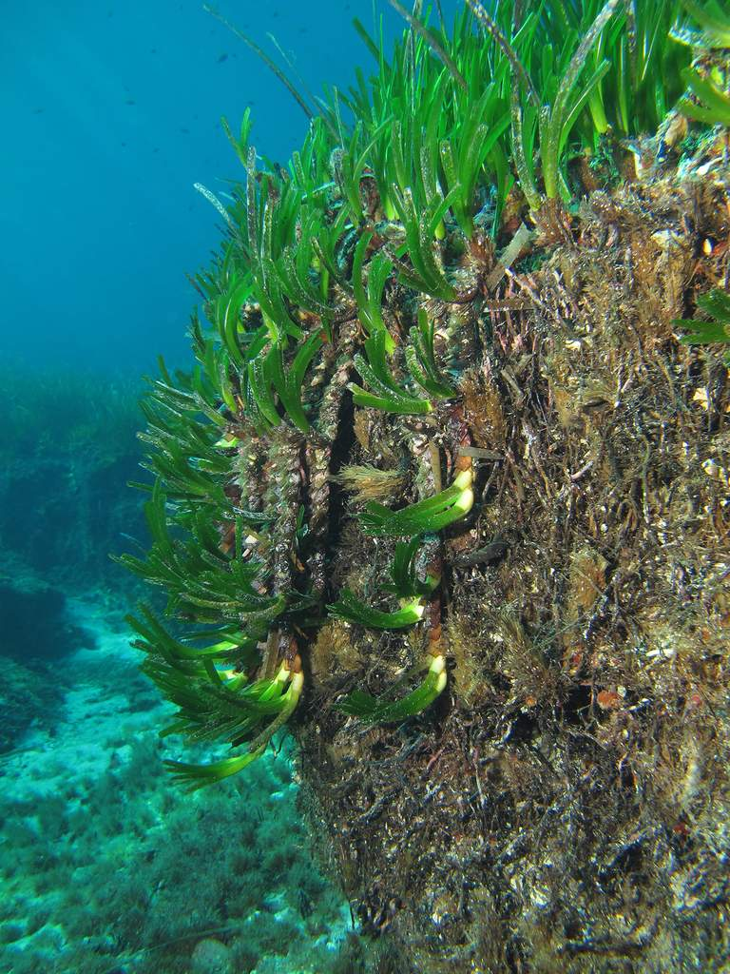
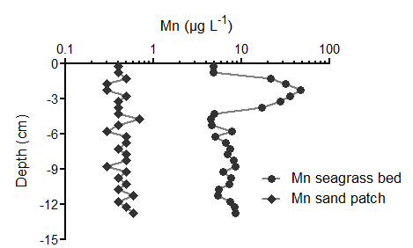
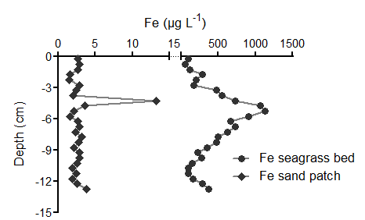
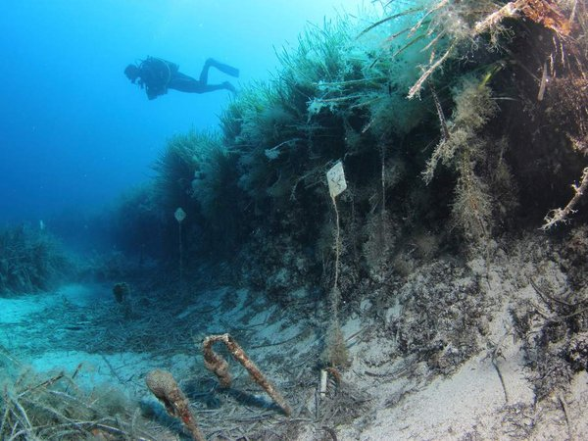
Porewater TE concentrations
APPLICATION
3
Rem.: concentrations in the resine eluats after ICP-MS measurements.

Slide 23
Mussel caging: TE bioaccumulation
APPLICATION
4

Slide 24
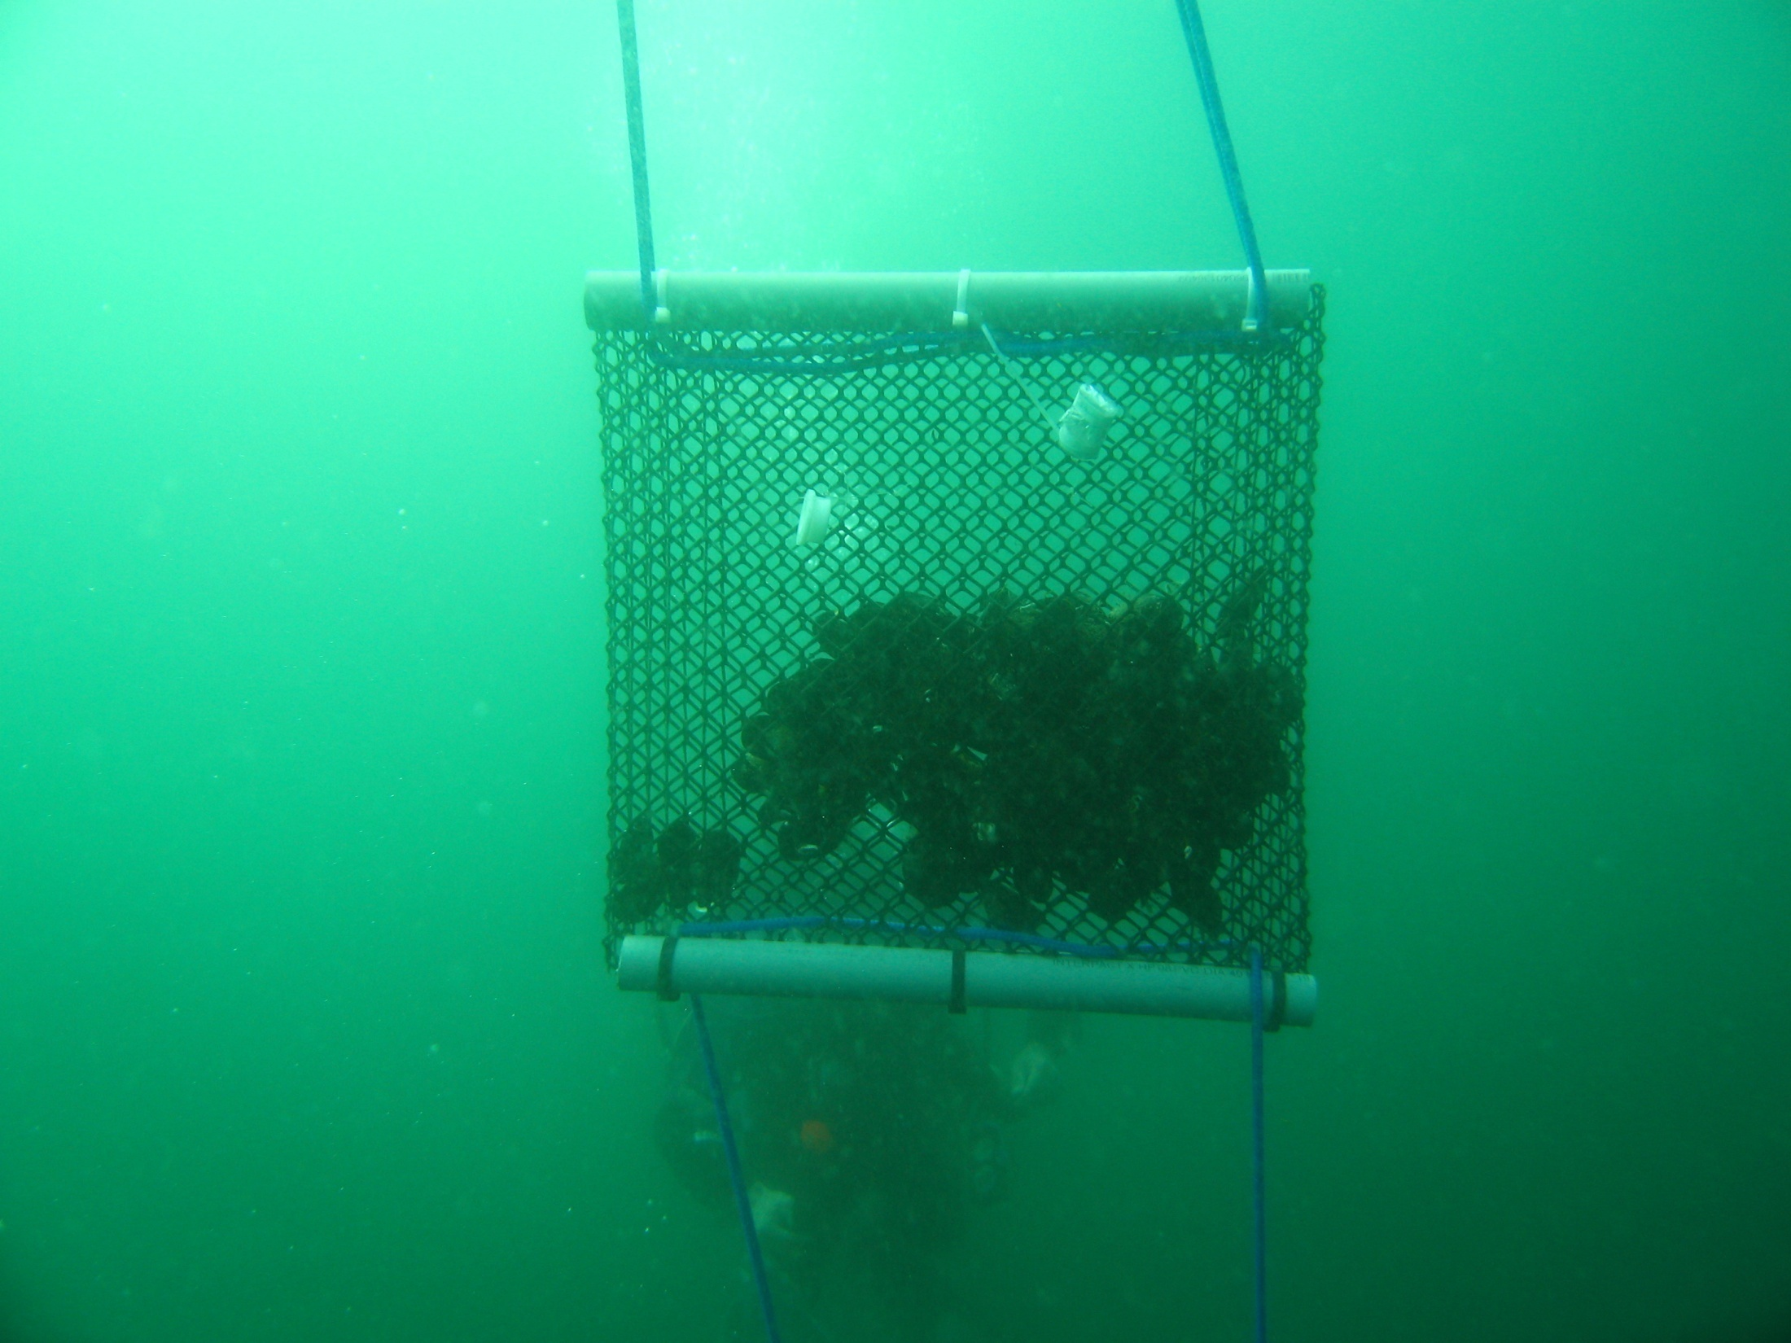
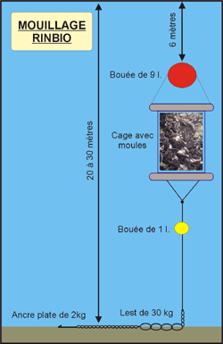
Applications
APPLICATIONS
www.ifremer.fr

Slide 25
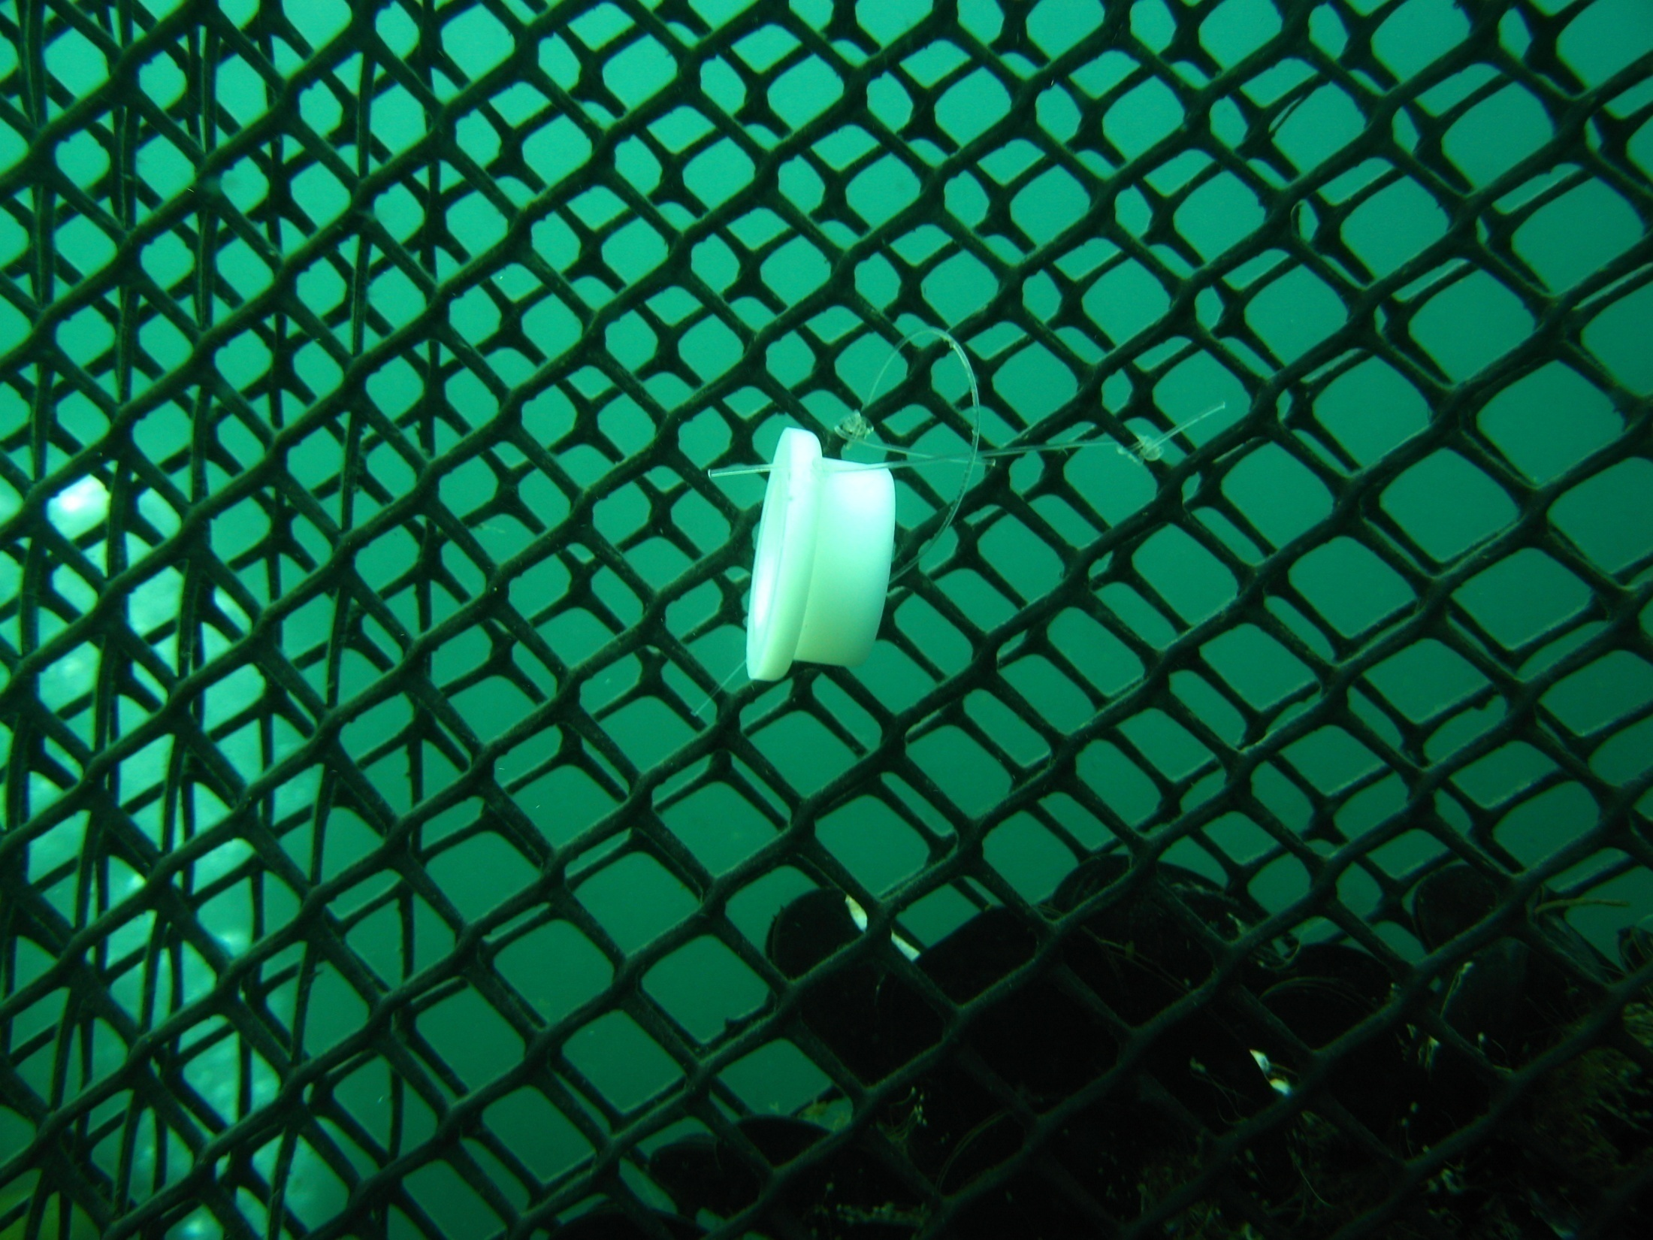

Slide 26
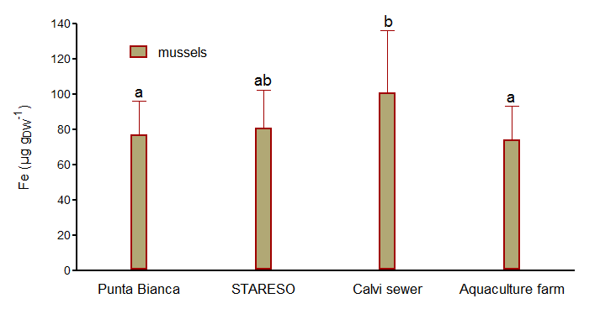
Mussel caging: TE bioaccumulation
Calvi sewer / Aquaculture farm:
mussels = 1.36
APPLICATION
4

Slide 27
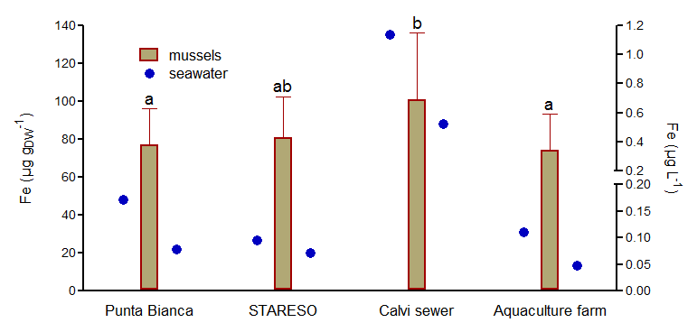
Mussel caging: TE bioaccumulation
Calvi sewer / Aquaculture farm:
mussels = 1.36
APPLICATION
4

Slide 28
Mussel caging: TE bioaccumulation
Calvi sewer / Aquaculture farm:
mussels = 1.36
water ~ 10
APPLICATION
4

Slide 29

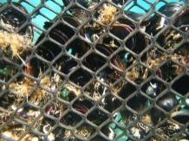

Mussel caging: TE bioaccumulation
Calvi sewer / Aquaculture farm:
mussels = 1.36
APPLICATION
4
7m
22m
top-down contamination

Slide 30
Mussel caging: TE bioaccumulation
Calvi sewer / Aquaculture farm:
mussels = 1.36
7m
bottom-up contamination
13m
20m
40m

Slide 31
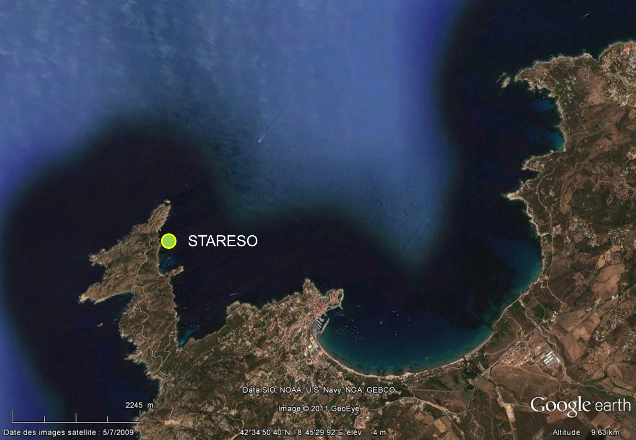
TE kinetics in caged mussels
APPLICATION
5

Slide 32
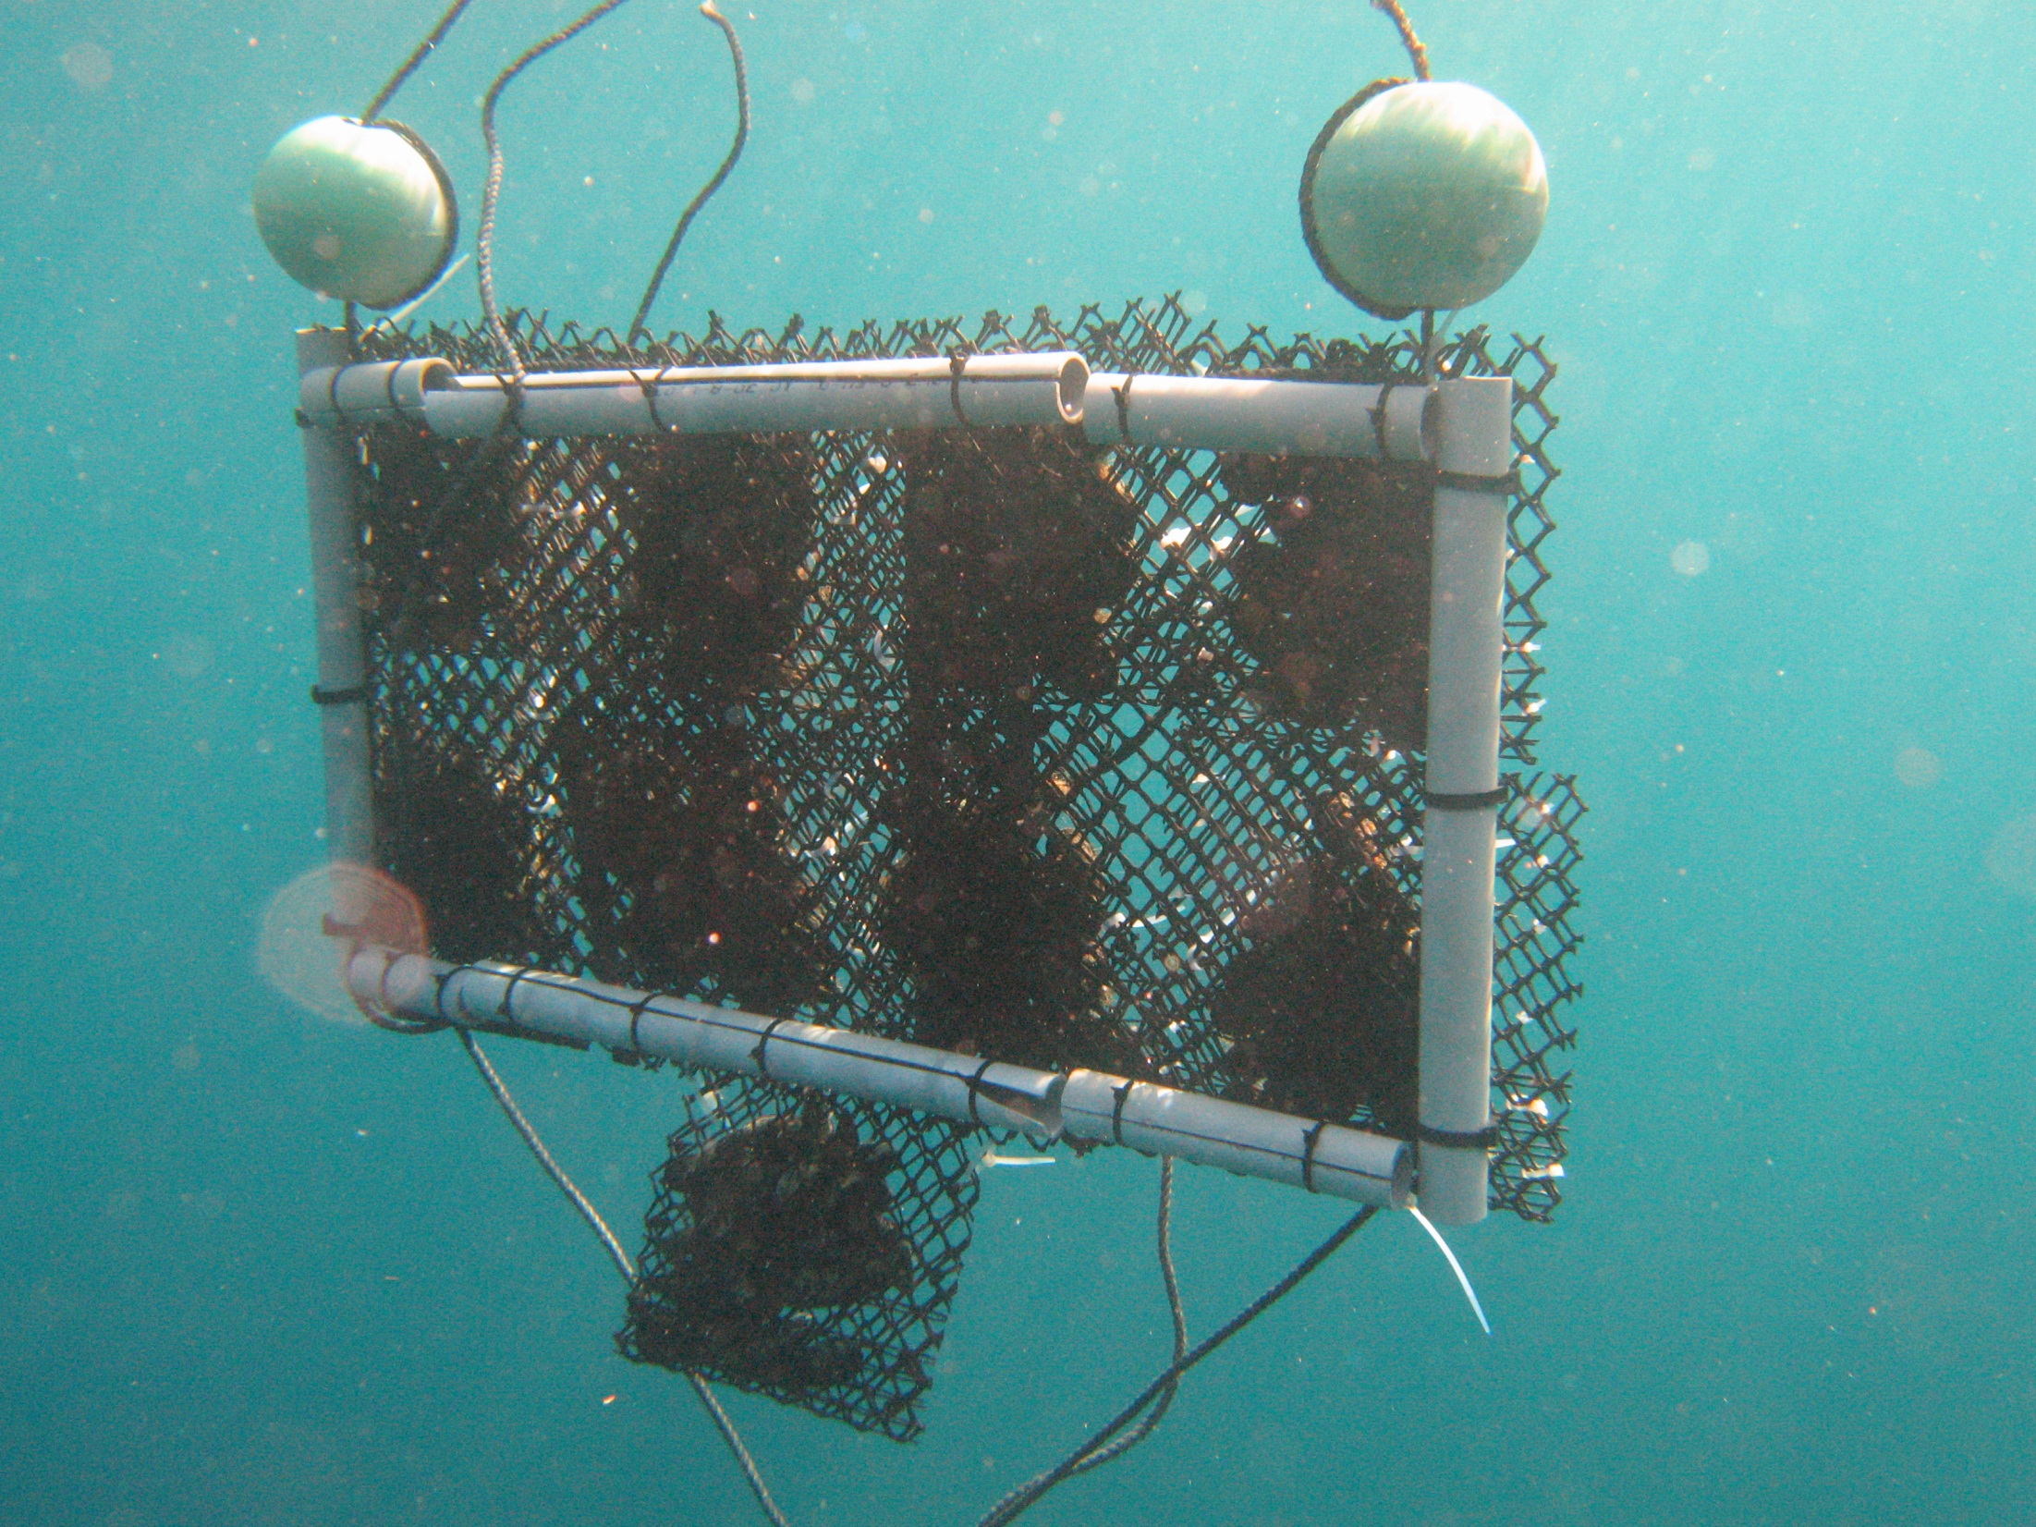

Slide 33
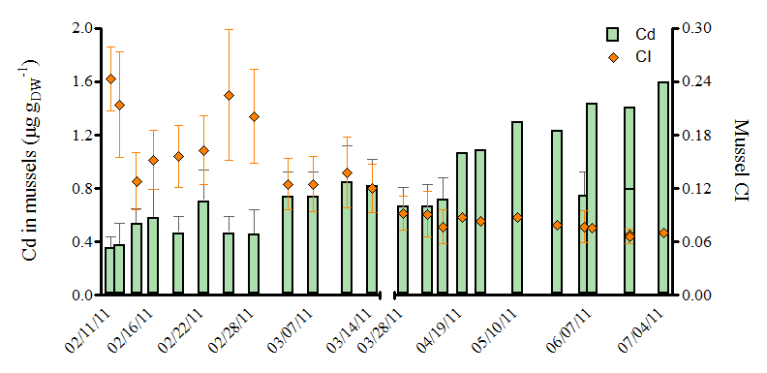
TE kinetic in caged mussels
APPLICATION
5

Slide 34
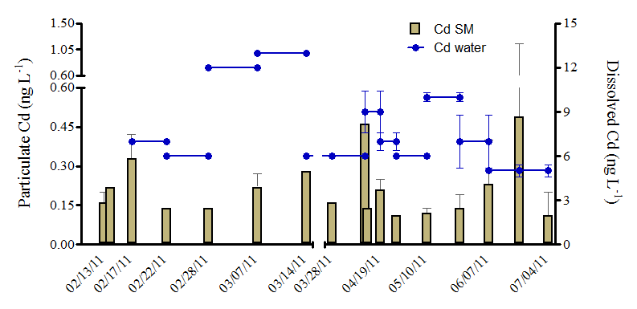
TE kinetic in caged mussels
APPLICATION
5

Slide 35
TE kinetic in caged mussels
what did you expect?

Slide 36


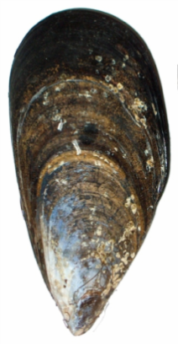
DGTs vs bioindicators
Different and complementary information;
Organism ecology in their chemical environment;
Average TE concentrations over deployment time;
Scheduled monitoring campaigns.
CONCLUSIONS
Combined use in ecological, ecotoxicological and ecosystemic approaches of marine coastal environment functioning.
+
≈
(intheskies / Fotolia.com)

Slide 37
Thank you for your
attention
J. Richir, G. Lepoint,
Donnay, P. Lejeune,
K. Das, S. Gobert.
Donostia-San
Sebastián
01-10-15

