Slide 1
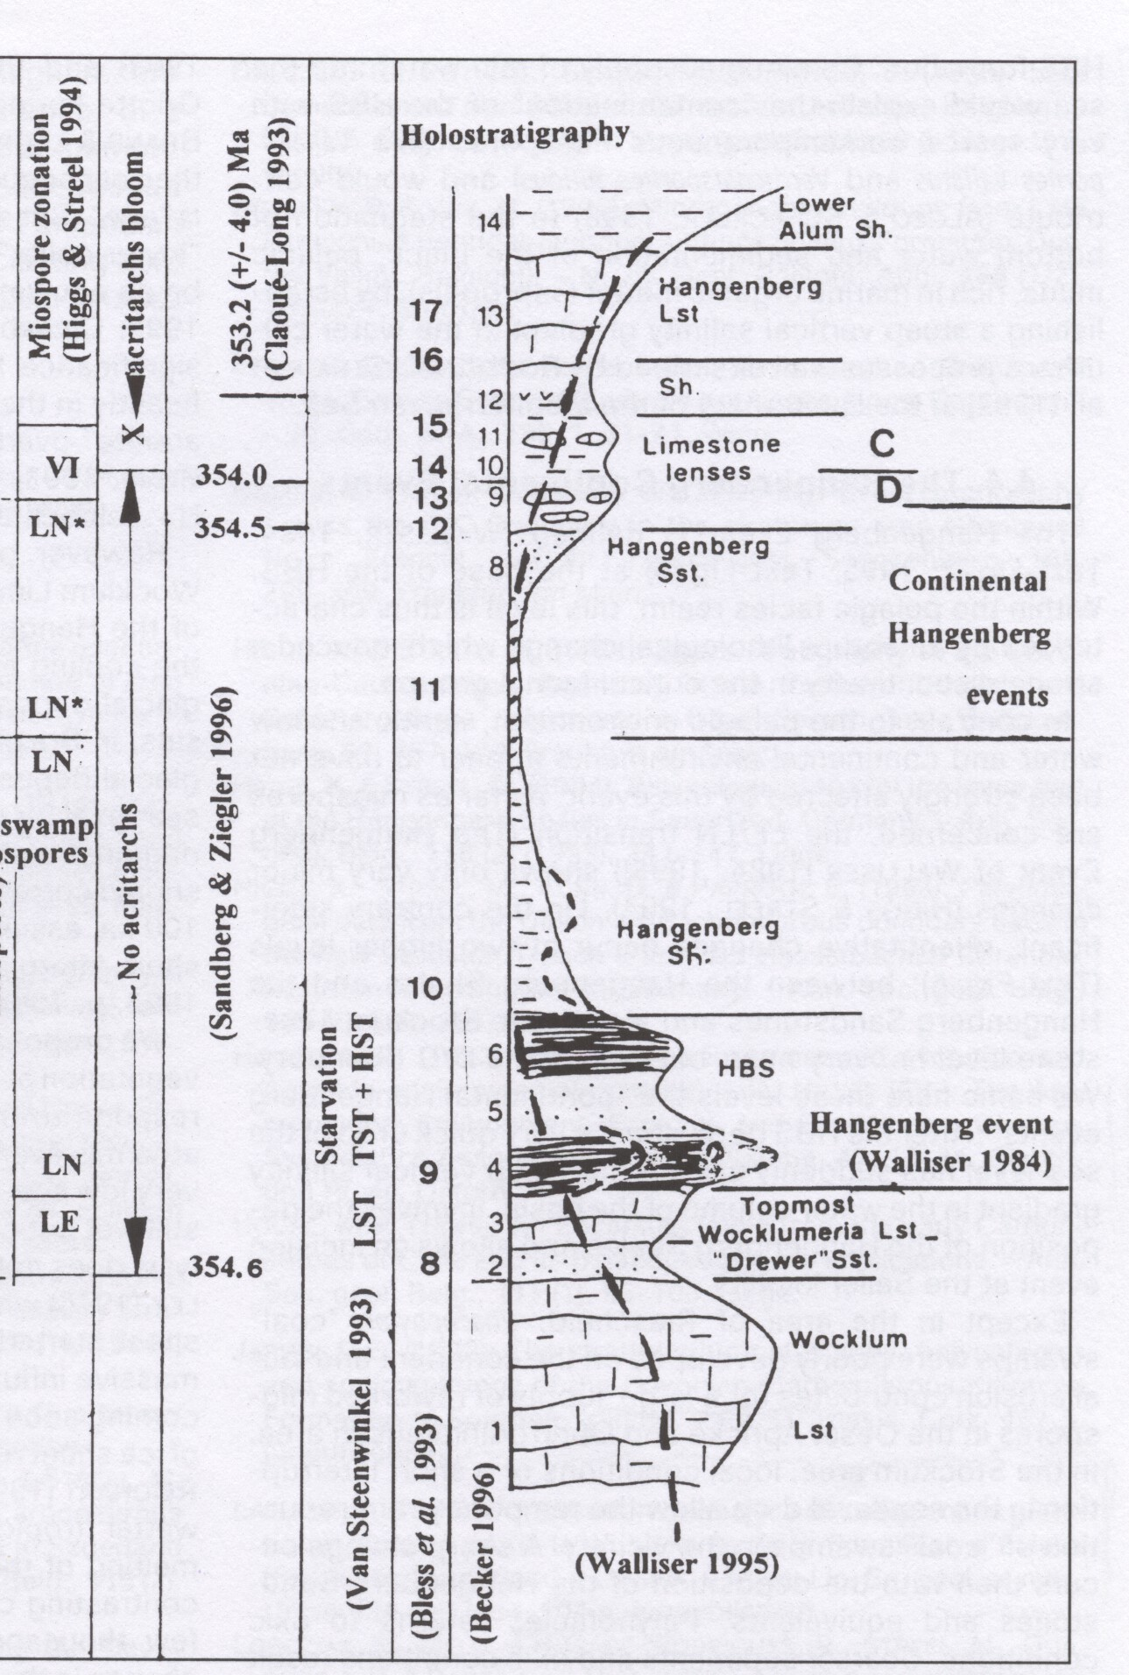
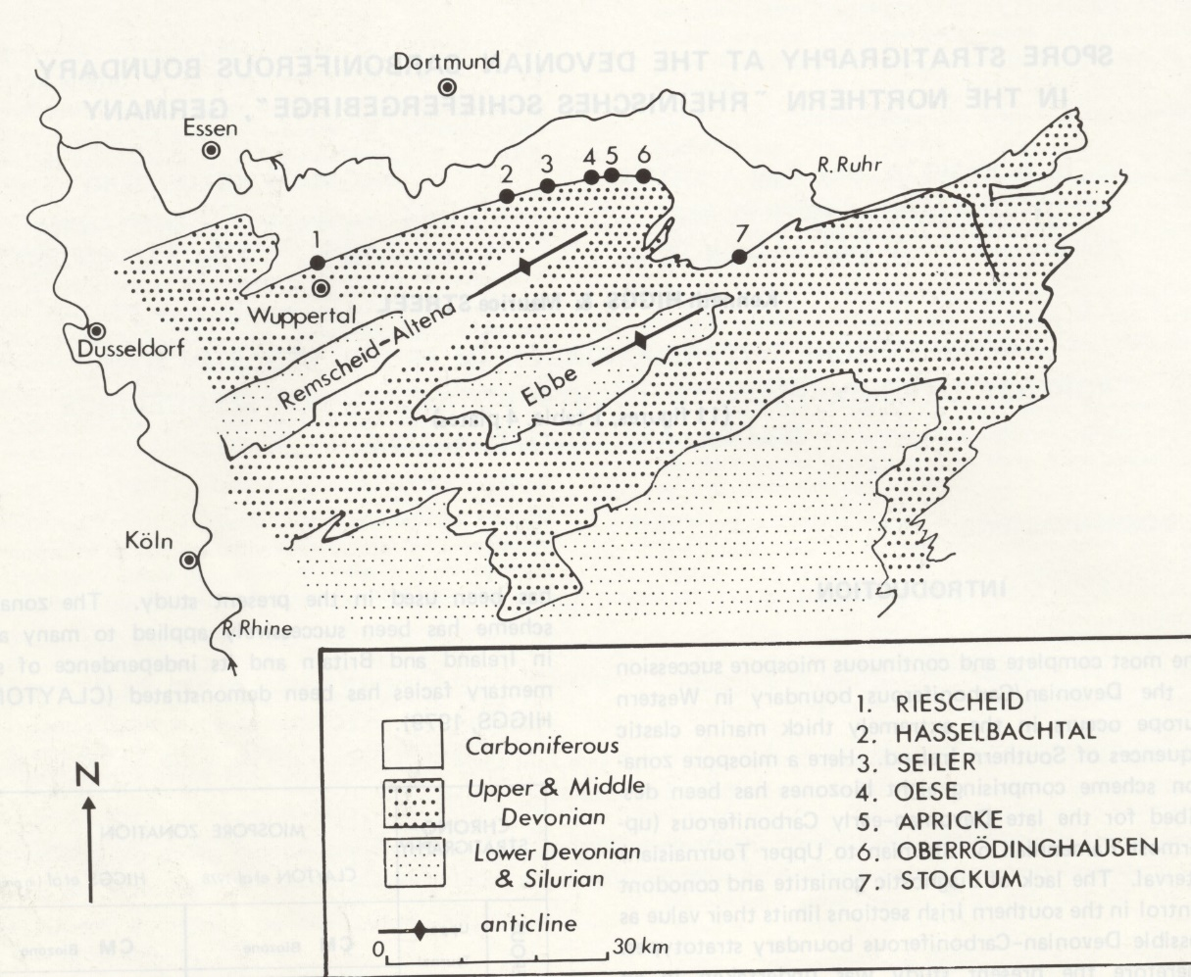
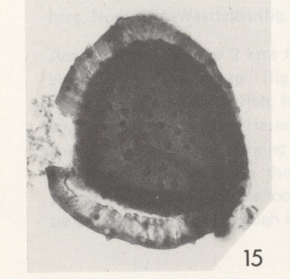
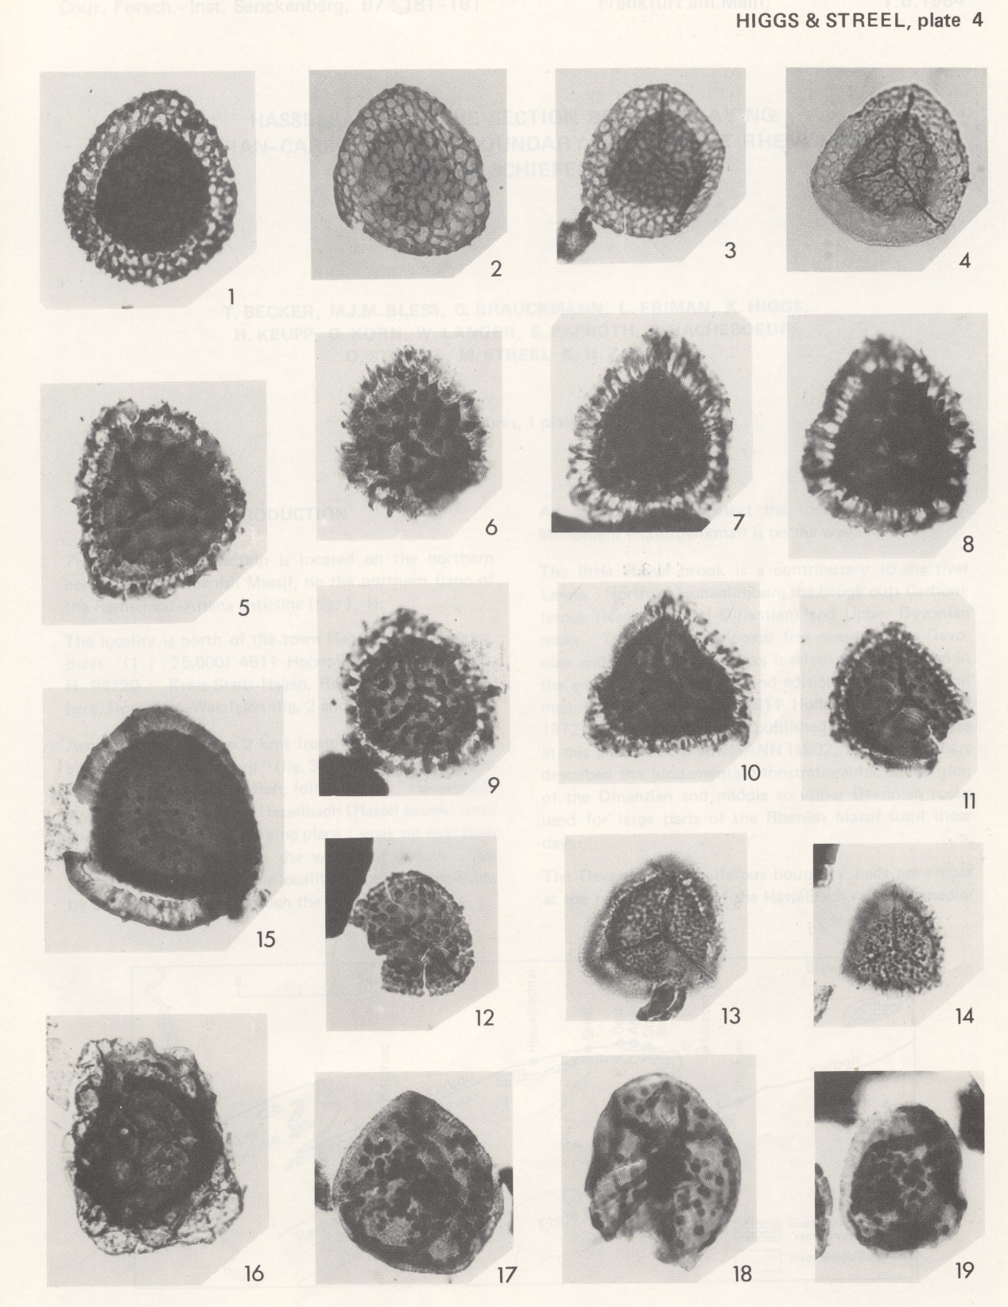
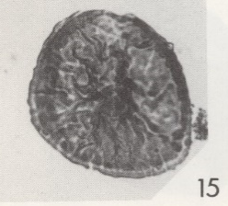
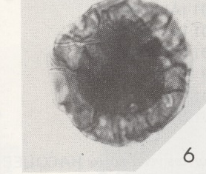
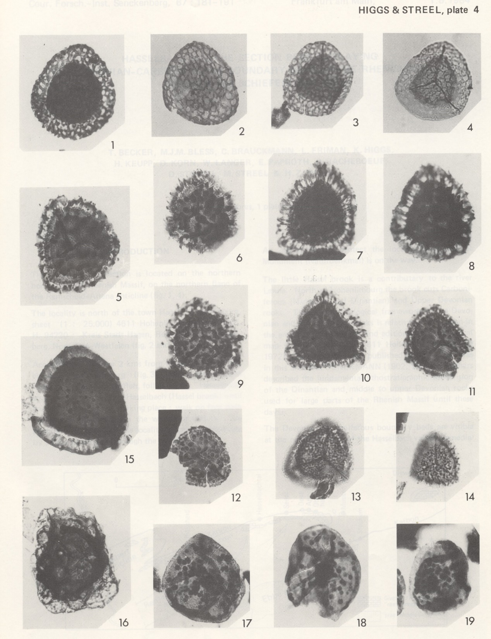
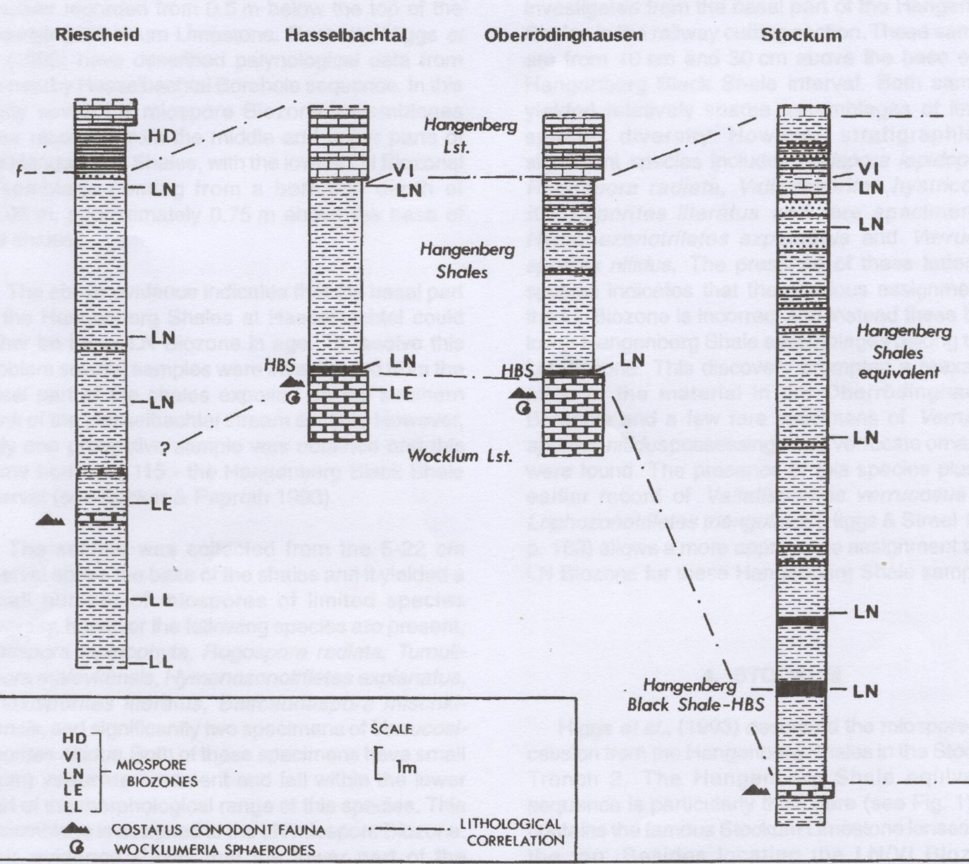
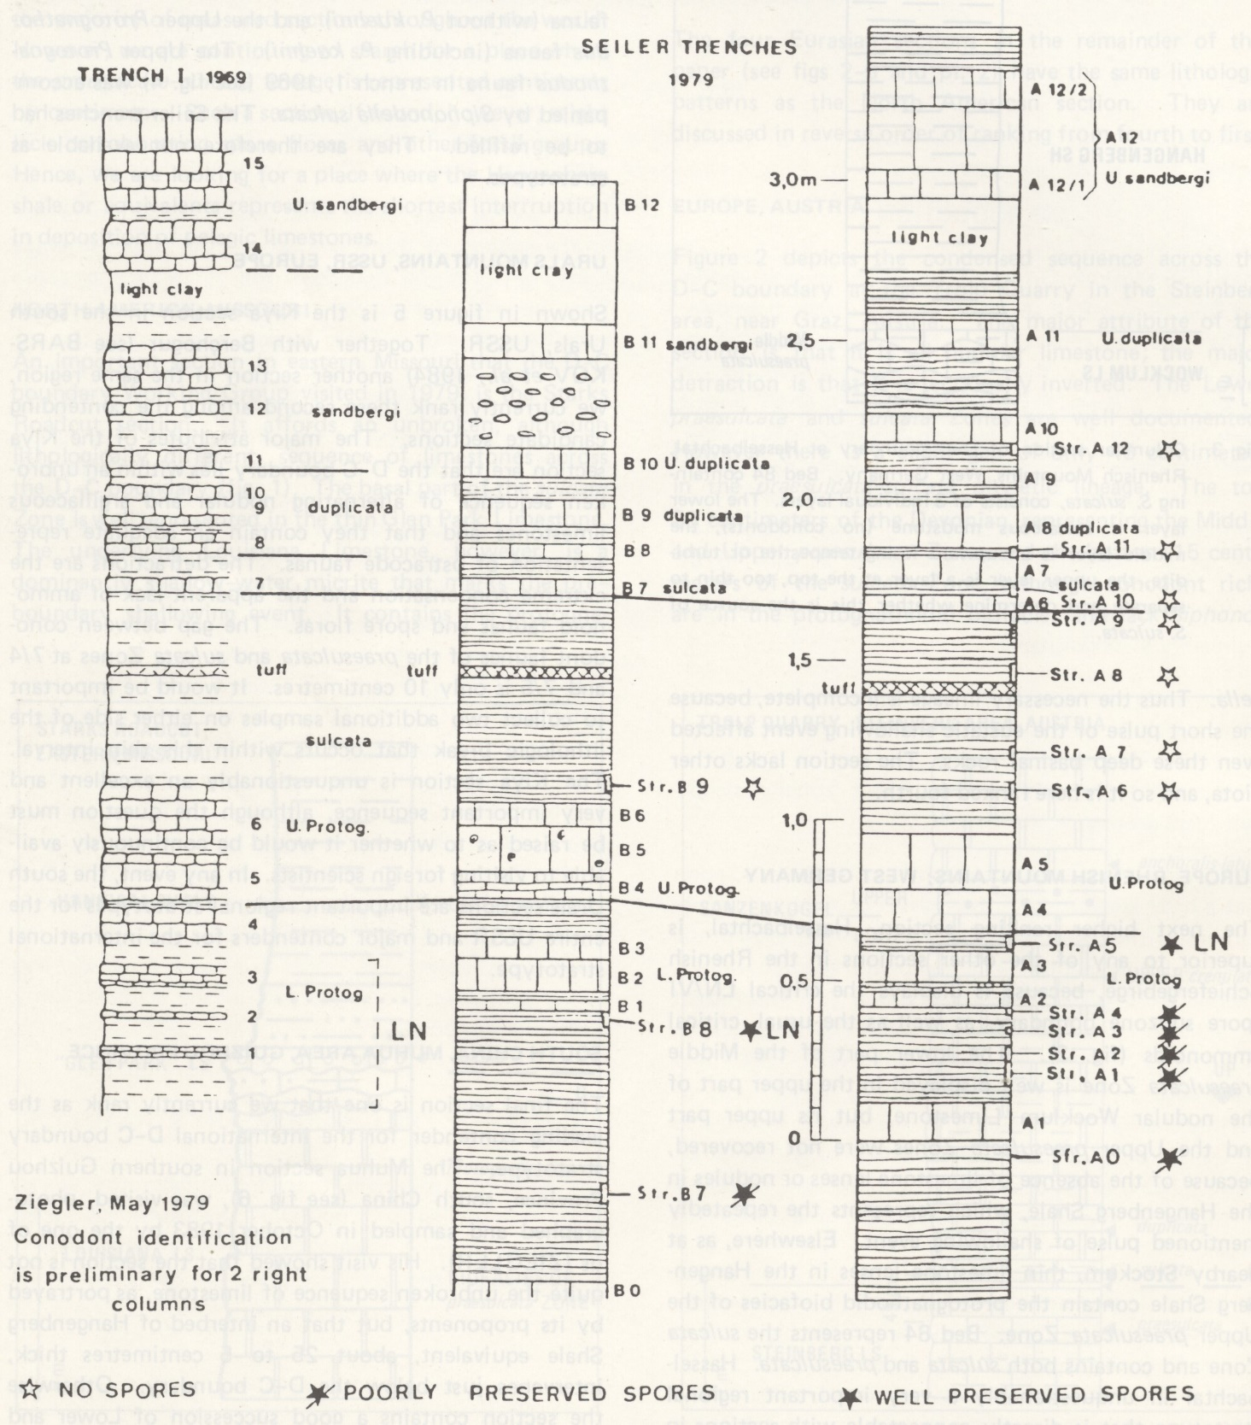
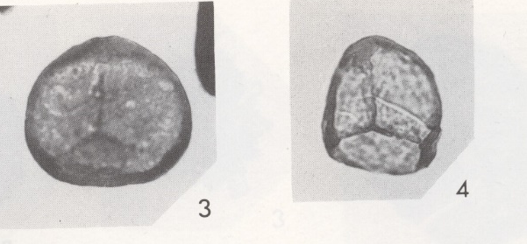
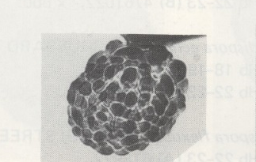
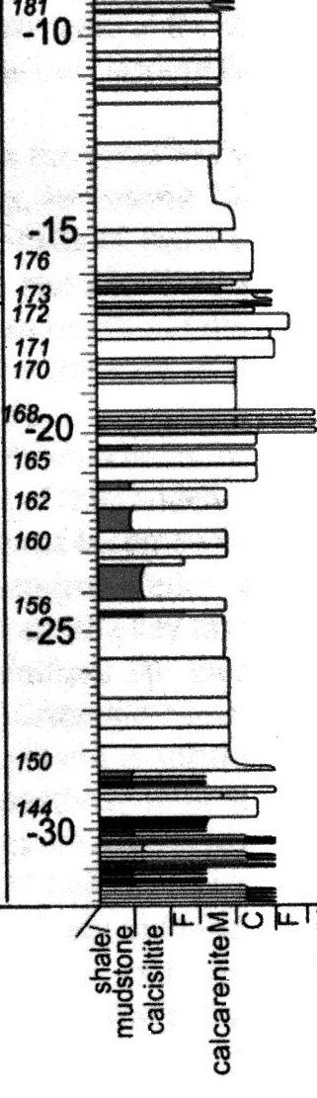
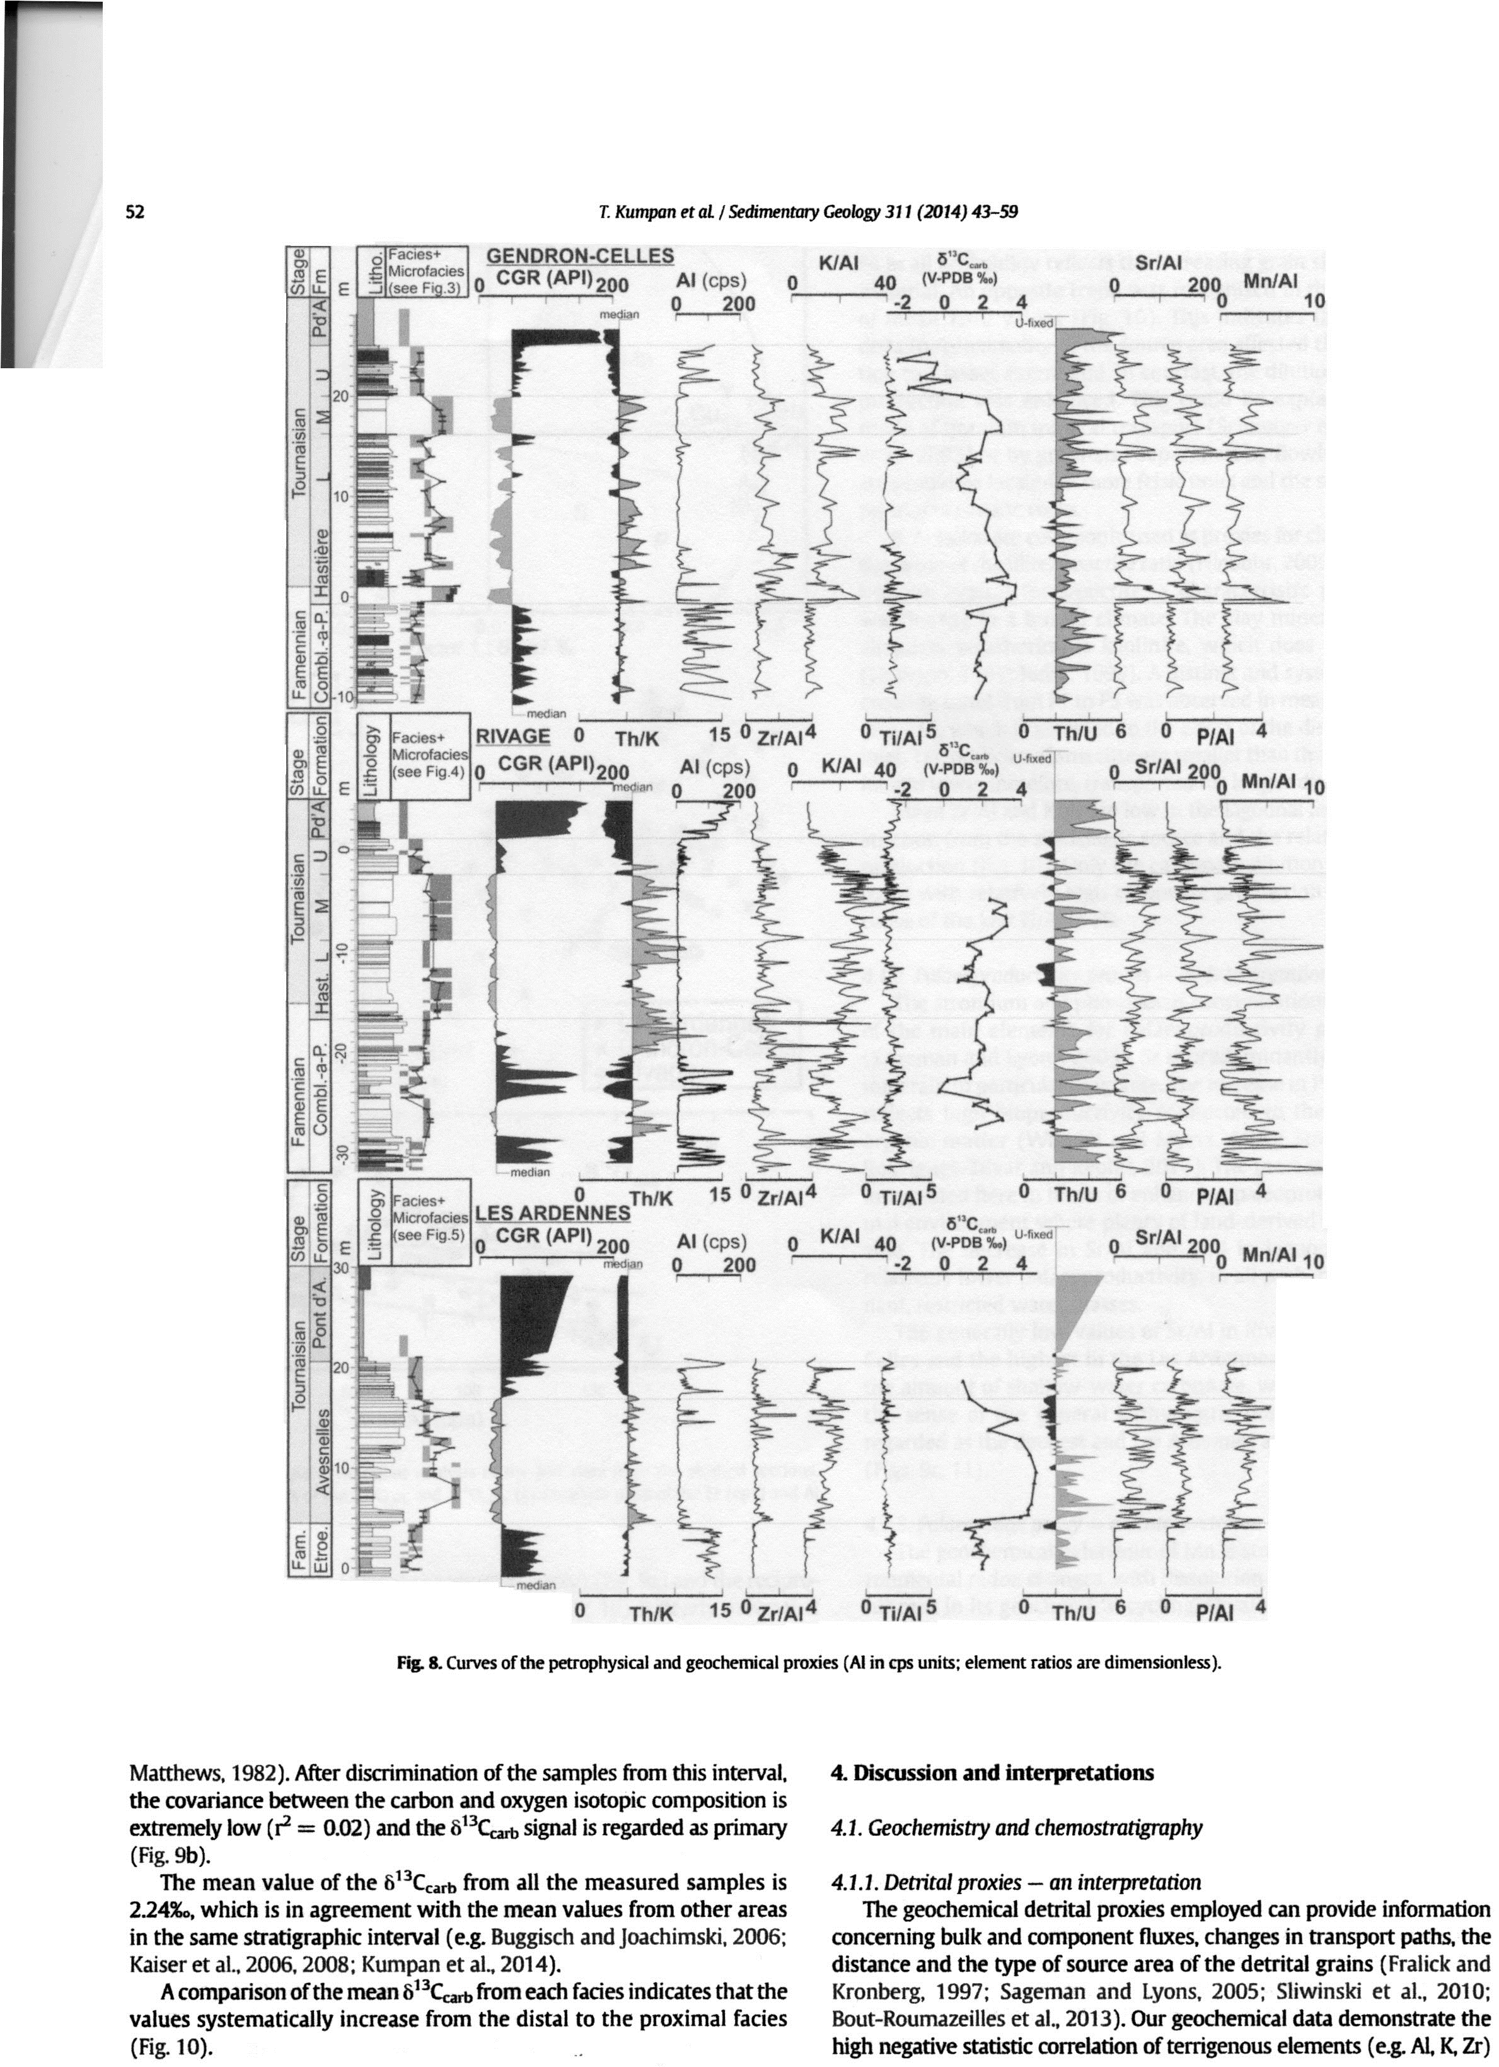
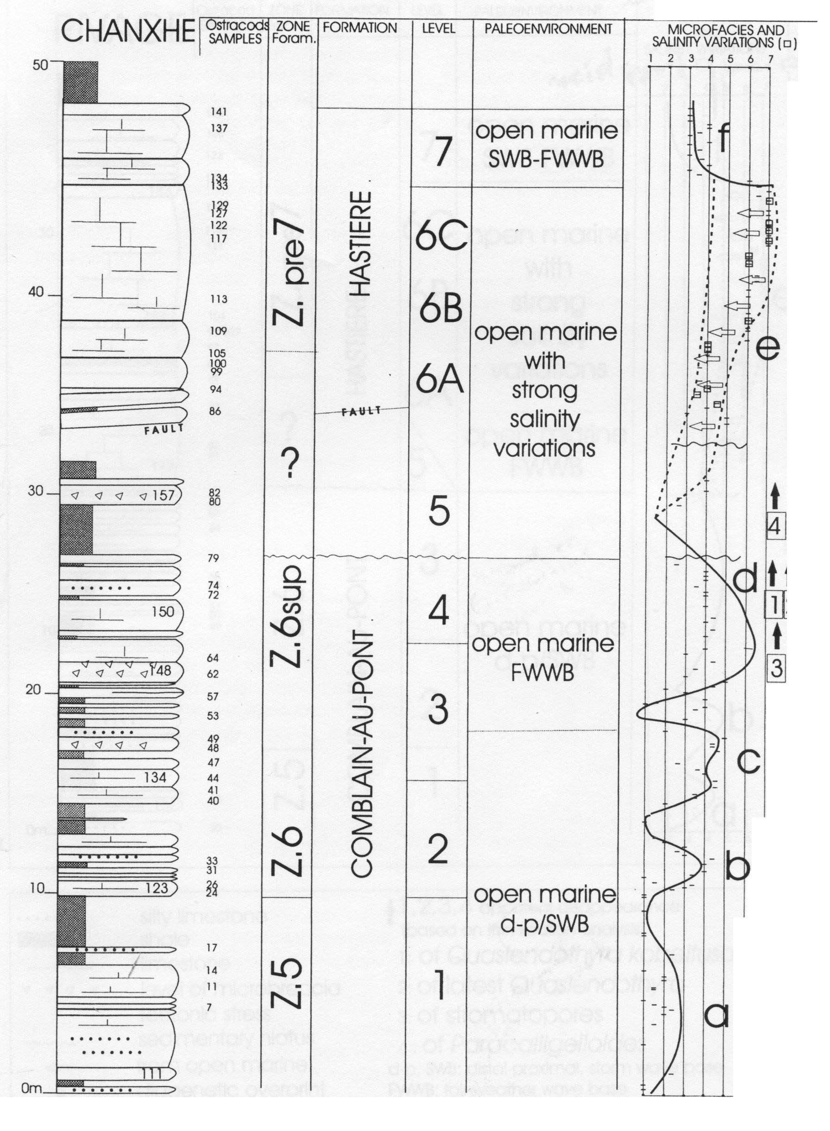
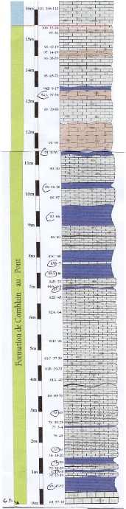

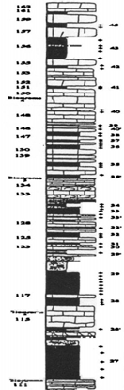









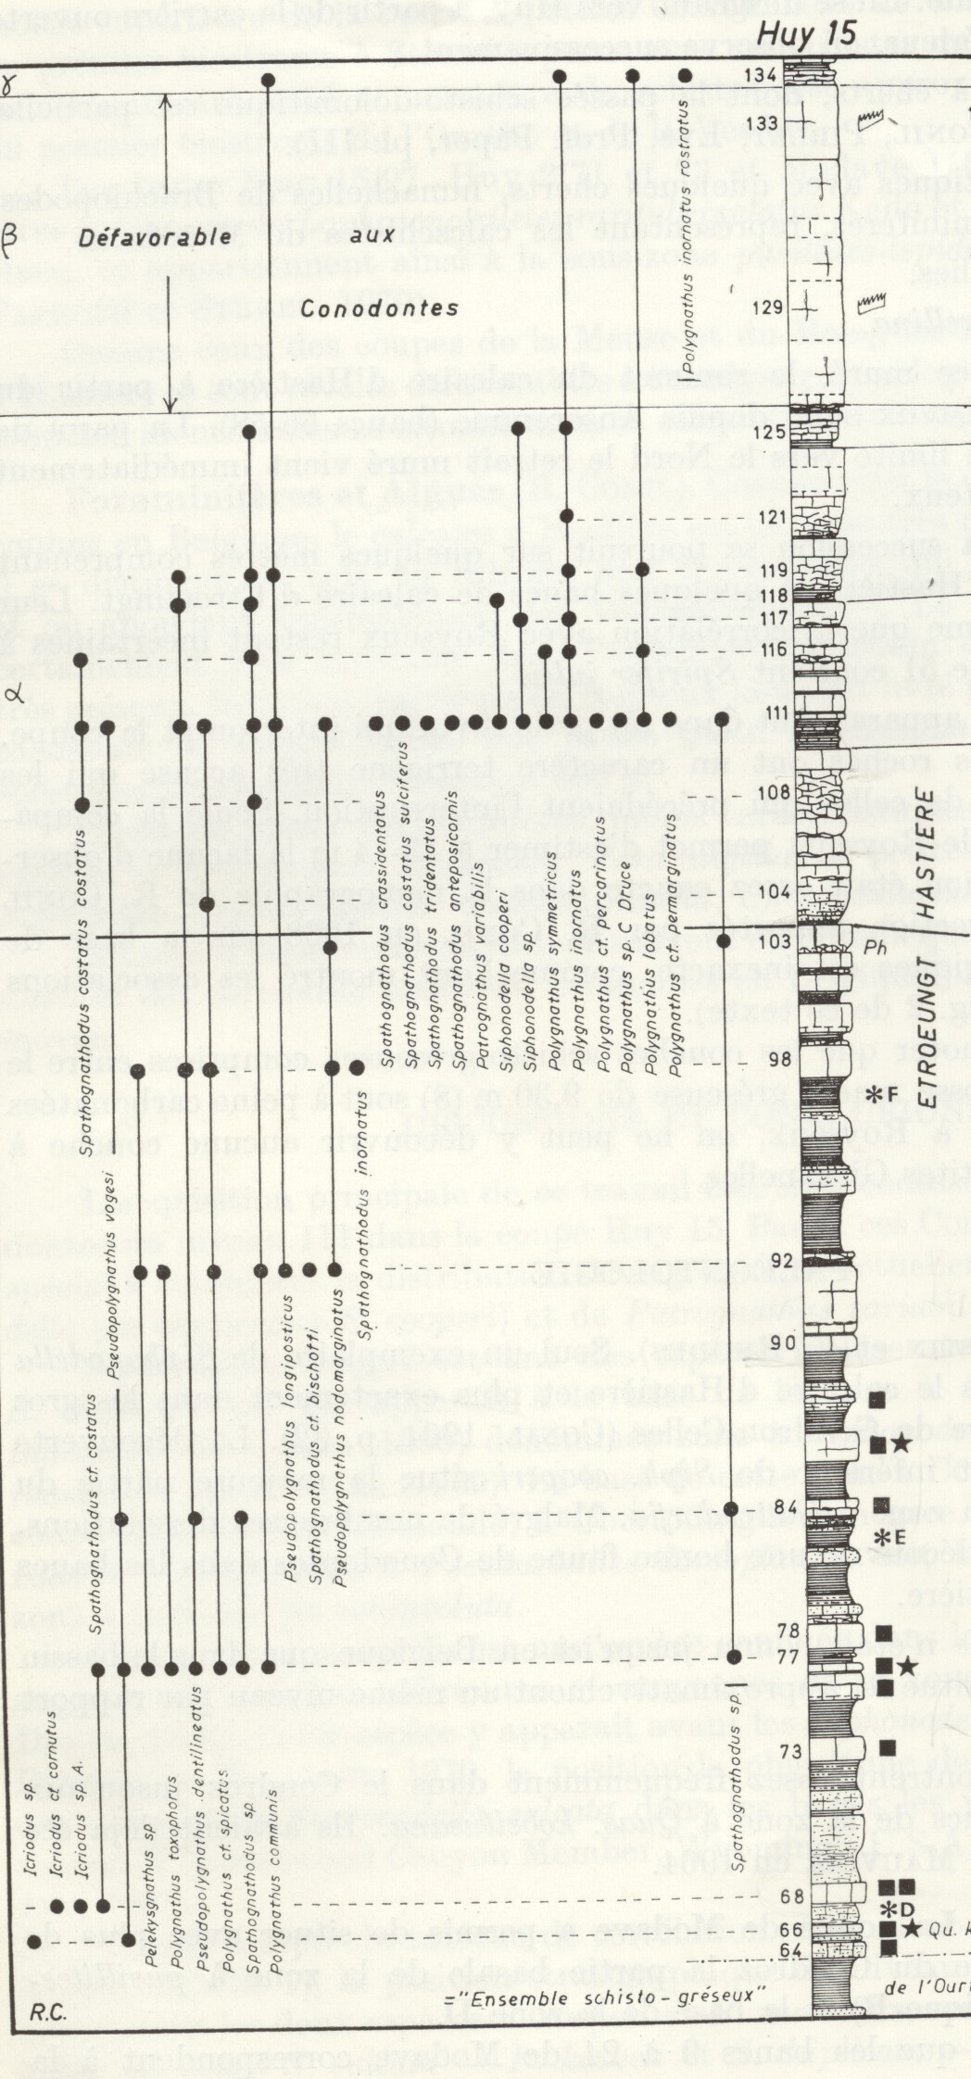

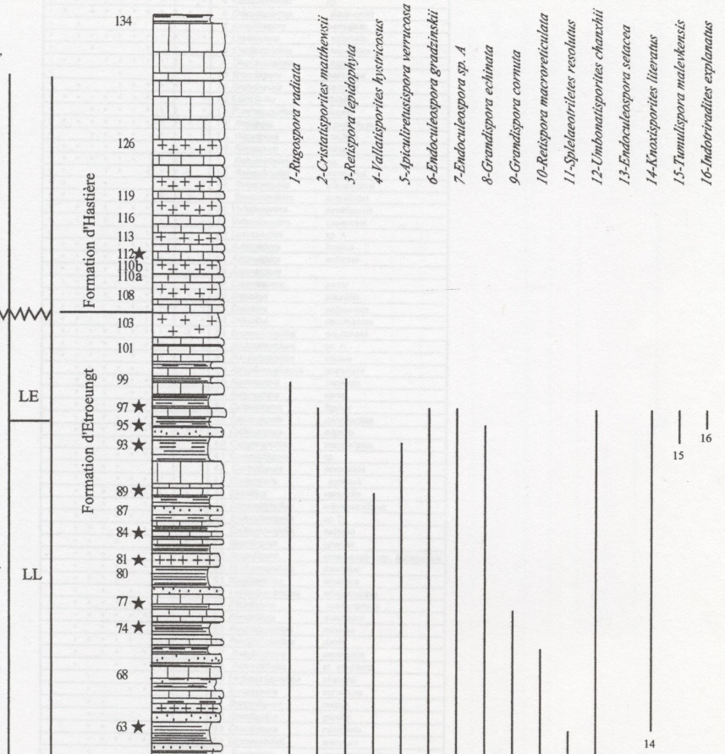
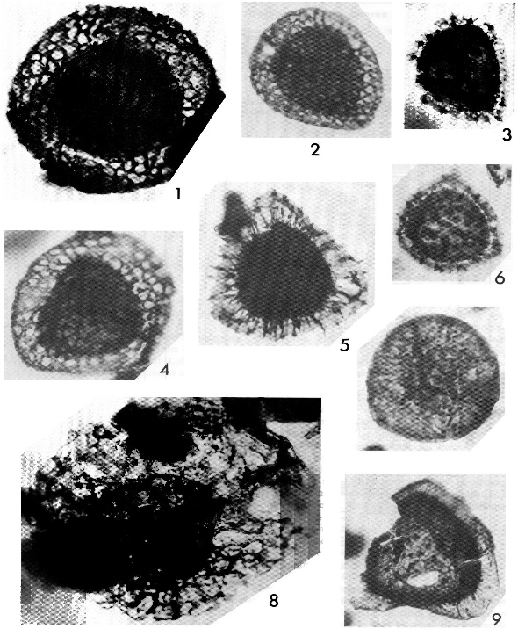
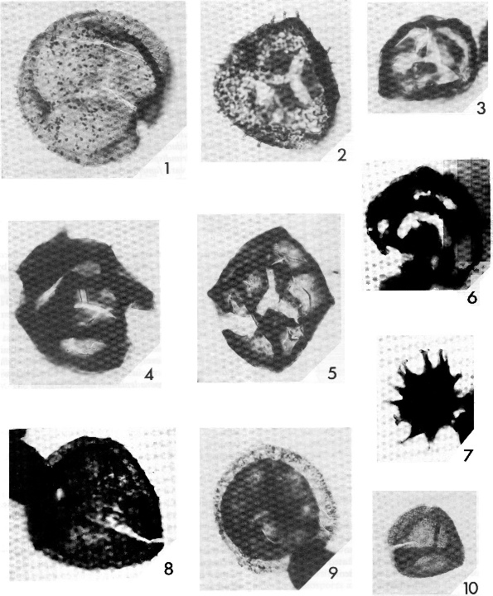
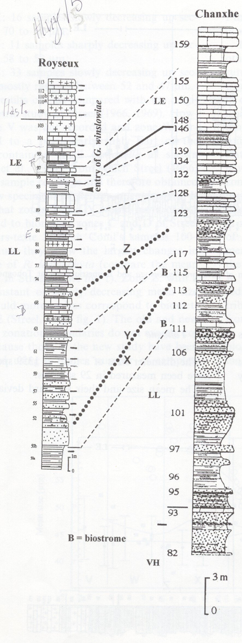
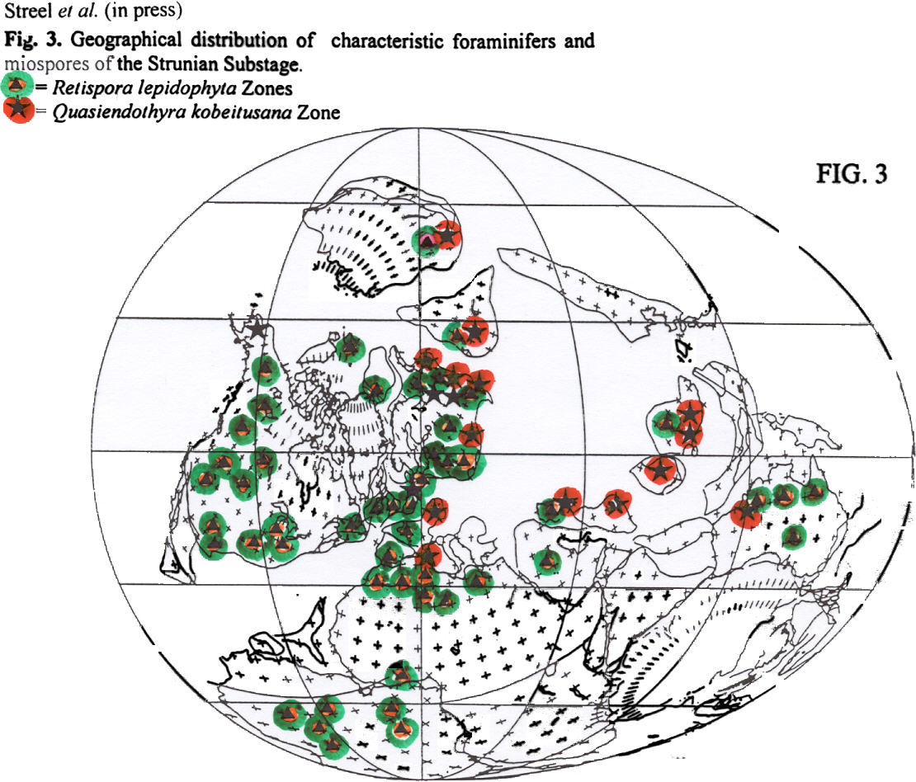
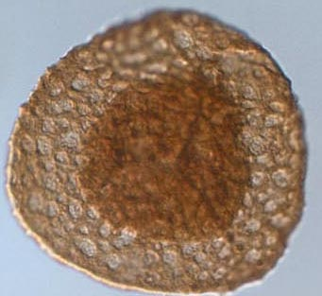
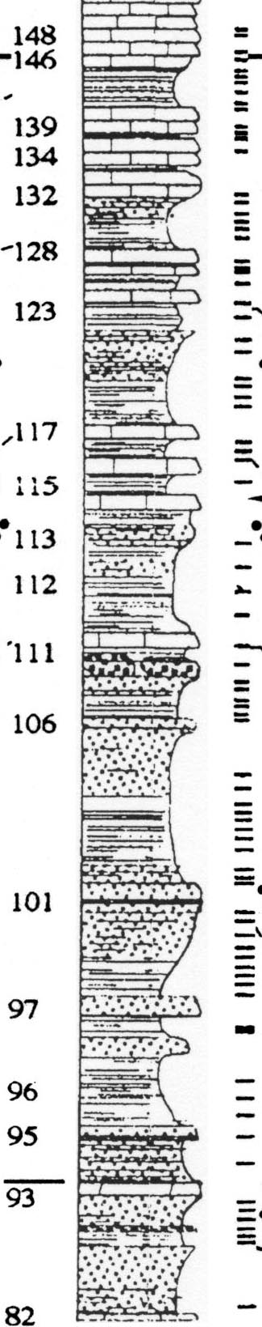
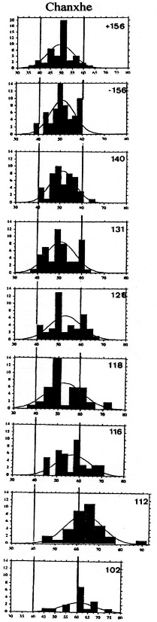
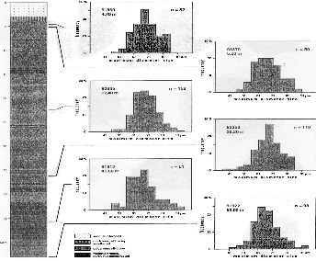
PALYNOMORPHS (MIOSPORES, ACRITARCHS, PRASINOPHYTES) BEFORE AND DURING THE HANGENBERG CRISIS.
Maurice STREEL, University, Geology, Sart Tilman B18, 4000 Liège, Belgium
LE-LN-VI Zones in the Rhenish Massif
Stockum II trench Higgs et al 1993
VI
LN
Rugospora flexuosa
Diducitesversabilis
Indotriradites explanatus
Vallatisporites vallatus
Retispora
lepidophyta
Seiler trenches Ziegler & Sandberg 1984
Higgs & Streel 1994
Streel 1999
Rivage Pont de Scay (left bank)
Kumpan et al 2014
Conil 1964?
Casier et al 2005
Outer ramp Mid-ramp Inner ramp
Sautois 2007 Prestiani et al.
Acritarch and miospore
concentration
Acritarch diversity
Ostracods
(48 taxa)
Shallow semirestricted environments
Chanxhe: Maziane et al. 2002, et al. 2007
LE
Selected acritarch percentage
Leiosphaeridia<20
Gorgonisphaeridium<20
Cymatiosphaera
Pterospermella
Verhyachium
Gorgonisphaeridium>20
Synsphaeridium
Stellinium
Solisphaeridium
Micrhystridium
LE
LE
LE
LLm/LE
LLm
LE
LL
LLm
LLm
LLm
LLm
kobeitusana
transition
LLl
Late expansa
Strunian base
Austin et al 1970
LL-LE Zones in the Ardennes
0 10000 20000 0 5 10 15 100% 80% 60% 40% 20%
Maziane 1999
Maziane et al 2002
Maziane et al 2002
Maziane et al 2002
Retispora lepidophyta
Chanxhe
60µ
Late expansa
Middle expansa
Middle expansa
Palynol. Sampling
Refrath borehole
Conil 1964
Streel & Hartkopf-Fröder 2005

