Slide 1
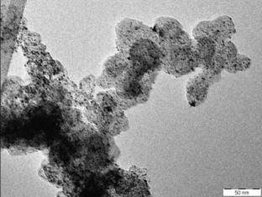
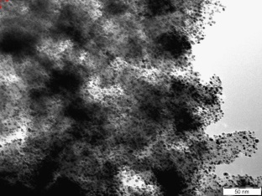
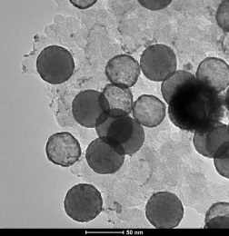
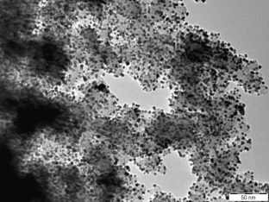
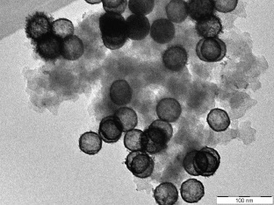
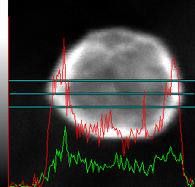
Synthesis and characterisation of
Pt-Co/carbon xerogel electrocatalysts
for Proton Exchange Membrane Fuel Cells (PEMFC)
A. Zubiaur*¹, T. Asset^{1,2,3}, P.-Y. Olu^{1,2,3}, L. Dubau^{2,3}, F. Maillard^{2,3}, N. Job¹
¹ Department of Chemical Engineering – Nanomaterials, Catalysis, Electrochemistry, University of Liège, 4000 Liège, Belgium
² CNRS, LEPMI, F-38000 Grenoble, France
³ Univ. Grenoble Alpes, LEPMI, F-38000 Grenoble, France
(*Contact: a.zubiaur@ulg.ac.be)
The catalytic layers used in proton exchange membrane fuel cell (PEMFC) are classically based on Pt particles supported on a high surface area carbon (HSAC). The structure of these catalytic layers is however not optimal, resulting in incomplete utilization of the mass of Pt loaded onto the carbon support [1]. To reduce the cost of the catalytic layer without decreasing its performance, two parameters can be improved: the support and the metallic particles. The properties of commonly used carbon blacks, as described by Rodríguez-Reinoso [2] are not optimal for electrocatalysis. A possible solution to these drawbacks is to use synthetic nanostructured materials with a controllable, reproducible texture and with a pure, known and constant chemical composition; carbon xerogels (CX) exhibit such properties [3]. Highly dispersed CX-supported Pt nanoparticles catalysts (Pt/CX) have been synthesized via formic acid (HCOOH) reduction inspired from a previous work of Alegre [4]. However, the decrease of the Pt mass contained in the PEMFC electrodes, in particular at the cathode where the oxygen reduction reaction (ORR) occurs, remains a major challenge. Improving the ORR mass activity is currently best achieved by alloying Pt with 3d-transition metal atoms such as cobalt (Co). These alloys show better ORR performance due to the substitution of some Pt atoms by 3d-metal atoms with smaller radius, which leads to a modified Pt electronic structure [5]. Bimetallic catalysts (PtCo₃/CX) were synthesized via a new method using trisodium citrate in order to obtain core@shell or hollow particles. These particular nanostructures could induce an increase in mass activity for the ORR.
1. Commercial catalyst
2. Pt/CX catalysts
3. PtCo₃/CX catalysts
1. Commercial Catalyst
Core@shell
particle
50 nm
Hollow
particles
Tanaka 37 wt.% Pt/HSAC TEM micrograph
50 nm
50 nm
4. Particle size
4. Particle size
Catalyst | d_{TEM} (nm) | σ (nm)
Tanaka 37 wt.% | 3.1 | 1.1
18 wt.% Pt/CX | 2.8 | 1.0
39 wt.% Pt/CX | 3.6 | 1.2
10 wt.%_{Pt} PtCo₃/CX-A | 47.8 | 2.6
10 wt.%_{Pt} PtCo₃/CX-B | 45.8 | 2.0
*
50 nm
50 nm
18 wt.% Pt/CX (top) and 39 wt.% Pt/CX (bottom) synthesized by HCOOH reduction TEM micrographs
10 wt.%_{Pt} PtCo₃/CX-A (top) and
10 wt.%_{Pt} PtCo₃/CX-B (bottom) TEM micrographs
* Some agglomerates were observed
5. ORR activity
Tanaka 37 wt.%
18 wt.% Pt/CX
39 wt.% Pt/CX
10 wt.%_{Pt} PtCo₃/CX-A
10 wt.%_{Pt} PtCo₃/CX-B
EDX line-scans and HAADF image of a single PtCo hollow particle, the profiles show Pt (red profile) and Co (green profile) over the entire particle.
6. Hollow particles
Higher specific and
mass activity
Specific activity and mass activity for the ORR at 0.9 and 0.85 V vs. RHE in 0.1 M HClO₄
Less platinum
The Tanaka 37 wt.% Pt on HSAC, i.e. the commercial catalyst used as reference, and the 18 wt.% Pt/CX catalyst display similar average particle diameter, 3.1 and 2.8 nm respectively, and the same standard deviation, 1.1 and 1.0 nm. The 39 wt.% Pt/CX catalyst presents a slightly higher particle diameter, 3.6 nm, with the same standard deviation, 1.2 nm. A combination of core@shell and hollow nanoparticles was obtained for the PtCo₃/CX catalysts with a diameter of ca. 47 nm. Such nanoparticles were synthesized by the formation of a Co core followed by the deposition of a PtCo shell by (i) galvanic replacement and (ii) chemical reduction of Pt and Co by NaBH₄. The Pt/CX and the PtCo₃/CX catalysts have a higher specific and mass activity toward the ORR than the Tanaka 37 wt.%. This can be explained by (i) an improved nanoparticle distribution on the support, CX instead of HSAC, (ii) a modification of the Pt electronic structure induced by Co atoms (for the PtCo₃/CX catalyst) and (iii) the core@shell – hollow morphology. These results, obtained by a new synthesis process using trisodium citrate, are promising. Further experiments are planned by our groups to optimize the nanoparticles morphology and activity.
[1] H. A. Gasteiger, et al. Appl. Catal. B : Environmental 56 (2005) 9-35. [2] F. Rodriguez-Reinoso, in: Porosity in carbons, J. W. Patrick (Ed.), Wiley, UK, 1995, p.153. [3] N. Job, et al. Carbon 43 (2005) 2481. [4] C. Alegre, et al. Appl. Catal. B : Environmental 147 (2014) 947-957. [5] J. R. Kitchin, et al. Journal of Chemical Physics 120 (2004) 10240.

