Slide 1



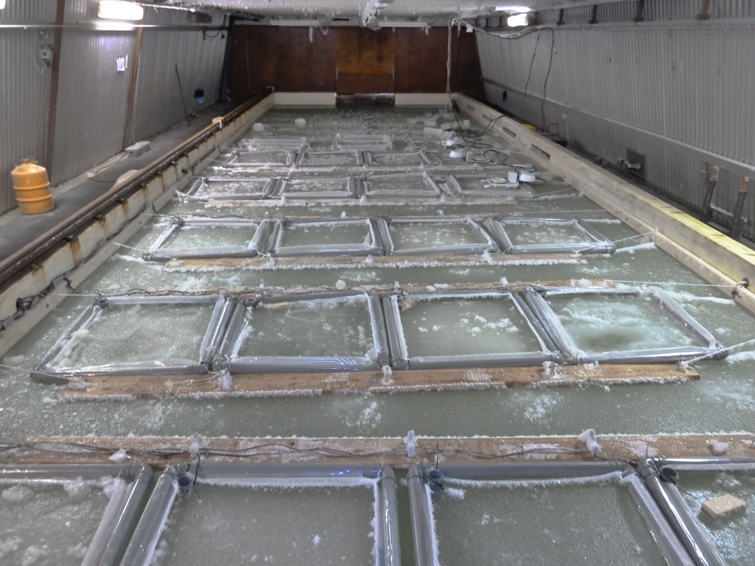




The study of air-ice CO₂ exchange emphasize the importance of gas bubble transport during sea ice growth
Marie Kotovitch^{1,2}, Sébastien Moreau³, Jiayun Zhou^{1,2}, Jean-Louis Tison², Fanny Van der Linden¹, Gerhard Dieckmann⁴, Karl-Ulrich Evers⁵, David Thomas^{6,7} and Bruno Delille¹
Carbon dioxide (CO₂) plays a crucial role in climate changes and global warming. Sea ice is involved in CO₂ exchanges between the ocean and the atmosphere. In the present study, we used a tank that allows to control freezing of seawater in order to reproduce ice growth and decay over a 19 days experiment. The aims of this study were to: (1) determine a gas transfer coefficient for CO₂ in sea ice during its growth, (2) understand the processes responsible for CO₂ transport between air and sea ice by comparing our results with a 1D biogeochemical model.
Materials and Methods: The temperature of the atmosphere above the tank water was set to -15 °C the first 14 days, then to -1 °C until the end of the experiment. We measured continuously in situ ice temperature, underwater salinity and air-ice CO₂ fluxes. Ice cores were also collected regularly to measure biogeochemical variables.
INTRODUCTION
F = air-ice CO₂ fluxes
dC = air-ice difference in CO₂ partial pressure
dx = depth in ice for air-ice CO₂ exchange
Cooling ->
Warming ->
Cooling ->
Warming ->
We measured temperature and air-ice CO₂ flux in continuous with a chamber over the ice. Sea ice shifts from:
(i) a sink during the first crystals formation,
(ii) to a source during ice growth and, finally
(iii) return to a sink during ice melt.
From the difference in partial pressure of CO₂ in the air and the ice, we calculated daily dC.
The evolution of dC is consistent with measured flux (F), shifting from: (i) negative, (ii) to positive and, finally (iii) return negative.
We define dx from the observation of the total inorganic carbon (DIC) profiles. We observed a CO₂ depletion in the 12 first centimetres. We assumed that it was due to a CO₂ release from the ice to the air.
Gas transfer coefficient : K = F / (pCO_{2 ice} - pCO_{2 air} ) = 2,5 mol m⁻² d⁻¹ atm⁻¹
We included the 3 parameters determined above in the equation define by Liss and Slater (1974) and Sarmiento and Gruber (2004) and deduced a gas transfer coefficient for CO₂ (K). This coefficient is applicable for a growing permeable and artificial sea ice.
1D MODELLING EMPHASIZES THE ROLE OF BUBBLE
TAKE HOME MESSAGES:
Sea ice exchange gas with the atmosphere
During sea ice growth, gas are transported by diffusion and buoyancy while convection is limited
The gas transfer coefficient for CO₂ at the air- ice interface of growing sea ice is 2,5 mol m⁻² d⁻¹ atm⁻¹
Our 1D model can simulate air-ice CO₂ fluxes and point to the role of gas bubbles in sea ice
Gas bubbles may explain a large part (~ 92 %) of the observed CO₂ fluxes in the present experiment
To mimic the observed air-ice CO₂ fluxes, we used the 1D model of Moreau et al. (2015). The inversion between outward CO₂ fluxes during ice growth and inward CO₂ fluxes during ice melt depicts well the observations. However, the model (M2015) strongly underestimates the fluxes during the cold phase if the formation rate of gas bubbles is low. Since ice is permeable throughout the cold phase, higher gas bubble formation rates lead to higher CO₂ fluxes (i.e. gas bubbles escape the ice surface and add to the outward CO₂ flux).
¹Unité d’Océanographie Chimique, Ulg, Belgium, ²Laboratoire de Glaciologie, ULB, ³Georges Lemaître Centre for Earth and Climate Research, UCL, ⁴Alfred Wegener Institute Helmhotz Center for Polarand Marine Research, Germany, ⁵Hamburgische Schiffbau-Versuchsanstalt GmbH (HSVA), ⁶Marine Research Center, Helsinki, Finland, ⁷School of Ocean Sciences, Bargor University, United Kingdom
References: Moreau et al., 2015. Drivers of inorganic carbon dynamics in first-year sea ice : a model study. J. Geophys. Res. Ocean. 120, 471–495.
Notes:
Air-ice CO₂ flux is negative during first ice crystal formation, positive during ice growth and negative again during the ice decay

