Slide 1
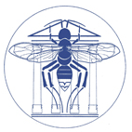


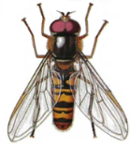
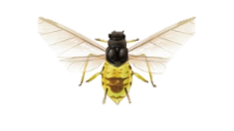
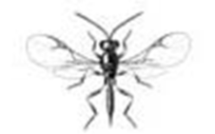
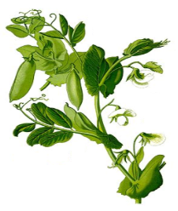
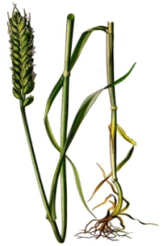

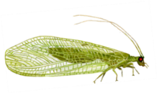

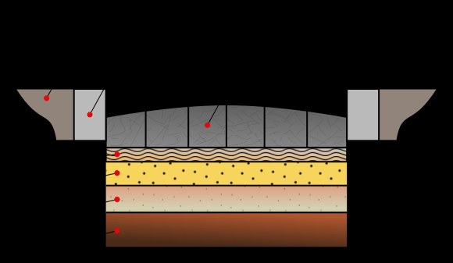
Functional & Evolutionary
Entomology
Does combining a wheat and pea mixture with methyl salicylate reduces aphid populations in both crops?
Thomas Lopes
Pr. Frédéric Francis

Slide 2
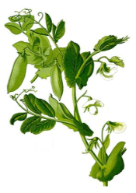

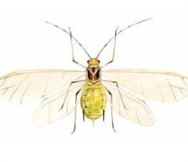
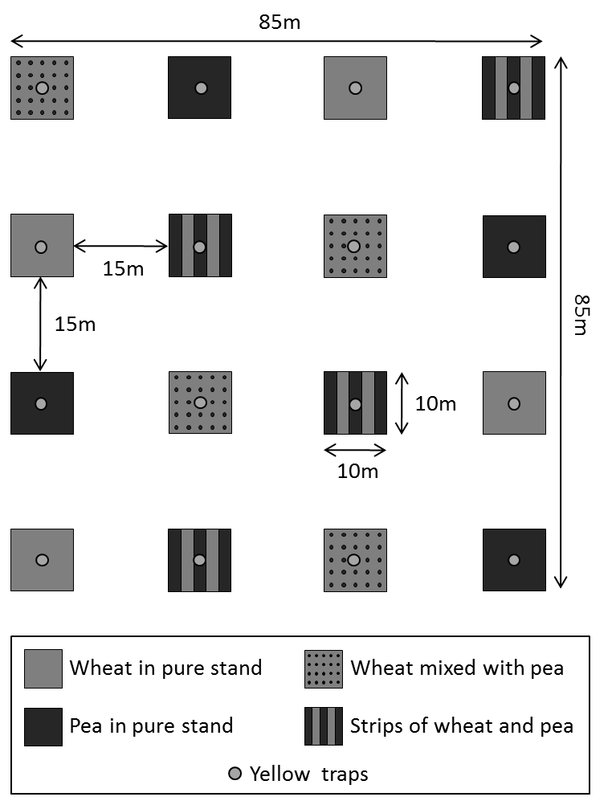

Context
N₂ fixation (low external inputs)
Association of wheat with pea
Wheat tutor for pea (prevent lodging)
Aphid populations?
Previous study (Lopes et al., 2015):
Resource concentration hypothesis (Root, 1973)
“Specialist herbivores are more likely to find and remain on host plants that are concentrated in dense or pure stands”
Enemy hypothesis (Root, 1973)
“Natural enemies are expected to be more abundant in complex environments and therefore supress herbivores more efficiently“
How to attract adult beneficials?

Slide 3
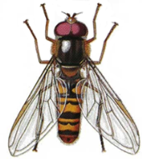
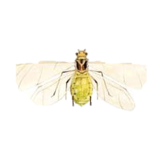
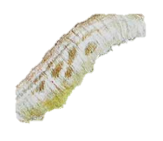




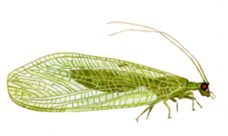
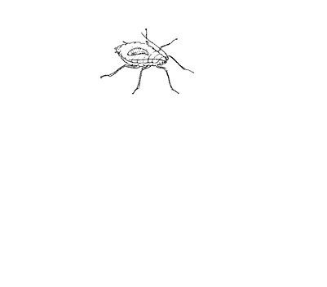

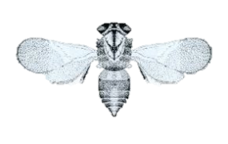
Context
Herbivore-induced plant volatiles (HIPV)
HIPV
(e.g. methyl salicylate )
HIPV
(e.g. methyl salicylate )
HIPV
(e.g. methyl salicylate )
e.g. infested soybean plants (Zhu & Park, 2005)

Slide 4
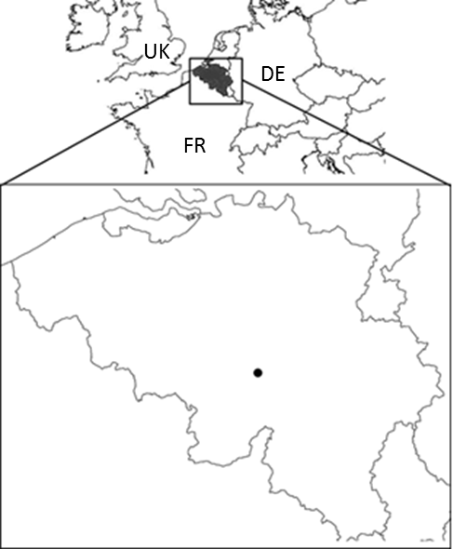
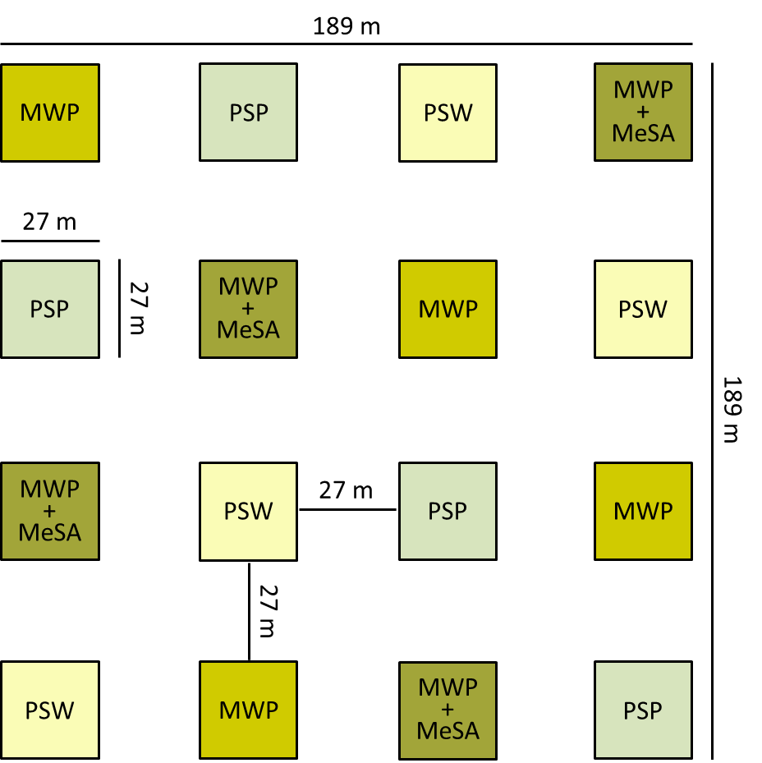

Experimental design
729 m² plots
4 treatments:
PSW - pure stand of wheat
PSP - pure stand of pea
MWP – mixture
MWP + MeSA - mixture with MeSA
Pea: 40 seeds/m²
Wheat: 350 seeds/m²
Pea:
80 seeds/m²
Wheat:
350 seeds/m²

Slide 5
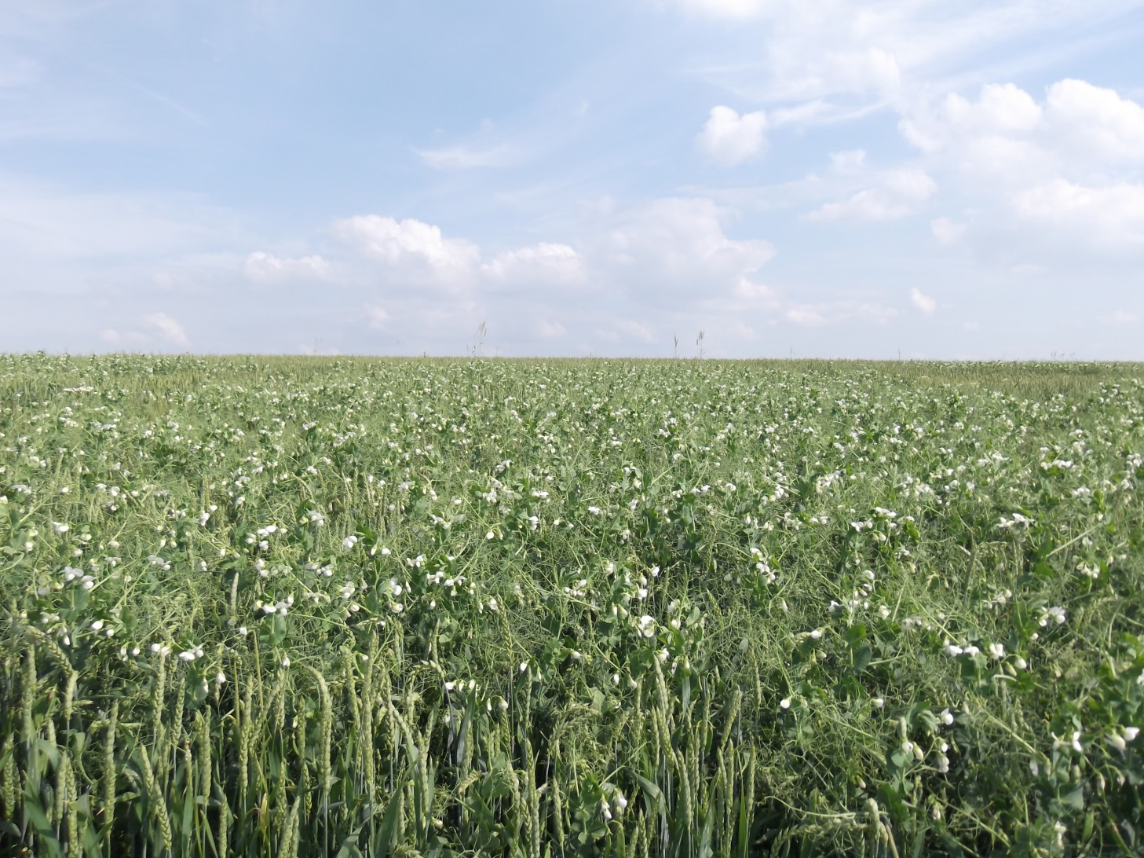
Mixture of wheat with pea

Slide 6
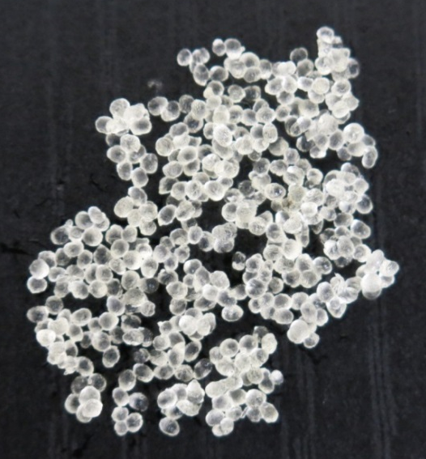
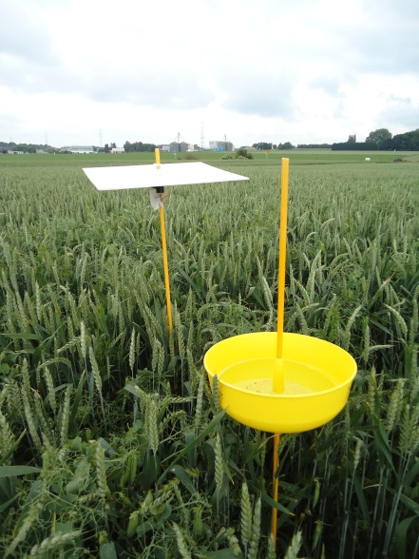
Alginate gel beads with Methyl salicylate
Slow-release formulation
In the field
(Heuskin et al., 2012)

Slide 7

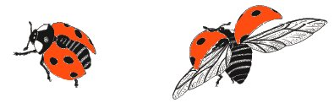
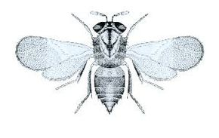
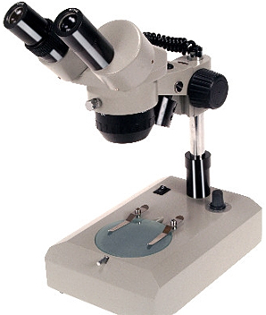
Sampling methodology
Water + Soap
Trapping of adult beneficials
2013 and 2014: 10 collections each year
Identified until the species

Slide 8



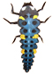
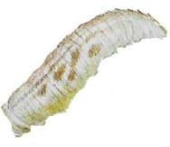
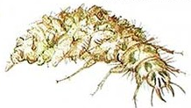
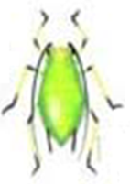
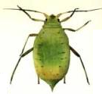
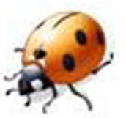
Observations on pea plants and wheat tillers
PSW PSP MWP MWP + MeSA
30x
30x
30x
30x
30x
30x
Ladybird, hoverfly and lacewing larvae
Aphids
Adult ladybirds
Mummified aphids
2013 and 2014: 11 observations each year

Slide 9

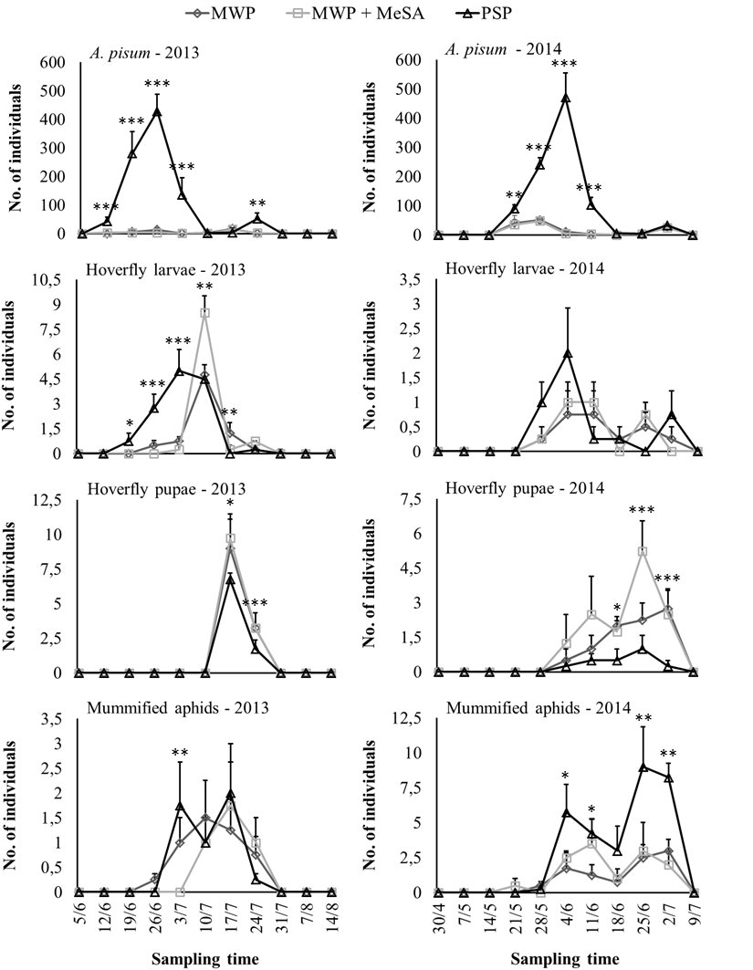
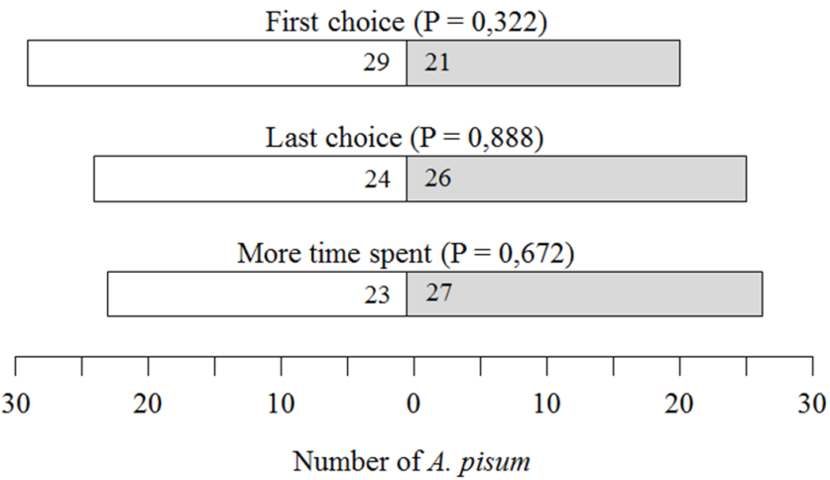


Aphids on pea plants
Populations were significantly denser in the pure stand compared with both mixtures
Masking of host plant odours (Tahvanainen & Root, 1972)?
Physical obstruction (Perrin & Phillips, 1978)?
Visual camouflage (Smith, 1976)?
Y-tube olfactometer bioassay with A. pisum
Enemy hypothesis (Root, 1973)?
NS
More beneficials in the mixtures?
NS
NS
10 5 44

Slide 10
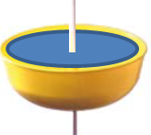


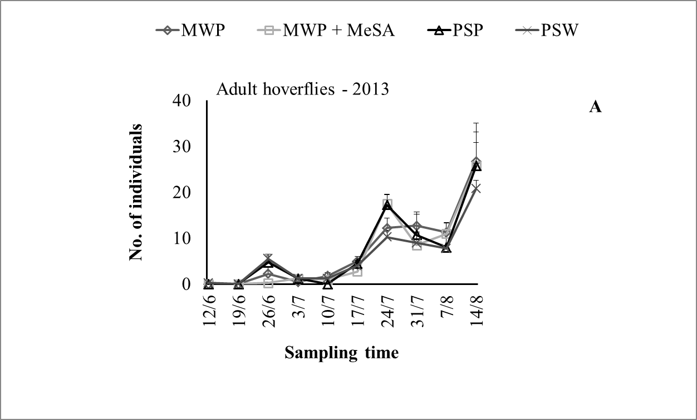
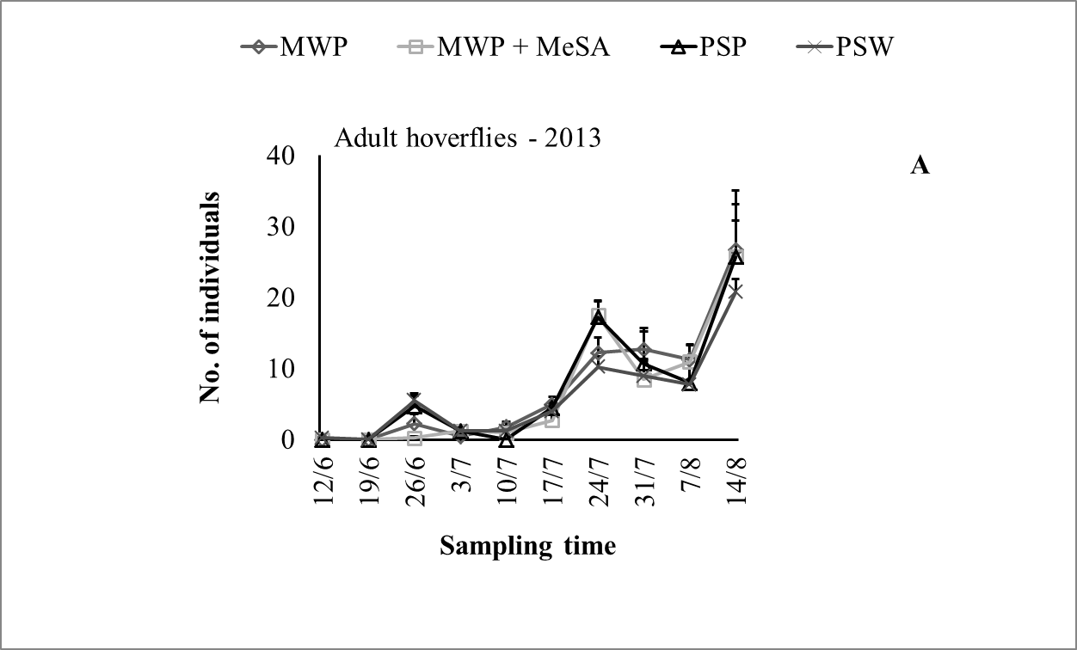
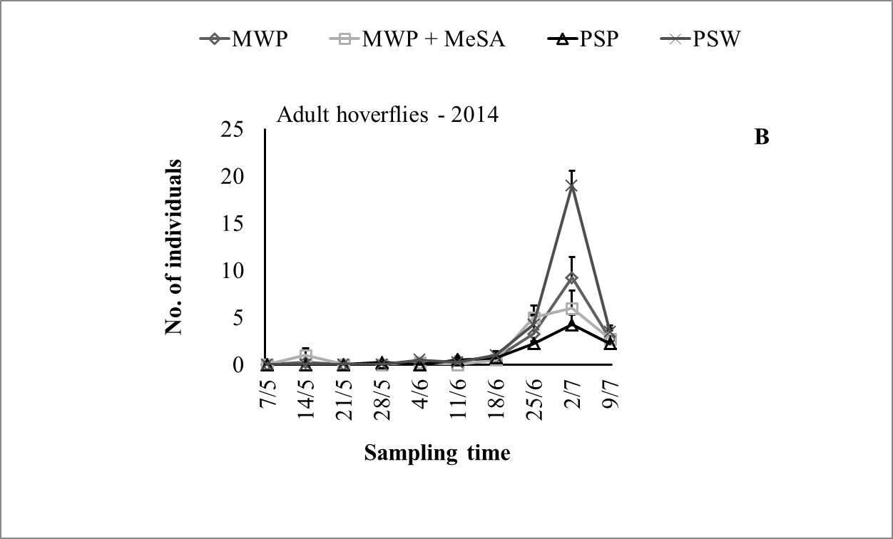
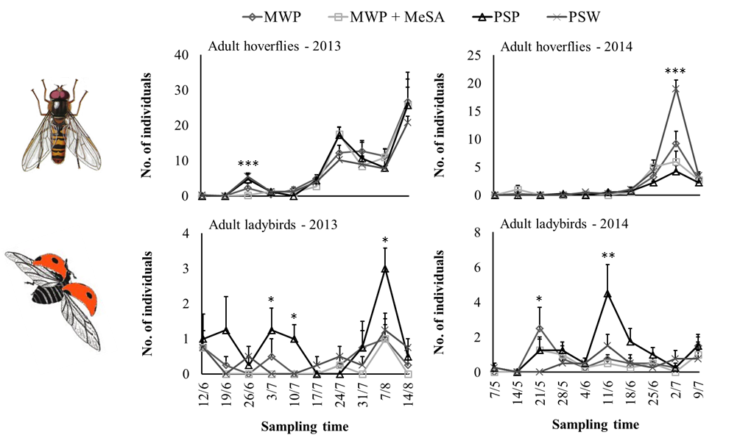
Hoverflies in traps
Hoverfly larvae on pea plants
***
NS

Slide 11

Other beneficials in traps
But Few on pea plants

Slide 12
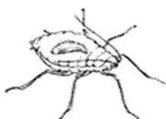
Other beneficials on pea plants
Few
Parasitoids (mummified aphids):
Adults were not attracted by methyl salicylate ?
Higher searching efficiency in the pure stand of pea (Randlkofer et al., 2010)

Slide 13
Conclusions
Aphids
The mixture can reduce aphid infestations on pea plants (very low abundances compared with the pure stand)
Beneficials
Hoverflies were not particularly attracted by methyl salicylate (enough quantity emitted?)
No attraction for parasitoids
However, the mixture is enough to reduce aphid populations at very low levels

Slide 14

Supervised by Pr. Frédéric Francis
With the collaboration of:
Bérénice Fassotte
Séverin Hatt
Antoine Boullis
Dr. Stéphanie Heuskin
Pr. Georges Lognay
Pr. Bernard Bodson
Thank you for your attention
tlopes@doct.ulg.ac.be

