Slide 1
A typology of Labour Market Intermediaries (LMIs) supporting professional transitions
University of Liege
Nadège Lorquet, HEC-ULg (LENTIC)
Prof. François Pichault, HEC-ULg (LENTIC)
Prof. Jean-François Orianne, ISHS-Ulg (CRIS)

Slide 2
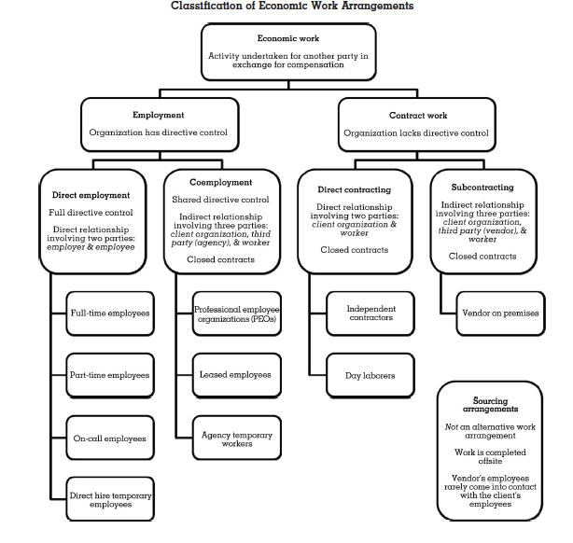
Source: Cappelli & Keller (2013)
Notes:
Really want to have your opinion on the starting point of the research

Slide 3

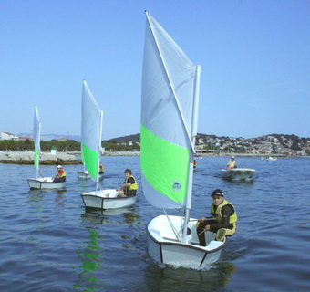
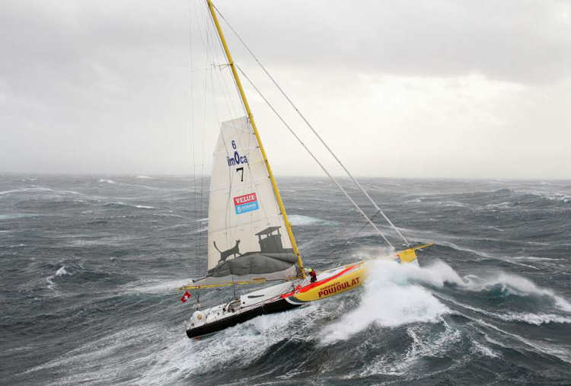
Organizational careers
Supported careers
Boundaryless careers

Slide 4
Main methodological steps
Selection of a dozen Belgian intermediation solutions aiming at securing job transitions
Abductive process (Dubois and Gadde, 2002):
  Designing differentiation criteria for exploring job transition supports
  Dividing up these criteria into modalities based on the existing literature
Classification of the empirical material according to the grid

Slide 5
The multidimensional grid in questions
Criteria | Modalities
Partnership logic (Miles & Snow, 1992, 1995 ; Williamson, 1975) | How did LMIs emerge onto the labour market?
Responsability for matchmaking (Bonet et al., 2013) | Who is responsible for the matchmaking process?
Main regulatory framework (Supiot, 1999) | How do they secure career paths?
HR configurations (Delery & Doty, 1996) | What kind of HR services do they offer?
Availability of information produced (Bessy et Eymard-Duvernay, 1997) | How is the information they produced made available?
Innovativeness (Van de Ven and Hargrave , 2004; Lawrence, Suddaby & Leca, 2009) | To what extent do LMIs’ activities lead to change the current way of working labour market?

Slide 6
The multidimensional grid divided in modalities
Criteria | Modalities
Partnership logic (Miles & Snow, 1992, 1995 ; Williamson, 1975) | Outsourcing | Mutualisation by user companies | Mutualisation by employees
Responsability for matchmaking (Bonet et al., 2013) | Who is responsible for the matchmaking process?
Main regulatory framework (Supiot, 1999) | How do they secure career paths?
HR configurations (Delery & Doty, 1996) | What kind of HR services do they offer?
Availability of information produced (Bessy et Eymard-Duvernay, 1997) | How is the information they produced made available?
Innovativeness (Van de Ven and Hargrave , 2004; Lawrence, Suddaby & Leca, 2009) | To what extent do LMIs’ activities lead to change the current way of working labour market?

Slide 7
The multidimensional grid divided in modalities
Criteria | Modalities
Partnership logic (Miles & Snow, 1992, 1995 ; Williamson, 1975) | Outsourcing | Mutualisation by user companies | Mutualisation by employees
Responsability for matchmaking (Bonet et al., 2013) | LMIs | User companies | Employees themselves
Main regulatory framework (Supiot, 1999) | How do they secure career paths?
HR configurations (Delery & Doty, 1996) | What kind of HR services do they offer?
Availability of information produced (Bessy et Eymard-Duvernay, 1997) | How is the information they produced made available?
Innovativeness (Van de Ven and Hargrave , 2004; Lawrence, Suddaby & Leca, 2009) | To what extent do LMIs’ activities lead to change the current way of working labour market?

Slide 8
The multidimensional grid divided in modalities
Criteria | Modalities
Partnership logic (Miles & Snow, 1992, 1995 ; Williamson, 1975) | Outsourcing | Mutualisation by user companies | Mutualisation by employees
Responsability for matchmaking (Bonet et al., 2013) | LMIs | User companies | Employees themselves
Main regulatory framework (Supiot, 1999) | Prevailing labour rights | Prevailing transition rights | Prevailing social rights
HR configurations (Delery & Doty, 1996) | What kind of HR services do they offer?
Availability of information produced (Bessy et Eymard-Duvernay, 1997) | How is the information they produced made available?
Innovativeness (Van de Ven and Hargrave , 2004; Lawrence, Suddaby & Leca, 2009) | To what extent do LMIs’ activities lead to change the current way of working labour market?

Slide 9
The multidimensional grid divided in modalities
Criteria | Modalities
Partnership logic (Miles & Snow, 1992, 1995 ; Williamson, 1975) | Outsourcing | Mutualisation by user companies | Mutualisation by employees
Responsability for matchmaking (Bonet et al., 2013) | LMIs | User companies | Employees themselves
Main regulatory framework (Supiot, 1999) | Prevailing labour rights | Prevailing transition rights | Prevailing social rights
HR configurations (Delery & Doty, 1996) | HR development and personnel administration | HR development only | Personnel administration only
Availability of information produced (Bessy et Eymard-Duvernay, 1997) | How is the information they produced made available?
Innovativeness (Van de Ven and Hargrave , 2004; Lawrence, Suddaby & Leca, 2009) | To what extent do LMIs’ activities lead to change the current way of working labour market?

Slide 10
The multidimensional grid divided in modalities
Criteria | Modalities
Partnership logic (Miles & Snow, 1992, 1995 ; Williamson, 1975) | Outsourcing | Mutualisation by user companies | Mutualisation by employees
Responsability for matchmaking (Bonet et al., 2013) | LMIs | User companies | Employees themselves
Regulatory framework (Supiot, 1999) | Prevailing labour rights | Prevailing transition rights | Prevailing social rights
HR configurations (Delery & Doty, 1996) | HR development and personnel administration | HR development only | Personnel administration only
Availability of information produced (Bessy et Eymard-Duvernay, 1997) | Closed access | Limited access | Open access
Innovativeness (Van de Ven and Hargrave , 2004; Lawrence, Suddaby & Leca, 2009) | To what extent do LMIs’ activities lead to change the current way of working labour market?

Slide 11
The multidimensional grid divided in modalities
Criteria | Modalities
Partnership logic (Miles & Snow, 1992, 1995 ; Williamson, 1975) | Outsourcing | Mutualisation by user companies | Mutualisation by employees
Responsability for matchmaking (Bonet et al., 2013) | LMIs | User companies | Employees themselves
Regulatory framework (Supiot, 1999) | Prevailing labour rights | Prevailing transition rights | Prevailing social rights
HR configurations (Delery & Doty, 1996) | HR development and personnel administration | HR development only | Personnel administration only
Availability of information produced (Bessy et Eymard-Duvernay, 1997) | Closed access | Limited access | Open access
Innovativeness (Van de Ven and Hargrave , 2004; Lawrence, Suddaby & Leca, 2009) | Compliance | Niche innovation | Systemic innovation

Slide 12
Five empirical cases in the grid
Criteria | Modalities
Partnership logic (Miles & Snow, 1992, 1995 ; Williamson, 1975) | Outsourcing (Défi+) | Mutualisation by user companies (Job’Ardent, PIL) | Mutualisation by employees (Smart, Dies)
Responsability for matchmaking (Bonet et al., 2013) | LMIs (Job’Ardent, Défi+) | User companies (PIL) | Employees themselves (Smart, Dies)
Regulatory framework (Supiot, 1999) | Prevailing labour rights (Défi+, Dies, Job’Ardent) | Prevailing transition rights (PIL) | Prevailing social rights (Smart)
HR configurations (Delery & Doty, 1996) | HR development and personnel administration (Défi+) | HR development only (PIL) | Personnel administration only (Smart, Dies, Job’Ardent)
Availability of information produced (Bessy et Eymard-Duvernay, 1997) | Closed access (Défi+) | Limited access (PIL, Job’Ardent, Dies) | Open access (Smart)
Innovativeness (Van de Ven and Hargrave , 2004; Lawrence, Suddaby & Leca, 2009) | Compliance (Job’Ardent, Défi+, PIL) | Niche innovation (Dies) | Systemic innovation (Smart)

Slide 13
LMIs as
quasi-employers
Workers as
« self-employers »
Criteria | Modalities
Partnership logic (Miles & Snow, 1992, 1995 ; Williamson, 1975) | Outsourcing (Défi+) | Mutualisation by user companies (Job’Ardent, PIL) | Mutualisation by employees (Smart, Dies)
Responsability for matchmaking (Bonet et al., 2013) | LMIs (Job’Ardent, Défi+) | User companies (PIL) | Employees themselves (Smart, Dies)
Regulatory framework (Supiot, 1999) | Prevailing labour rights (Défi+, Dies, Job’Ardent) | Prevailing transition rights (PIL) | Prevailing social rights (Smart)
HR configurations (Delery & Doty, 1996) | HR development and personnel administration (Défi+) | HR development only (PIL) | Personnel administration only (Smart, Dies, Job’Ardent)
Availability of information produced (Bessy et Eymard-Duvernay, 1997) | Closed access (Défi+) | Limited access (PIL, Job’Ardent, Dies) | Open access (Smart)
Innovativeness (Van de Ven and Hargrave , 2004; Lawrence, Suddaby & Leca, 2009) | Compliance (Job’Ardent, Défi+, PIL) | Niche innovation (Dies) | Systemic innovation (Smart)

Slide 14
Discussion
Diverse ways of supporting transitions + two ideal-typical situations:
Do quasi-employers LMIs necessarily offer secure transitions?
Do “self-employer” LMIs necessarily lead to unsecure transitions ?
Next steps of the research :
Attention to the risks/side effects of each intermediation solution
Design of guidelines for promoting the most sustainable job transition supports
Some ideas : quality of jobs offered, income continuity through the provision of functional equivalents, social rights portability, reinforced collective capacity supporting the activation of individual rights, etc.

Slide 15
Thank you for you attention
Do you have any questions?
E-mail: nlorquet@ulg.ac.be

