Slide 1

Functionality of microbial phenotypic heterogeneity in bioprocessing conditions: an analysis based on the use of on/off-line flow cytometry
Delepierre Anissa¹, Brognaux Alison¹, Baert Jonathan¹, Delvigne Frank¹.
¹ University of Liège, Gembloux Agro Bio Tech
Microbial processes and interactions - Belgium

Slide 2
Microbial phenotypic heterogeneity ?
Negative impact of microbial phenotypic heterogeneity on process productivity but improvement of robustness?
Accepted picture : only a fraction of the population (non productive phenotypes) affects the global production profile
Productive phenotypes
Metabolite concentation
Global production profile
Non productive phenotypes
Time

Slide 3
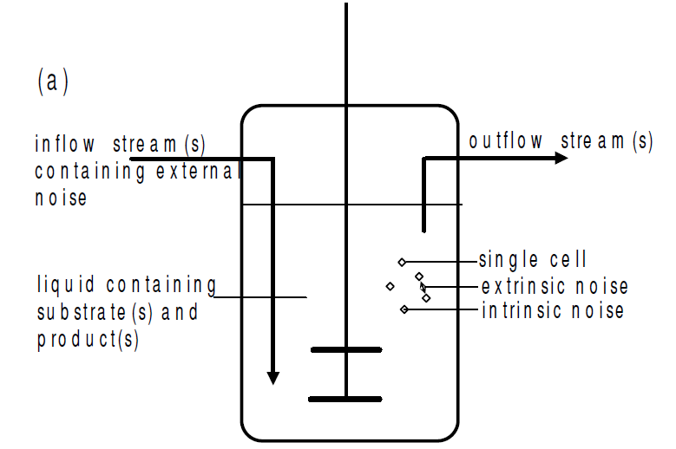
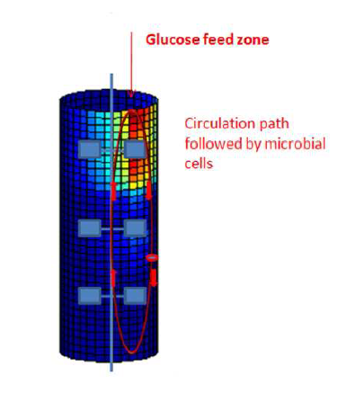
Phenotypic heterogeneity
Noise (Intrinsic and extrinsic noise)
Reinforced by external noise: spatial heterogeneity
Patnaik PR, (2006) External, extrinsec and intrinsec noise in cellular systems : analogies and implications for protein synthesis. Biotechnology and Molecular Biology Review Vol. 1 (4), pp, 121-127.

Slide 4
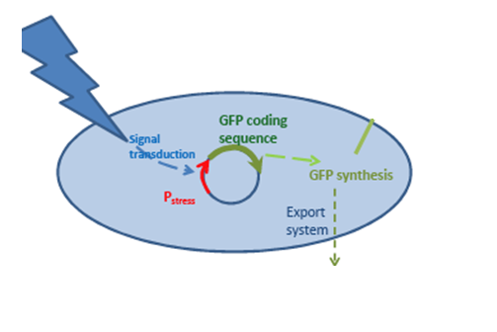
How to track this phenotypic heterogeneity?
By combining flow cytometry, genetically encoded biosensors and external dyes
Genetically encoded: GFP
Brognaux Alison
Exogenous: Propidium iodide
Flow cytometry and cell sorting session

Slide 5
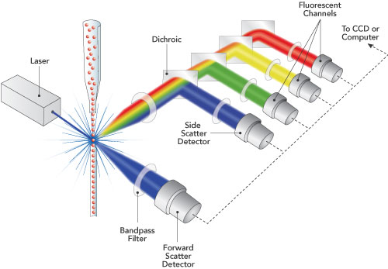
The flow cytometry

Slide 6
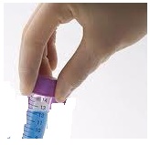
FCM
Q_{FC}
Flow cytometry (FCM) : different modes of operation
Manual sampling
FCM
On-line
Q_{FC}
Sampling pump
Real time
Brognaux, A., Han, S., Sorensen, S. J., Lebeau, F., Thonart, P., Delvigne, F., (2013) A low-cost, multiplexable, automated flow cytometry procedure for the characterization of microbial stress dynamics in bioreactors. Microbial cell factories 12, 1475-2859

Slide 7
Application of flow cytometry
Evaluation of E. coli outer membrane permeability

Slide 8
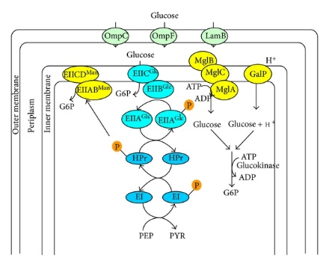
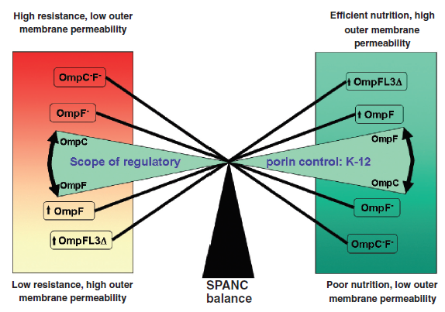
Bioprocess conditions: Limitation of carbon substrate
Modulation of membrane permeability: Self-preservation and nutritional competence SPANC
Glucose uptake: 2 barriers
Shimizu K(2013) Regulation systems of bacteria such as escherichia coli in response to nutrient limitation and environmental stresses. Metabolites 2013, 4(1):1-35.
Ferenci T. (2005) Maintaining a healthy SPANC balance through regulatory and mutational adaptation. Mol. Microbiol. 2005;57:1-8
Phenotypic heterogeneity

Slide 9
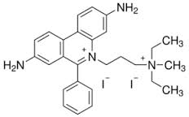
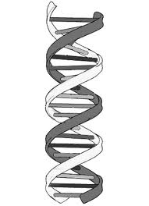
How to track the Porin-mediated outer membrane permeability?
Exogenous dye: Propidium iodide staining
Hypothesis : accumulation of PI in the periplasm when cells are exposed to substrate limitation (increased expression of porins)
OmpF
OmpC
PI
PI (MW = 668 Da)
Cut-off < 800 Da
Cut-off < 600 Da
Cytoplasm
Periplasm
LamB
Extracellular env.

Slide 10
Intermediate PI uptake : Propidium iodide (PI) uptake and appearance of an intermediate subpopulation with reduced red fluorescence
Fed-batch, well-mixed reactor

Slide 11
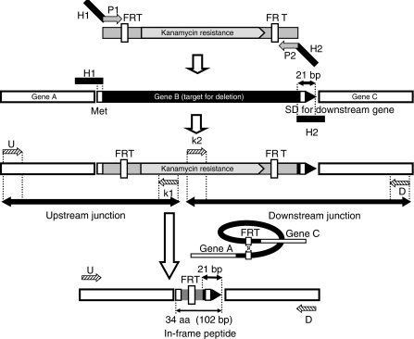
Outer membrane permeabiliy in metabolic engineered E. coli k-12 strains?
single-gene Knockout deletion (KEIO collection)
ΔLamB
ΔOmpF
ΔOmpC
Impact on robustness and phenotypic heterogeneity?

Slide 12
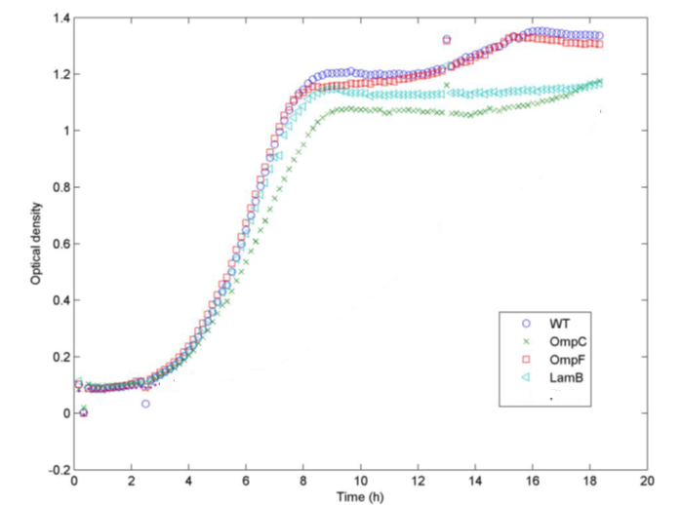
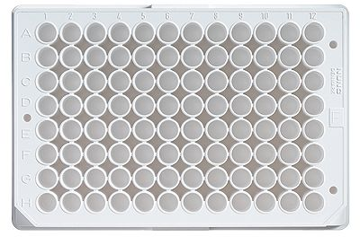
Test in microwell plate: Batch culture
Comparaison of microbial growth kinetic
Spectramax
On-line measuring of OD600nm

Slide 13
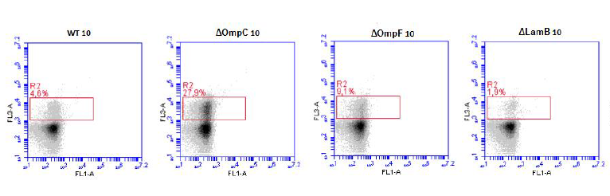
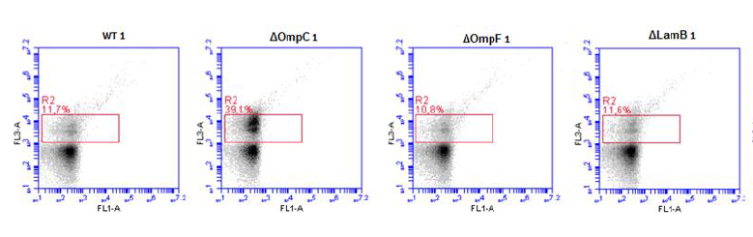
Sampling at stationary phase: PI staining and FC analysis
10g/L
1g/L

Slide 14
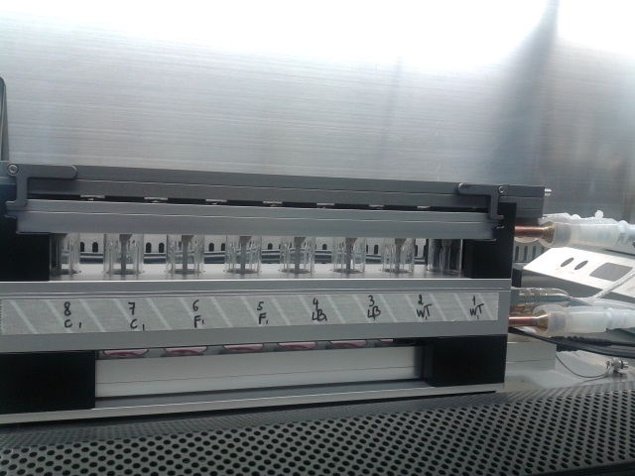
Test in mini-bioreactor: batch culture
8 mini-bioreactors in parallel
8-15 ml
On-line measure of pH and Dissolved oxygen by optical sensors

Slide 15
Sampling at exponential and stationary phase: OD600nm

Slide 16
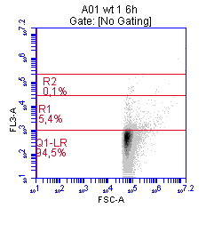
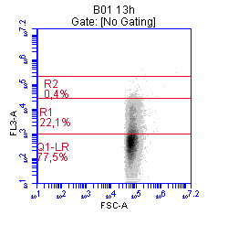
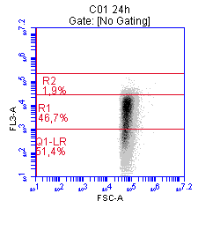
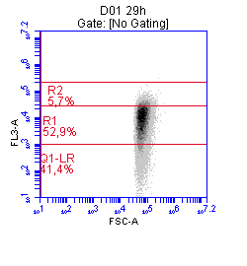

Sampling at exponential and stationary phase: PI staining and FC analysis
6h
13h
24h
29h
47h
WT
Exponential phase
Stationary phase
Membrane permeability increasing

Slide 17
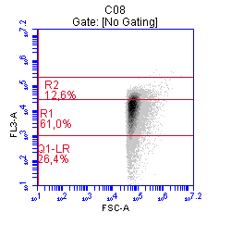
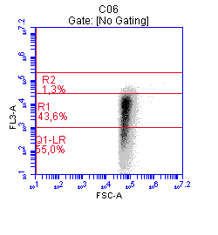
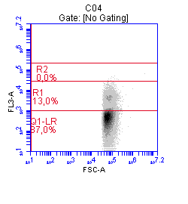
Comparaison of strains in stationary phase (24h)
WT
ΔOmpC
ΔOmpF
ΔLamB

Slide 18
High cut-off porins upregulation?
CONCLUSIONS
ΔOmpC : increased level of intermediate PI+ sub-population
High outer membrane permeability
Efficient nutrition
Low resistance
Lower biomass production

Slide 19
LamB: Major implication in the outer membrane permeability related to substrate limitation?
ΔLamB: Decreased level of intermediate PI+ sub-population
Low outer membrane permeability
Poor nutrition
High resistance
Lower biomass production

Slide 20
Thank you for your attention

Slide 21
What’s next?
Omics approach on the subpopulation by cell sorting: Stress response?

