Slide 1
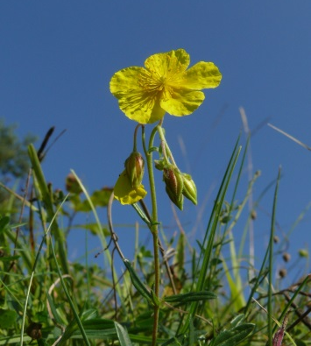
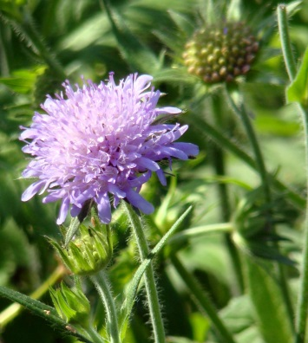
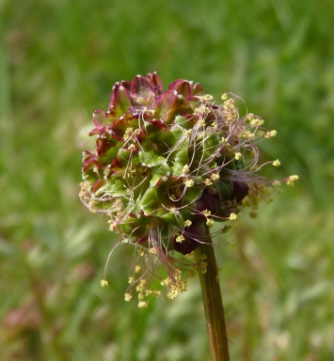
Do large scale restoration projects reduce within-species trait variability?
Harzé Mélanie*, Monty Arnaud
and Mahy Grégory
University of Liege, Gembloux Agro-Bio Tech, Biodiversity and Landscape Unit
*melanie.harze@ulg.ac.be

Slide 2
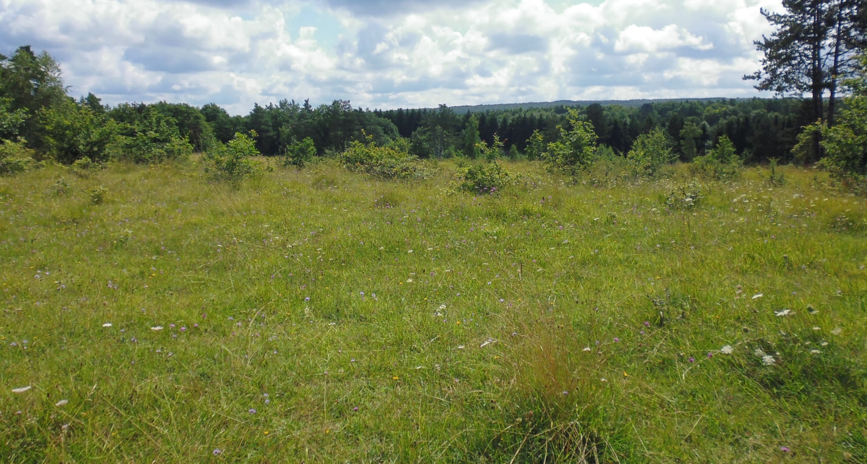
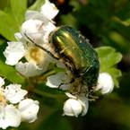
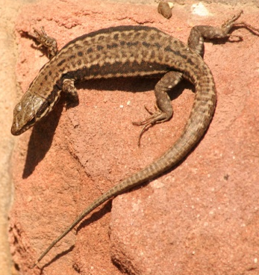
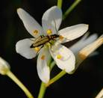
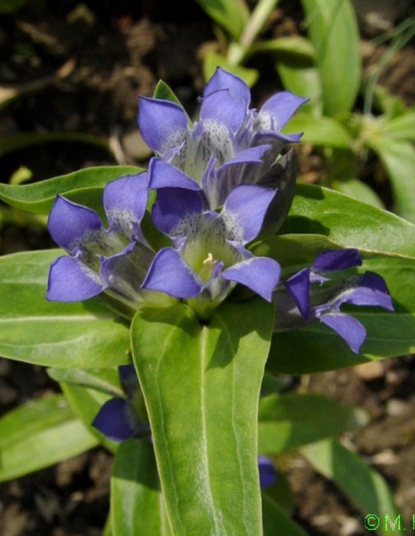
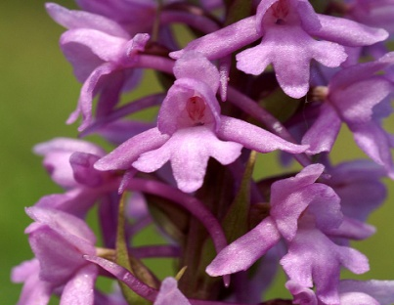
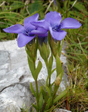
Context
Aims
Methods
Results

Slide 3
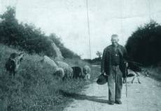
Context
Aims
Methods
Results

Slide 4
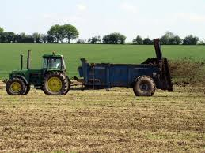
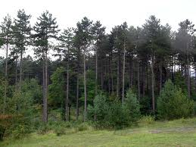
Context
Aims
Methods
Results

Slide 5
Context
Aims
Methods
Results

Slide 6
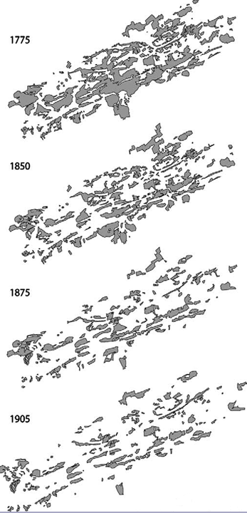
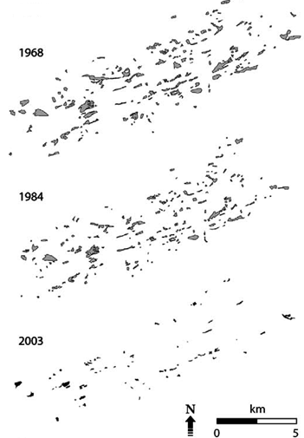
Context
Aims
Methods
Results
Adriaens et al. 2006

Slide 7
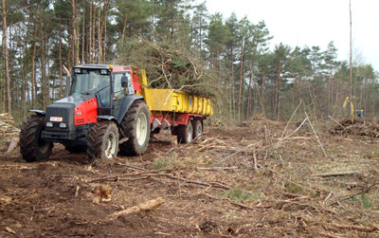
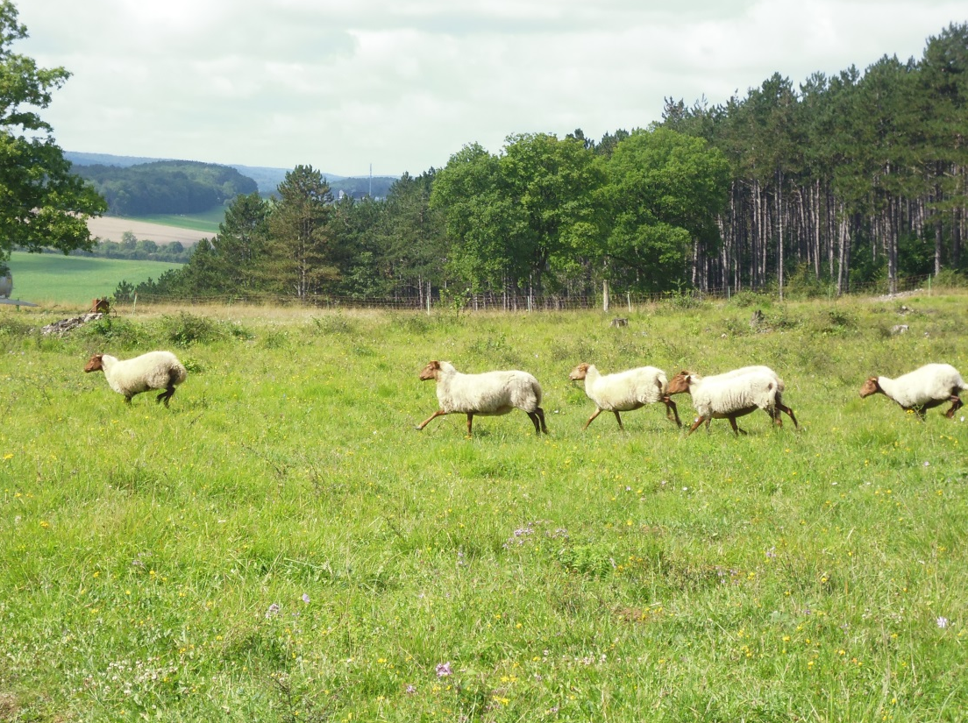
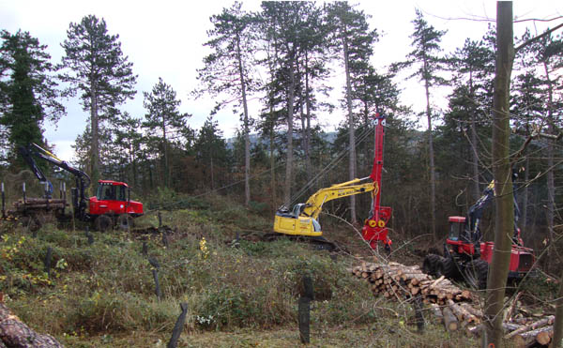
Context
Aims
Methods
Results

Slide 8
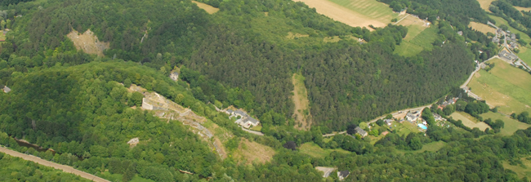
Context
Aims
Methods
Results

Slide 9
Context
Aims
Methods
Results

Slide 10
Context
Aims
Methods
Results
1. Diversity : species richness and abundance
2. Vegetation structure : vegetation cover, biomass
3. Ecological processes : nutrient cycling, biological interractions

Slide 11
Context
Aims
Methods
Results
1. Diversity : species richness and abundance
2. Vegetation structure : vegetation cover, biomass
3. Ecological processes : nutrient cycling, biological interractions
→ Populations?

Slide 12
Context
Aims
Methods
Results
Fragmentation
Habitat fragmentation
Small populations
Large isolation
Stochasticity (chance)
Inbreeding
Inbreeding depression
Natural
gene flow
Outbreeding depression
Mutation
Artificial
gene flow
Individual / population fitness
Biotic interactions
Abiotic effects
Modified from Lienert 2004

Slide 13
Context
Aims
Methods
Results
Restoration ?
Habitat fragmentation
Small populations
Large isolation
Stochasticity (chance)
Inbreeding
Inbreeding depression
Natural
gene flow
Outbreeding depression
Mutation
Artificial
gene flow
Individual / population fitness
Biotic interactions
Abiotic effects
Modified from Lienert 2004

Slide 14
Context
Aims
Methods
Results
Restoration ?
Habitat fragmentation
Small populations
Large isolation
Stochasticity (chance)
Inbreeding
Inbreeding depression
Natural
gene flow
Outbreeding depression
Mutation
Artificial
gene flow
Individual / population fitness
Biotic interactions
Abiotic effects
Modified from Lienert 2004

Slide 15
Context
Aims
Methods
Results

Slide 16
Context
Aims
Methods
Results
Restoration ?
Habitat fragmentation
Small populations
Large isolation
Stochasticity (chance)
Inbreeding
Inbreeding depression
Foundation effect
Small populations
Reduced genetic diversity
Natural
gene flow
Outbreeding depression
Mutation
Artificial
gene flow
Individual / population fitness
Biotic interactions
Abiotic effects
Modified from Lienert 2004

Slide 17
Context
Aims
Methods
Results
Restoration ?
Habitat fragmentation
Small populations
Large isolation
Stochasticity (chance)
Inbreeding
Inbreeding depression
Foundation effect
Small populations
Reduced genetic diversity
Natural
gene flow
Outbreeding depression
Mutation
Artificial
gene flow
Individual / population fitness
Biotic interactions
Abiotic effects
Modified from Lienert 2004

Slide 18
Context
Aims
Methods
Results
“The discipline of population biology provides one perspective on what might be considered a successful restoration.”

Slide 19
Context
Aims
Methods
Results
“Restored populations must possess attributes necessary for reproduction, growth, migration, and adaptive evolutionary change.”

Slide 20
Context
Aims
Methods
Results
“Restored populations must possess attributes necessary for reproduction, growth, migration, and adaptive evolutionary change.”
Functional traits
= Any measurable features at the individual level that directly or indirectly affect overall plant fitness
(Lavorel et al. 1997; Violle et al. 2007)

Slide 21
Context
Aims
Methods
Results
“Restored populations must possess attributes necessary for reproduction, growth, migration, and adaptive evolutionary change.”
Functional traits

Slide 22
Context
Aims
Methods
Results
“Restored populations must possess attributes necessary for reproduction, growth, migration, and adaptive evolutionary change.”
Functional traits
Specific Leaf Area (SLA)

Slide 23
Context
Aims
Methods
Results
“Restored populations must possess attributes necessary for reproduction, growth, migration, and adaptive evolutionary change.”
Functional traits
Plant height

Slide 24
Context
Aims
Methods
Results
“Restored populations must possess attributes necessary for reproduction, growth, migration, and adaptive evolutionary change.”
Functional traits
Seed mass

Slide 25
Context
Aims
Methods
Results
“Restored populations must possess attributes necessary for reproduction, growth, migration, and adaptive evolutionary change.”
Functional traits variability
= one way to understand plant response to environmental variability and their capacity to cope with environmental changes.

Slide 26
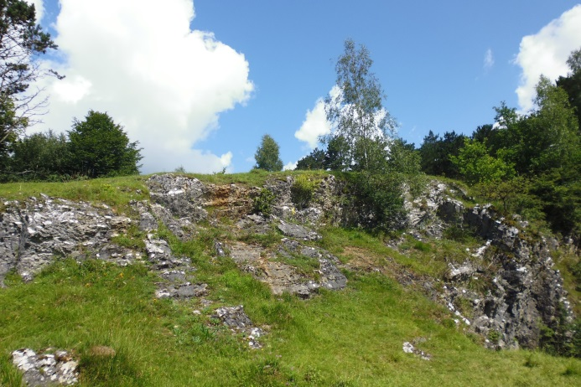
Context
Aims
Methods
Results

Slide 27
Context
Aims
Methods
Results

Slide 28
Context
Aims
Methods
Results

Slide 29
Context
Aims
Methods
Results

Slide 30
Context
Aims
Methods
Results

Slide 31
Context
Aims
Methods
Results
To compare the environmental heterogeneity and the trait variability of reference and restored populations of a calcareous grasslands species: Potentilla tabernaemontani.

Slide 32
Context
Aims
Methods
Results
Species
Potentilla tabernaemontani
A perennial forb producing yellow entomophilous flowers
Specialist of calcareous grasslands in Belgium
Present on various environment
Abundant in the study area

Slide 33
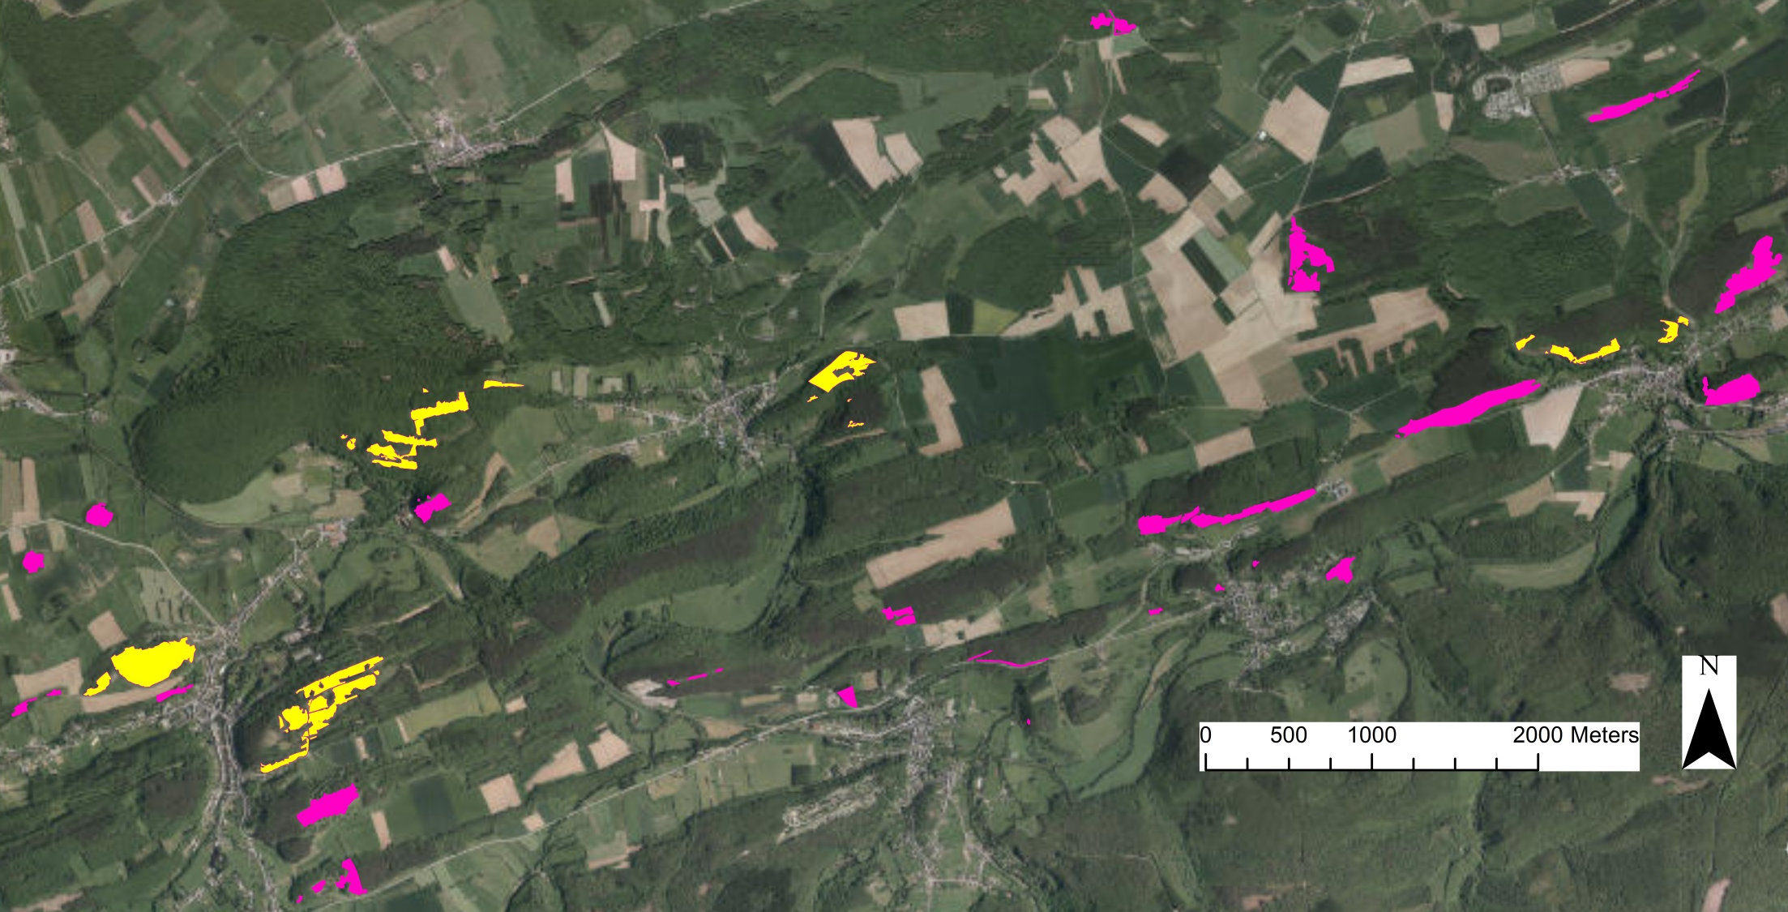
Context
Aims
Methods
Results
6 sites
4.
5.
6.
3.
1.
2.

Slide 34
Context
Aims
Methods
Results
Protocol
6 sites
vs
6 reference populations
6 restored populations

Slide 35
Context
Aims
Methods
Results
Protocol
6 sites
vs
6 reference populations
30 individuals/pop
6 restored populations
30 individuals/pop

Slide 36
Context
Aims
Methods
Results
Protocol
6 sites
vs
6 reference populations
30 individuals/pop
6 restored populations
30 individuals/pop
Intra-population trait variability :
Specific leaf area (2 leaves/indiv)
Vegetative height

Slide 37
Context
Aims
Methods
Results
Protocol
6 sites
vs
6 reference populations
30 individuals/pop
6 restored populations
30 individuals/pop
Intra-population trait variability :
Specific leaf area (2 leaves/indiv)
Vegetative height
Environmental heterogeneity :
Soil depth

Slide 38
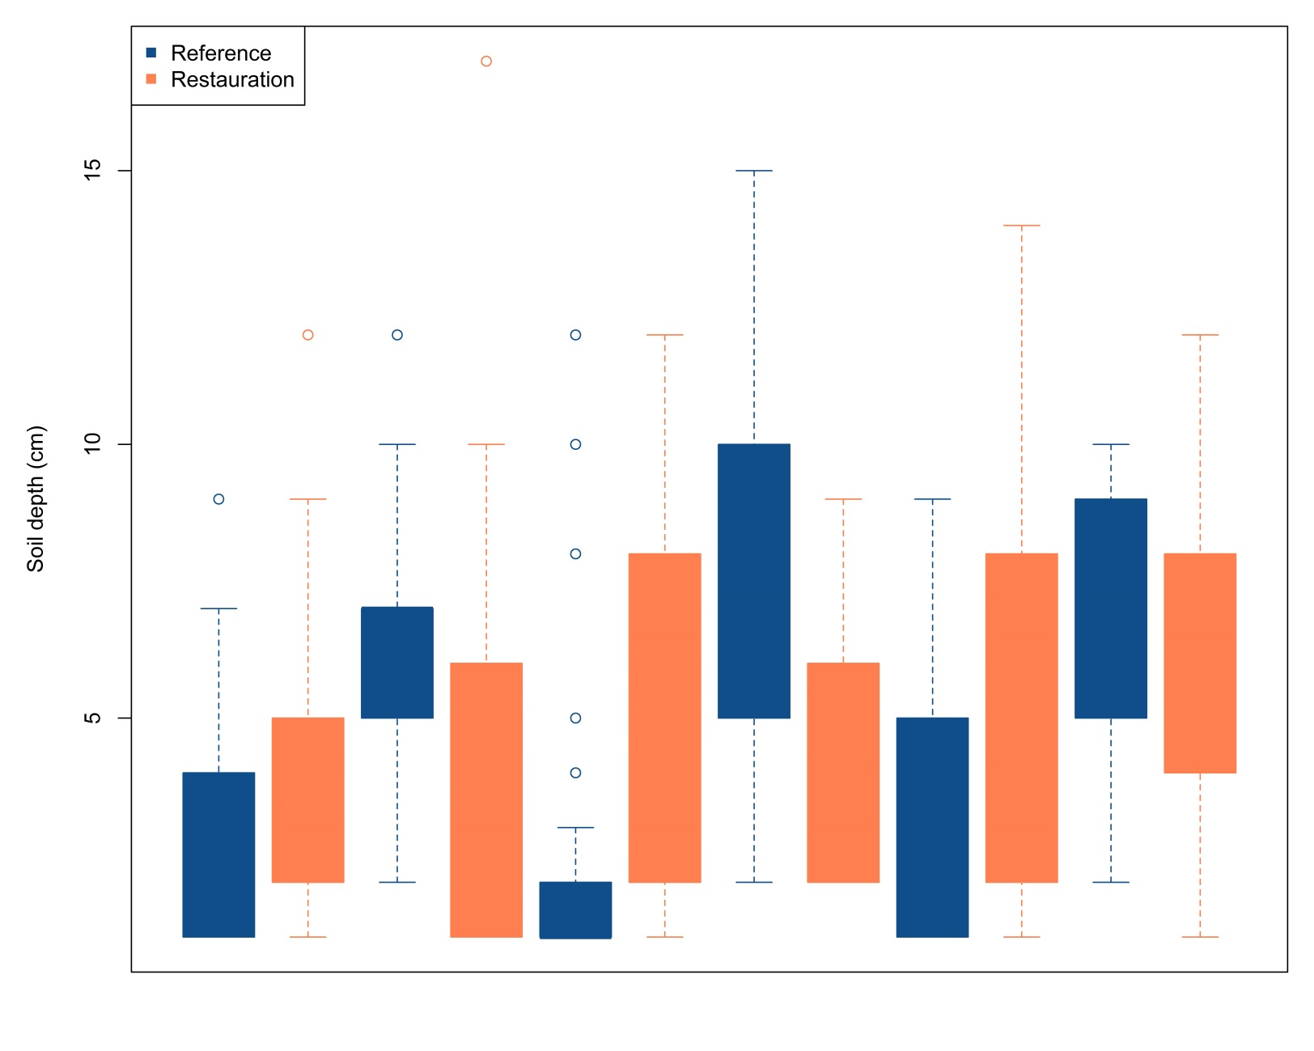
Context
Aims
Methods
Results
Is restoration recreating the entire range of environmental variability experience by the populations of the species ?
Soil depth (cm)
Site 1 Site 2 Site 3 Site 4 Site 5 Site 6

Slide 39
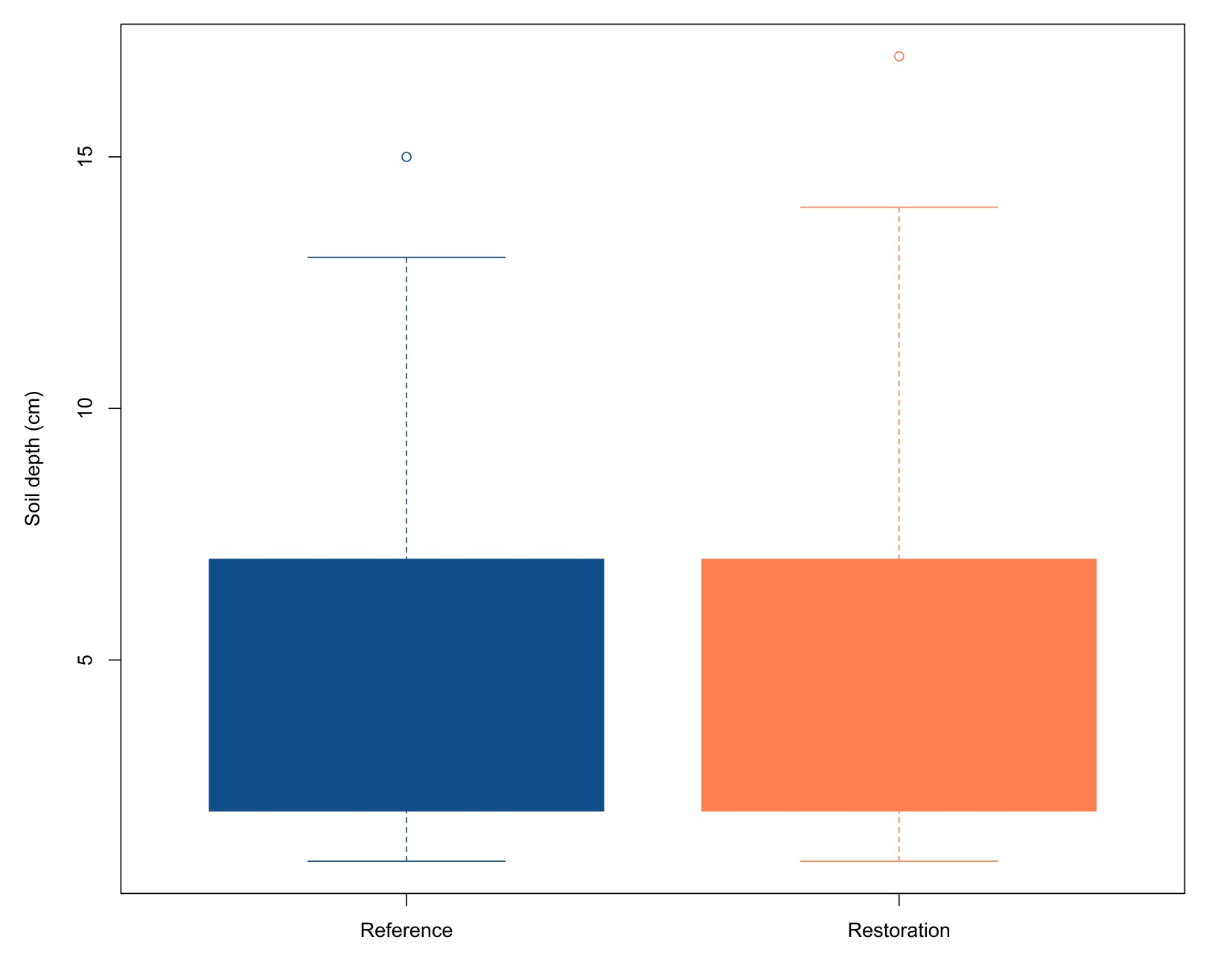
Context
Aims
Methods
Results
Is restoration recreating the entire range of environmental variability experience by the populations of the species ?
Soil depth (cm)
Reference Restoration

Slide 40
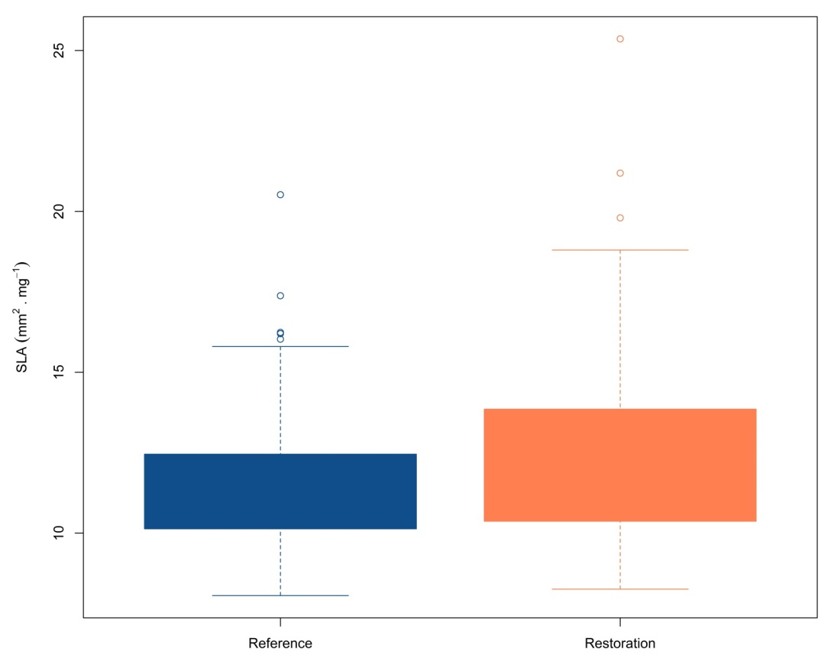
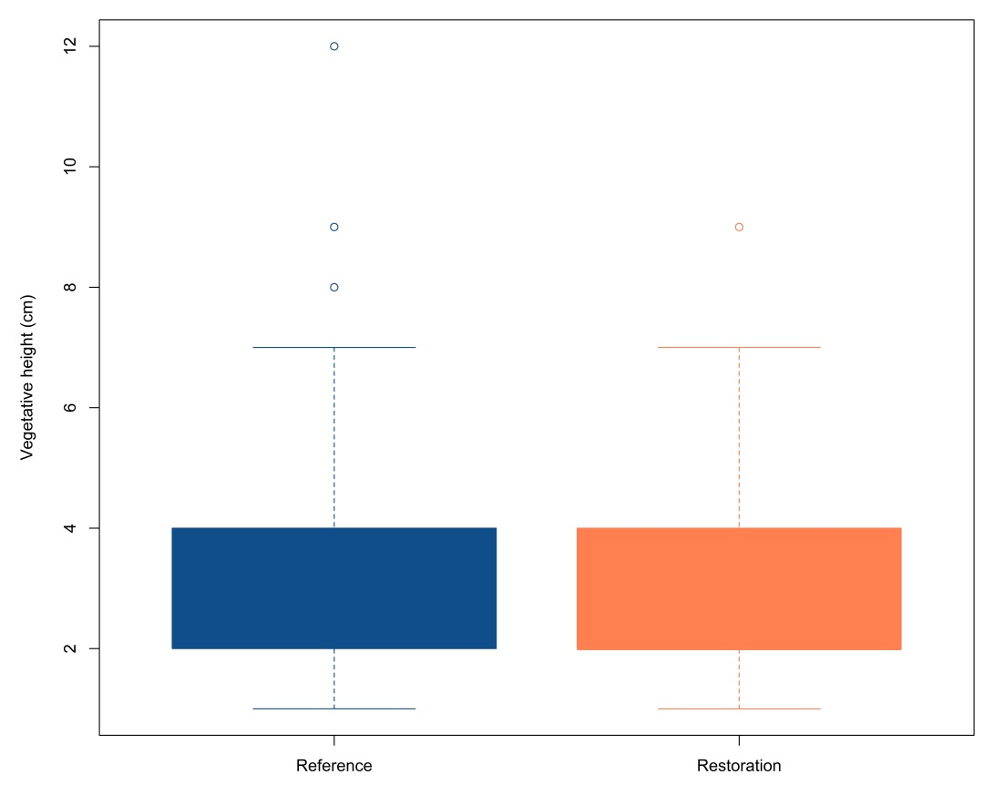
Context
Aims
Methods
Results
Is restoration selecting only a part of the trait variability of source populations?
SLA (mm² . mg⁻¹)
Vegetative height (cm)
Reference Restoration
Reference Restoration

Slide 41
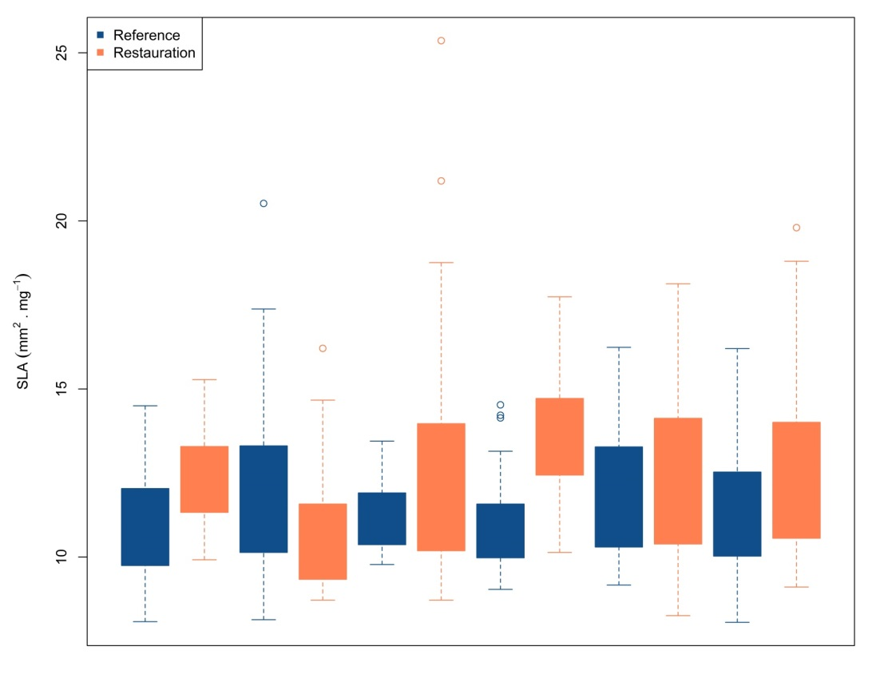
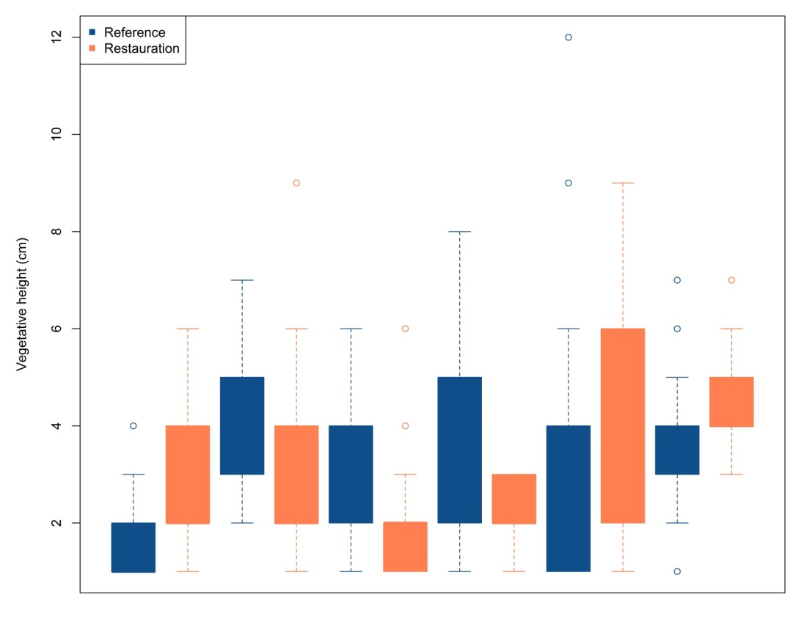
Context
Aims
Methods
Results
Is restoration selecting only a part of the trait variability of source populations?
SLA (mm² . mg⁻¹)
Vegetative height (cm)
Site 1 Site 2 Site 3 Site 4 Site 5 Site 6
Site 1 Site 2 Site 3 Site 4 Site 5 Site 6

Slide 42
CONCLUSION
A population approach is important to evaluate more aspects of restoration success
Good news for restored populations and species persistence in the future.
Reference = goal? Or restore more diverse populations?
What about new sites creation? Rare species?

Slide 43
Thank you for your attention!
Any questions?
melanie.harze@ulg.ac.be

