Slide 1

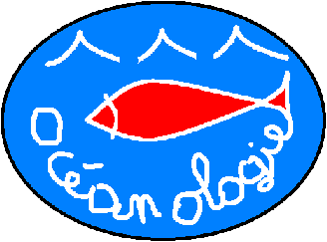

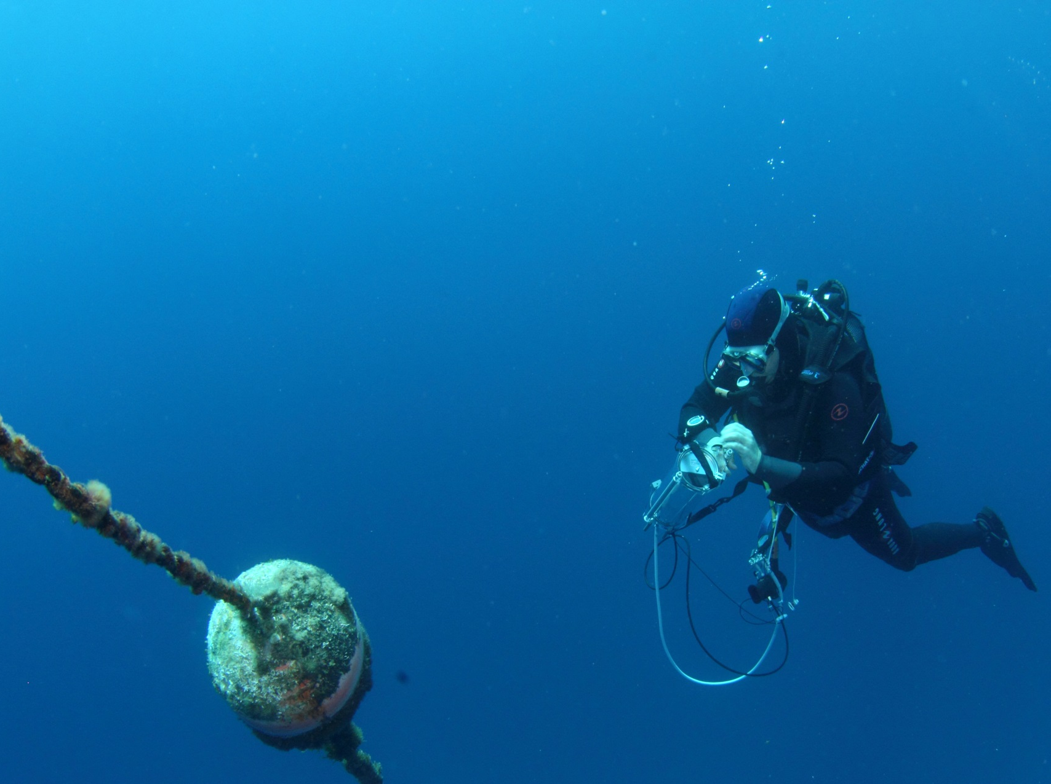
A consensual Diving-PAM protocol to monitor Posidonia oceanica photosynthesis
S. Gobert, G. Lepoint, J. Silva,
R. Santos, P. Lejeune, P. du Jardin,
B. Delvaux, J.-T. Cornelis,
J. Richir
Oristano, Italy
05-2015
Arnaud Abadie
Notes:
Ladies and gentlemen, I would like to present you, during this talk, a collaborative conceptualization model in order to fill knowledge gaps regarding trace element flows with P. oceanica meadows.

Slide 2


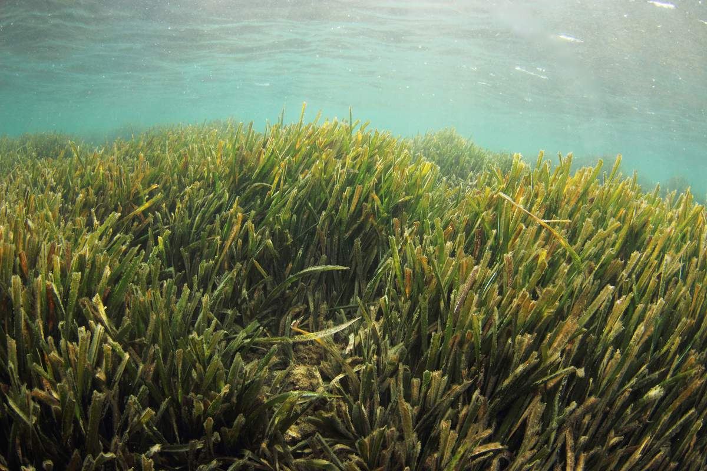
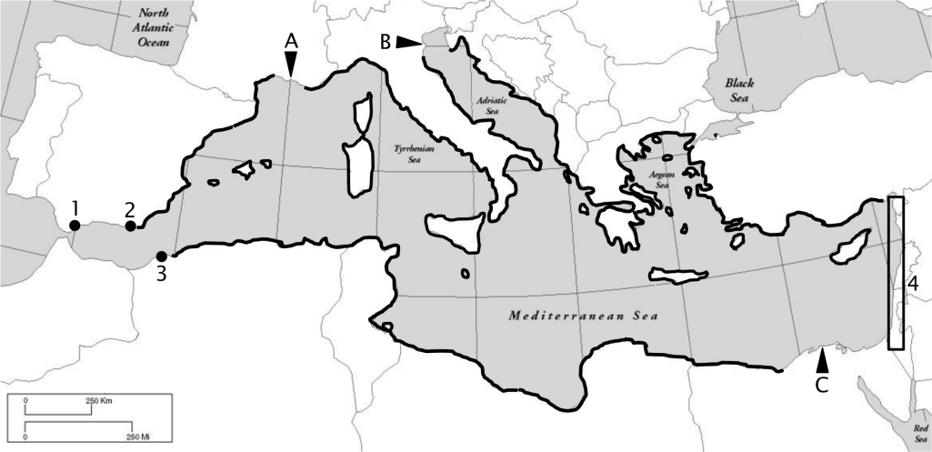
P. oceanica as primary producer
Arnaud Abadie
Michel, 2012
Notes:
The Mediterranean is submitted to numerous anthropogenic threats, among them the chemical contamination of its densely anthropized coasts. The red circles on this map hilights pollution hot spots along Mediterranean coasts.

Slide 3
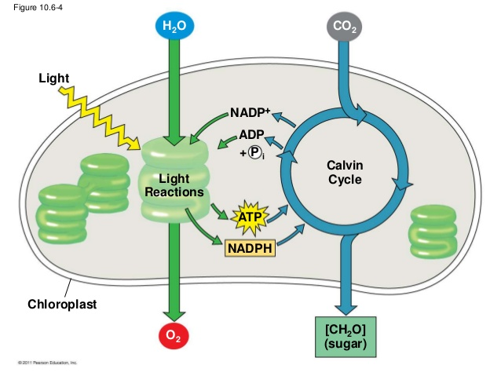
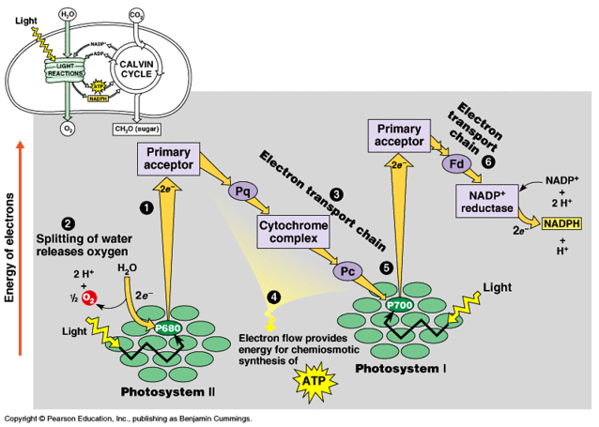
The light reactions
Chemical equation of photosynthesis:
6CO₂ + 6H₂O → C₆H₁₂O₆ + 6O₂
_{Light energy}
I
NTRODUCT
I
ON
Campbell & Race, © Pearson Education Inc.
Notes:
The Mediterranean is submitted to numerous anthropogenic threats, among them the chemical contamination of its densely anthropized coasts. The red circles on this map hilights pollution hot spots along Mediterranean coasts.

Slide 4
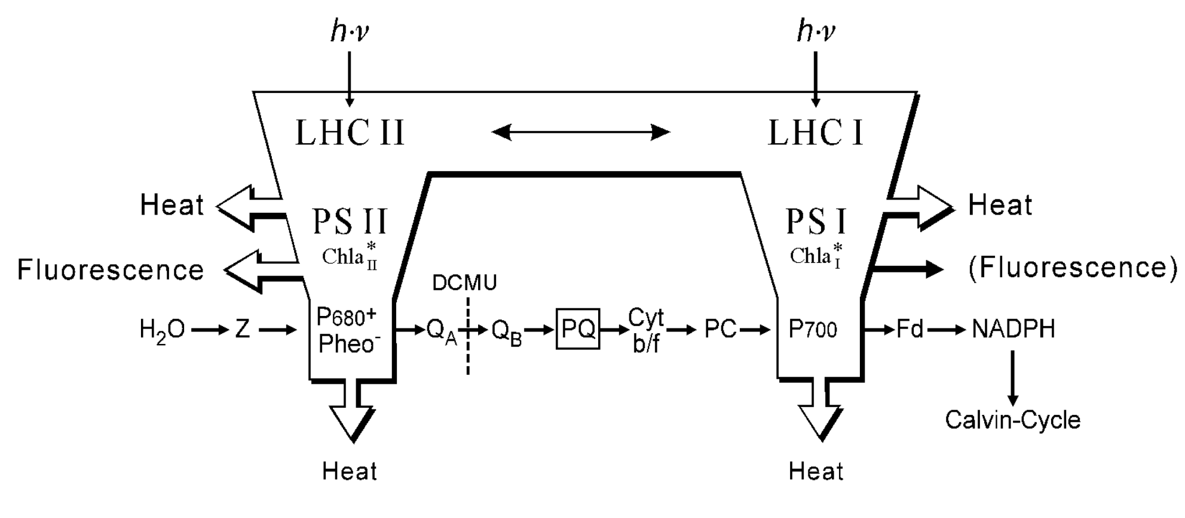
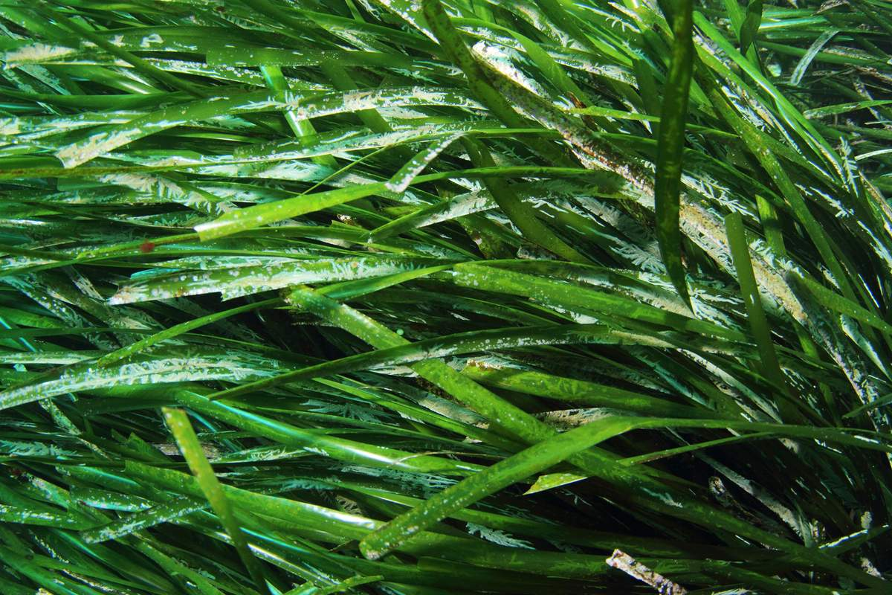
Fluorescence emission
© Walz Inc.
Fluorescence emission is complementary to the alternative pathways of
de-excitation, which are photochemistry and heat dissipation.
Notes:
The Mediterranean is submitted to numerous anthropogenic threats, among them the chemical contamination of its densely anthropized coasts. The red circles on this map hilights pollution hot spots along Mediterranean coasts.

Slide 5
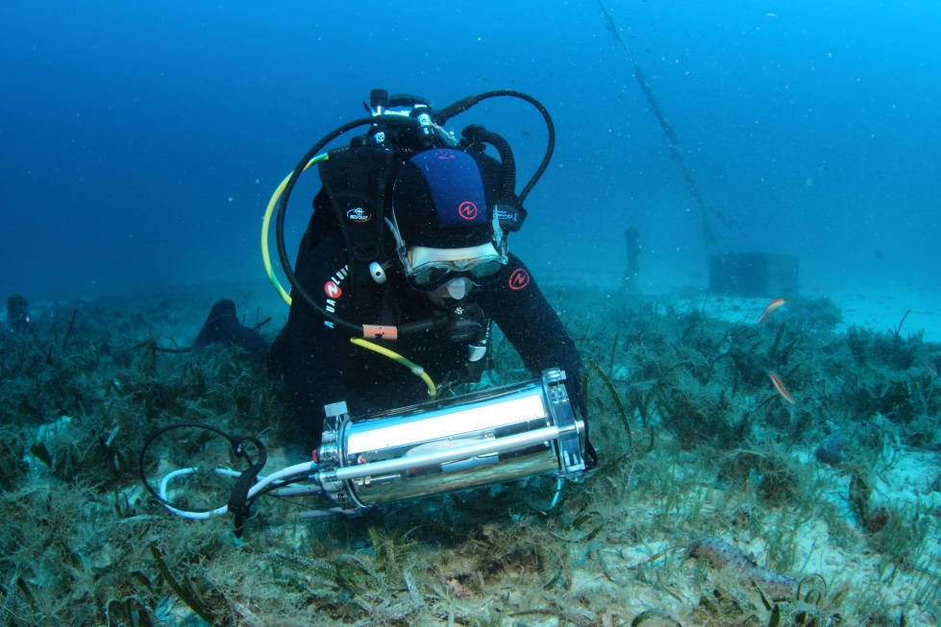
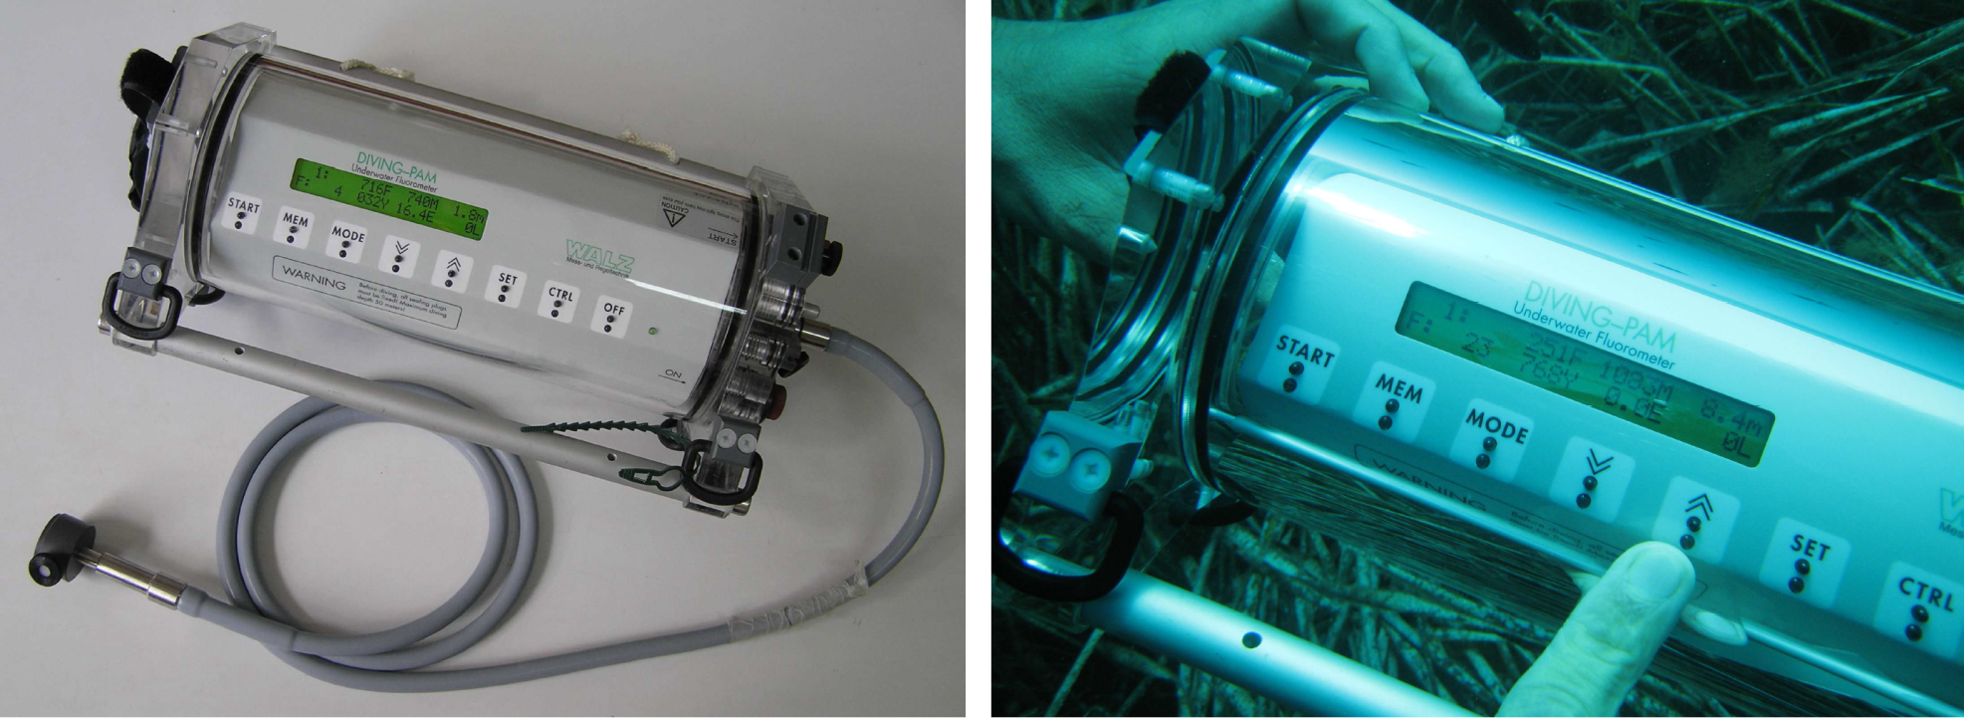
Diving-PAM
Underwater study of in situ photosynthesis;
Optimized to determine of the effective quantum yield of photosynthetic energy conversion, ΔF/Fm’.
I
NTRODUCT
I
ON
Arnaud Abadie
Julien Lassauque
Notes:
The Mediterranean is submitted to numerous anthropogenic threats, among them the chemical contamination of its densely anthropized coasts. The red circles on this map hilights pollution hot spots along Mediterranean coasts.

Slide 6
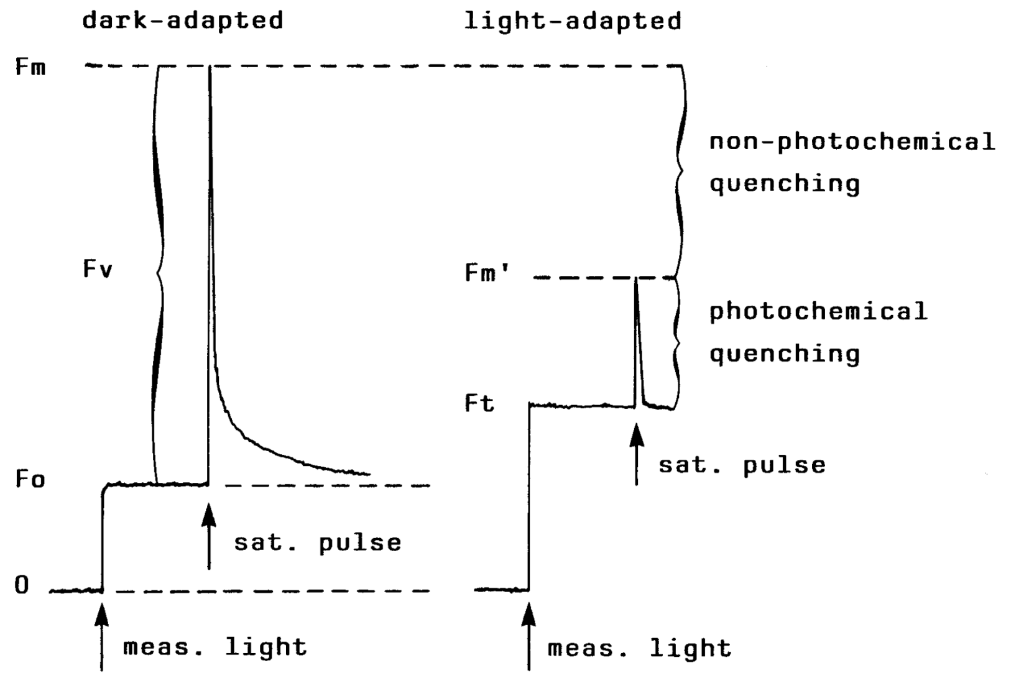
Fluorescence measurement
YIELD = (Fm’-F)/Fm’ = ΔF/Fm’
Fluorescence yield is highest when the yields of photochemistry and heat dissipation are lowest
© Walz Inc.
Notes:
The Mediterranean is submitted to numerous anthropogenic threats, among them the chemical contamination of its densely anthropized coasts. The red circles on this map hilights pollution hot spots along Mediterranean coasts.

Slide 7

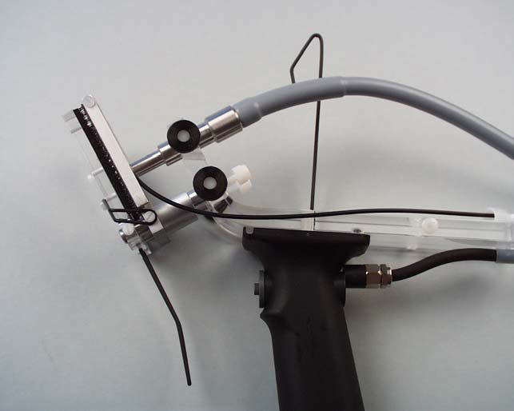
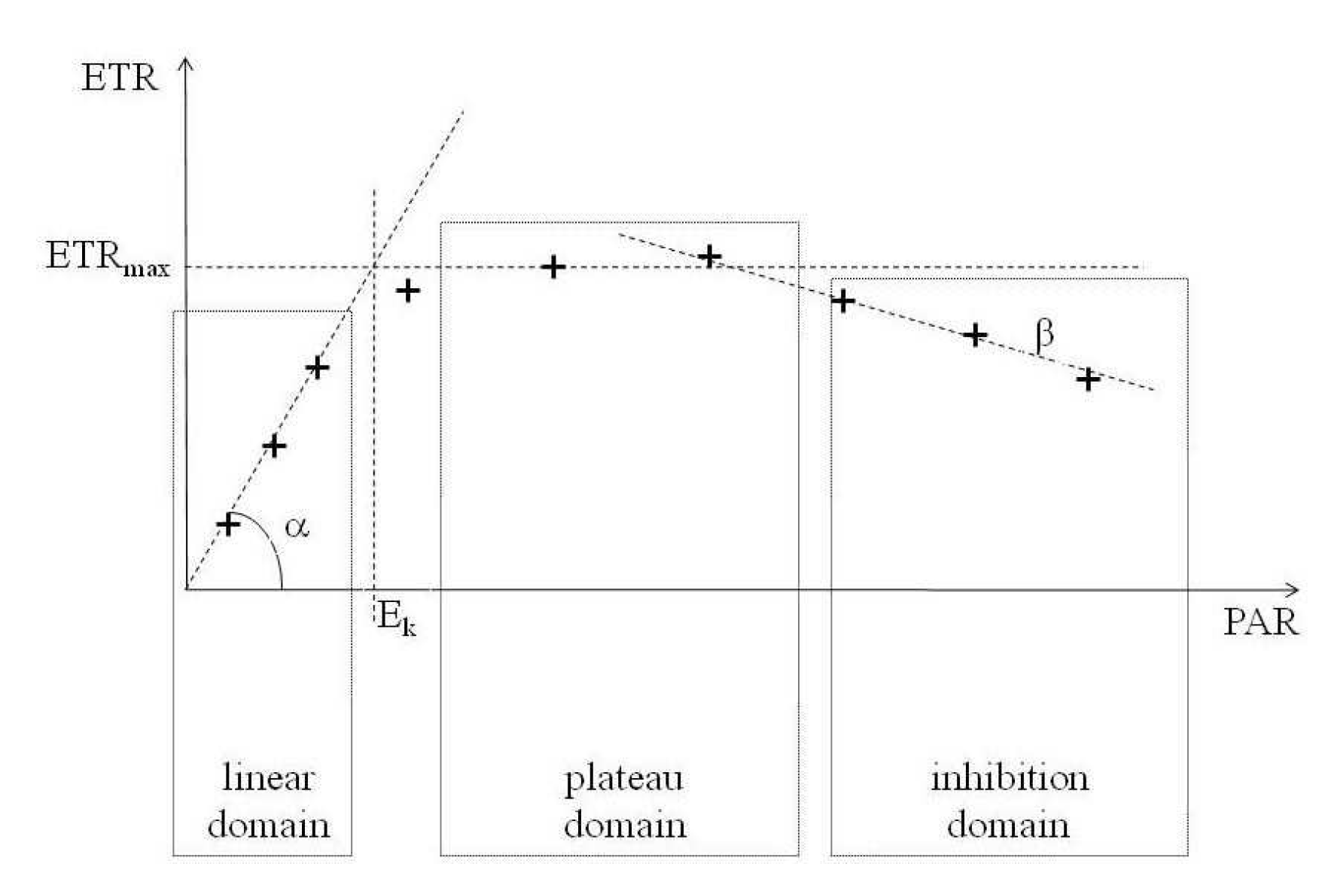
ETR - RLC
Relative Electron Transfert Rate : ETR = YIELD x PAR x 0.5 x ETR-factor
Rapid Light Curve : insight into the physiological flexibility with which a plant sample can adapt its photosynthetic aparatus to rapid changes of ligh intensity.
(Lassauque, 2008)
Notes:
The Mediterranean is submitted to numerous anthropogenic threats, among them the chemical contamination of its densely anthropized coasts. The red circles on this map hilights pollution hot spots along Mediterranean coasts.

Slide 8
In practice - ecophysiology
Date | Seagrass | Parameters | Description
1998 | Cymodocea nodosa, Halophila stipulacea, Zostera marina | ETR, RLC | Inter-species comparaison study of the ratio O₂/ETR (Beer et al., 1998).
1998 | Posidonia australis, Amphibolis antartica, Halophila ovalis | ETR, qP, qN, Y | Inter-species comparison and diurnal cycle (Ralph et al., 1998).
2002 | Posidonia oceanica | Y, ETR | UV effect on photosynthesis (Figueroa et al., 2002).
2006 | Posidonia oceanica | F_{v}/F_{m}, α, ETR_{max} | Diurnal variability of photosynthetic parameters (Lorenti et al., 2006a).
2006 | Posidonia oceanica | F_{v}/F_{m}, E_{k}, ETR_{max} | Seasonnal variability of photosynthetic parameters (Lorenti et al., 2006b).
I
NTRODUCT
I
ON
Notes:
The Mediterranean is submitted to numerous anthropogenic threats, among them the chemical contamination of its densely anthropized coasts. The red circles on this map hilights pollution hot spots along Mediterranean coasts.

Slide 9
In practice - ecotoxicology
Date | Seagrass | Parameters | Description
1999 | Halophila ovalis | F₀, F_{m}, F_{v}/F_{m} | Effect of light deprivation on photosynthesis (Longstaff et al., 1999).
2000 | Halophila ovalis, H. spinulosa, Halodule uninervis, Zostera capricorni, Cymodocea serrulata | F_{v}/F_{m} | Effect of metal contamination on photosynthesis (Prange and Dennison, 2000).
2001 | Amphibola antarctica, Posidonia australis | F₀, F_{m}, F_{v}/F_{m} | Effect of high temperatures and dessication on phytosynthesis (Seddon and Cheshire, 2001).
2006 | 7 tropical species | F_{v}/F_{m}, qP, qN | Effect of increasing temperature on photosynthesis (Campbell et al., 2006)
2012 | Posidonia oceanica | F_{v}/F_{m}, α, E_{k}, ETR_{max}, RLC | Fluorescence along a pre-established gradient of anthropogenic pressures (Gera et al., 2012).
I
NTRODUCT
I
ON
Notes:
The Mediterranean is submitted to numerous anthropogenic threats, among them the chemical contamination of its densely anthropized coasts. The red circles on this map hilights pollution hot spots along Mediterranean coasts.

Slide 10
Objectives
"With our present understanding of seagrass photosynthetic responses to anthropogenic stress, it would be ill advised to employ PAM as anything but a complementary tool to validate environmental stress derived with other, more robust methodologies." (Gera et al., 2012)
I
NTRODUCT
I
ON
A more in-depth knowledge of the natural causes of variability of P. oceanica photosynthetic responses is a prerequisite to any surveys relying on that time and cost-effective method.
This work aimed to determine the influence of :
several environmental parameters: depth, daytime, season;
plant-specific characteristics: leaf age, leaf part analyzed, epiphytic coverage,
…. on the photosynthetic responses : Y, ETR, RLC, of P. oceanica.
Notes:
The Mediterranean is submitted to numerous anthropogenic threats, among them the chemical contamination of its densely anthropized coasts. The red circles on this map hilights pollution hot spots along Mediterranean coasts.

Slide 11
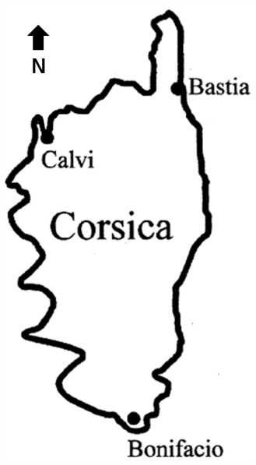
Study place
The field survey was performed in the P. oceanica meadow facing the STARESO, in the Calvi Bay (Corsica, France).
Notes:
The Mediterranean is submitted to numerous anthropogenic threats, among them the chemical contamination of its densely anthropized coasts. The red circles on this map hilights pollution hot spots along Mediterranean coasts.

Slide 12
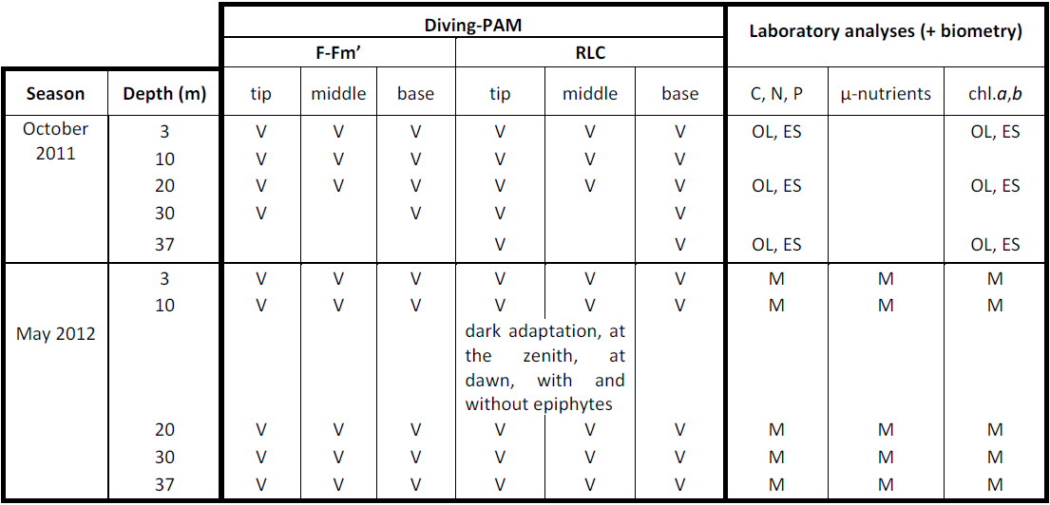
In situ and laboratory analyses
PAM - October: longest leaf; May: 3rd-4th external leaf.
Biochemistry - October: OL: 1 of the 2 oldest leaf; ES: entire shoot; May: M: middle of the 3rd, 4th external leaf.
Notes:
One of the most widely used bioindicator species in the Mediterranean is the seagrass Posidonia oceanica (and more precisely the shoots of leaves of that seagrass).

Slide 13
Yield and ETR (October and May)
RESULTS
-
D
I
SCUSS
I
ON
Yield:
Increase with depth.
ETR :
decrease with depth; lower in basal part.
Light adaptation with depth, and less phosynthetic pigments in basal part.
Notes:
One of the most widely used bioindicator species in the Mediterranean is the seagrass Posidonia oceanica (and more precisely the shoots of leaves of that seagrass).

Slide 14
RLC (October)
ETR_{max} :
decrease with increasing depth
increase from the base to the tip of the leaf
RESULTS
-
D
I
SCUSS
I
ON
Notes:
One of the most widely used bioindicator species in the Mediterranean is the seagrass Posidonia oceanica (and more precisely the shoots of leaves of that seagrass).

Slide 15
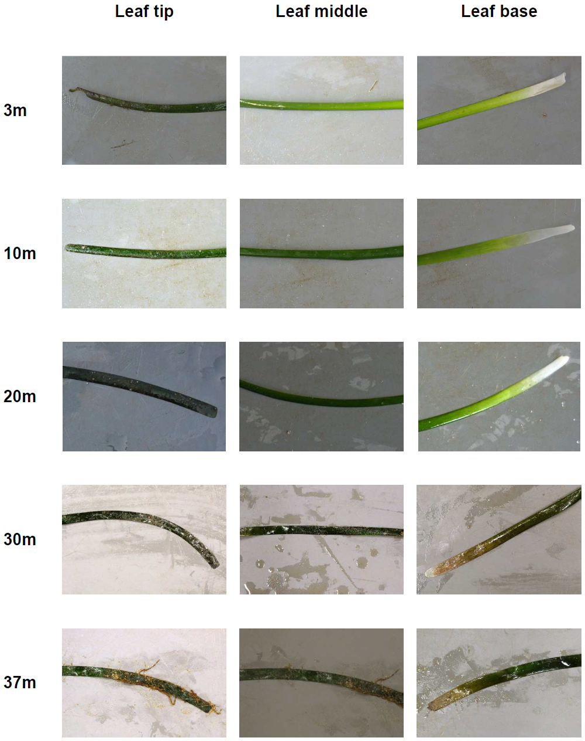
Epiphytism and RLC (May)
Over-evaluation of ETR_{max} when working on epiphyted tissue ...
May 2012, 10m
Notes:
One of the most widely used bioindicator species in the Mediterranean is the seagrass Posidonia oceanica (and more precisely the shoots of leaves of that seagrass).

Slide 16
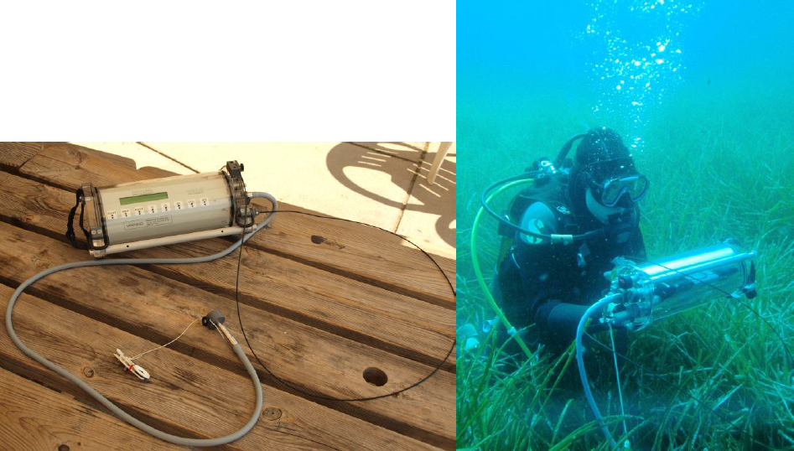
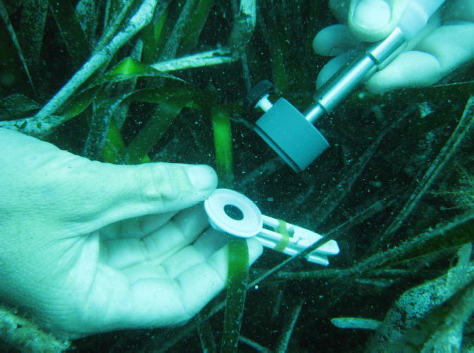
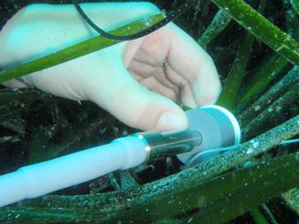
Day, night … or night simulation (May)
RESULTS
-
D
I
SCUSS
I
ON
In situ measurements at the zenith, when solar irradiance is maximal.
Notes:
One of the most widely used bioindicator species in the Mediterranean is the seagrass Posidonia oceanica (and more precisely the shoots of leaves of that seagrass).

Slide 17
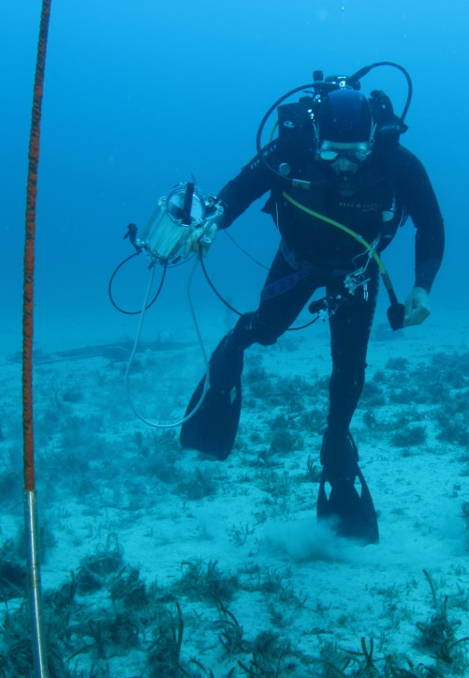
Photosynthesis, biochemistry and biometry
Arnaud Abadie
The foliar surface decreases with depth, whilst the Yield increases with depth.
N and chl.b increase with depth, whilst ETR decreases with depth, such as P.
Photosynthesis, plant growth, pigment production and energetic allocation are physiological adaptation to deeper depth.
Notes:
One of the most widely used bioindicator species in the Mediterranean is the seagrass Posidonia oceanica (and more precisely the shoots of leaves of that seagrass).

Slide 18
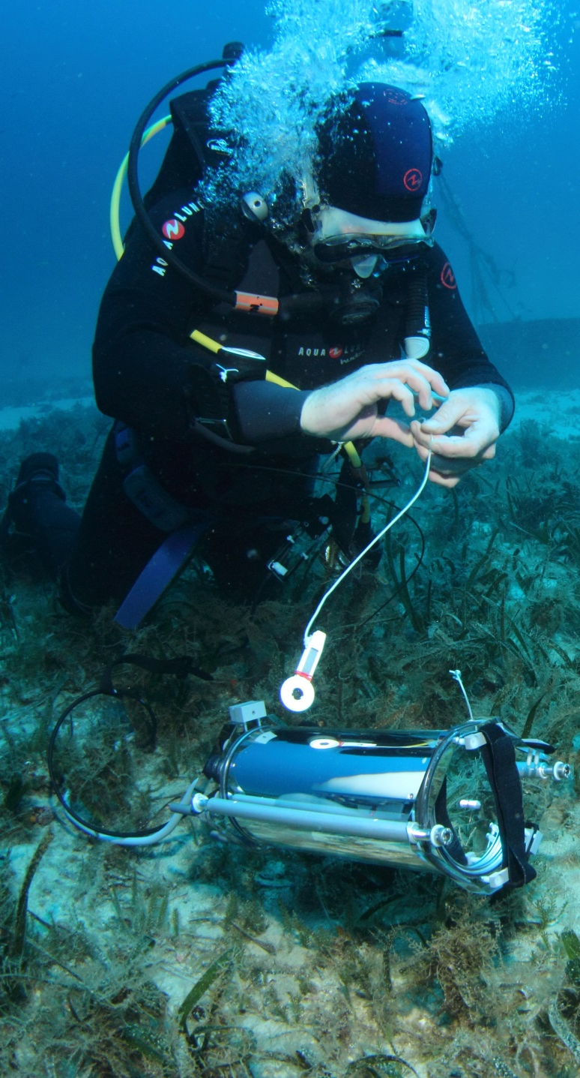
Conclusion
Environmental and plant-physiological characteristics influenced photosynthesis :
Yield and ETR vs depth;
ETR vs leaf part;
ETR vs epiphytism;
RLC vs depth and leaf part;
…
Essential to develop a consensual protocol to publish reliable and comparable results :
to perform measurements at the zenith;
at 10-15 m depth ;
on the middle part of the 3rd leaf, highly photosynthetic, little epiphyted.
P. oceanica fluorescence was correlated with N, P and chl.b leaf contents:
the PAM-method is promising as bioindicator technique.
CONCLUS
I
ON
Arnaud Abadie
Notes:
One of the most widely used bioindicator species in the Mediterranean is the seagrass Posidonia oceanica (and more precisely the shoots of leaves of that seagrass).

Slide 19
What’s next
One year cycle:
every week at 10m depth;
every 2 months at 3, 10, 20, 30, 37m depth.
PAM:
Yield, ETR, RLC.
P. oceanica :
biometry;
biochemistry: C, N, S and their stable isotope ratios, P; trace elements (Mg, Fe, …); Si; DMSP; sugars.
Water column characterization:
Nutrients (free- and pore-water), phyto biomass, O₂ production, temperature, light, PAR, CTD.
Meteorology:
Meteorological station: PAR, wind, …
PERSPECT
I
VES
Arnaud Abadie
Notes:
One of the most widely used bioindicator species in the Mediterranean is the seagrass Posidonia oceanica (and more precisely the shoots of leaves of that seagrass).

Slide 20
Aknowledgements
… and questions … if any …
I
NTRODUCT
I
ON
Camille Léonard master thesis
Notes:
The Mediterranean is submitted to numerous anthropogenic threats, among them the chemical contamination of its densely anthropized coasts. The red circles on this map hilights pollution hot spots along Mediterranean coasts.

