Slide 1
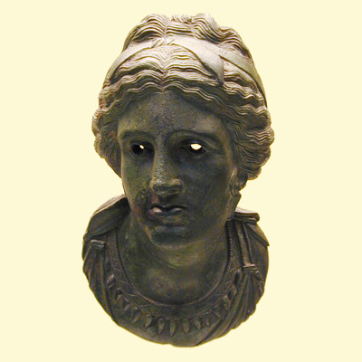
Auroral emission at Jupiter
through Juno's UVS eyes
Denis Grodent
Bertrand Bonfond
G. Randy Gladstone
Jean-Claude Gérard
Jacques Gustin
Aikaterini Radioti
Maïté Dumont
Benjamin Palmaerts
the Juno Science Team
LPAP, Université de Liège, Belgium
Southwest Research Institute, USA

Slide 2
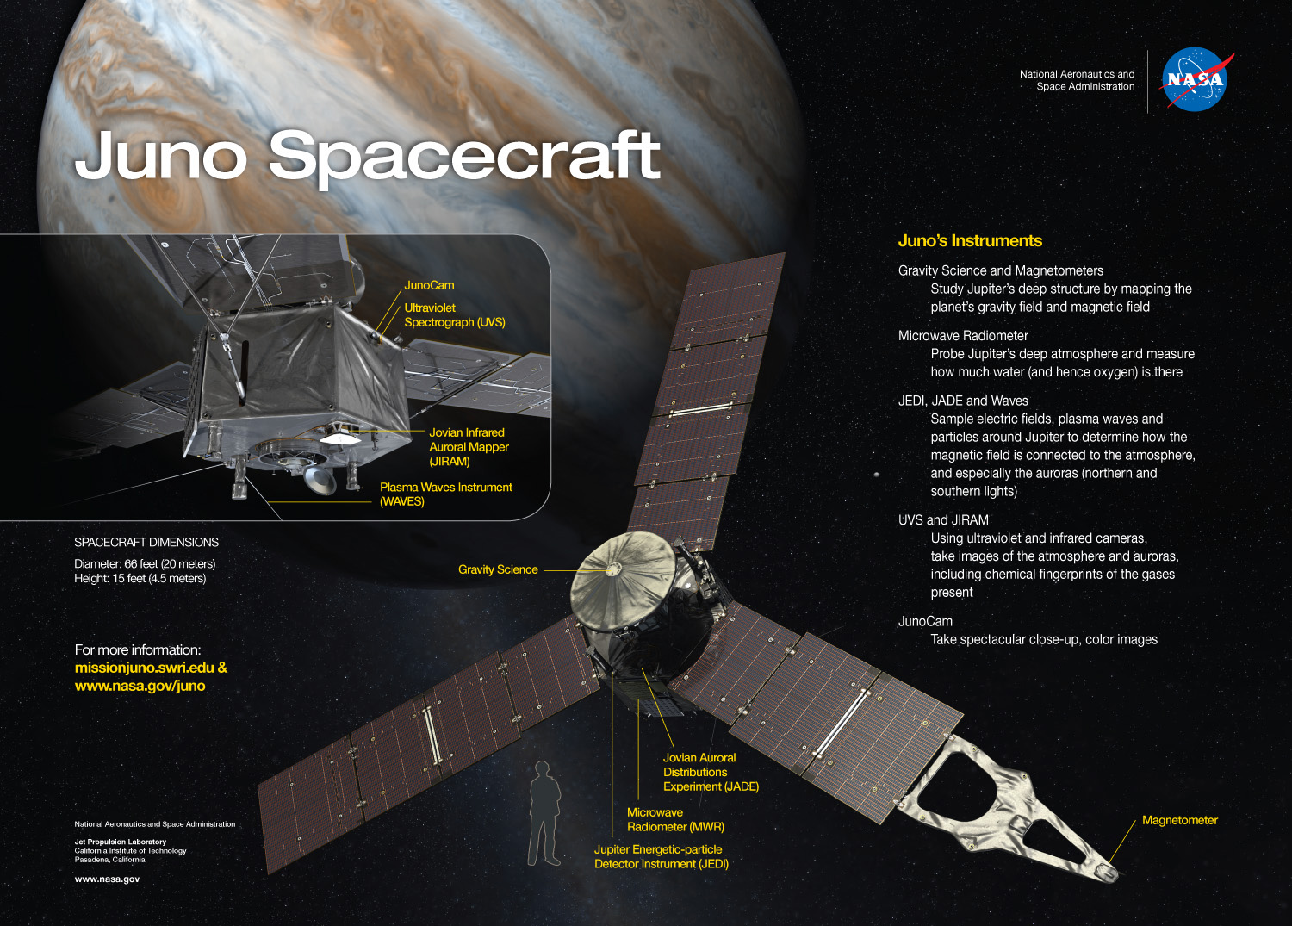
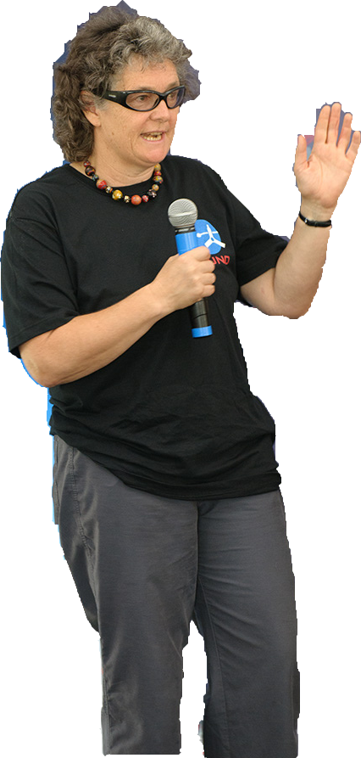
UVS
D. Grodent ULg

Slide 3
Juno UltraViolet Spectrograph UVS (PI: G.R. Gladstone)
Gladstone et al. 2014
UV light
D. Grodent ULg

Slide 4
Dog bone shaped slit
0.025°
0.2°
0.2°
2°
2.5°
2.5°
D. Grodent ULg

Slide 5
Slit projected onto XDL MCP detector
256 "pixels" (spatial) / 2048 pixels (spectral)
electronically digitized pixels
<- 256 px ->
higher spatial res.
200 illuminated pixels
D. Grodent ULg
Notes:
cross delay line micro channel plate detector

Slide 6
Slit projected onto XDL MCP detector
256 "pixels" (spatial) / 2048 pixels (spectral)
Toroidal diffraction grating
PSF < 0.6 nm
"Data Cube" (x , t , λ) Events List
2048
D. Grodent ULg

Slide 7
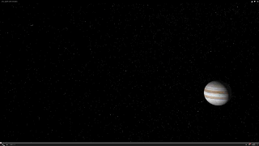
Juno orbit
NASA
D. Grodent ULg

Slide 8
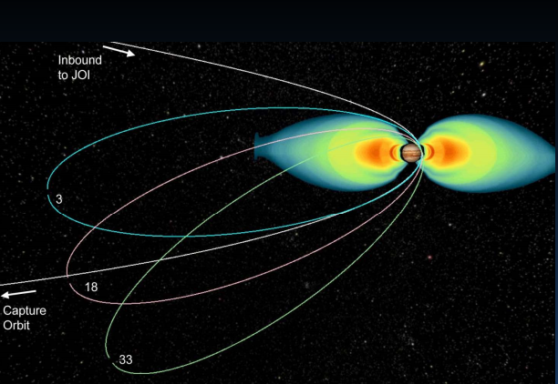

electronic (dark) noise when in/close to radiation belts
D. Grodent ULg

Slide 9
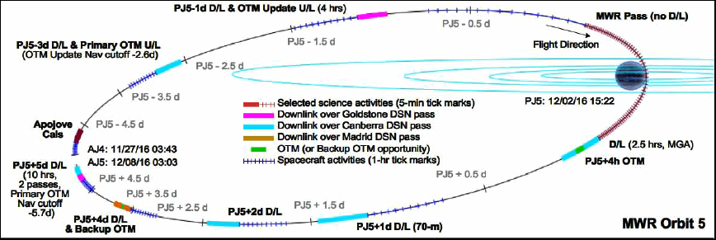
33 14-Day orbits
UVS segment:
~6 hours of continuous operations
2.5 hrs
aurora N
UVS observes
aurora
< 2% of orbit
Also near-apojove UVS obs. (aurora ~few pixels)
1 hr
we need HST for the rest (> 98%) of the time
2.5 hrs
aurora S
Grodent et al., 2015
HST White Paper (ArXiv)
D. Grodent ULg

Slide 10
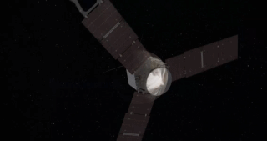
Juno is spin stabilized at 2 RPM: 1 rotation every 30 seconds in a plane containing the UVS boresight
NASA
Use this rotation to scan the auroral region
D. Grodent ULg

Slide 11
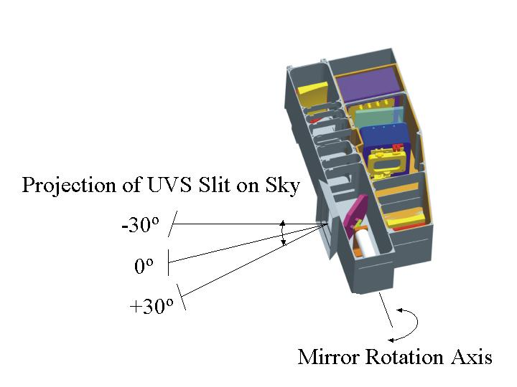
Scan Mirror
steps < 1°
D. Grodent ULg

Slide 12
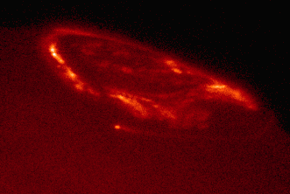
HST GO-12883
D. Grodent ULg

Slide 13
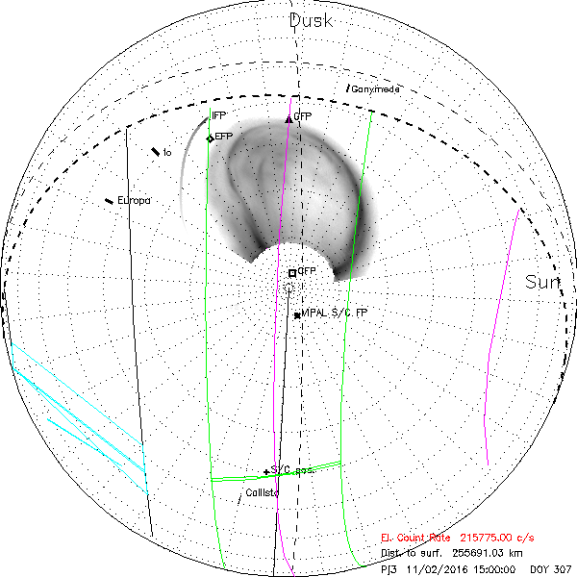
Night Side
Day Side
North,
Observer at ∞
Average UV aurora (dayside)
Juno Horizon
0°
+20°
UVS Swath
+10°
JIRAM
FOV
Orbit PJ3
Radiations
Credit: B. Bonfond,
LPAP-SwRI 2015
D. Grodent ULg

Slide 14

5-min steps
15:00 to 21:00
Credit: B. Bonfond,
LPAP-SwRI 2015
D. Grodent ULg

Slide 15
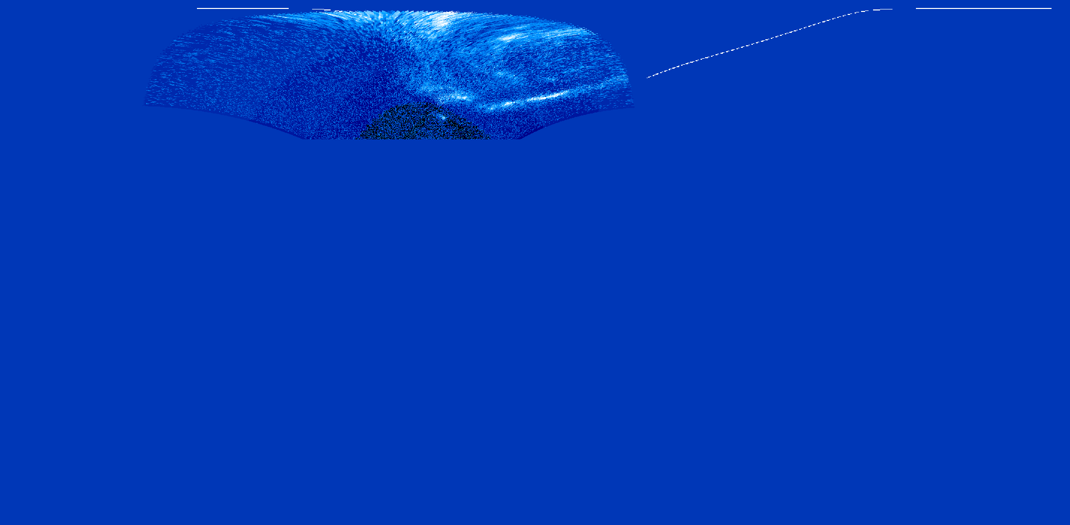
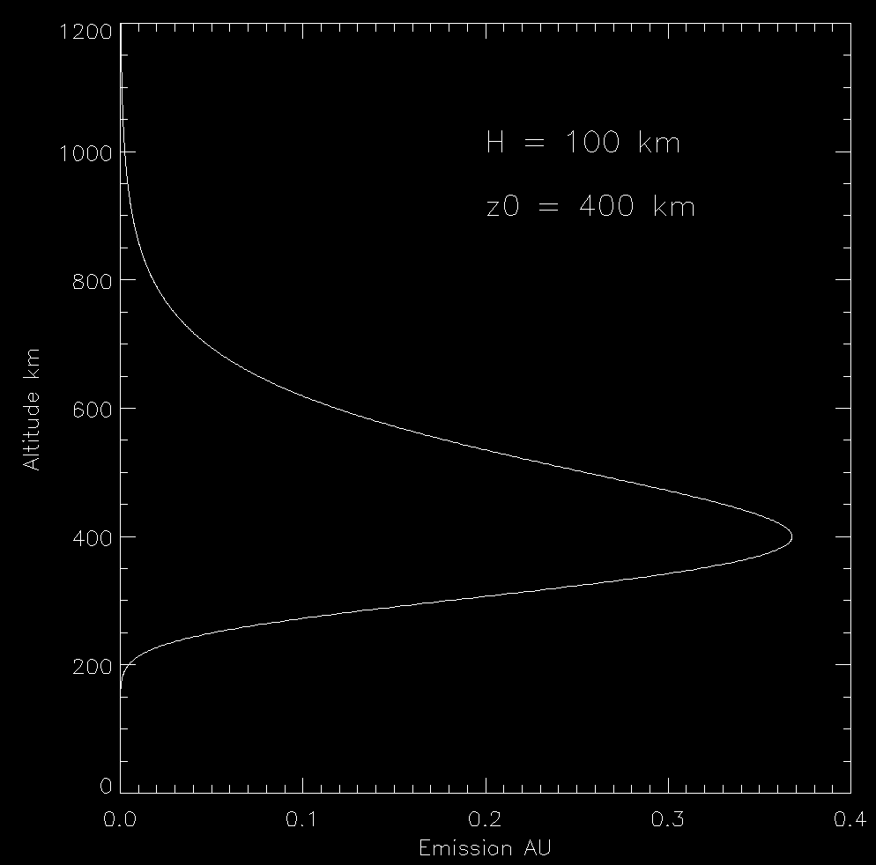
Extrapolate missing aurora
latitude
longitude (S3)
2D map of HST aurora
⟹ Build 3D map
Simulate 3rd dimension with
Chapman function (z₀, H)
Use 143 maps accumulated for 10 sec (STIS ttag)
⟹ 4D
Build H₂ spectrum for each pixel
⟹ 5D
D. Grodent ULg
Notes:
replace average constant map with time varying ttag map

Slide 16
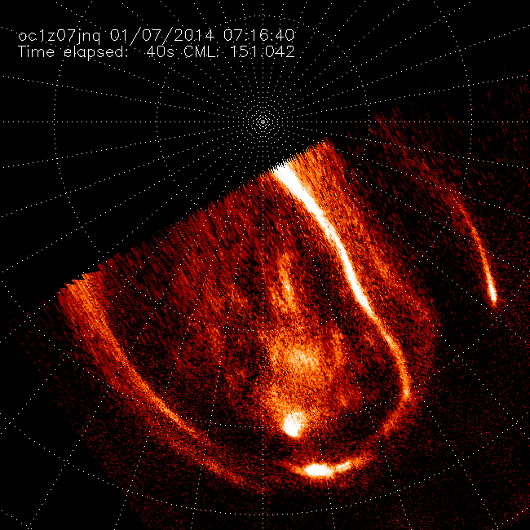
D. Grodent ULg

Slide 17
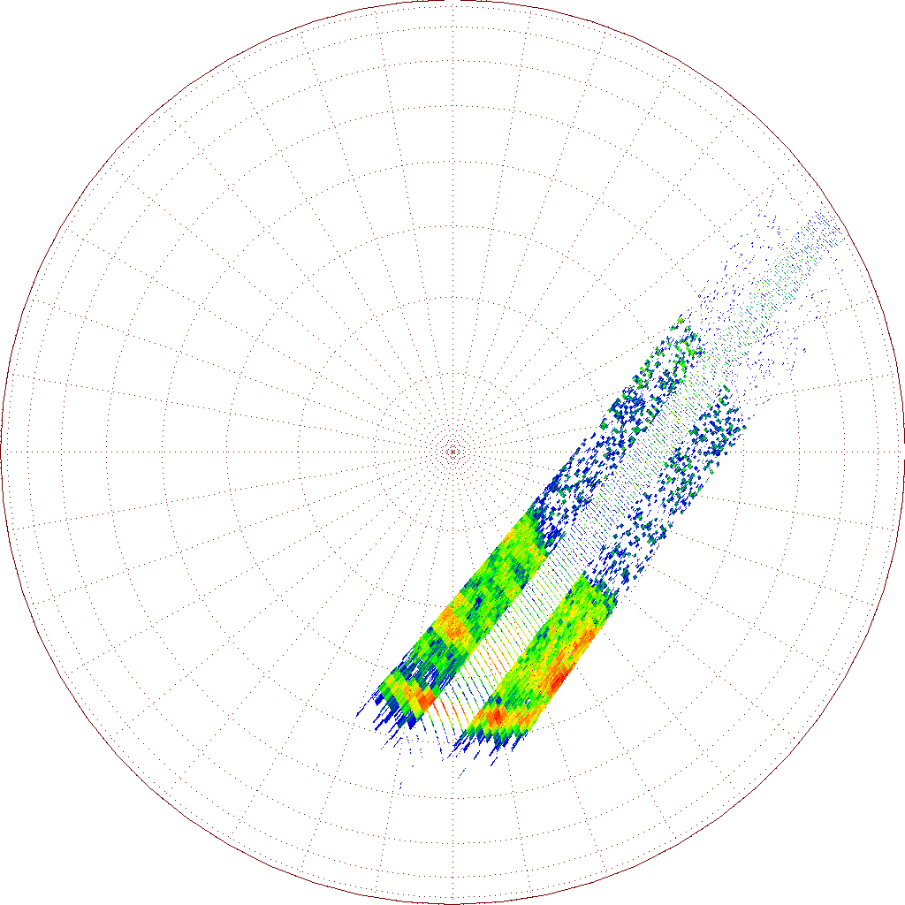
1 sec
D. Grodent ULg
Notes:
In the central portion of the slit: better spatial resolution at the cost of a lower sensitivity.

Slide 18
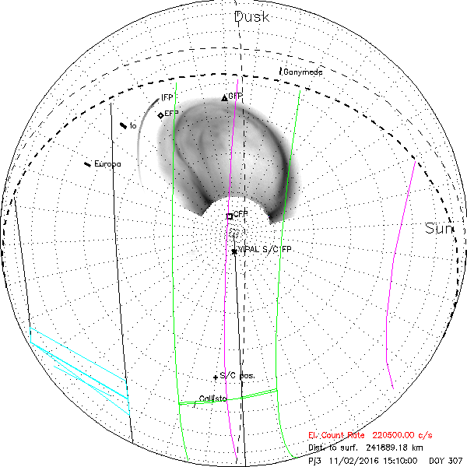
Start: 02 Nov 2016 15:00:04
End: 02 Nov 2016 15:10:34
Orbit #3
Aurora sitting on dayside terminator
(50% night-50% day)
Altitude_{start} = 3.6 R_{J}
Instantaneous spat. res. ~ 156 km x 893 km / pix²
Dark count rate ~ 216 kC/s

Slide 19
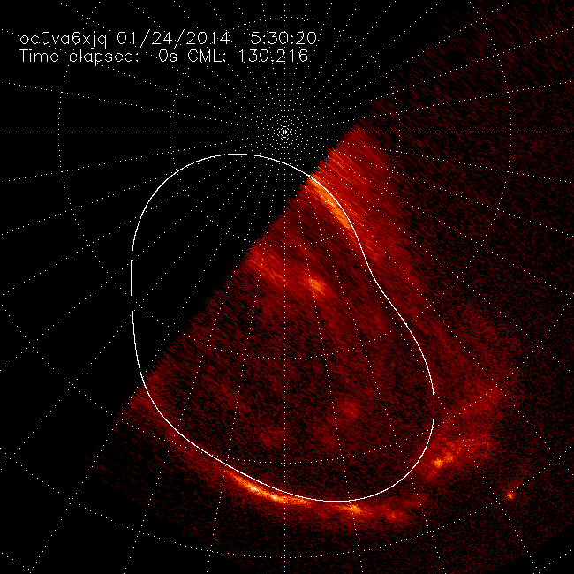
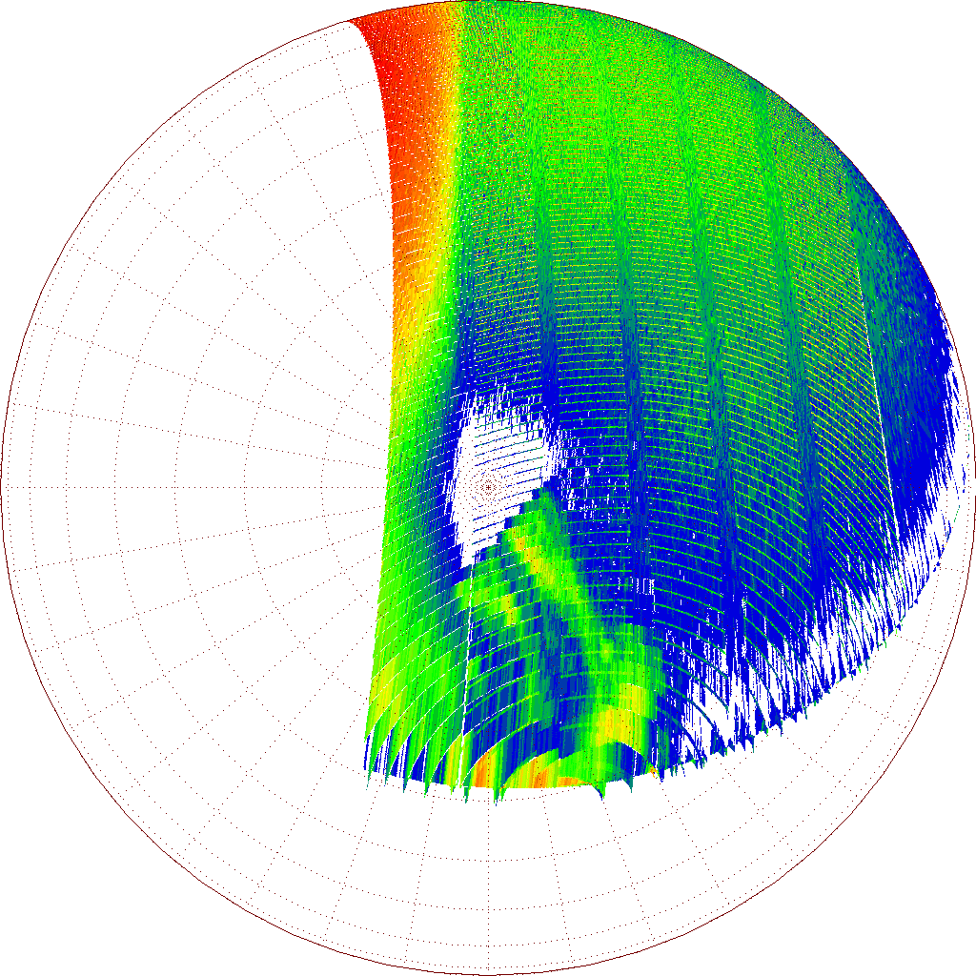
Dark counts
Daylight
1st HST frame
Aurora
= 5 angles
= 5 rotations
= 5 x 30 sec

Slide 20
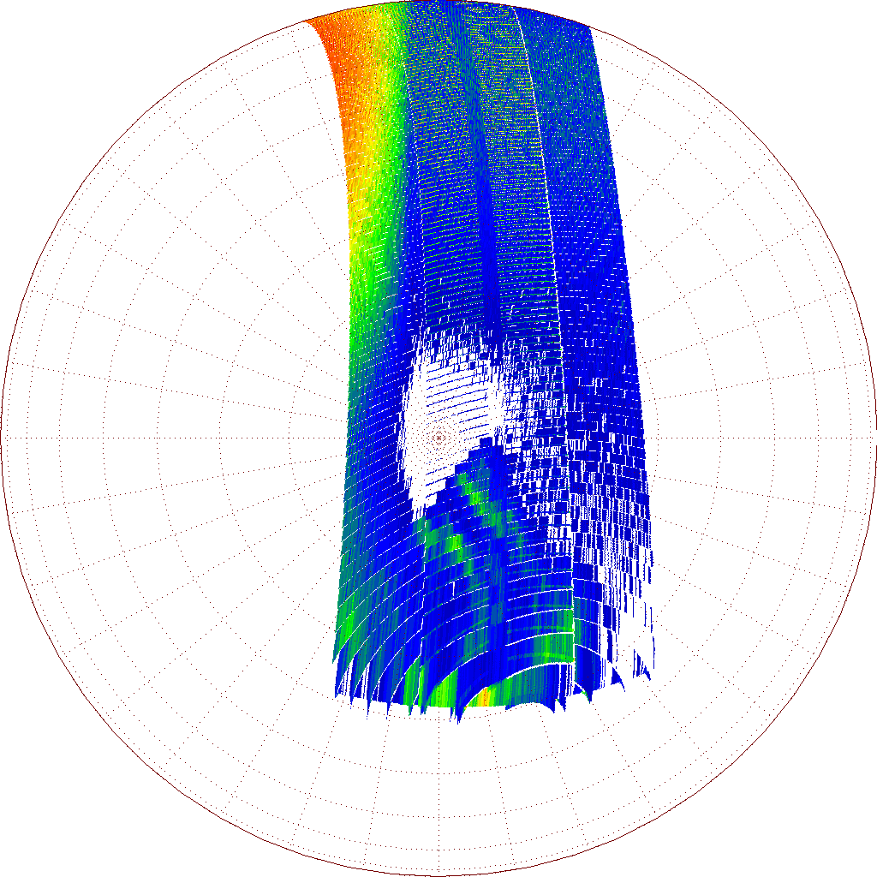
Flare
= 2 (1) angles
= 2 (1) rotations
= 2 (1) x 30 sec
D. Grodent ULg

Slide 21

10.5 min
D. Grodent ULg

Slide 22
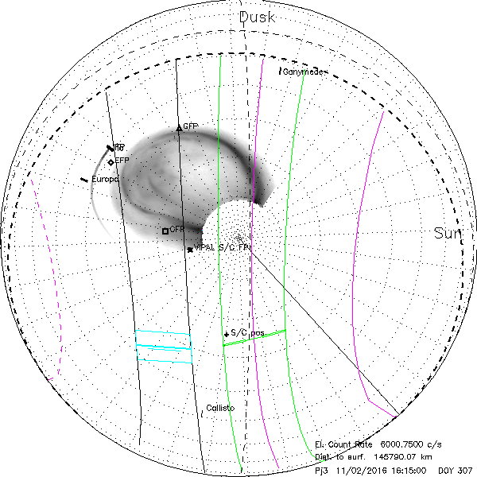
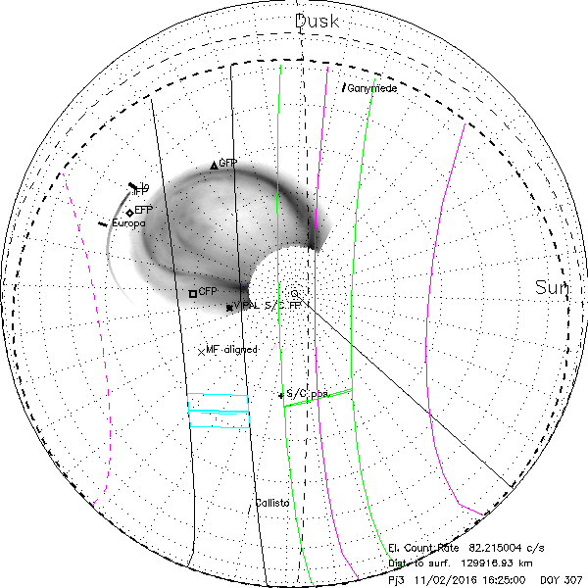
Start: 02 Nov 2016 16:15:04
End: 02 Nov 2016 16:23:04
Orbit #3
75 min later
Aurora almost fully in nightside
Altitude_{start} = 2.04 R_{J}
Instantaneous spat. res. ~ 89 km x 509 km / pix²
Dark count rate ~ 6 kC/s
D. Grodent ULg

Slide 23
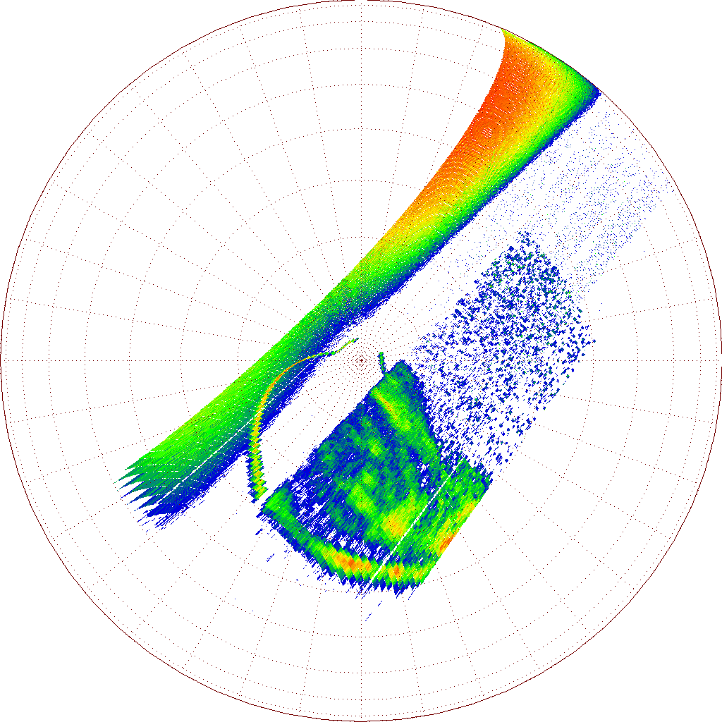
Daylight
Dark counts
1st HST frame
= 5 angles
= 5 rotations
= 5 x 30 sec
Aurora
D. Grodent ULg

Slide 24
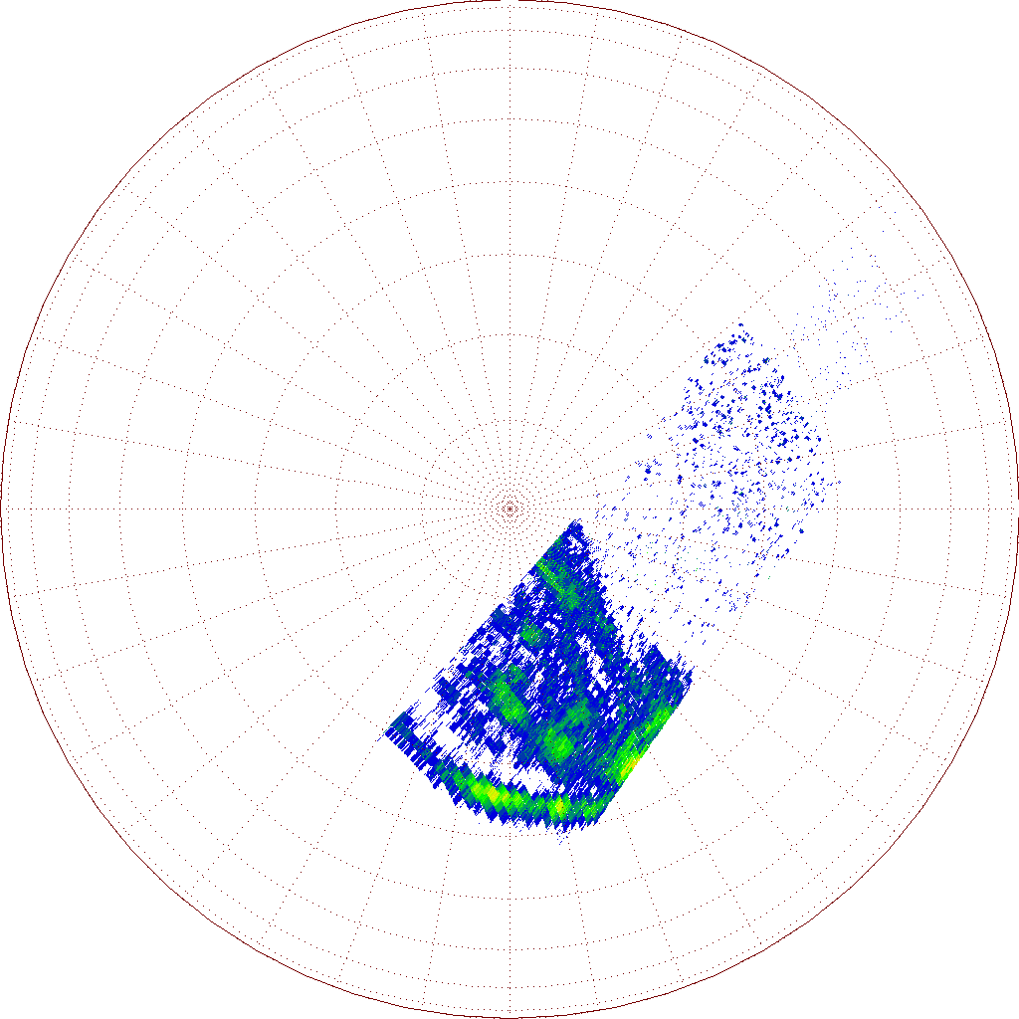
Flare
= 2 (1) angles
= 2 (1) rotations
= 2 (1) x 30 sec
D. Grodent ULg

Slide 25

8 min
D. Grodent ULg

Slide 26
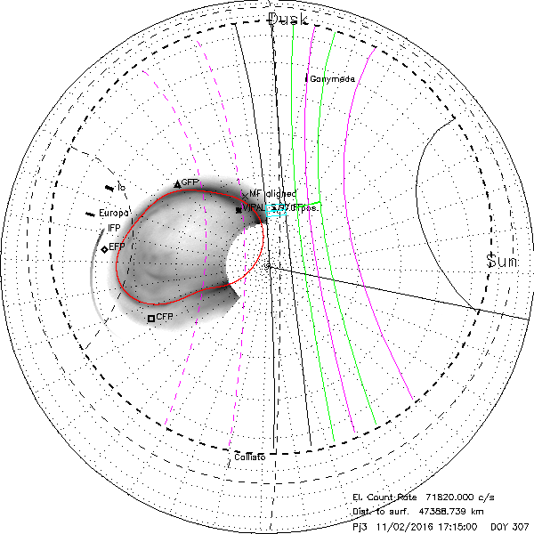
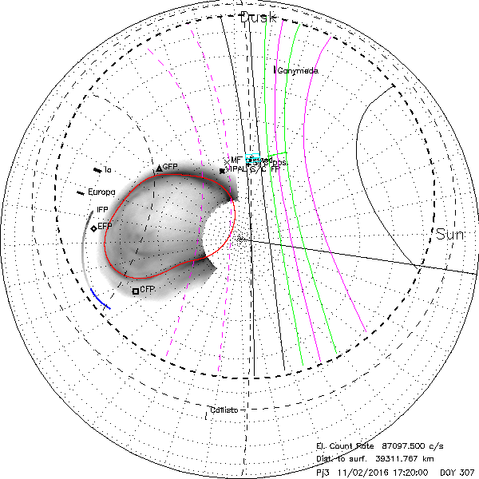
Start: 02 Nov 2016 17:15:04
End: 02 Nov 2016 17:19:04
Orbit #3
1 hr later
Aurora fully in nightside
S/C magnetic footprint on main emission
Altitude_{start} = 0.66 R_{J}
Instantaneous spat. res. ~ 29 km x 165 km / pix²
Dark count rate ~ 72 kC/s
D. Grodent ULg

Slide 27
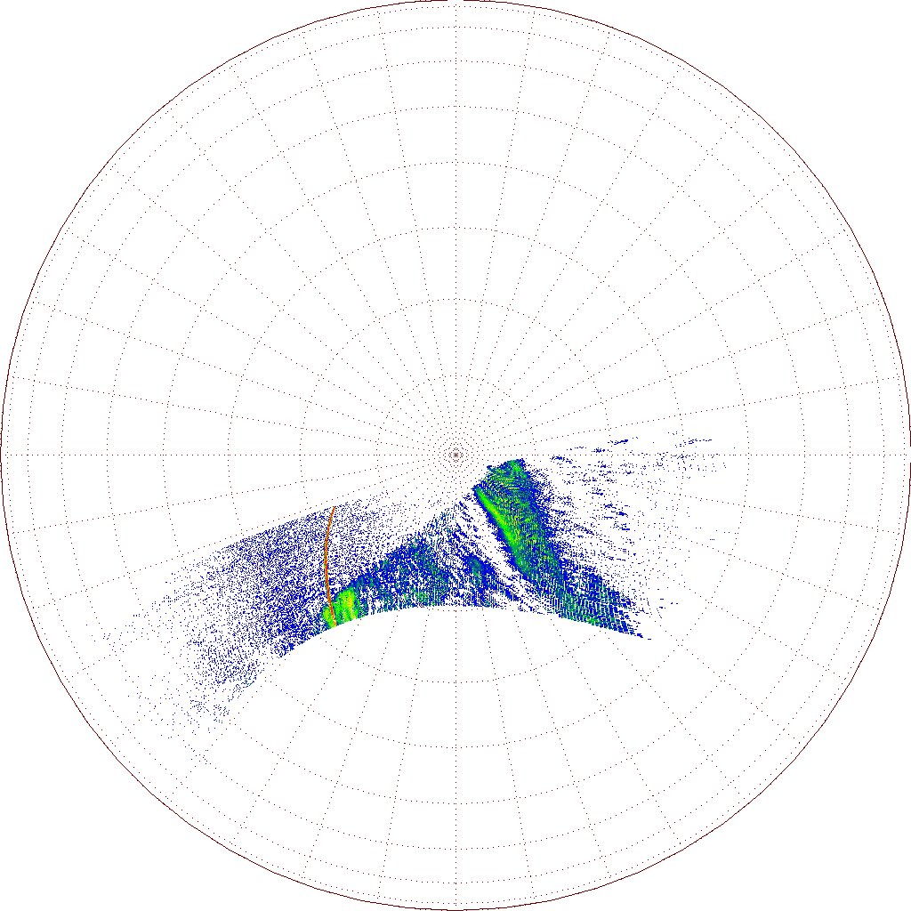
1st HST frame
Daylight
Dark counts
Aurora
= 7 angles
= 7 rotations
= 7 x 30 sec
D. Grodent ULg

Slide 28
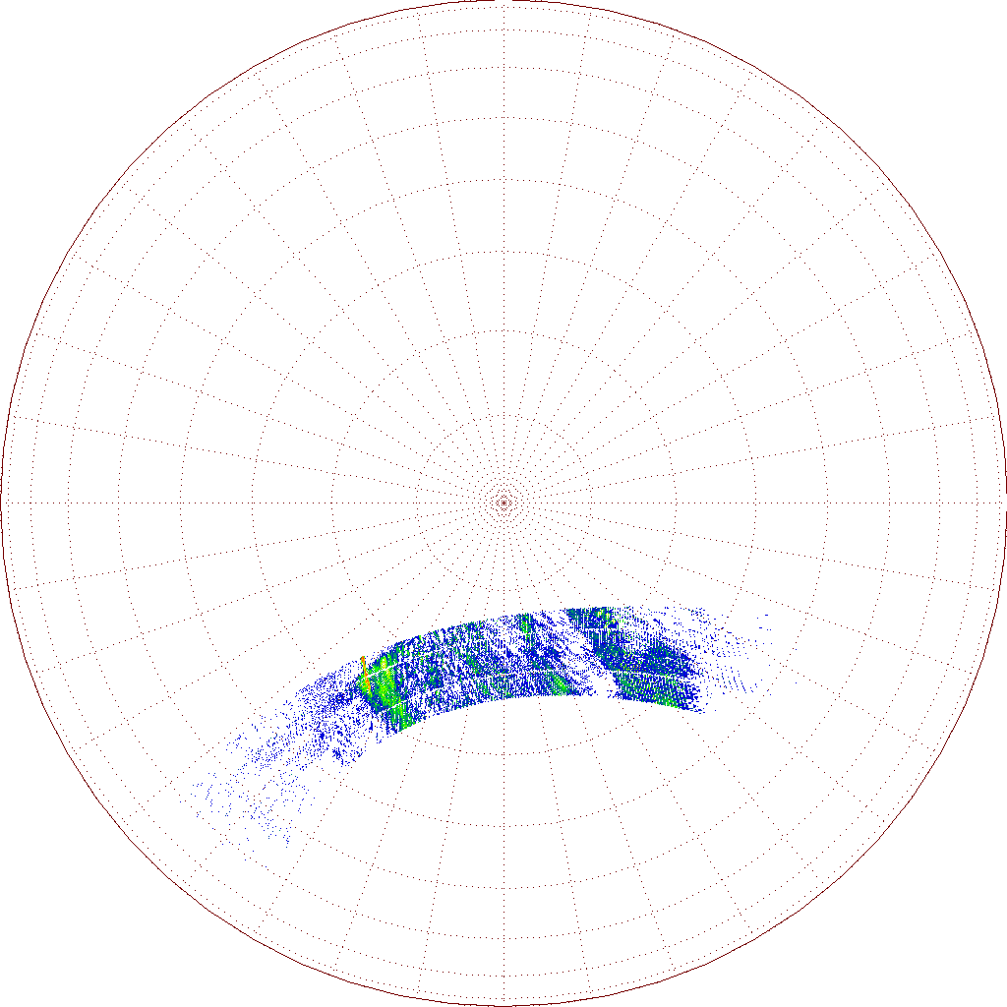
= 2 (1) angles
= 2 (1) rotations
= 2 (1) x 30 sec
4 min
D. Grodent ULg

Slide 29
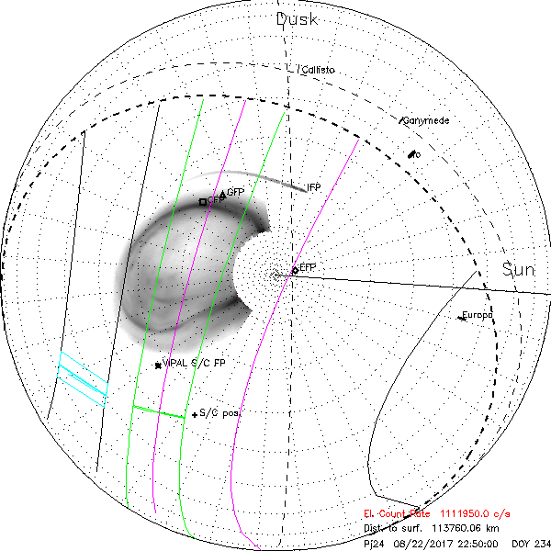
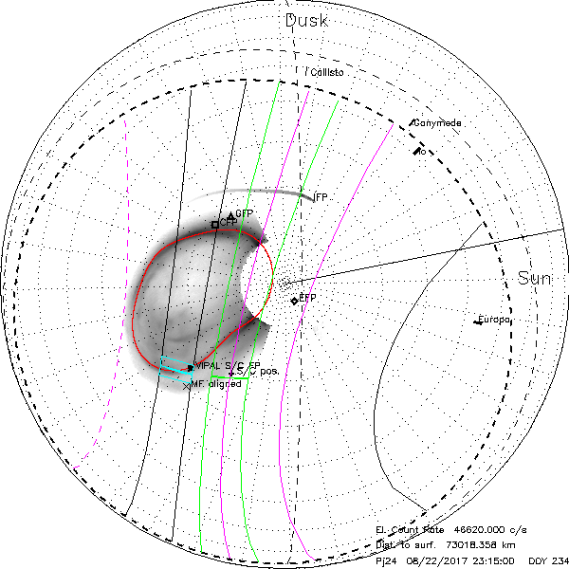
Start: 22 Aug 2017 22:49:53
End: 22 Aug 2017 23:12:48
Orbit #24
~10 months later
Aurora fully in nightside
S/C magnetic footprint on main emission
Altitude_{start} = 1.6 R_{J}
Instantaneous spat. res. ~ 70 km x 397 km / pix²
Dark count rate ~ 1112 kC/s ⟹ 40 kC/s
D. Grodent ULg

Slide 30
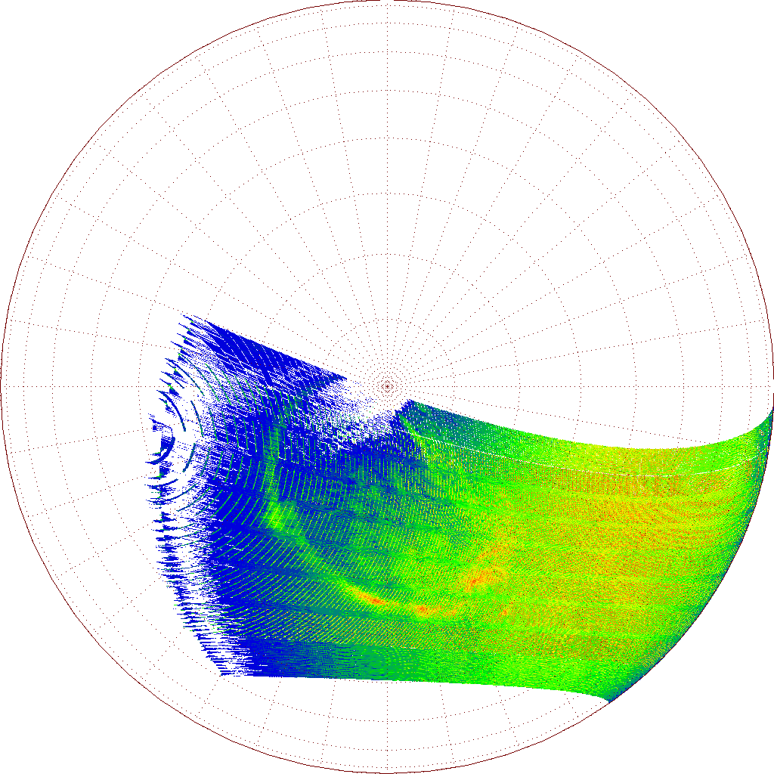
7 angles
per 30 sec
frame
(should be
1 angle/frame)
23 min
Just 1 year to go!
D. Grodent ULg

Slide 31
D. Grodent ULg

Slide 32
0.017 s
D. Grodent ULg

