Slide 1









Recent ethane increase above North America:
comparison between FTIR measurements and model simulations
B. Franco¹, W. Bader¹, E. Mahieu¹, B. Bovy¹, E. V. Fischer², Z. A. Tzompa-Sosa², K. Strong³, S. Conway³,
J. W. Hannigan⁴, E. Nussbaumer⁴, K. Sudo⁵, P. F. Bernath^{6,7,8}, C. D. Boone⁸ & K. A. Walker^{3,8}
¹University of Liège (bruno.franco@ulg.ac.be), ²Colorado State University, ³University of Toronto,
⁴NCAR Boulder, ⁵Nagoya University, ⁶Old Dominion University, ⁷University of York, ⁸University of Waterloo
NDACC-IRWG Meeting 2015, Toronto, June 11

Slide 2
Recent ethane increase above North America:
comparison between FTIR measurements and model simulations
B. Franco¹, W. Bader¹, E. Mahieu¹, B. Bovy¹, E. V. Fischer², Z. A. Tzompa-Sosa², K. Strong³, S. Conway³,
J. W. Hannigan⁴, E. Nussbaumer⁴, K. Sudo⁵, P. F. Bernath^{6,7,8}, C. D. Boone⁸ & K. A. Walker^{3,8}
¹University of Liège (bruno.franco@ulg.ac.be), ²Colorado State University, ³University of Toronto,
⁴NCAR Boulder, ⁵Nagoya University, ⁶Old Dominion University, ⁷University of York, ⁸University of Waterloo
Outline
Ethane retrieval strategy
Recent ethane increase
Comparison with GEOS-Chem
Ongoing work
NDACC-IRWG Meeting 2015, Toronto, June 11

Slide 3
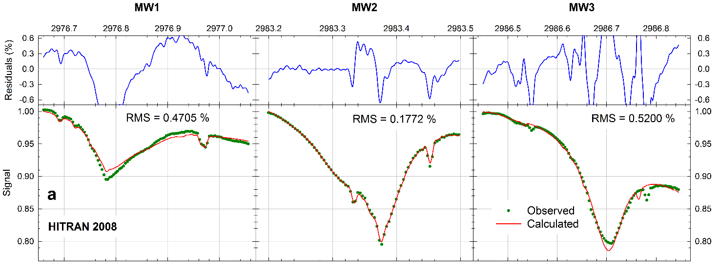
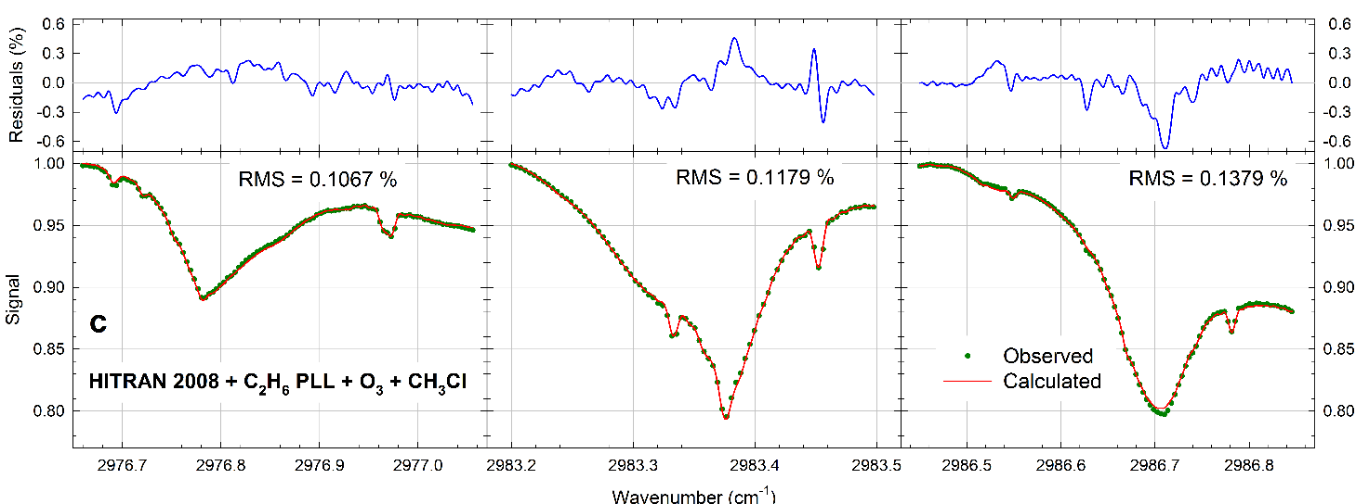
1. Ethane retrieval strategy
Strategy originally developed by E. Mahieu (project UFTIR) and then adopted by the NDACC network
2976.660 – 2977.059 cm⁻¹
2983.200 – 2983.500 cm⁻¹
2986.450 – 2986.850 cm⁻¹
Spectroscopic parameters
HITRAN 2008
C₂H₆ pseudolines (G. C. Toon) based on J. J. Harrison’s lab measurements
Update for three O₃ lines (P. Chelin)
Update for CH₃Cl line positions and intensities (C. Bray)
NB: Changes in HITRAN 2012 temperature and pressure-dependency parameters of the H₂O feature at 2983.316 cm⁻¹ increase the residuals
NDACC-IRWG Meeting 2015, Toronto, June 11

Slide 4
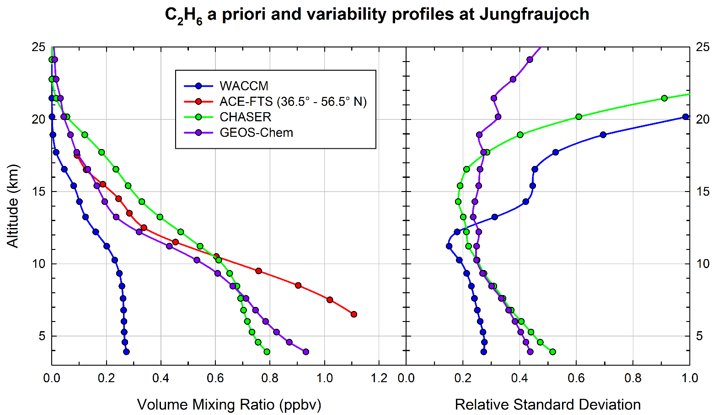
1. Ethane retrieval strategy
=> A priori and variability profiles derived from a 2007-2009 CHASER simulation (K. Sudo)
=> Large discrepancies between WACCM, and ACE-FTS, CHASER and GEOS-Chem profiles
NDACC-IRWG Meeting 2015, Toronto, June 11

Slide 5
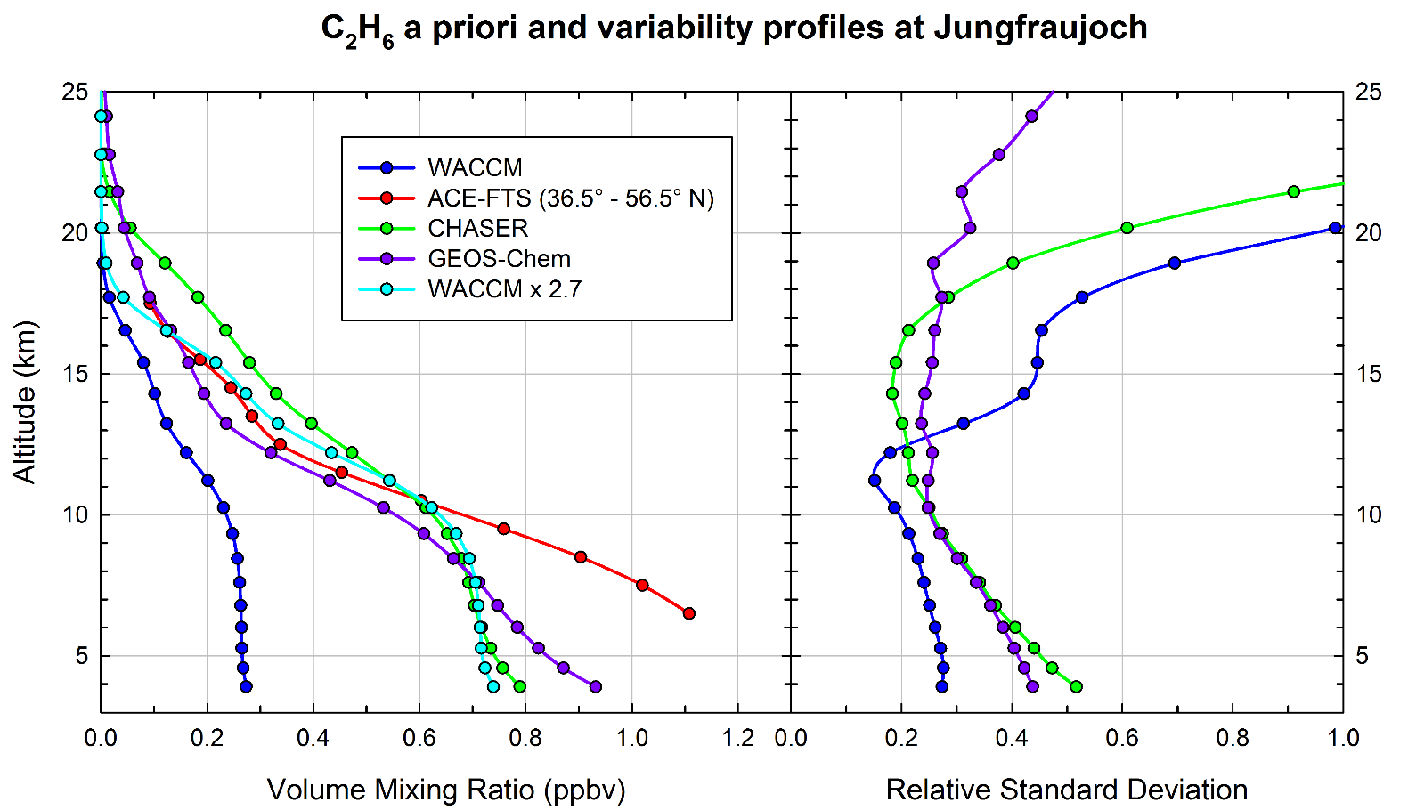
1. Ethane retrieval strategy
WACCM can be scaled by a constant factor to match the ACE-FTS, CHASER and GEOS-Chem profiles
No significant impact on the retrieved C₂H₆ columns, residuals of fitting and DOFS
NDACC-IRWG Meeting 2015, Toronto, June 11

Slide 6
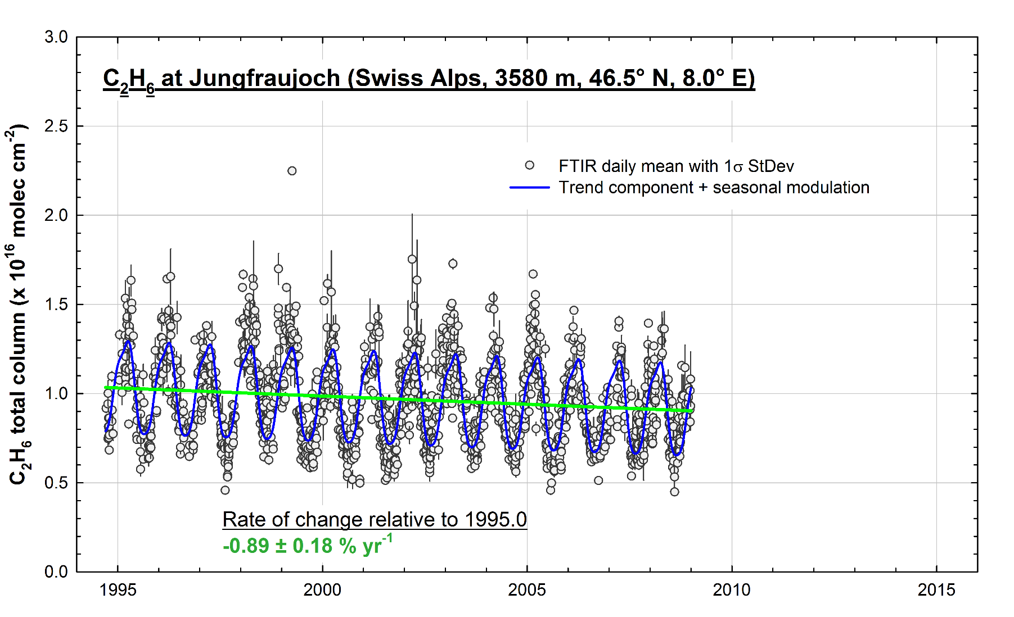
2. Recent ethane increase
Trend analysis: bootstrap resampling tool, combining a linear function and a 3rd order Fourier series accounting for the intra-annual variability (Gardiner et al., 2008)
NDACC-IRWG Meeting 2015, Toronto, June 11

Slide 7
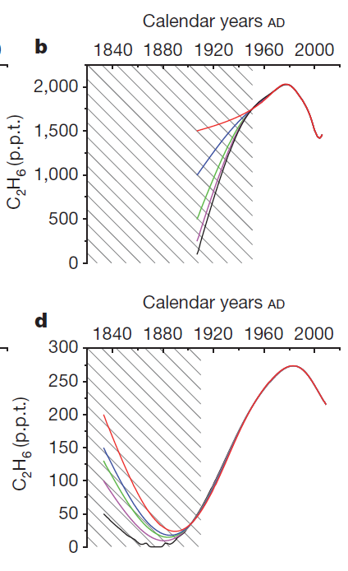
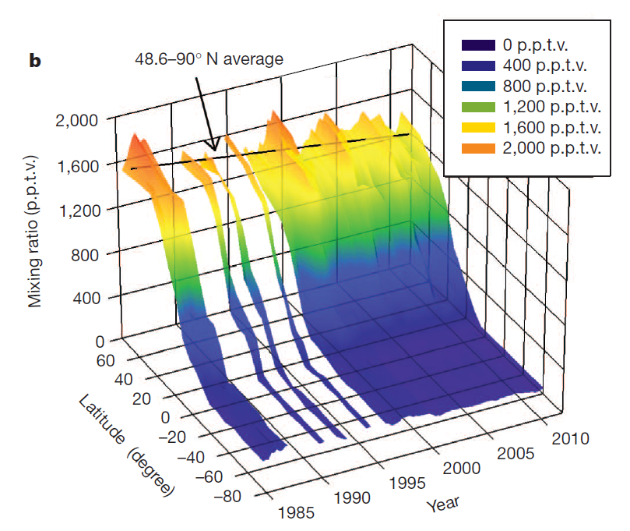
2. Recent ethane increase
Regular decrease of atmospheric C₂H₆ burden consistent with the global decline of fugitive emissions from fossil fuel sources from the mid-1980s
-> from firn air measurements
-> from air sampling measurements
Simpson et al., 2012, Nature
Aydin et al., 2011, Nature
NDACC-IRWG Meeting 2015, Toronto, June 11

Slide 8
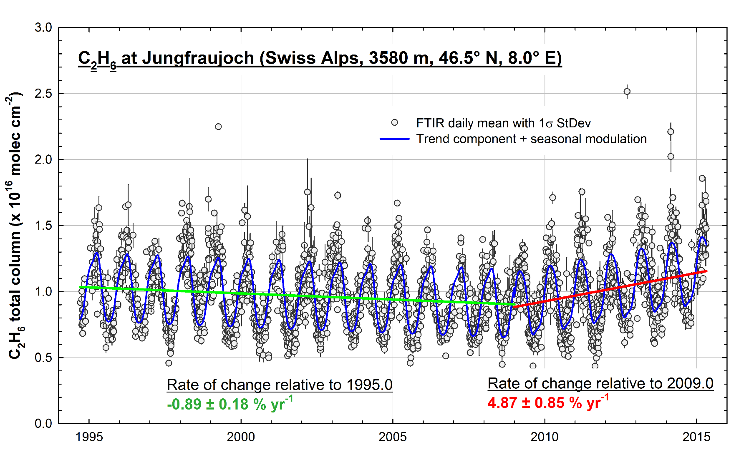
2. Recent ethane increase
Franco et al., 2015, JQSRT
NDACC-IRWG Meeting 2015, Toronto, June 11

Slide 9
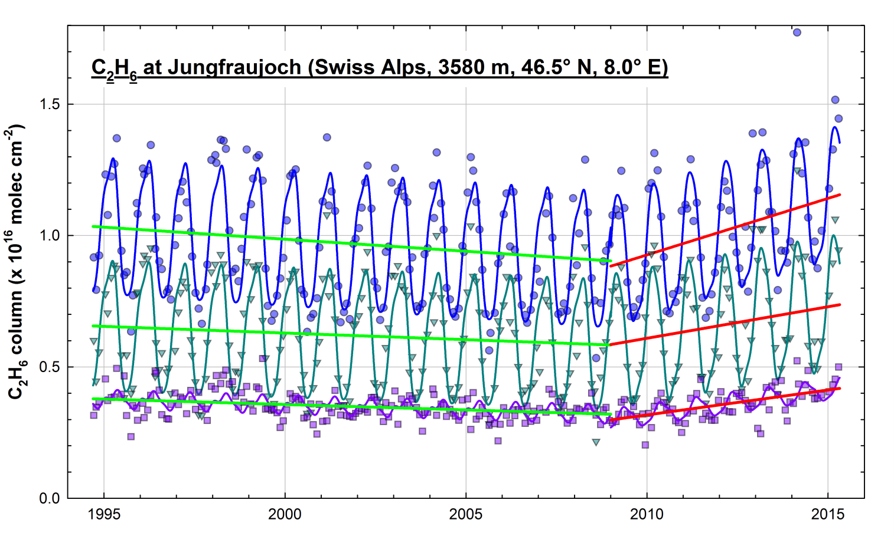
2. Recent ethane increase
Two independent partial columns may be deduced from the FTIR retrievals (DOFS ≈ 2.0)
Vertically-homogeneous increase of C₂H₆ throughout the troposphere and lower stratosphere
Total columns:
=> +4.9 ± 0.8 % yr⁻¹
Lower troposphere
(< 8 km)
=> +4.1 ± 0.9 % yr⁻¹
UTLS (8 - 20 km)
=> +6.4 ± 1.0 % yr⁻¹
NDACC-IRWG Meeting 2015, Toronto, June 11

Slide 10
2. Recent ethane increase
Cause of the C₂H₆ rise from 2009 onwards?
Sharp fluctuations of OH concentration in the atmosphere?
  The gobal OH levels have not exhibited large interannual variability since the end of the 20th century
  => Montzka et al., 2011, Small Interannual Variability of Global Atmospheric
  Hydroxyl, Science 331, 67
NDACC-IRWG Meeting 2015, Toronto, June 11

Slide 11
2. Recent ethane increase
Cause of the C₂H₆ rise from 2009 onwards?
Sharp fluctuations of OH concentration in the atmosphere?
  The gobal OH levels have not exhibited large interannual variability since the end of the 20th century
  => Montzka et al., 2011, Small Interannual Variability of Global Atmospheric
  Hydroxyl, Science 331, 67
  Neither CO nor other species that have oxidation by OH as their major removal pathway such as HCN and C₂H₂, present an upturn in their retrieved columns
NDACC-IRWG Meeting 2015, Toronto, June 11

Slide 12
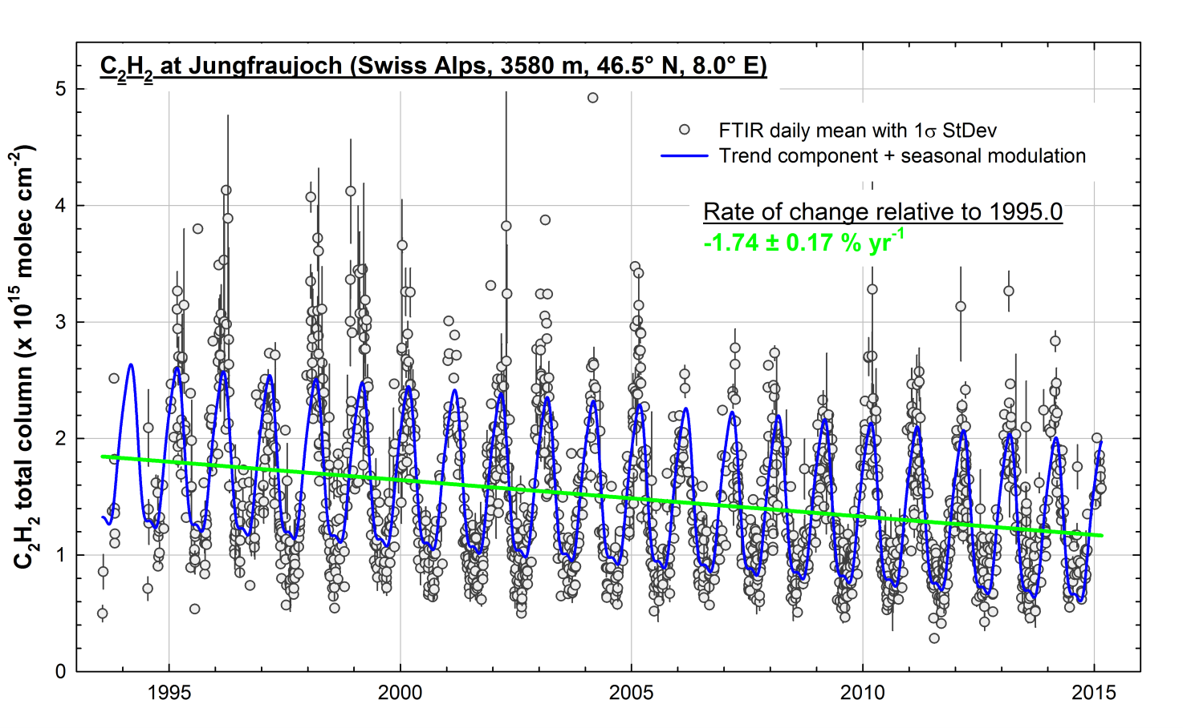
2. Recent ethane increase
  Neither CO nor other species that have oxidation by OH as their major removal pathway such as HCN and C₂H₂, present an upturn in their retrieved columns
NDACC-IRWG Meeting 2015, Toronto, June 11

Slide 13
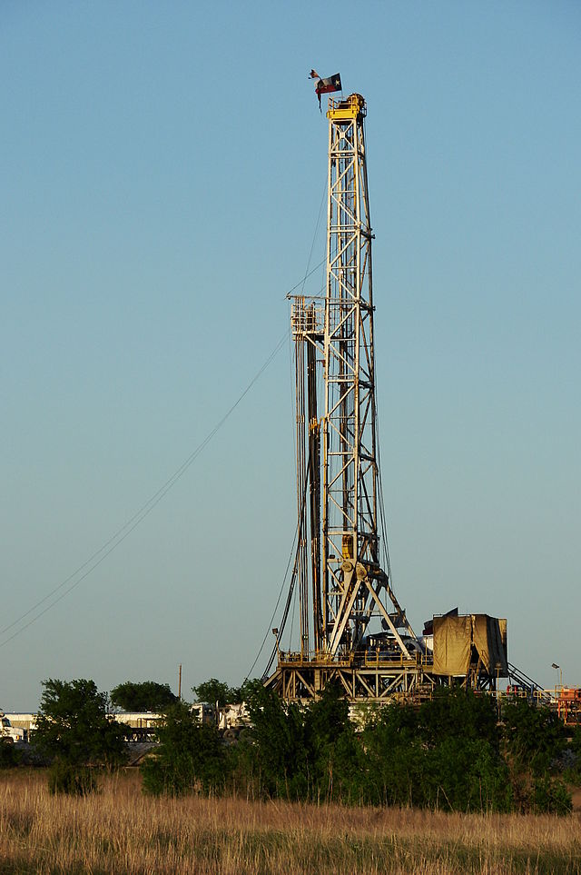

2. Recent ethane increase
Cause of the C₂H₆ rise from 2009 onwards?
Product of enhanced fugitive emissions?
  May be linked to the recent massive growth in the exploitation of shale gas and tight oil reservoirs, especially in North America
Hydraulic fracturing
(« fracking »)
Texas Barnett Shale gas drilling rig near Alvarado, Texas. Courtesy of David R. Tribble
www.huffingtonpost.com
NDACC-IRWG Meeting 2015, Toronto, June 11

Slide 14
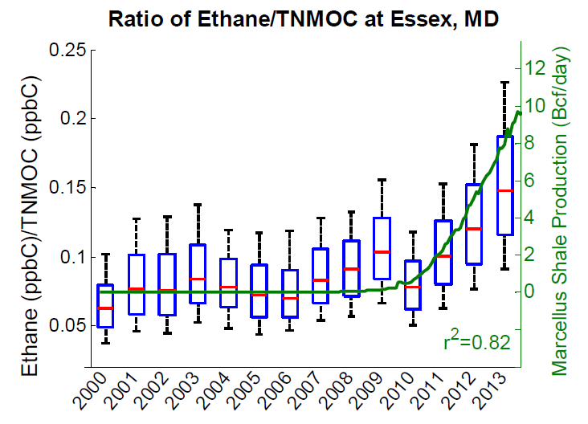
2. Recent ethane increase
Cause of the C₂H₆ rise from 2009 onwards?
Product of enhanced fugitive emissions?
  May be linked to the recent massive growth in the exploitation of shale gas and tight oil reservoirs, especially in North America
  Increases of hydrocarbons related to oil and gas industries are detected over North American regions where the drilling productivity began to grow rapidly after 2009
Marcellus Shale production
C₂H₆/TNMOC ratio
PAMS measurements at Essex, MD, located downwind from the giant Marcellus Shale play (WV, PA and NY)
Vinciguerra et al., 2015, Regional air quality impacts of hydraulic fracturing and shale natural gas activity: Evidence from VOC observations, Atmospheric Environment 110, 144-150.
NDACC-IRWG Meeting 2015, Toronto, June 11

Slide 15
2. Recent ethane increase
Cause of the C₂H₆ rise from 2009 onwards?
Product of enhanced fugitive emissions?
  May be linked to the recent massive growth in the exploitation of shale gas and tight oil reservoirs, especially in North America
  Increases of hydrocarbons related to oil and gas industries are detected over North American regions where the drilling productivity began to grow rapidly after 2009
  Could represent a change in C₂H₆ throughout the Northern Hemisphere
  FTIR and ACE-FTS measurements over North America support this hypothesis
Toronto, Boulder, Thule, Eureka…
NDACC-IRWG Meeting 2015, Toronto, June 11

Slide 16
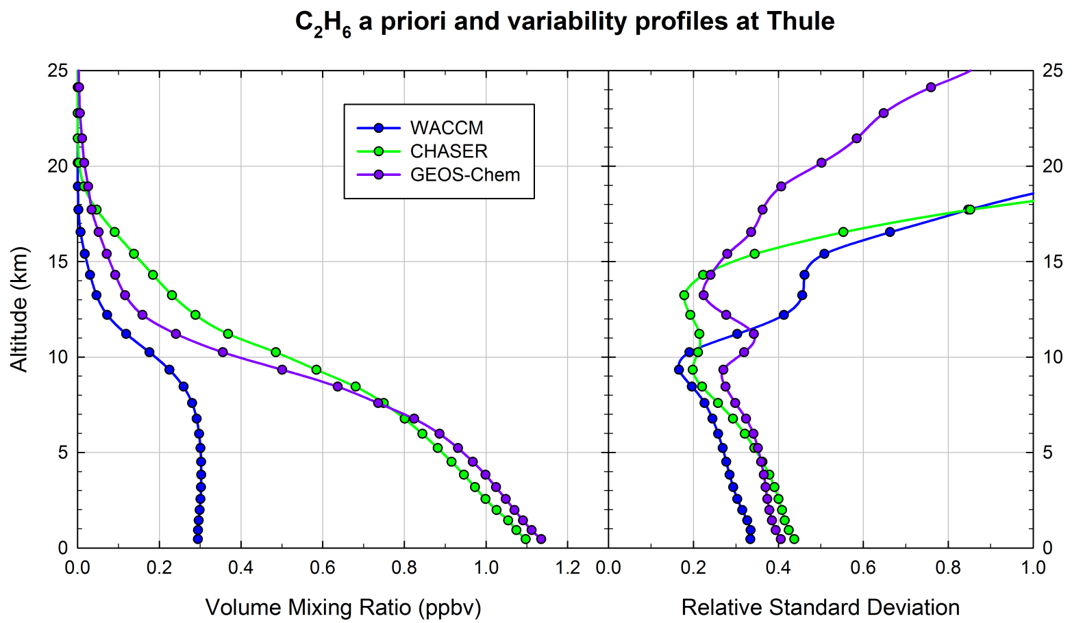
2. Recent ethane increase
=> Large discrepancies between WACCM, and CHASER and GEOS-Chem profiles
NDACC-IRWG Meeting 2015, Toronto, June 11

Slide 17
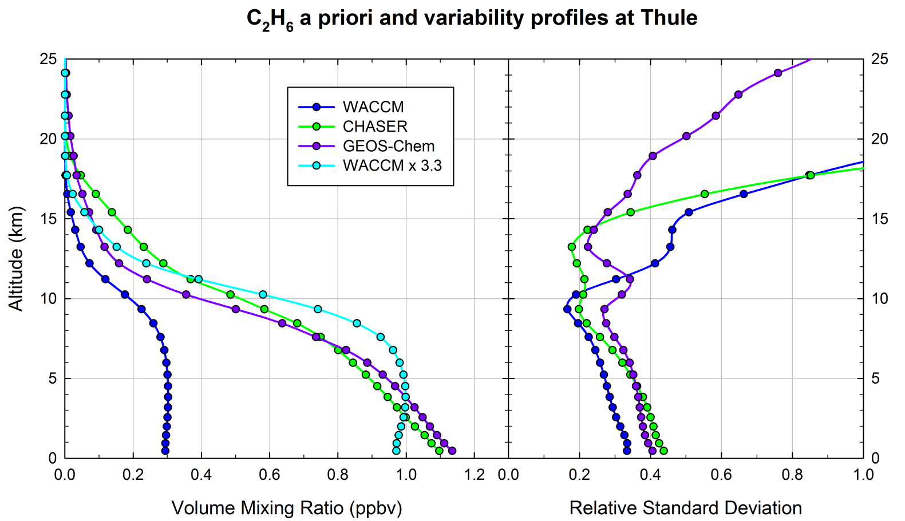
2. Recent ethane increase
=> WACCM is scaled by a constant factor to match the CHASER and GEOS-Chem profiles
NDACC-IRWG Meeting 2015, Toronto, June 11

Slide 18
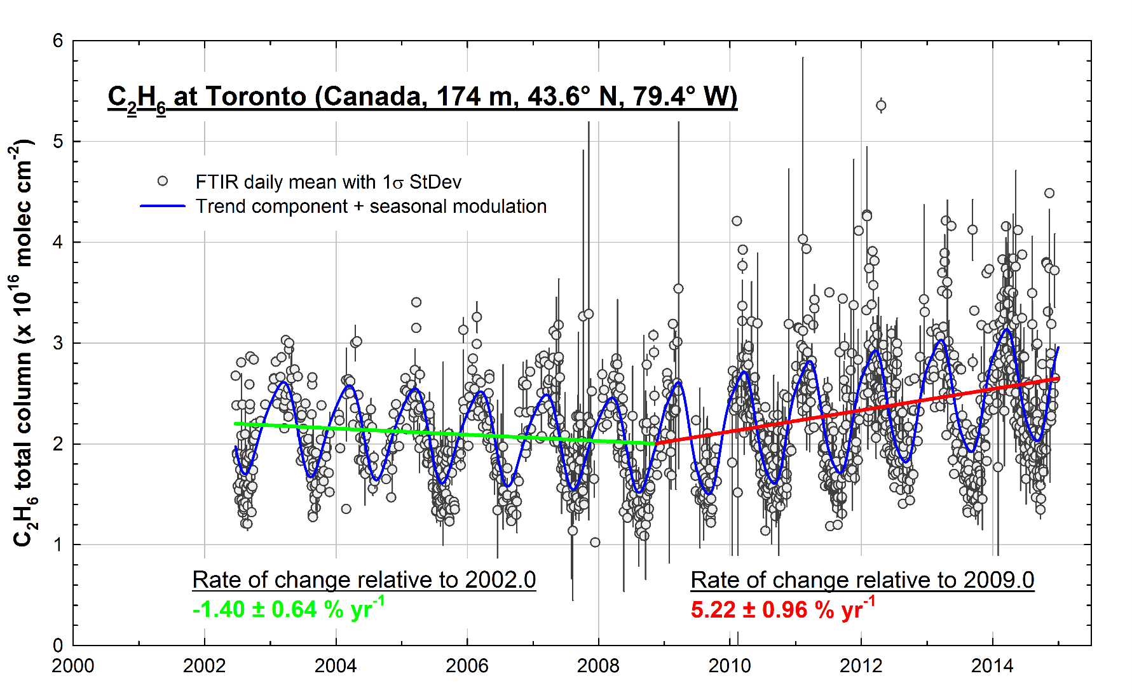
2. Recent ethane increase
NDACC-IRWG Meeting 2015, Toronto, June 11

Slide 19
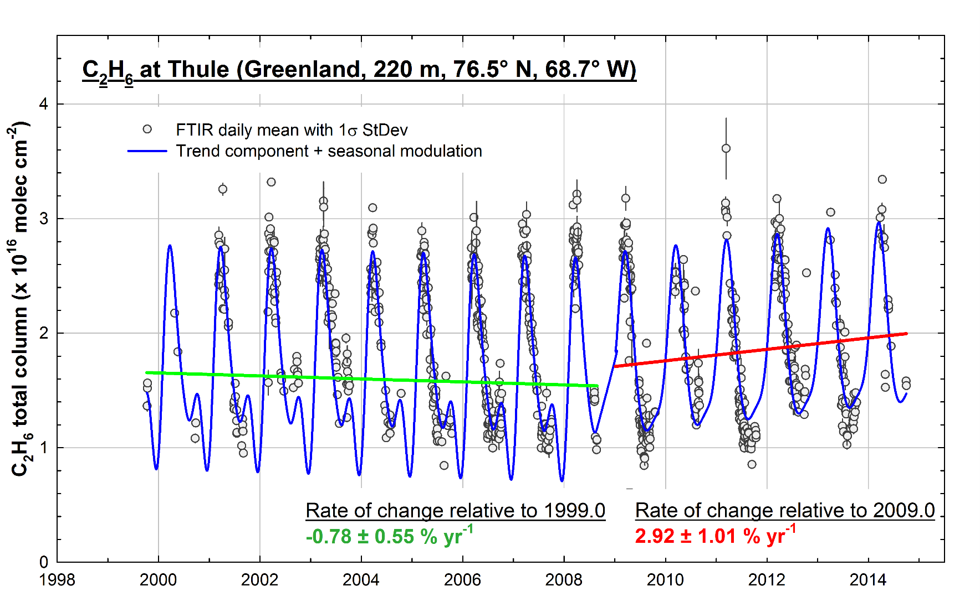
2. Recent ethane increase
NDACC-IRWG Meeting 2015, Toronto, June 11

Slide 20
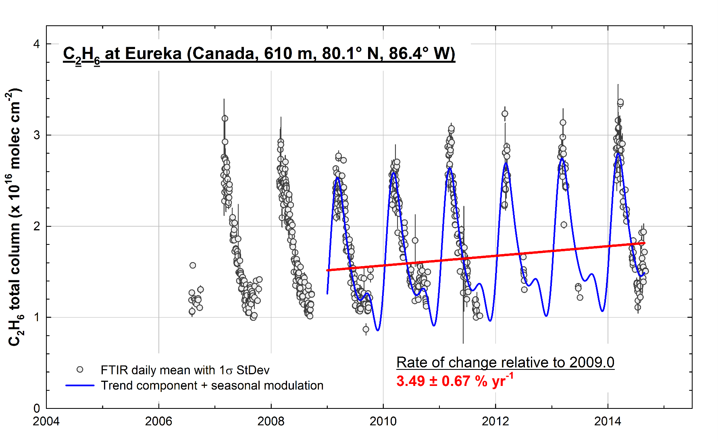
2. Recent ethane increase
NDACC-IRWG Meeting 2015, Toronto, June 11

Slide 21
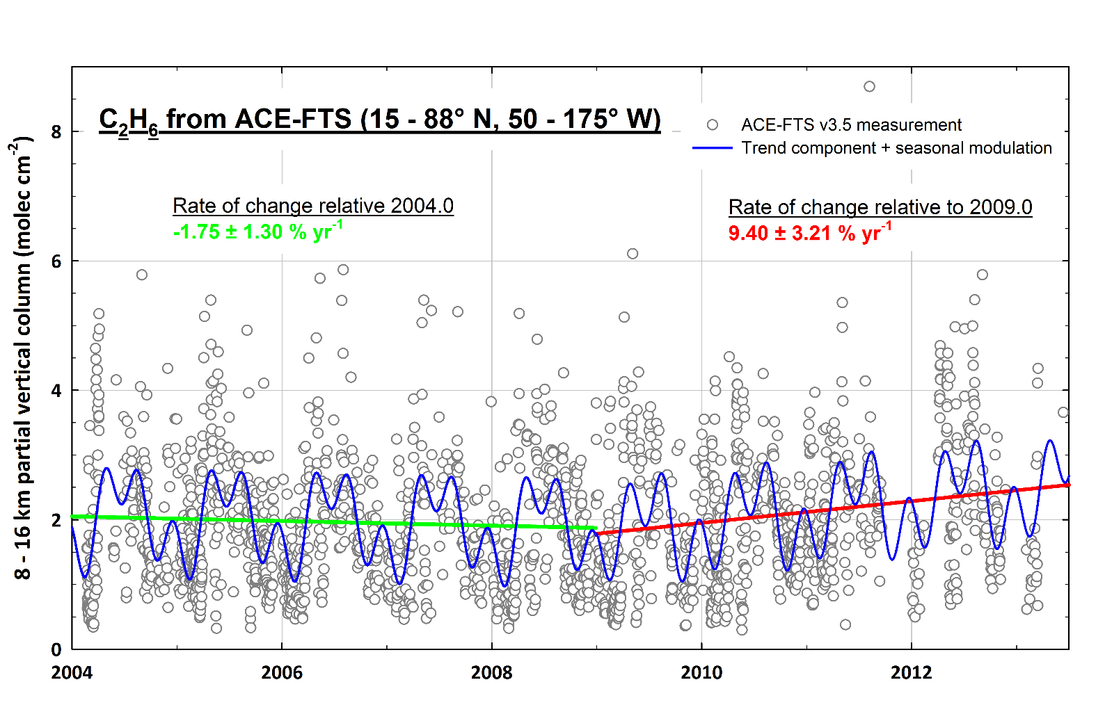
2. Recent ethane increase
Preliminary results…
NDACC-IRWG Meeting 2015, Toronto, June 11

Slide 22
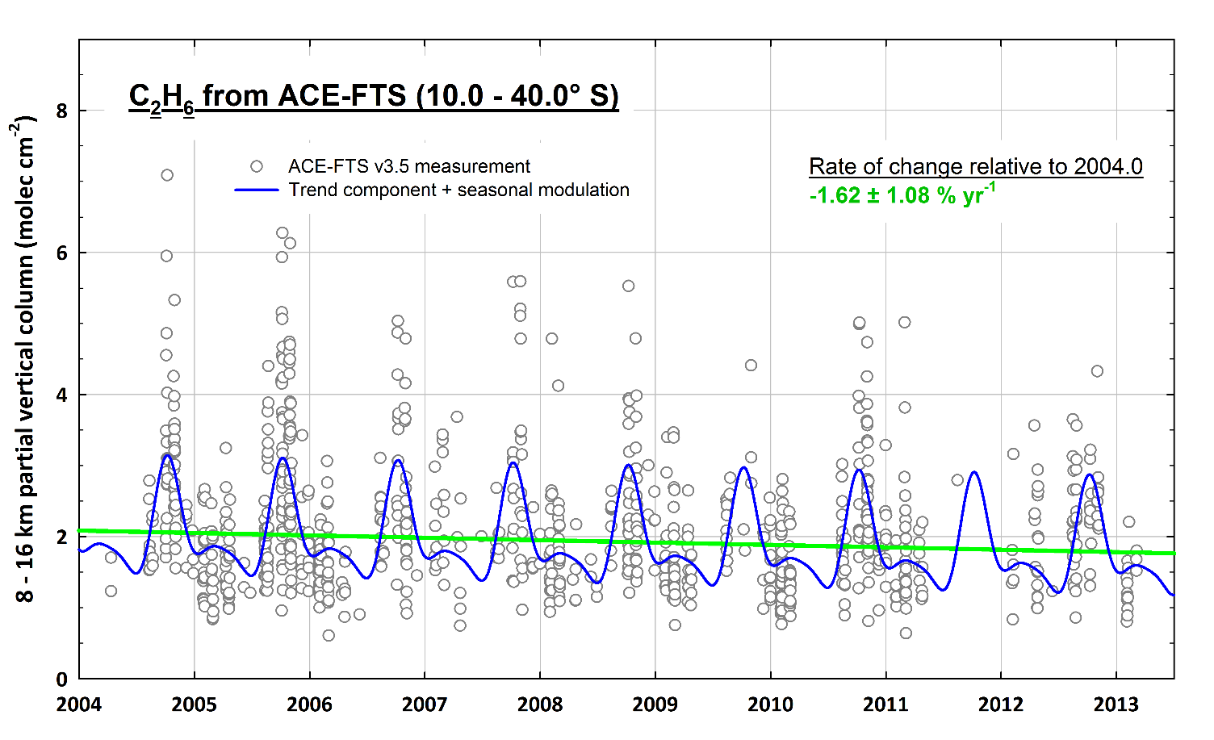
2. Recent ethane increase
FTIR and ACE-FTS observations in the Southern Hemisphere do not reveal any recent increase
Weak latitudinal exchange of C₂H₆ between both hemispheres
Observed increase of C₂H₆ currently limited to the Northern Hemisphere
Preliminary results…
NDACC-IRWG Meeting 2015, Toronto, June 11

Slide 23
3. Comparison with GEOS-Chem
Comparison between FTIR measurements and GEOS-Chem simulations
GEOS-Chem CTM:
=> v9-01-03 standard full-chemistry simulation
=> 2° x 2.5° horizontal resolution
=> driven by the GEOS-5 meteorological fields
  => simulations over the mid-2005 – mid-2013 time period
The vertical resolution and specific sensitivity of the FTIR retrievals are accounted for:
  => VMR profiles interpolated onto the FTIR vertical layer scheme
  => then smoothed by applying the FTIR AVKs
The comparisons are made for the 2005 – 2013 observational days only
NDACC-IRWG Meeting 2015, Toronto, June 11

Slide 24
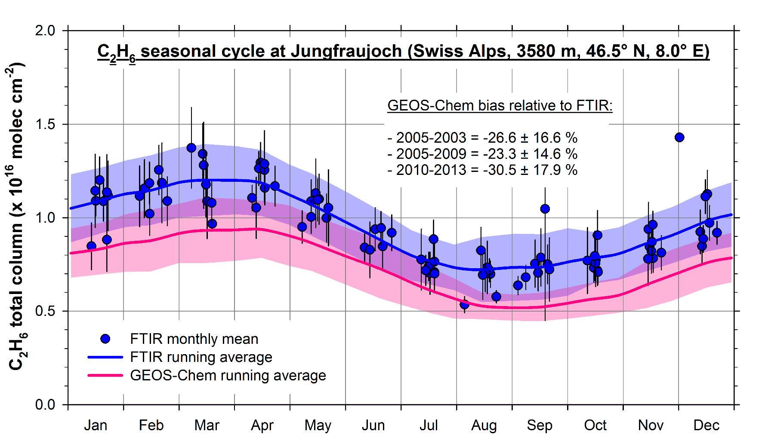
3. Comparison with GEOS-Chem
C₂H₆ total columns (2005-2013) displayed on a 1-year time base
Comparison made on the basis of the daily means
FTIR
GEOS-Chem
=> Good agreement (R = 0.77)… but systematic negative bias relative to FTIR
NDACC-IRWG Meeting 2015, Toronto, June 11

Slide 25
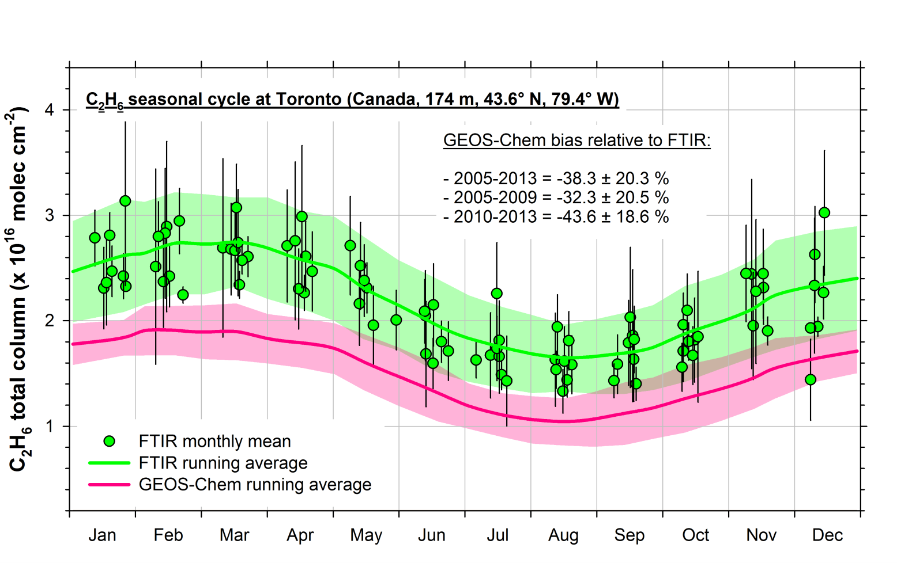
3. Comparison with GEOS-Chem
FTIR
GEOS-Chem
=> Good agreement (R = 0.73)… but systematic negative bias relative to FTIR
NDACC-IRWG Meeting 2015, Toronto, June 11

Slide 26
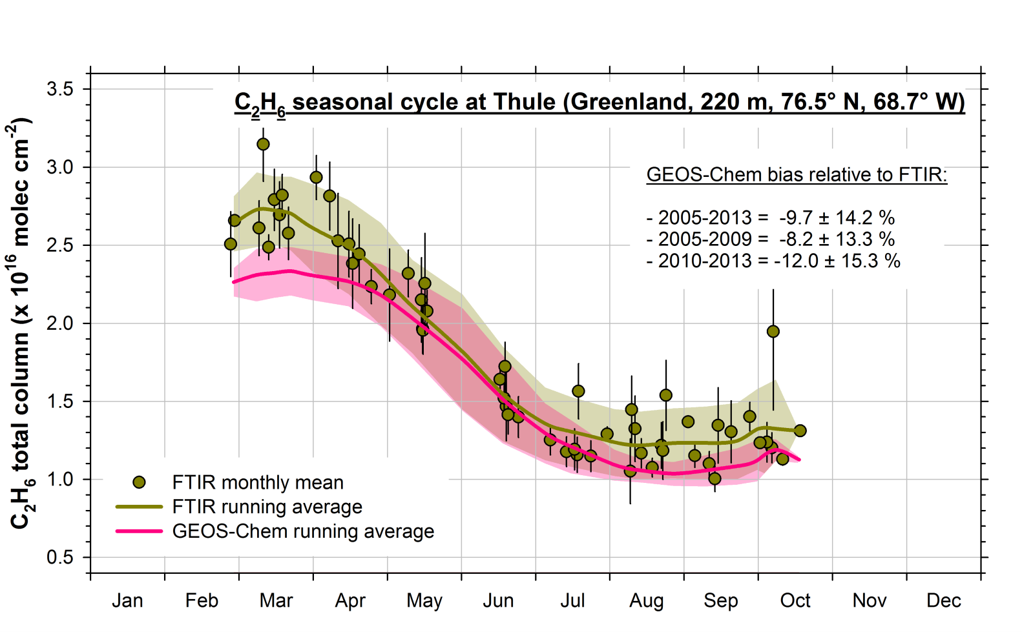
3. Comparison with GEOS-Chem
FTIR
GEOS-Chem
=> Good agreement (R = 0.93)… but systematic negative bias relative to FTIR
NDACC-IRWG Meeting 2015, Toronto, June 11

Slide 27
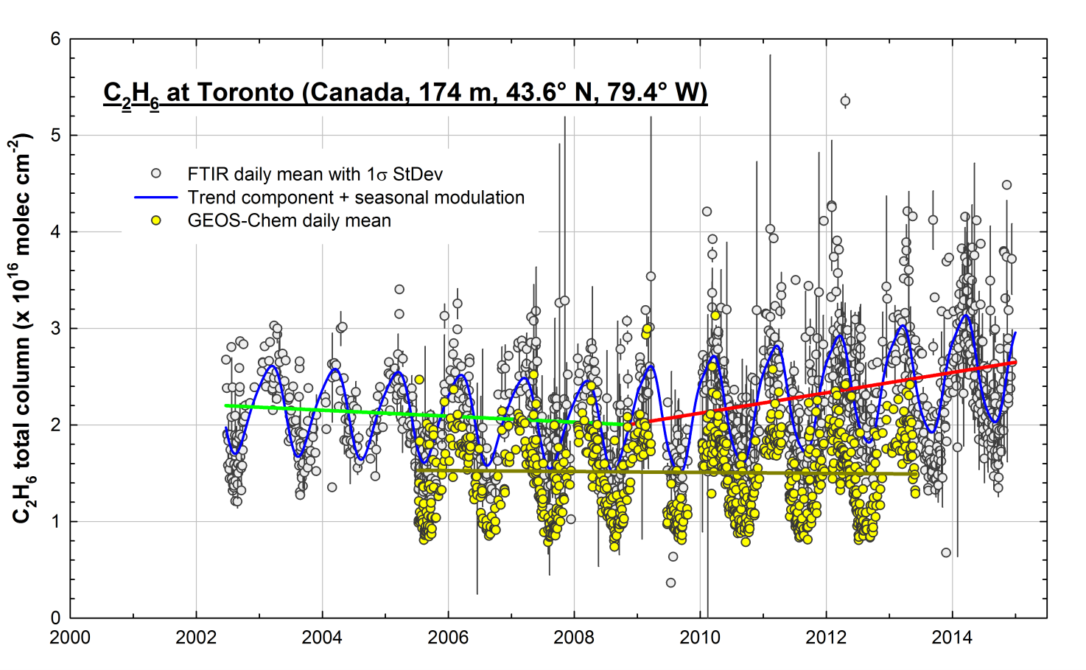
3. Comparison with GEOS-Chem
Underestimation of C₂H₆ emissions in the current inventories implemented by GEOS-Chem
The recent C₂H₆ increase is not captured by the model
FTIR
GEOS-Chem
NDACC-IRWG Meeting 2015, Toronto, June 11

Slide 28
4. Ongoing work
Incorporating updated inventories in GEOS-Chem
to reconcile FTIR and GEOS-Chem results
to reproduce the observed C₂H₆ increase
Current C₂H₆ emission inventories:
Anthropogenic and pyrogenic sources from Xiao et al., 2008 (JGR)
=> offline simulation based on surface and aircraft observations
Biomass burning sources from the GFED3 database (monthly means)
Updated C₂H₆ emission inventories: (E. V. Fischer and Z. A. Tzompa-Sosa, CSU)
By applying C₂H₆/CH₄ emission ratios to satellite-derived CH₄ emissions (Turner et al., 2015, ACPD)
=> CH₄ emissions inferred from GOSAT and subsequently evaluated by surface and aircraft data
NDACC-IRWG Meeting 2015, Toronto, June 11

Slide 29
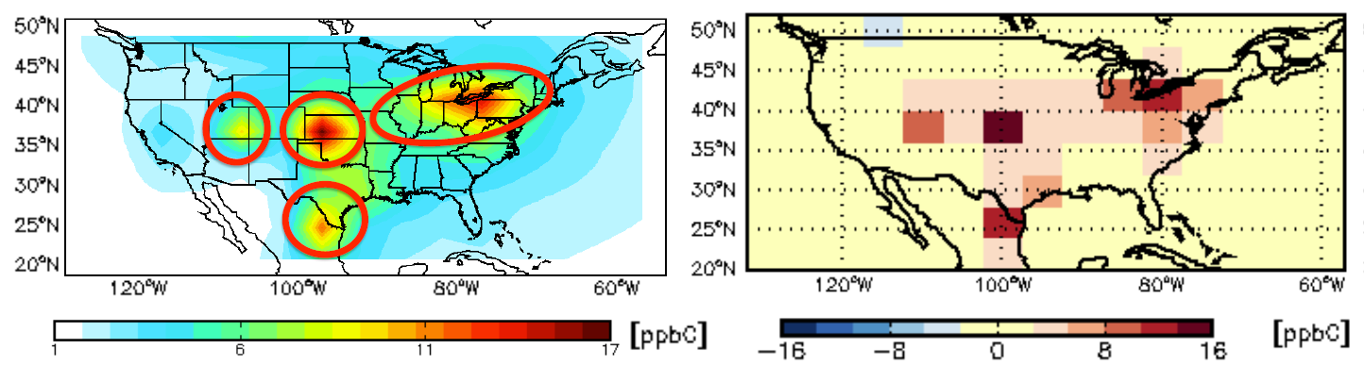
4. Ongoing work
Incorporating updated inventories in GEOS-Chem
to reconcile FTIR and GEOS-Chem results
to reproduce the observed C₂H₆ increase
Major oil and gas basins
Preliminary results…
Courtesy of Z. A. Tzompa-Sosa (CSU)
GEOS-Chem C₂H₆ surface concentration for December 2010
December 2010 absolute difference in surface C₂H₆ (ppbC) for a simulation using emission ratios to CH₄ vs. Xiao et al. (2008) + GFED3 emission inventories
NDACC-IRWG Meeting 2015, Toronto, June 11

Slide 30
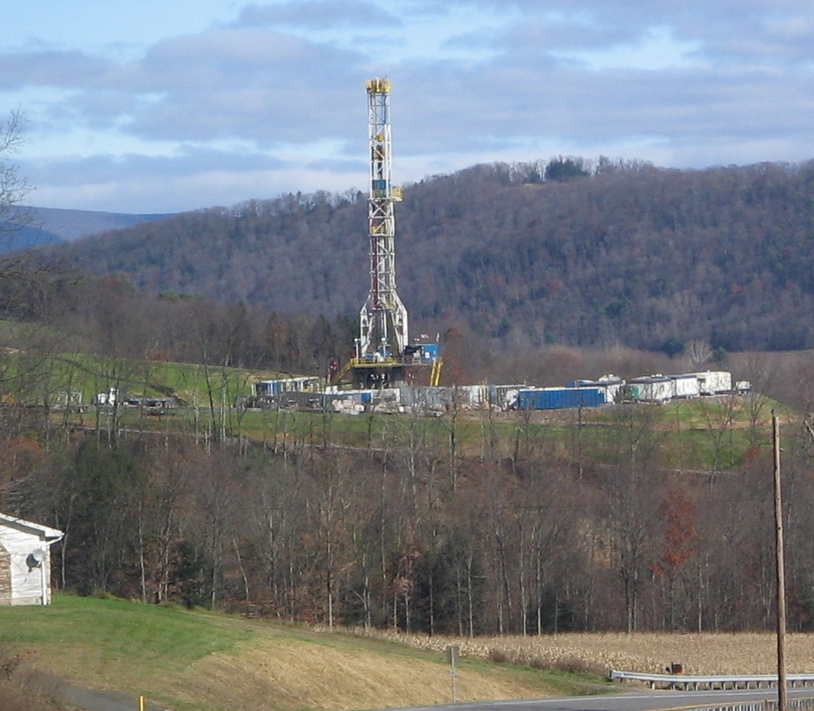
Thank you for your attention !
Acknowledgments:
The University of Liège contribution to the present work has mainly been supported by the AGACC-II project of the Science for Sustainable Development (SSD) program of the Belgian Science Policy Office (BELSPO, Brussels).
Additional support was provided by MeteoSwiss (Global Atmospheric Watch), the Fédération Wallonie–Bruxelles and the F.R.S. – FNRS.
We thank the International Foundation High Altitude Research Stations Jungfraujoch and Gornergrat (HFSJG, Bern).
E. Mahieu is Research Associate with F.R.S. – FNRS. We are grateful to the many colleagues who have contributed to FTIR data acquisition at the Jungfraujoch station.
The Atmospheric Chemistry Experiment (ACE), also known as SCISAT, is a Canadian-led mission mainly supported by the Canadian Space Agency and the Natural Sciences and Engineering Research Council of Canada.
We warmly thank Jeremy Harrison and colleagues for their high quality lab measurements of C₂H₆.
EGU General Assembly 2015, April 13th, Vienna, Austria

