Slide 1




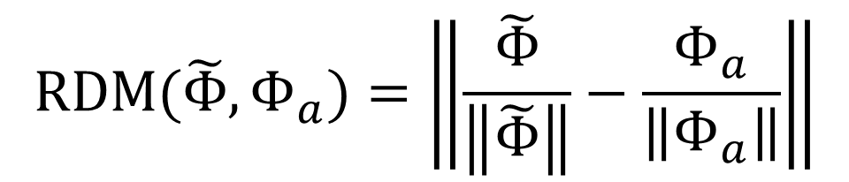
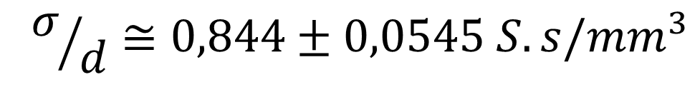

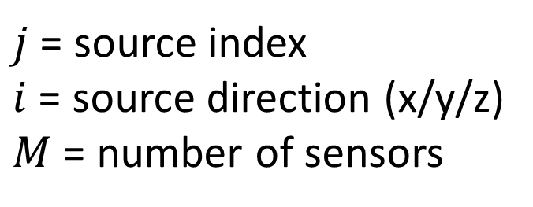
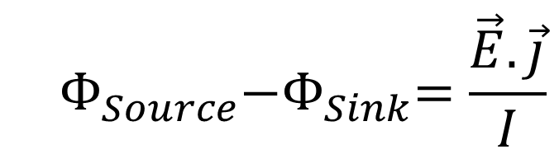
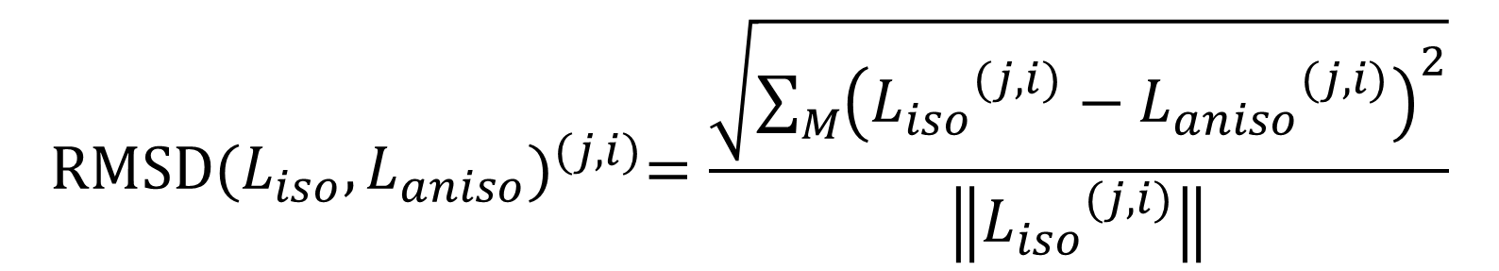
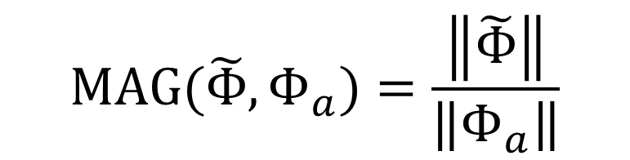
A finite-element solution for EEG forward modeling with realistic individual head models
#2274
Erik Ziegler ¹, Christophe Geuzaine ², Christophe Phillips ^{1,2}
¹ Cyclotron Research Centre; ² Department of Electrical Engineering & Computer Science; University of Liège, Belgium
Identifying the sources of neuronal activity from M/EEG data but requires the solution of the forward and inverse problems. The former requires the modeling of the electromagnetic properties of the subject's head:
Spherical and boundary element models (BEM) are common but rely on unrealistic assumptions, e.g. over-simplified geometry with homogeneous and isotropic conductivity.
White matter fiber structures are highly directional (i.e. anisotropic) and their electrical conductivity can be approximated from the water diffusion tensor (DTI) [1], derived from diffusion-weighted MRI (DWI).
“Finite Element Modeling” (FEM) allows the inclusion of local information about the conductivity of the tissues, unlike BEM.
We therefore propose a FEM implementation for solving the forward problem in EEG, using an anatomically realistic model of the head including white matter anisotropic conductivity.
Background
Results & application
Human head model: (A) T1-weighted MR image, (B) Surface meshes, (C) 3D volumetric meshes, (D) anisotropic conductivity
D
(B) 2D meshes: GM,WM, cerebellum, ventricles, CSF, scalp, and skin.
(C) 3D meshes: scalp (light blue), skull (bright yellow), ventricles (blue), CSF (green), GM (orange), WM (light green), and cerebellum (yellow).
(D) Primary eigenvectors of the conductivity tensor within the WM (full tensor used for computation!).
Mesh building pipeline, from T1-MRI to 2D and 3D meshes with SimNIBS [2] linking: NiPype [3] & Freesurfer [4] (→ segmentation and 2D meshing), MeshFix [5] (→ 2D meshes correction), and Gmsh [6] (→ 3D meshing).
Conductivity tensor approximated from water diffusion tensor [1], with Dipy [7] (→ DTI estimation):
With 3D meshes, tissue properties, and electrode positions, solve forward problem with GetDP [8], relying on the “reciprocity theorem” [9]:
→ leadfield built line by line
Methods
$$σ/d≅0,844±0,0545 S.s/{mm}^{3}$$
Current source
Realistic electromagnetic modeling: (A) potential, (B) current density, (C) electric field.
$$Φ_{Source}{−Φ}_{Sink}=\frac{\vec{E}.\vec{j}}{I}$$
A
B
C
Current sink
Validation
With spherical 4-layer model, compare analytical solution, $Φ_{a}$, with that of GetDP, OpenMEEG (BEM solution) [10], and NeuroFEM/SimBio (FEM solution) [11], $\tilde{Φ}$.
With realistic model, compare leadfields with anisotropic ($L_{aniso}$) vs. isotropic ($L_{iso}$) WM conductivity
$$\text{RDM}(\tilde{Φ},Φ_{a})=\left\|\frac{\tilde{Φ}}{\left\|\tilde{Φ}\right\|}−\frac{Φ_{a}}{\left\|Φ_{a}\right\|}\right\|$$
$$\text{MAG}(\tilde{Φ},Φ_{a})=\frac{\left\|\tilde{Φ}\right\|}{\left\|Φ_{a}\right\|}$$
Isotropic vs. anisotropic conductivity RMS differences
$$\text{R}\text{MS}\text{D}{(L_{iso},L_{aniso})}^{(j,i)}=\frac{\sqrt{\sum_{M}{{\left({L_{iso}}^{(j,i)}−{L_{aniso}}^{(j,i)}\right)}^{2}}}}{\left\|{L_{iso}}^{(j,i)}\right\|}$$
$j$ = source index
$i$ = source direction (x/y/z)
$M$ = number of sensors
Conclusions & Perspectives
4-shell spherical model validation shows performance comparable (SimBio) with or better (OpenMEEG) than current state-of-the-art alternatives
Gmesh/GetDP are professional and open source mesh generator/finite element solver: http://geuz.org/gmsh/ & http://geuz.org/getdp/
Main benefits of FEM: the ability to include anisotropic conductivities, derived from DWI measures, in the head model.
Fast, accurate, open-source and freely available online: http://cyclotronresearchcentre.github.io/forward/.
Similar approach could be used to model current flow in tDCS...
REFERENCES:
[1] Tuch, D.S. (2001), PNAS, 98:11697–11701.
[2] SimNIBS, http://simnibs.org/
[3] Gorgolewski, K. (2011), Frontiers in Neuroinformatics, 5:13.
[4] Desikan, R.S. (2006), NeuroImage, 31:968–980.
[5] Attene, M. (2010), Visual Computer 26:1393–1406.
[6] Geuzaine, C. (2009), Int. J. Numerical Methods in Engineering, 79:1309–1331.
[7] Garyfallidis, E (2014), Frontiers in Neuroinormatics, 8:8.
[8] Dular, P. (1998), IEEE Transaction in Magnetism, 34:3395–3398.
[9] Rush, S. (1969), IEEE TBME, 16:15–22.
[10] Gramfort, A. (2010), Biomedical Engineering Online, 9:45.
[11] Fingberg, J. (2003), NEC Research & Development, 44:140–145.
ACKNOWLEDGEMENTS & SPONSORS : FRS-FNRS, ULg, FMRE, MC-ITN in Neurophysics (PITN-GA-2009-238593).
Cyclotron Research Centre | http://www.cyclotron.ulg.ac.be | Christophe Phillips | c.phillips@ulg.ac.be

