Slide 1
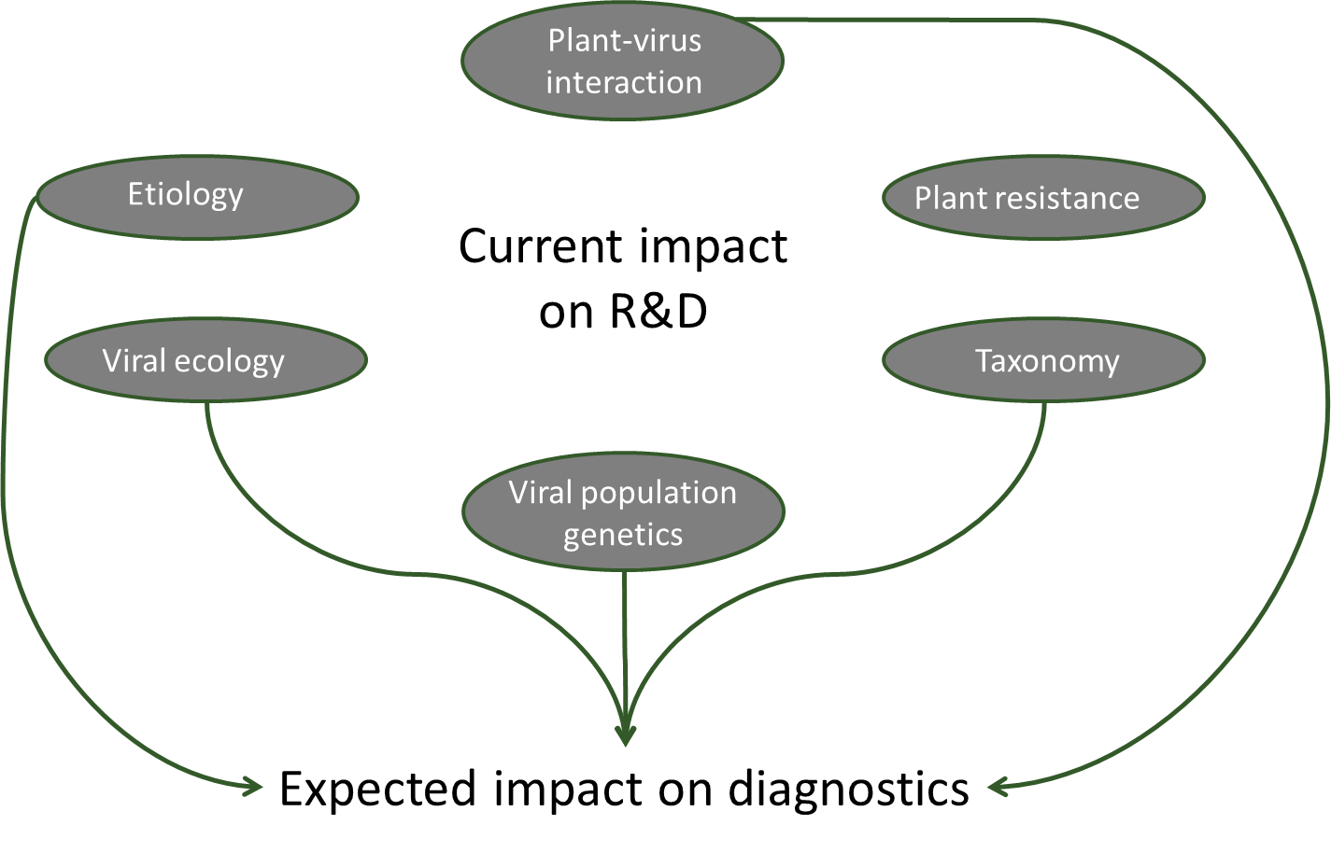
Empowering NGS technologies for the study and diagnostic of plant viruses
European COST Action FA1407
www.cost-divas.eu
PRESENTING AUTHOR : Pascal Gentit¹ Antonio Olmos, Neil Boonham, Carmen Büttner, Thierry Candresse, Rosario Felix, Isabel Font, Miroslav Glasa, Risto Jalkanen, Petr Kominek, Margit Laimer, Tadeusz Malinowski, Varvara Maliogka, Angelanotio Minafra, Nelia Ortega Parra, Annalisa Poliverari, Maja Ravnikar, Dana Safarova, Rene Vandervlugt, Christina Varveri, Johanna Witzell, Ioan Zagrai, Thierry Wetzel and Sebastien Massart ²
¹: Corresponding author : pascal.gentit@anses.fr ANSES - Plant health laboratory – Virology lab – 7 rue Jean Dixméras 49044 ANGERS - FRANCE
²: Chair of the action : sebastien.massart@ulg.ac.be - Laboratory of Phytopathology – University of Liège – Gembloux Agro-BioTech – Passage des déportés, 2 – 5030 Gembloux – Belgium
Viral thread:
Billions of damages on crops yearly menacing grower income, food quality and food security
Current worsening factors :
The ability to provide fast, inexpensive and reliable diagnostics for any viral infection is a key
measure for cost-effective control of these ubiquitous pathogens
50 % of emergent pathogens are viruses ⁽¹⁾
Worldwide trade
Climate change
Drivers of the Action:
Technological revolution of NGS
« Virus Rush » with
>50 new viruses
Bioinformatic simplification
Challenges and Impact for diagnostic ⁽²⁾:
Technical challenges
Sampling protocol ?
Extraction and library preparation ?
Bioinformatic pipeline ?
Validation challenge
Sensitivity ?
Repeatability and reproducibility ?
Contamination ?
Impact on trade
For which diagnostic ?
New virus identified ?
Latent virus ?
Regulatory impact
Certification?
Quarantine ?
Legal framework ?
Objectives of the Action : Leveraging plant virus control through NGS
Designing research framework for characterization of new viruses & evaluation of their impact
Developing and validating NGS technological standards for plant virus diagnostic
Proposing decision schemes on plant virus diagnostic for policy makers, NPPO, EPPO, diagnostic lab
Evaluating impact of NGS on virus taxonomy and on the plant-virus interactions
Working Groups
WG1 Development of protocols for NGS
WG2 Etiology and biological impact of new viruses
WG3 Taxonomy and viral population genetics
WG4 Regulatory and socio economic impact
Contact us Action website : http://www.cost.eu/COST_Actions/fa/Actions/FA1407
Action Chair : sebastien.massart@ulg.ac.be
References
Anderson, 2004. Trends Ecol.
Massart et al (2014) Virus Research

