Slide 1
Auroral Morphologies of Jupiter and Saturn
Denis Grodent
Laboratory for Planetary and Atmospheric Physics
Université de Liège, Belgium
d.grodent@ulg.ac.be

Slide 2
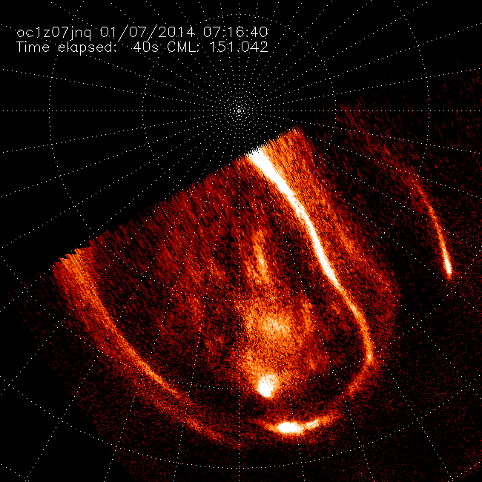
HST-STIS
GO-12883
Jupiter UV aurora
Northern hemisphere
d.grodent@ulg.ac.be

Slide 3
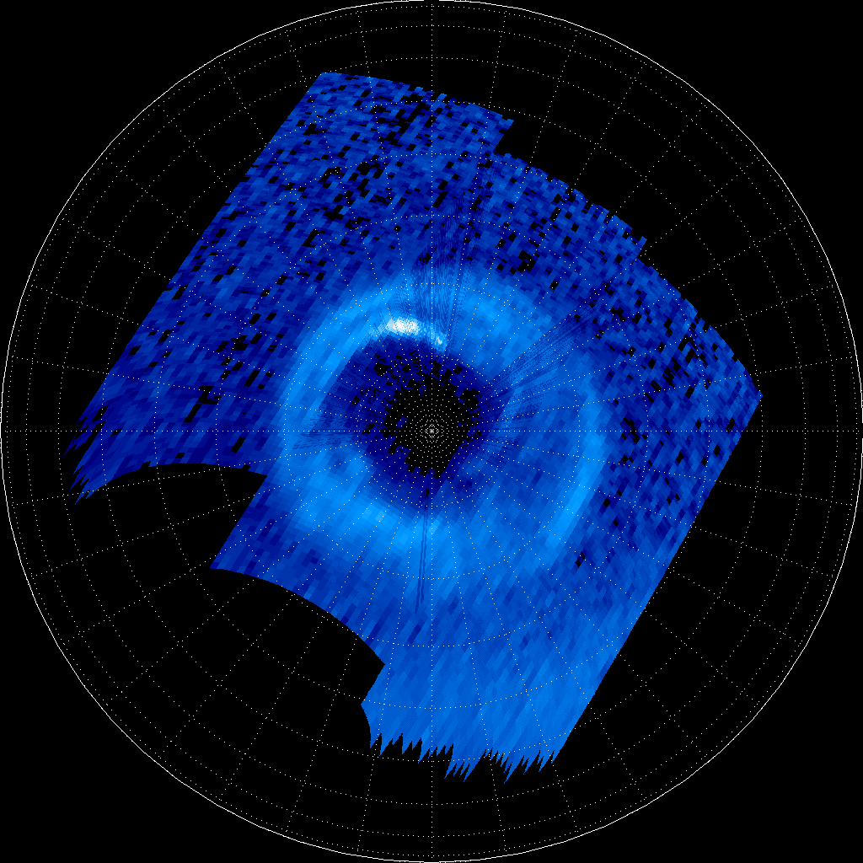
Saturn UV aurora
Southern hemisphere
Cassini -UVIS
DOY 2013-079
alt.:
13.2_12.7 RS
ssc lat:
-49.3°_-47.1°
3 frames:
15:19
16:32
17:44
d.grodent@ulg.ac.be

Slide 4

d.grodent@ulg.ac.be

Slide 5
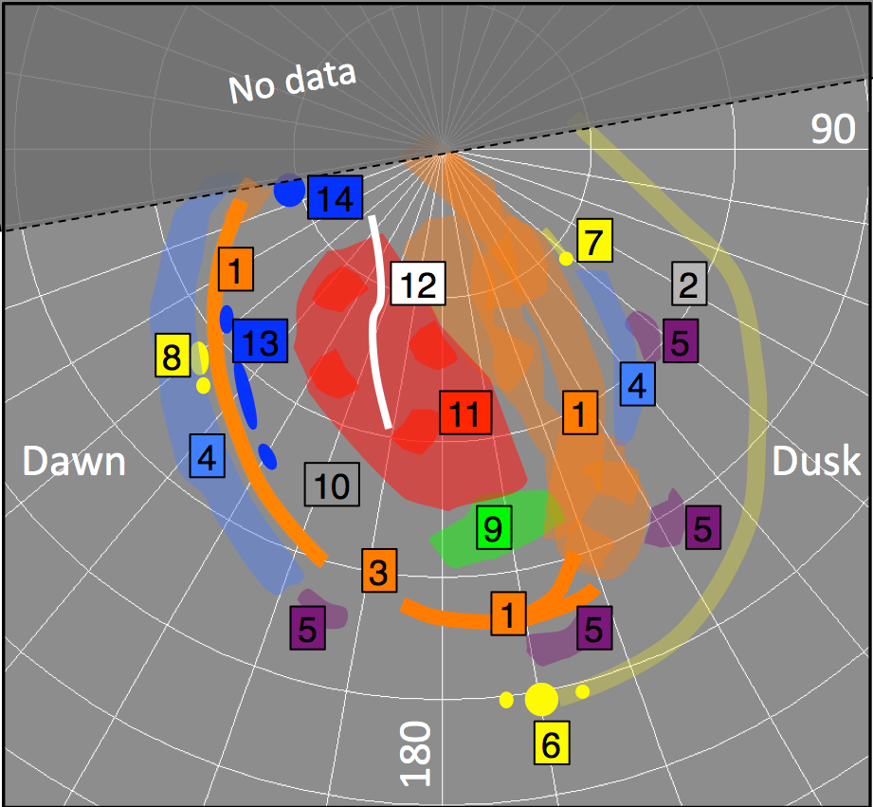
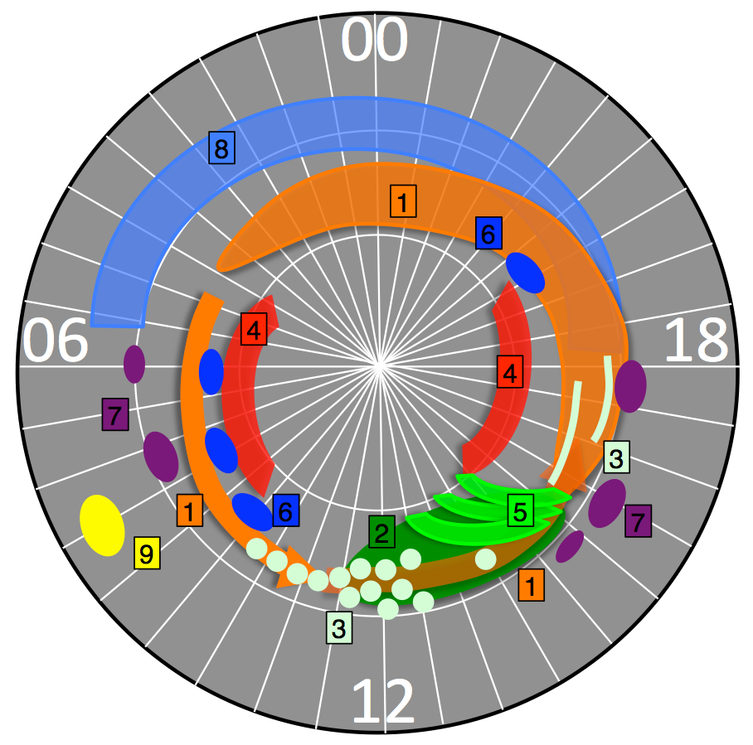
Sketches with comparable "ingredients"
Jupiter (North)
Saturn (both)
S3 frame (equiv. to LT if CML=180°)
LT frame
Grodent (SSR, 2014-2015)
d.grodent@ulg.ac.be

Slide 6
Jupiter
Update
Saturn
Palmaerts et al. (2014): Transient localized auroral enhancement (few 10s min). Inward plasma flow near noon (Galileo obs. + MHD sim., SW trig.). Strong ∇B_{z}
Radioti et al. (2014): Rare polar arc, Dungey recon. (flux closure), Vasyliunas recon., dayside recon.
Radioti et al. (subm.): large scale vortices. Field line deformation from msph to ionsph?
d.grodent@ulg.ac.be
Notes:
Jupiter
intermittent inward plasma flow near noon in the equatorial plane is responsible for the transient small-scale structure observed in the auroral images, as the induced plasma velocity shear would lead to consistently localized field-aligned currents. he possibly intermittent presence of a region of inward moving plasma would create a strong gradient in Bz in the azimuthal direction due to the radial velocity shear with the surrounding plasma. Since positive azimuthal Bz gradients generate radial electrical currents in the current sheet, the electrical currents responsible for the main auroral emission would increase in the local time sector where the shear induced by the inward flow are observed. This localized and intermittent enhancement in the field-aligned current density would result in a localized increase of the brightness of the main emission around noon.
Saturn
the arc is formed by flux closure due to magnetotail reconnection (Dungey type) during an interval of suppressed closed field line tail reconnection (Vasyliunas type) and in the absence of dayside reconnection

Slide 7
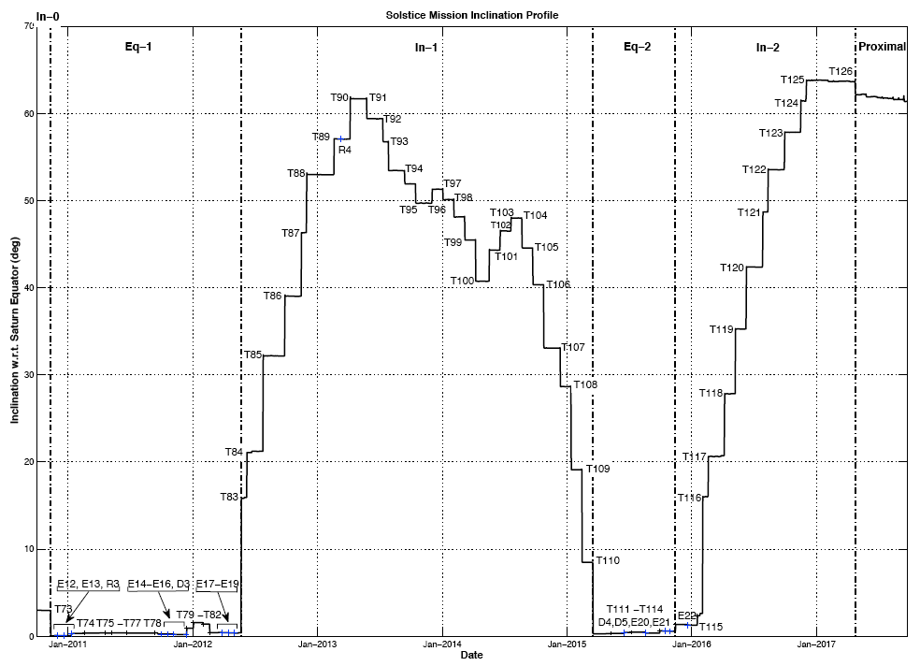
FANTASTIC
Inclination (degrees)
0 70
GREAT
2016
2017
INTERESTING
2013
2014
2015
Cassini UVIS Auroral Observations at High Latitude
d.grodent@ulg.ac.be

Slide 8
Exercise by UVIS Team A. Jouchoux, W. Pryor
⟹ NOTHING IMPLEMENTED YET!
Tested 4 realistic auroral cases:
assumed that aurora covers 65-90 deg of latitude.
use all 64 spatial pixels (instead of 32).
use a scan rate of 0.12 mrd/sec (instead of 0.06 mrd/sec).
start date
271_NAURSLEW 25 Apr 2017
271_SAURSTARE 26 Apr 2017
275_NAURSLEW 21 May 2017
275_SAURSTARE 22 May 2017
-Y Sun avoidance issues (Southern hemisphere)
d.grodent@ulg.ac.be

Slide 9
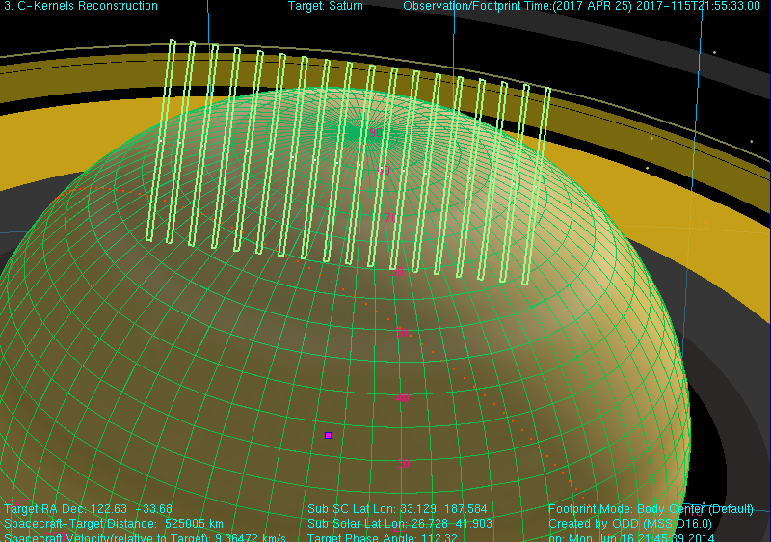
UVIS_271_NAURSLEW001_PRIME
First of the five 1*1 scans
sub-SC-lat = 33°
altitude = 8.7 R_{S}
d.grodent@ulg.ac.be

Slide 10
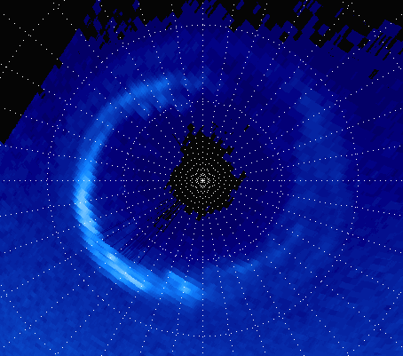
2013-006
sub-SC-lat = 48.2°
altitude = 8.6 R_{S}
d.grodent@ulg.ac.be

Slide 11
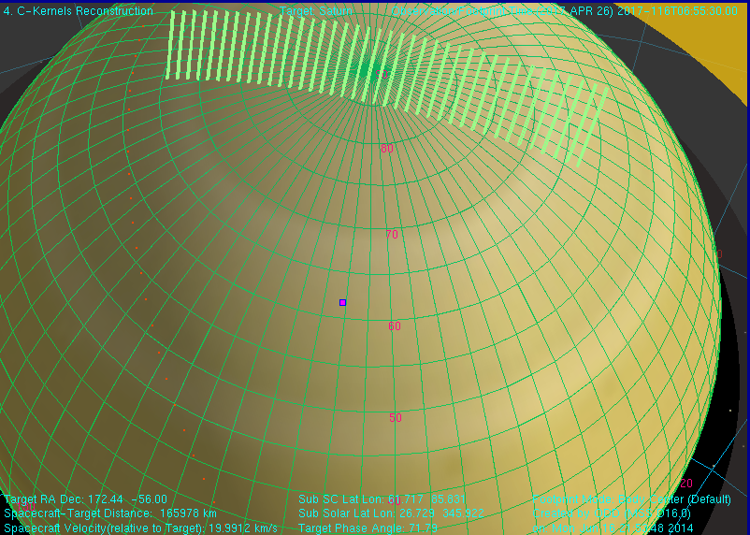
UVIS_271SA_NAURSLEW001_PRIME
The last 1* 1 scan
9 hours later
sub-SC-lat = 61.7°
altitude = 2.8 R_{S}
Fantastic view point
d.grodent@ulg.ac.be

Slide 12
DOY 239 of 2008, North (3*26min)
sub-SC lat.= 62 to 55° SC-alt.= 5 to 4.5 R_{S}
Spatial resolution ~200 km (~Jupiter with HST)
At 2.8 R_{S}, spatial res. ~120 km !
d.grodent@ulg.ac.be

Slide 13
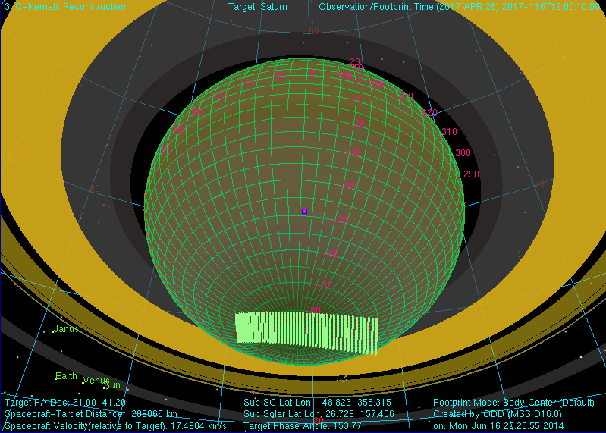
UVIS_271SA_SAURSTARE001_PRIME
First 1*1 scan
sub-SC-lat = -48.8°
altitude = 3.5 R_{S}
d.grodent@ulg.ac.be

Slide 14
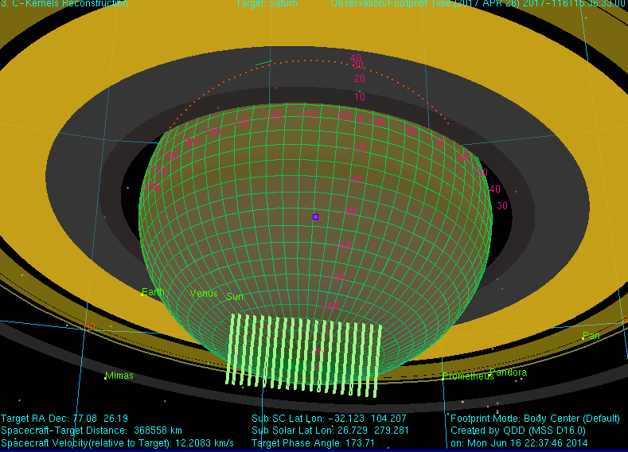
UVIS_271SA_SAURSTARE001_PRIME
First of the last 4 1*1 scan
3.5 hours later
sub-SC-lat = -32.1°
altitude = 6.1 R_{S}
d.grodent@ulg.ac.be

Slide 15
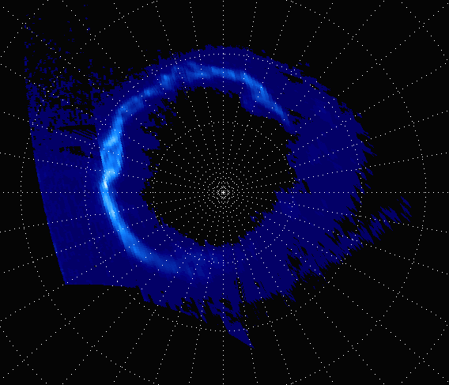
2013-112
sub-SC-lat = +33.7°
altitude = 5.3 R_{S}
d.grodent@ulg.ac.be

Slide 16
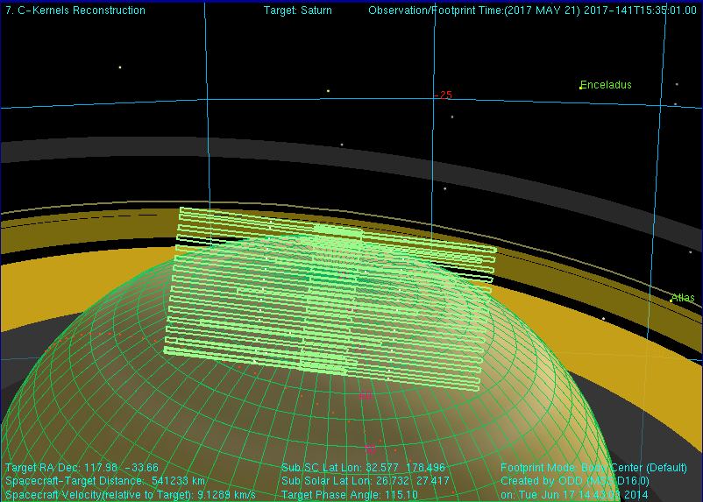
UVIS_275SA_NAURSLEW001_PRIME
First 1*2 scan
sub-SC-lat = 32.6°
altitude = 9 R_{S}
d.grodent@ulg.ac.be

Slide 17
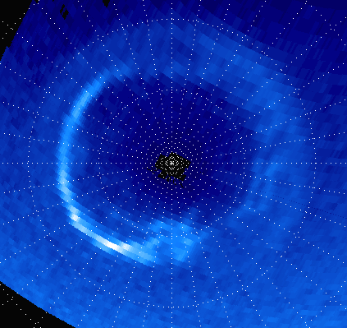
2013-006
sub-SC-lat = 44.3°
altitude = 9.2 R_{S}
d.grodent@ulg.ac.be

Slide 18
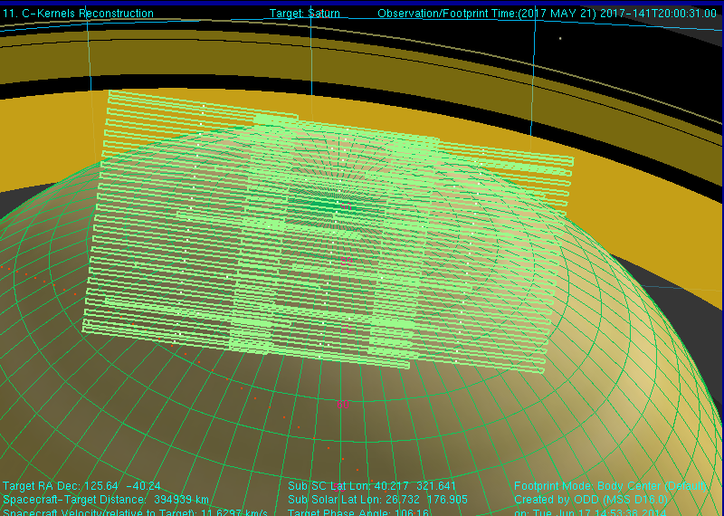
UVIS_275SA_NAURSLEW001_PRIME
The last 1*3 scan
4.5 hours later
sub-SC-lat = 40.2°
altitude = 6.6 R_{S}
d.grodent@ulg.ac.be

Slide 19
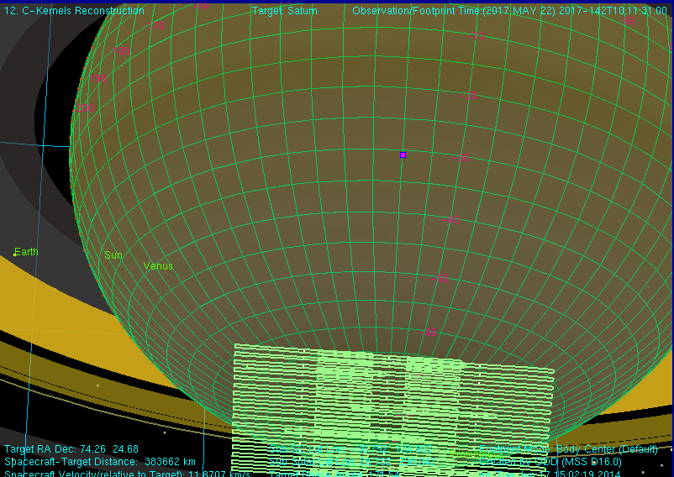
UVIS_275SA_SAURSTARE001_PRIME
The 1*3 scan
sub-SC-lat = -30.8°
altitude = 6.4 R_{S}
d.grodent@ulg.ac.be

Slide 20
Remote + in situ observations
Upward
Cassini
Downward
UVIS
HST
2013 HST – Cassini Coordinated observations
Badman et al., 2014 (in press)
d.grodent@ulg.ac.be
Notes:
Badman
Observations of Saturn’s aurorae on 2013-111. Local noon is to the bottom and dawn to the left. The yellow grid marks circles of latitude at intervals of 10􏰡 and the noon-midnight and dawn–dusk meridians. The white line shows the ionospheric footprint of Cassini’s trajectory on 2013-111 to 2013-113 mapped into the appropriate ionosphere. The yellow square on this line indicates the position of Cassini at the time this image was taken, while the purple and orange shaded regions show the location of the upward and downward field-aligned current regions, respectively, determined from the magnetic field data in this hemisphere.

Slide 21
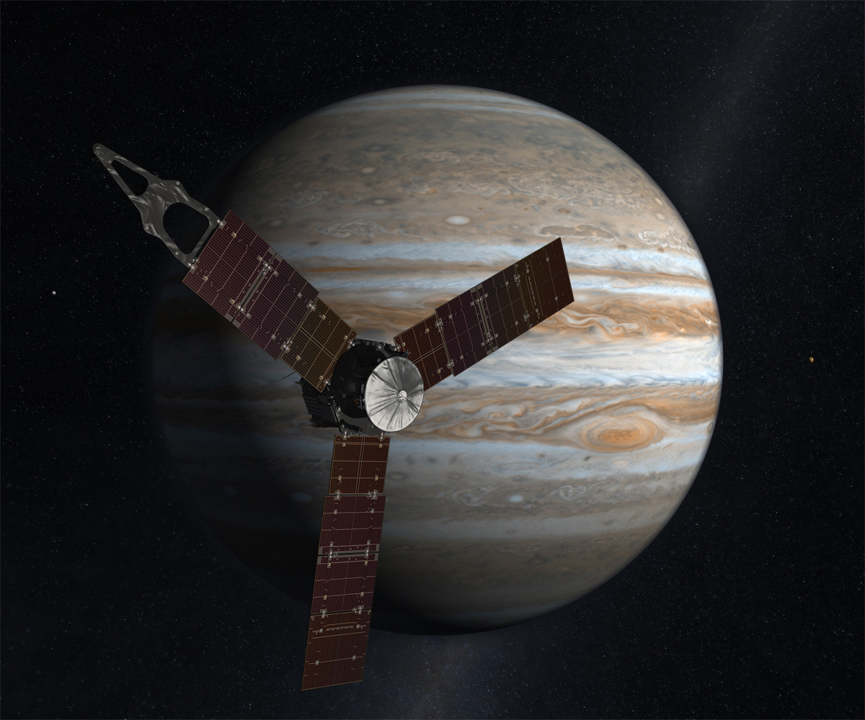
see my
presentation
Tu 11:40
Juno
d.grodent@ulg.ac.be

Slide 22
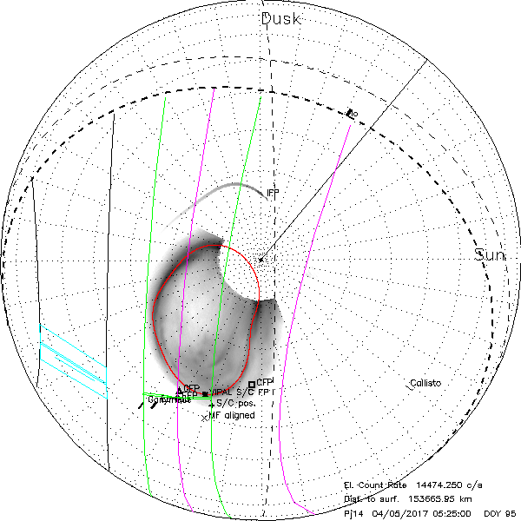
Juno
Juno
d.grodent@ulg.ac.be

Slide 23
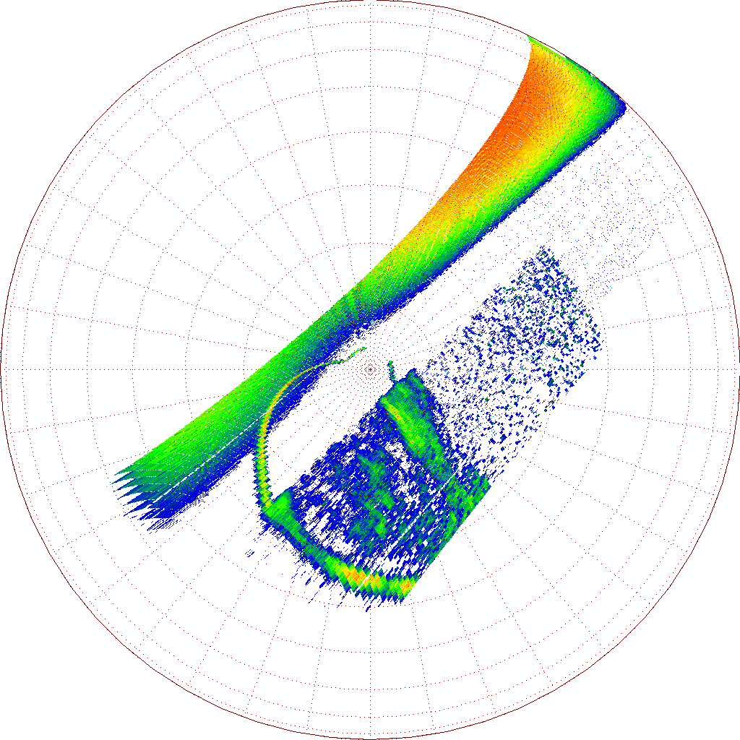
Juno-UVS
obs.
Juno (VIPAL) footprint off-aurora
we need HST
Orbit 3
DOY 2016-307
16:23
d.grodent@ulg.ac.be

Slide 24
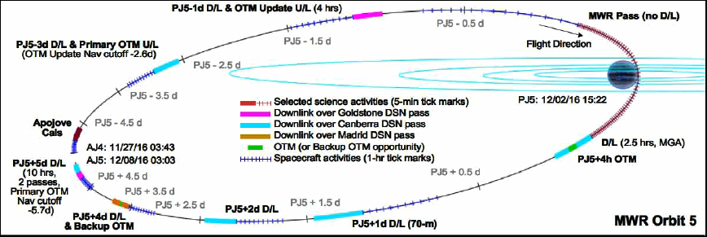
33 14-Day orbits
UVS segment
= ~6 hours
2.5 hrs
UVS observes
< 2% of orbit
1 hr
we need HST for the rest (> 98%) of the time
2.5 hrs
Grodent et al., 2015
HST White Paper (ArXiv)
d.grodent@ulg.ac.be

Slide 25
Large HST proposal during cycles 24 and 25
in support of Juno
"it is important that an appropriately large number of HST orbits are put aside to support these missions without jeopardizing other solar system proposals"
EuroPlanet HST-Juno workshop?
d.grodent@ulg.ac.be

Slide 26
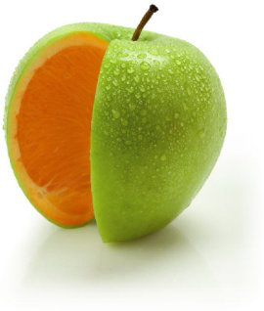
d.grodent@ulg.ac.be

