Slide 1
Antitrust and The challenge of policing « moligopolists »
Nicolas PETIT
CLEEN Annual Conference
29 May 2015
Twitter: @CompetitionProf

Slide 2
World of Antitrust (AT) officials, lawyers and economists
Archipelago of relevant markets with monopolists on each island
  Microsoft (OS for PC)
  Google (Mobile OS)
  Intel (x86 CPUs)
  Samsung (SEPs) and Apple (SEPs)
  Rambus (JEDEC compliant products)
  IBM (mainframe maintenance)

Slide 3
World of business corporations and analysts
The tech world
The tech war
http://uk.businessinsider.com/face-apple-and-microsoft-versus-google-2014-12?r=US
http://thenextweb.com/insider/2013/05/17/rivals-a-short-history-of-google-and-microsoft-long-burning-turf-and-platform-war/
http://www.wired.com/2015/01/smartest-richest-companies-cant-crack-mobile-future-belongs-anyone-can/
Google, Microsoft, Facebook, Amazon, Apple are all competitors at war in the market
Some of their activities overlap, but their core is distinct (Google search, Apple smartphone, Microsoft OS, Facebook social networks, Amazon online commerce)
As a result, they dont compete head on in a relevant market
http://www.slate.com/articles/technology/low_concept/features/2013/wargames/what_if_google_and_apple_went_to_war_in_real_life.html

Slide 4
The moligopoly paradox
Monopolists (AT) exposed to cutthroat competition (Tech) of large rivals outside of their RM?
Handful of technology oligopolists (Tech) with entrenched market positions (AT) in distinct segments and intense coordination?
Fair to say that antitrust policy has traditionally approached monopoly with a structural spin: crude rules on abuse of dominance and blunt merger presumptions
Risk of type I errors (false convictions)
Fair to say that antitrust policy has traditionally had a tough time with oligopoly markets (outside merger control)
Risk of type 2 errors (false acquittals)
+ Intense wedge of ties amongst non rivals: antitrust policy does not deal with coordination amongst non competitors

Slide 5
IS A new paradigm is needed?
Classic antitrust approach
New antitrust approach?
Define a relevant market
Establish market power
Formulate a theory of harm (econ) and of liability (law)
Craft remedies
Procedural choice: ex ante or ex post
Existing research: Y. Zvetiev; J. Wright; J. Wright and D. Ginsburg; G. Sidak and D. Teece
  Antitrust enforcement is too blunt
  When antitrust is well applied it is not applied systematically or only at the margins
  Other tools ought to be invented?
Submission is that we many not fully understand the complex competition relationships above, beyond and accross relevant markets

Slide 6
Market definition
I

Slide 7
Where do moligopolists compete?
Moligopolist is firm with monopoly but that compete at the same time in oligopoly
  Microsoft monopolist in OS, oligopolist in browser, search and further
  Google monopolist in search, oligopolist in car, glasses and other
  Apple monopolist in handset, oligopolist in social network
  Should we seek to approach this multidimensional competition in a holistic manner, and if yes how?
  After all, a firm is a singular entity, and it is artificial and arbitrary to view it as a bundle of insulated production functions

Slide 8
Where do moligopolists compete? (2)
Moligopolists compete for future products and services
  Actual competition irrelevant for Moligopolists?
  Process of constant tinkering with ideas to find the new black: Google car; Microsoft Hololens; Amazon drones
  EU Guidelines on technology transfer, 2014: “Some licence agreements may affect competition in innovation. In analysing such effects, however, the Commission will normally confine itself to examining the impact of the agreement on competition within existing product and technology markets”
Moligopolists compete for stock market valuation and venture capital
  24 February 2015, Wall Street Journal: “In their current fundraising efforts, both Uber Technologies Inc. and Lyft Inc. have asked potential investors to sign agreements stating they won’t invest in competitors for a period of six months to a year, according to people familiar with the policies” http://www.wsj.com/articles/uber-and-lyft-force-investors-to-play-favorites-1424811518
Moligopolists compete for talents
  3 March 2015, Four Tech Giants Reach Tentative $415 Mln Settlement In Antitrust Hiring Case; emails of late Apple's co-founder Steve Jobs, former Google CEO Eric Schmidt, Google Co-founder Sergey Brin and some others that revealed plans to avoid hiring each others prized engineers http://www.rttnews.com/2466216/four-tech-giants-reach-tentative-415-mln-settlement-in-antitrust-hiring-case.aspx
  Acquisition war: see following slide

Slide 9
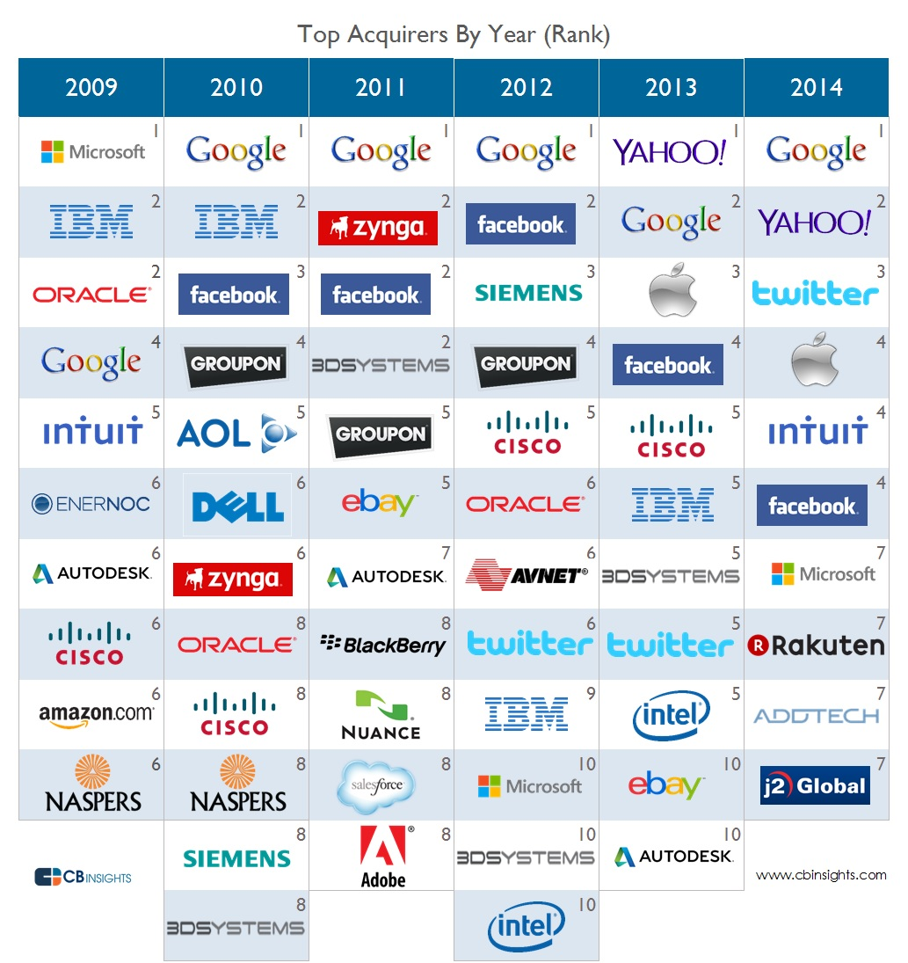
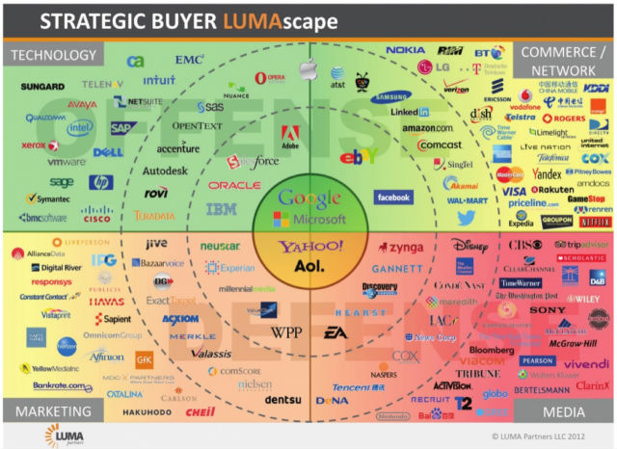

Slide 10
Where do moligopolists compete? (3)
Moligopolists compete on data and freebies
  Bork and Sidak (2012): "the two-sided market for Internet search: Internet users have demand for free search, and advertisers have demand for viewers”; “search engines compete on quality alone”
  Luccheta (2012): “Probably not. In the upstream market [...] it buys eyeballs from single consumers in exchange of search services (inkind payment). Then, it sells well-profiled eyeballs to advertisers in the downstream market”
  But how to monetize data that is given away and how to make SSNIP assessment when price=0 + market is two sided?
  Antitrust law deals indirectly with free markets: “search advertising” is not yet a market, but online ad is (Google/DoubleClick; Microsoft/Yahoo); Internet search left unclear (Microsoft/Yahoo); Data collection not viewed as a market, but indirect relevance for ad business (Facebook/Whats’App)

Slide 11
Bottom lines
Moligopolists compete in same market?
AT implications
Statement of Bureau of Competition Director Richard Feinstein Regarding the Announcement that Google CEO Eric Schmidt Has Resigned from Apple's Board, 2009:“We have been investigating the Google/Apple interlocking directorates issue for some time and commend them for recognizing that sharing directors raises competitive issues, as Google and Apple increasingly compete with each other”
https://www.ftc.gov/news-events/press-releases/2009/08/statement-bureau-competition-director-richard-feinstein-regarding
Risk of missing the forest for the trees
Introduce literature on dynamic capabilities (Teece and Pisano, 1994)
Abandon market definition? L. Kaplow, « Market Definition: Impossible and Counterproductive », Antitrust Law Journal, 2014: “At least to industrial organization economists [...] the notion of a relevant market does not exist in the field”
But market definition can be useful
  For “out-of-monopoly market” efficiency assessments
  Innovation markets must be taken seriously, and defined

Slide 12
Gauging Market power
II

Slide 13
Existing framework
Guidance Paper, §11, focus on power over price/output
  “the expression ‘increase prices’ includes the power to maintain prices above the competitive level and is used as shorthand for the various ways in which the parameters of competition — such as prices, output, innovation, the variety or quality of goods or services”
Guidance Paper, § 12, three-pronged method
  « market position of the dominant undertaking and its competitors »
  « expansion and entry »
  « countervailing buyer power »

Slide 14
Structural factors (i)
Antitrust economics
What happens in practice
Market shares is the pick of the crop for antitrust agencies
HHI
Concentration ratios
Lerner Index
Critical loss analysis
Profusion of confusing arguments
Complex to separate wheat from chaff
Example of the smartphone industry

Slide 15
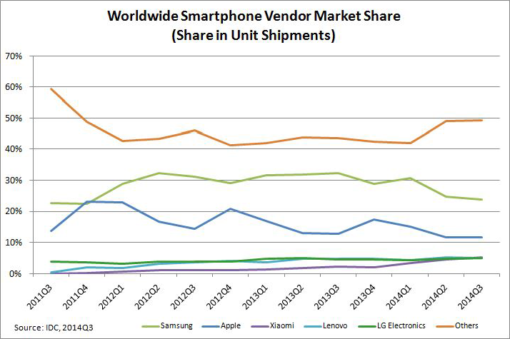
Market Share smartphones Volumes
Period | Samsung | Apple | Xiaomi | Lenovo | LG | Others
Q3 2014 | 23.7% | 11.7% | 5.2% | 5.1% | 5.0% | 49.3%
Q3 2013 | 32.2% | 12.8% | 2.1% | 4.7% | 4.6% | 43.6%
Q3 2012 | 31.2% | 14.4% | 1.0% | 3.7% | 3.7% | 46.0%
Q3 2011 | 22.7% | 13.8% | - | 0.4% | 3.7% | 59.4%

Slide 16
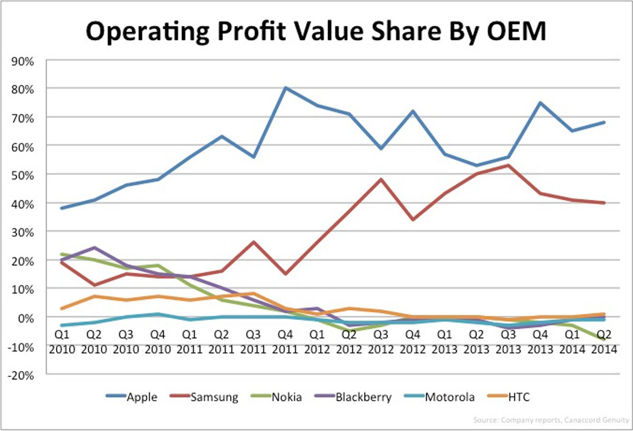
Market share smartphones profits

Slide 17
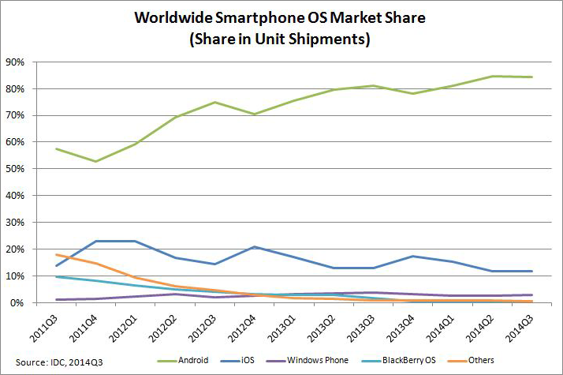
Market share smartphones OS
Period | Android | iOS | Windows Phone | BlackBerry OS | Others
Q3 2014 | 84.4% | 11.7% | 2.9% | 0.5% | 0.6%
Q3 2013 | 81.2% | 12.8% | 3.6% | 1.7% | 0.6%
Q3 2012 | 74.9% | 14.4% | 2.0% | 4.1% | 4.5%
Q3 2011 | 57.4% | 13.8% | 1.2% | 9.6% | 18.0%

Slide 18
How to read this?
Apple and Samsung both dominant in a same relevant market?
No one is dominant? Apple competes on profits, Samsung on size, basta...
  But can you really capture 93% of the industry profits, without being dominant?:
    “Apple's domination in the smartphone market compelled Canaccord Genuity to raise its price target on Apple stock to $145 on Monday, advising investors to buy in on the continued strength of the new iPhone 6, which decimated profits for competitors last quarter”.
http://appleinsider.com/articles/15/02/09/canaccord-raises-apple-price-target-to-145-estimates-iphone-captured-93-of-smartphone-profits
http://bits.blogs.nytimes.com/2015/02/09/apple-grabs-93-of-the-handset-industrys-profit-report-says/

Slide 19
Barriers to entry (and expansion) (II)
Unsettled debate in antitrust policy on the concept of barrier to entry
  Bain, Barriers to new competition, Cambridge : Harvard University Press, 1956
  Stigler “costs that must be incurred by an entrant that were not incurred by established firms”
Bainian focus on incumbency as a barrier to entry deep ingrained in AT policy
  Guidance paper, §17 lists economies of scale as a possible barrier
  Horizontal merger guidelines, §71 consider that “barriers to entry may also exist because of the established position of the incumbent firms on the market”
  In Intel, the Commission noted that scale was a barrier to entry, §866: “it will be necessary to achieve a high capacity utilisation to maximise average cost reductions and hence compete most efficiently with the producers already in the market (essentially, AMD and Intel)”

Slide 20
Barriers to entry (and expansion) (ii)
P. Thiel, Zero to One, 2012: “First mover isn’t what’s important — it’s the last mover”
C. Christensen, The Innovators Dilemma, 1997 and the role of disruptive technologies
C. Anderson, Free on Yahoo 25 MB mail accounts for v Google 2 GB for free in 2004; Yahoo significantly impacted, though erosion was slow (now 8, Gmail 2: https://emailclientmarketshare.com/)

Slide 21
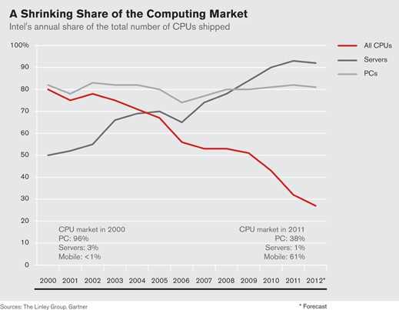
Barriers to entry (and expansion) (II)
Intel
Others
http://techland.time.com/2012/07/16/arm-vs-intel-how-the-processor-wars-will-benefit-consumers-most/
Incumbency played no role
  Google
    35th search engine to enter the market
    6 years old market for search engines
    With large companies (Yahoo, Lycos, etc.)
    Confirmation in Gandal, 2001, International Journal of Industrial Organization, 19 (2001) 1103–1117
  Microsoft
    In June 1985, Mac was the market leader in OS, MSFT DOS a distant rival
    Mac had the dominant GUI, which it bought from Xerox: killer app
    Bill Gates letter to Apple: http://www.cultofmac.com/148548/in-1985-bill-gates-pitched-apple-to-make-macintosh-into-windows/
    MSFT developed the Excel spreadsheet

Slide 22
Countervailing power (III)
Two decisions in 2014 involving Apple
  Antitrust, 39939, 29.04.2014, Samsung – Enforcement of UMTS SEPs
  Antitrust, 39985, 29.04.2014, Motorola – Enforcement of GPRS SEPS
Proceedings related to enforcement of Standard Essential Patents before courts
Narrow technology market (« Motorola Cudak GPRS SEPs ») where Motorola is inevitably a monopolist
Motorola counter-argued that Apple had countervailing power: “Apple is one of the world's largest companies and is estimated to account for 70% of all smartphone profits worldwide whereas Motorola has made substantial losses in the past few year”, §238
But the Commission said it did not matter: “It is, however, possible for both a seller and for a buyer to hold a dominant position within the meaning of Article 102 TFEU”, §246 …
How can one be dominant and dominated at the same time?
Samsung “pinch to zoom” dispute with Apple. No SEP. And eventually worked around + invalidated

Slide 23
Bottom lines
Observations
Policy questions
Moligopolists may have power over price and output, but not necessarily on innovation
Moligopolists often compete on distinct markets, and rarely on overlapping markets
Moligopolists can be displaced by competition at the periphery (RIM did not see rise of touch screen; Intel did not anticipate tablet growth)
Moligopolists engage in preemptive competition, on future products/markets
Moligopolists durability/resilience
  Microsoft’s several lives
  Apple’s several lives
Power over price outdated?
Monopolists often last movers (Microsoft, Google, etc.) => obsessive focus on early market development?
Antitrust authorities to focus on barriers to entry but also on barriers to periphery?
Time matters: permanence > dominance?

Slide 24
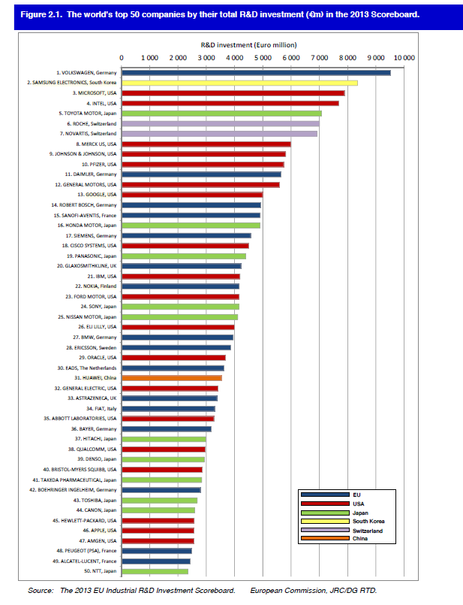
Power over price/output v R&D investments
Firms from this chart subject to recent antitrust proceedings?
Samsung (2)
Microsoft (3)
Intel (4)
Google
Cisco
IBM
Nokia
Sony
Ericsson
Oracle
Huawei
Qualcomm

Slide 25
Theories of harm and liability
III

Slide 26
Theories of harm (econ)
Story telling is fine
  Eating rival market share to capture direct and indirect network externalities
  Antitrust economics has all the needed theories: horizontal, vertical and conglomeral foreclosure
  Network effects (« snowball effect ») and switching costs (« lock-in »)
  Often, 2 markets strategies:
    Vertical: « Walled garden » (AOL/TimeWarner)
    Conglomeral: « Platform threat » (Microsoft)
  See joint study CMA and FCA on open and closed systems: http://www.autoritedelaconcurrence.fr/doc/economics_open_closed_systems.pdf

Slide 27
Theories of harm (econ)
Evidence (or testing) is problematic
  Case-evidence that dominant firms losing shares and profits: Microsoft IE, Intel CPUs, etc.
    Absence of foreclosure effects or proof of attempted foreclosure?
    Dominant firm decline should have gone faster: you dope, you loose. But still sanctioned because you would have lost worse?
    Rival should have thrived faster
  Counterfactual analysis needed to test abuse; but counterfactual analysis is complex in digital economy
Other sources of contradictory evidence (event study): J. Wright (2011) finds that AMD experienced significant financial gains until 2006 => how to explain
Little work on magnitude of anticompetitive effects: « Hold up » and the patent war, $100 million in total legal costs incurred by Apple in 2012 represent less than 0.1% of its total revenues… What kind of leverage is this? Unable to hold up/exclude?

Slide 28
Theories of liability (law)
Abuse legislation is elastic
Should it be rigidified?
Rambus: gap case and the road to dominance story (L-H. Röller) => abuse of a non-dominant position
Microsoft – WMP and Internet Explorer: access to convenient distribution facility => circumvented, with reclassification as abusive tying
Google Search: duty to not favour own search services over other? Essential facility? Search neutrality? Discrimination?
Yes: caution warranted given the amount of oligopolistic competition outside the monopoly market, risks of type I errors
No: adaptability needed to cover new kinds of abuse, risks of type II errors
Debate needed on the probability and seriousness of welfare losses caused by type I and II decisional errors in digital economy

Slide 29
remedies
IV

Slide 30
Designing effective remedies is hard
Microsoft, WMP: retailers bought 1,787 copies which amounted to less than 0.005% of the copies of all sales of Windows XP (heavy resting costs for retailers unwilling to compensate OEMs, etc.); Excluded Real Networks launches but contemporary to the investigation, Real launches successful Raphsody service in 2001…
Microsoft, Server OS: MS still has 85% in PC OS and server OS share increased…
Intel: AMD’s share decreased since 2006 to 20-30% in 2014; AMD announced 2012 it will refocus away from X86 to tablets; ARM entry in tablets, and now CPUs
Rambus: Commitments by Rambus to license its patents worldwide at either a zero royalty rate (for technology reading on standards that were adopted when Rambus was a member of JEDEC) or a 1.5% royalty rate for future JEDEC compliant products. Many JEDEC-based products sold at 0,75% or 1% rate…
Motorola: 2014 decision addressed to Motorola … but toothless, because it is Google that has kept most patents following de-merger (http://thevarguy.com/information-technology-merger-and-acquistion-news/013014/lenovo-buying-spree-delivers-motorola-mobility-goo)
Need ex post assessment of remedial effectiveness in digital markets

Slide 32
Process
V

Slide 33
Time of the essence?
Antitrust is slow
Alternatives
  Duration of proceedings
  Google, 6 years old
  Intel, 9 years following complaint
  Microsoft, 6 years following complaint, but implementation of remedy took 10 years (Sun 1998 complaint led to 2004 decision implemented 2008)
  Astra Zeneca, 7 years following complaints
Ex ante regulation?
  Net neutrality example?
  Risks of rent seeking?
Ex post but faster?

Slide 34
Tools exist
EU Commission has powers to make quick impact
Article 8(1) of Regulation 1/2003
  “[i]n cases of urgency due to the risk of serious and irreparable damage to competition, the Commission, acting on its own initiative may by decision, on the basis of a prima facie finding of infringement, order interim measures”;
  “[a] decision under paragraph 1 shall apply for a specified period of time and may be renewed in so far this is necessary and appropriate.”
  Article 9 commitments
  Timing is slow too: Rio Tinto (4y and 11m); Google (5y)
  Compliance and monitoring issues (Microsoft, Browser)

Slide 35
CONCLUSION
VI

Slide 36
GENERAL Take aways
Need a theory of the « whole » where more than one narrow market matters
Moligopolists seek to develop an outter core where they become monopolists, and only compete as oligopolists in the inner periphery?
Moligopolists vie to find new outter cores (like oil exploration) then try to build walled garden with periphery barriers?
AT obsessive attention to RM
Risk to focus on bug bites and lose big picture; and risks of losing relevancy to the benefit of ex ante populistic regulation (incl. rent seeking risk)
Incumbency v last to market
Permanence, resilience and the illusion that tech companies are new

Slide 37
Take aways for lawyers and economists?
Take aways for IO?
Take aways for AT lawyers?
Need more thinking on how to balance markets and think more in equilibrium?
IO tends to generate assumptions remote from day to day market reality; inductive reasoning, not deductive; comes close to advocacy; bridge with business sciences would help; more empirical: business facts?
Tools to measure non price competition: talents, acquisitions, share value?
Avoid object-type restrictions (per se prohibition rules) and use rule of reason, to balance degree of monopoly power in relevant market with intensity of oligopolistic competition outside: 101(1)-102(1) assessment?
Integration of future markets in AT analysis: need framework to delineate them; degree of early competition on those markets to balance actual restrictions in relevant markets: 101(3)-102(3) assessment? Tools to measure intensity of R&D competition?

Slide 38
Next
Book on Moligopolists
Method:
  Verify paradox with systematic survey of business analysts reports (CRAs?); focus on 5-10 firms
  Ex post impact assessment of Commisson decision in DE markets

